Slide 1
IPPOG Resource Database
Making Particle Physics outreach & education available worldwide
On behalf of IPPOG Collaboration
Barbora Bruant Gulejova
Strategic Development and Communications Lead, IPPOG

Slide 2
Outline
Why outreach in particle physics and related sciences matters?
IPPOG - strategic pillar for worldwide outreach
What IPPOG offers to teachers
Resource Database (RDB)
- What? Who for?
- Development of new RDB
IPPOG Global Cosmic Studies Portal
Invitation for audience to take part!

Slide 3
Challenges of particle physics / science community
Main challenges of scientific community
Challenged financial support of large experimental endeavours
Falling interest of young people to study physics and STEM
Mistrust in science
Reasons
Misperception of physics / science in society – complicated, abstract, disconnected from real life
Lack of awareness and understanding

Slide 4
Why is physics & basic research misperceived?
Scarce exposure of society to modern physics
School curricula – mostly no modern physics
Media – misinformation and disinformation
Cell phones and computers were sewn into reality thanks to fundamental science.
Despite this:
Most students finish high school believing that there are only:
3 elementary(?) particles (electron, proton, neutron)
2 types of forces (gravitational and electromagnetic)

Slide 5
Why exposure of society to modern physics matters?
Exposure to modern physics, like particle physics and its technological applications, like medical applications, sensor technologies, space applications, www, ... increases the interest of students in physics and their perception of its role in society and sustainable development.
Study in Germany and UK:
General interest in physics at schools has increased strongly thanks to inclusion of
extra-curriculum activities in particle physics (exhibitions, Physics Masterclasses, teaching)!
Teaching contemporary natural science/ physics leads to understanding of:
scientific method
high financial and personal investments to large experiments, as LHC
media misinformation
IPPOG Resource Database

Slide 6
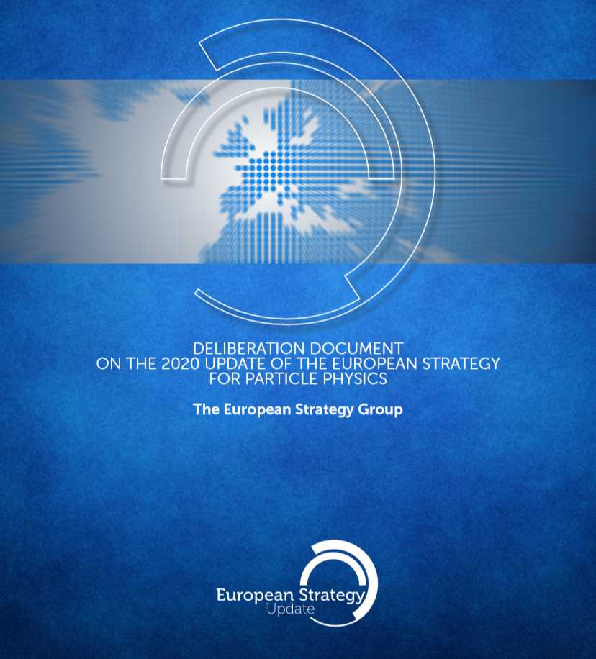
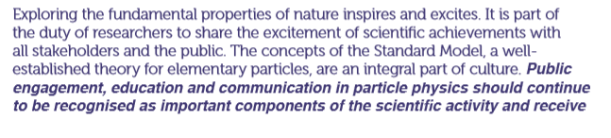
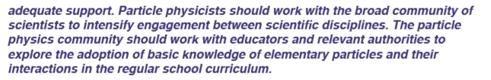

European Particle Physics Strategy Update
CERN-ESU-014
Importance to update physics curricula is now officially recognised by full particle physics community
6

Slide 7
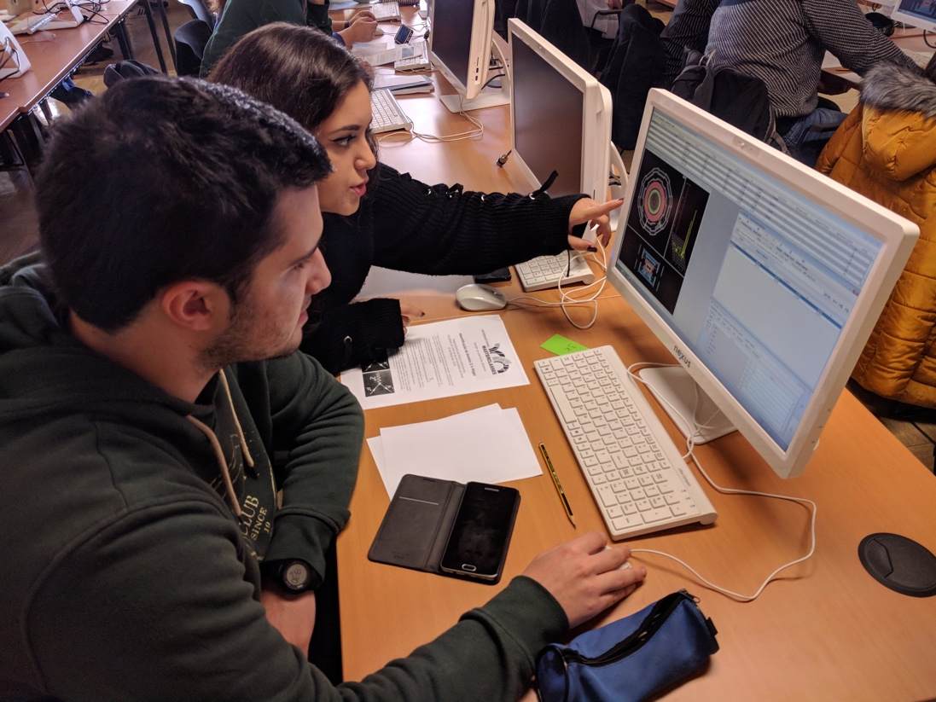
International Particle Physics Outreach Group
Before the update of physics school curricula is achieved (long-term process)…..
Outreach
Informal education
Extra-curricula activities
The way to bridge the gap
between contemporary
science and school education
and increase appreciation of
science by society
The International Particle Physics Outreach Group (IPPOG) has been making concerted and systematic efforts to present and popularise particle physics and related sciences across all audiences and age groups since almost 25 years.
Today, scientific community has in IPPOG a strategic pillar in fostering long-term, sustainable support for fundamental scientific research around the world.

Slide 8
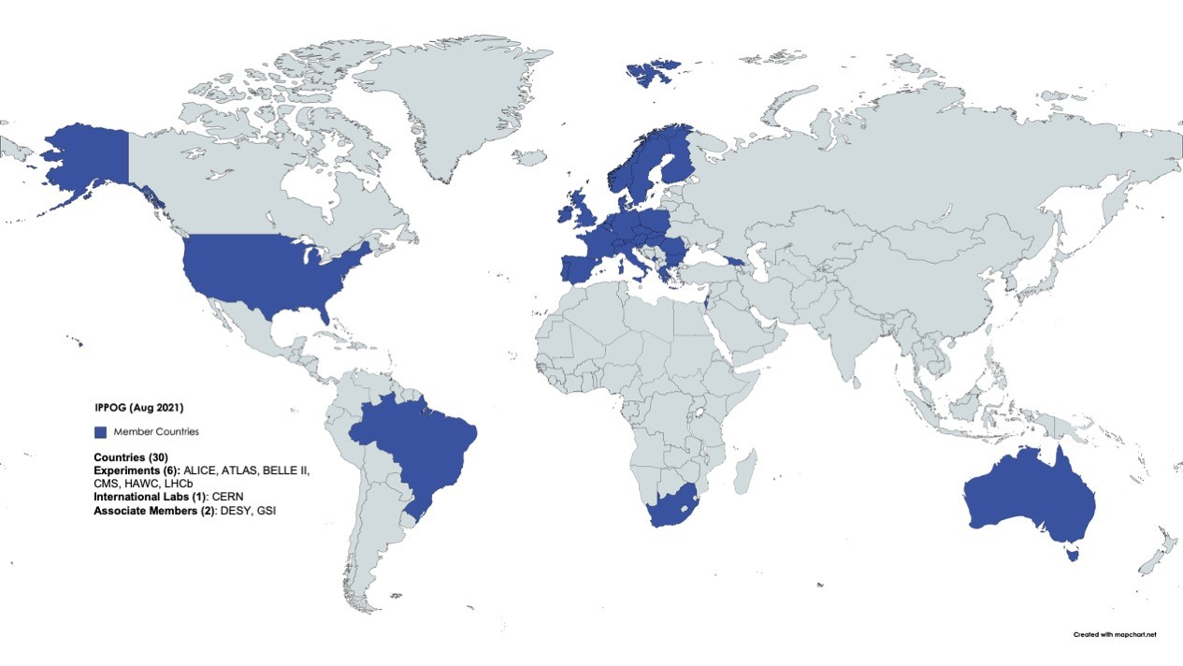
IPPOG: Global Network & Scientific Collaboration
• Asia
• Africa
• Australia
• Europe
• The Americas
• International Labs
and Collaborations
37 Members:
30 Countries
6 Collaborations / Experiments (ATLAS, ALICE, Belle II, CMS, HAWK, LHCb)
1 International Lab (CERN)
2 Associate Members:
2 National Labs (DESY, GSI)
+6 Int’l Collaborations
Associate Members

Slide 9
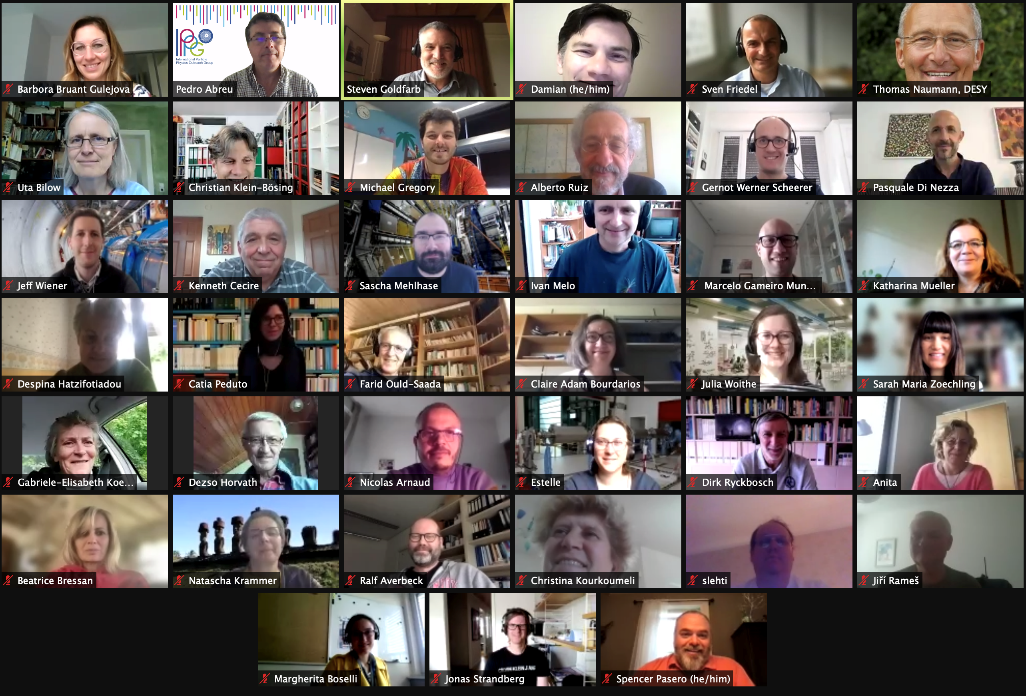

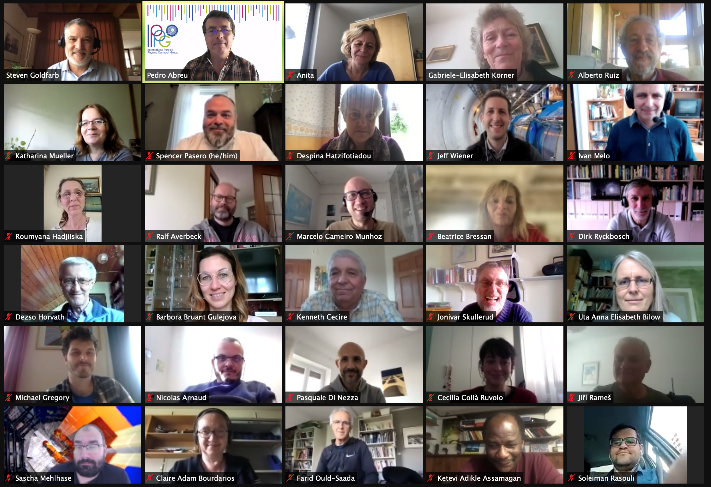
IPPOG Collaboration
International Scientific Collaboration
  Active Researchers with Experience in Education & Outreach
  Experts in Communication & Education
Mission
Establish Understanding of scientific process
Instil Appreciation of fundamental research and importance of evidence-based reasoning
Build Trust with communities
Inspire Next Generation of scientists
Organise Global Activities
Support Local Activities
• Sharing of expertise, best practices, resources to support events, kick-start activities
for teachers!!
IPPOG meeting, May 2021

Slide 10
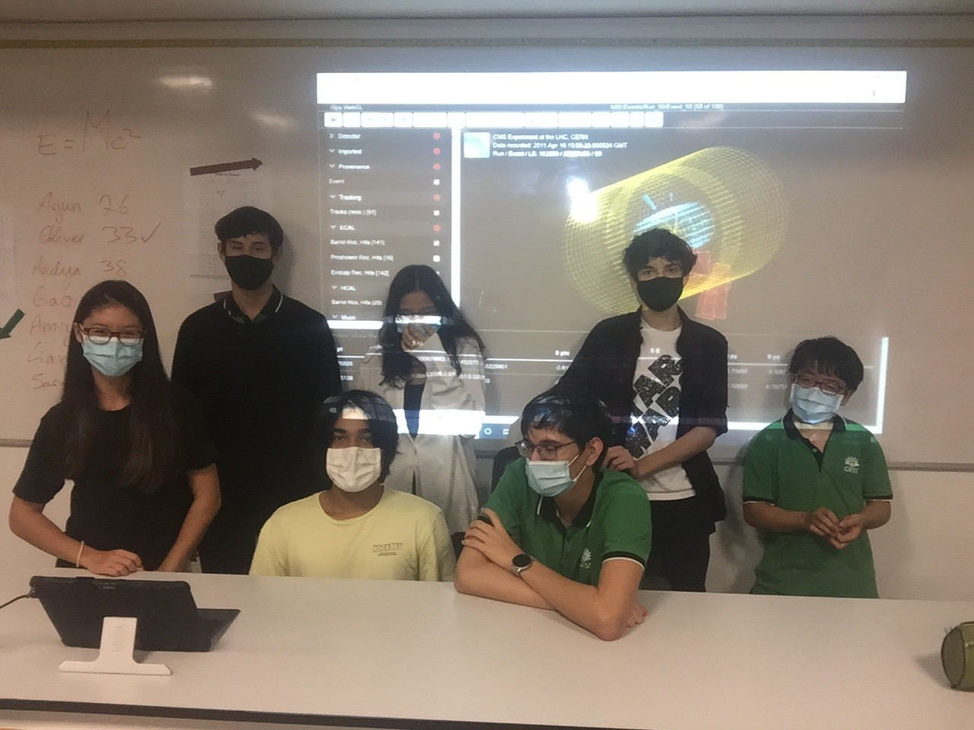
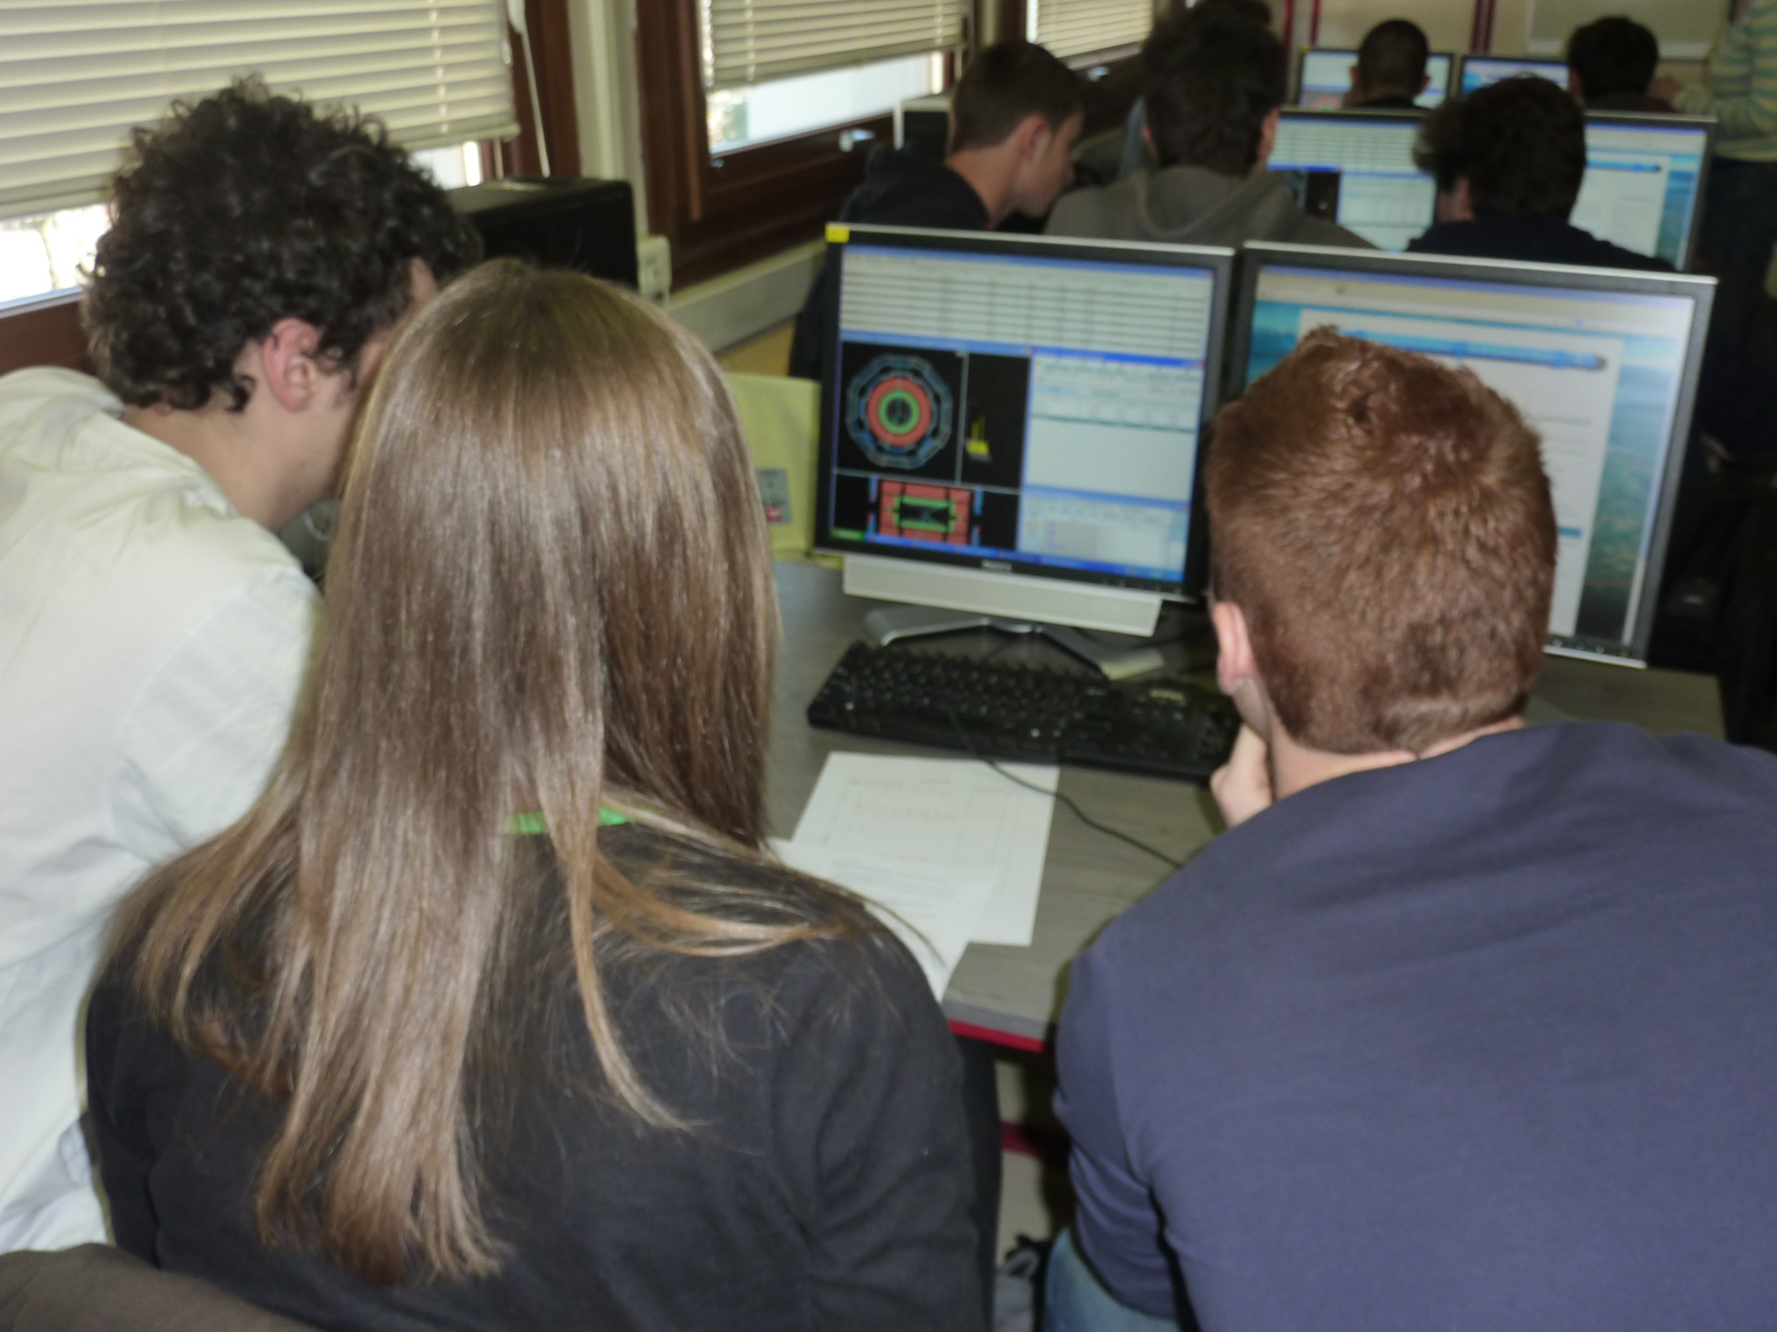
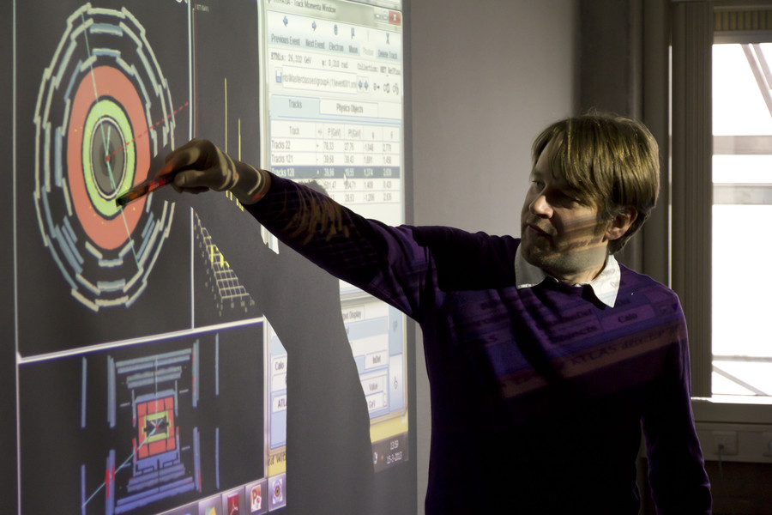

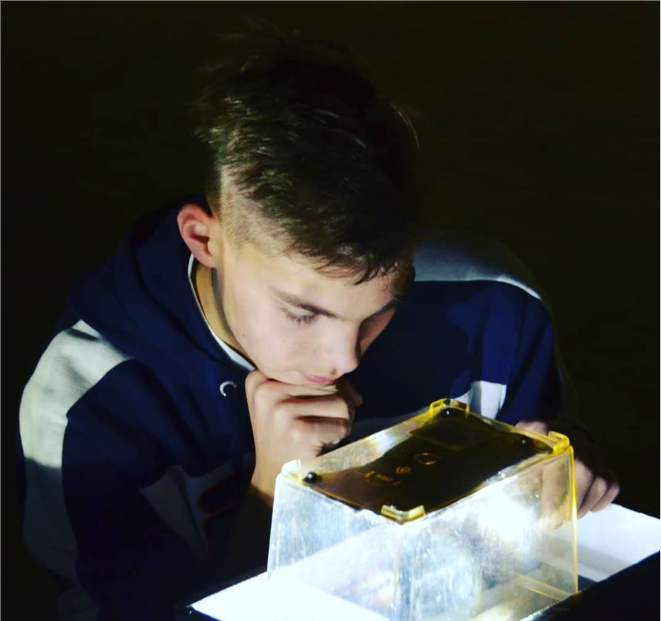
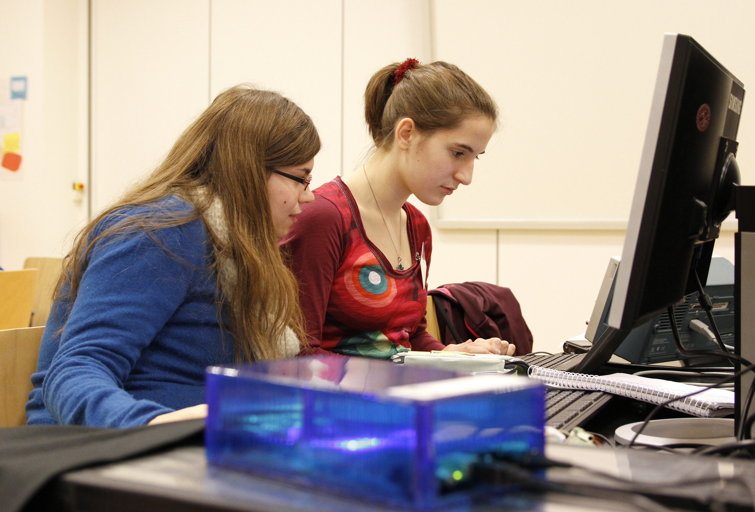
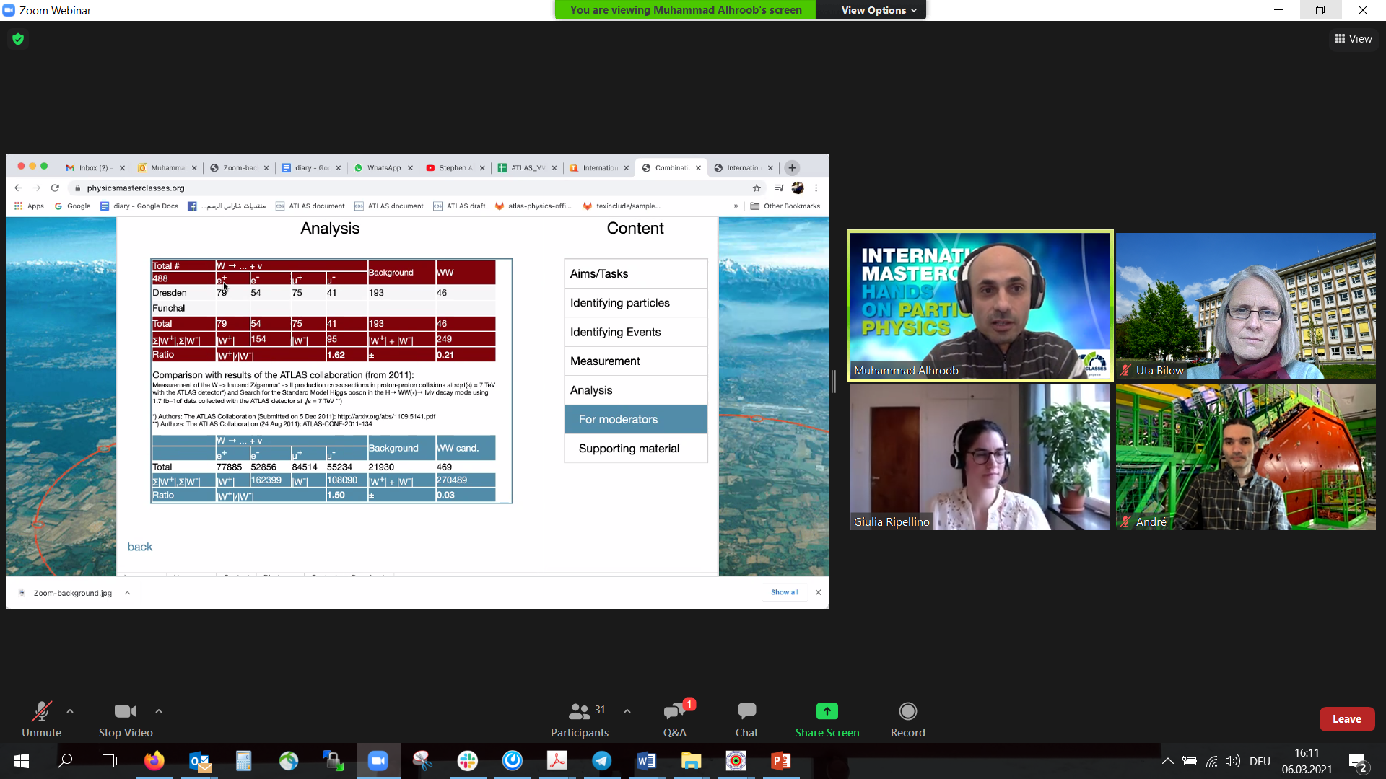

Activities with global reach
International Masterclasses in Particle Physics
• Flagship activity for high-school students (15–18 y.)
• Become a physicist for a day!
• Real Data from ATLAS, CMS, ALICE, LHC-b, Belle-II,
MINERvA, Hadron therapy
Worldwide data Day
EPS HEPP Outreach Prize 2021 awarded to coordinators of International Masterclasses, Uta Bilow and Ken Cecire
and Sascha Mehlhase, IPPOG representative of ATLAS exp.
NEW!
Global Cosmics: online portal!
• Network of Cosmic Rays Projects for Schools
• International Cosmic Day and International Muon Week
NEW!
Resource Database
• Primary source of particle physics outreach material in the world
… and many other projects, competitions, campaigns and activities…

Slide 11
IPPOG Website & Resource Database
IPPOG is an ideal platform for:
sharing, developing and improving
explanatory and teaching materials, strategies, methods, activities and tools
to reach broader audiences
based on the world best practices in education and outreach of particle physics and related sciences
“IPPOG wants the new website to become more open to students, teachers and the general public, and for the RDB to become the primary source of particle physics outreach material in the world.”
IPPOG is upgrading its website:
improve the user experience across the IPPOG digital portfolio
strengthen IPPOG online presence by creating a new website including a new RDB
greatly broaden the audience type and use of the webpages & available resources

Slide 12
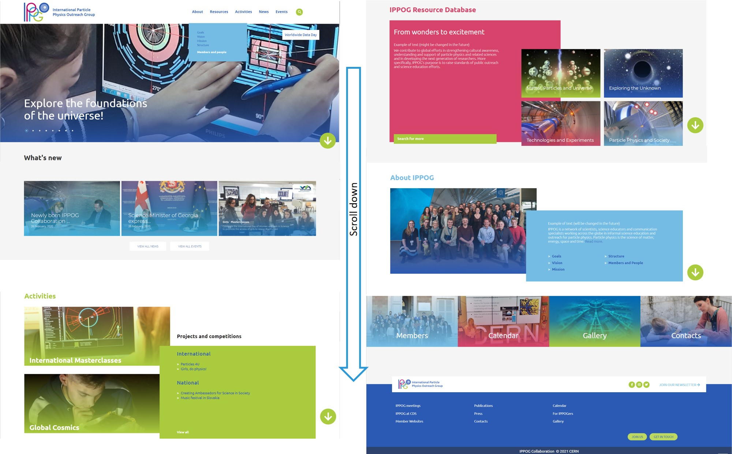
IPPOG New Websites
New IPPOG website under development
Coming soon!
Will replace current ippog.org in 2022!

Slide 13
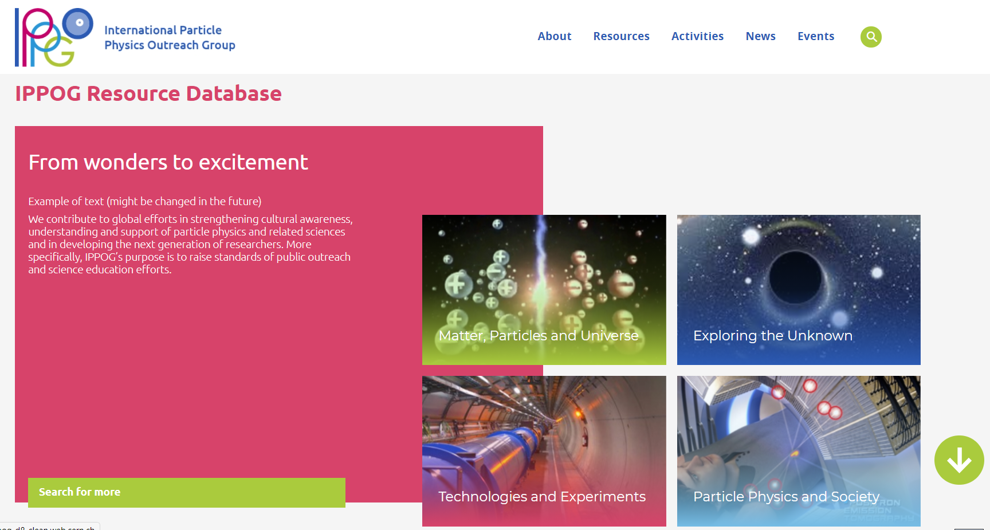
IPPOG Resource Database
Targeted for:
Teachers
classroom materials, lesson plans,
videos, presentations, games…
Scientists doing
outreach!
Inspirational materials…

Slide 14
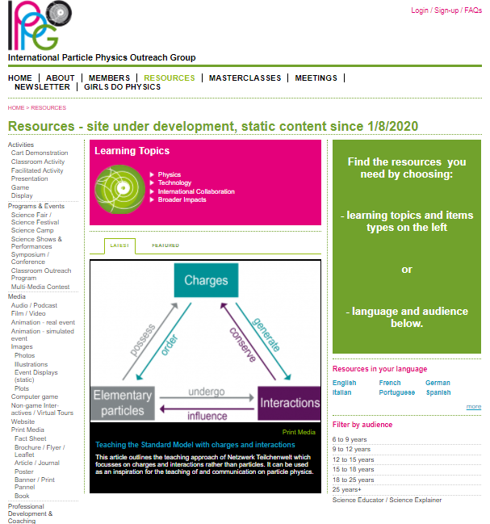
IPPOG Resource Database History
Idea born in 2009: transformation of EPPOG (former IPPOG) from a “discussion forum” to a possible world leader in informal scientific E&O activities for particle physics and related fields: IPPOG.
Initially “EPPOG Best Practice Database” meant to be used by science institutions and laboratories for outreach and informal science education purposes
self-sustaining, users vote on highest quality & most useful items to be best practice
First version released in 2011
Today about 370 resources collected over last 10 years
Current RDB static, no submissions.
New RDB to be published early 2022

Slide 15
New IPPOG Resource Database is / will be…
online platform to facilitate the exchange of particle physics education and outreach resources across the globe
collection of high-quality engaging materials (e.g. videos, posters, talks, hands-on activities, tools, brochures and more)
content recommended by experts
to share wonders and excitement of particle physics with teachers, students and general public
readily understandable and regularly updated to reflect the latest discoveries in HEP
Primary source of HEP outreach material in the world

Slide 16
New IPPOG Resource Database
REVIEW and REDESIGN of Resource Database
Several years of discussions, efforts and feedback
New improved Resource Database proposal in 2017
Intense collaboration with high school teachers
“IPPOG Friends” group created!
Broaden audiences
Improve functionality and user-friendliness
for both users and contributors
Simplify categories
Full coverage of relevant topics
Keep the content up-to-date
Continuous feedback and improvements
Teachers & educators worldwide!
JOIN!
GOALS
Contact: barbora.gulejova@cern.ch

Slide 17
IPPOG Resource Database Challenges
TECHNICAL
Building interface between website (Drupal) and CERN Documents Server
(where resources will be stored)
CONTENT
Curation of existing / “old” items
Collection of new / up-to-date best items
New content development

Slide 18
IPPOG RDB Curation
RDB CURATION group (since summer 2020)
~ 40 experts from around the world: - physics teachers, scientists and science communicators
Alberto Ruiz Jimeno
Andreas Delannoy
Ani Torres
Anna Marie Wolf
Carlos Cunha
Cassondra McHugh-Lowther
Cédric Vanden Driessche
Claire Adam-Bourdarios
Claire Bonnoit-Chevalier
Daniela Ambar Gayoso Miranda
Dario Menasce
Despina Hatzifotiadou
Enrique Arce-Larreta
Harry Stuckey
Ian Bearden
Ivan Melo
Jean-Christophe Pelhate
Joel Klammer
José María Díaz Fuentes
Julia Woithe
Kevin Martz
Kevin Mosedale
Lucia Battistella
Luís Afonso
Maria Niland
Marla Glover
Michael R. Fetsko
Michael Wadness
Miki Otsuka
Moritz Springer
Patricia Teles
Pierluigi Paolucci
Ram Krishna Sharma
Richard Dower
Robert Nickson
Soleiman Rasouli
Spencer Pasero
Stefania Della Sciucca
Yury Ivanov
CRITERIA
Is the physics right?
Is it a topic of interest?
Is it related to particle physics or associated fields?
Is it up-to-date or has it been superseded?
Are you aware of a similar resource in the same language?
Do you consider this resource as really outstanding?
Special Curation tool developed – launched Dec ‘20
370 resources: each evaluated by 2-3 experts =>
Nearly 1000 evaluation reports have entered curation process by now!

Slide 19
IPPOG Resource Database Challenges
TECHNICAL
Building interface between website (Drupal) and CERN Documents Server
(where resources will be stored)
CONTENT
Curation of existing / “old” items
Collection of new / up-to-date best items
New content development

Slide 20
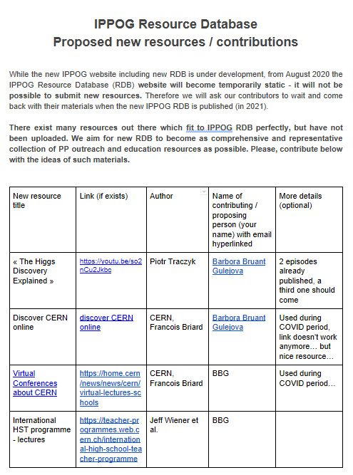
Collecting new resources for RDB
Collecting efforts since December 2020 (google doc )
New RDB Working Group (May 2021):
Complete
Wrap up
Evaluate
Assign new tags
- with help of dedicated
curation tool
RUIZ JIMENO, Alberto
SHARMAZANASHVILI, Alexander
STRANDBERG, Jonas
WOZNIAK, Krzysztof Wieslaw
WETZLER, Susan
WEGNER, Jeremy
KLAMMER, Joel
GLOVER, Marla
COYLE, Helen
PAOLUCCI, Pierluigi
KIRILOVA, Galina
KLEIN BOESING, Christian
BEARDEN, Ian Gardner
GAMEIRO MUNHOZ, Marcelo
GORISEK, Andrej
HADJIISKA, Roumyana Mileva
HATZIFOTIADOU, Despina
MELO, Ivan
PRICE, Darren
BARDEEN, Marge
ADAM BOURDARIOS, Claire
~ 100 new
resources
RDB standing committee will be created soon.

Slide 21
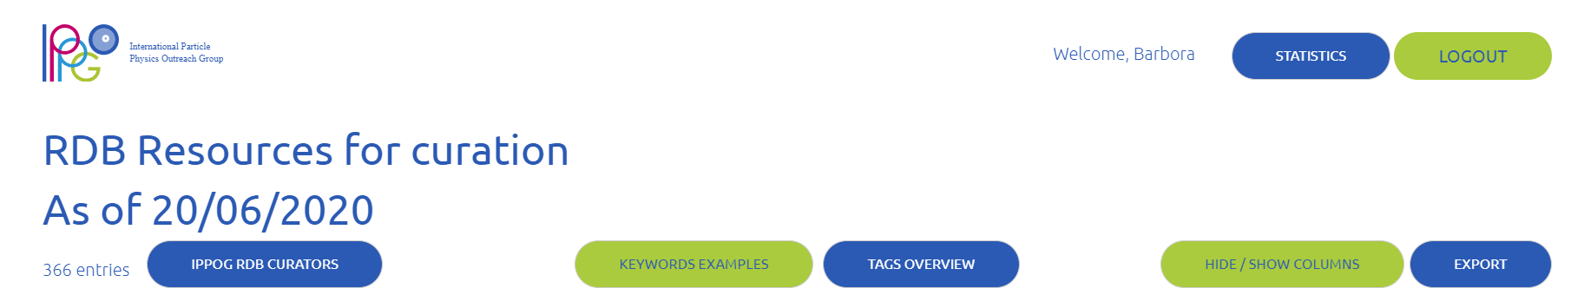
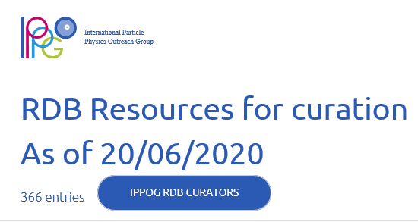

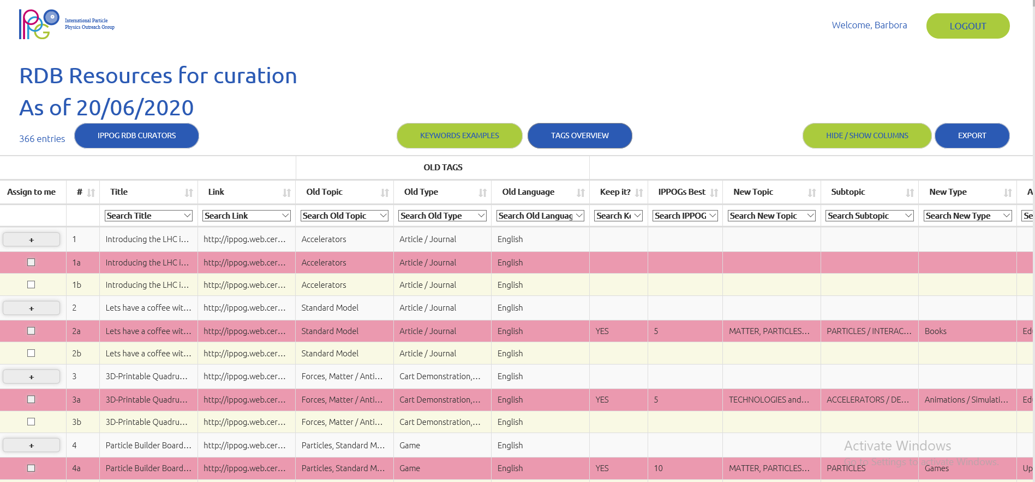

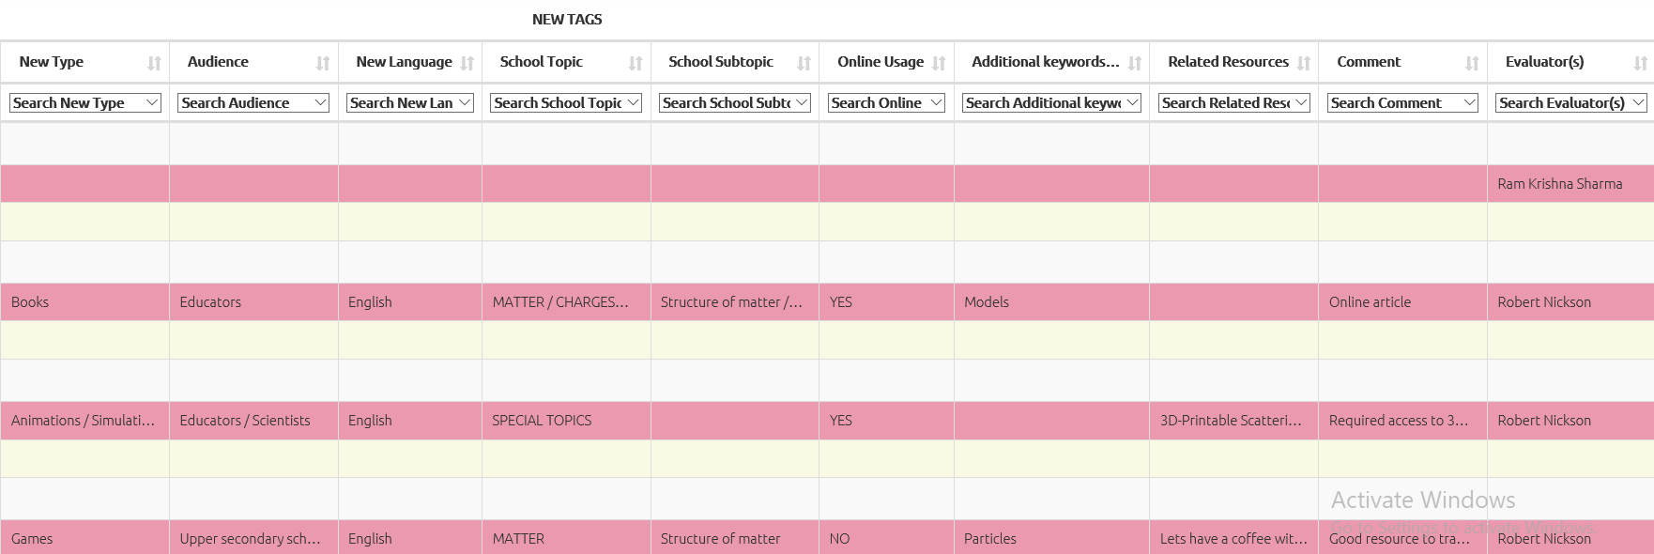
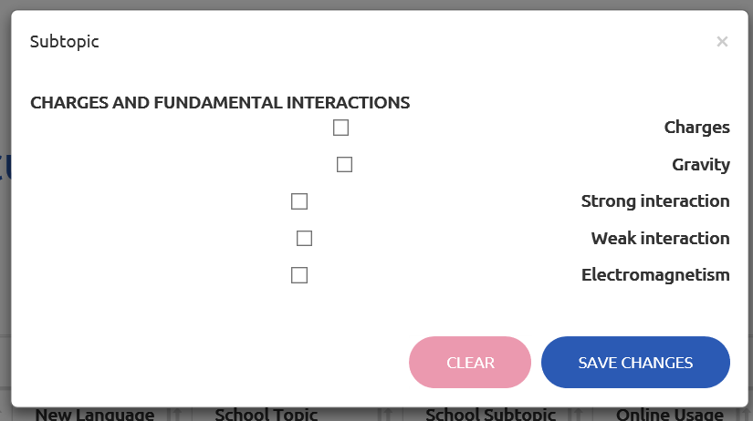
IPPOG RDB Curation tool
GREAT FUNCTIONALITIES
(impossible with google docs)
SECURITY: users sign in with their account and can edit only their entries
SECURITY: editable (only new tags) and non-editable fields
SEARCH & FILTERING : each tag / column can be filtered with chosen values
DROPDOWN MENUS with predefined lists
MULTIPLE CHOICE when entering values
CLEAR: red line - taken by somebody else; blue line - mine
UNDO / CLEAR OPTION
VIEW and EXPORT options
PLAN: TO BE USED (at least partly) to help populating new RDB…

Slide 22
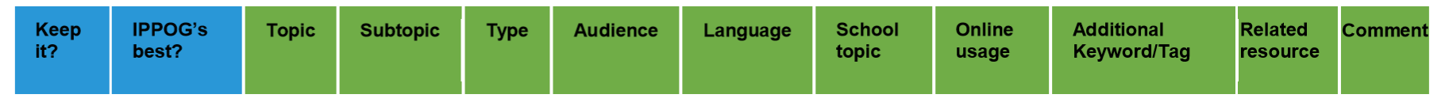
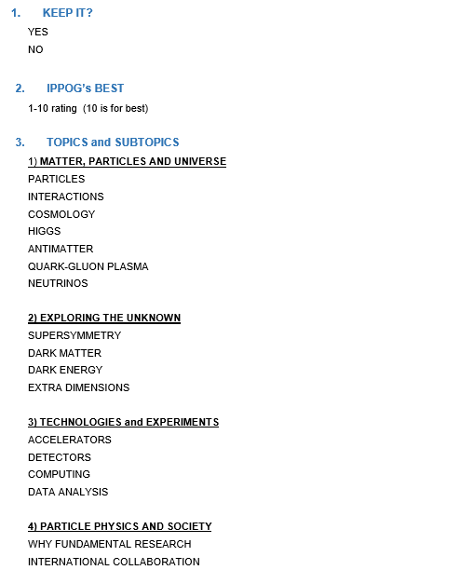
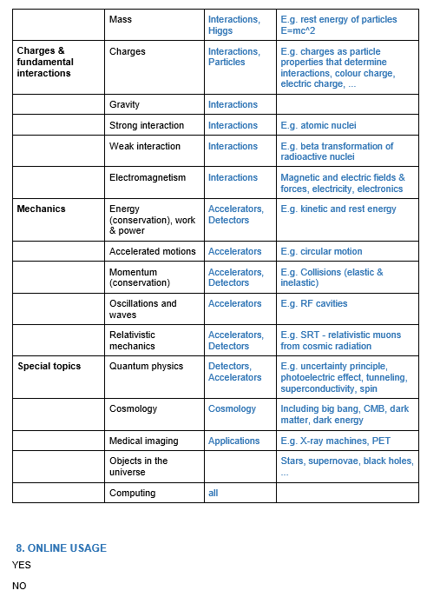
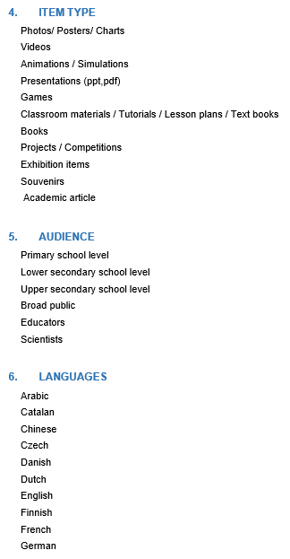
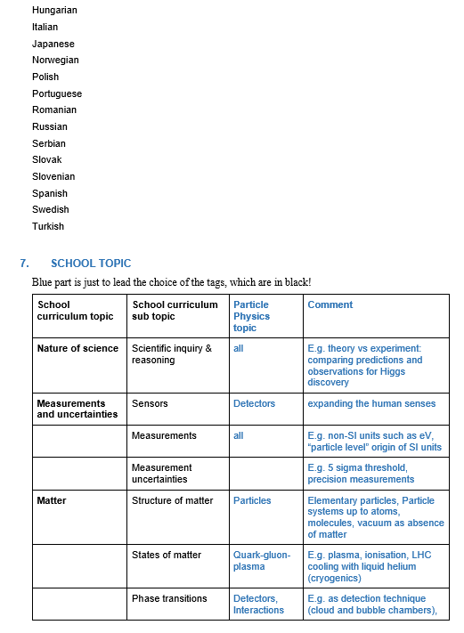
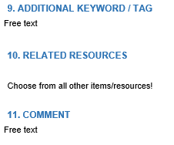
IPPOG Resource Database Curation
NEW
Link to school
physics curiculum

Slide 23
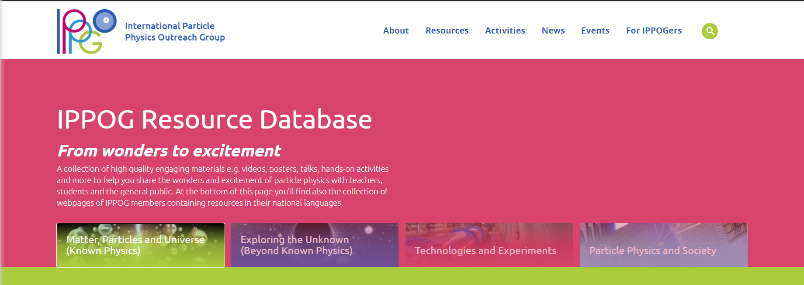
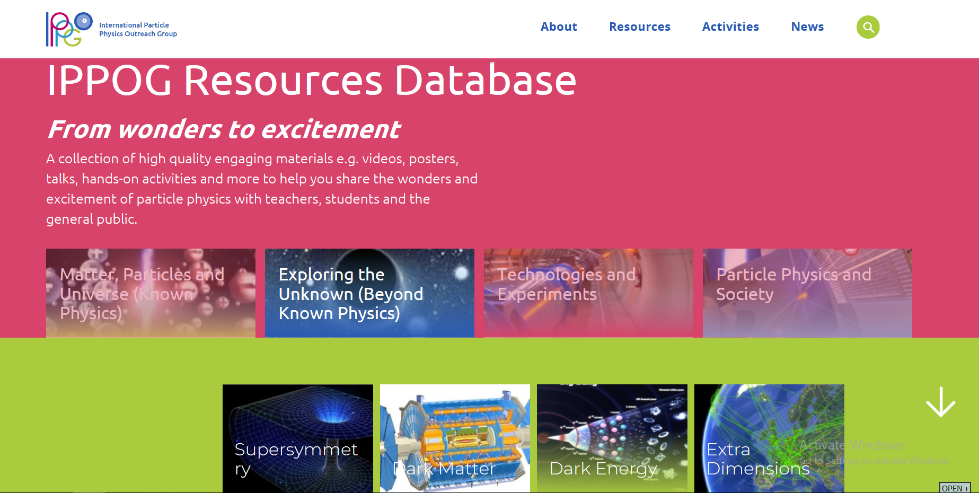
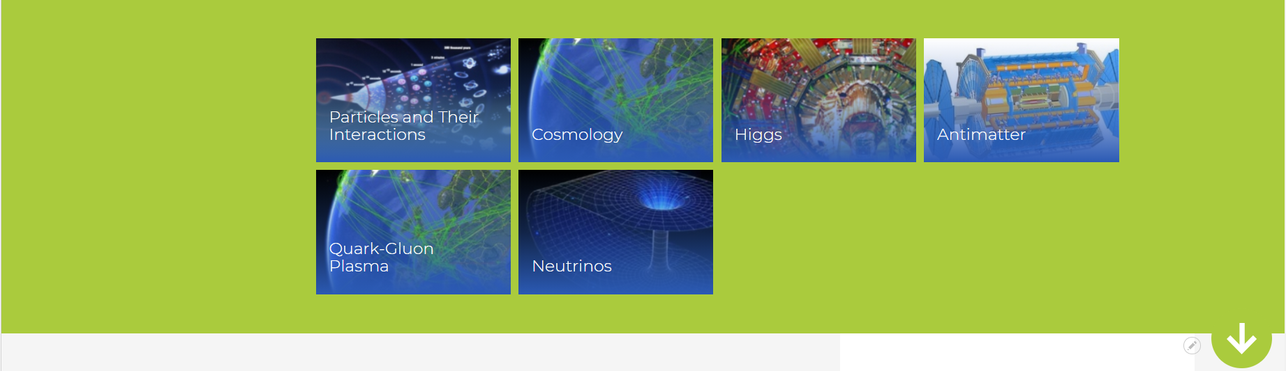
New IPPOG RDB website preview
https://test-ippog-d8-clean.web.cern.ch/
SEARCH:
1) Choose physics topic
(from picture)
2) Filter in search
engine
Hover on 1 from
4 main topics:
- Subtopics shown
- Random selection
changing at each refresh
shown below

Slide 24
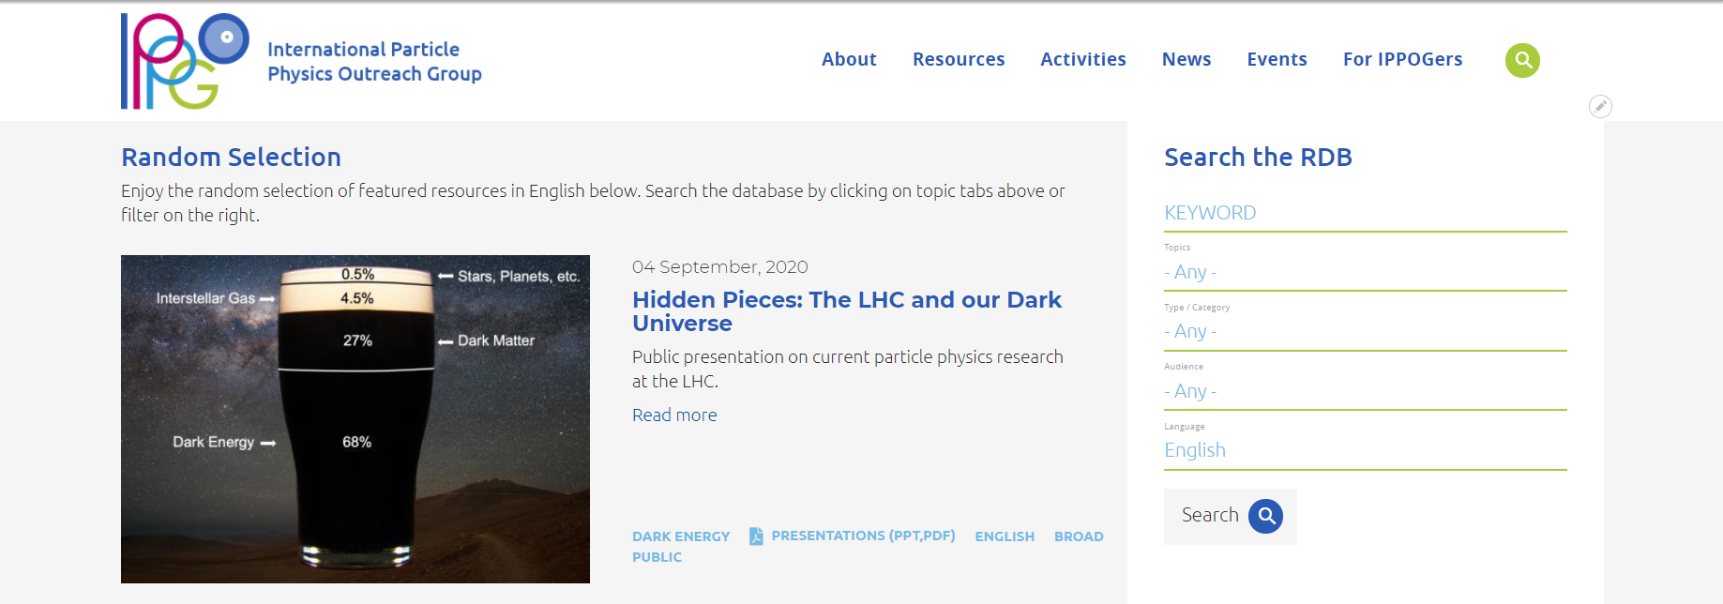
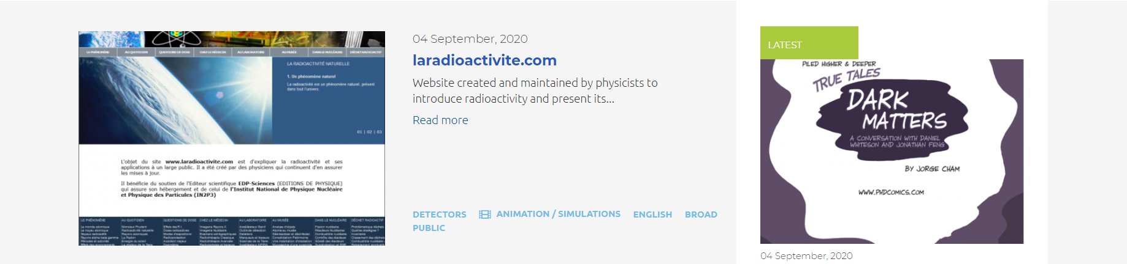
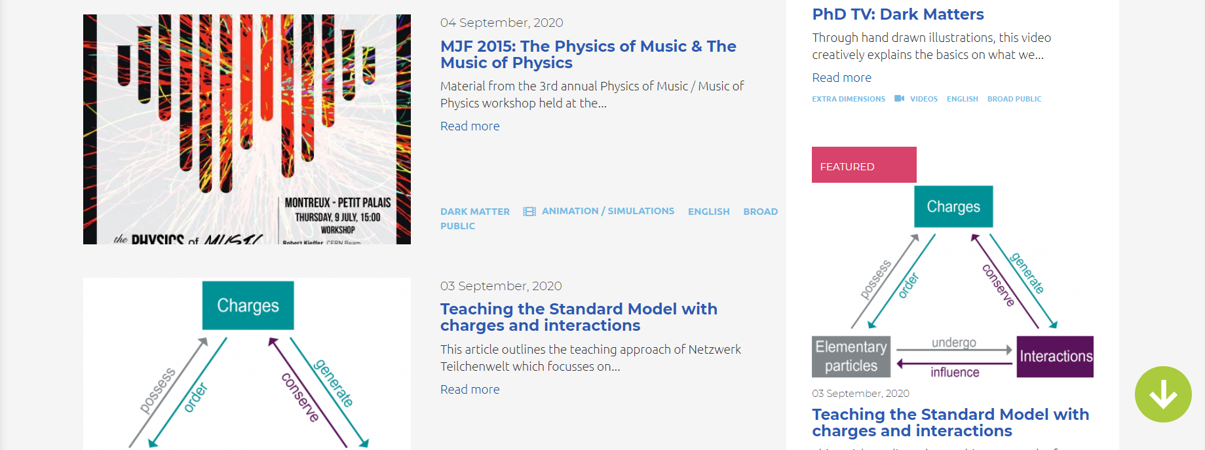
https://test-ippog-d8-clean.web.cern.ch/
SEARCH:
1) Choose physics topic
(from picture)
2) Filter in search
engine
Order of items according to rating
20th IPPOG meeting, 3 December 2020, online
24

Slide 25
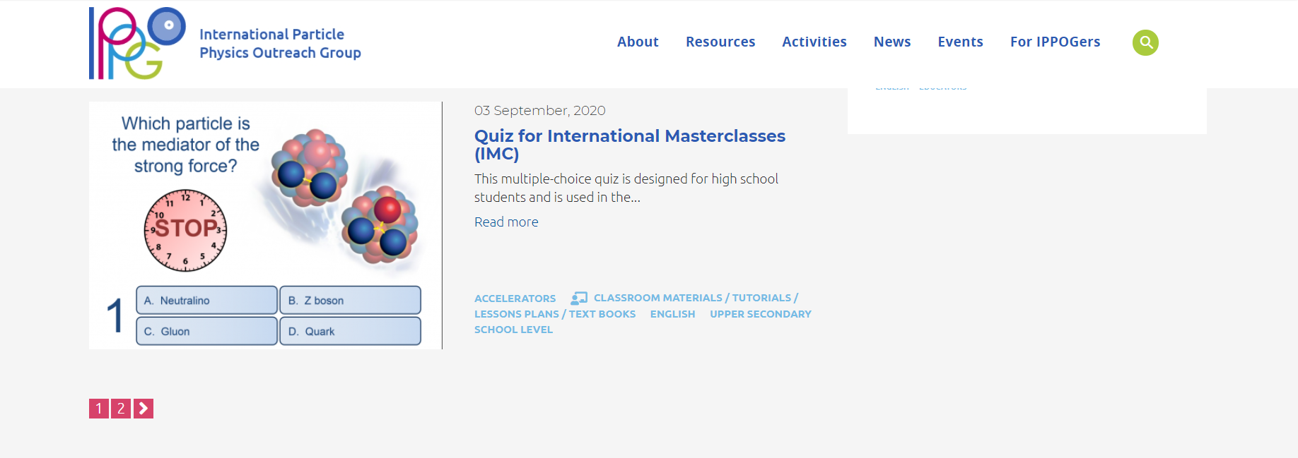
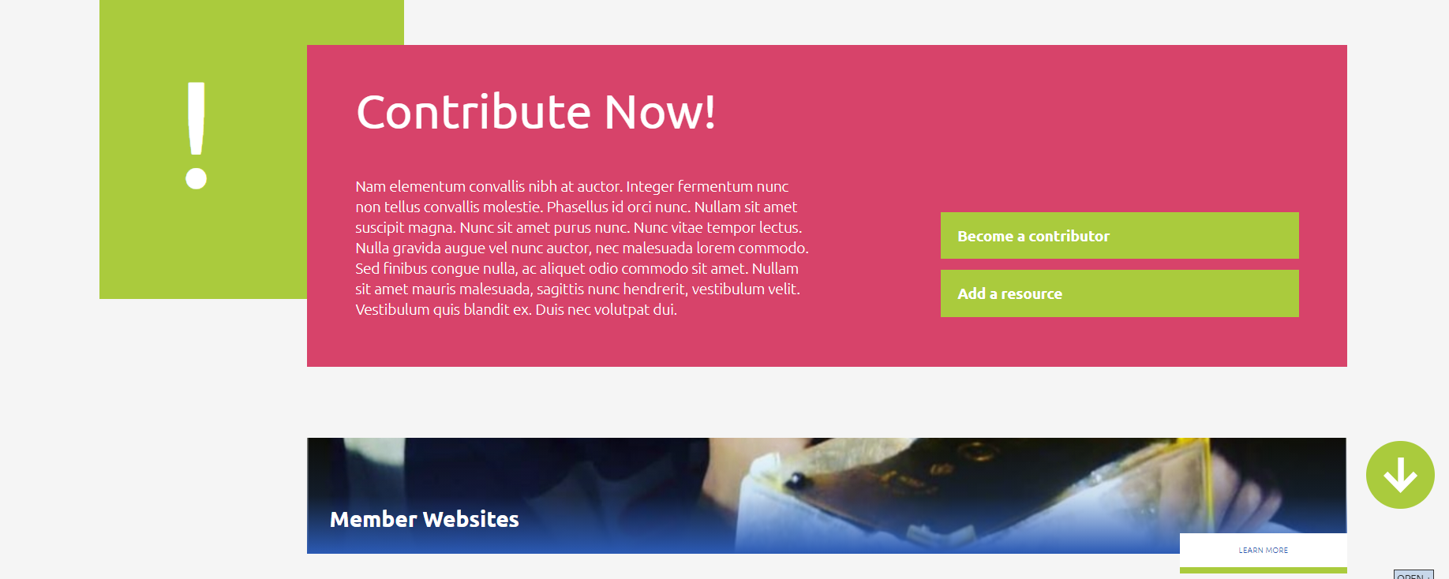
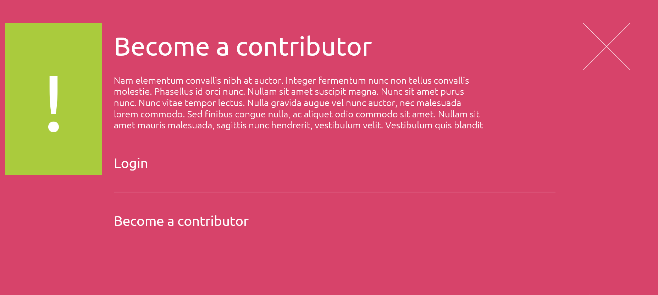
USER FRIENDLY
SUBMISSIONS:
- Clear instruction
- Form for contributors

Slide 26
IPPOG Resource Database Challenges
TECHNICAL
Building interface between website (Drupal) and CERN Documents Server
(where resources will be stored)
CONTENT
Curation of existing / “old” items
Collection of new / up-to-date best items
New content development

Slide 27
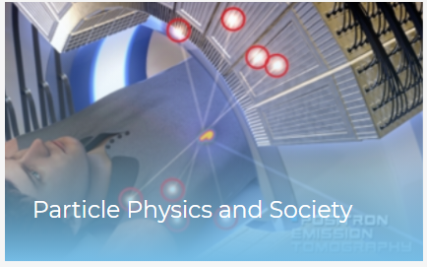
IPPOG New content under development
IPPOG Working Groups
Explaining PP to Lay audience
Outreach of Applications for Society
Analogies, images, examples, stories…
Stories with human touch
Tool for community to shape attitude and perception
of physics and fundamental research by decision makers,
funding bodies, media and public and even motivate young people to undertake physics studies.
RDB main topic No 4
Studies (CERN) show: Context matters much more than content when raising interest of students in physics!

Slide 28
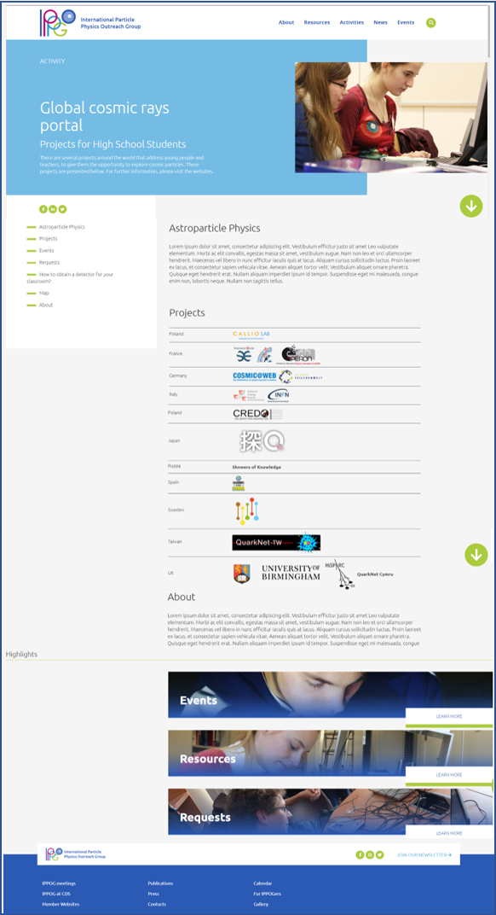
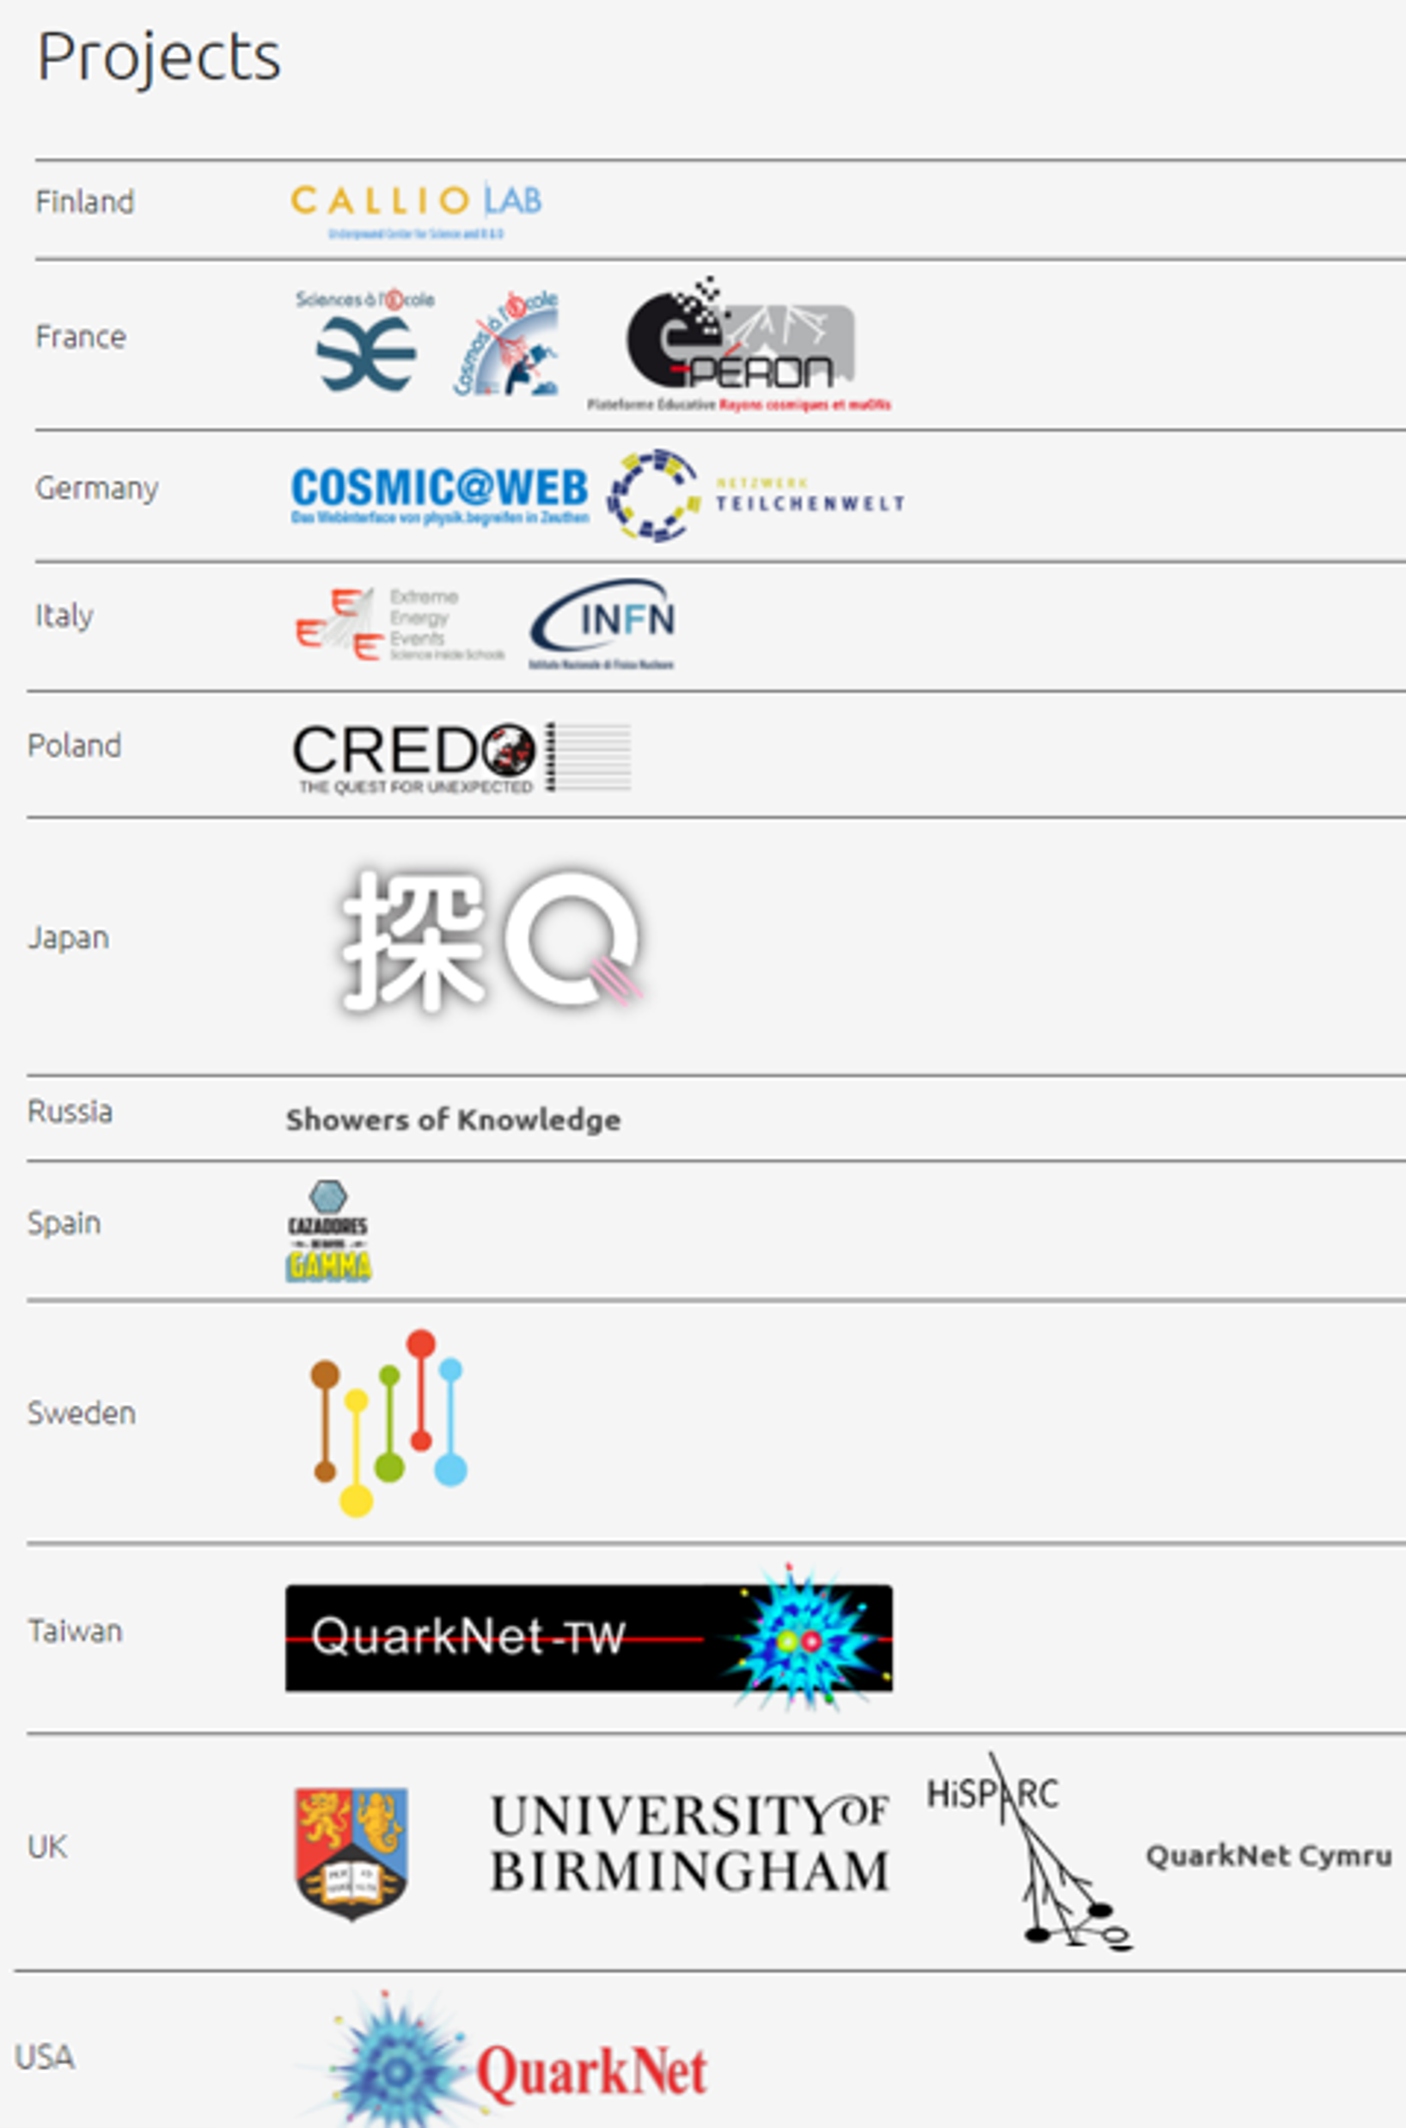
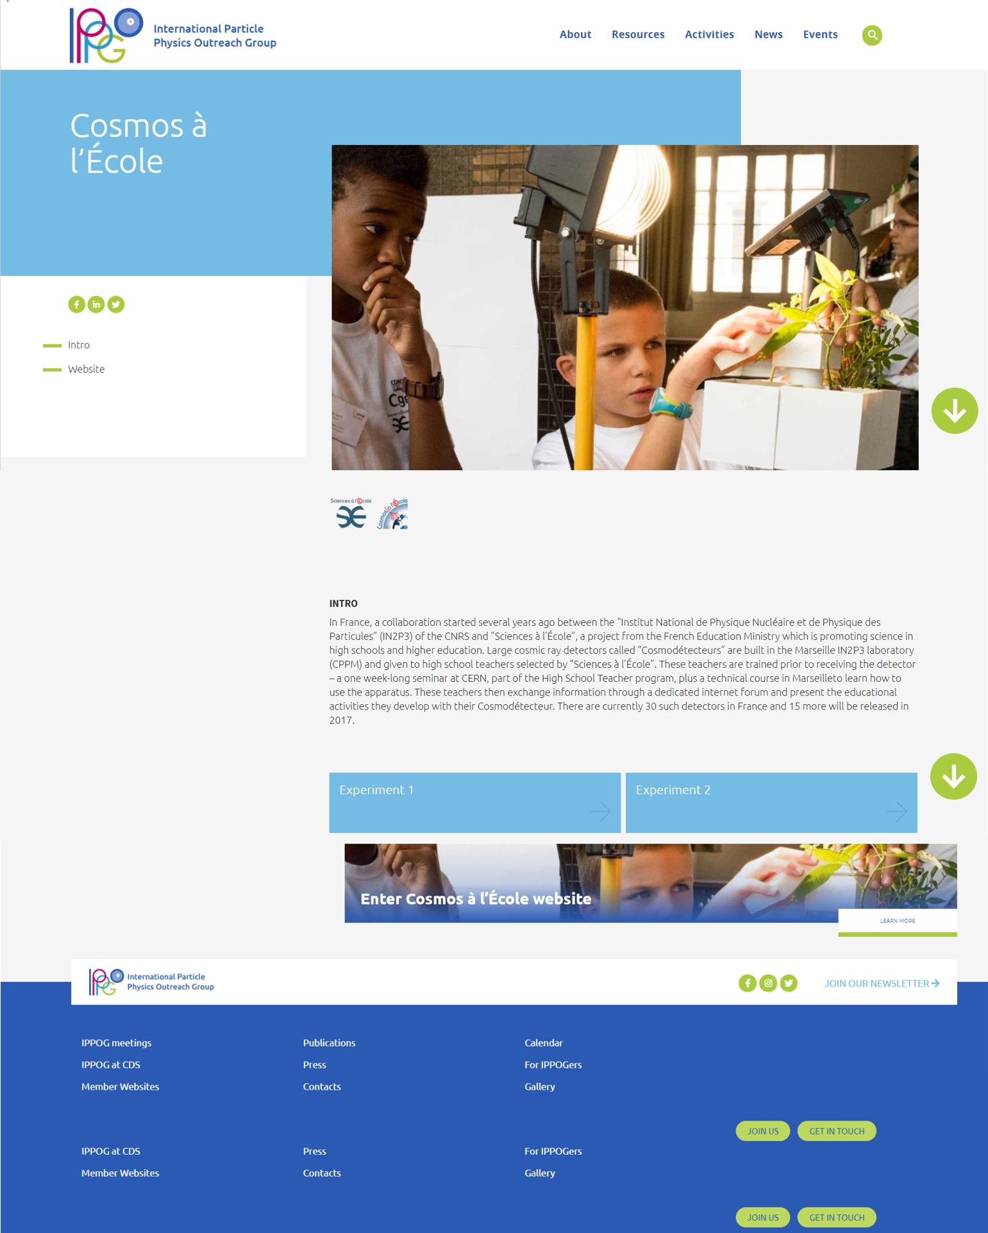
Global Cosmic Rays Portal
Making Cosmic Rays Studies
available to schools worldwide
18 open-data projects, 12 countries
Coming soon: early 2022!
Each project
own entry site

Slide 29
TAKE PART!
STAY TUNED!!! New IPPOG websites coming up end 2021
Join IPPOG FRIENDS!
Take part in IPPOG ACTIVITIES for schools!
- Masterclasses
- Global Cosmics – from 2022
- Use IPPOG Resources – from 2022
If you have good material to share, become an RDB CONTRIBUTER!
- Submit resources from 2022
Contact barbora.gulejova@cern.ch

Slide 30
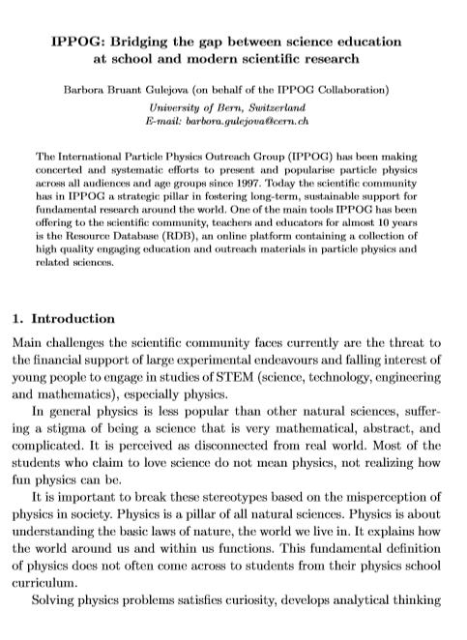
Learn more ….
IPPOG - Bridging the gap between science education at school and modern scientific research
Article submitted to World Scientific WSPC Gribov 90 (Pre-print available)
https://cds.cern.ch/record/2746338 and http://arxiv.org/abs/2011.14743
IPPOG Global Cosmic Rays Portal: Making Cosmic Rays Studies available to schools worldwide
Proceedings paper, 37th International Cosmic Ray Conference (ICRC 2021) https://cds.cern.ch/record/2775675
THANK YOU!
Strategic importance of dialogue between science and society
Article in last Swiss Physical Society Communication, Section: «Physics and Society»
SPS Mitteilungen.64.pdf (www.sps.ch) (page 48)

