Slide 1
General information
G. Iadarola
ABP Computing Meeting – 26 Mar 2021

Slide 2
General information
Phil from CSS will join the next meeting: anything specific to discuss?
CERN thematic School on Computing on "Scientific Software for Heterogeneous Architectures”. Inform your supervisor and myself in case you interested in participating.
Guide on mounting EOS on mac prepared Ilias/Guido/Joshua
  http://abpcomputing.web.cern.ch/guides/eos_on_mac/
  see also mattermost discussion)
Accelerating Python user's meeting 2021 Q1 on 29 April
  Topics: PyTimber, PyJapc, accwidgets, asyncio usage
A pilot program launched by IT and IPT to access commercial cloud services (Google, Amazon). A workshop will be held on Apr 28 to have a first overview.
  https://indico.cern.ch/event/1021544/
Question NDC team: does anybody in the group have experience with Molflow
2

Slide 3
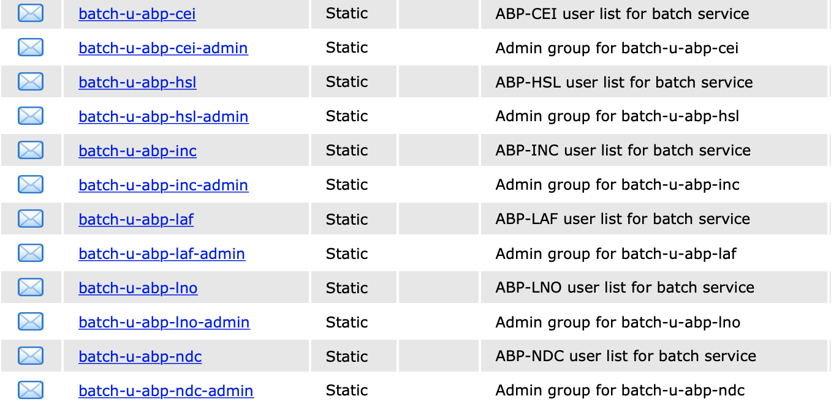
General information
New e-groups for access to HTCondor have been created
  One per section, with associated admin e-group
  SL and CP members have been added to admin e-group for their sections
  Each section could define how to manage their e-group
Will ask remapping of our quota next week:
  Should be transparent --> inserted old e-groups inside the old ones
  We should gradually empty the old groups and move users to the new ones
3

