Slide 1
Inverted and thin NEG, where we are
M.Taborelli, L.Lain Amador, P.Costa Pinto, L.Ferreira, P.Chiggiato
TE-VSC

Slide 2
Summary
Inverted NEG scheme
Performance of inverted NEG
Performance of thin NEG < 1μm

Slide 3
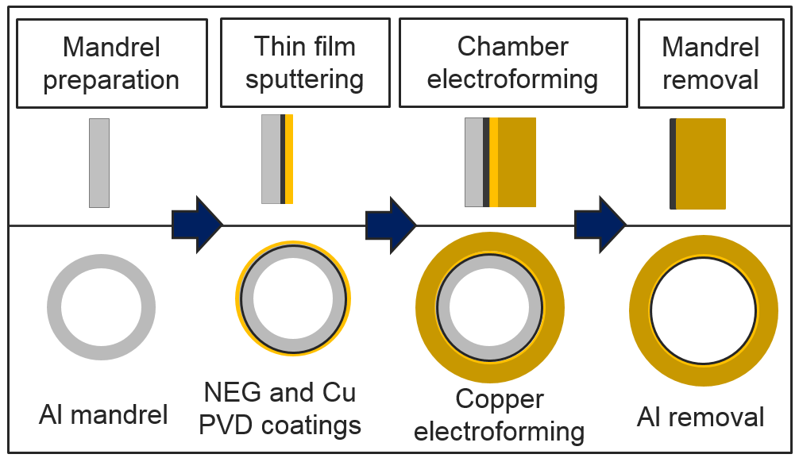
Inverted NEG (Non Evaporable Getter) scheme
Additional NEG layer on the Al mandrel

Slide 4
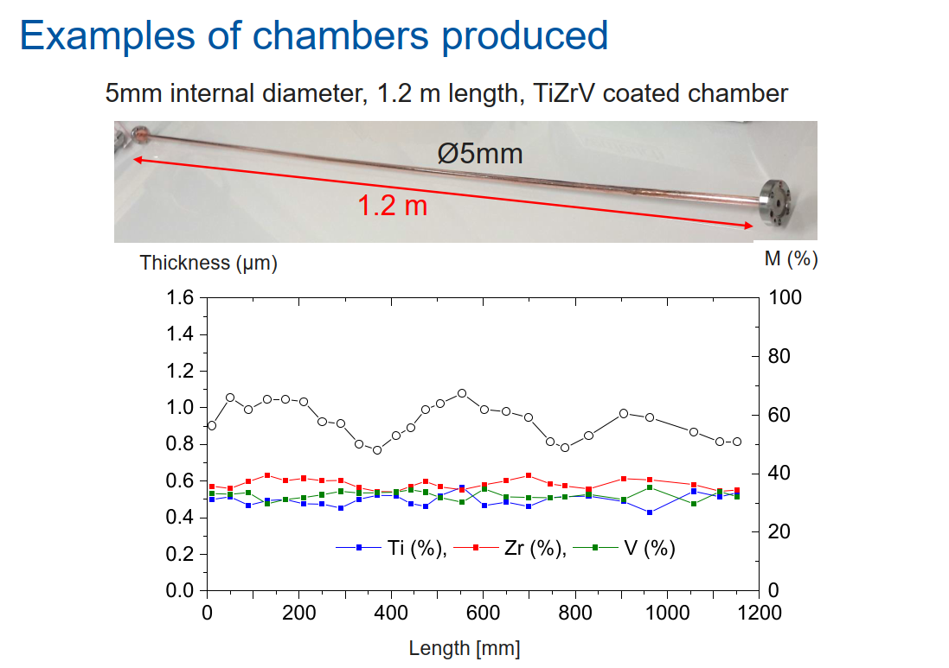
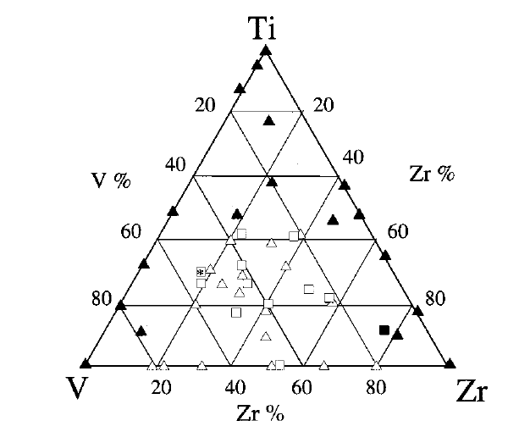
Control of the NEG thickness
Analysis in XRF after cutting the chamber:
The thickness is uniform
Composition is uniform and correct
A. E. Prodromides et al. Vacuum 60 (2001) 35, 41

Slide 5
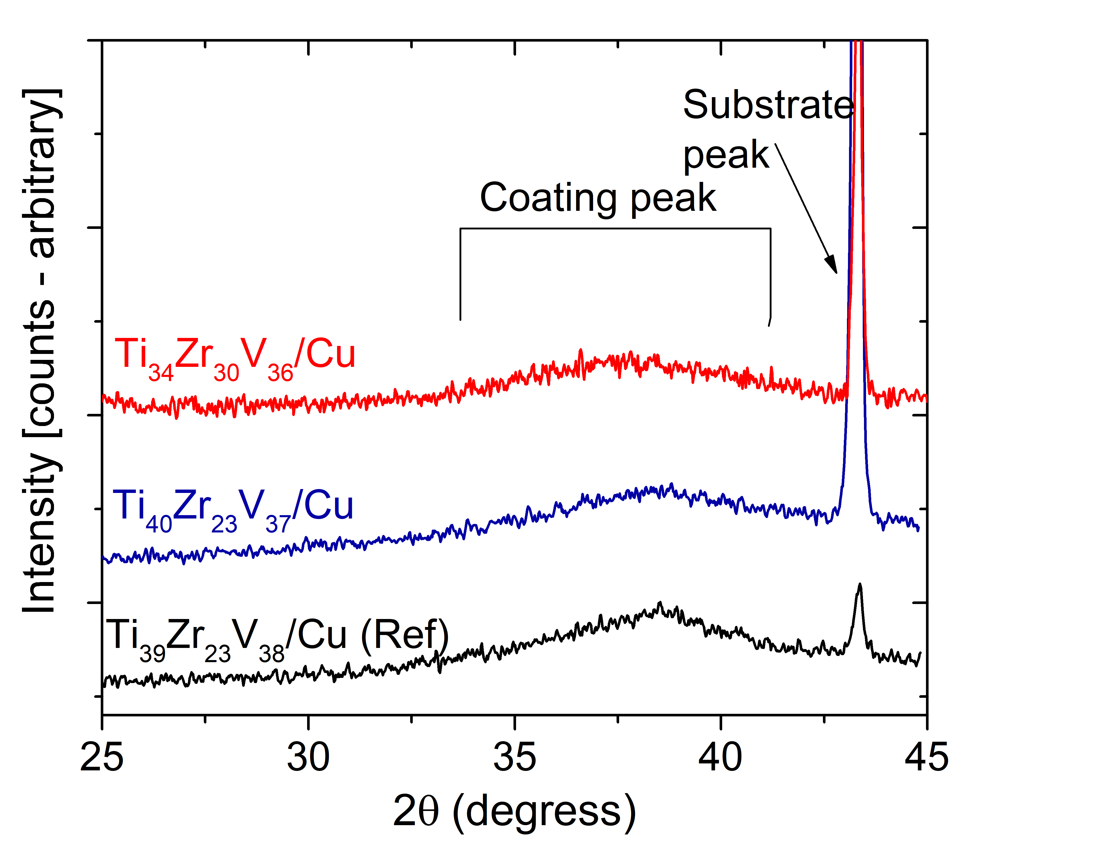
Crystalline Structure
XRD analysis
All samples show the small crystal size (estimated around 3 nm)
Ref. prepared by the conventional coating process
5

Slide 6
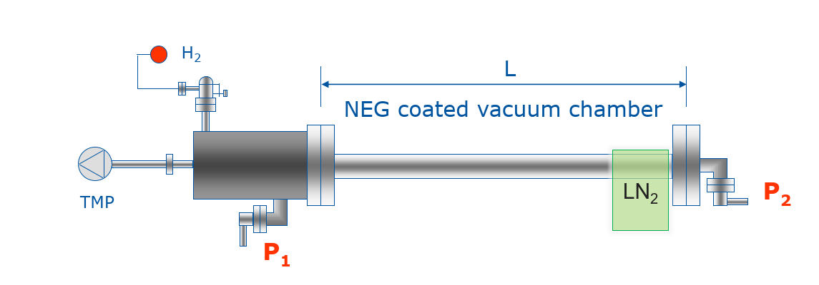
Pumping performance: transmission method
Cold trap to remove “parasitic” CH₄ (not pumped by NEG)
Steady state upon H2 injection:
P₂/P₁ + Monte Carlo calculation (Molflow) : enable to get the sticking coefficient for hydrogen

Slide 7
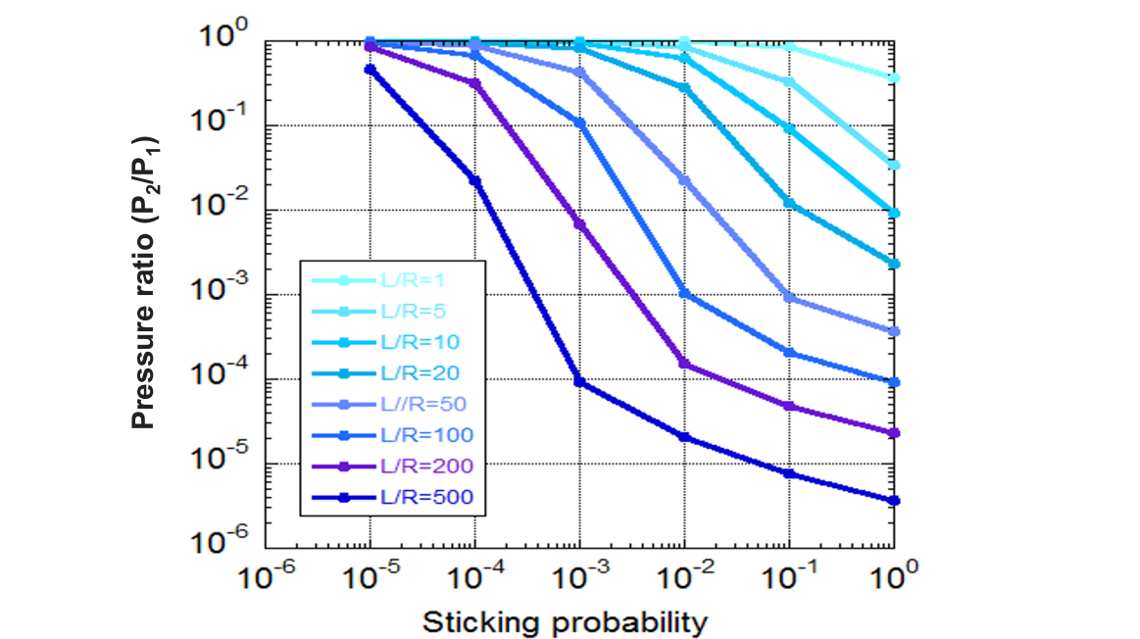
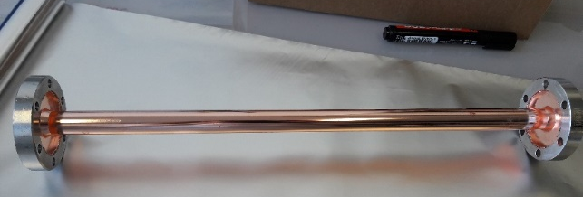
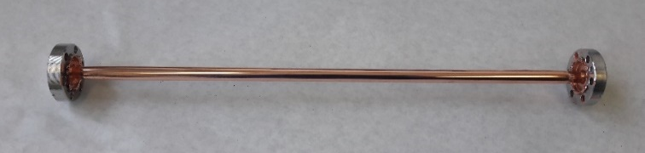
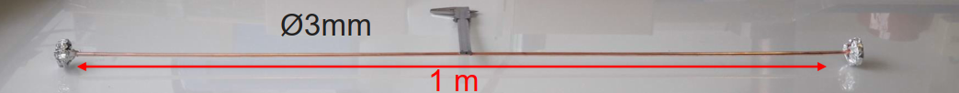
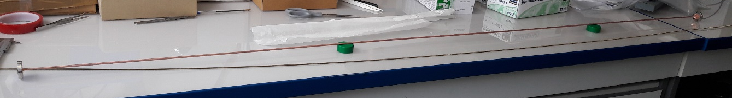
Pumping performance: what can be measured
We expect a sticking of 10⁻³ 10⁻² and can easily measure a pressure ratio of 0.5-0.005: not for too slim chambers!
Φ 16 mm x 0.4 m
Φ 12 mm x 0.3 m
L/R=50
Φ 5 mm
L/R=120
0.3 m
L/R=480
L/R=666
2 m
Φ4 mm
L/R=1000

Slide 8
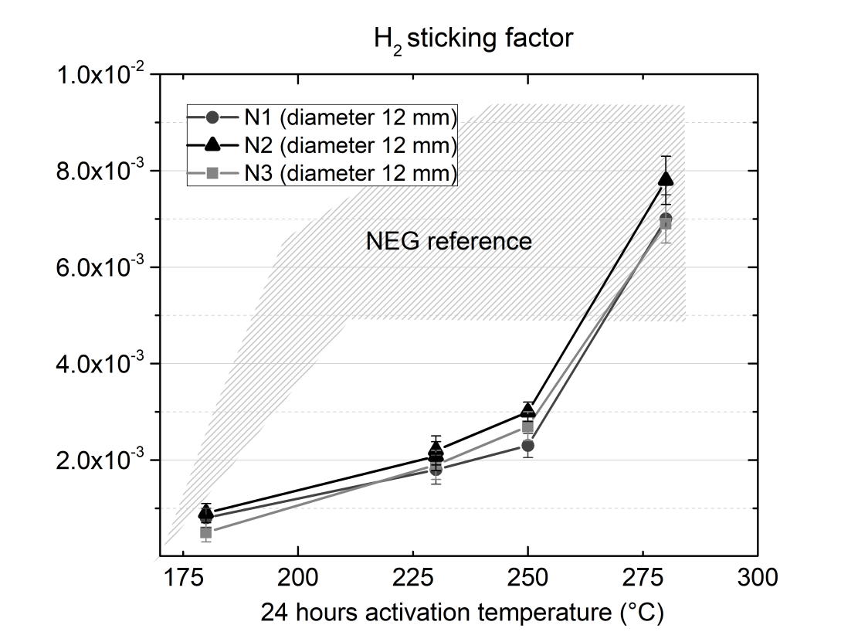
Pumping performance: sticking factor and speed
Reproducible
Reaches reference sticking and pumping speed (Ex: For a chamber of 6 mm diam. the pumping speed for H₂ will be 5.6 l/s/m)
Activation is delayed in temperature compared to standard reference
0.4
0.3
0.2
0.1
Sticking factor for H₂
Pumping speed l/s/cm₂

Slide 9

Pumping performance: aging
Aluminium mandrel 0.5 mm
Expected for standard NEG

Slide 10
Pumping performance: CO capacity
Saturated surface: 1 Monolayer ML CO (defined as 5x10¹⁴ -1x10¹⁵)
CO is adsorbed on the surface
1ML
C=O
C=O
C=O
The expected capacity( as reference) is reached
Also in this case there is a delay in the temperature

Slide 11
Hypotheses for the origin of delay
Impurities incorporated during the process?
transferred to the NEG from the electroplated copper substrate
coming from the chemical baths
The active surface of the film is the part deposited initially on the Al mandrel
Does it oxidize more than for the usual air exposure?
Is the structure of the very first layer of coating different?

Slide 12
Origin of delay: comparison of substrates
Electroformed copper has in general few more impurities than OFE:
Measured in Thermal Desorption Spectroscopy on 10x10x1 mm samples
Still there is no evidence that O related impurities those play a role for the activation

Slide 13
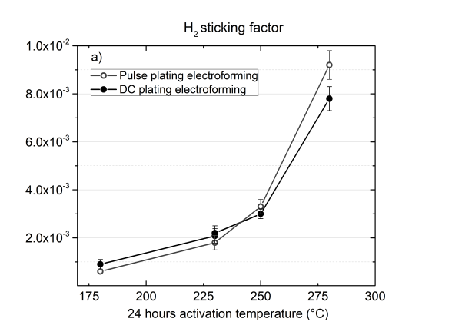
Orgin of delay: different plating recipes?
Not much statistics, but ...no marked difference with electroforming in pulse mode or DC (with brightener)
In spite of the different purity of the copper the performance of NEG is similar and delayed with respect to the reference NEG
Sticking factor for H₂

Slide 14
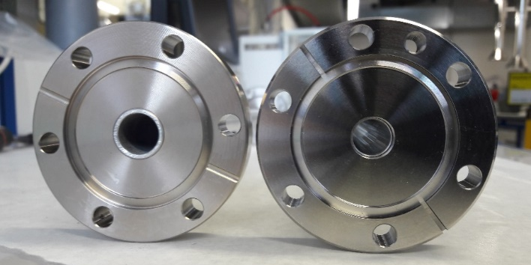
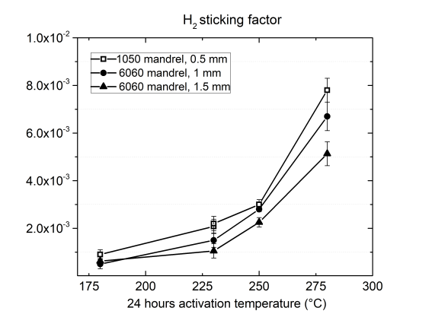
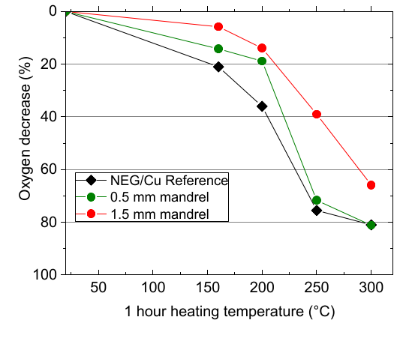
Origin of delay: etching and mandrel thickness
Thickness of aluminium mandrel
0.5 mm, 7h etching
1.5 mm, 24 h etching
2 Al(s) + 2 NaOH(aq) + 2 H₂O(aq) → 2 NaAlO₂(aq) + 3 H₂(g)
Decrease of O in XPS
100
80
60
40
20
0
O1s peak area % (rel. units)
Sticking factor for H₂
Better activation with thin mandrel
This was on cut the chambers? See PhD

Slide 15
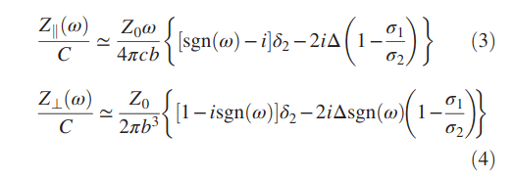
Making the NEG thin (if necessary for impedance)
For a film with much lower conductivity (σ_{f} NEG) than the substrate (σ_{s} Cu) the impedance is only governed by film thickness d
σ_{f}
d
E.Belli et al
PR Accel Beams 21 111002 (2018)
s
σ_{s}
σ_{f}
s
d
σ_{s}

Slide 16
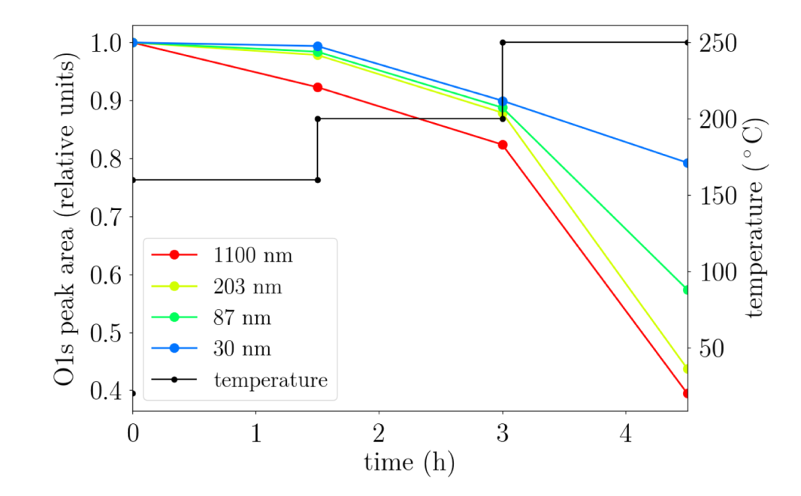
How much cycles for thin NEG?
The expected effect is a higher sentitivity to venting/activation cycles for thin NEG: indeed……
After 4 cylces of venting /activation the activation of thinner films requires more time
→It is more difficult for the surface oxygen to diffuse into the film

Slide 17
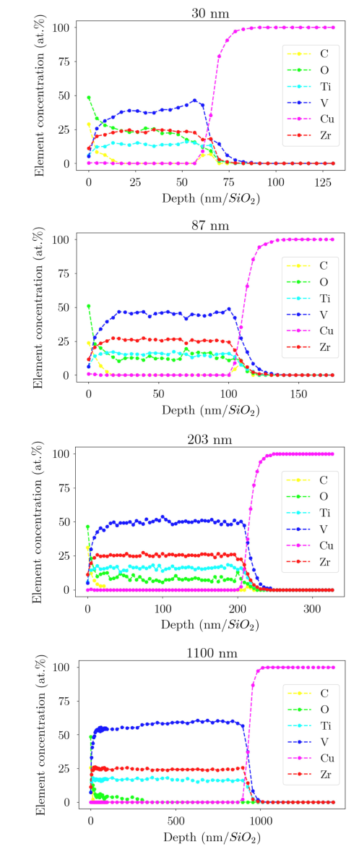
How much cycles for thin NEG?
30 nm
203 nm
XPS
depth profiles
As expected after some cycles the concentration of dissolved oxygen is higher in thinner films
The lower concentration gradient slows down the further diffusion and activation
1100 nm

Slide 18
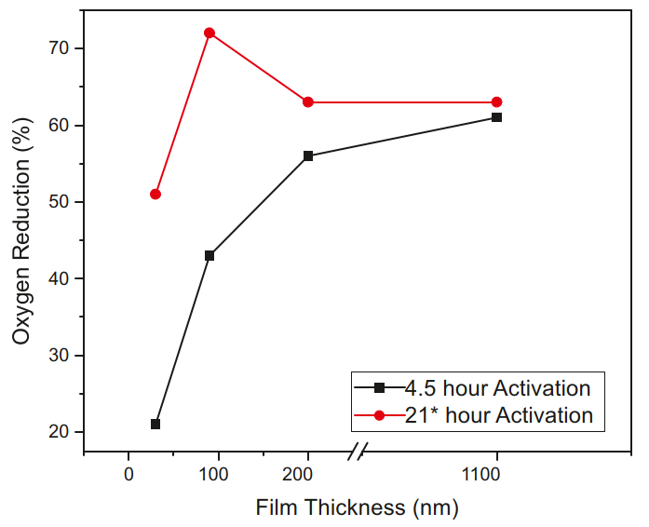
How much cycles for thin NEG?
Reduction of the surface oxides
(X-ray Photoelectron Spectroscopy)
80
70
60
50
40
30
For film thickness ≥100 nm the activation after few (4) cycles can be recovered for 21h of activation at 250C
O1s peak area % (rel. units)
250C activation

Slide 19
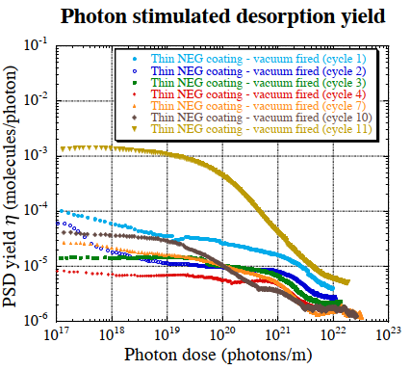
Photon stimulated Desorption on thin NEG
Critical energy:4keV
Incidentangle:10mrad
Powerdensity:20W/m
150 nm thick NEG
Cycles 1-4: PSD decrease with venting/activation(250C x 4h)/irradiation cycles
Cycle 10: slight increase when venting/activating without further irradiationn, but conditions quickly (irradiation helps to reduce H content)
Cycle 11: venting without activation
For PSD the thin NEG is robust upon cycling
Y.Tanimoto et al.
StSt

Slide 20
What do we know on thin and inverted NEG
Property/NEG | Standard NEG | Thin NEG | Inverted NEG
1st activation O decrease | 250C x 1h | Lowest thickness 30nm | 250C x 1h
N cycles: O decrease | (see pumping) | >100 nm 250C x 24h N ≤ 4 | ?
1st activation pumping speed | 180-200C x 24h | Reduced for 200 nm | 275C x 24h
pumping speed: N cycles | Sticking 1/N , N≤ 20 200C x 24h | ? | Sticking as expected 1/N, N≤ 3 , 275Cx24h
PSD | Ec = 20keV, 250C x 24h | 150 nm, Ec=4KeV, 250C x 4h, N=10 | ?
SEY | 1.1 for 250 C x 1h | >30 nm 1.2, 250C x 24h | 1.2 for 250C x 1h
SEY, N cycles | 1.2 , 250C x 1h for N=3 recovers at 300 x 1h for N=10 | ≥200 nm 1.2, 250C x 24h , N = 4 | ?

Slide 21
Thank you!

Slide 22
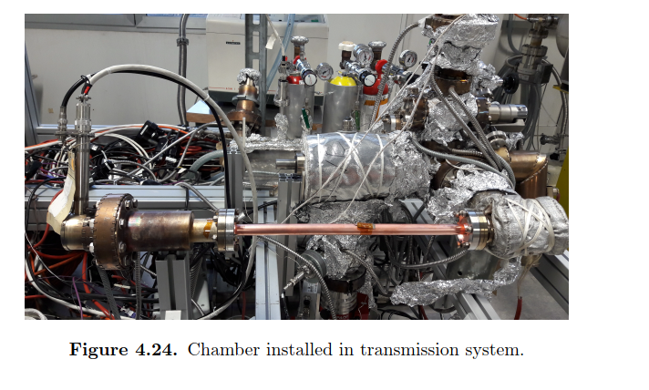

Slide 23
Pumping speed and H2 saturation of NEG
For 1000 nm the pumping speed is as expected: after saturation a regeneration (no venting) of 24h x 250C, recovers only half of the initial pumping speed.
For 200 nm the pumping speed is about half of reference: after saturation and regeneration (no venting) it recovers the same value for several saturation (no venting) cycles
Atomic concentration of H in the film is similar for both thicknesses (~4% at. H in the film): did we reach equilibrium of H dissolved and H₂ pressure during activation?

Slide 24
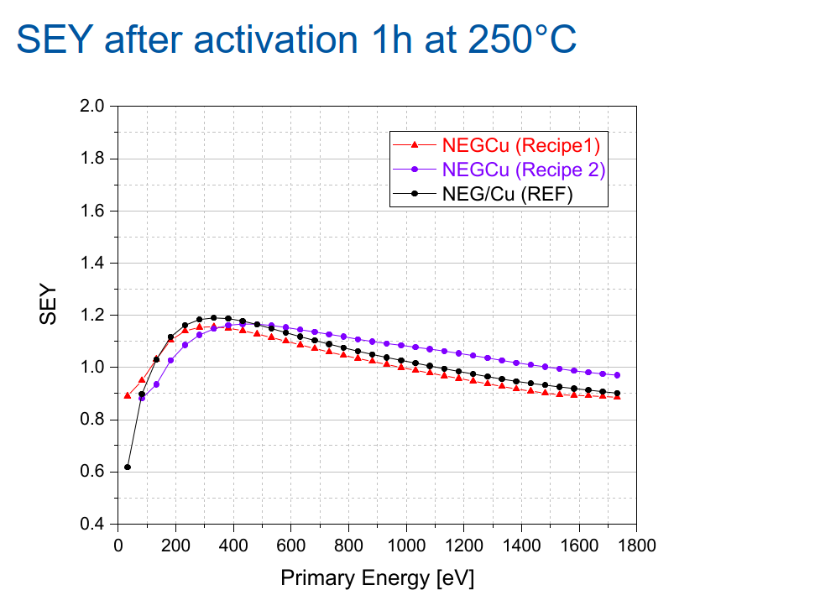
Inverted NEG:
Shows a decrease of SEY which is not delayed

Slide 25
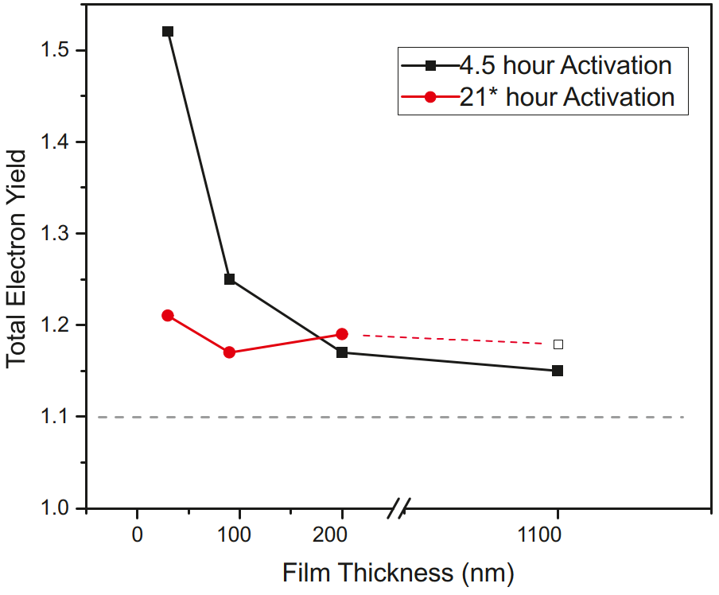
3 – Studies on “very thin” NEG films
4th activation cycle at 250 ºC
Reduction of the surface oxides
(X-ray Photoelectron Spectroscopy)
Maximal secondary electron yield

