Slide 1
Towards an FCC effort on detector concepts
Mogens Dam
1st Meeting
7th April 2021

Slide 2
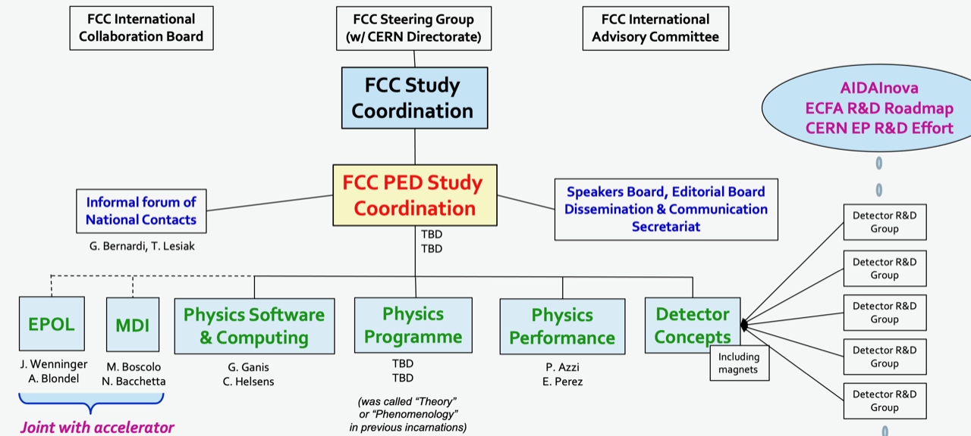
FCC Organization

Slide 3
This meeting
First meeting in ad-hoc task force to prepare a proposal for the organization and the mandate of an FCC-ee ”detector concept” effort, within the FCC PED
Members:
  Martin Aleksa
  Nicola Bacchetta
  Alain Blondel
  Paula Collins
  Mogens Dam (chair)
  Gerado Ganis
  Paolo Giacomelli
  Patrick Janot
  Emmanuel Perez
  Werner Riegler (?)
  Frank Simon
  Guy Wilkinson
From invitation letter (A.Blondel, P.Janot):
  The task force is encouraged to consult outside our group
  A first report will be expected after about a month

Slide 4
Thoughts for this first meeting – mainly extracted from Blondel/Janot
Goals - what we want to achieve ?
  Increased community interest and engagement !
  Make sure detector concepts are capable of delivering the detector requirements
  Detector R&D steered in the direction of the requirements of FCC-ee
    Specific R&D needs to be identified and initiated
    Close contact with R&D efforts: ECFA Roadmap, CERN EP R&D, AIDAInova, …
    Detector technology investigation group?
Deliverables ?
  Define what should appear in the CDR+ at end 2024 – early 2025
    As point of reference, a strawman detector (e.g. CLD) for which
      a model exists in FCCSW (2021?) from which benchmarks performance for case studies can be estimated
      cost, consumables etc. have been estimated
    Descriptions of alternatives and corresponding changes/improvements in performance
      Fx IDEA concept including drift chamber, DR calo, coil placement; and LAr, crystals, …
    Description of R&D and resources that are still required to achieve the detector requirements at the time
  Define ”what tools and by whom” should be provided as community support
    Common software platform FCCSW (key4HEP based)
    FCCSW geometry, simulation, and reconstruction tools for various sub-detectors available in FCCSW
      Test possible ”hybrid” concepts via plug-and-play.

Slide 5
Thoughts for this first meeting – mainly extracted from Blondel/Janot
Gathering the community around challenges
  Invite community and potential leaders to participate in the challenge of implementing detector solutions that satisfy detector requirements using technology that either exists, or can be realistically developed over the next 10-15 years
    Keeping in mind, that new technological developments can lead to new physics opportunities
  Develop proposal for how to proceed over the next few months
    workshop?, working groups?, kick-off event? etc.
      broadning vs. in-depth
Timeline:
  Today: first discussion, exchange og views and ideas …
    Brief report to FCC SG Meeting next week
  1 – 2 follow-up meetings within the next month
    First report at the May FCC SG (date?)

