Slide 1

Status of LHC Operations
Gianluigi Arduini – BE Accelerator and Beam Physics Group
for the LHC Commissioning team,
equipment and support groups
LPCC, 6th August 2010

Slide 2
Outline
Goals
Overview of the major steps during the past two weeks
Present performance
Conclusions and plans

Slide 3
Goals for the past 2 weeks
Re-establish physics conditions after the technical stop
Run pre-cycles with faster ramp-rates
Increase number of bunches (double it)
Increase stored beam energy to >1 MJ and start to acquire experience in this regime
Achieve L_{tot} = 1 pb⁻¹

Slide 4
Faster pre-cycles
At the beginning of June the hardware modifications to be able to (safely) ramp the magnets at 10 A/s were completed and tested.
  Delayed opening of the energy extraction switches to avoid spurious (fake) quench triggers
Changing the ramp rate has a significant impact on operation (persistent current effects) through larger perturbations of tune, chromaticity at injection and in the first part of the ramp.
Decided to implement the faster ramp rate in steps starting from the pre-cycle and ramp-down after having completed the effort of increasing the nominal bunch intensity profiting of the re-start after the technical stop
The first days following the technical stop were used to re-establish good ramps and squeeze and perform verifications of optics and collimation.

Slide 5
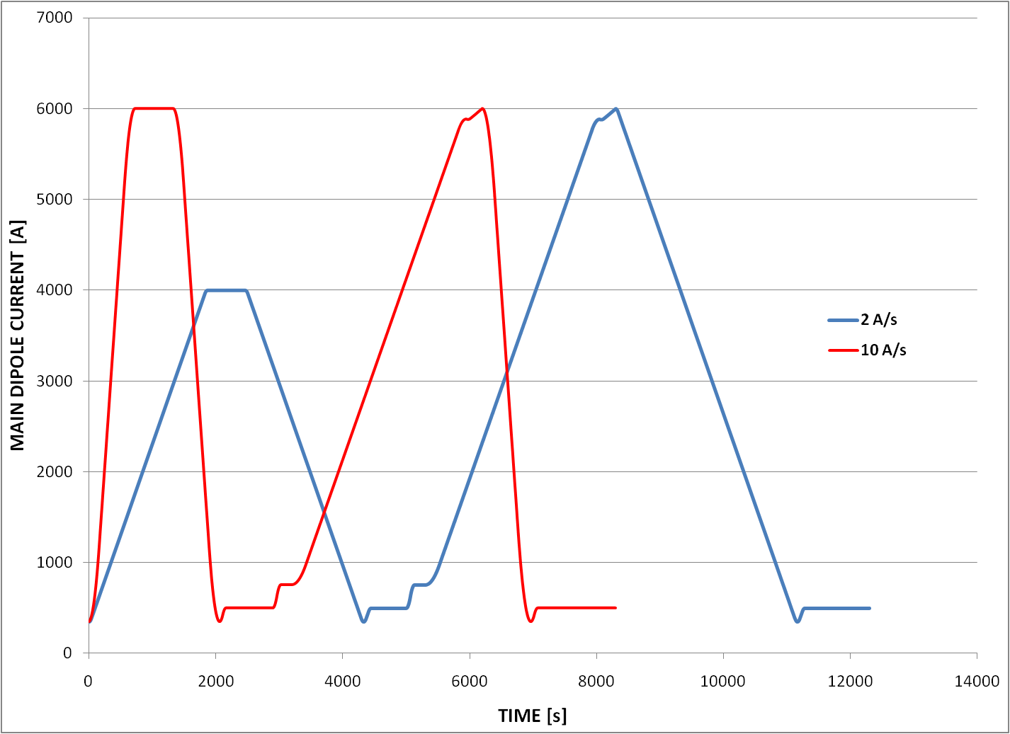
Faster pre-cycles
Advantages:
  Faster turn-around
  Pre-cycle to 6 kA of the main circuits (previously limited to 4 kA) ➔ same conditions after a ramp down after physics and after a pre-cycle ➔ better machine reproducibility

Slide 6
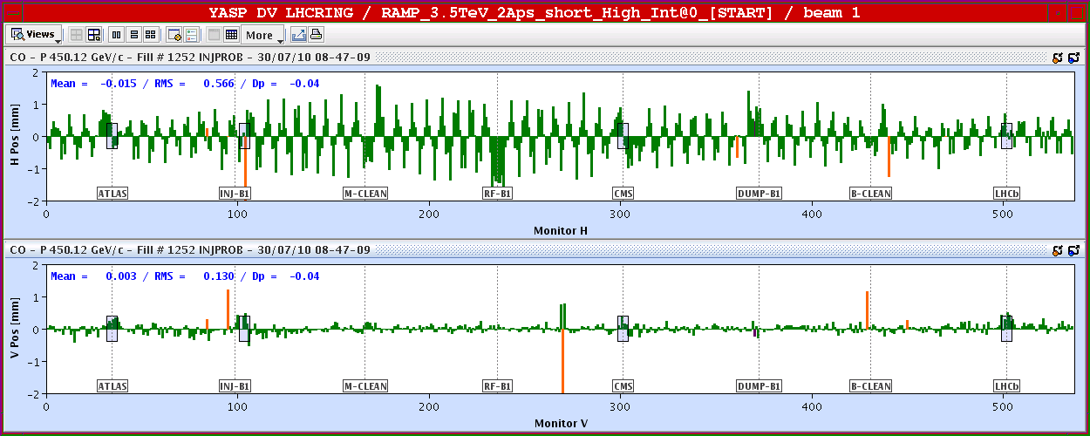
Effect of faster pre-cycle (orbit)
Since the introduction of the 10 A/s, much larger orbit variations are observed fill to fill at injection in the horizontal plane – signature of random b1 (dipole) error. Due to larger persistent currents. Expected and correctable
  0.3-0.6 mm RMS

Slide 7
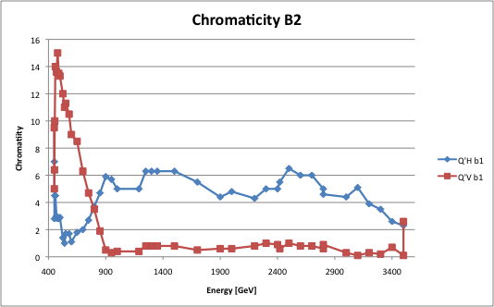
Effect of faster pre-cycle (chromaticity)
Large chromaticty swing at the beginning of the ramp (snap-back effect)
Corrected iteratively

Slide 8
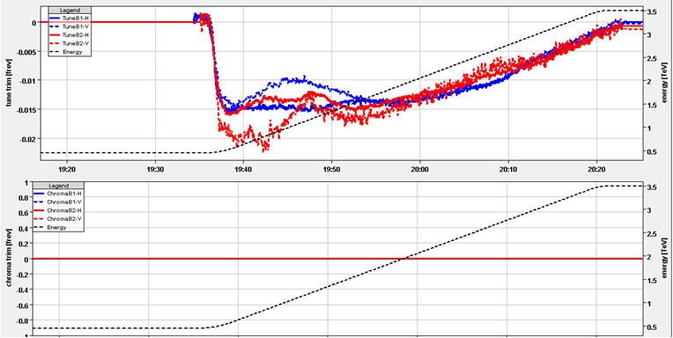
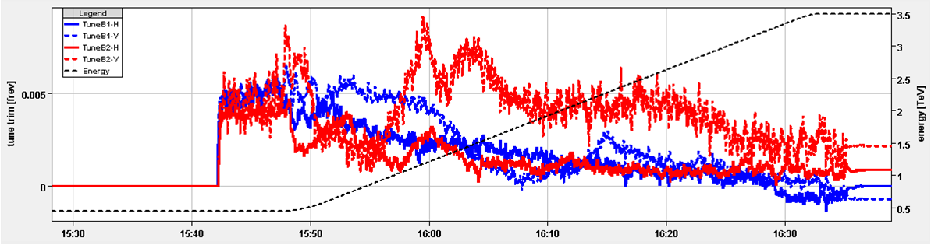
Effects of faster pre-cycle (tune)
Tune trims: OK on flat top, large in ramp
Initially taken care by the tune feedback
Then corrected with feed-forward

Slide 9
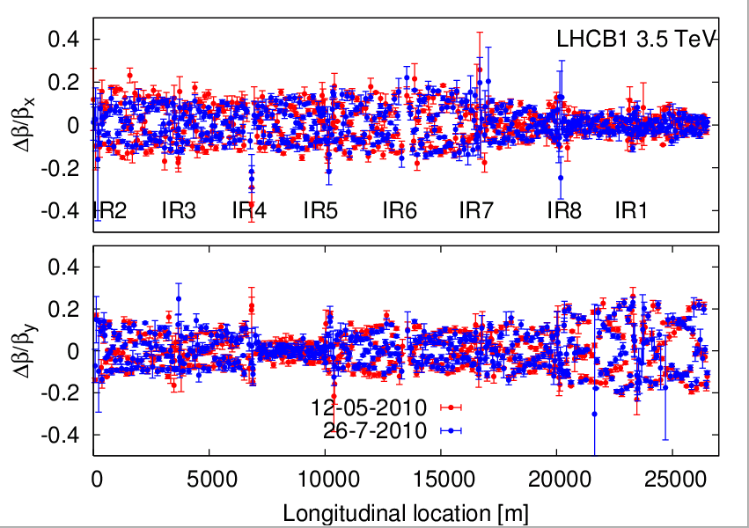
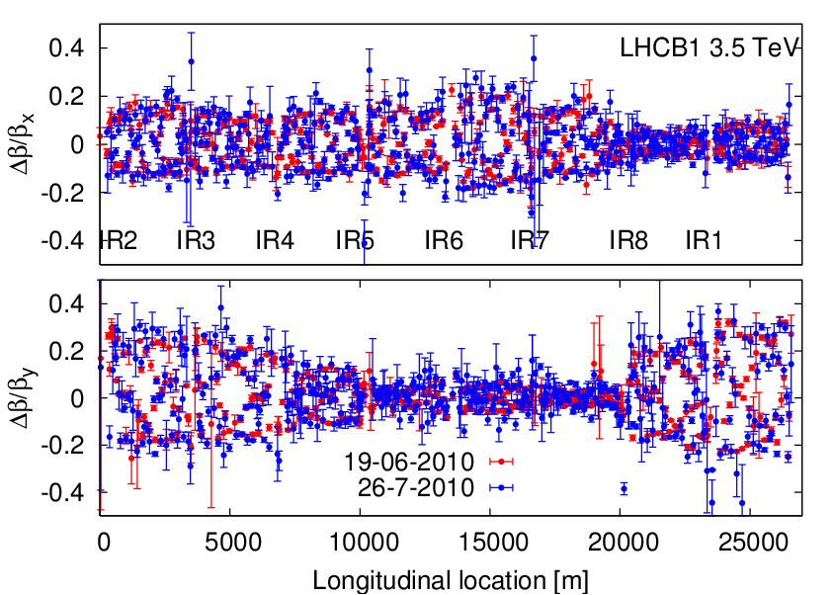
Effects of faster pre-cycle (Optics)
Optics measurements show excellent reproducibility
Squeezed optics
Injection optics
R. Tomas et al.

Slide 10
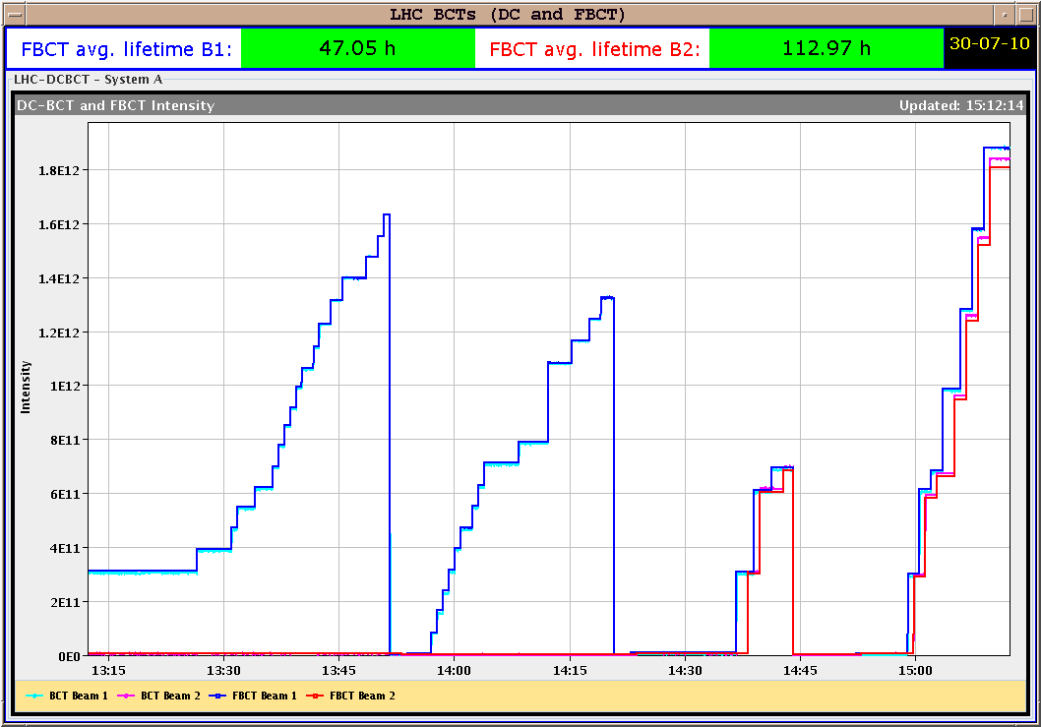
Increasing Intensity (injection)
Multi-bunch injection set-up:
  Fine energy matching of both rings using closed orbit correctors to adapt the two circumferences (correction of Δp/p ~5x10⁻⁵) : and improve RF capture efficiency
  Steering and collimator settings had to be adjusted for B1
  Still some issues with the reproducibility of the trajectory of the beam in the injection line being investigated
Injection of 25 bunches 6x4 +1
Injection of
25 bunches
B. Goddard, M. Meddahi et al.

Slide 11
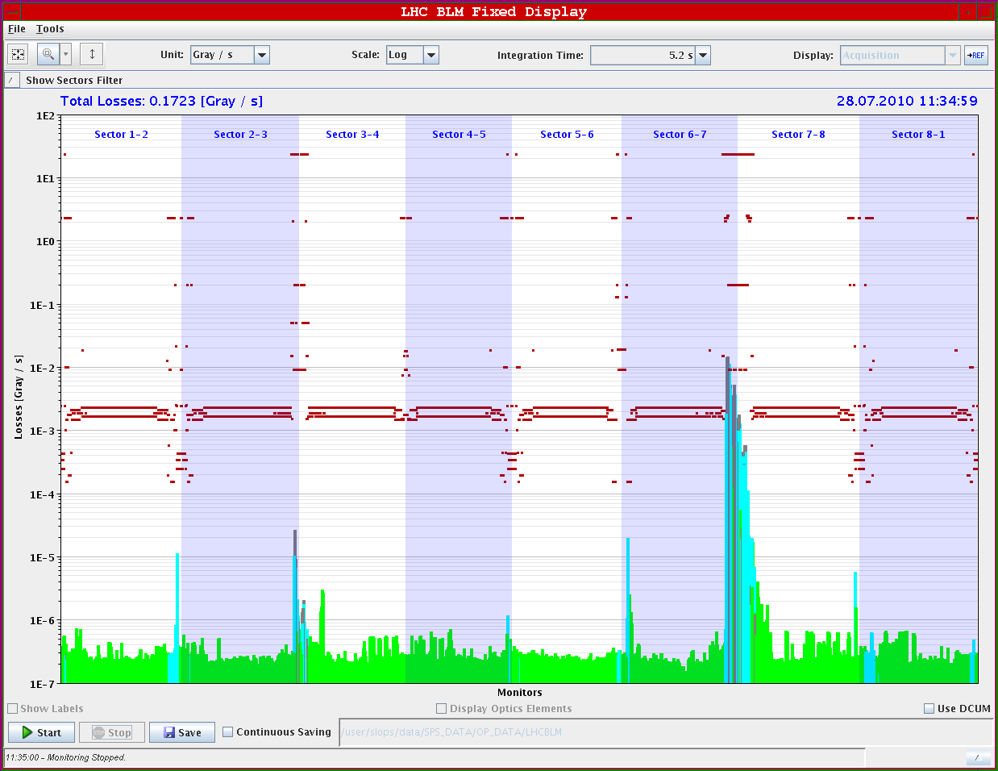
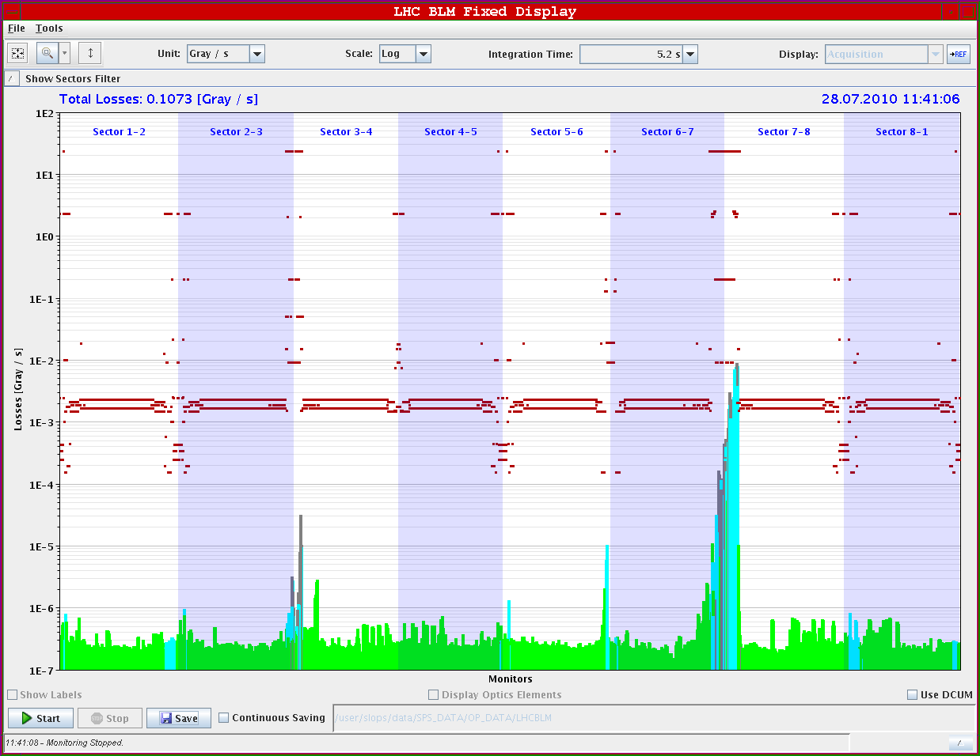
Periodic machine protection verification
Validation of collimation setup for stable beams (ongoing):
  collimators set up for high intensity one month ago!
  with TOTEM RPs at 25 (V)/ 30 (H) sigma.

Slide 12
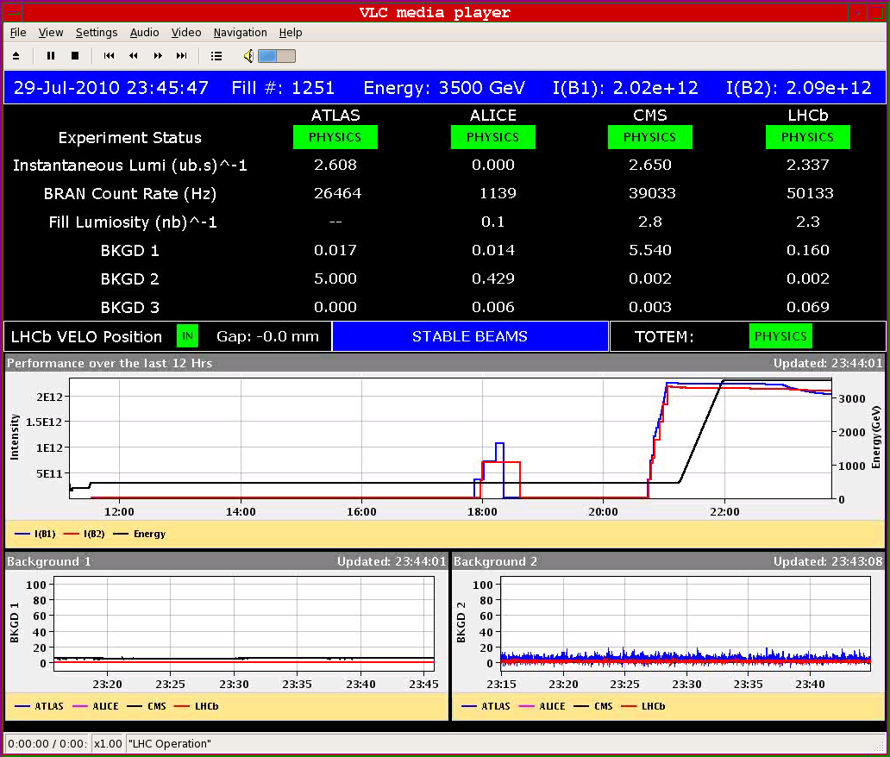
Collisions with 25 bunches
First fill (1251) with 25 bunches
  Peak L seen just after colliding ~2.8x10³⁰ cm⁻²s⁻¹
  In STABLE BEAMS peak L ~2.6x10³⁰ cm⁻²s⁻¹
  TOTEM RPs at 30/25 sigma (H/V)
~1.2 MJ of stored beam energy!!!!

Slide 13
Collisions with 25 bunches
- 0 collisions
- 3 collisions IP 1 5 and 2 (with offset in IP2)
- 3 collisions IP 1 5 and 8
- 2 collisions IP 2 and 8 (with offset in IP2).
Low lifetime on B1 just after colliding.
B1 and B2 different.
G. Papotti, W. Herr

Slide 14
Collisions with 25 bunches
- 0 collisions
- 3 collisions IP 1 5 and 2 (with offset in IP2)
- 3 collisions IP 1 5 and 8
- 2 collisions IP 2 and 8 (with offset in IP2).
Relative losses
for B1 and B2:
Fill 1257
Q split
Vs.
Fill 1262
with no Q split
Now possible thanks to the transverse feedback
G. Papotti, W. Herr

Slide 15
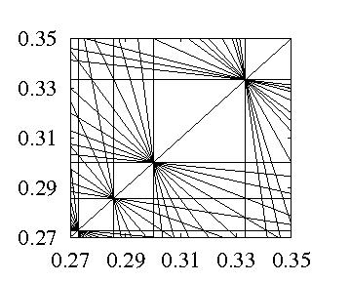
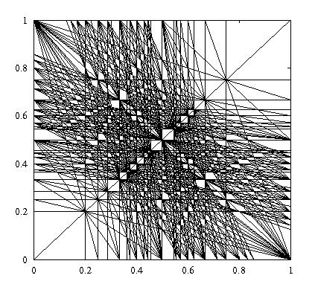
Collisions with 25 bunches
We have to fit the working point here
So we are interested in maximizing the overlap between the two beams working points
L_{peak}>3x10³⁰cm⁻² s⁻¹
L_{fill}~120 nb⁻¹ in 18.5 h

Slide 16
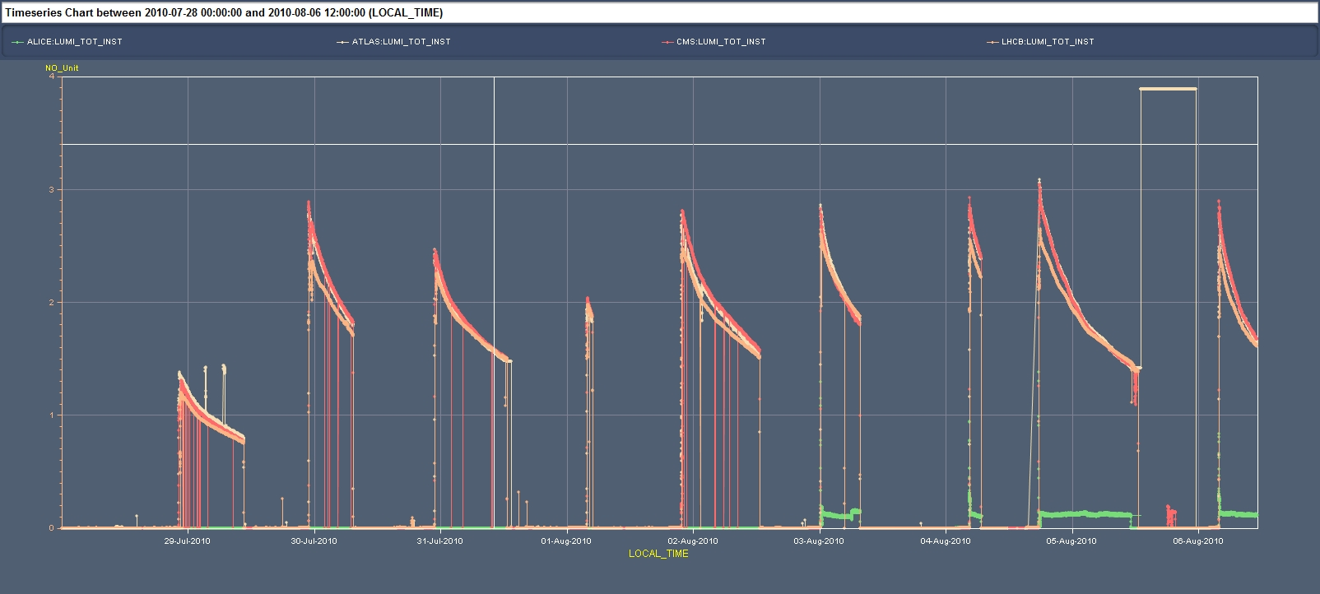
Luminosity
After the completion of the commissioning of the shorter pre-cycle and first machine protection verifications:
  At least 1 fill for physics/day interleaved with remaining tests for machine protection verification and operational improvement
L_{peak}>3x10³⁰cm⁻² s⁻¹
L_{fill}~120 nb⁻¹ in 18.5 h
L_{tot} delivered in STABLE BEAMS condition >910 nb⁻¹

Slide 17
Luminosity
No more sudden losses observed during stable beam operation thanks to the operation of the transverse feedback in collision
Coast duration not yet optimized mainly limited by unprogrammed (but non-spurious) dumps so far. Only 2 programmed dumps in the past 2 weeks.
Programmed dumps

Slide 18
MPS statistics
We have accumulated ~180 dumps above 450 GeV.
In all cases the MPS reacted correctly, even for yet un-explained events.
There are 2 events where the cause is not understood, on July 7th (BLM IR7) and July 30th (BLM IR5).
  Common features:
    Fast loss at cold element
    Loss time scale ~2 milliseconds ~20 turns.
    Loss after a bending section (DS IR7, D1 IR5).
    Orbit and trajectory stable.
  Event July 30th:
    All PC currents rock stable – no trims etc.
    Orbit stable to few microns, trajectory to few tens of microns (resolution!).
J. Wenninger

Slide 19
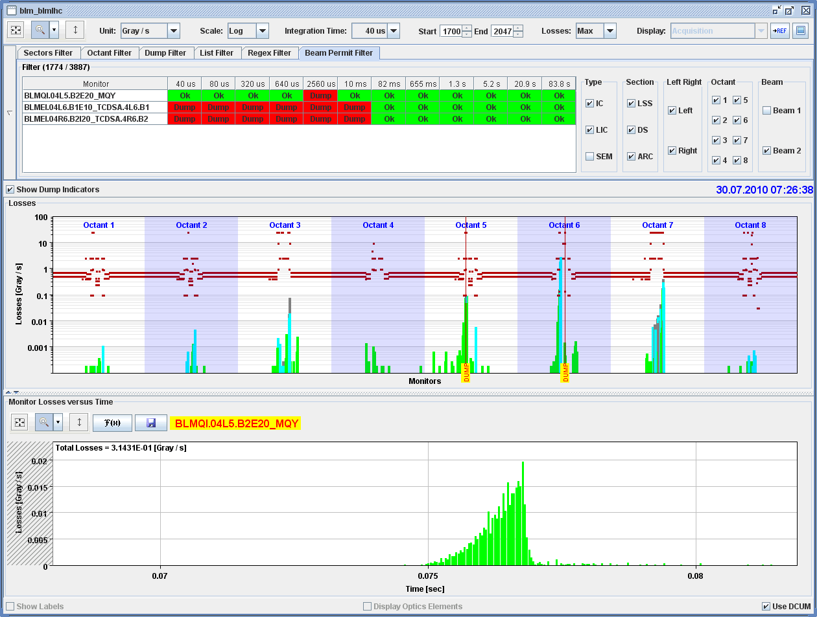
Event 30th July
Loss on Q4 L5 from beam 2.

Slide 20
Conclusions & Plans
We have achieved an important milestone in the road towards increasing the complexity of the operation step-wise and without compromising on safe operation: > 1 MJ stored beam energy
New record peak luminosity (3x10³⁰ cm⁻² s⁻¹) and fill luminosity (120 nb⁻¹) although we have still a long way to go..
Next steps
  Consolidation of the operational procedures with 25 bunches and nominal bunch intensity ➔ turn-around time
  Gain experience and monitor machine and machine protection performance at >1 MJ stored energy during the month of August
  Luminosity production and further understanding of the performance in collision

Slide 21
Thanks to all the teams involved
Thanks to the Physics Coordinator and to the experiments for the fruitful collaboration and feedback

