Slide 1
Tier-2 Network Requirements
Kors Bos
LHC OPN Meeting
CERN, October 7-8, 2010

Slide 2
Disclaimer and References
Although my presentation is very ATLAS biased, CMS have confirmed that they have identical issues and that the conclusions apply to both experiments. Their list of Tier-2 sites is slightly different though.
The LHCb experiment does not use Tier-2 sites for analysis and is less concerned by this proposal. Alice has a different model but would generally profit from what is proposed. Their list of sites is slightly different again.
This presentation can be seen as another contribution from the experiments to the Tier-2 requirements working group and one of the final steps towards conclusion.
DAaM Brainstorming session in Amsterdam, June 16-18
  http://indico.cern.ch/conferenceDisplay.py?ovw=True&confId=92416
Discussed extensively again at WLCG Workshop @ IC London, July 7-9
  http://indico.cern.ch/conferenceOtherViews.py?view=standard&confId=82919#20100707.detailed

Slide 3
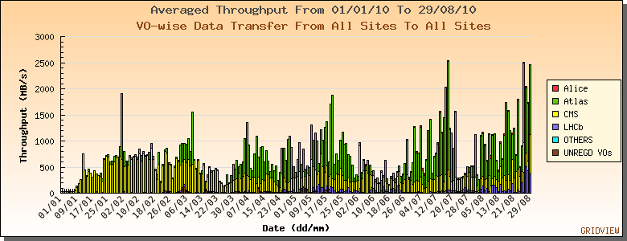
The success #1 unprecedented data distribution by all LHC experiments

Slide 4
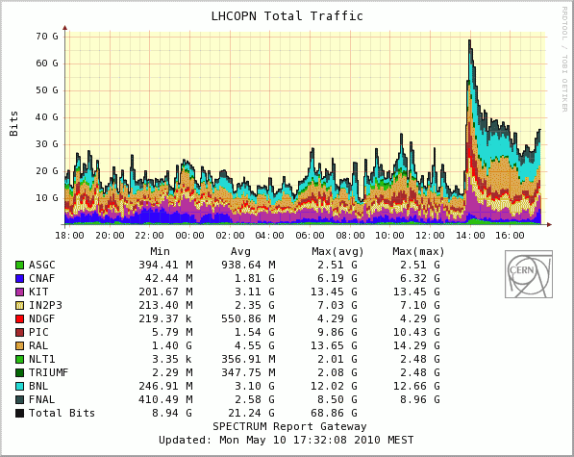
The success #2 full usage of the LHC OPN

Slide 5
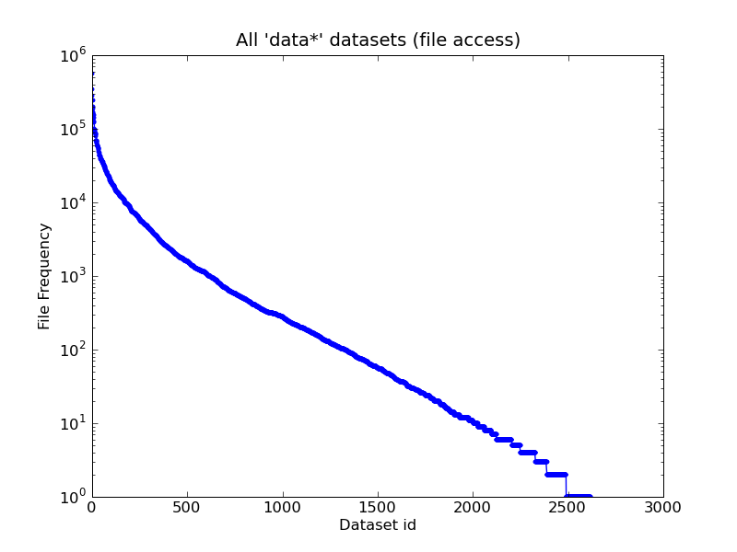
Difficulty #1
A small fraction of the data we distribute is actually used
Data* datasets
Counts dataset access
Only by official tools
There are ~200k datasets

Slide 6
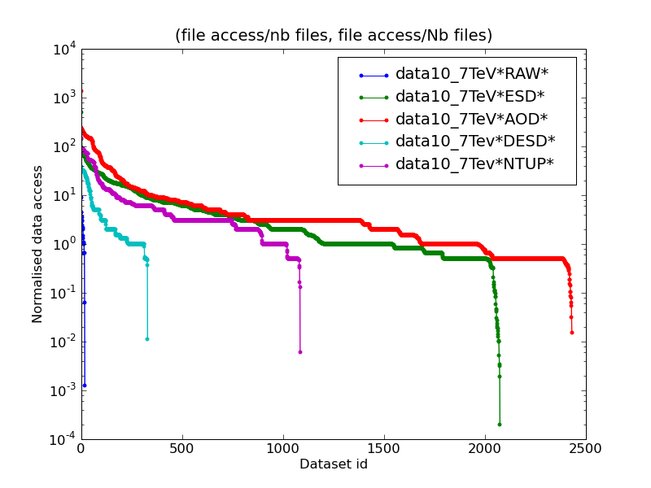
Difficulty #2
We don’t know a priori which data type will be used most
Same plot, normalized for the number of files per dataset

Slide 7
Difficulty #3
Data is popular for a very short time
Dataset: data10_7TeV.00158116.physics_L1Calo.recon.ESD.f271
Dataset Events: 99479
Replicas: 6, Files: 6066, Users: 35, Dataset Size: 17.1 TB
Note: Search was for the last 120 days, but only used for 13 days

Slide 8
Data placement model
T0
Keeps 1 full copy of RAW
RAW → ESD, AOD
another full copy of RAW
5 full copies of ESD
10 full copies of AOD
T1
T1
ESD → DESD AOD→D3PD
T2
T2
T2
T2
T2
T2
analysis on
ESD, AOD, DESD, D3PD
2 full copies of ESD
24 full copies of AOD, DESD, D3PD

Slide 9
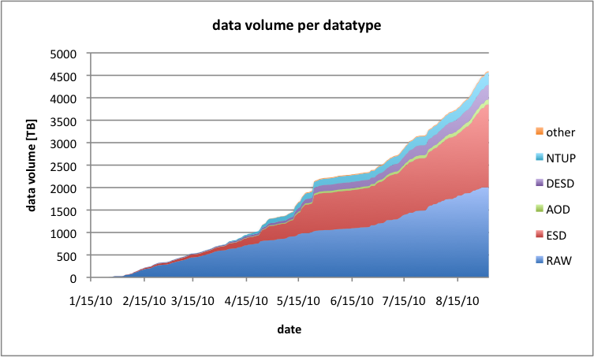
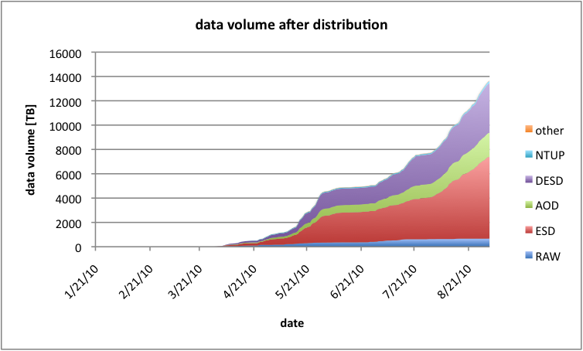
Volume of 7 TeV Data in 2010
Data selection %data01_7TeV%
2.0 PB of RAW and 1.8 PB of ESD
0.1 TB of AOD and 0.3 PB of DESD, 0.2 PB of NTUP and 0.01 B of “other”
After distribution …
0.8 PB of RAW but 6.7 PB of ESD
2.0 PB of AOD and 4.1 PB of DESD, 0.2 PB of NTUP. 0.03 PB of “other”

Slide 10
Volume 7 TeV Data in 2010
Data selection %data01_7TeV%
2.0 PB of RAW and 1.8 PB of ESD
0.1 TB of AOD and 0.3 PB of DESD, 0.2 PB of NTUP and 0.01 B of “other”
After distribution …
0.8 PB of RAW but 6.7 PB of ESD
2.0 PB of AOD and 4.1 PB of DESD, 0.2 PB of NTUP. 0.03 PB of “other”

Slide 11
Volume 7 TeV Data in 2010
Data selection %data01_7TeV%
2.0 PB of RAW and 1.8 PB of ESD
0.1 TB of AOD and 0.3 PB of DESD, 0.2 PB of NTUP and 0.01 B of “other”
After distribution …
0.8 PB of RAW but 6.7 PB of ESD
2.0 PB of AOD and 4.1 PB of DESD, 0.2 PB of NTUP. 0.03 PB of “other”

Slide 12
Volume 7 TeV Data in 2010
Data selection %data01_7TeV%
2.0 PB of RAW and 1.8 PB of ESD
0.1 TB of AOD and 0.3 PB of DESD, 0.2 PB of NTUP and 0.01 B of “other”
After distribution …
0.8 PB of RAW but 6.7 PB of ESD
2.0 PB of AOD and 4.1 PB of DESD, 0.2 PB of NTUP. 0.03 PB of “other”

Slide 13
Oversubscription of data ?
Starting with 2 PB of RAW from the detector
We end up with 14 PB of derived data for analysis (ignoring simulated data)
Very many copies in Tier-1’s and Tier-2’s to allow efficient analysis
Caching data in stead !
With a well performing network we could do as well with fewer copies
Download data needed for analysis → automatic selection of popular data
Possibility to use Tier-0 and Tier-1’s and Tier-2’s as data source
Best probably to do limited amount of “intelligent” pre-placement

Slide 14
Network Requirements
Part of the requirements are already well covered by the OPN.
For controlled (re-) processing:
Data Distribution from Tier-0 to Tier-1s
  Initial data from the detector and from first pass reconstruction
Data Distribution from Tier-1 to all other Tier-1’s
  After re-processing of the initial data in the Tier-1’s
Data Distribution from Tier-1s to some Tier-2s
  After re-processing to distribute derived data
For uncontrolled data analysis:
Data Distribution from all Tier-1s to all Tier-2s
  For further derived data for/from analysis
Data Distribution from any Tier-2 to any other Tier-2
  For further derived data for/from analysis
To allow for a full caching model additional services are needed.
OPN
OPN
GPI
GPI
GPI

Slide 15
Tier-2 Analysis Bandwidth Requirements
Based on CPU capacity
  A typical Tier-2 site with 1000 cores, a typical rate of 25 Hz for AOD analysis, …
Based on cache turnover after re-processing
  A typical 1 week turnover of a typical 400 TB cache, …
Based on analysis efficiency and user expectations
  A typical 1 day latency for a 25 TB analysis sample, …..
Tier-2 Connectivity Categories
Minimal
  Small Tier-2s, well suited for end-use analysis
Nominal
  Nominal sized Tier-2s , big analysis samples can be updated regularly
Leadership
  Large Analysis Centers, supporting many users, frequent cache turnovers
Meant is shared, best effort connectivity,
not guaranteed bandwidth between each of the sites
1 Gb/s
5 Gb/s
3 Gb/s
1
Gb/s
5
Gb/s
10
Gb/s

Slide 16
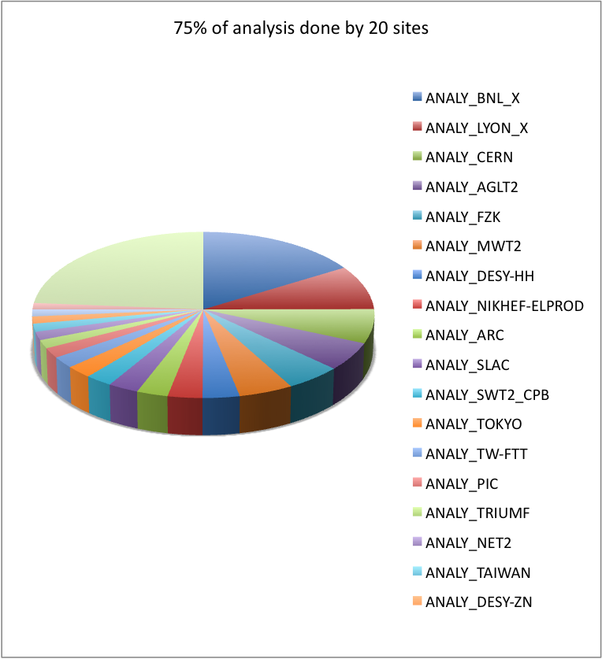
ATLAS Tier-2 categories .. momentarily!
Counting the analysis jobs
  July + August
75% done in 18 sites
  One of them being CERN (Tier-0)
  Seven of them being a Tier-1
90% done at 36 sites
  24 of them genuine Tier-2’s
  All in Western Europe or the US
  Except, Tokyo and Taipei
ATLAS has 58 Tier-2’s
  And 10 Tier-1’s and 1 Tier-0
  And 5 analysis sites co-located to a Tier-1
  And 5 Tier-3’s soon becoming Tier-2’s
This list may change a lot
  Reflects situation of this summer
  Analysis will be pushed out of tier-1s
  Sites are continuously improving
  Better networking will improve smaller sites more

Slide 17
Flexibility Requirement
Leadership sites unlikely to go down, but
sites may improve from Minimal to Nominal or from Nominal to Leadership
Some sites, currently Tier-3, may apply to become Tier-2
Better networking may improve some sites more than others
Special Tier-2’s
Some Tier-2’s are outside Western Europe and Northern America
  Taipei and Tokyo are the exception
  But there are also China, India, South America, Australia and South Africa
  And on the European rim: Russia, Romania, Turkey, Israel, ..
Costs
Networking was not considered in the resource estimates
For Tier-2 sites it is important to know how much must be invested

Slide 18
Hybrid Approach
The optimal solution may be a push- as well as pull- solution
Based on our knowledge of usage patterns we may pre-place some data
  In Tier-1’s because generally Tier-1 → Tier-2 traffic is well optimized
  After well organized challenges such as full re-processing
Could be used to anticipate on expensive connections
  Pre-place data in the US and Asia to avoid too much trans-Atlantic traffic
Force to be 2 copies readily available to avoid single site overload
  These sites could be all Tier-2’s
This can be further re-fined if the need occurs

Slide 19
Conclusions
All LHC experiments, but in the first place ATLAS and CMS, would benefit greatly from better connected Tier-2’s
The Leadership Tier-2’s are mostly in Europe and Northern America and need 10 Gb/s to connect to other Tier-1 and Tier-2 sites
Nominal Tier-2’s need a 5 Gb/s connection to the same infrastructure
All Tier-2s should at least have 1 Gb/s connectivity (Minimal)
By connectivity is meant, shared and best effort
The infrastructure needs to be flexible to allow easy change and expansion
Tier-2 sites outside Western Europe and Northern America need a special approach
Costs need to be estimated to allow Tier-2 sites to plan their resource requests
This OPN meeting needs to specify what else is needed to now propose an architecture

Slide 20
The end

Slide 21
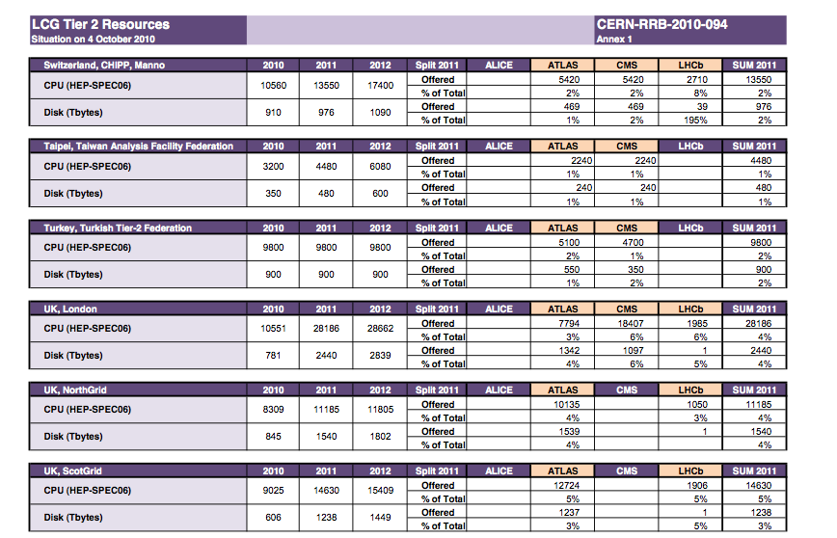
Table of Tier-1 and -2 sites
Official WLCG table with 2011 pledges of all Funding Agencies:
http://lcg.web.cern.ch/LCG/Resources/WLCGResources-2010-2012_04OCT2010.pdf
Shows all Tier-2s and their disk and CPU capacities
Snapshot:

Slide 22
Goal: collect requirements on network connections of a site to be able to efficiently participate in data analysis in a scheme whereby not all data will be assumed to be locally available
Deadline: to be finalized in September 2010
Reporting to: WLCG GDB/MB
Members:
  Harvey Newman and Artur Barczyk (LHCNet )
  Bill Johnson ( ESNet )
  Eric Boyd ( Internet2 )
  Jerry Sobieski ( NORDunet )
  Klaus Ullmann ( DFN and Dante )
  David Foster and Edoardo Martelli ( CERN )
  Ian Fisk ( CMS )
  Kors Bos,( ATLAS )
Initial work
  List of sites (to be connected first)
  Definition of a “typical” site
  List of important parameters ( cache turnover, type of analysis jobs, analysis efficiency, etc. )
Slide from July 8
Replaced Klaus:
KarinSchauerhammer (DFN)
Vasilis Maglaris (NRENPC)
Dany Vandromme (Renater)
Richard Hughes-Jones (DANTE)
Invited at a later stage:
Jim Williams (Tier-2)
Shawn McKee (Tier-2)
Erik-Jan Bos (SurfNet)

Slide 23
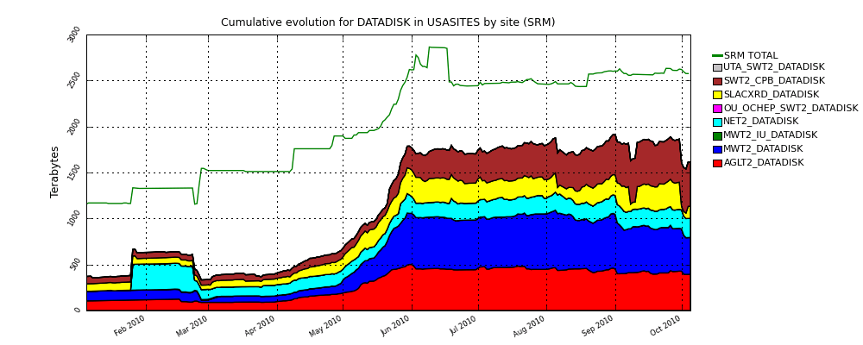
Data Flow to US ATLAS Tier 2’s
Example above is from US Tier 2 sites
  Exponential rise in April and May, after LHC start
  We changed data distribution model end of June – caching ESD and DESD
  Much slower rise since July, even as luminosity grows rapidly

