Slide 1
GGUS – current status and future
LHCOPN Meeting Geneva
Guenter Grein

Slide 2
Outline
Some words on GGUS
GGUS infrastructure
GGUS user communities
GGUS statistics
GGUS and LHCOPN
Merging GGUS and LHCOPN
Future plans
LHCOPN status list

Slide 3
Some words on GGUS
Run by KIT in Karlsruhe/Germany
Funding: 50% EGI, 50% local/national co-funding
GGUS team: 3 FTEs
Infrastructure:
  Using KIT data bases and mailing systems
  BMC Remedy servers
  Apache web servers

Slide 4
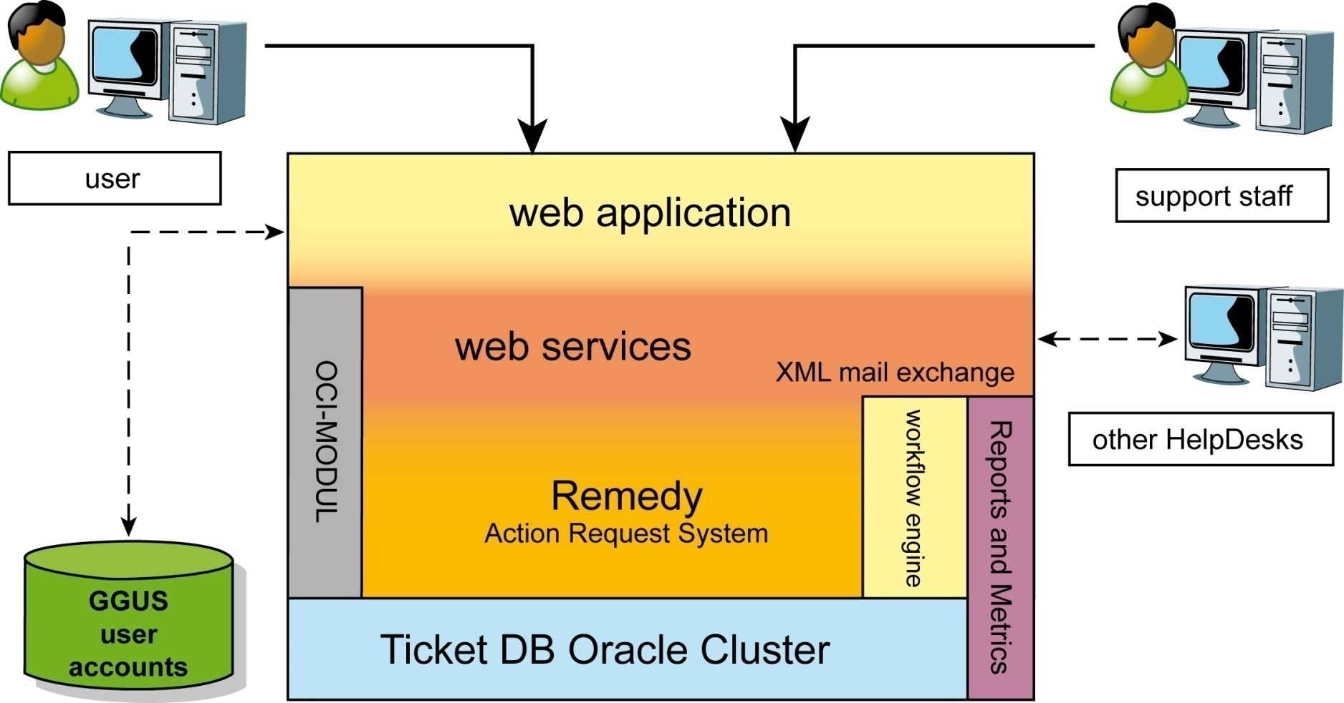
GGUS infrastructure

Slide 5
GGUS user communities
Projects
  EGEE/EGI/NGIs
  EMI
  IGE
  OSG
  WLCG
Users
  Most users from WLCG
  Biomed
  > 2000 registered support staffs

Slide 6
GGUS statistics

Slide 7
GGUS and LHCOPN
Summary of work
  Dashboard https://gus.fzk.de/pages/all_lhcopn.php
  Closed items on status list https://twiki.cern.ch/twiki/bin/viewauth/LHCOPN/GGUSstatusList
Effort to spend in future
  Depends on requests
  Work has to be done besides our day by day business
Things that ease work
  Communication
  Clear definition of requirements

Slide 8
Merging GGUS and LHCOPN
GGUS users can benefit of additional information
Network people in EGI (former ENOC) are considering using GGUS as well
Sophisticated search engine needed for
  avoiding confusion of users
  avoiding overloading the web pages
  easily finding relations between GGUS tickets and LHCOPN tickets

Slide 9
Future plans
Adapt the system to the needs of EGI
  Review and restructuring of support units
  Integration of new support units for EMI and IGE projects
Replace email interfaces by SOAP web services or messaging bus

Slide 10
LHCOPN status list
74 We need to link GGUS LHCOPN tickets with standard GGUS LHCOPN tickets. Parent/Child relationship was chosen during OpsWG6.
  Strongly related to the merging of LHCOPN with GGUS (see slide 7)
  GGUS prefers to cover this issue with the merger of the two systems
  Helmut Dres and Guillaume Cessieux will get in touch for discussing the details

Slide 11
LHCOPN status list
91 Provide to sites an API to remotely handle their GGUS tickets. Privilege to be implemented (i.e. at least constrain submitter fields).
  Need to think further on privilege mapping!
  What is the max. number of “interfaces” ?
  Can be done using SOAP or messaging bus
  Issue is related with items 94, 116, 119, 120 of the status list

Slide 12
LHCOPN status list
92 A checkbox: "clone this ticket and assign it to all impacted site name" could be great. The main ticket assigned to the submitting site being parent of all cloned tickets. Notifications need to be handled carefully. More complex than duplicating as each child ticket will be assigned to a different site.
  In principle we can implement this.
  Helmut Dres and Guillaume Cessieux will get in touch for discussing the details

Slide 13
LHCOPN status list
94 Possibility of "regular ticket" could be good.
  GCX: This will be done remotely (crontab spirit) through SOAP interface or messaging bus.
  “Regular ticket” means GGUS ticket?
  Alternative: calling submit form with parameters in the URL
  Issue is related with items 91, 116, 119, 120 of the status list

Slide 14
LHCOPN status list
116 Enable some network provider to only update history of ticket (not status, as sites are responsible). Authentication with certificate. GCX to list and ask interested network providers.
  They should be able to add only comments?
  Need to think further on privilege mapping!
  Could this be covered by training for the network providers?

Slide 15
LHCOPN status list
116 Some sites would like detailed report about their LHCOPN GGUS tickets (they saw the feature in the standard GGUS, with the "Report Generator"). They have quite clear idea of what they want.
CSV and chart report:
  Number of ticket per category, per month, assigned to a site.
  Number of ticket per category, per month, related to a site.
  CSV export to be provided as a first step, more work on this topic (options are: Externally done through web service; using standard GGUS report generator; tailored one for LHCOPN helpdesk) after seeing outcomes of item #117
  Currently not possible
  Alternative: modify dashboard

Slide 16
LHCOPN status list
  119 Provide a read only account for the web service interface as this could increase performing, and several actions did not require write access
    Need to think further on privilege mapping!
    Issue is related with items 91, 94, 116, 120 of the status list

Slide 17
LHCOPN status list
  120 Provide an account for web services able to open/update tickets.
    Need to think further on privilege mapping!
    Duplicate of item 91

