Slide 1
DYNES
Storage Infrastructure
Artur Barczyk
California Institute of Technology
LHCOPN Meeting
Geneva, October 07, 2010

Slide 2
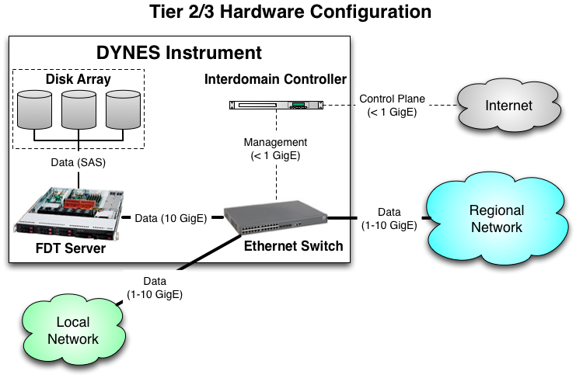
DYNES Instrument at Tier2 & 3
DYNES instrument comes with a storage server and attached disk array
DYNES instrument allows connecting other (e.g. existing) storage elements!

Slide 3
DYNES Storage
The storage part of the DYNES instrument will consist of (per deployment instance at Tier2/3 site)
  One FDT server
  One attached disk array (SAS)
FDT will be used as transport application
  FDT/Hadoop
  FDT/dCache

Slide 4
FDT – Fast Data Transfer
FDT is an open source application for efficient data transfers.
Easy to use: similar syntax with SCP, iperf/netperf
Written in java and runs on all major platforms.
Single .jar file (~800 KB)
Based on an asynchronous, multithreaded system
Uses the New I/O (NIO) interface and is able to:
  stream continuously a list of files
  use independent threads to read and write on each physical device
  transfer data in parallel on multiple TCP streams, when necessary
  use appropriate size of buffers for disk IO and networking
  resume a file transfer session

Slide 5
FDT - Architecture
Control connection / authorization
Pool of buffers
Kernel Space
Pool of buffers
Kernel Space
Data Transfer Sockets / Channels
Restore the files from
buffers
Independent
threads per device
Ramiro Voicu

Slide 6
FDT features
User defined loadable modules for Pre and Post Processing to provide support for dedicated Mass Storage system, compression, dynamic circuit setup, …
Pluggable file systems “providers” (e.g. non-POSIX FS)
Dynamic bandwidth limitations
Different transport strategies:
  blocking (1 thread per channel)
  non-blocking (selector + pool of threads)
On the fly MD5 checksum on the reader side
Configurable number of streams and threads per physical device (useful for distributed FS)
Automatic updates
Can be used as network testing tool (/dev/zero → /dev/null memory transfers, or –nettest flag)

Slide 7
FDT security
DYNES security is based on secure point-to-point connection setup
  AA for circuit setup
In addition, FDT architecture allows to "plug-in" external security APIs and to use them for client authentication and authorization
Supports several security schemes :
  IP based ACL filtering
  SSH
  GSI-SSH
  Standalone Globus-GSI
  Plain SSL

Slide 8
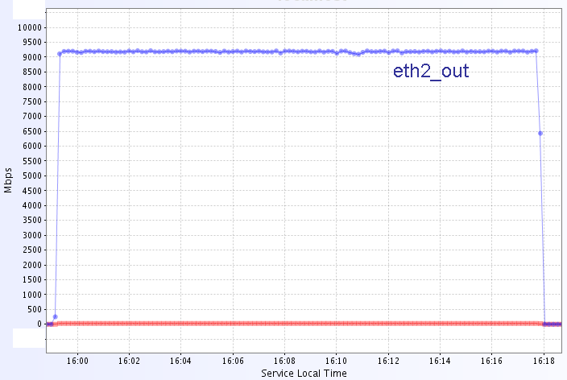
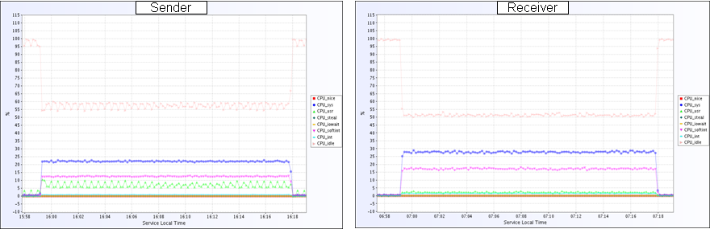
FDT performance:
Memory-to-Memory
WAN data transfers (CERN-Caltech)
CPU utilisation
55-60 % CPU idle
50 % CPU idle

Slide 9
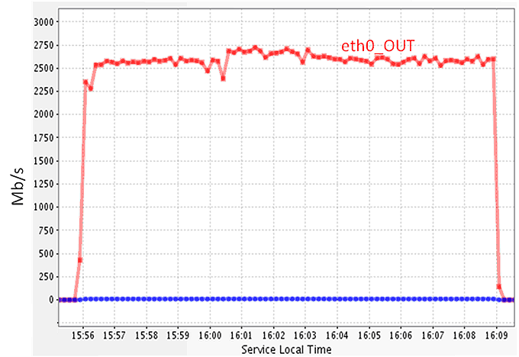
FDT Performance: Storage
Storage-to-storage performance between pair of servers: sustained 2.6 Gbps

Slide 10
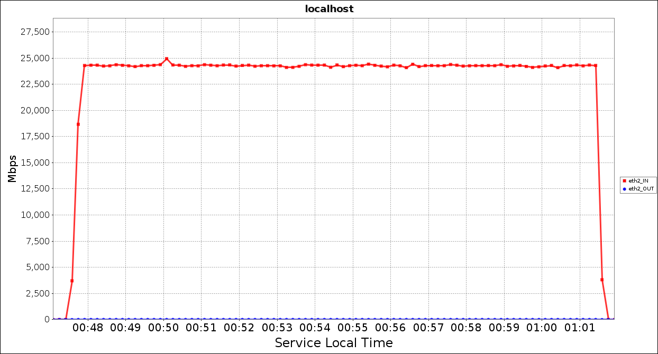
FDT @ 40G
Recently received a pair of Mellanox 40GE NICs
Performance tests done in CERN Openlab and Ultralight environment
Example: Memory-to-Memory in LAN
Unidirectional transfers
25Gbps: hitting the PCIe v2 (8 lane) limit!
Need PCIe v3 for full 40Gbps

Slide 11
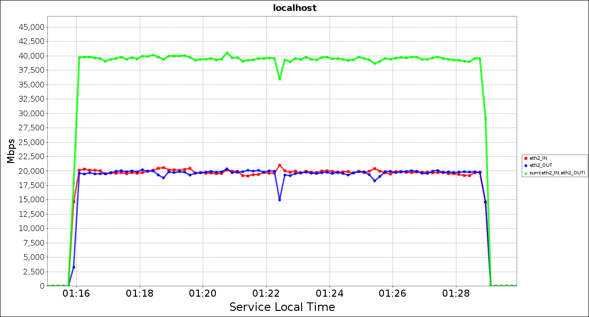
FDT @ 40G
Bi-directional memory-to-memory transfers
Currently investigating storage transfer performance

Slide 12
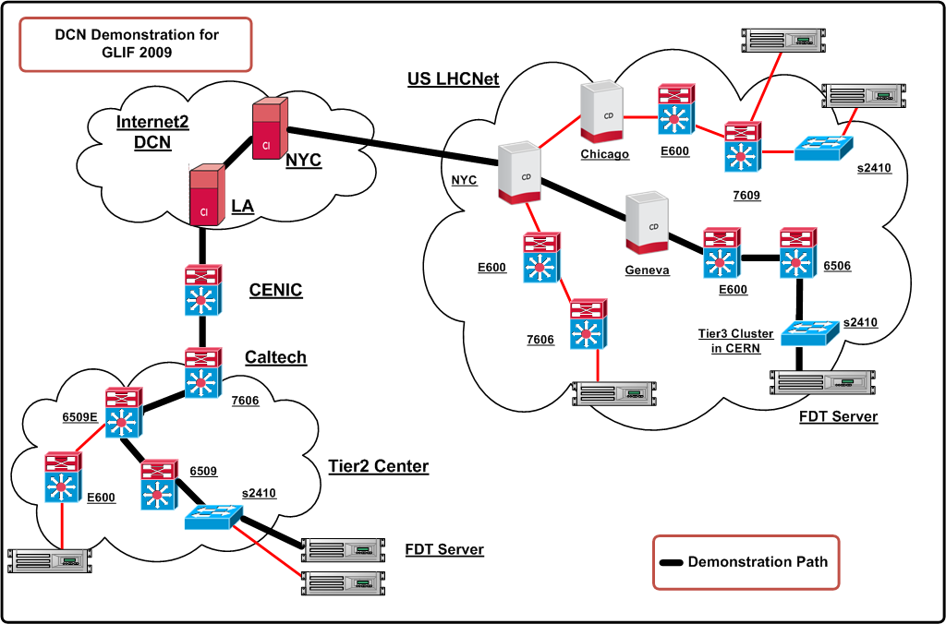
FDT with Dynamic Circuits:
GLIF’09 Demo
FDT can use IDC API to set up lightpaths.
Example: Caltech Tier2 to compute cluster at CERN

Slide 13
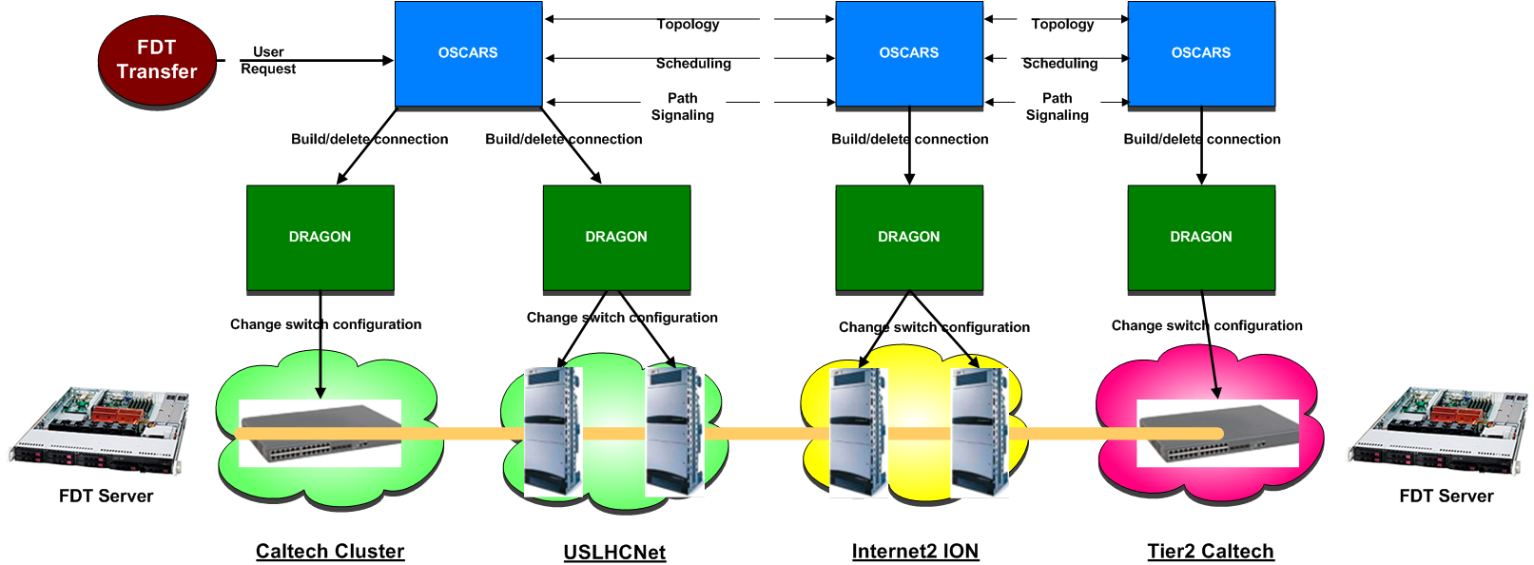
Path setup
3 domains involved, all using DCN/ION (OSCARS+DRAGON)
  Caltech
  Internet2
  USLHCNet
Path requested by FDT to USLHCNet IDC

Slide 14
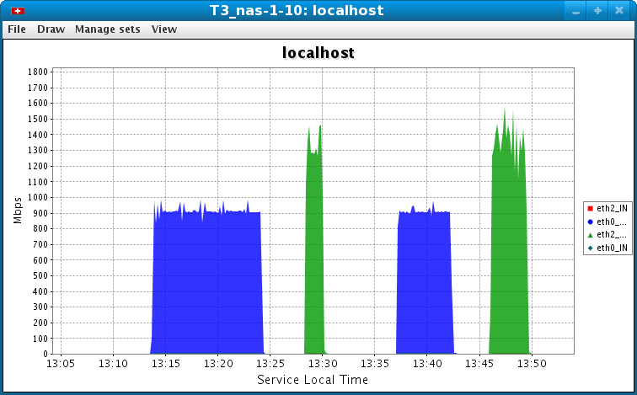
Automatic path selection
FDT automatically selects the correct interface to send data
Successful setup of Lightpath, transfer speed limited by capability of server!
No dynamic circuit, use default 1GbE interface

Slide 15
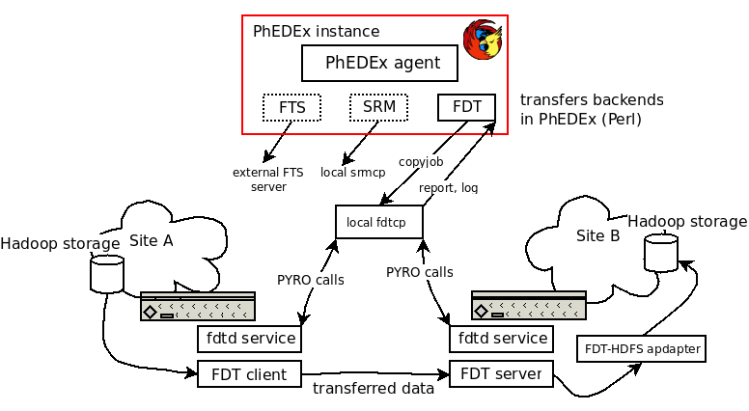
FDT-PhEDEx integration
Work ongoing in CMS
Will facilitate the integration of DYNES instrument in the CMS data operations
(Will be presented at CHEP’10)

Slide 16
FDT Summary & Future developments
FDT is a mature and a robust open source software
Key features:
  Portability – runs on all major platforms
  Simple to use and small size
  Streams data over multiple channels
  Pluggable security (SSH, GSI, GSI+SSH, …)
  Can be used as a network testing tool (TCP only)
  Pluggable user filters ( e.g. MS storage, compression, …)
  Dynamic circuits capability
Future developments:
  GUI interface
  New features once Java7 will be released
    NIO.2 (asynchronous I/O, new FS interface, SCTP, …)
    FJ tasks

Slide 17
Thank You!
Artur.Barczyk@cern.ch
Ramiro.Voicu@cern.ch

