Slide 1
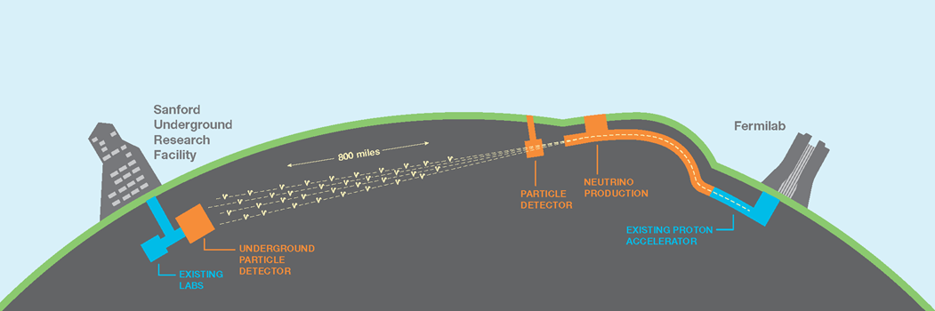
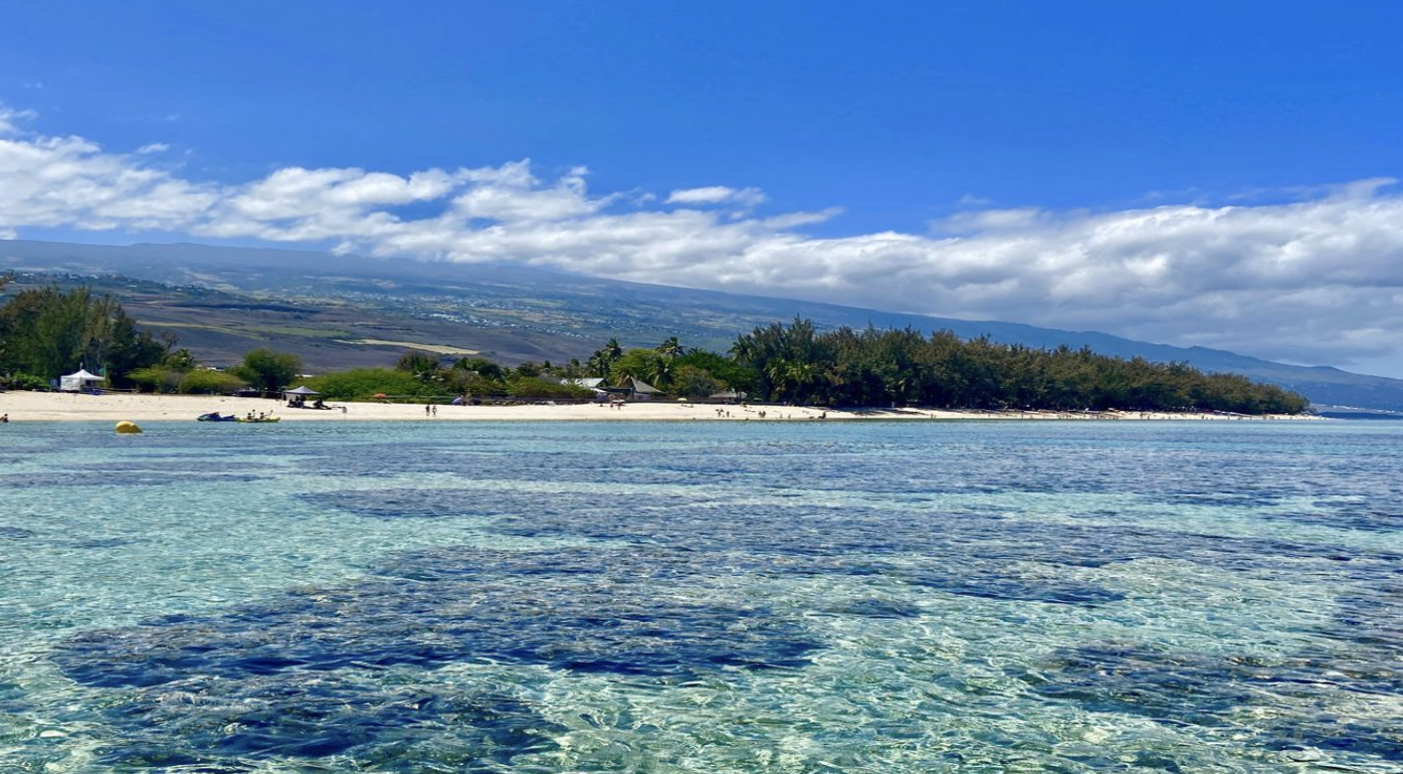
The Status of DUNE
EDSU2022
8 November 2022
Albert De Roeck, CERN
For the DUNE Collaboration

Slide 2
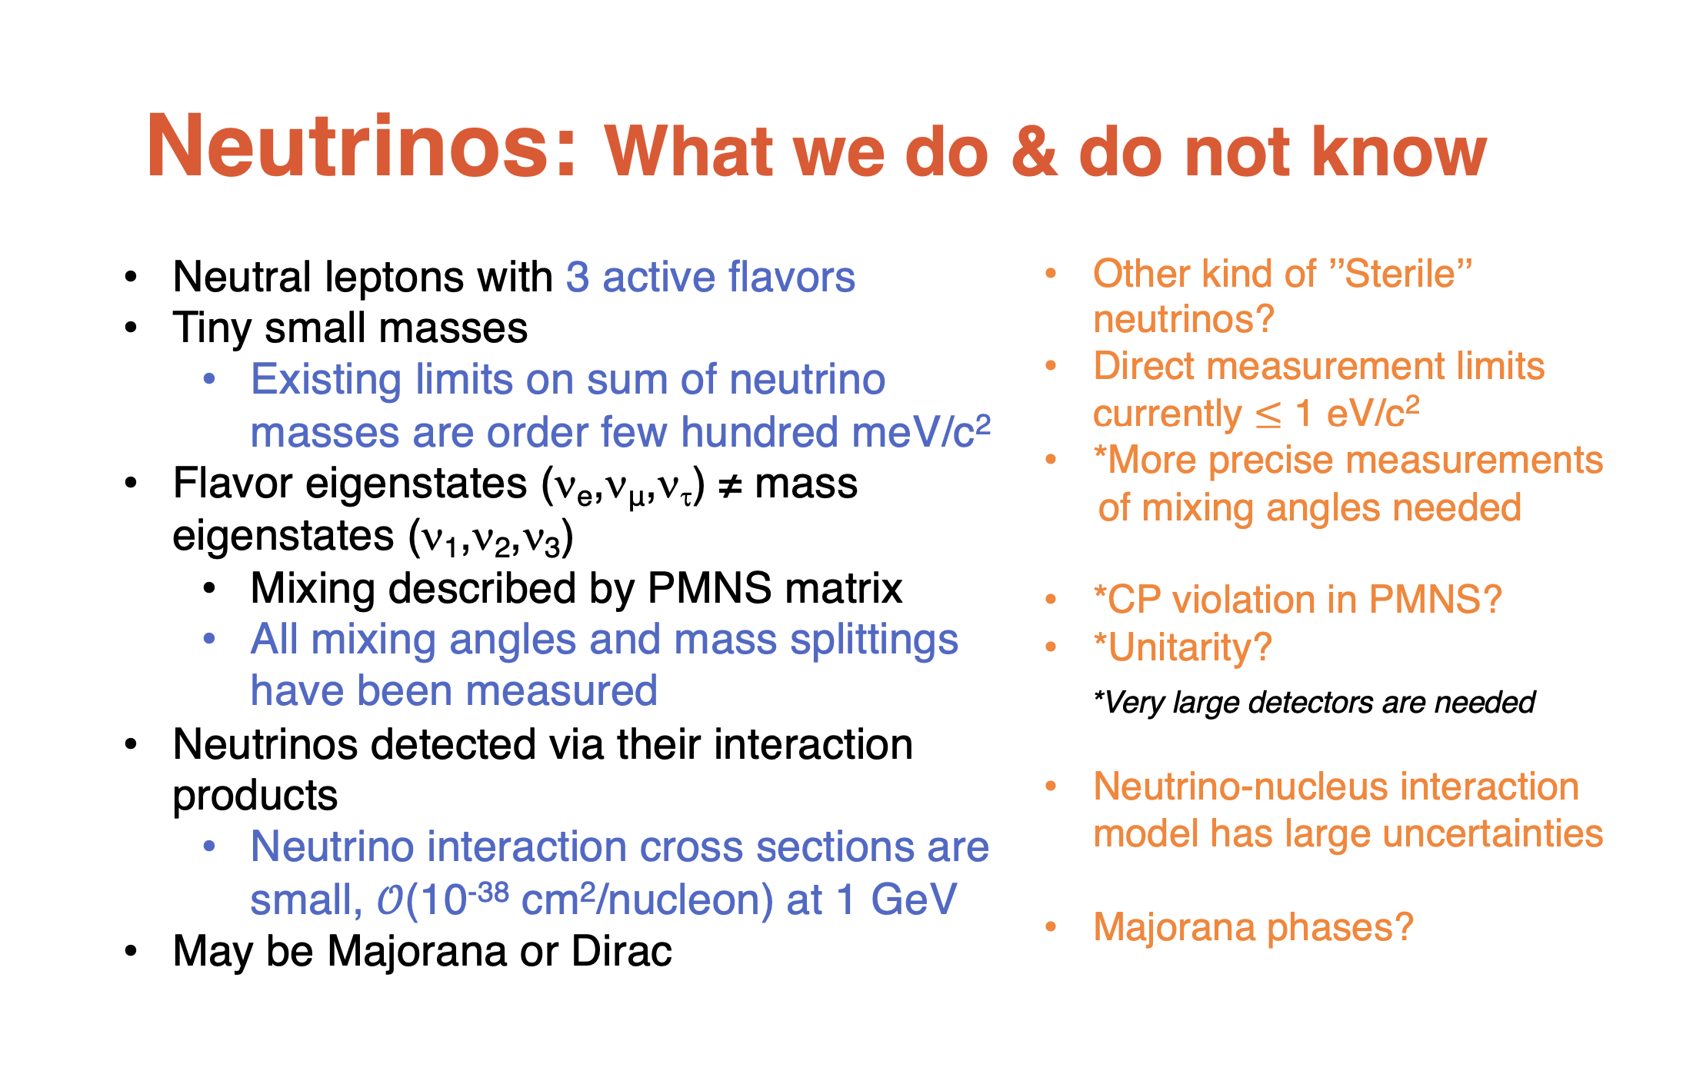

Slide 3
DUNE: The Main Physics Program
Precision Neutrino Measurements: Neutrino Oscillations
  Search for leptonic CP violation
  Determine neutrino mass ordering
  Precision PMNS measurements. Test 3-flavour paradigm
Supernova Physics
  Observation of time and flavour profile provides insight into collapse and evolution of supernova
Baryon number violation (BSM physics)
  LAr TPC technology well-suited to certain proton decay channels (e.g., p→K+𝜈)
  𝛥(B-L) ≠ 0 channels accessible (e.g., n→n)
Other opportunities
  Atmospheric and solar neutrino physics
  Searches for dark matter, axions, HNLs etc in Near Detector Additional neutrinos?
  Neutrino physics with the Near Detector.

Slide 4
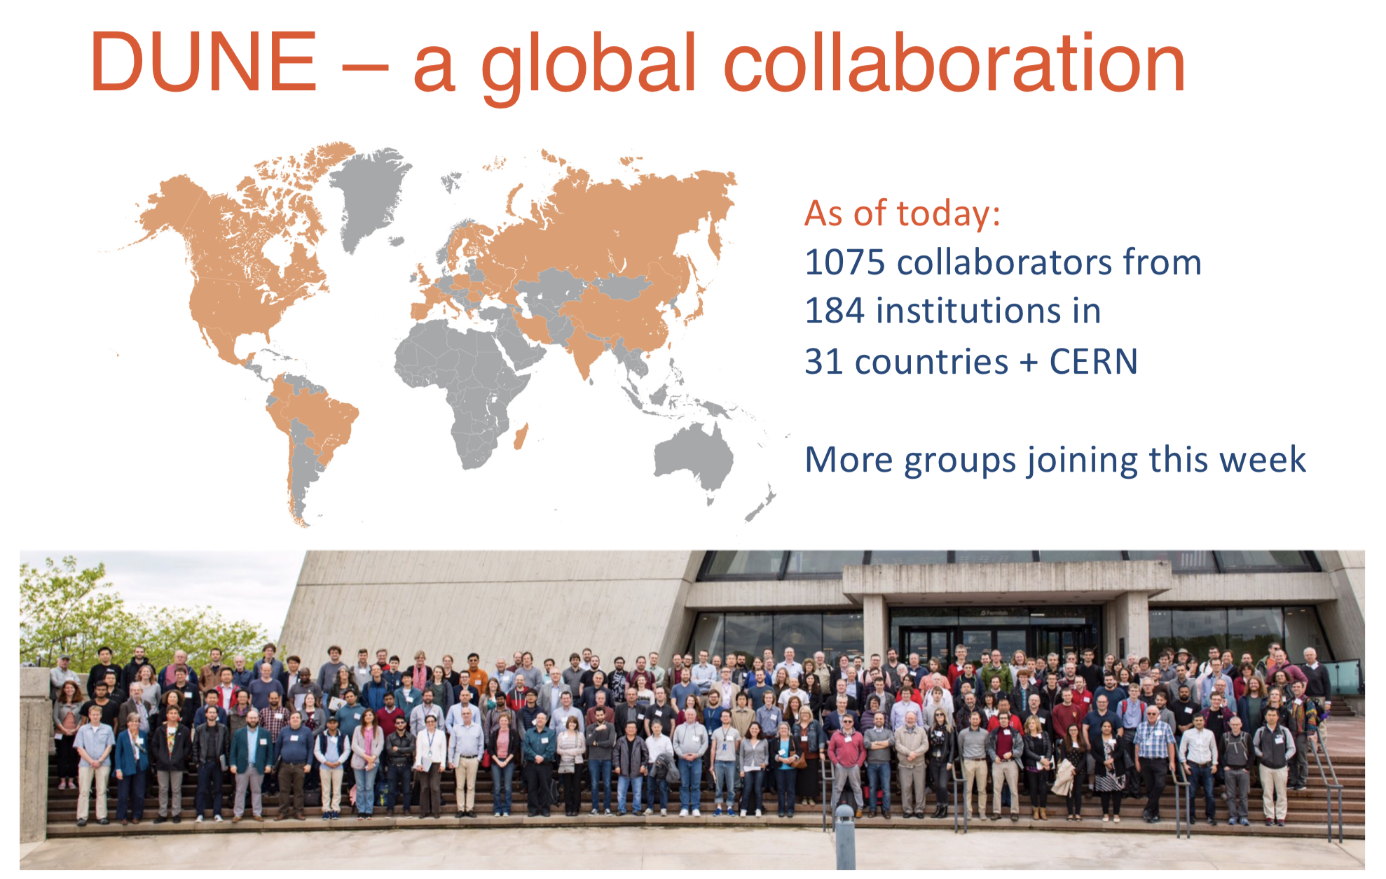

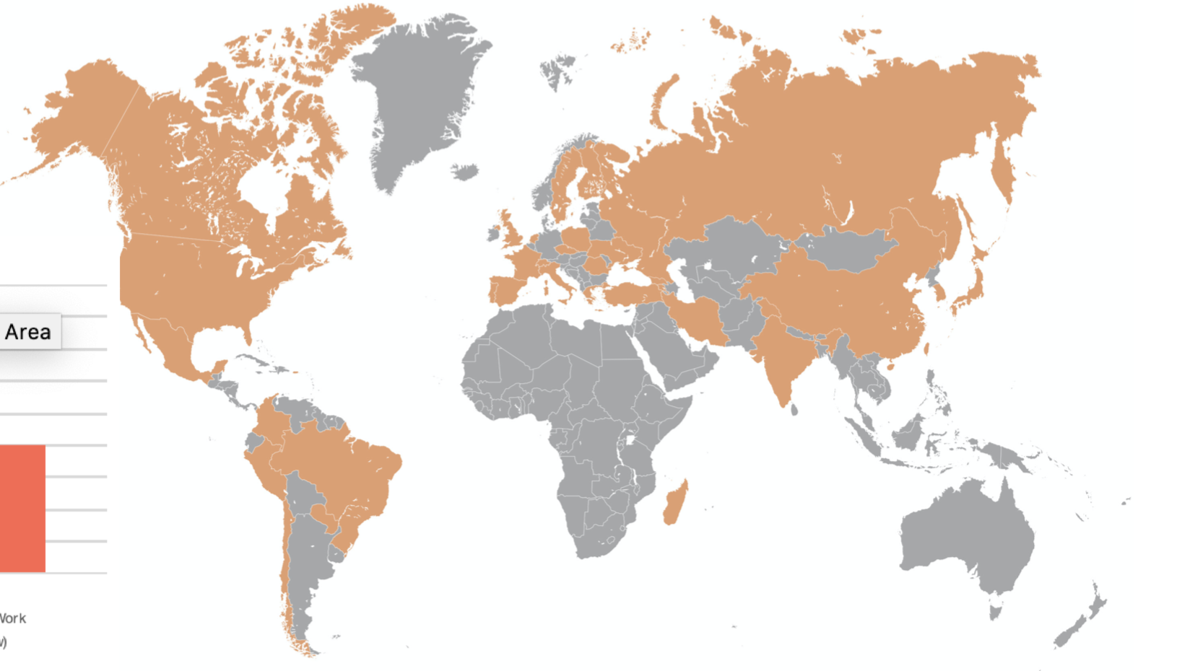
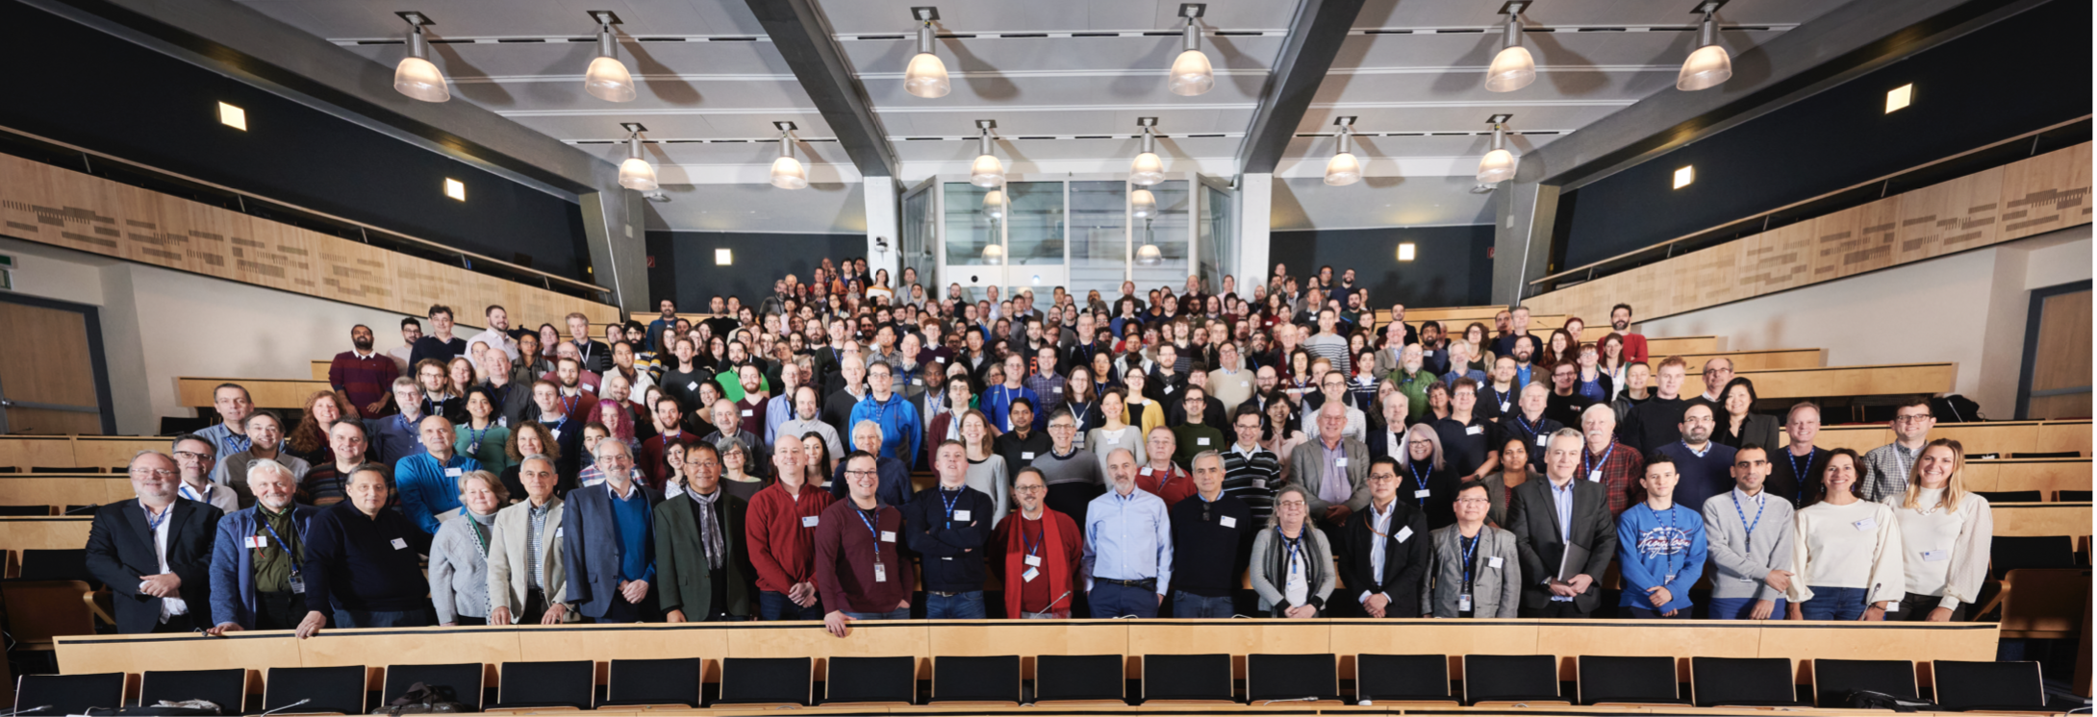
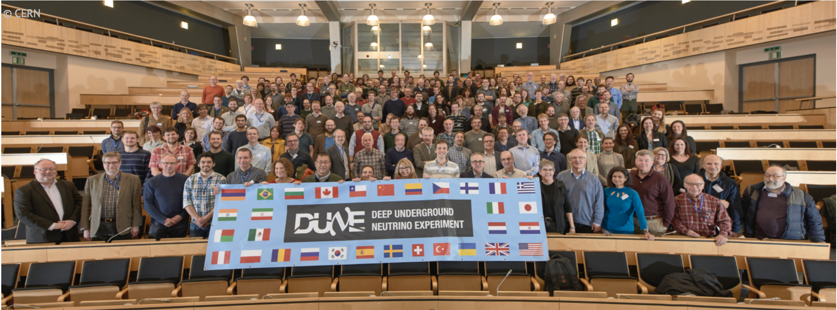
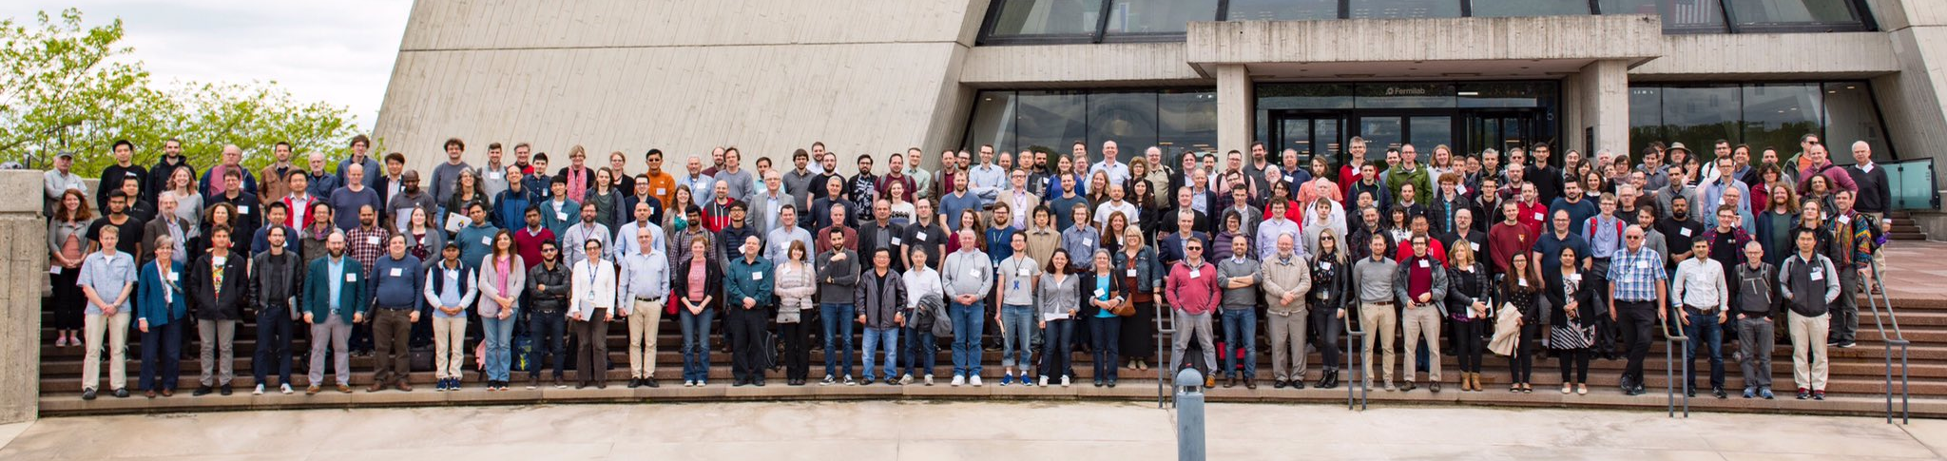
Status October 2020:
  1400+ people
  200+ Institutes
  31 countries
  Still more groups joining
An international science collaboration
1106 collaborators from 184 institutions in 31 countries
Collaboration meeting at CERN end of January 2020 350 participants

Slide 5
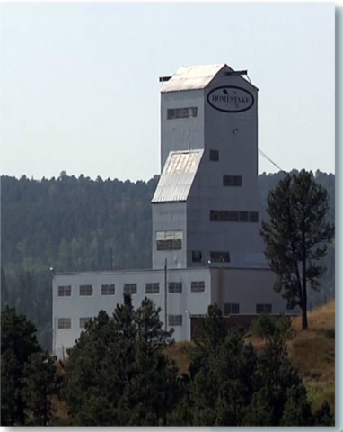
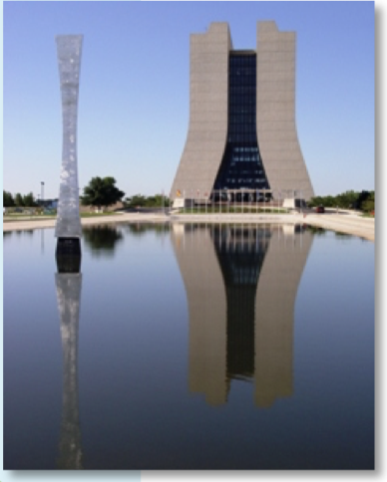

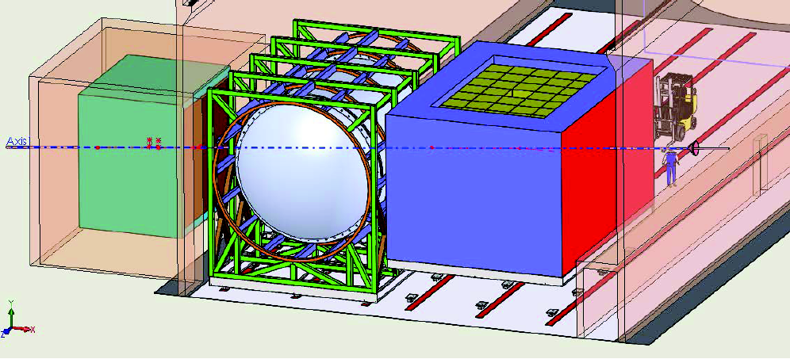
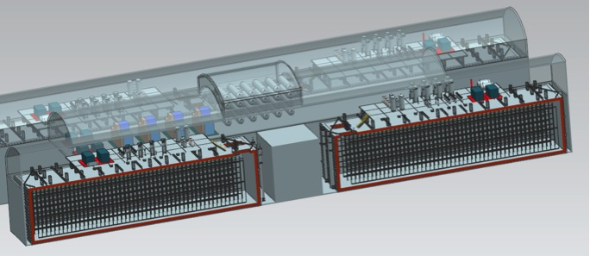
General Setup
LBNF/DUNE will consist of
  An intense 1.2 MW upgradeable 60-120 GeV 𝜈-beam fired from FNAL
  A massive 70 kt (40kt fiducial) deep underground LAr Far Detector (FD) in South Dakota and a large Near Detector (ND) complex with multiple detectors at Fermilab
1300 km
South Dakota
Chicago
ν_{μ} & ν_{e}
ν_{μ}
FD
ND

Slide 6
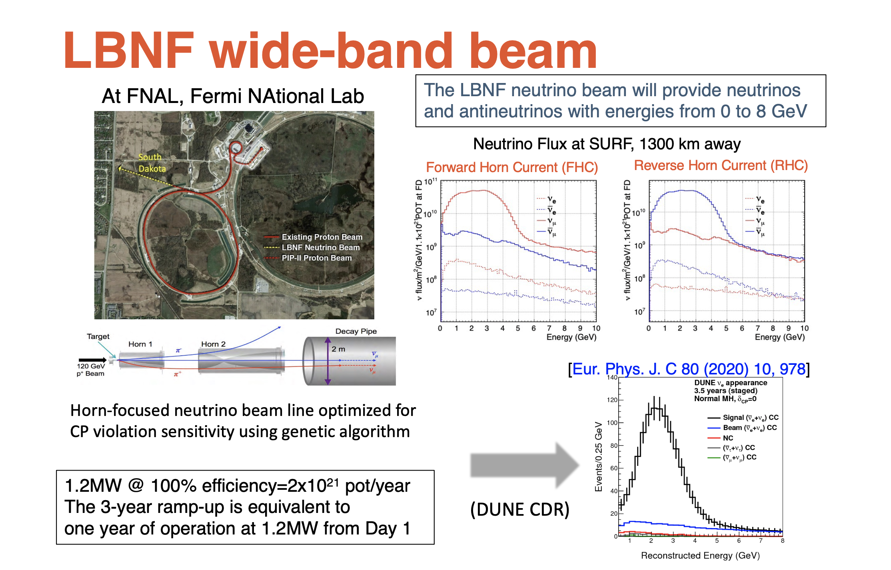

Slide 7
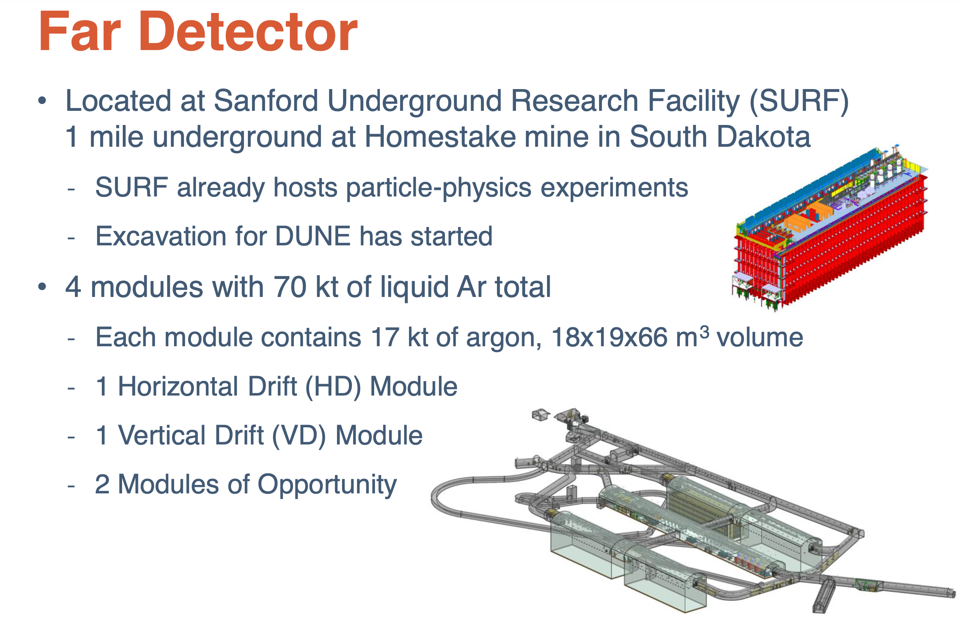
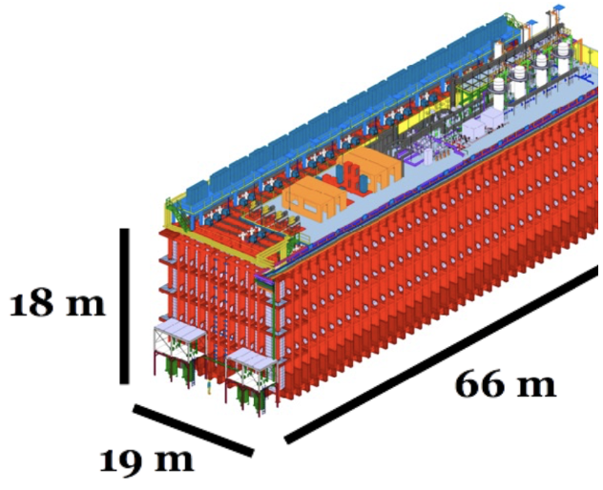

Slide 8
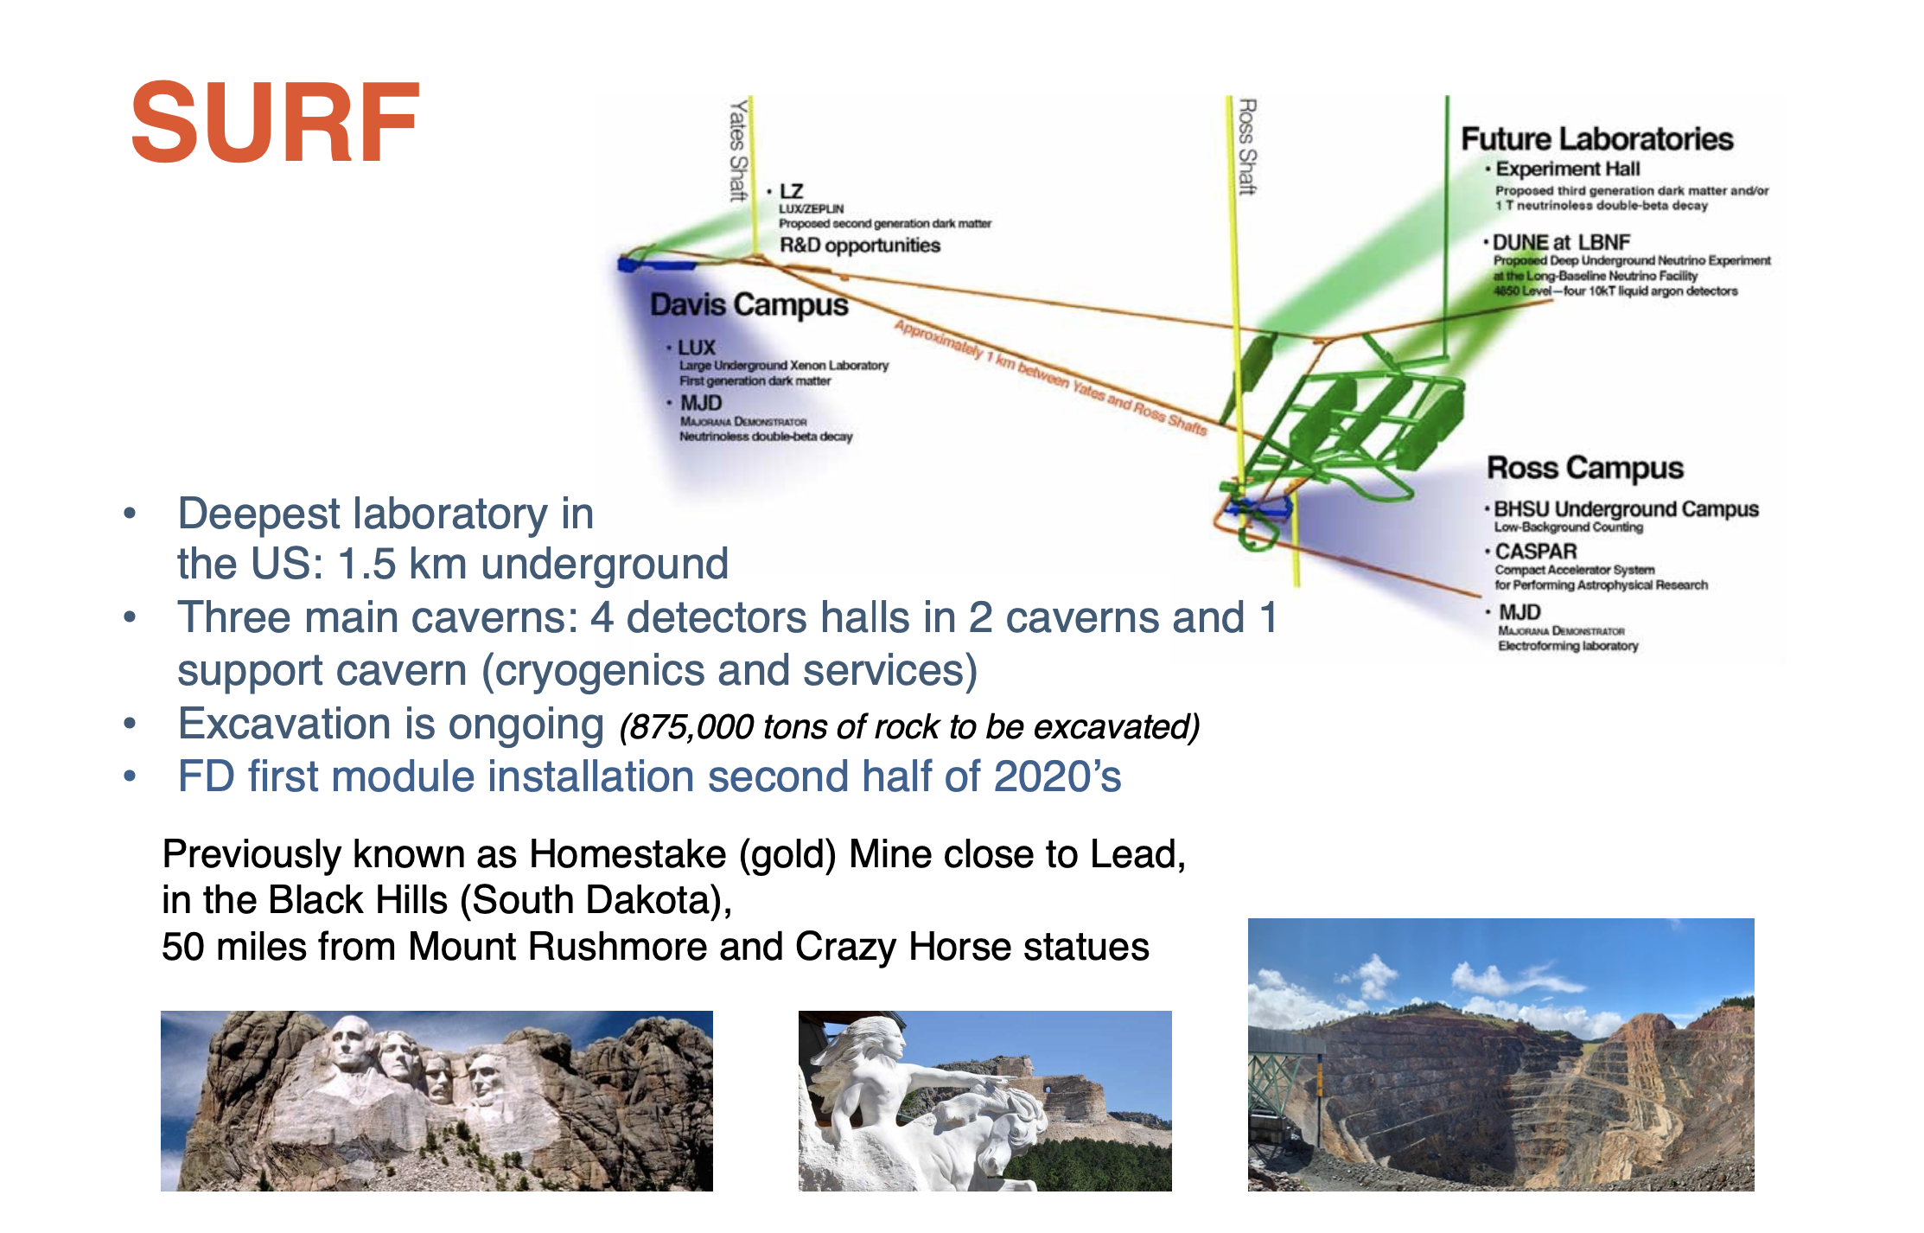

Slide 9
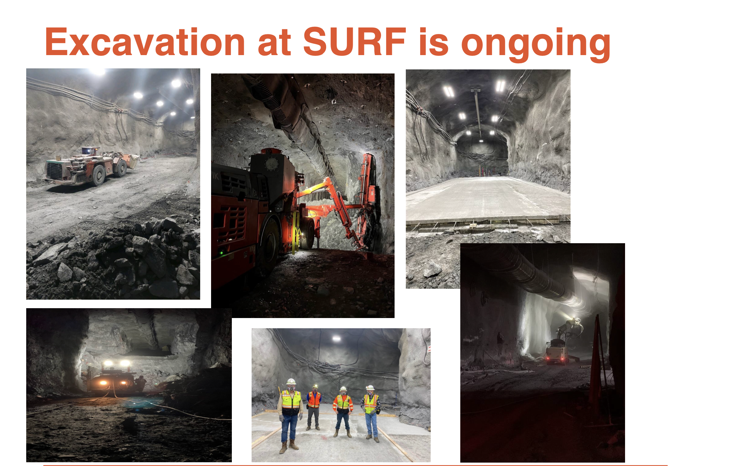
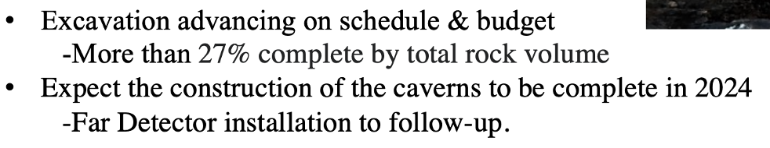

Slide 10
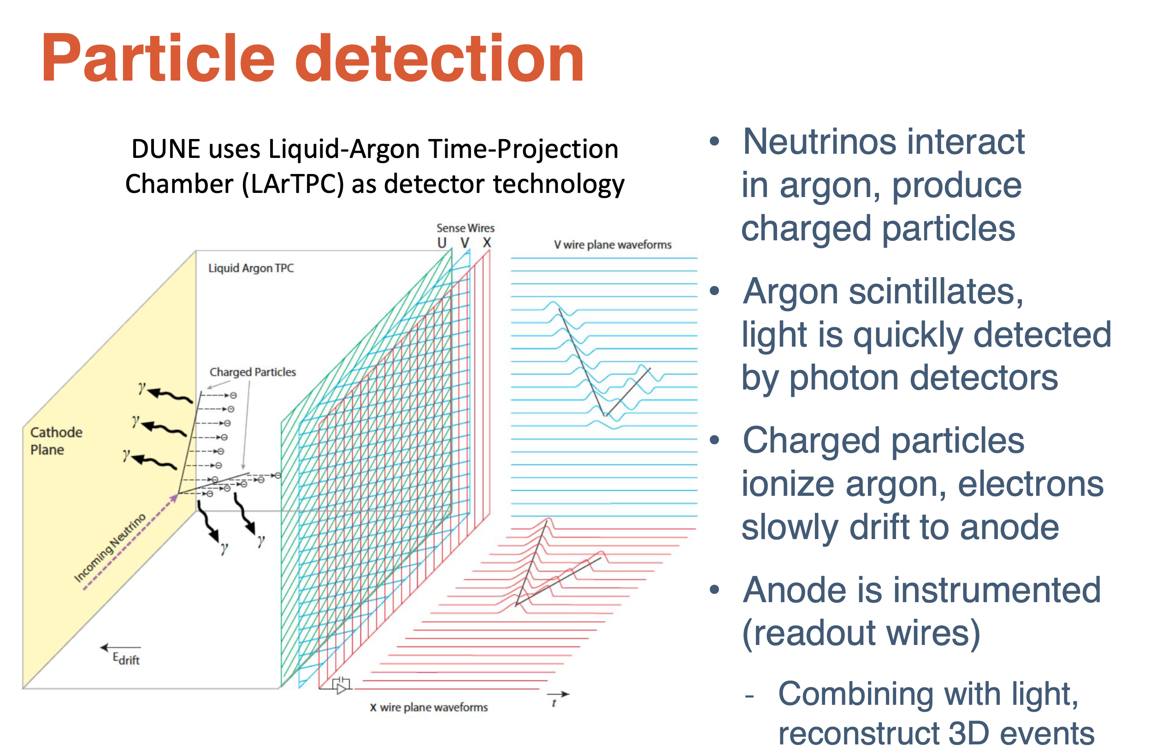
Particle Detection

Slide 11
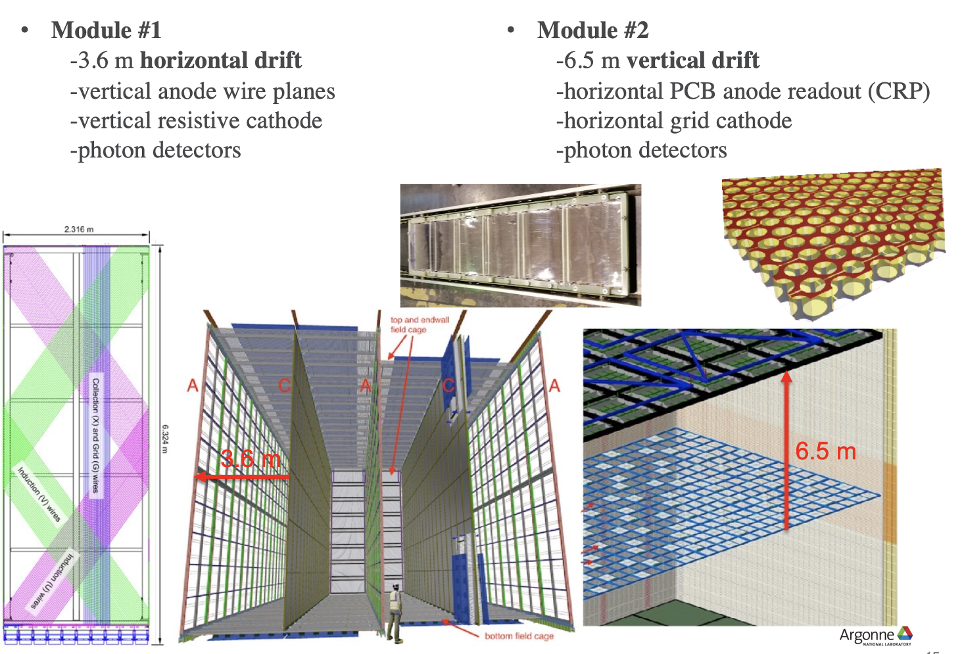
LArTPC Readout Technologies

Slide 12
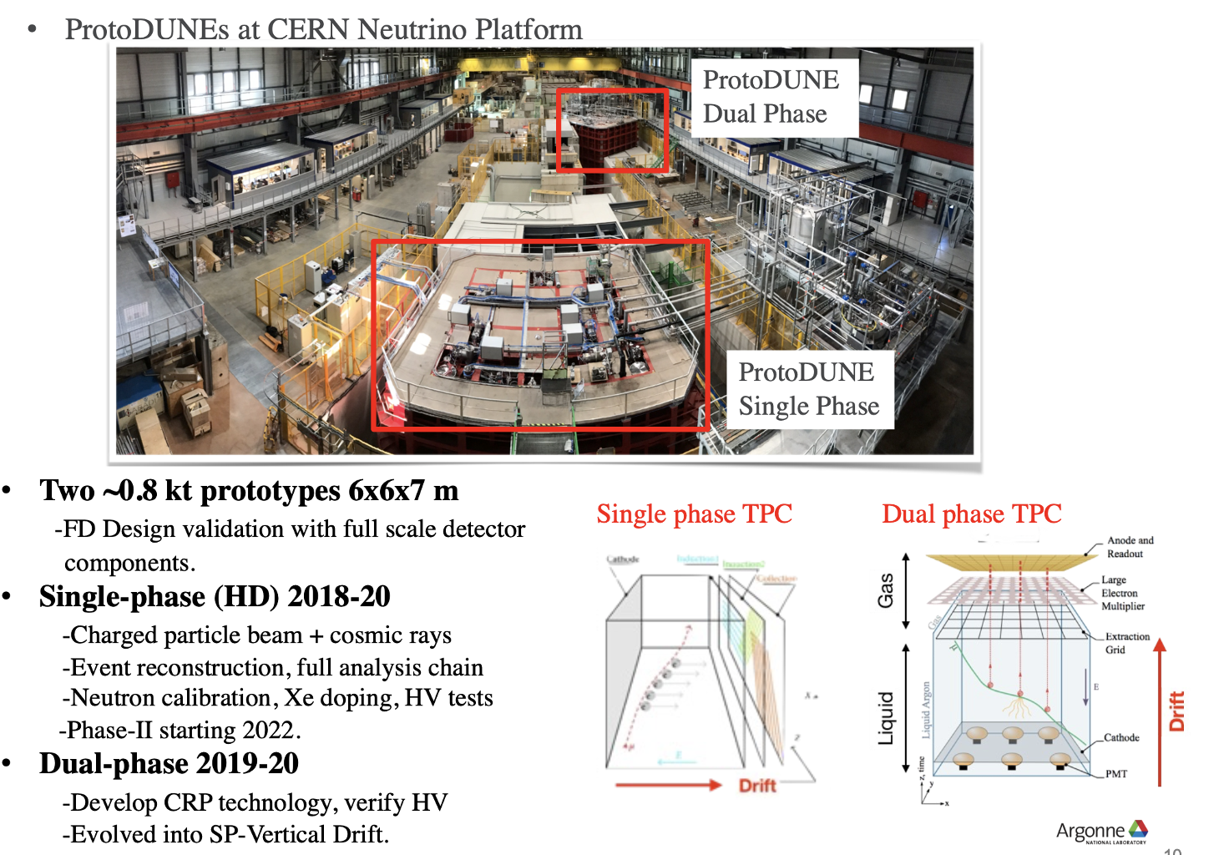
DUNE Far Detector Prototyping
Now single phase with
Vertical drift

Slide 13
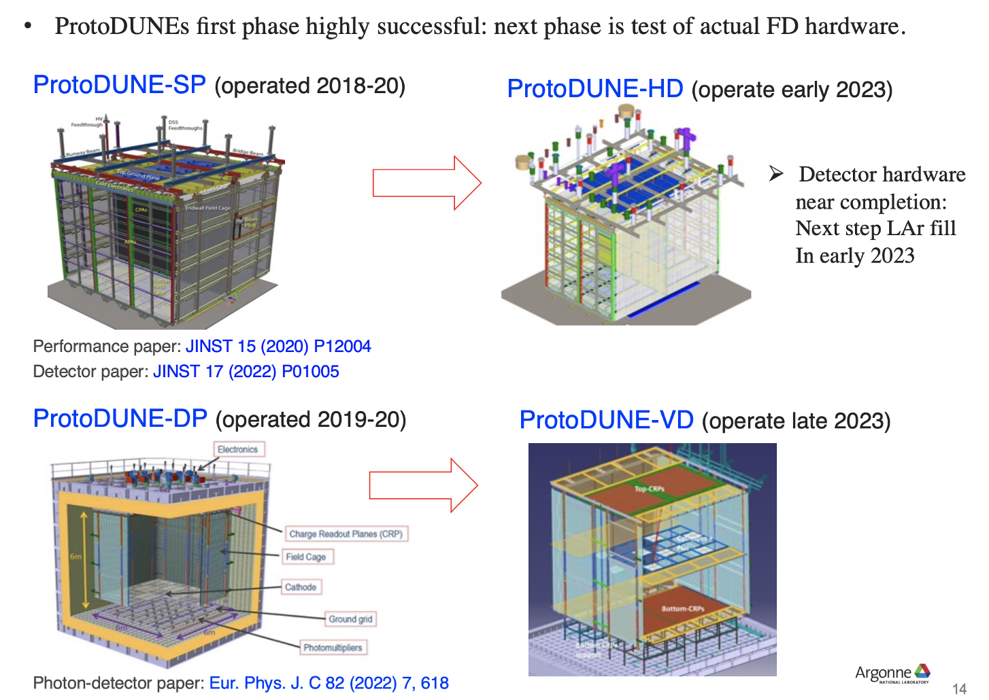
ProtoDUNEs Current and next Phases
4% of the full
size if the Far
Detectors

Slide 14
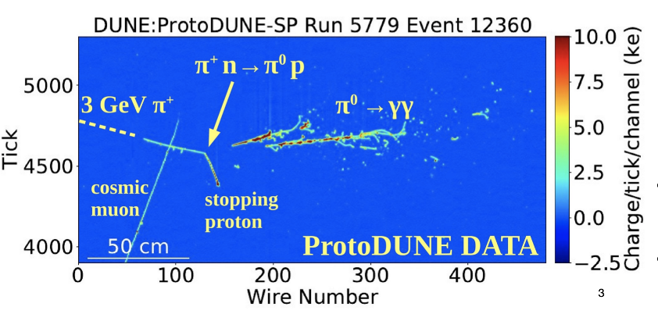
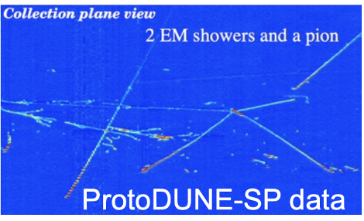
LArTPC Events
DUNE will be excellent at imaging neutrino interactions
  Both at high energy (~GeV) and low energy (~ 10 MeV)
LArTPC technology: full tracking and calorimetry

Slide 15
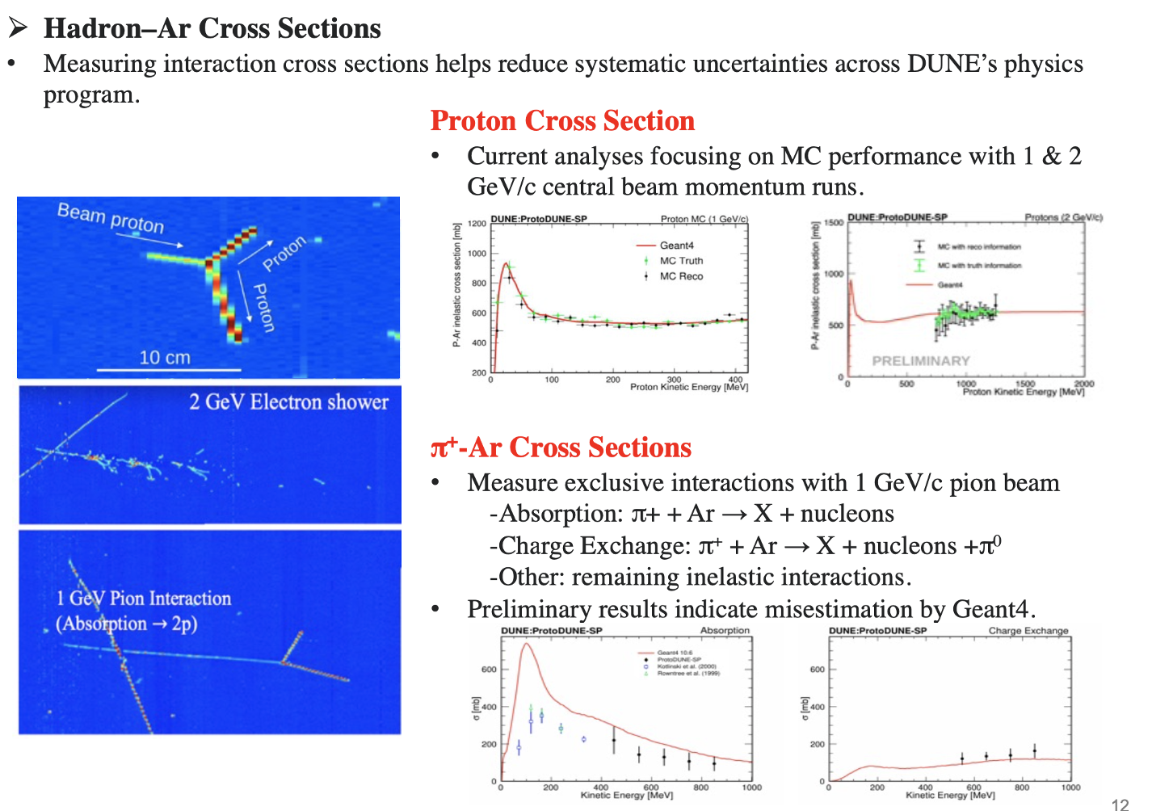
ProtoDUNE Results
-> Improve the simulation!

Slide 16
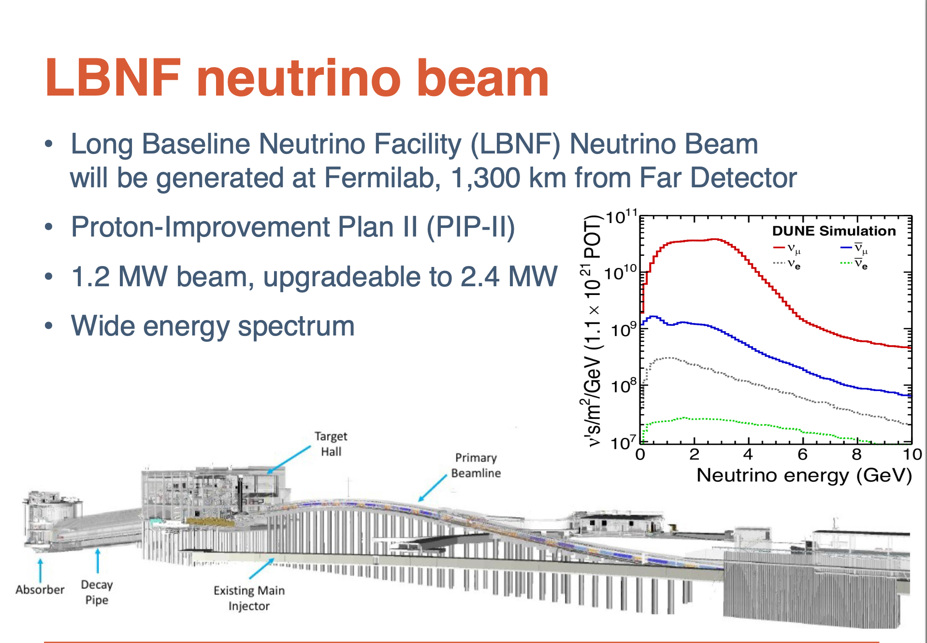
Final Design beamline and ND complex completed
NSCF will start reconstruction upon available funding

Slide 17
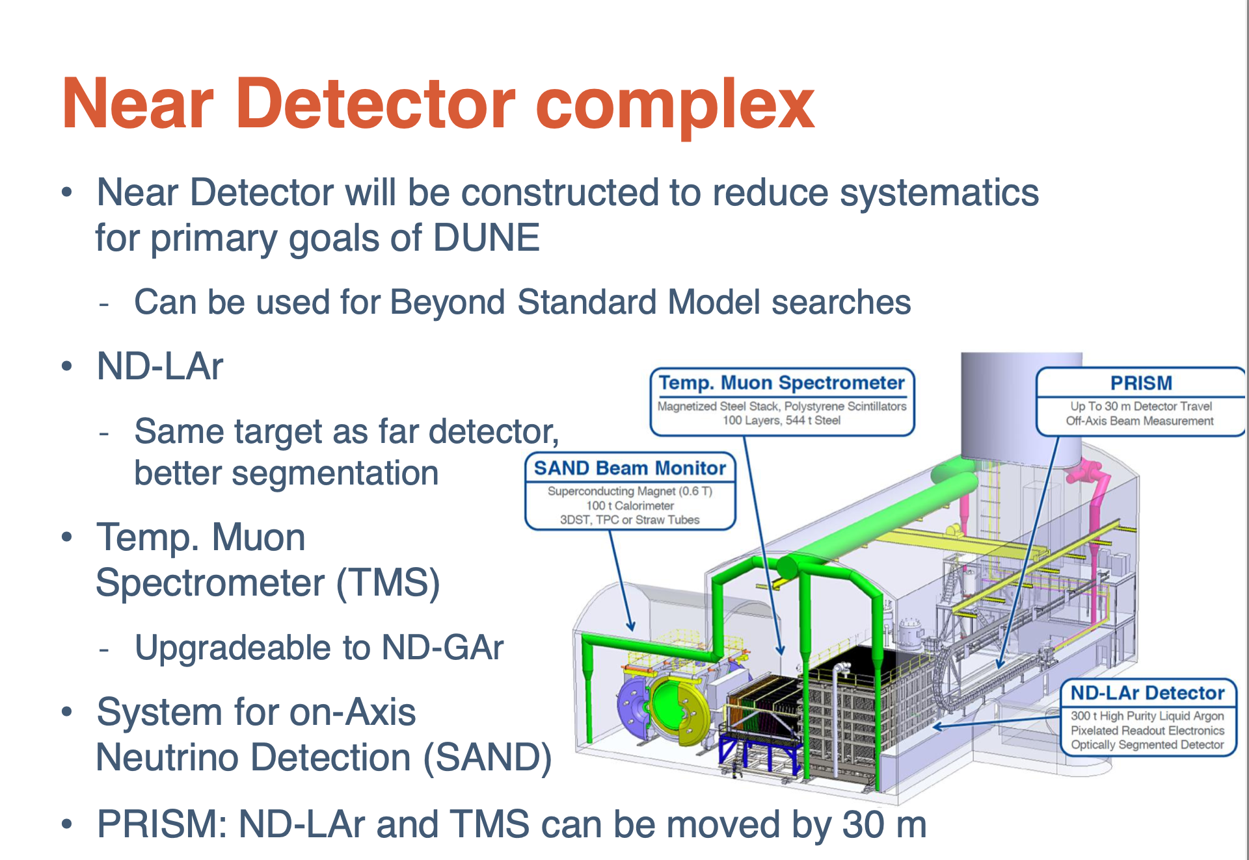

Slide 18
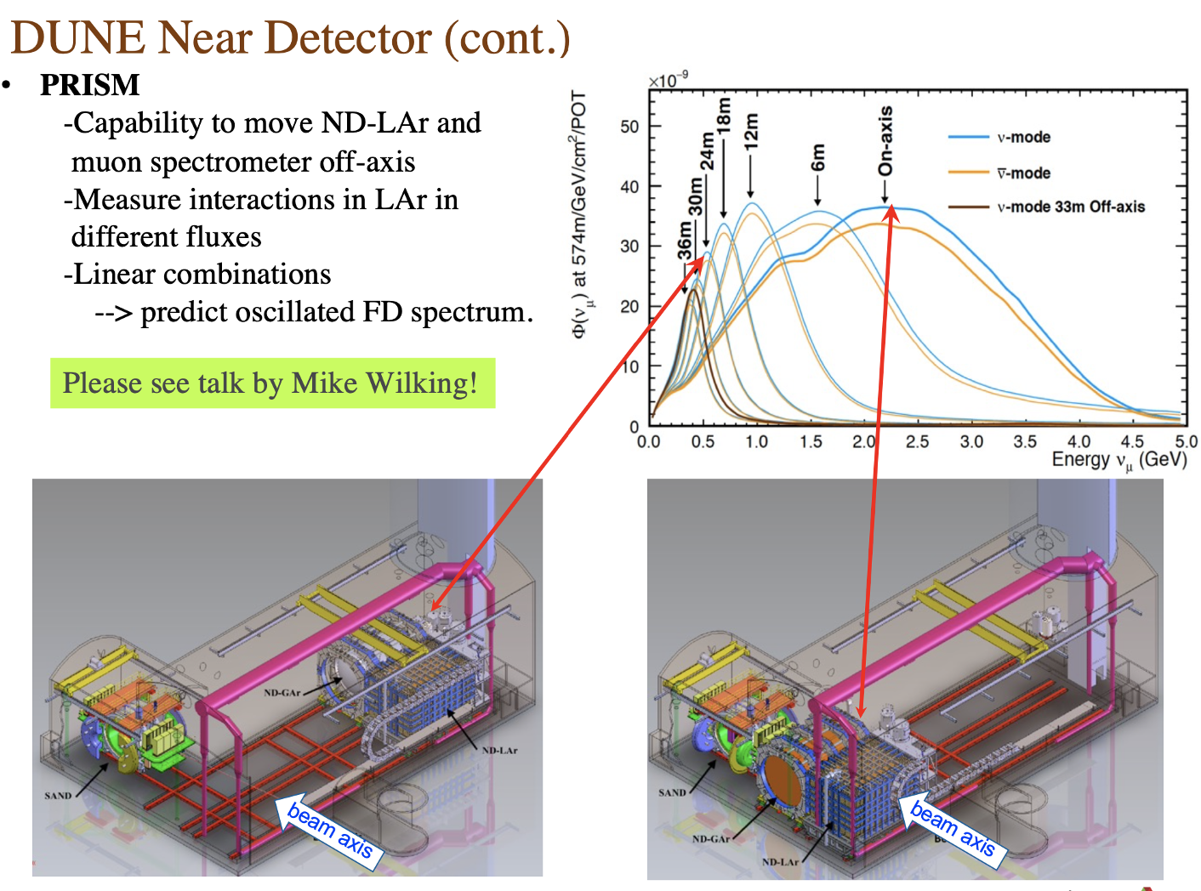
DUNE Prism Concept
Precision process independent spectrum measurement
Moving ND detectors by 30m results in different measured energy spectra
Linear combinations of these spectra can better reproduce oscillated FD spectrum which will reduce the uncertainties

Slide 19
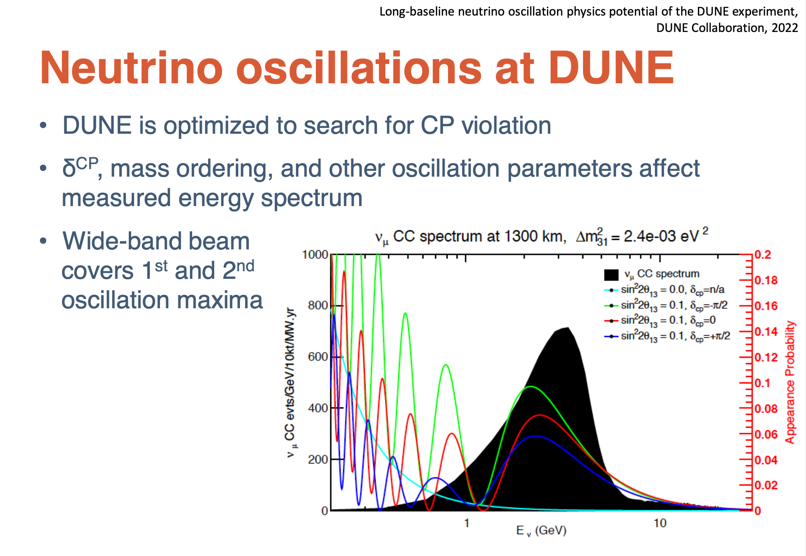

Slide 20
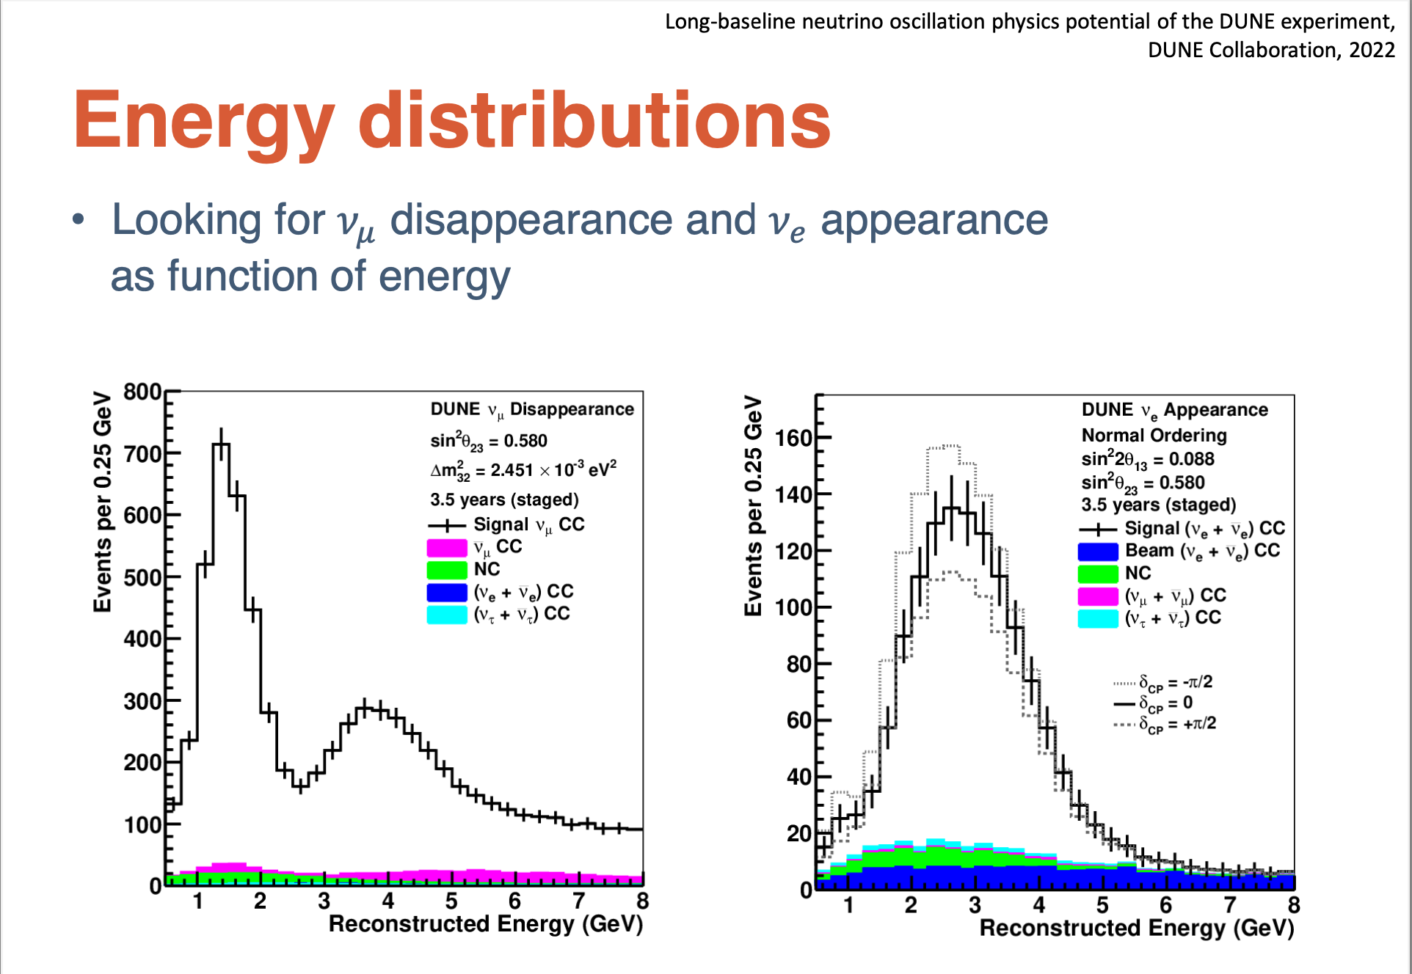

Slide 21
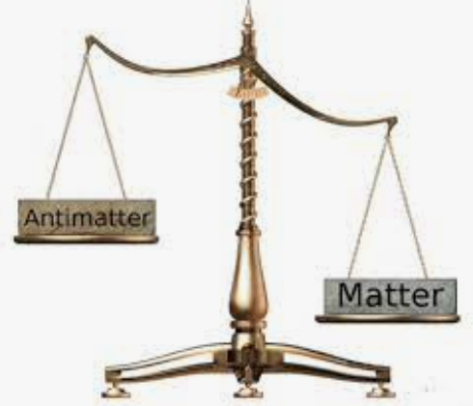
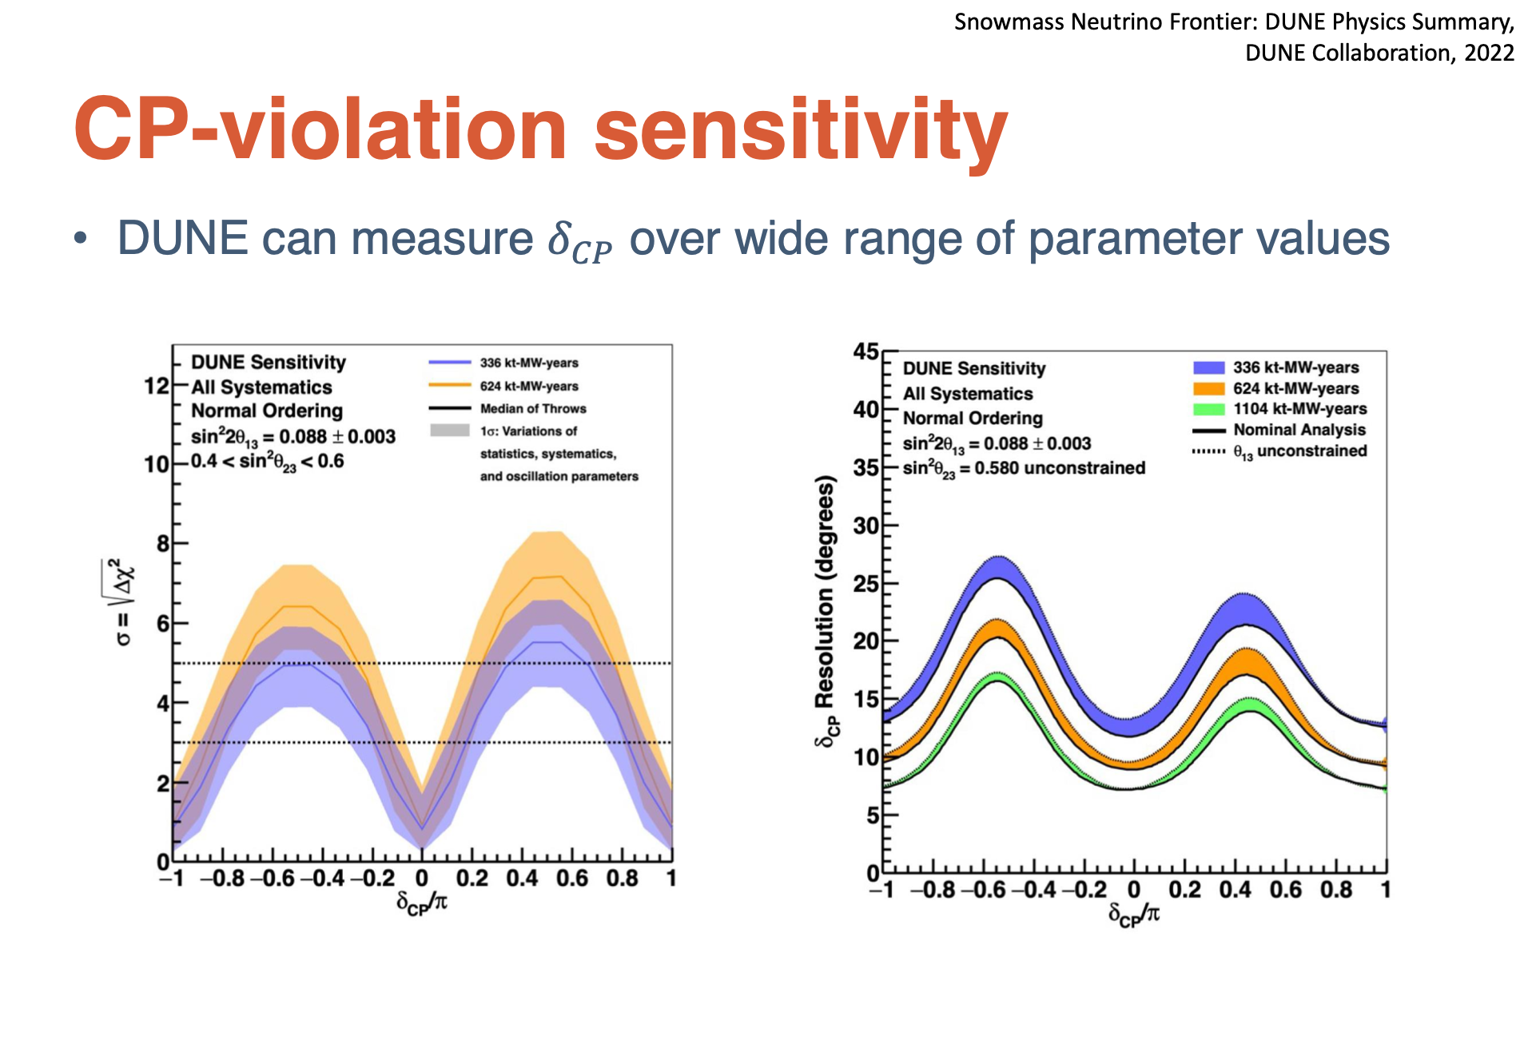
arXiv:2006.16043

Slide 22
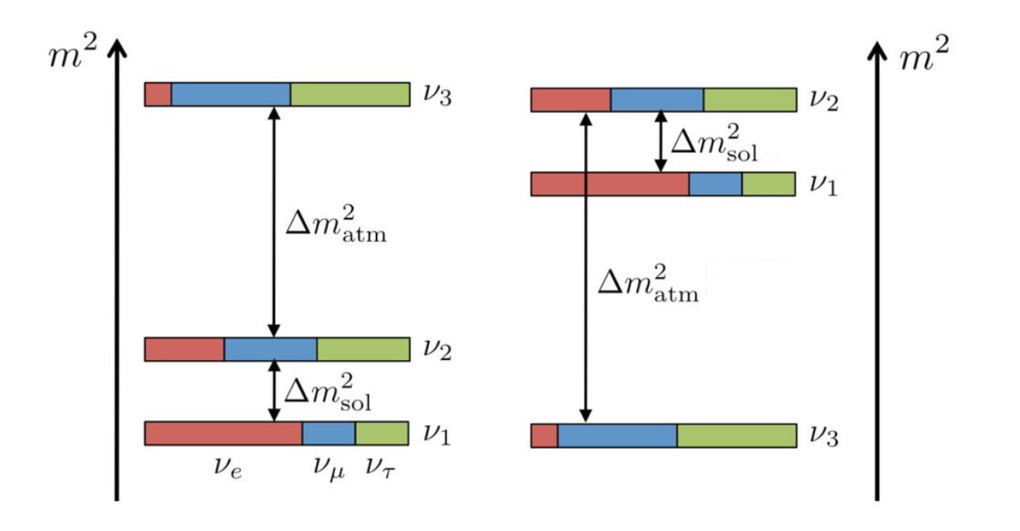
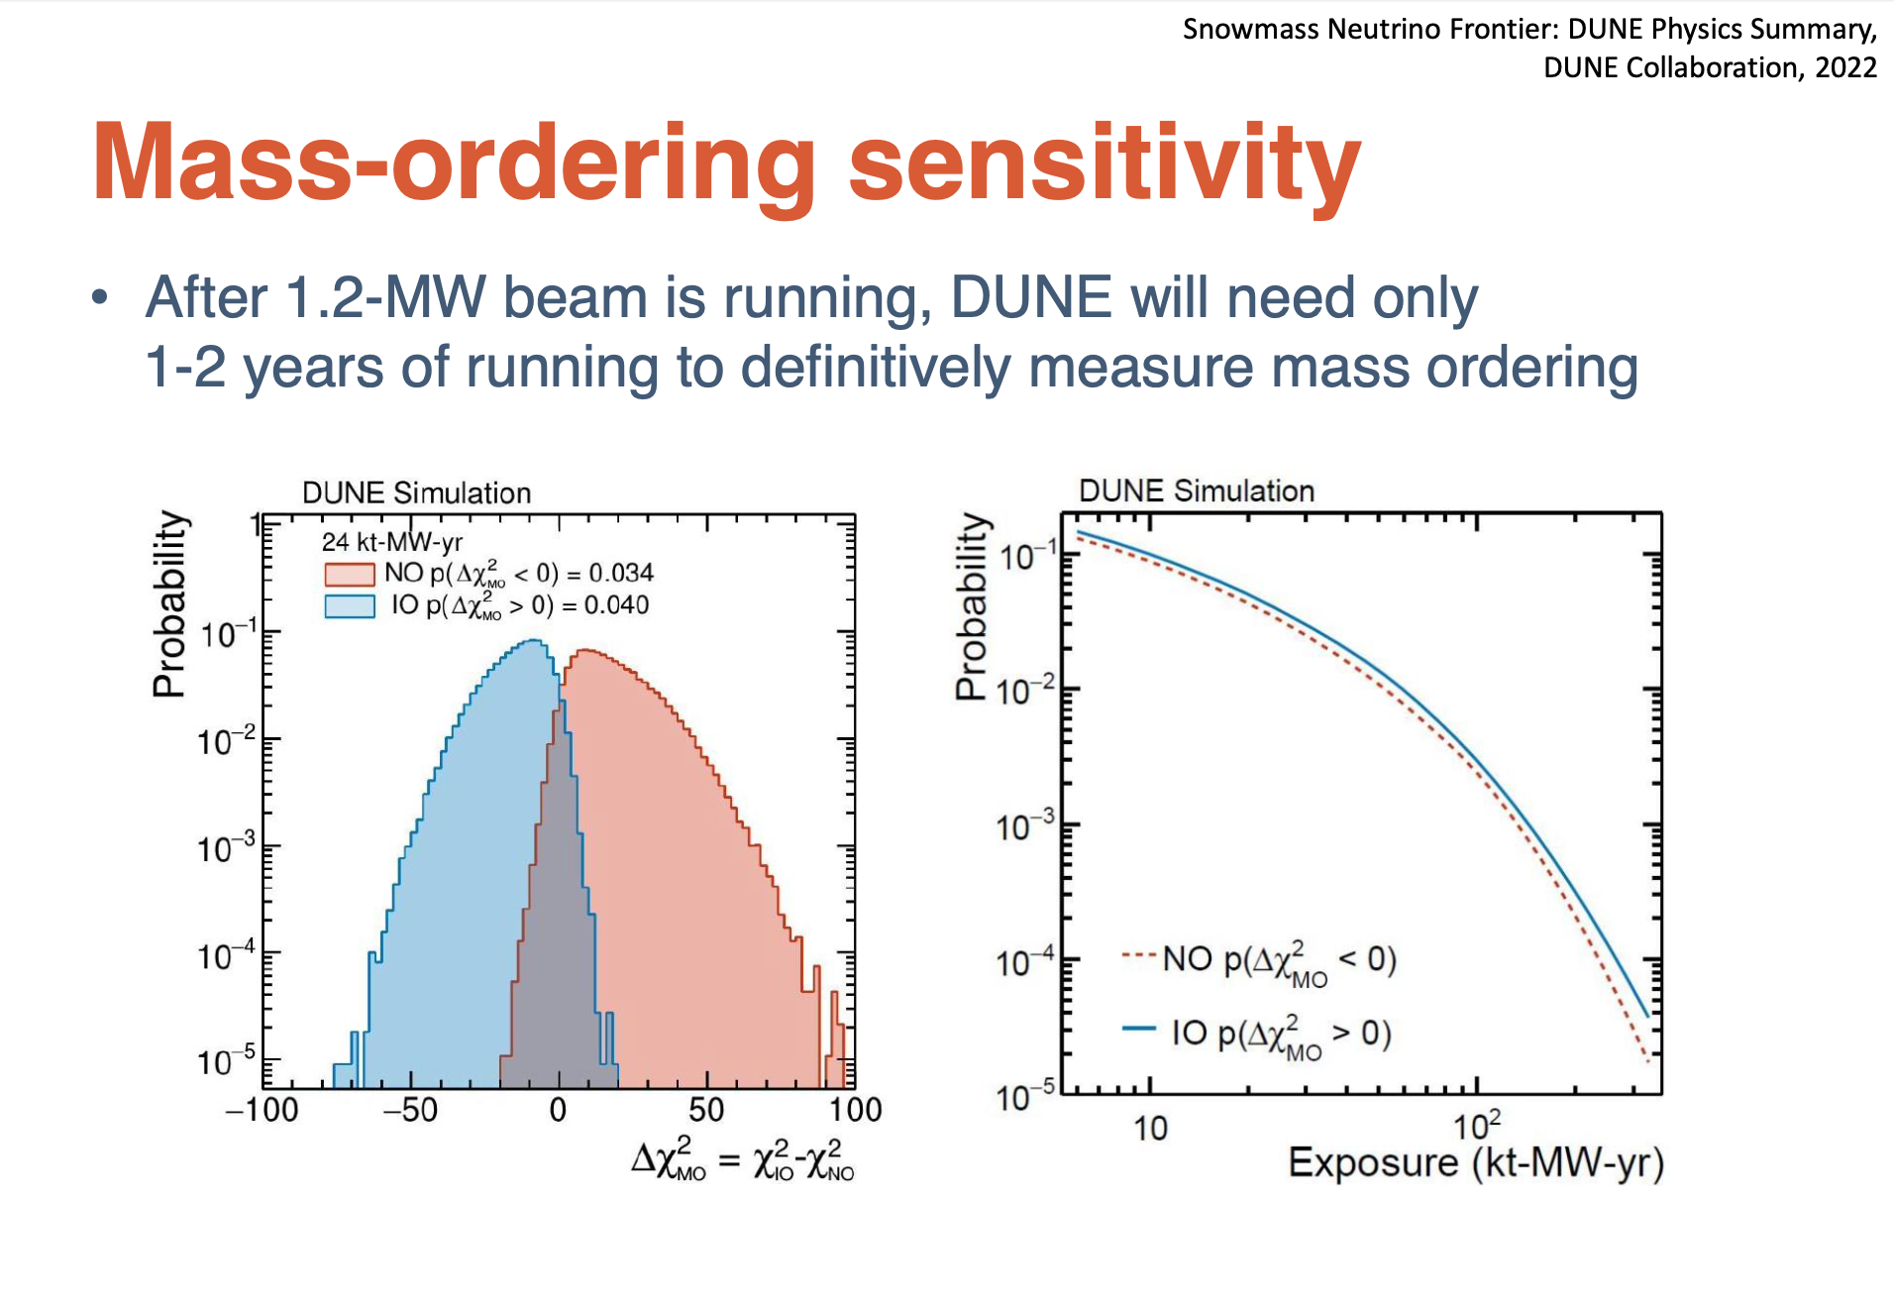
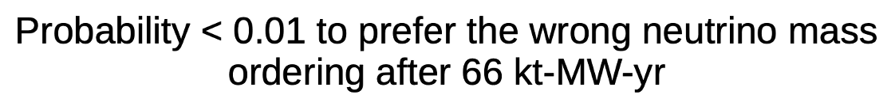
Probability for
preferring the
wrong neutrino
mass ordering
arXiv:2109.01301

Slide 23
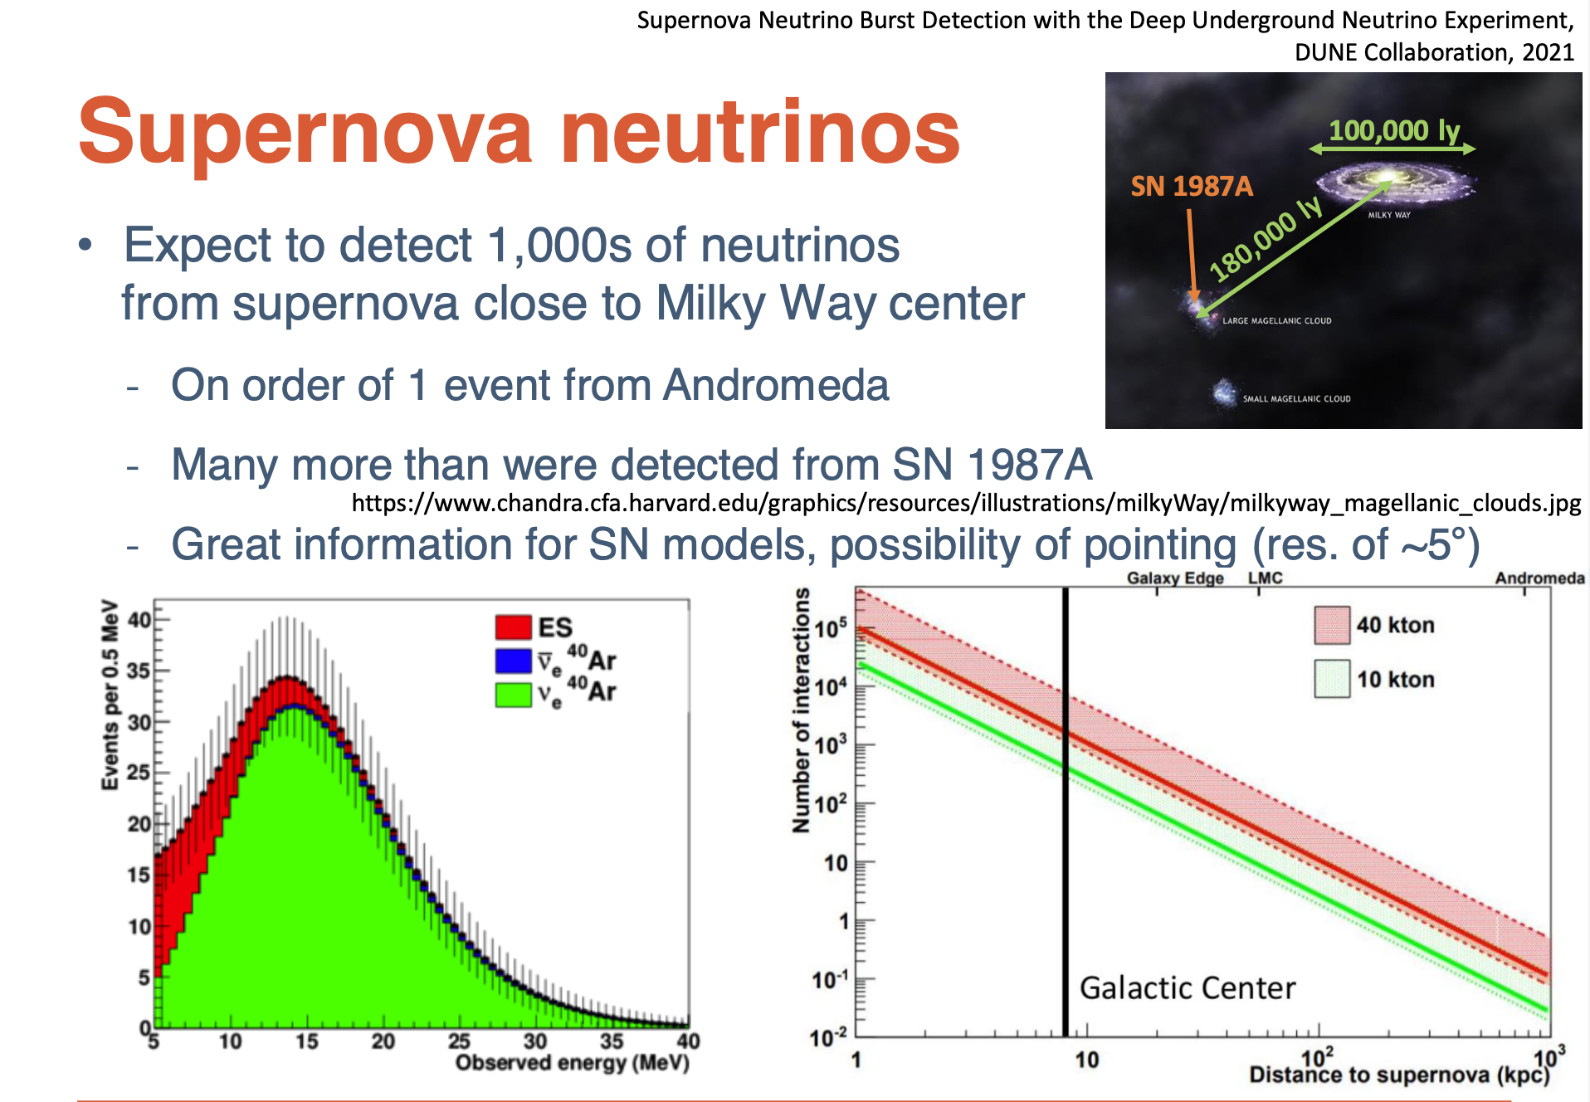

  The 𝝼_{e} flavor dominates. Detectable in DUNE via

Slide 24
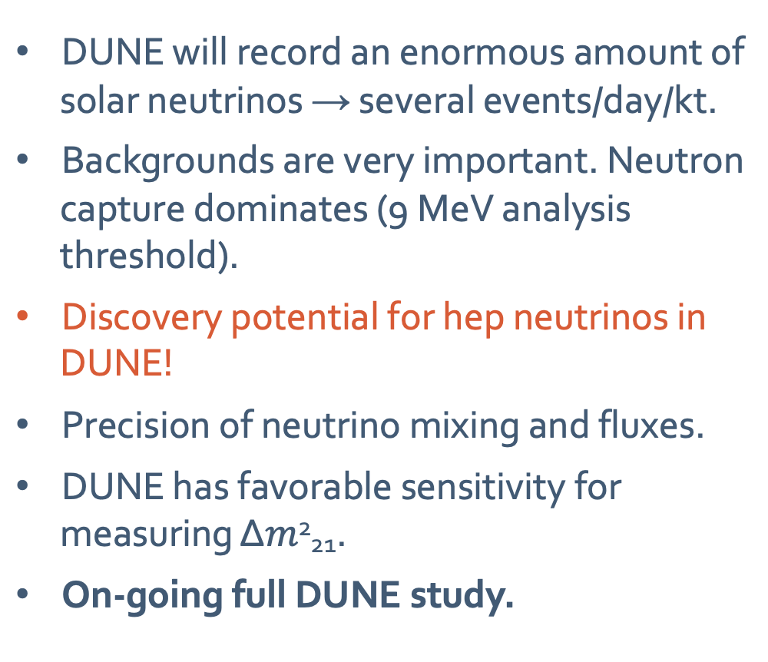
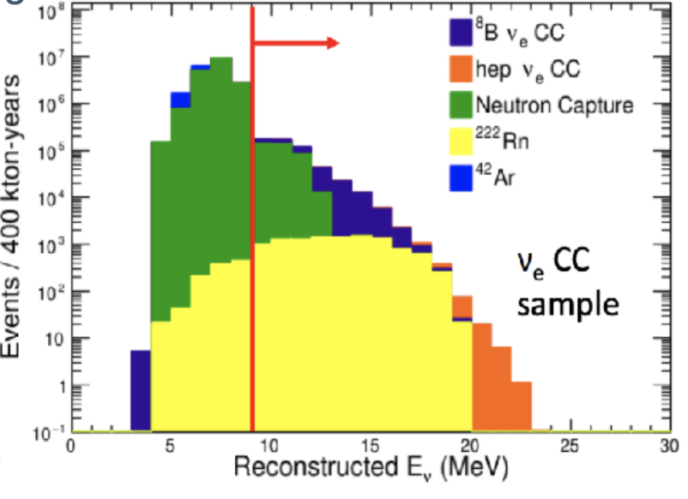
Solar Neutrinos in DUNE

Slide 25
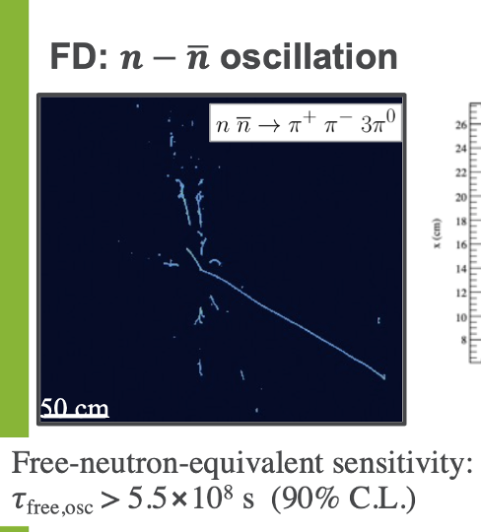
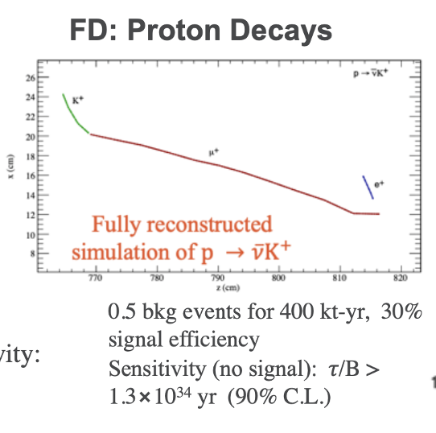
Baryon Number Violation
Neutron anti-neutron oscillations and proton decay with 400kt-yr of data taking

Slide 26
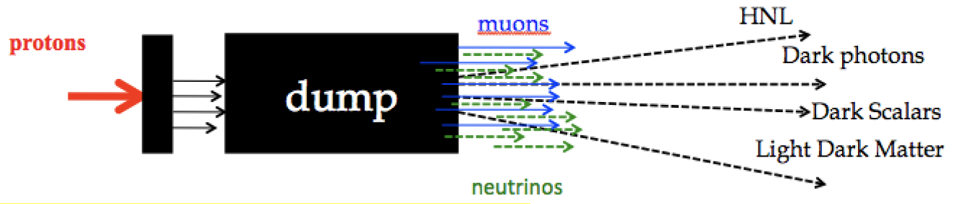
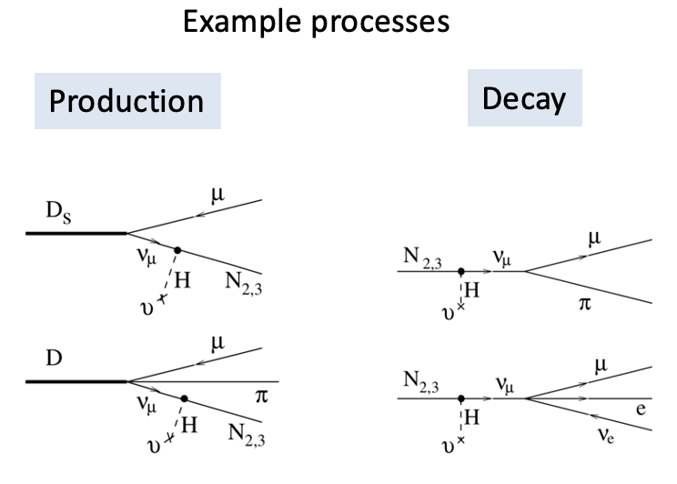
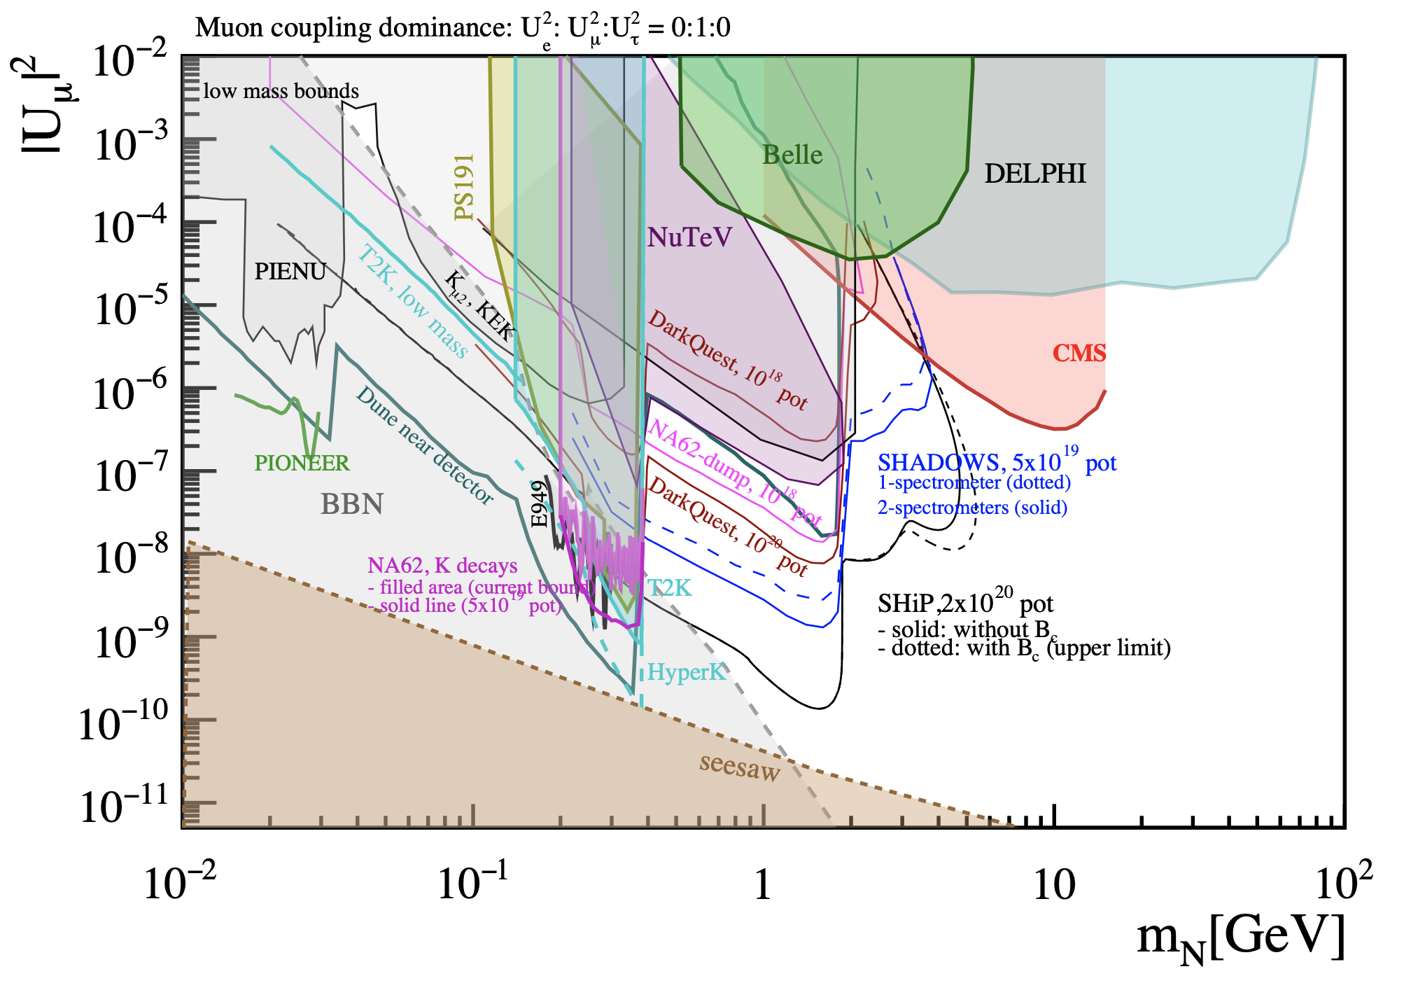
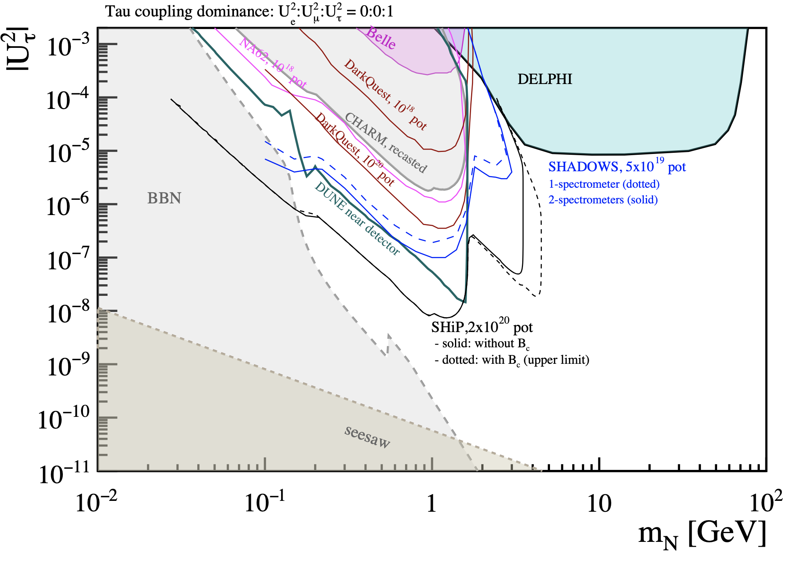
Searches for BSM Physics
High intensity proton beam on target/dump can be a source for low mass BSM particle production
ND detectors at ~500m can detect BSM particle scattering or decays.
Examples are: light dark matter, dark scalars, dark photons, axions, heavy neutral leptons (HNLs).
Example shown here for HNLs
-->
Near
Detecter
arXiv:2203.08039

Slide 27
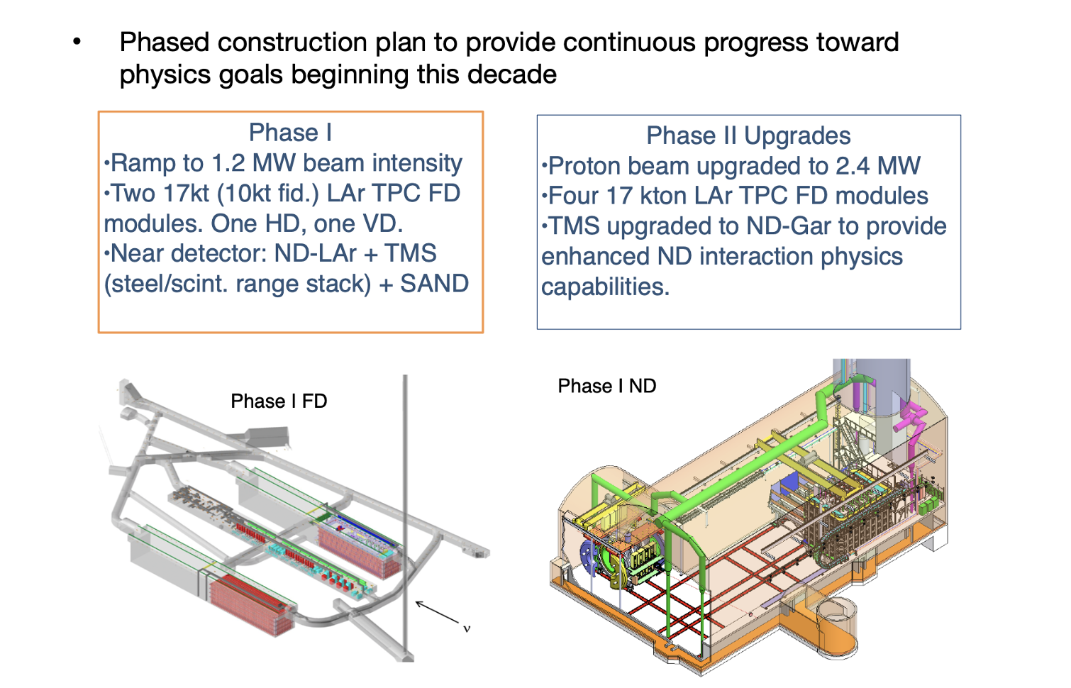
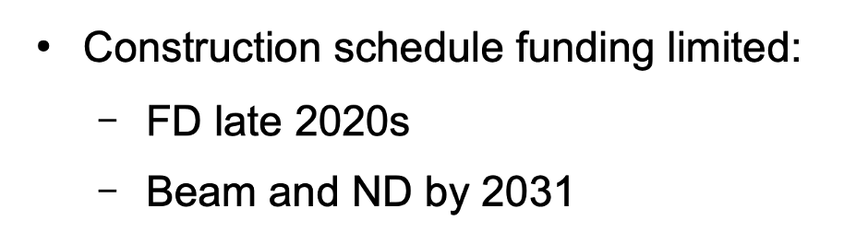
DUNE Plans and Installation

Slide 28
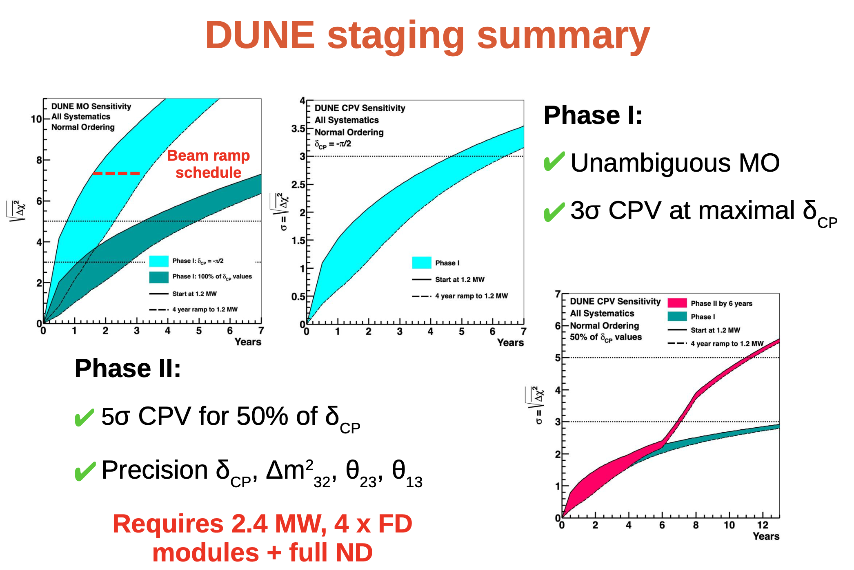
DUNE Sensitivity vs Staging
arXiv:2203.06100

Slide 29
Summary
The Deep Underground Neutrino Experiment (DUNE) is a next-generation long-baseline neutrino oscillation experiment, consisting of
  High power, broadband neutrino beam
  High capable near detector located on site at Fermilab
  Massive liquid argon TPCs far detector located 1300 km at SURF underground facility
The primary physics goals of the experiment are
  Precise measurements of all parameters governing long-baseline neutrino oscillation parameters in a single experiment
  Sensitivity to observe supernova, solar and atmospheric neutrinos, and access to BSM searches
Milestones ProtoDUNEs successfully operated at CERN. Far side civil construction to be completed in 2024 with far detector installation next.
Near site and beamline are fully designed. DUNE construction is phased to provide progress towards physics goals beginning end of this decade

Slide 30
Backup

Slide 31
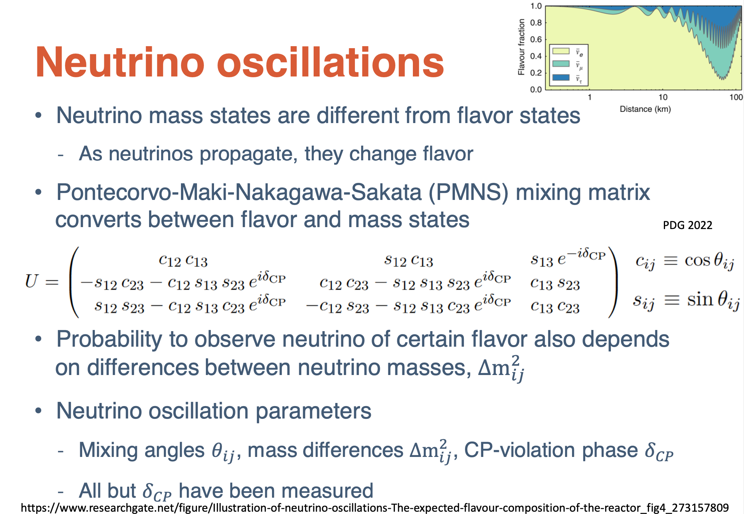

Slide 32
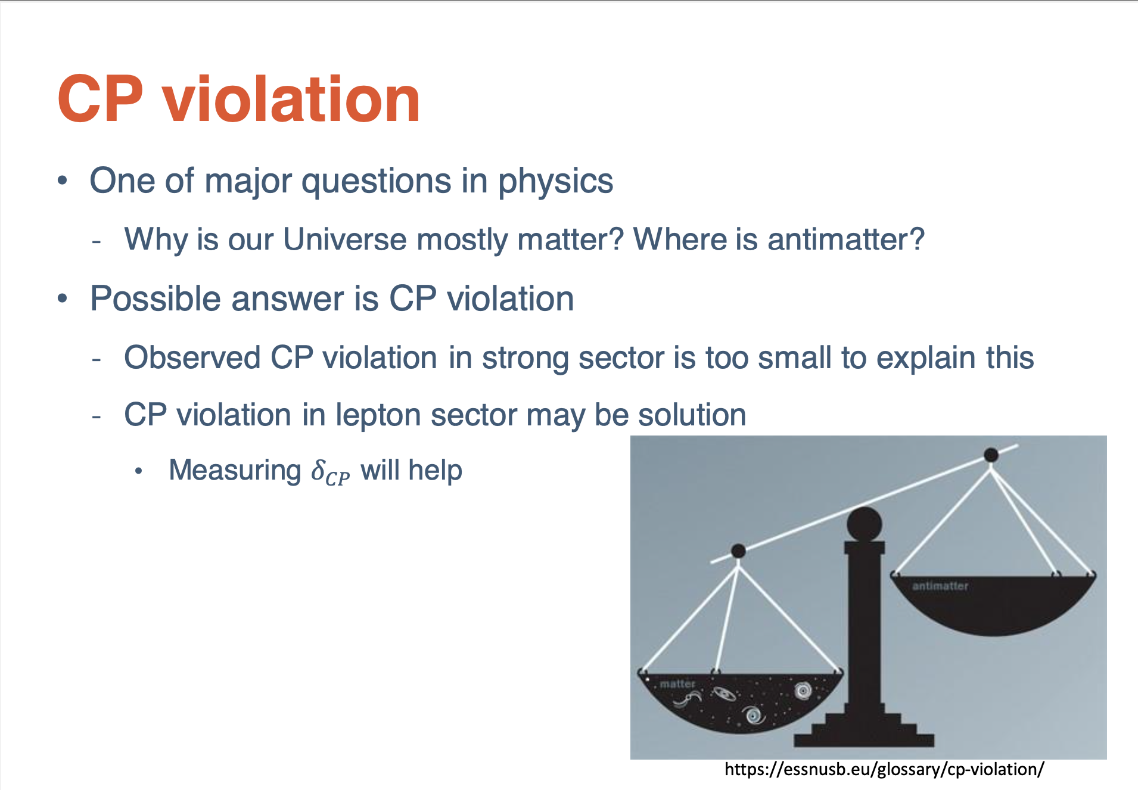

Slide 33
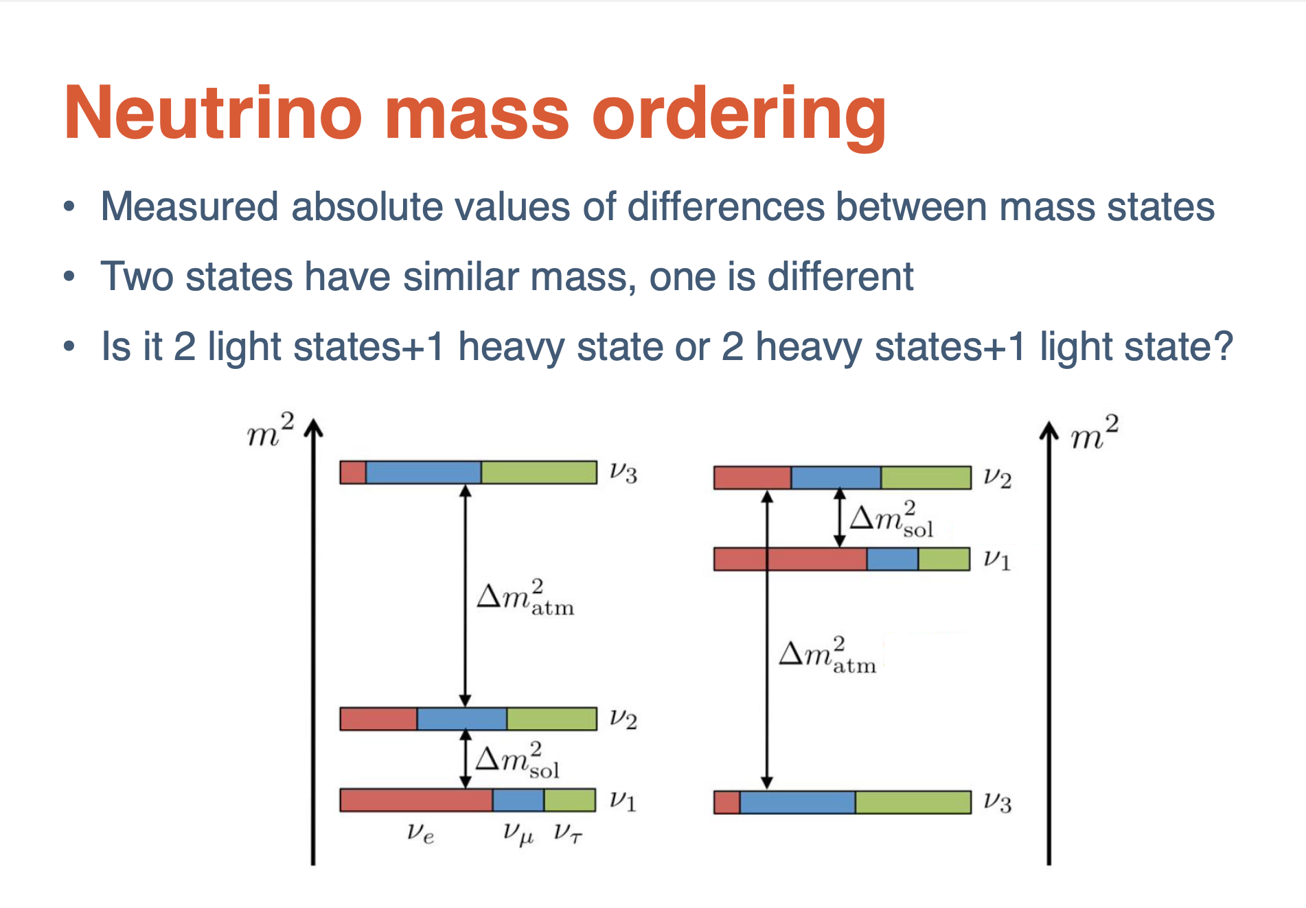

Slide 34


Slide 35

DUNE Plans and Installation

Slide 36

DUNE Plans and Installation

Slide 37

DUNE Phase 1

Slide 38


Slide 39


