Slide 1


Progress on the development of key technologies for the 4th generation ECR ion source FECR
IMP
W. Lu
L. Sun, H. W. Zhao, J. W. Guo, W. Wu, B. M. Wu, X. J. Ou, E. M. Mei, S. J. Zheng,
X. Z. Zhang, L. Zhu, C. J. Xin, Y. Q. Chen
and the other FECR team members
Institute of Modern Physics, CAS, 730000, Lanzhou, China
ICIS’21, Sept. 20~24, 2021, TRIUMF, Canada

Slide 2
Outline
High Intensity HCI Beam Needs
FECR: a 4th Generation ECRIS
Key Technologies Development for FECR
  FECR magnet progress
  Microwave system
  Plasma chamber cooling
Summary

Slide 3
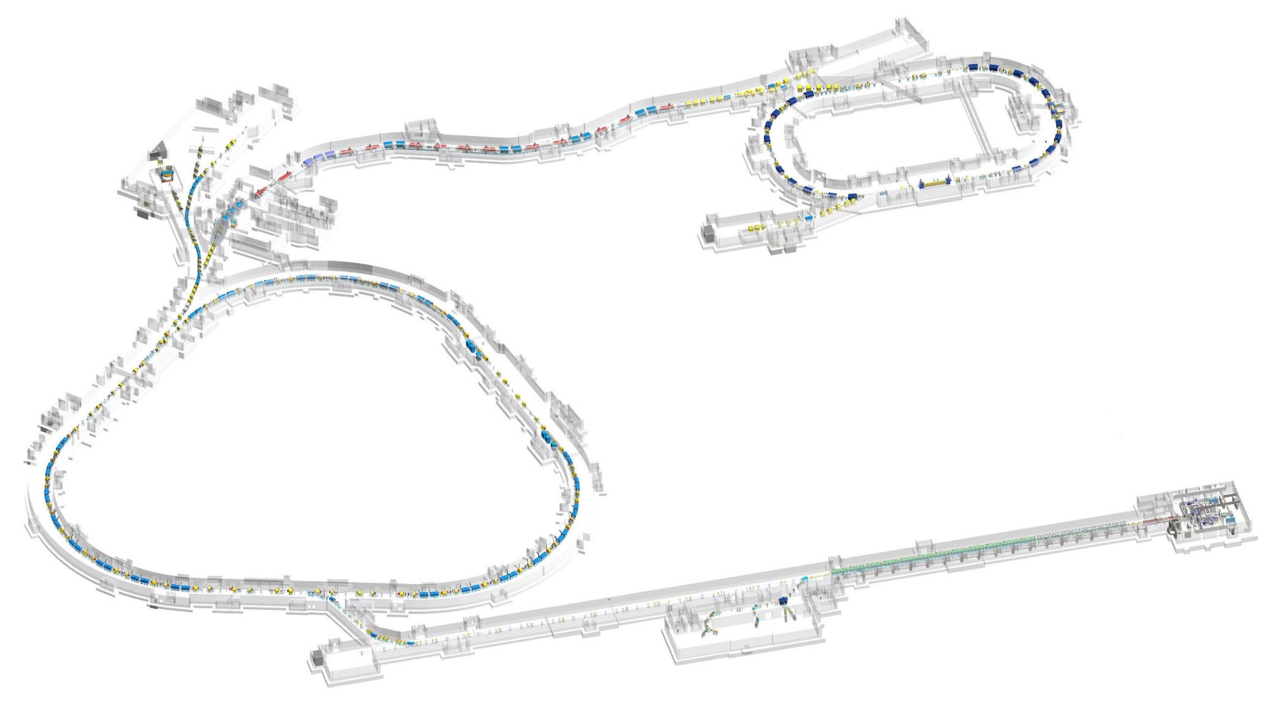
HIAF Layout
High Intensity heavy-ion Accelerator Facility (HIAF，2018-2025)
T5
Physics:
Low energy nuclear structure terminal
Multi-discipline terminal
High energy fragment separator HFRS
High precision spectrometer ring SRing
Radioactive isotope beam terminal
High energy density physics terminal
HFRS
T3
T2
T4
SRing: Spectrometer ring
C: 278m
Bρ: 15Tm
T6
BRing: Booster Ring
C: 569 m
Bρ: 34 Tm
iLinac: Superconducting linac
E: 17 MeV/u( ²³⁸U³⁵⁺)
SECR
E: 14 keV/u (²³⁸U³⁵⁺)
iLinac-2 (reserved)
E: 100 MeV/u U⁴⁶⁺
T1

Slide 4
HIAF Main Specifications
 | SECR | iLinac | BRing | HFRS | SRing
Length / circumference (m) | / | 114 | 569 | 192 | 277
Beam Species | H₂⁺~U^{n+} | H₂⁺~U^{n+} | H~U | / | /
Final energy of U (MeV/u) | 0.014 (U³⁵⁺) | 17 (U³⁵⁺) | 835 (U³⁵⁺) | 800 (U⁹²⁺) | 800 (U⁹²⁺)
Max. magnetic rigidity (T.m) | / | / | 34 | 25 | 15
High Power Mode (pulsed) | 50 pμA (U³⁵⁺) | 28 pμA (U35+) | 10¹¹ppp (U³⁵⁺) | / | 10¹⁰ppp (U⁹²⁺)
High Energy Mode (CW) | >10 pμA (U⁴⁶⁺) | >6 pμA (U46+) | / | / | /
Operation mode | DC | CW | / | / | /
 | Pulsed 0.2~2 ms/3 Hz | Pulsed 0.2~2 ms/3 Hz | fast ramping (12 T/s, 3 Hz) | Momentum-resolution 1100 | DC, deceleration
Emittance or Acceptance (H/V, π·mm·mrad, dp/p) | ≤0.2 | 5 / 5 | 200/100, 0.5% | ±30mrad(H)/±15 mrad(V), ±2% | 40/40, 1.5% (normal mode)
The highest beam intensity requirement for highly charged heavy ions in the world

Slide 5
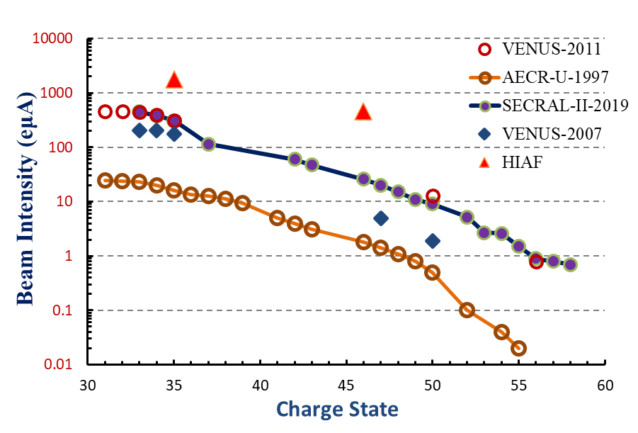
High Intensity HCI Beam Needs: Production
4th G ECRIS
3rd G ECRIS
2nd G ECRIS
²³⁸U

Slide 6
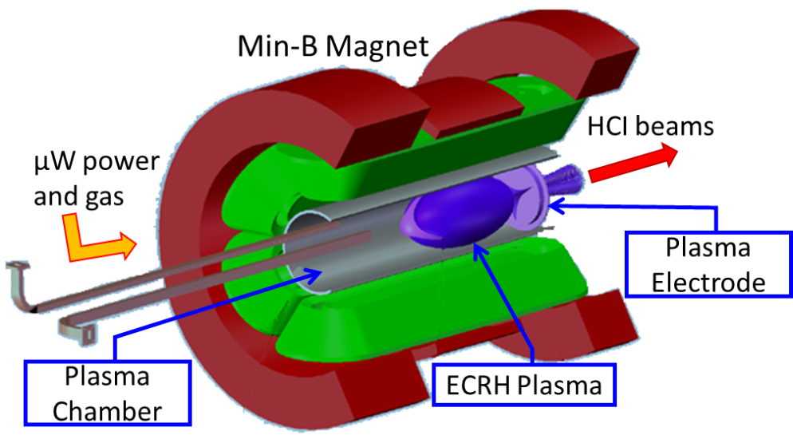
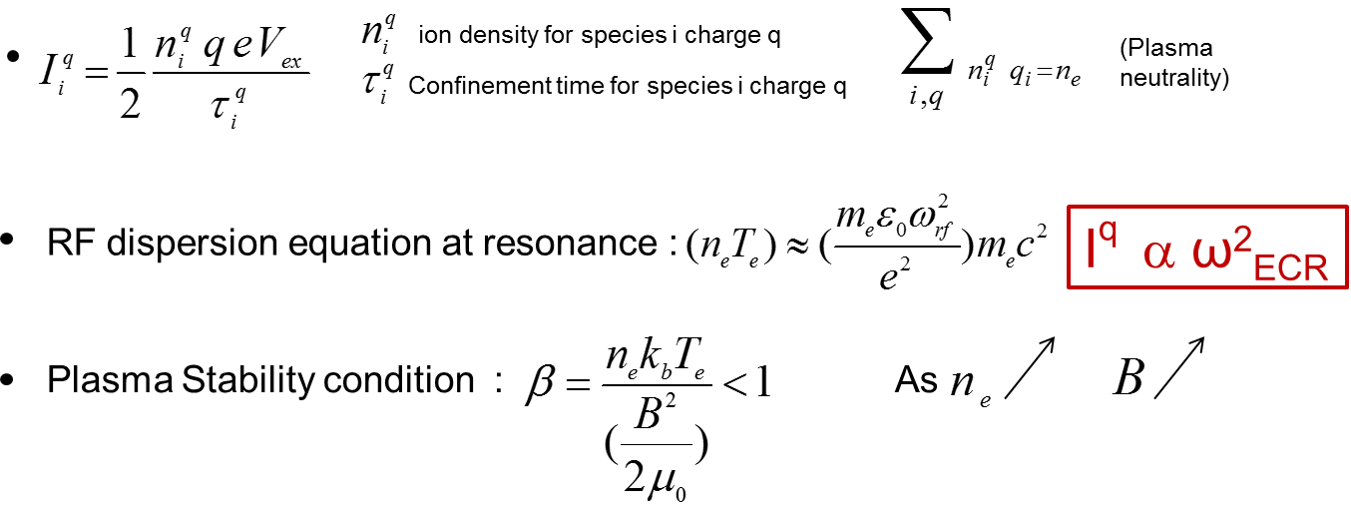
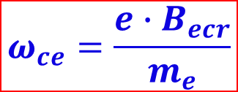
FECR: What is a 4th G ECRIS?
Plasma
Magnet
Microwave
Electron Cyclotron Resonance Ion Source
$$ω_{ce}=\frac{{e∙B}_{ecr}}{m_{e}}$$
Higher Frequency!
Higher B Field!
Bigger Volume!
Higher rf power!

Slide 7
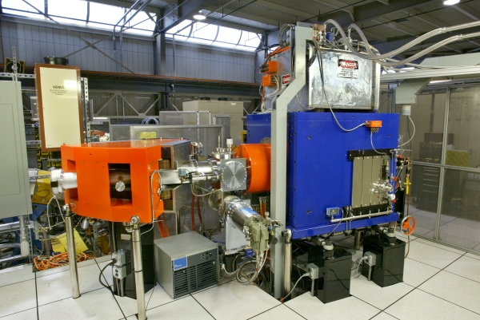
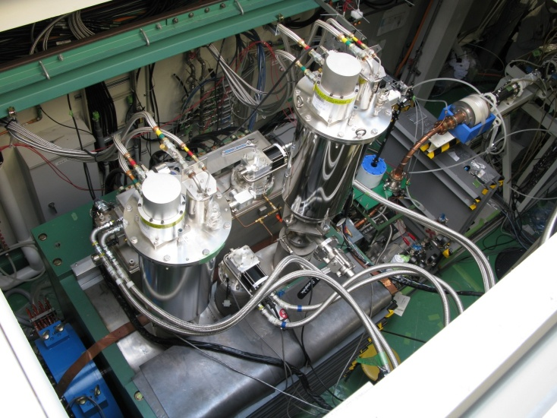
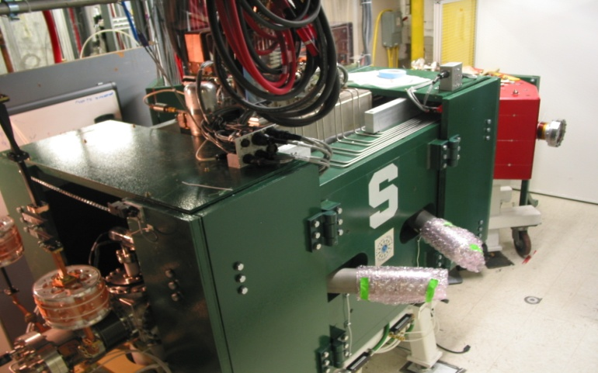
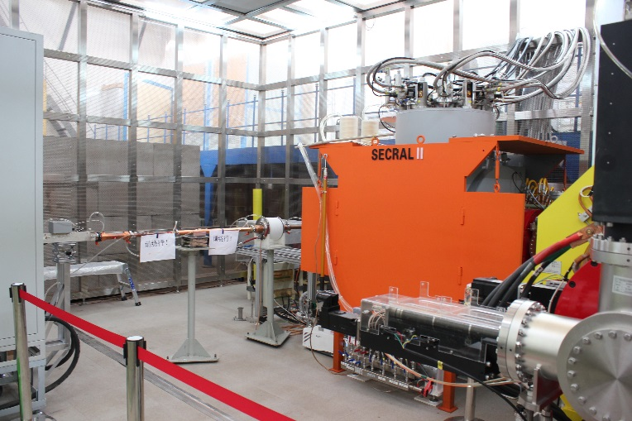
State of the Art ECRIS: 3rd G Sources
VENUS@LBNL: 28+18 GHz
SCECRISs@RIKEN: 28+18 GHz
SuSI@MSU: 24+18 GHz
SECRAL, SECRAL-II@IMP: 28/24+18 GHz

Slide 8
FECR: a 4th G ECRIS
Specs. | Unit | 3rd G ECRIS | 4th G ECRIS | FECR
frequency | GHz | 24-28 | 40~56 | 45
Operational RF Power | kW | 4~10 | 10~40 | 20
B_{ECR} | T | 0.86~1.0 | 1.4~2.0 | 1.6
B_{rad} | T | 1.8~2.2 | 2.8~4.0 | ≥3.2
B_{inj} | T | 3.4~4.0 | 5.6~8.0 | ≥6.4
B_{min} | T | 0.5~0.7 | / | 0.5~1.1
B_{ext} | T | 1.8~2.2 | 3.0~4.5 | ≥3.4
Plasma Chamber ID | mm | 100~150 | >100 | ≥140
Mirror Length | mm | 420~500 | ≥500 | 500
Cooling Capacity@4.2 K | W | 0~6.0 | >10.0 | ≥10.0

Slide 9
FECR: Challenges
Specs. | Unit | FECR | Challenges
frequency | GHz | 45 | High frequency high power microwave coupling High power plasma chamber & components cooling
Operational RF Power | kW | 20
B_{ECR} | T | 1.6 | Reliable High Field Magnet with min-B Field Configuration
B_{rad} | T | ≥3.2
B_{inj} | T | ≥6.4
B_{min} | T | 0.5~1.1
B_{ext} | T | ≥3.4
Plasma Chamber ID | mm | ≥140
Mirror Length | mm | 500
Cooling Capacity@4.2 K | W | ≥10.0 | Radiation degradation and dynamic heat load
U³⁵⁺ | mA | >1.0 | Intense solid material beam production
Pulsed Beam Frequency | Hz | 0.5~3 | High afterglow yield and pulse duration
Afterglow pulse width | ms | >2.0
Wang Lu, et al., Rev. Sci. Instrum. 92, 033302 (2021)
See Lixuan Li’s Poster-41 on Sept. 23

Slide 10
FECR Progresses: towards the Challenges
  FECR magnet progress
    Coldmass and cryogenics
  Microwave system
    High power high frequency microwave transmission and coupling
  Plasma chamber & Components cooling

Slide 11
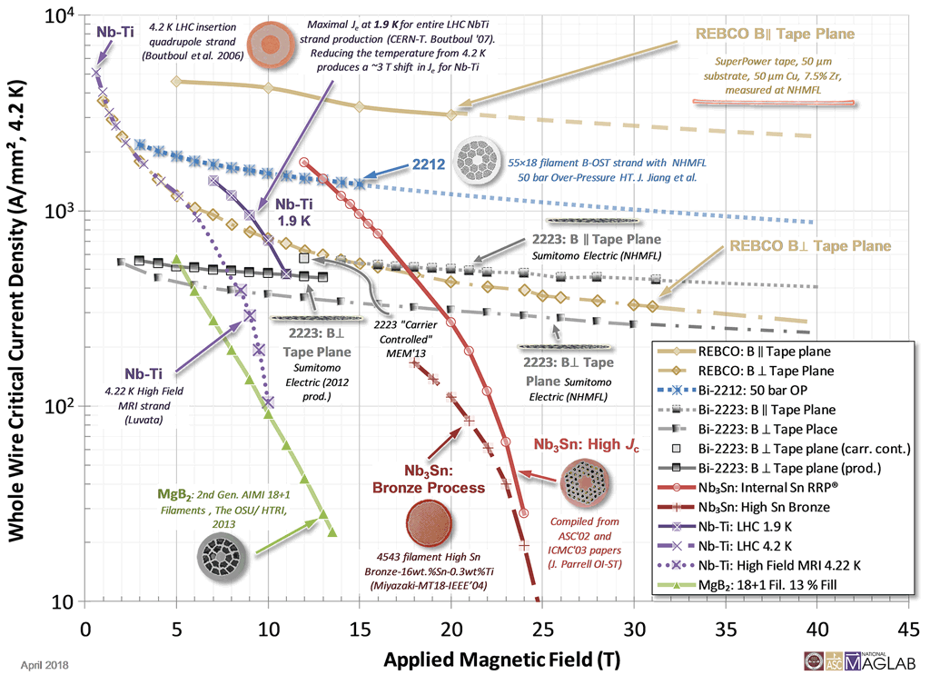
FECR Progresses: Magnet
1100
4th G ECRIS
3rd G ECRIS
Nb₃Sn vs. NbTi:
Treatment sensitive
Stress sensitive
500
7.0
12
Courtesy of MagLab

Slide 12
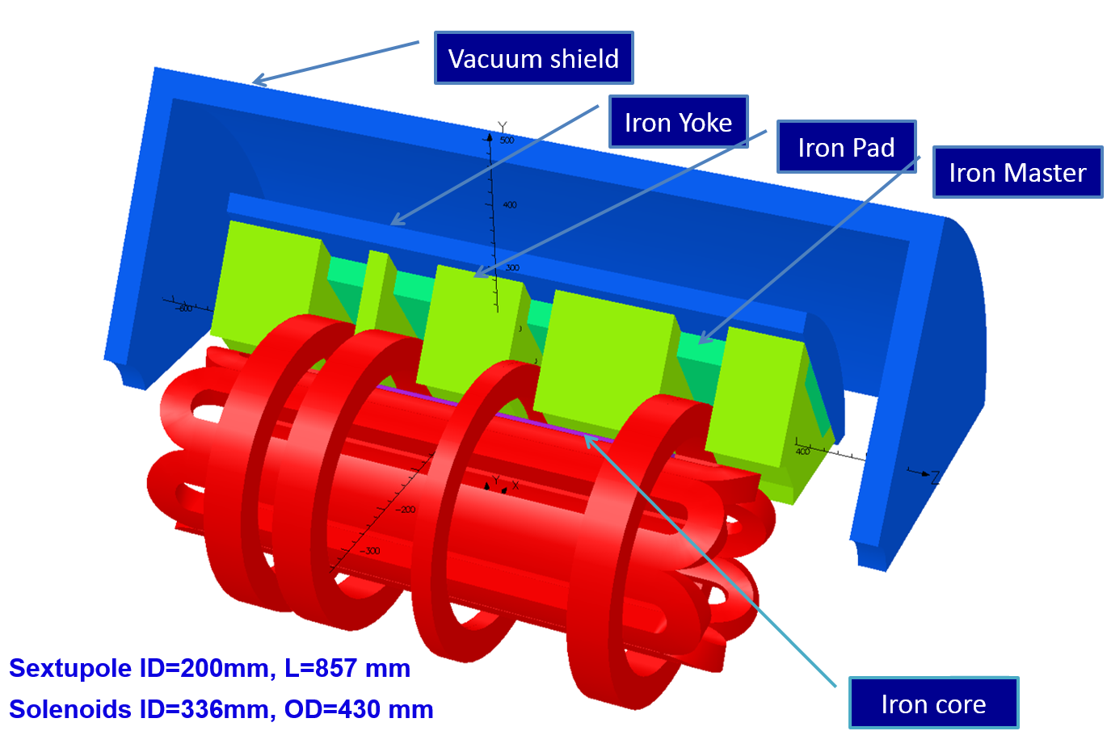
FECR Progresses: Magnet
1st Stage@50 K
2nd Stage@4.2 K
Vacuum iron shield
Copper shield
G10 Suspension
Coldmass
Warmbore
Axial Support Rods
Radial Support Rods
Coldmass Structure
Magnet Structure

Slide 13
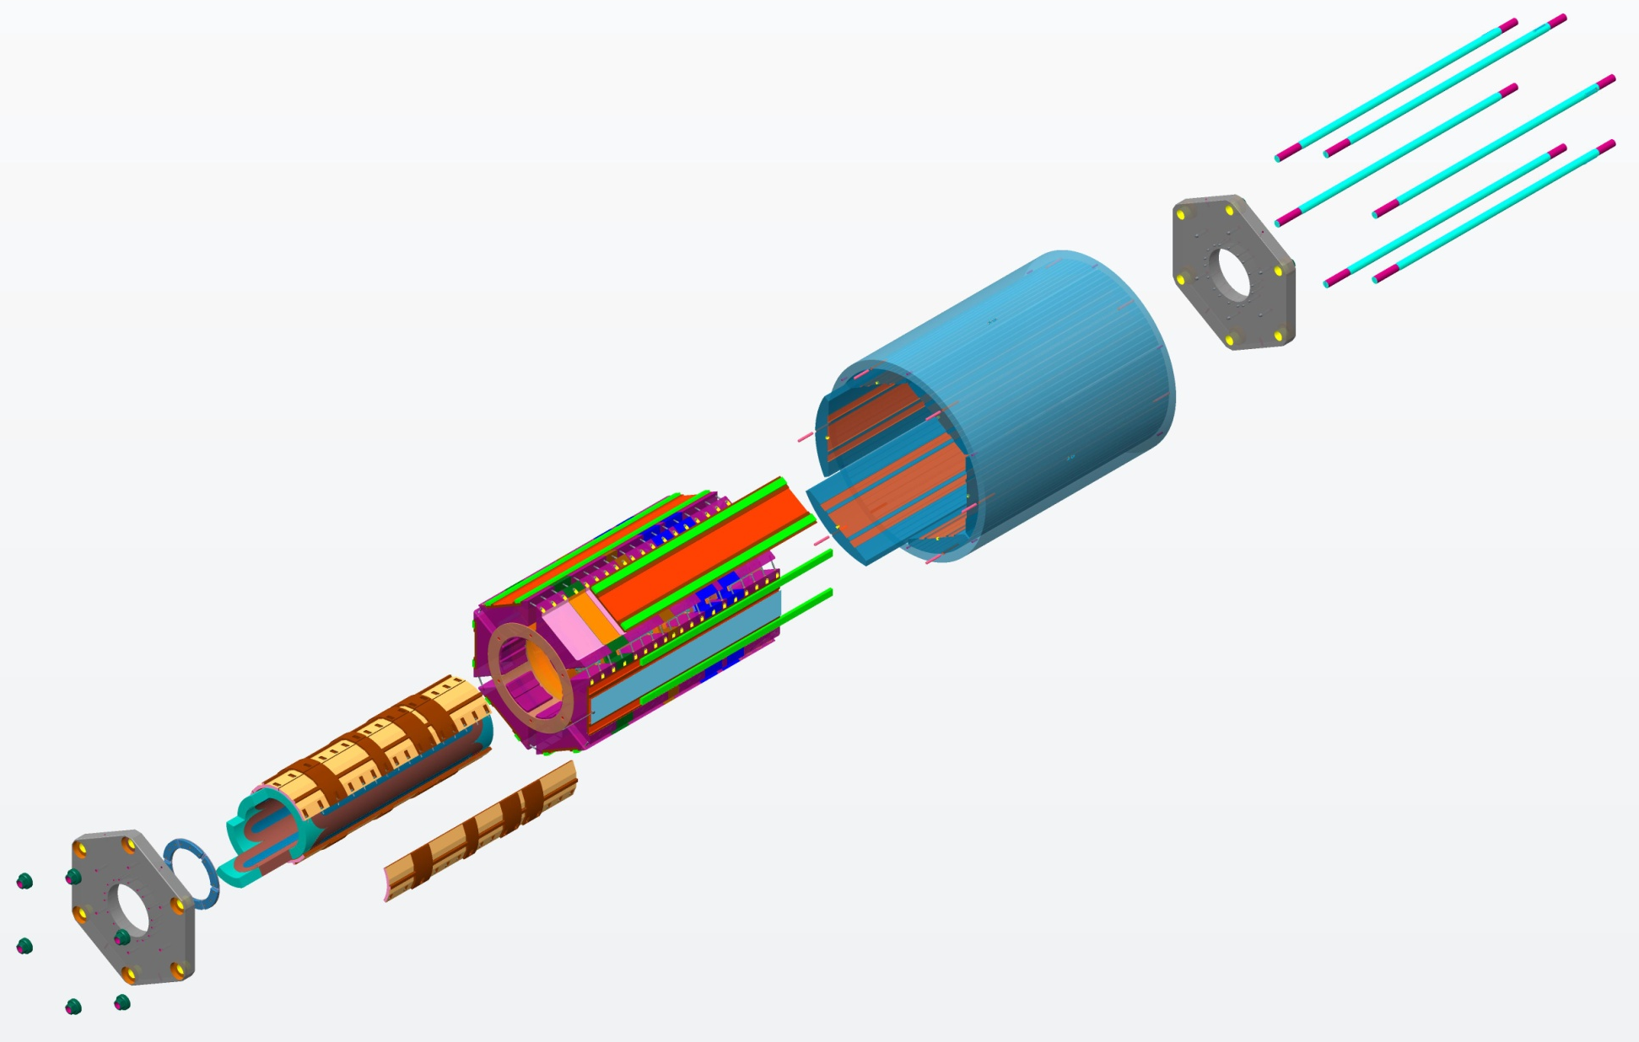
FECR Progresses: Magnet
The magnet mechanical structure was designed by
collaboration with ATAP magnet group at LBNL as of 2017
AXIAL RODS
(Strain Gauged)
Bladder & Keys assembly
YOKE-SHELL
ALIGNMENT PINS
MASTER-KEY PLATES
SOLENOID
STRUCTURE
SUBASSEMBLY
COIL-PACK
SUBASSEMBLY
AXIAL-LOAD
END PLATE
SUBASSEMBLYS
YOKES
SHELL-YOKE
SUBASSEMBLY
(Shell is strain gauged)
COIL END
BLOCKS
LOAD-KEYS
BLADDER
SUBASSEMBLY
COLLARS
SEXTUPOLE
COILS
This Nb₃Sn magnet is being built by a Chinese company without collaboration
with ATAP/LBNL. DOE did not approve such collaboration.

Slide 14
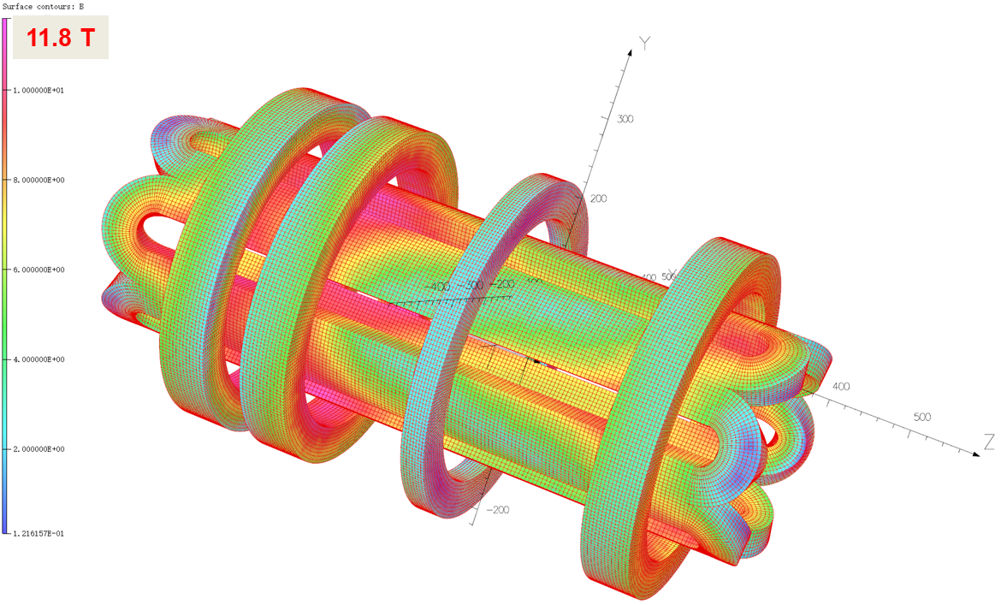
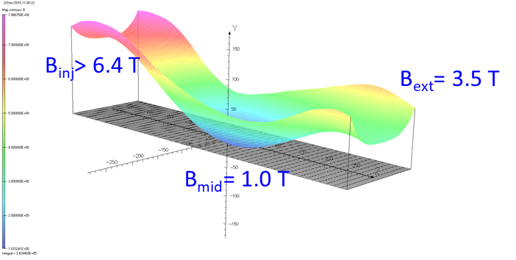
FECR Progresses: Magnet
 | Nominal engineering current density J_{e} (A/mm²) | Nominal wire current I_{e} (A) | Nominal peak field B_{peak-n} (T) | Load factor (%)
Sext. | 320 | 709 | 11.3 | 75.9
Inj. | 365 | 663 | 11.8 | 78.2
Mid. | -200 | 372 | 5.0 | 36.5
Ext. | 330 | 600 | 9.7 | 67.3

Slide 15

FECR Progresses: Magnet
Key technologies
Coils fabrication
Keys & Bladder
½ Prototype Coldmass
Quench protection
Full Sized Coldmass
Quality control of mass production
Quench protection
Quench protection
Know-how of Nb₃Sn coil
Quality control and analysis
SG assisted mechanical assembly
Reliability
Reliability
System integration
FECR Magnet
System integration
Coldmass alignment
Reliable operation
From prototyping to operational machine
2016-2019
2019-2021
2021-2022
2022-
To demonstrate 80~85% of FECR coldmass performance
Operational FECR ion source

Slide 16
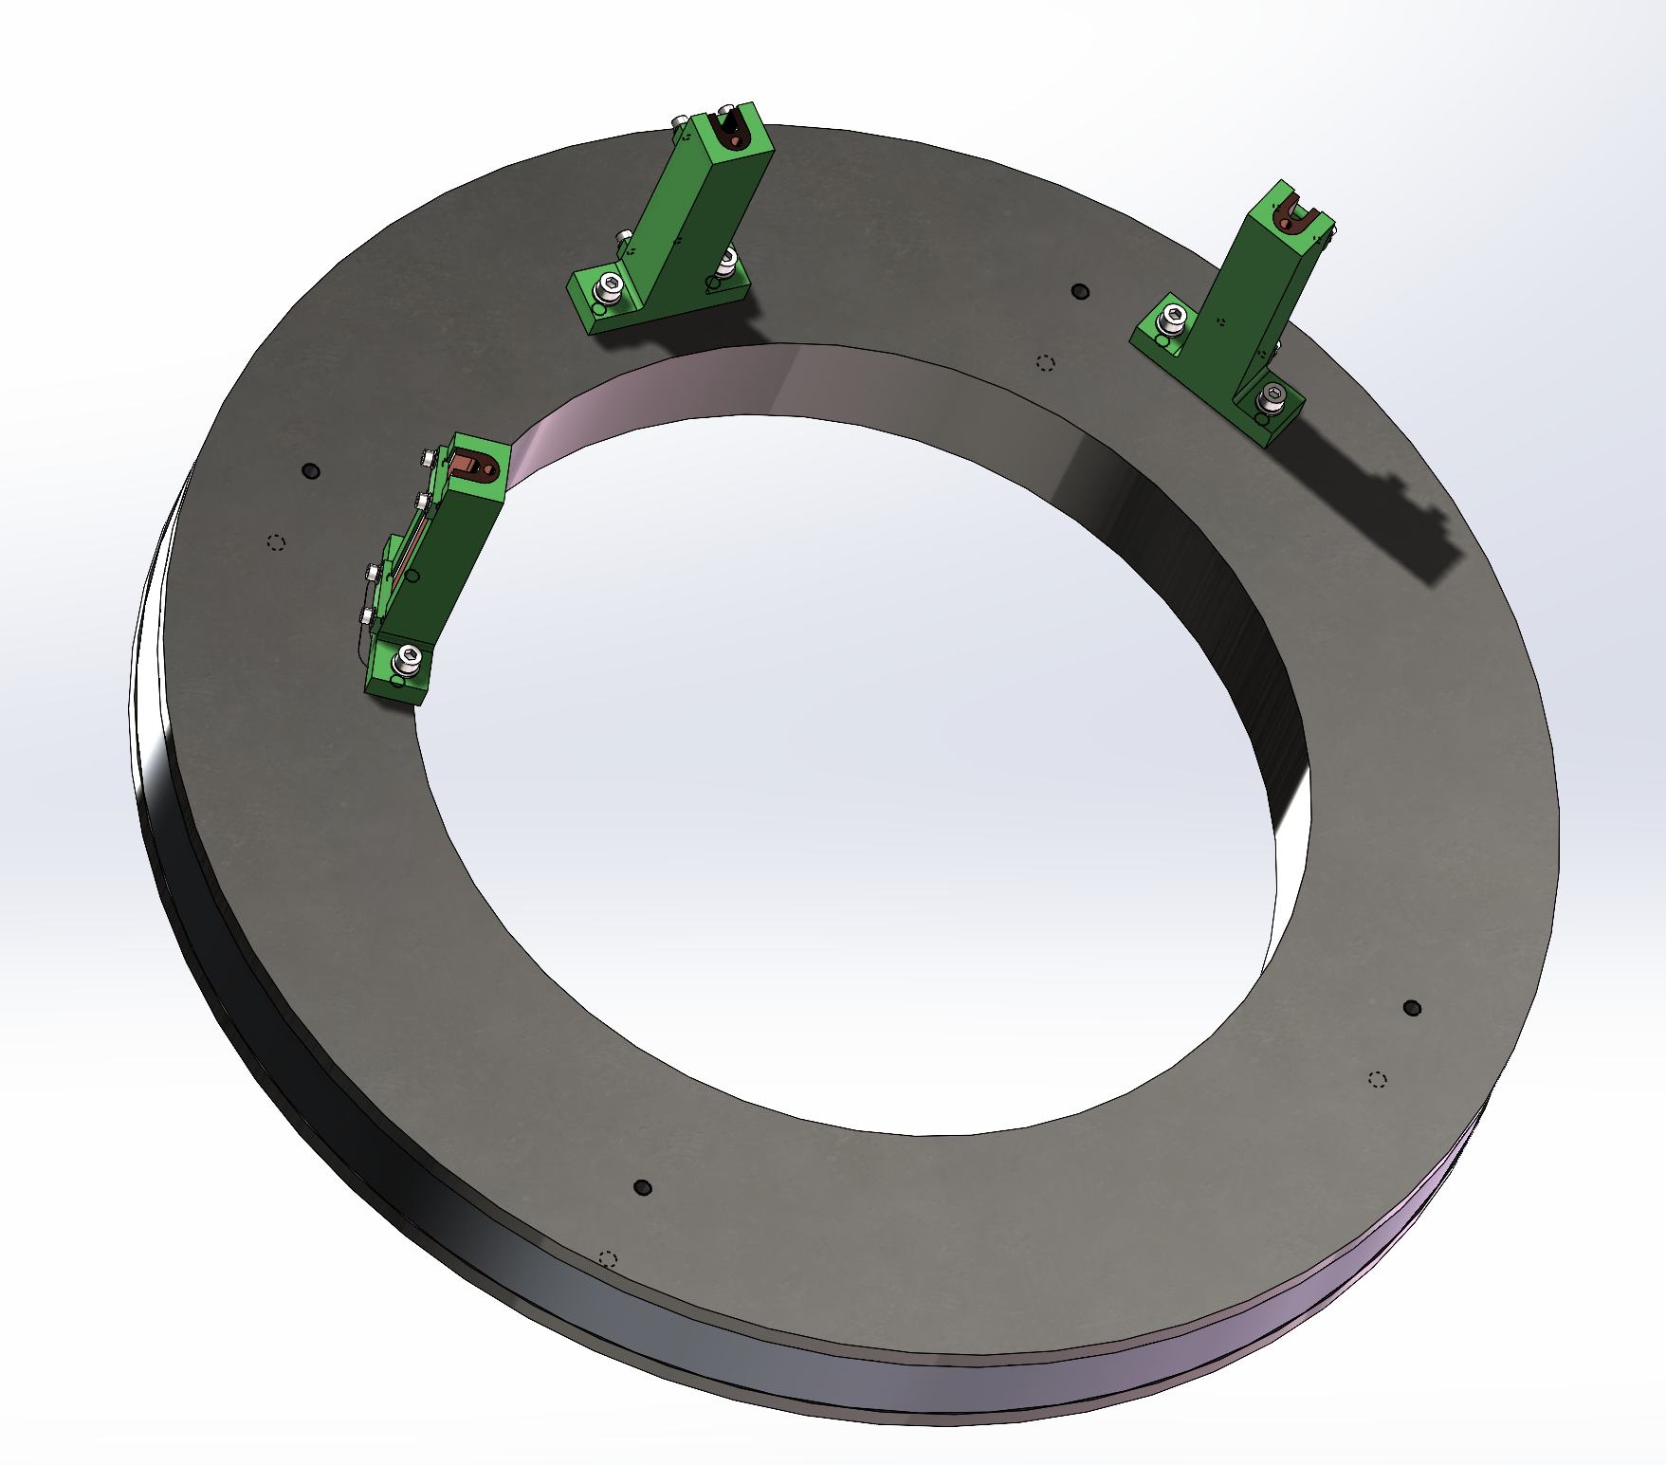
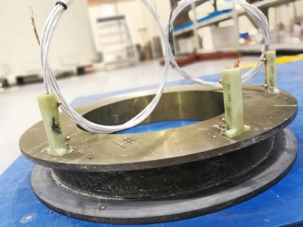
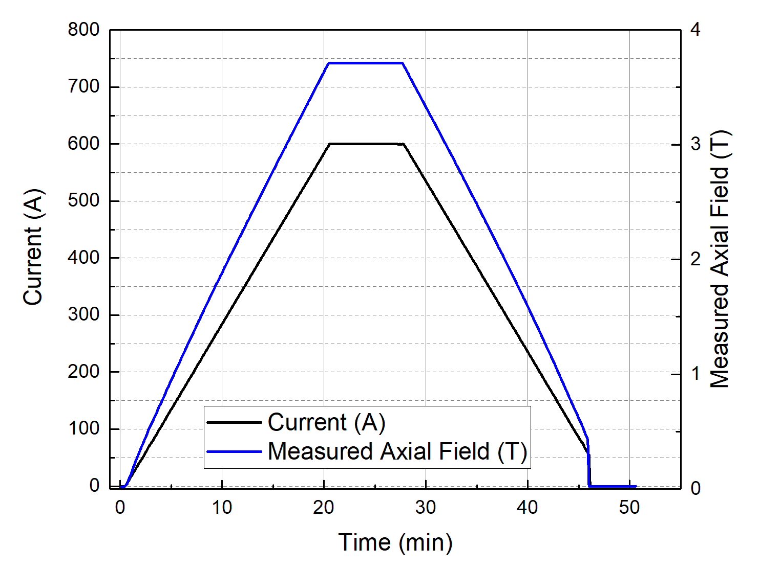
FECR Progresses: Prototyping Coils
Test of prototyping solenoid
Solenoid energized to 90% operation current 600 A (safety issue)
No quench!
Field consistent with calculation

Slide 17
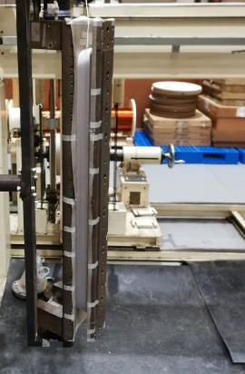
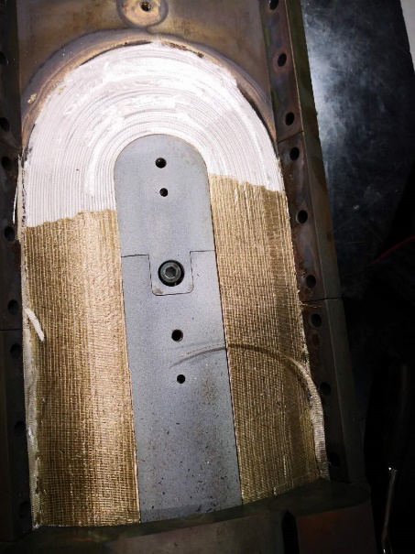
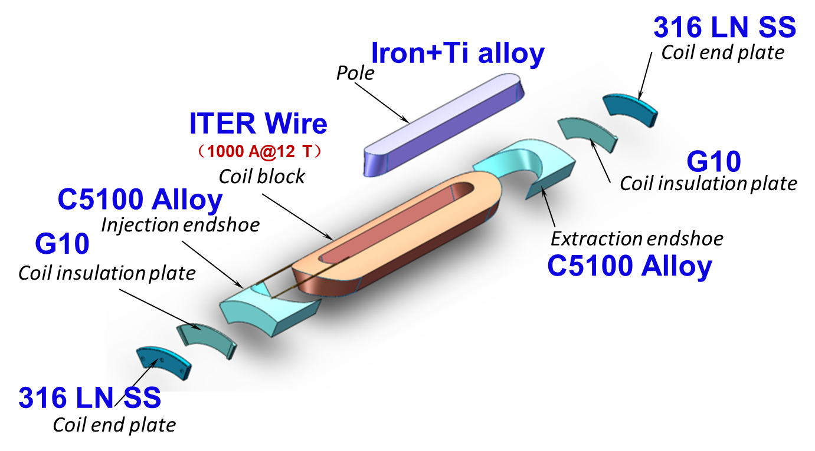
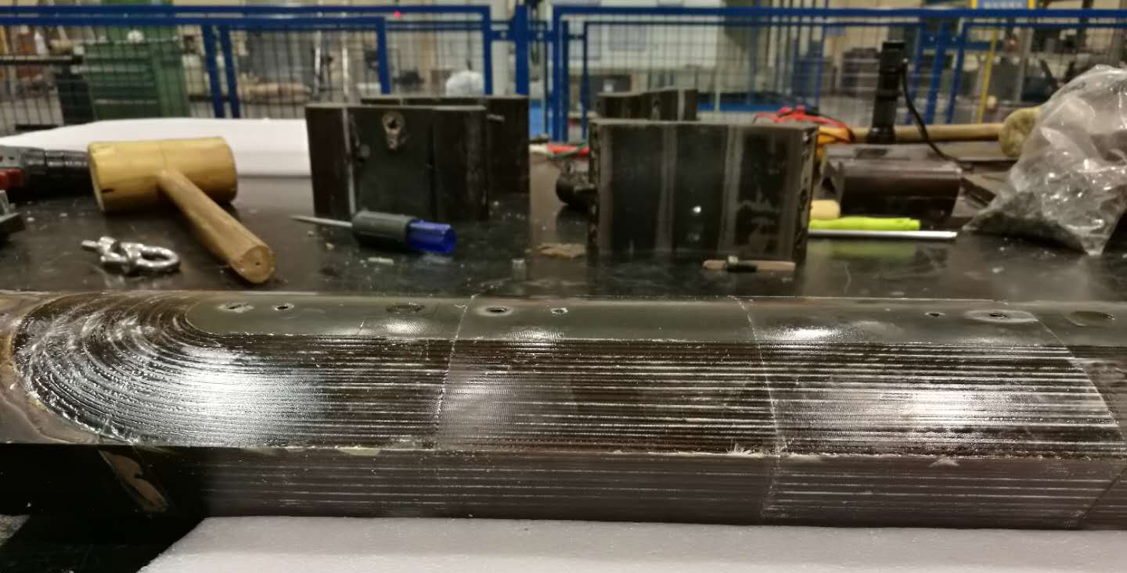
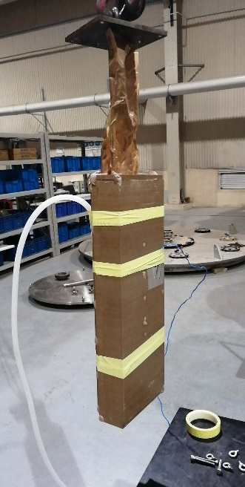
FECR Progresses: Prototyping Coils
Development of prototyping ½ sized sextupole coil
Winding
Heat Treatment
537 mm length
Prepared Coil
Mechanical mapping
Detailed Q/A
2016-2019
Potting

Slide 18

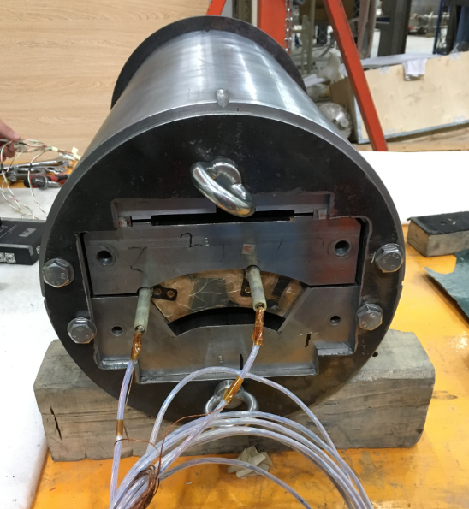
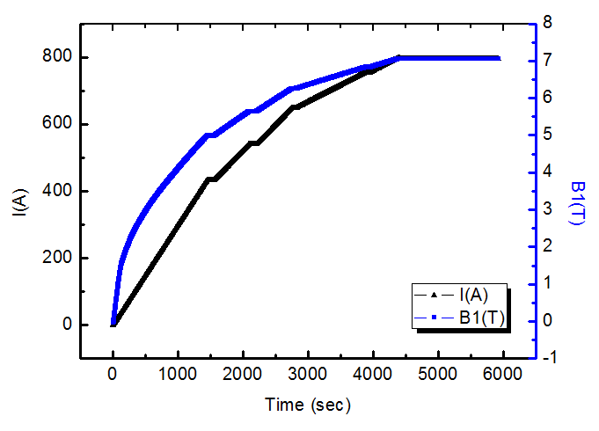
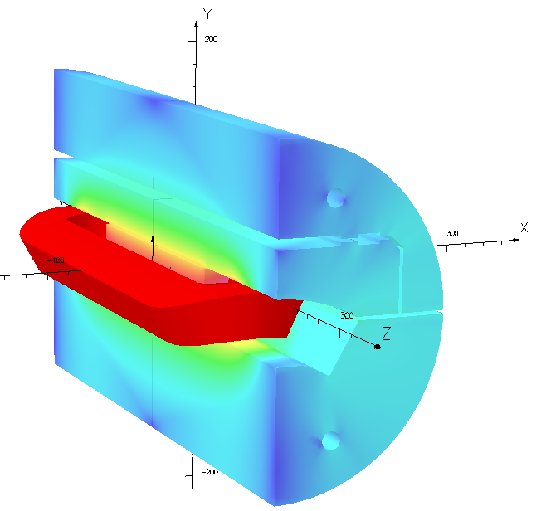
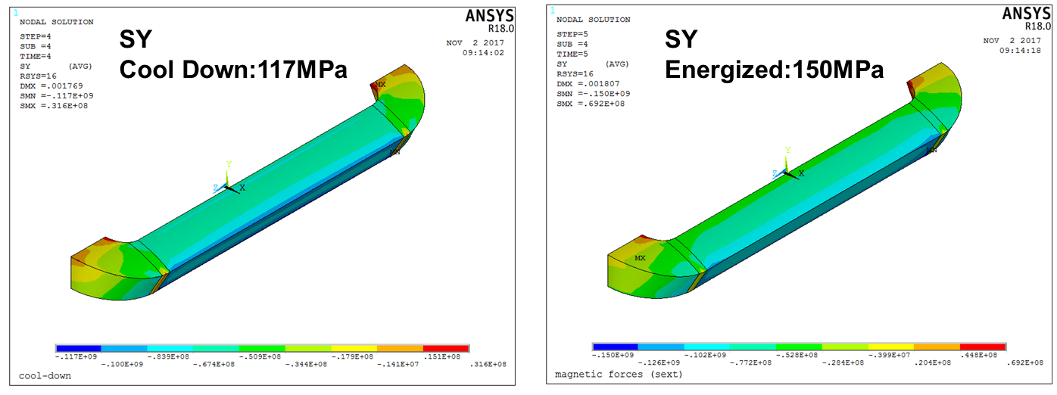
FECR Progresses: Prototyping Coils
Test of prototyping ½ sized sextupole coil
Al Shell
Bladder
Upper yoke
800A
Key
30 min
Pad
Pole field
Shim1+shim2
No Quench!
Lower yoke
Feb. 2019
Coil
A Mirror Structure for sextupole cold test
Highest field in superconductor: 10.4 T
LF : 80% of short sample

Slide 19
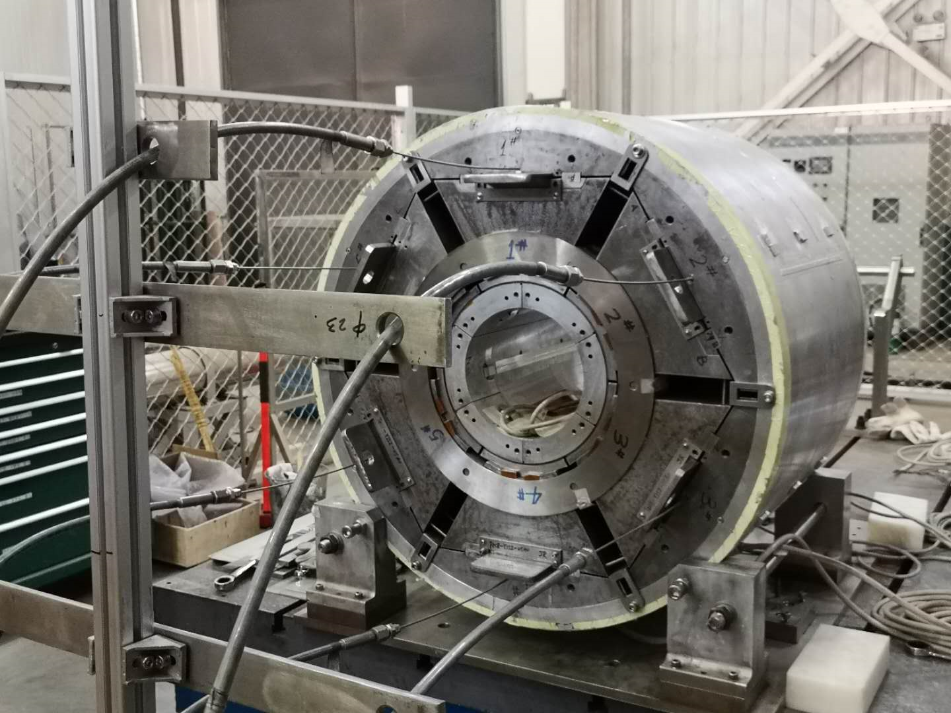
FECR Progresses: 1/2 sized prototype assembly
Strain Gauge monitored
½ prototype assembly
Bladder & Key
Al Coil
Locked with loading key & shim
Cool down to 77 K
Bladder pressurized
Axial pretension
Warm up
½ prototype with Al dummy coil mockup
Piston pressurized
Axially locked
Cool down to 77 K
Warm up

Slide 20
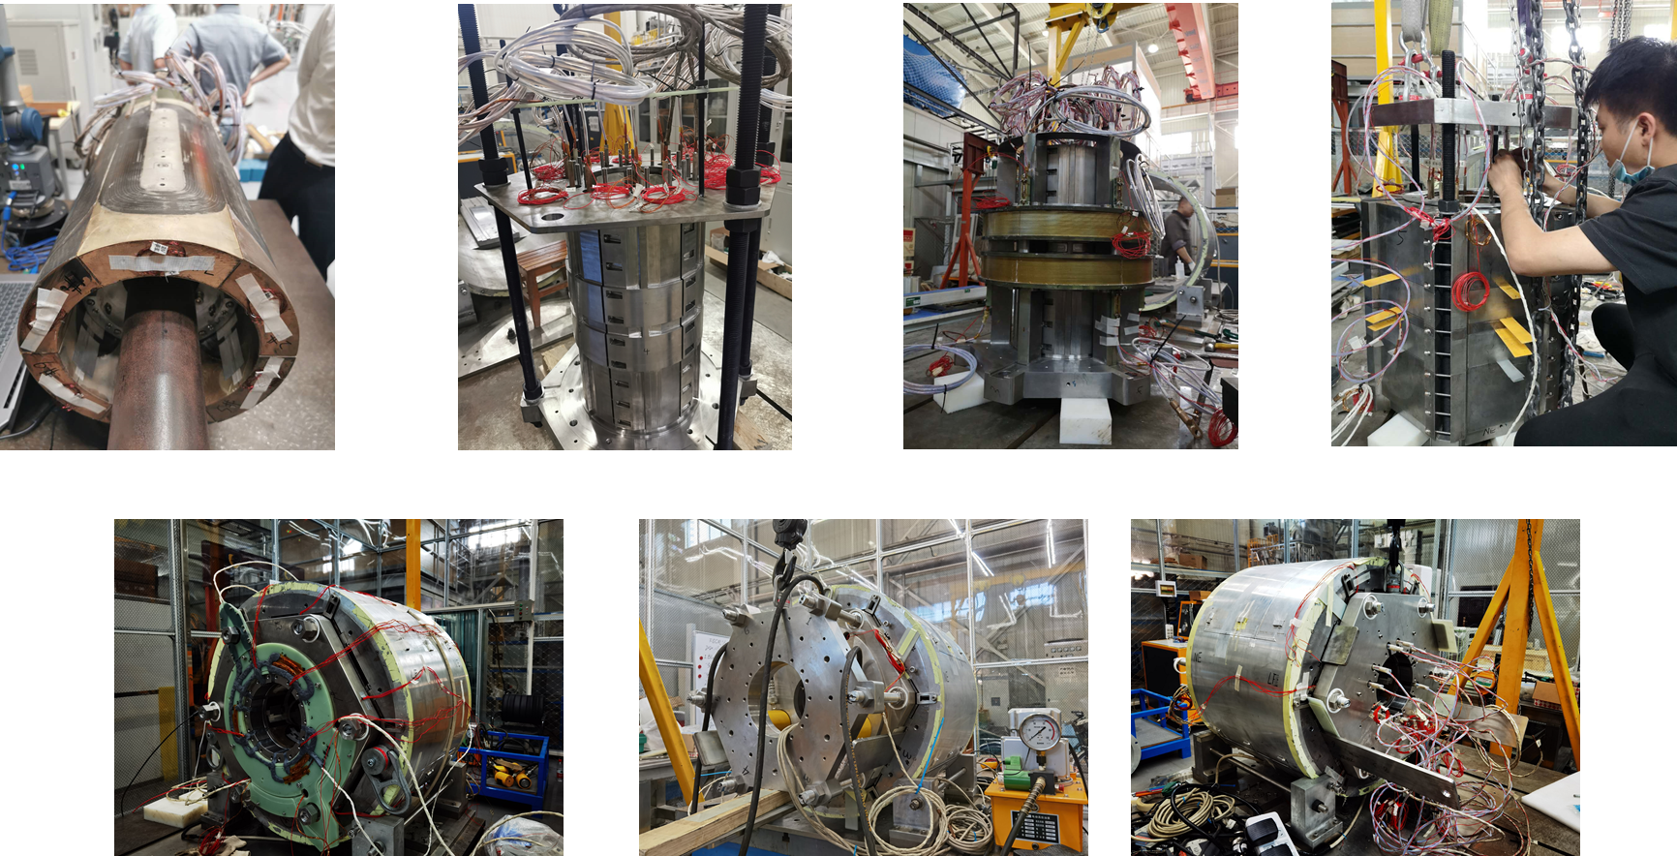
FECR Progresses: 1/2 sized prototype assembly
Sextupole pre-assembly
Sextupole in collars
Sextupole & solenoids
Load pad and wiring
2019-2020
Instrumentation in Pizzabox
Axial preload with pistons
Radial preload with bladder & keys

Slide 21
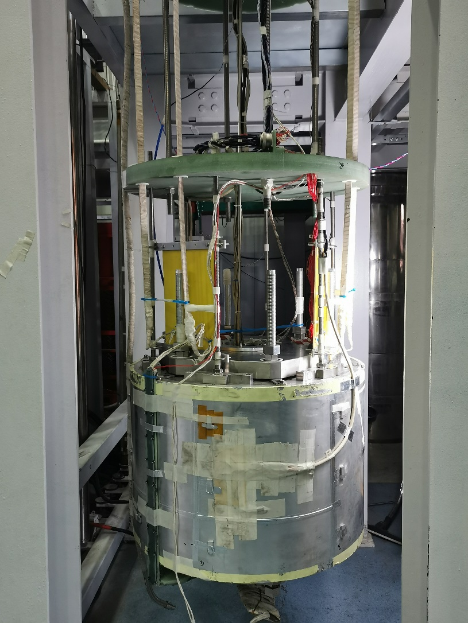
FECR Progresses: 1/2 sized prototype test
Challenges:
Quench detection and protection (in 10 ms)
Reliable active quench protection power supply
High voltage issues (~2 kV in helium gas)
Flux jumps (FJ) and resultant problems
Aug.2020

Slide 22
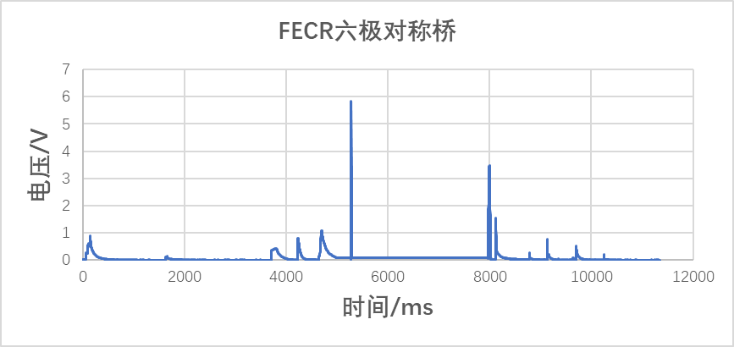
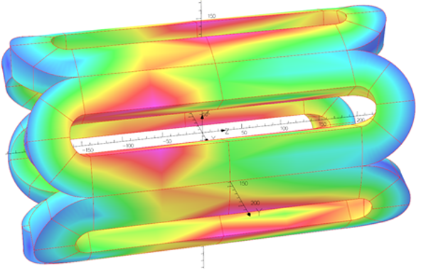
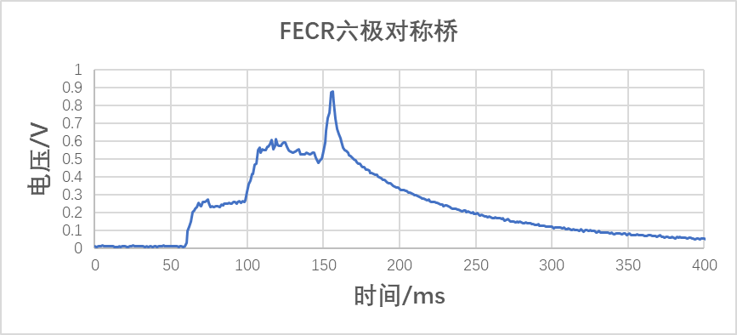
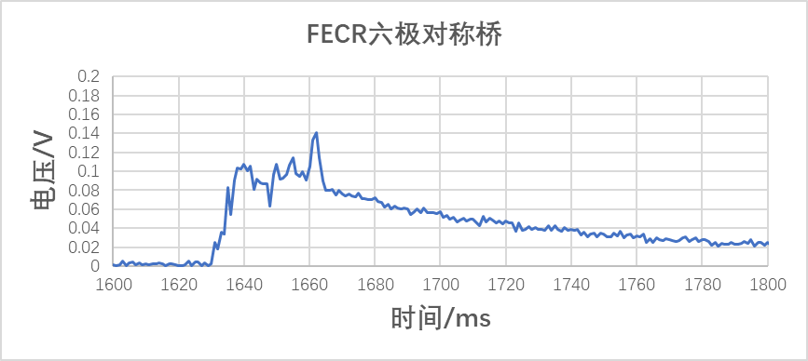
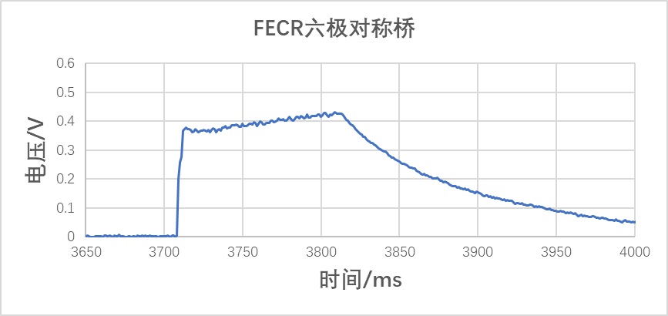
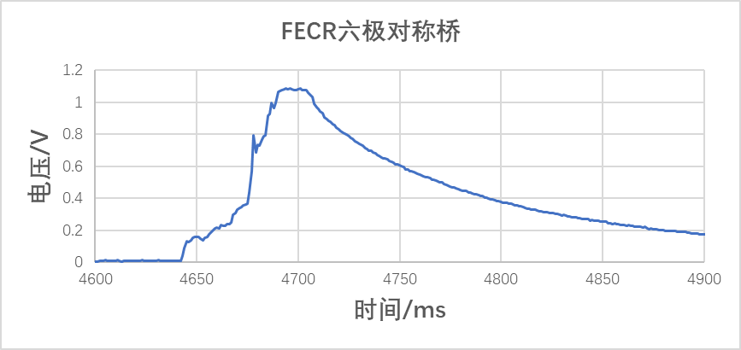
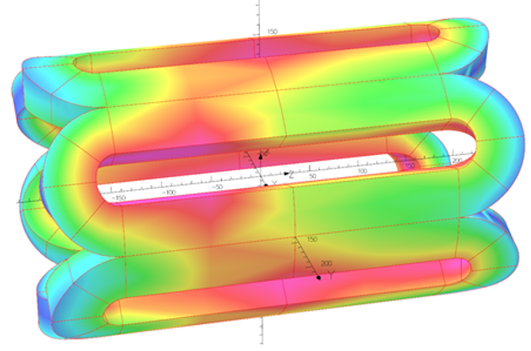
FECR Progresses: Flux Jump (FJ) Challenges
Monitored FJ voltage in quench detection system
FJ comes in many wave forms and hard to distinguish from real quench signal
Stemmed from complicated magnetic field configuration in ECRIS magnet
Detected voltage (V)
Time (ms)
B@10% currents
B@100% currents

Slide 23
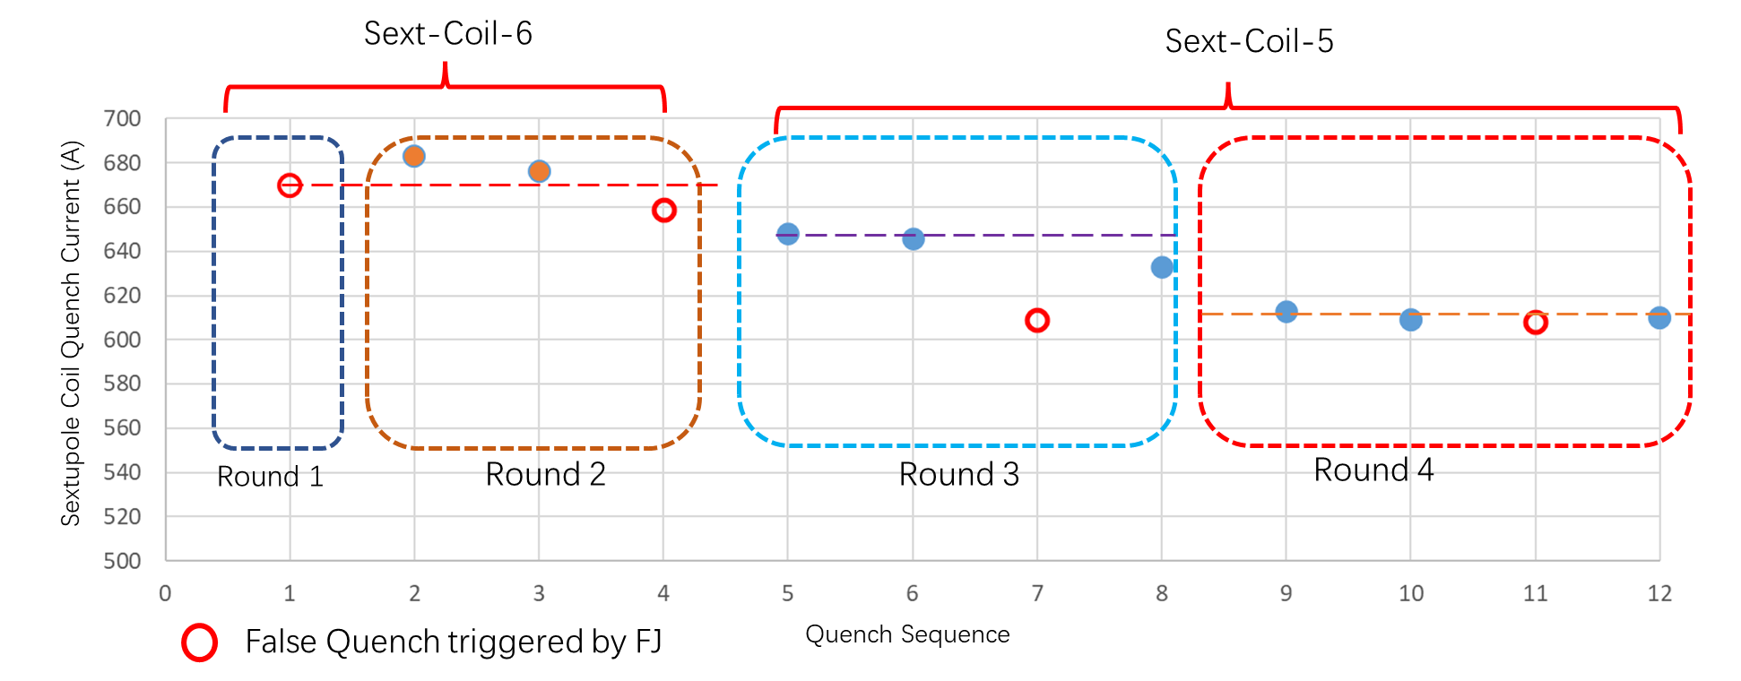
FECR Progresses: 1/2 sized prototype test
96% of operational current
Improper quench (>100 ms) protection interfered by FJ
96%
91%
86%
Sep.2020
Feb.2021
June.2021
Warm-up & cool-down
Warm-up & cool-down
Warm-up & cool-down
reassembly
Improper quench protection caused performance degradation in Coil-6
Unknown degradation in Coil-5 (to be replaced with spared)

Slide 24
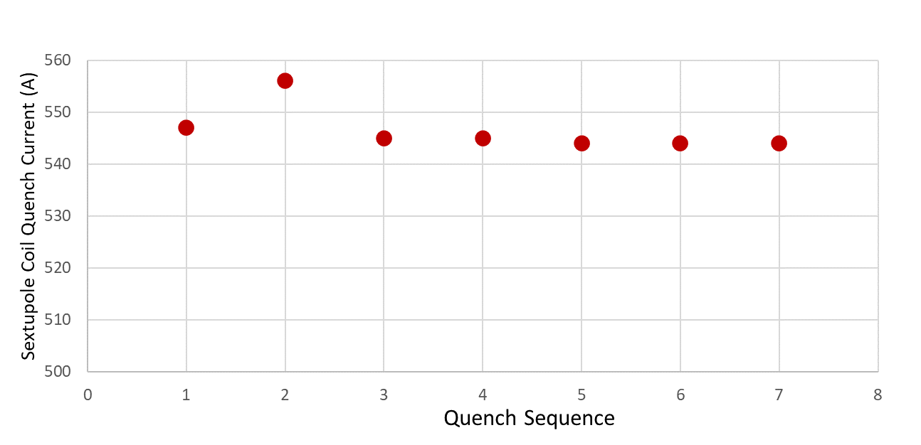
FECR Progresses: 1/2 sized prototype test
Sext + Solenoid training
78%
~78% of operation current
77%
77%
Sep.2020
Feb.2021
June.2021
Warm-up & cool-down
Warm-up & cool-down
reassembly
Round 2
Round 3
Round 4
Systematic training quenches in Coil 6 as performance degradation after late quench protection
No indication of further degradation in Coil 6

Slide 25
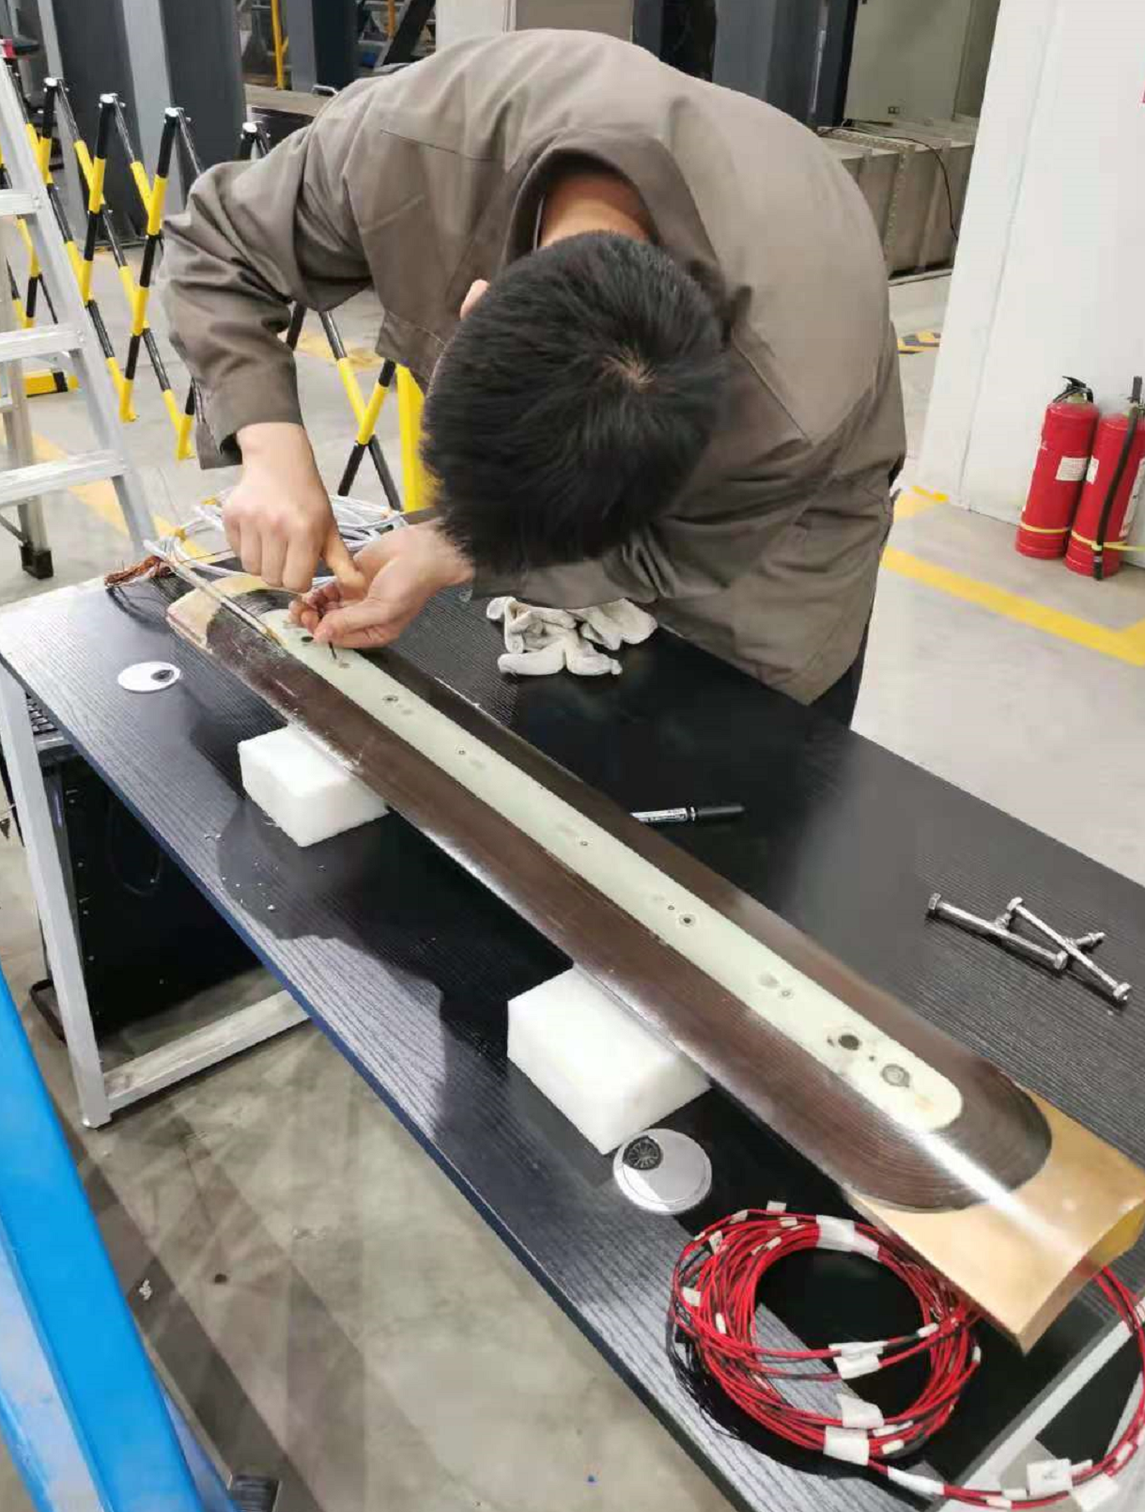
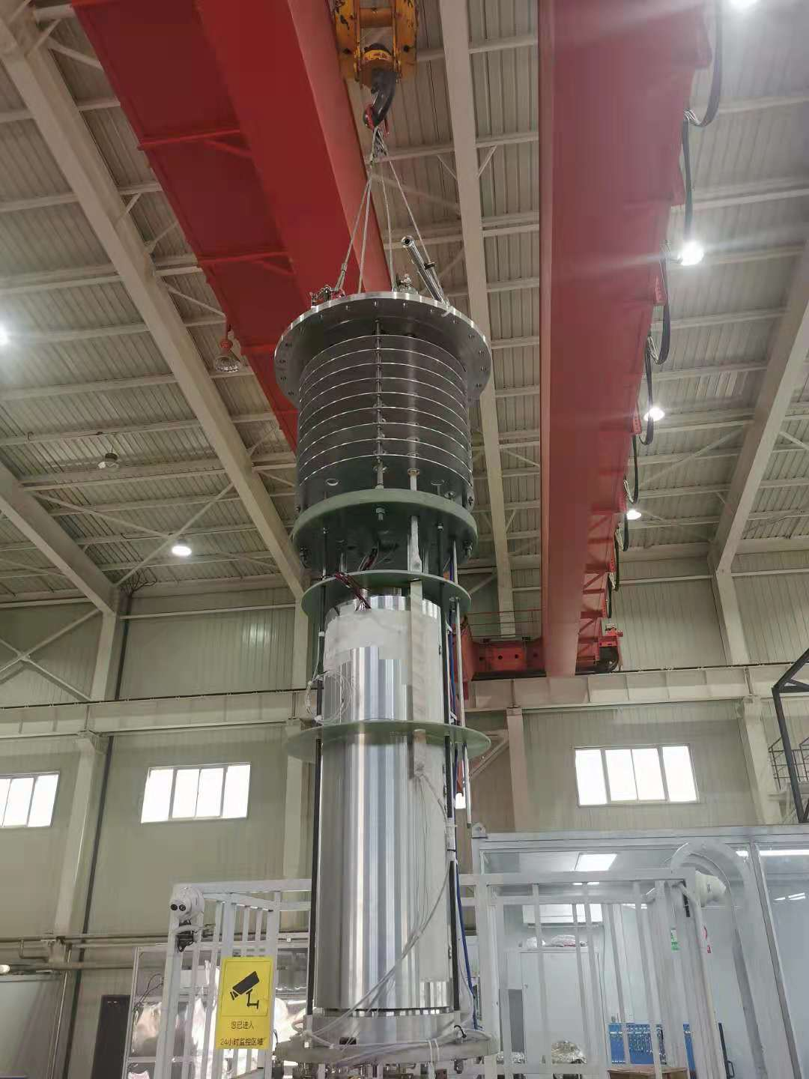
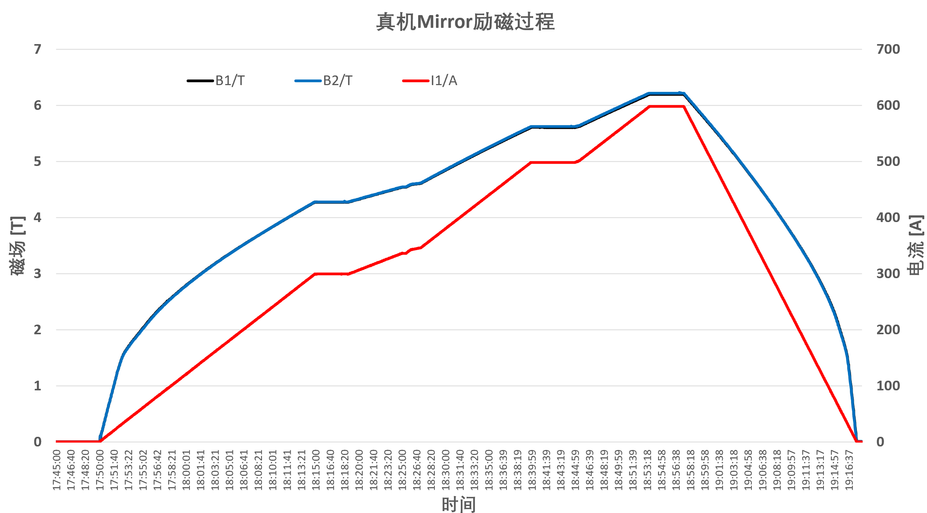
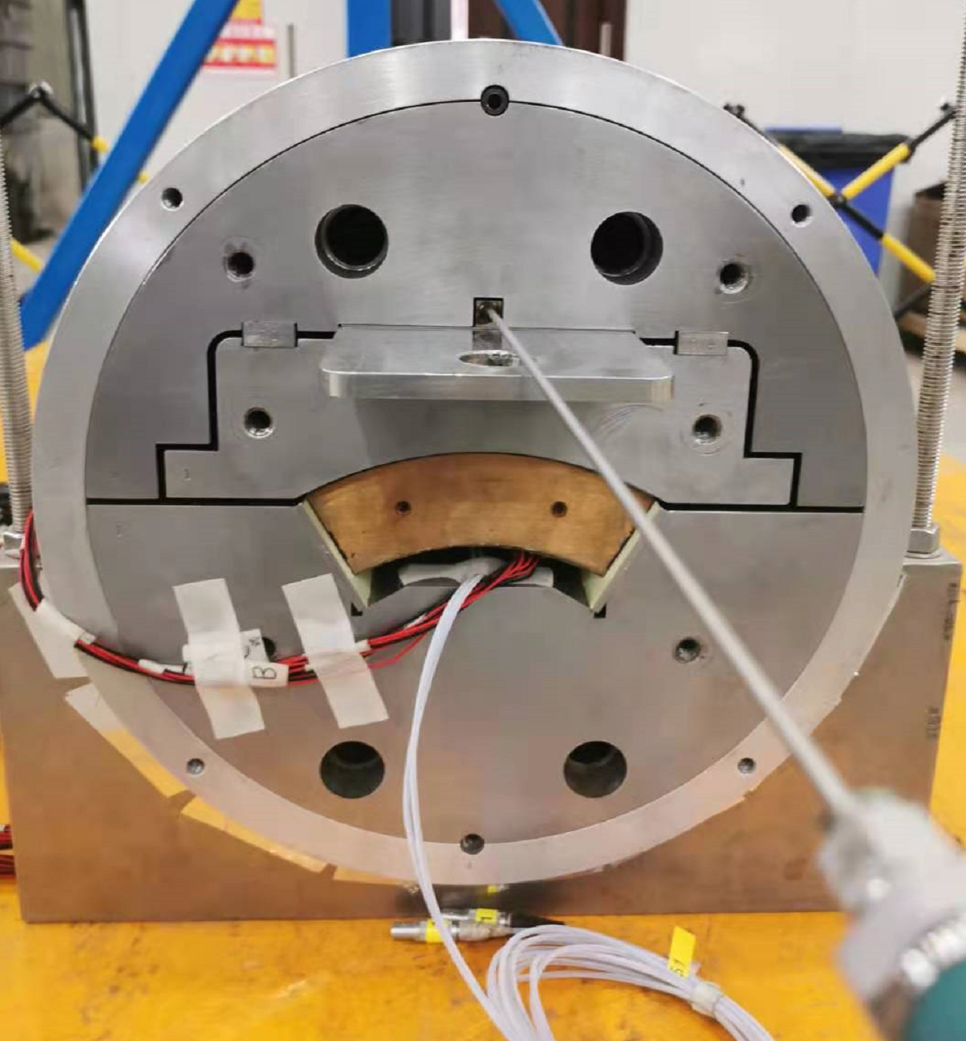
FECR Progresses: Full-sized Sextupole Coil Test
Test of full-sized sext. coil
85%
Pole Field (T)
Current (A)
85% of operation current
Tested full-sized mirror structure
Full-sized tested to 85% design current with no quench
Single coil performance demonstrated
July.2021

Slide 26
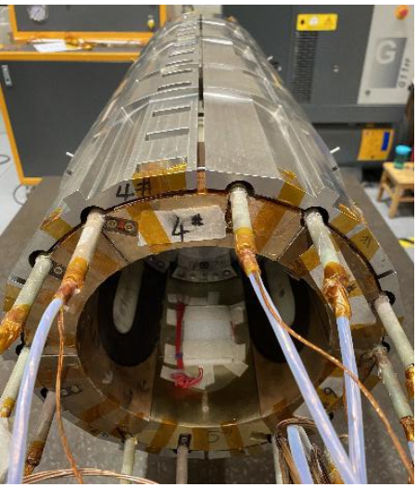
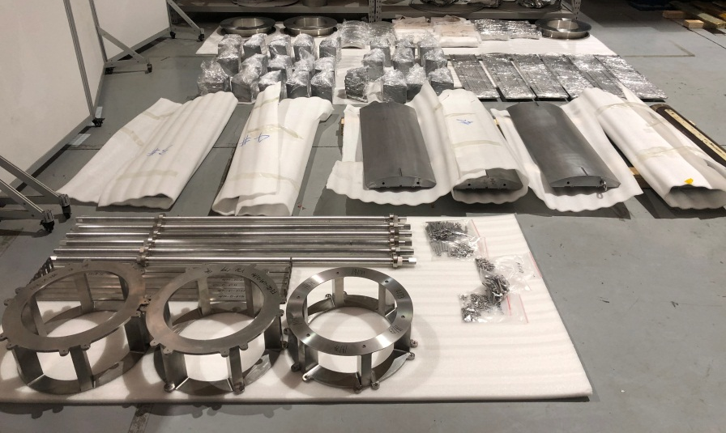
FECR Progresses: Full-sized Coldmass
COIL-PACK
SUBASSEMBLY
Ready for final assembly
AXIAL RODS
(Strain Gauged)
SHELL-YOKE
SUBASSEMBLY
YOKES
SOLENOID
STRUCTURE
SUBASSEMBLY
LOAD-KEYS
2021-2022

Slide 27
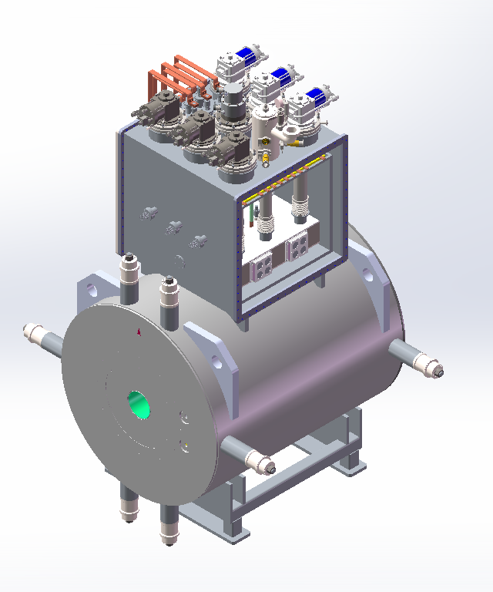
FECR Progresses: Cryogenic System
Current leads
Key parameters of FECR Cryogenic System
Cryocoolers
Parameters | Value | Note
Operation Temp. (K) | 4.3 K
Magnet Cooling | LHe bathing and “0” boiling-off
Stored Energy (MJ) | ~1.6 | 100% currents
Required heat load (W) | ≥ 12 | ~2 W static at 100% currents
Warm Bore (mm) | Ø162
LHe Volume (L) | ~330
Cryocoolers | 6 two-stage + 1 single stage coolers | Cold service enabled
Dimension (mm) | L1456×Ø1200×H2690
Total weight (ton) | ~6.1
Quench valve
Upper He Vessel
Adjustable
Suspension
2021-2022

Slide 28
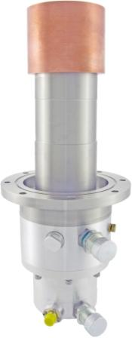
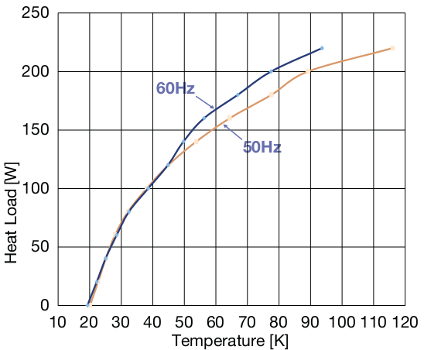
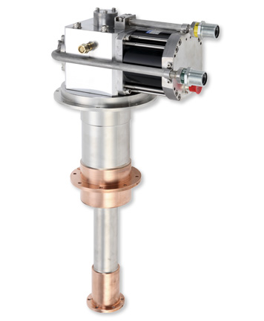
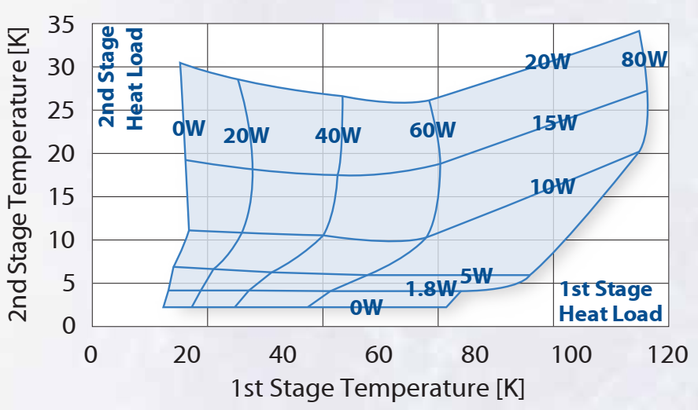
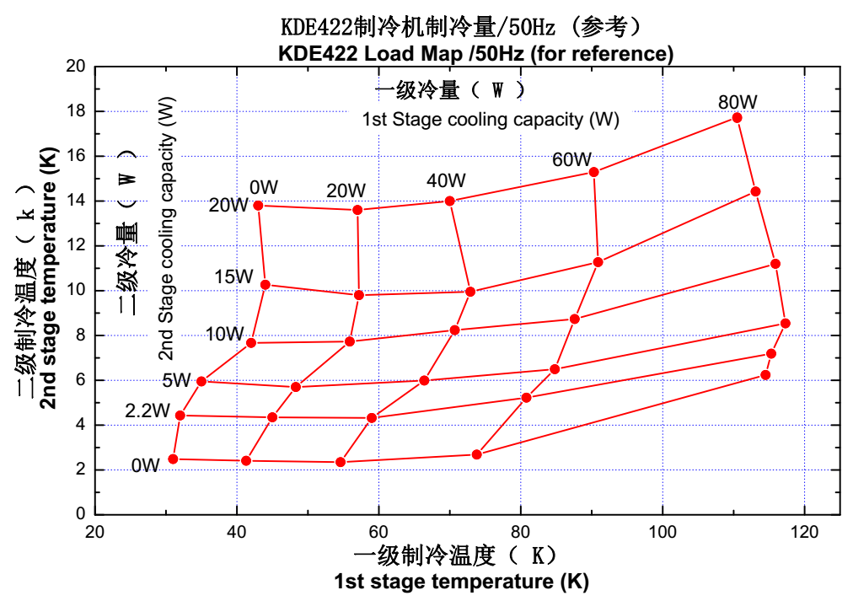

FECR Progresses: Cryogenic System
Sumitomo
Sumitomo
CH-110
3 × RDE-418D4
Nanjing KEDE
High power GM Cooler:
10 months continuous stability and reliability checking-test
3×KDE422 coolers ~6.6 W@4.2 K cooling capacity
3 × KDE422

Slide 29



FECR Progresses: Microwave System test with SECRAL-II
45 GHz Microwave System for FECR
2017-2018
45 GHz/20 kW microwave transmission system based on Quasi-optical design
First 45 GHz ECR plasma with SECRAL-II ion source
Efficient transmission and coupling demonstrated
J. W. Guo, et al., AIP Conference Proceedings 2011, 090001 (2018)

Slide 30







FECR Progresses: Microwave System Design
Quasi Optical
Oversized
WG

Slide 31





FECR Progresses: Plasma Chamber Cooling
Chamber burnt with SECRAL-II
Typically：>7 kW
Chamber burnt with VENUS
1 kW μW~1.25 MW/m² heat sink
LCW pressure of 6 kg/cm²，water BP =150~160℃
T. Thuillier, et al., Rev. Sci. Instrum. 87, 02A736 (2016)

Slide 32





FECR Progresses: Plasma Chamber Cooling
 | P_{rf} (kW) | T_{max} on Al wall | T_{max} of water at the hottest point
1 | 10 ：averagely distributed | 174℃ | 88℃
2 | 10：Gaussian distributed | 159℃ | 78℃
3 | 15：Gaussian distributed | 229℃ | 107℃
4 | 20：Gaussian distributed | 299℃ | 137℃
Water flow rate: 7 L/min with micro-channel
Water temperature distribution at the chamber wall of weakest plasma confinement point
Micro-channel structure of 0.4 mm×20
J. W. Guo’s talk @ECRIS 2020

Slide 33


FECR Progresses: Plasma Chamber Demo with SECRAL-II
Continuous operation of ~100 eμA Kr²⁸⁺ for 13 days with 6.0 kW microwave power
Robust chamber cooling enables long-term reliable operation
See Liangting Sun’s talk on Monday, Sept. 20

Slide 34





FECR Progresses: Plasma Chamber for FECR
Maximum permissible operating power exceeds 25 kW
Chamber ID:140 mm, Microchannel:0.4 mm *20, Channel height:1.5 mm, Flow rate: 15 L/min
T _{max} ：272 ℃
T _{max} ：272 ℃
T _{max} ：128 ℃
B
A
Plasma
A
B
Cross section
Chamber-wall
Water

Slide 35

FECR Progresses: Plasma Chamber for FECR
FECR
Chamber
Key Parameters | FECR Chamber | SECRAL-II Chamber
Max. Microwave Power | 25 kW | 12 kW
Max. Localized Power Density | 20 MW/m² | 10 MW/m²
Chamber ID | Ø140 mm | Ø125 mm
Chamber OD | Ø156 mm | Ø136 mm
Length | 1225 mm | 887 mm
Microchannel region | 15×15.6×1.5 mm³ | 15×15.6×1.0 mm³
Fins | 0.4 mm×19 | 0.4 mm×19
Channel | 0.4 mm×20 | 0.4 mm×20
Inside-wall thickness | 1.5 mm | 1.5 mm
Outside-wall thickness | 1.5 mm | 1.5 mm
Water pressure | 10 bar | 8.9 bar
Water flow per channel | ＞ 15 L/m | ＞ 4.0 L/m
Total water flow | ＞ 50 L/m | ＞ 13 L/m
SECRAL-II
Chamber
1225 mm
887 mm

Slide 36






FECR Progresses: Other Cooling Issues
Directly cooled Injection Baffle
Directly cooled Plasma Electrode
T_{max}~238℃
T_{max}~140℃
Directly cooled Biased Disk

Slide 37





FECR Progresses: System Setup
Injection parts
Extraction Solenoid
Extraction System
Plasma Chamber

Slide 38
FECR Progresses: Time Schedule
½ prototype coldmass success
2021.08
FECR coldmass readiness
2021.12
FECR on test bench
2022.04
FECR magnet completion
2022.02~03
FECR First beam
2022.05~06

Slide 39
Summary
FECR will demonstrate the first 4th G ECRIS using high field Nb₃Sn technology (expected in 2022)
Intense research towards the challenges of FECR find solutions to
  Reliable complicated configuration magnet with single-strand Nb₃Sn wire
  High power high frequency microwave coupling to ECR ion source
  Effective plasma chamber cooling for >10 kW microwave ECR heating
  Cryogenic cooling capacity >10 W@4.2 K with commercial cryocoolers

Slide 40








Acknowledgement
Xi’an Superconducting Magnet Technology Inc.
Coil fabrication
Cold mass fabrication and assembly
Lawrence Berkeley National Laboratory
Coldmass structure design
RIKEN
High temperature oven
Bruker OST LLC.
Nb₃Sn Wire
Western Superconducting Tech Co., Ltd.
Nb₃Sn Wire
Wire braiding
Fruitful discussions and suggestions:
D. Xie, C. Lyneis, D. Hitz, T. Thuiller, T. Nakagawa
O. Tarvainen, E. Ravaioli, X. J. Liu, W. Kasparek
Lanzhou Kejin Taiji New Technology Co., Ltd.
Mirror structure
Mechanical mapping
Shanghai Chenguang Medical Technologies Co., Ltd.
Cryogenic system fabrication and integration
Welcome collaborations and Postdoc research !!
GyCOM Co., Ltd.
Gyrotron microwave generator and microwave transmission solutions

