Slide 1







A cold electron-impact ion source driven by laser-induced electron emission
New opportunities for radioactive molecular beams?
Jochen Ballof, Mia Au, Katerina Chrysalidis, Christoph Düllmann, Valentine Fedosseev, Eduardo Granados, Reinhard Heinke, David Leimbach, Bruce Marsh, João Pedro Ramos, Annie Ringvall Moberg, Sebastian Rothe, Thierry Stora, Shane Wilkins, Alexander Yakushev

Slide 2
ISOLDE and available beams

Slide 3
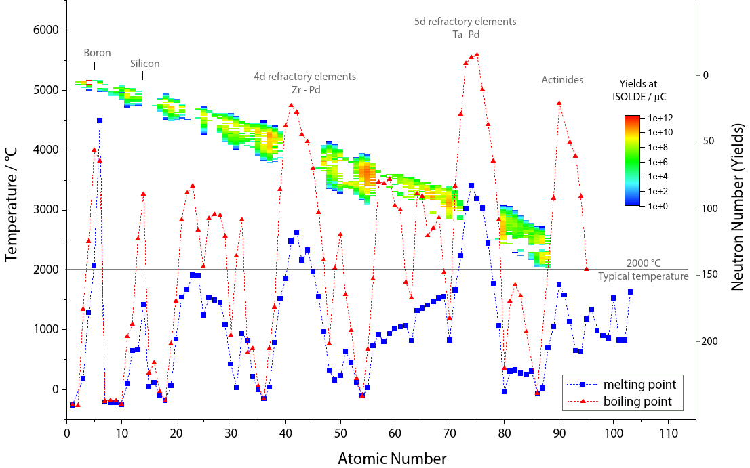
(Un)available beams at ISOLDE
Available beams
  more than 1000 radioisotopes
  74 chemical elements
  lightest element: Helium
  heaviest element: Uranium
  half-lives down to ~ ms
Unavailable beams
  Many refractory elements
Boron
5d refractories
Ta - Pd
Silicon
4d refractories
Zr - Pd
Actinides
Plot proposed by S. Rothe

Slide 4
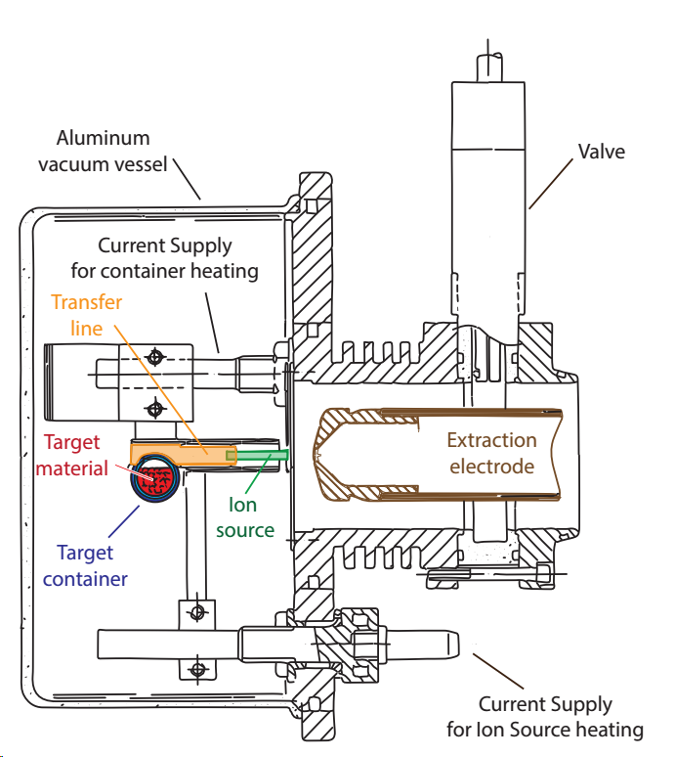
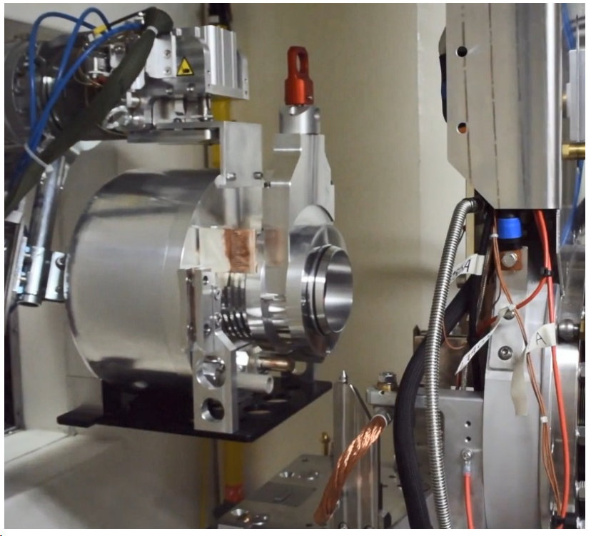
ISOLDE target and ion source unit
Principle design
2 cm
Part of the
target station

Slide 5
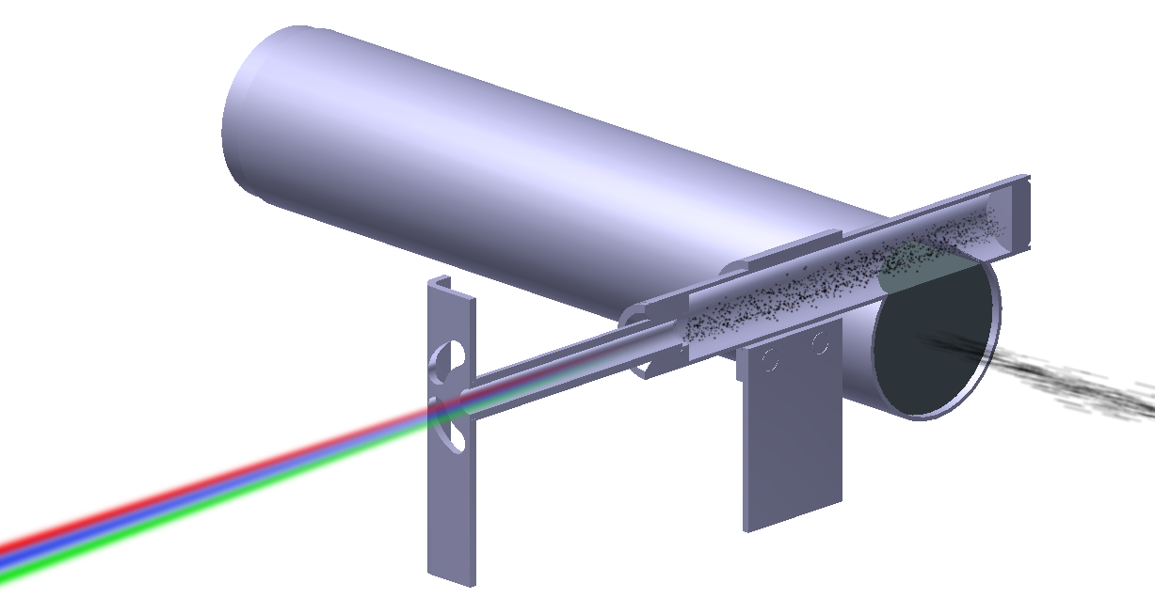
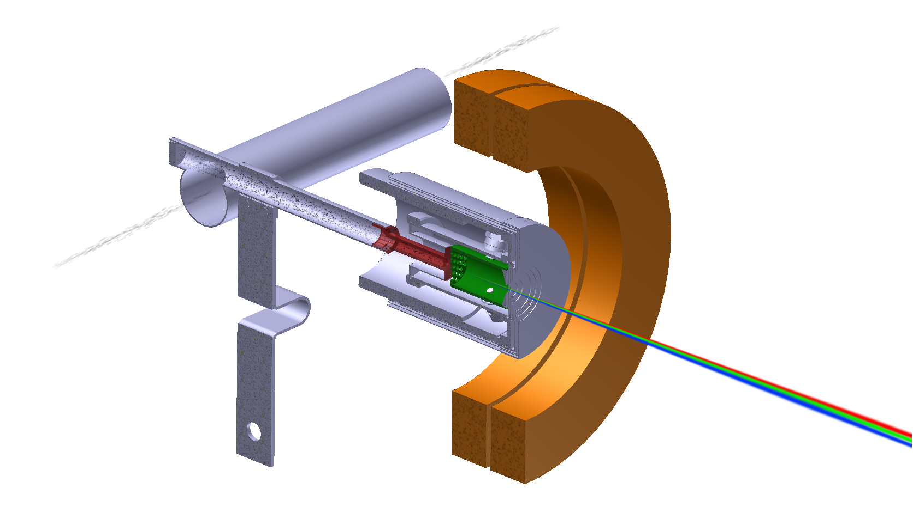
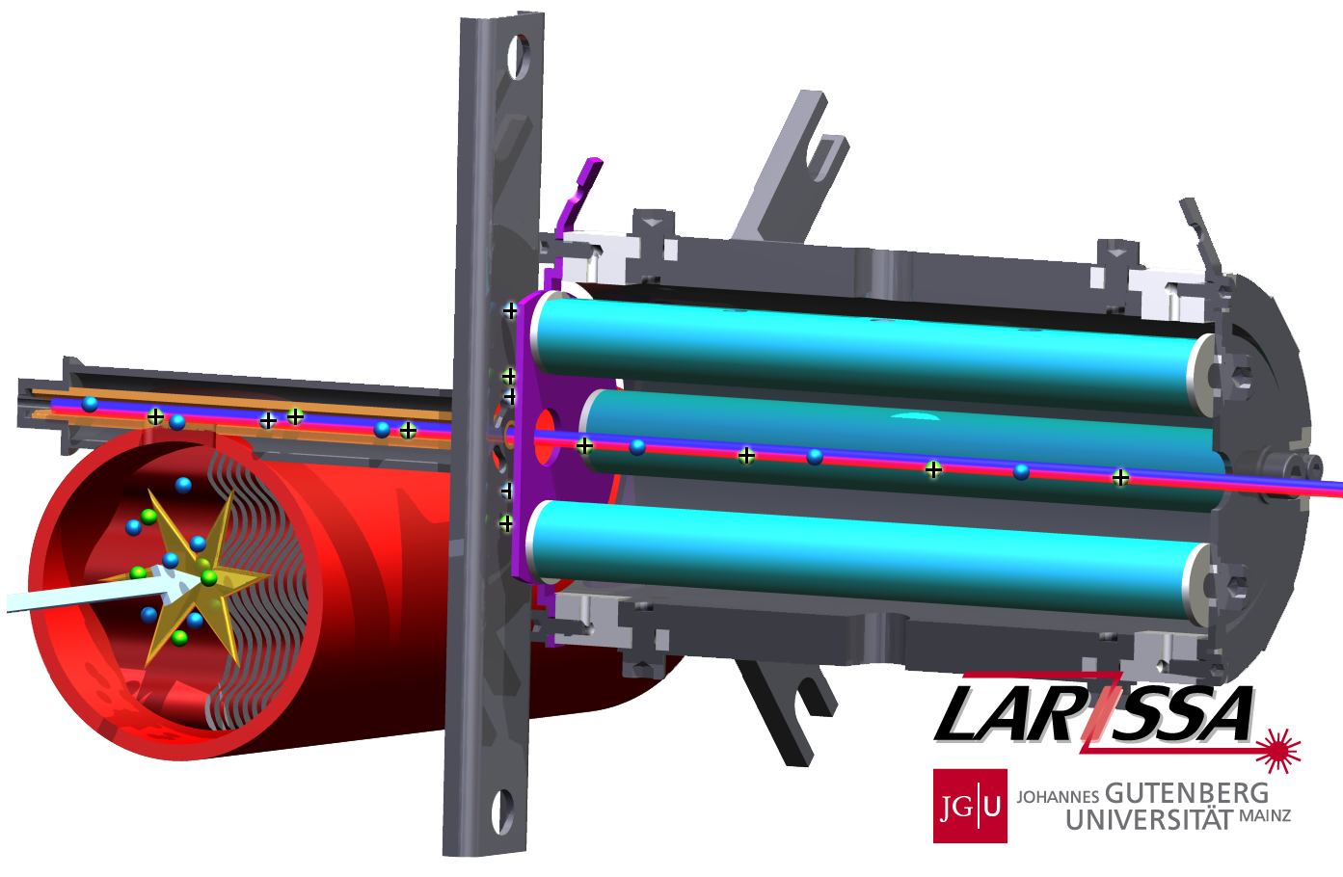
Ion sources at ISOLDE
Frequently used ion sources (1+)
Ion source requirements
  1. Compact and radiation hard
    Integrated in the target unit
    handling by robot required
  2. Withstand pulsed gas loads
    pulsed primary beam
  3. Efficient
  production of radio isotopes is limited
  4. Rapid
  low residence and ionization times
  decay of radio isotopes
  5. Chemical selectivity (desired)
  No (or less efficient) ionization of radiogenic impurities
hot cavity ionizer (with RILIS)
surface or resonant laser ionization
VADIS
electron impact ionization
thermionic electron emission
LIST ion source:
Hot cavity, repeller, RFQ ion guide
graphics by Y. Martinez-Palenzuela

Slide 6
Molecular beams

Slide 7
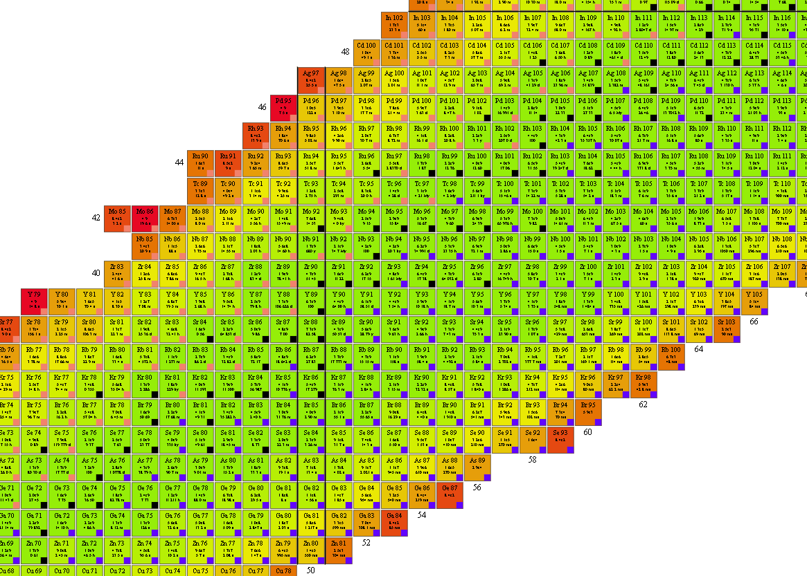
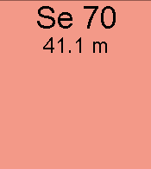



Molecular ISOL beams
SeCO
Beam purification
  Shift the mass region to a higher mass to avoid
  isobaric contaminants. e.g. ⁶⁶GeS, ¹³³SnS, ⁷⁰SeCO
Beam extraction by In-situ volatilization
  Elements with very low volatility are not released
  Reactive elements can be chemically trapped
  e.g. ⁸BF₂, ¹⁵CO
To study the radioactive molecules
  Fundamental properties, e.g. ²²³RaF
+ CO
Target material
https://web.mit.edu/radiomolecules/

Slide 8

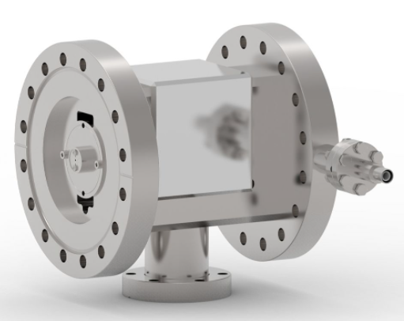
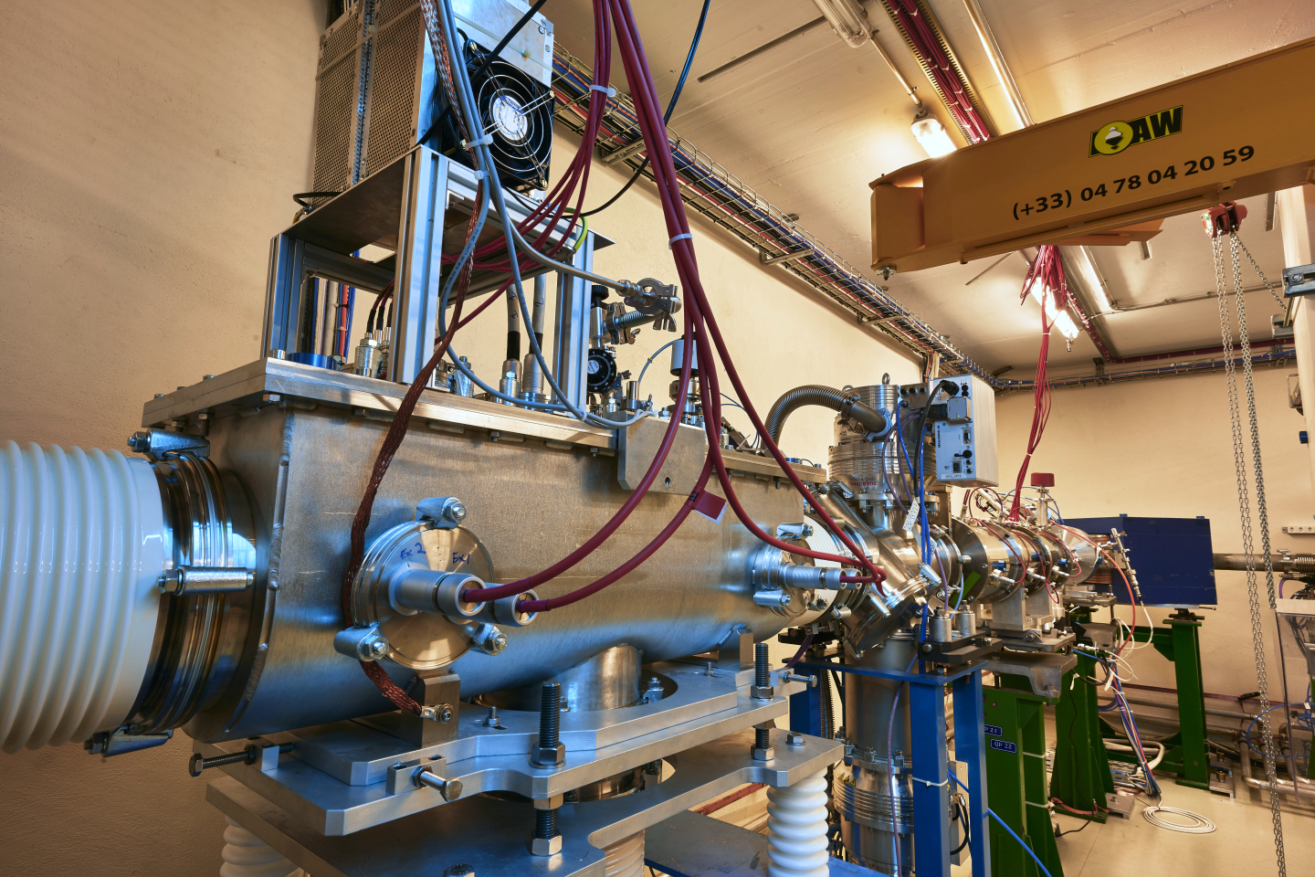
Molecule formation in RFQ structures
Ion traps for molecular formation/dissociation
  Development for gas injection into RFQ for in-trap chemistry
  Development of mass spectrometer and ToF detection for identification after RFQ
In-source laser ionization of molecules
Mia Au
DREEBIT Wien filter
M. Fan et al, Optical mass spectrometry of cold RaOH+ and RaOCH3+, PRL 126, 23002 (2021)
A. Ringvall Moberg et al, Time-of-Flight study of molecular beams extracted from the ISOLDE RFQ cooler and buncher NIMB 463, 522 (2020)
Offline 2 RFQ

Slide 9
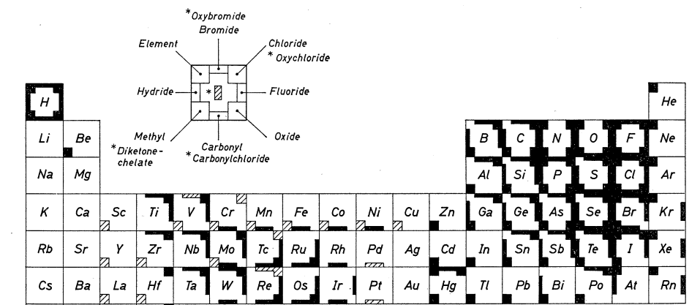
Volatile carrier molecules
Volatile carrier compounds
Volatile carriers known for all reactive elements
Many are not compatible with high-temperature conditions
U. Köster, (Im-)possible ISOL beams,
Eur. Phys. J. Special Topics 150, 285 (2007)
Element not available
as beam at ISOLDE
G. Herrmann, Ark. Fys. 36, 111 (1967)

Slide 10
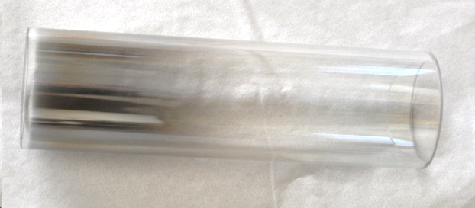
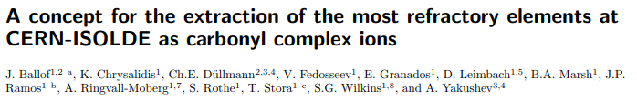
Do we have to operate at the highest temperatures?
Cold targets?
Cold ion sources?
Nano-sctructured target material (CaO) operated at ambient temperature
  fast diffusion in nano-materials and possible release by recoil effect
Foil target at ambient temperature, thermalizing recoils in gas atmosphere
  no diffusion required
Cold RF-heated plasma ion sources at ISOLDE:
  COMIC / Helicon
  For delicate molecules: favour breakup over ionization
A. Kronenberg et al, NIMB 266, 19 (2008)
J.P. Ramos et al, NIMB 376, 81 (2016)
Ionization chamber of Helicon plasma source
after operation with Mo(CO)₆
Ion source development required
J. Ballof et al., preprint, https://arxiv.org/abs/2108.01745

Slide 11
The photo-cathode electron-impact source
Decoupling electron-emission and temperature

Slide 12
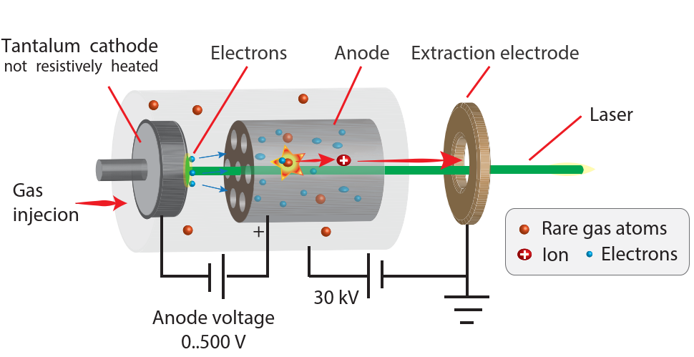
Proof-of-principle setup 1: Ta cathode
Laser
Pulse length | 265 fs
Power | ~ 4.5 W
Wavelength | 343 nm
Rep. Rate | 50 kHz
Beam diameter | ~ 6 mm
Beam spot on cathode | 1.5 mm
Cathode
Material | tantalum
Anode-cathode gap | 1.5 mm

Slide 13
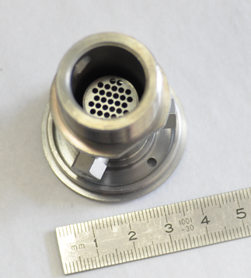
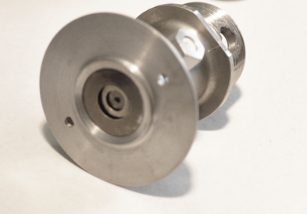
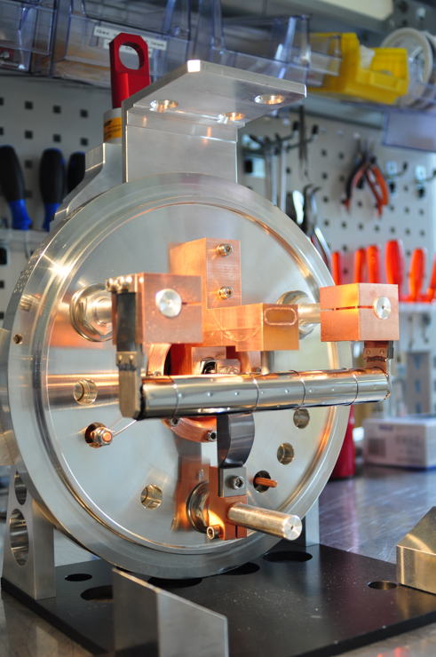
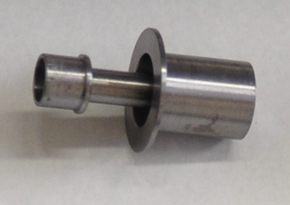
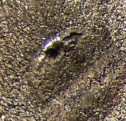
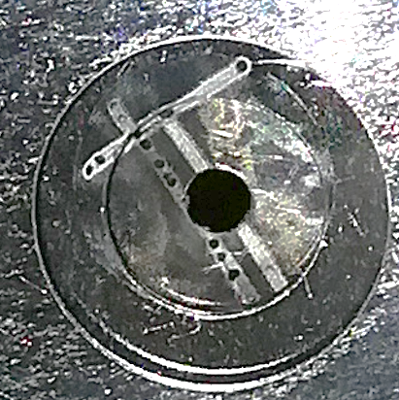
Proof-of-principle setup 1: Ta cathode
Target assembly
Before operation / during assembly
Anode assembly
Ta-cathode
Extraction side
2 mm
After operation
Laser-induced craters
on the cathode surface
during focusing attempts
Traces from laser-alignment on the extraction side

Slide 14
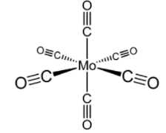
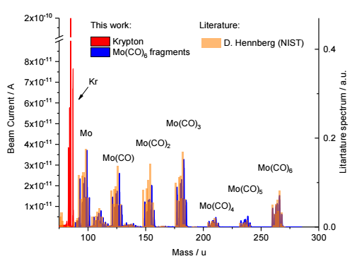
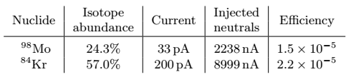
Proof-of-principle setup 1: Ta cathode
Fragile carrier compound Mo(CO)₆
Measured mass spectrum
FBDE: 1.7 eV
IP : 8.3 eV
Vapour pressure:
25 Pa (ambient temp.)
Measured efficiencies

Slide 15
Proof-of-principle setup 1: Ta cathode
Results from first operation
  Fragile compound Mo(CO)₆ could be ionized in the setup
  Efficiency of Mo(CO)6 is in the same order of magnitude as Kr
  Mechanism of electron production unclear: Photo-electric effect or thermionic emission?
  Efficiency is very likely limited by electron current:
  ~ 100 nA instead of ~ 100 mA with a hot VADIS
Further focusing attempts
  focusing the beam diameter from ~ 6 mm to below 1.5 mm caused cathode damage

Slide 16
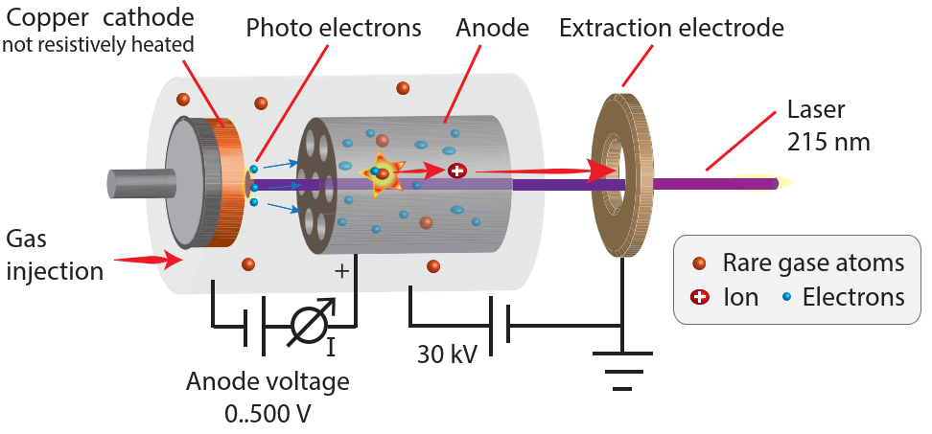
Proof-of-principle setup 2: Cu cathode
Setup optimized for photo-electric effect
Laser
Pulse length | 50 ns
Power | ~ 0.01 W
Wavelength | 215 nm
Rep. Rate | 10 kHz
Beam diameter | ~ 1.5 mm
Cathode
Material | copper
Anode-cathode gap | ~ 3 mm

Slide 17
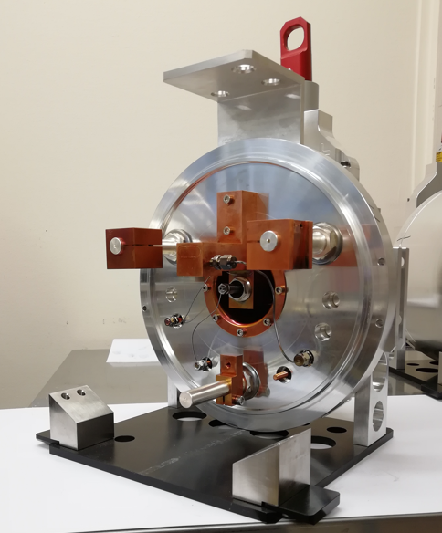
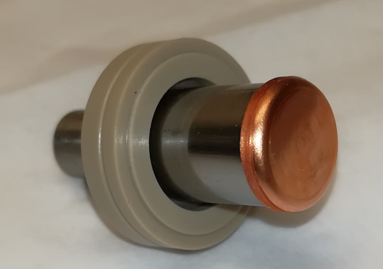
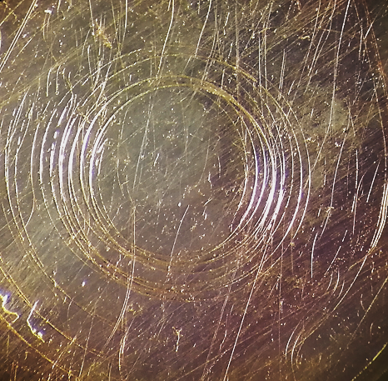
Proof-of-principle setup 2: Cu cathode
Photo-cathode after operation
Target assembly
2 mm
Cap made of oxygen free copper foil (OFHC)
PEEK insulator
No visible difference before and after operation
No polishing, nor special cleaning or bake out

Slide 18
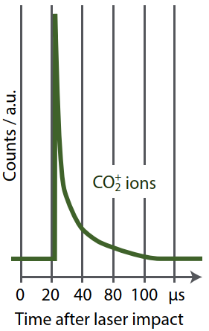
Proof-of-principle setup 2: Cu cathode
200 V
Results from Cu-cathode operation
  Source operated for 6 days (24/7)
  Kr and CO₂ can be ionized with a photo-cathode electron-impact ion source
  No electron emission with 440 mW of blue light (430 nm) confirms photo-electric effect
  Source magnet increased efficiency by factor ~8
  Estimated quantum efficiency: 3 x 10⁻⁴
  Decomposition of CO₂ degrades the photo-cathode.
    Estimated decrease of 65% in 66 hours, pressure ca. 1 x 10⁻⁴ mbar
    Typical hot VADIS: 1 x 10⁻⁶ mbar (injected gas)
Injected gas | Ionization efficiency
Kr | 4 x 10⁻⁵
CO₂ | 2 x 10⁻⁵

Slide 19
How to increase the efficiency?
Parameter | VADIS Thermionic emission | Photo-cathode prototype
Electron current | ~ 100 mA | ~ 0.1 to 1 µA
Ionization efficiency Kr | 30 % | 0.004 %
Diameter electron emitter | 1.2 cm | 0.15 cm
Increase of electron current required
First approximation: ionization efficiency increases proportionally with electron current
Ionization efficiency
ε ∝ n_{e} x σ x f
L. Penescu et al, RSI 81, 02A906
electron density
ion extraction
electron focusing
other effects
ionization cross section

Slide 20
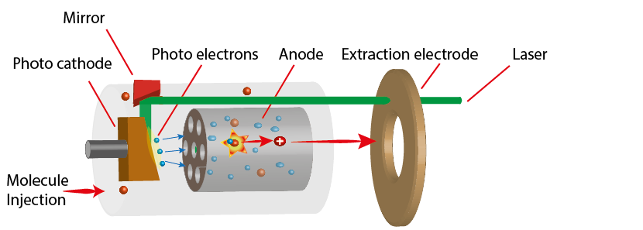
Next Prototype?
Proposal for a future prototype:
perpendicular illumination
  Resolves space charge limitations
  Beam path developed for the PI-LIST ion source
Efficiency estimate by scaling of space-charge limited electron currents
Estimated parameters to reach 1% ionization efficiency:
Parameter | Next prototype | Tested prototype
Electron emitter diameter | 12 mm | 1.5 mm
Anode-cathode distance | 3 mm | 1.5 mm
Repetition rate | 2 MHz | 50 kHz
Wavelength | 257 nm | 343 nm
Power | 3.7 W | 4.5 W
Mean electron current | 90 µA | 90 nA
Ionization efficiency Mo(CO)₆ | 1% | 0.001%
R. Heinke et al, Hyperfine Interactions 238, (2017)
J. Ballof et al., preprint, https://arxiv.org/abs/2108.01745

Slide 21
Conclusion
Electron-impact ion source can be driven by a photo-cathode
Photo-cathode can cope with typical ISOL conditions and gas-loads (~ 10⁻⁶ mbar)
Ionization efficiency (proof-of-concept experiment) 0.001% for Mo(CO)₆
Upgrading laser-system and source geometry could yield efficiencies of at least 1%
Impact on molecular beams
Decoupling of electron production from ion source temperature
First ISOL ion source for delicate molecules
Could facilitate refractory beam extraction and extract molecules for fundamental physics research

Slide 22
Thank you for
your attention!

Slide 25

The ISOL process
Isotope Separation On-Line
  Simultaneous production and separation of radioisotopes
  First applied in 1967 at CERN
  Target and ion source unit
  Analyzing magnet m/z ratio
  Proton beam of 1.4 GeV
  penetrates whole target
  Mass separated beams

Slide 26

The ISOL process
Molecular beam extraction
taking the example of ⁸BF2
  Molecule formation
SF₆
  ⁸B ⁸BF₃
Boron is refractory and reactive
Can‘t be extracted as atom -> more volatile molecule needed
  Effusion
  Diffusion through solid (slowest step)
  Ionization
  ⁸BF₃ ⁸BF_{x}⁺
  Proton
  Production of nuclide
  Fragmentation of ¹²C ⁸B
Yield =
N₀
ε_{release} (T_{1/2})
ε_{form}
ε_{ion} ε_{other}
  Thick target container 20 cm x 2 cm ø
  Multiwalled carbon nanotubes
  SF₆

Slide 27
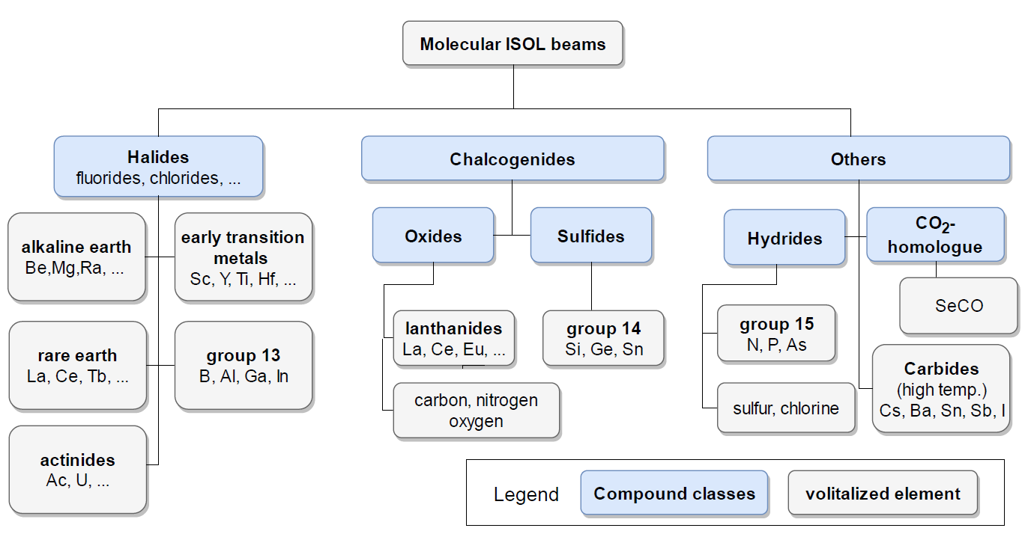
Extracted molecular beams
J. Ballof, PhD thesis (2021)

Slide 28
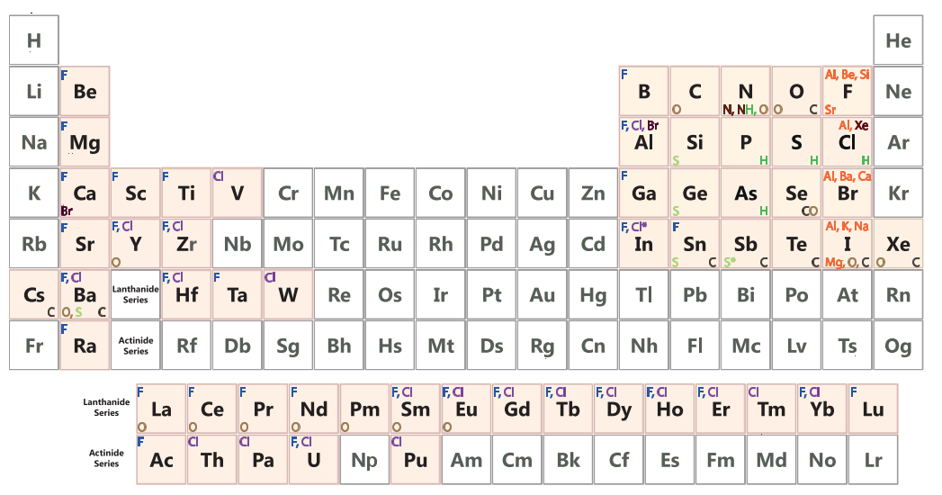
Extracted molecular beams

Slide 29
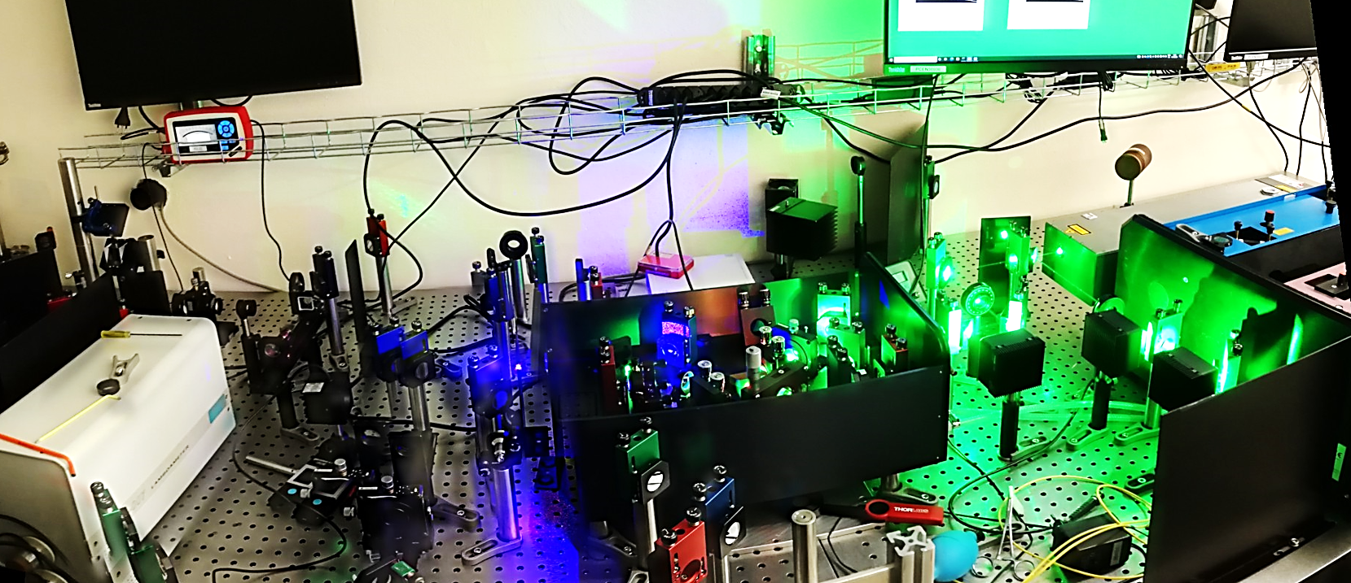
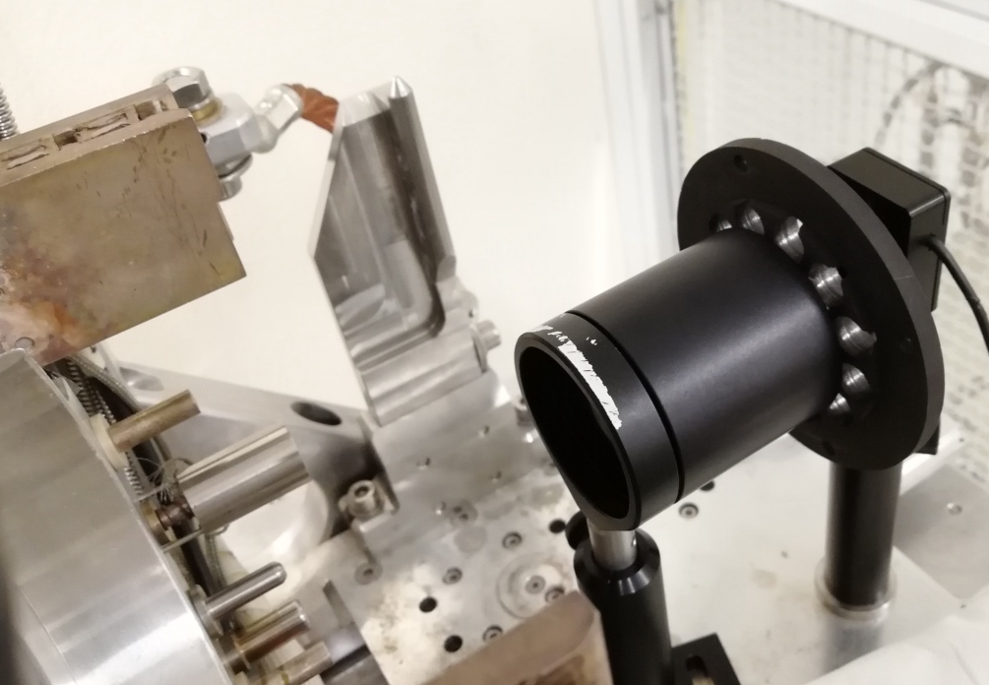

Proof-of-principle experiment 2: Cu cathode
Laser setup
IC
BIBO
BBO
Nd:YAG
IC doubled
Ti:Sa
861 nm
Ion source
532 nm
430 nm
215 nm
Estimation of transmission onto the cathode (ca. 35%)
2 mm

Slide 30
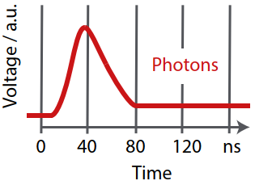
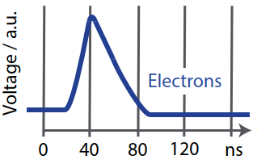
Proof-of-principle experiment 2: Cu cathode
Time structure
Magnetof detector
by photodiode, blue light
No significant broadening of electron bunch in comparison to laser pulse
Single ion bunch, in contrast to laser ionization in a VAD(L)IS
Offset between laser pulse and electron release not measured

Slide 31
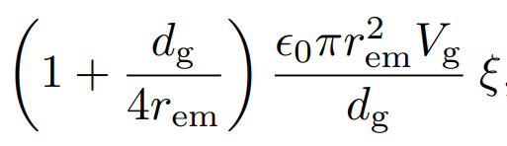

How to increase the electron density?
Geometry required in which electron current is not space-charge limited
Laser system required that can produce the required currents
For short-pulse lasers
(i.e., electron flight time >> laser pulse length)
Anode-Cathode gap length
Anode voltage
maximum mean electron current without virtual cathode formation
laser pulse repetition rate
A. Valfells et al, Phys. Plasmas 9, 2377 (2002)
electron emitter radius

Slide 32
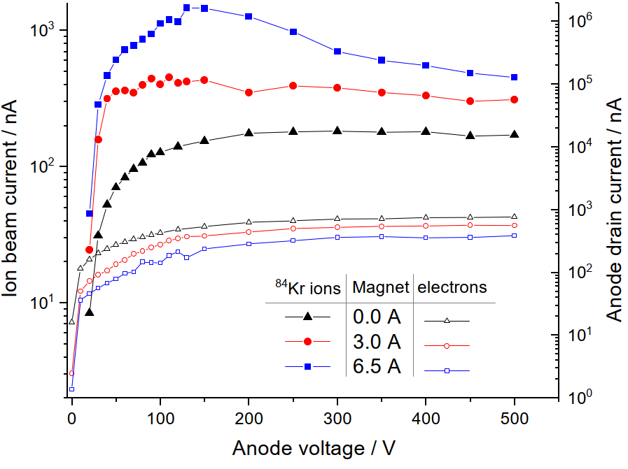
Proof-of-principle experiment 2: Cu cathode

Slide 33
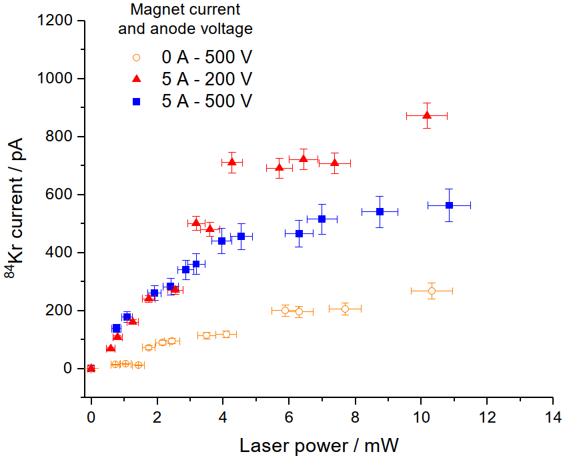
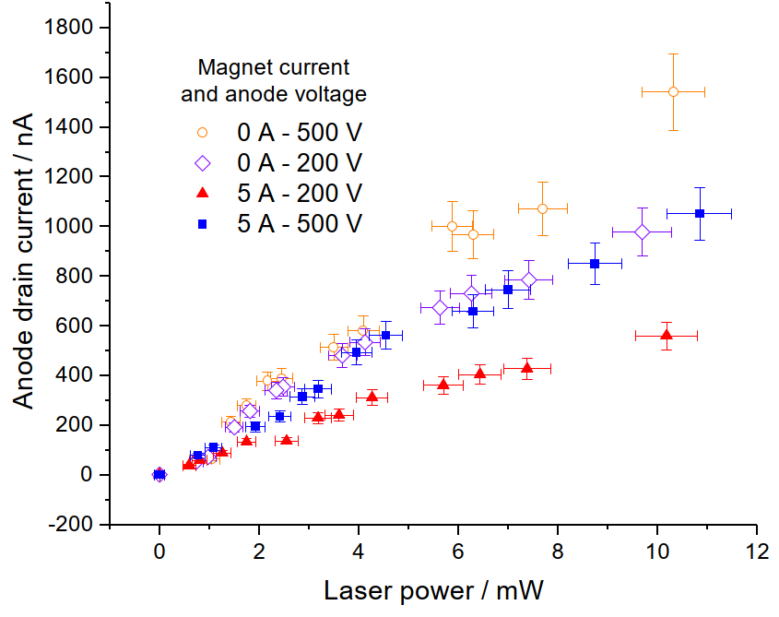
Proof-of-principle experiment 2: Cu cathode

