Slide 1
General information
G. Iadarola
ABP Computing Meeting – 16 Apr 2021

Slide 2
New HTCondor e-groups
ABP HTCondor quota remapped on Tuesday
  Single computing group “group_u_BE.ABP.NORMAL”, organized in six e-groups associated to the sections
    batch-u-abp-cei (contains the old e-group: htcondor-u-ICE)
    batch-u-abp-hsl
    batch-u-abp-inc
    batch-u-abp-laf
    batch-u-abp-lno (contains old e-group: htcondor-u-SLAP)
    batch-u-abp-ndc (contains old e-group: LHC-COLL-LSF-users)
Please use the new section e-groups to add new users
  The old e-groups will be discontinued after moving the users to the respective section e-group
2

Slide 3
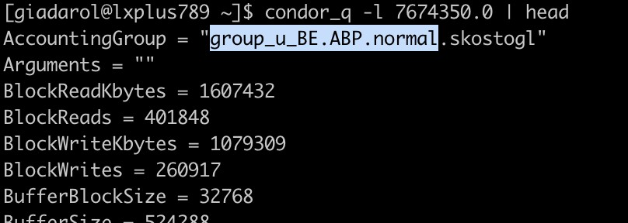
New HTCondor e-groups
You can check that the right computing group is taken into account for your simulations as follows:
It should be automatic unless you force a different group in the submission file
  No issue reported so far
  Let me know if you experience anything strange
3

Slide 4
Beam physics cluster at INFN-CNAF
Discussion have started to prolong the exploitation of the cluster at INFN-CNAF (800 cores) beyond the end of the contract (Dec 2022)
  We could prolong its usage for three more years (paying the energy consumption)
  If some extra funding is available, a few more nodes could be added to compensate for expected “ageing”
  Assuming it will be used mostly for single-node jobs (up to 48 cores) due to end of support of the installed low-latency network
    → OK based on past experience
4

Slide 5
BE department survey on IT services
A survey is being run across the BE department to identify services provided by the IT department on which we rely for simulations and data analysis
  The goal is to put in place a coordinated interface to IT and find synergies with other ATS departments
Some draft slides in the following, for your feedback…
5

Slide 6
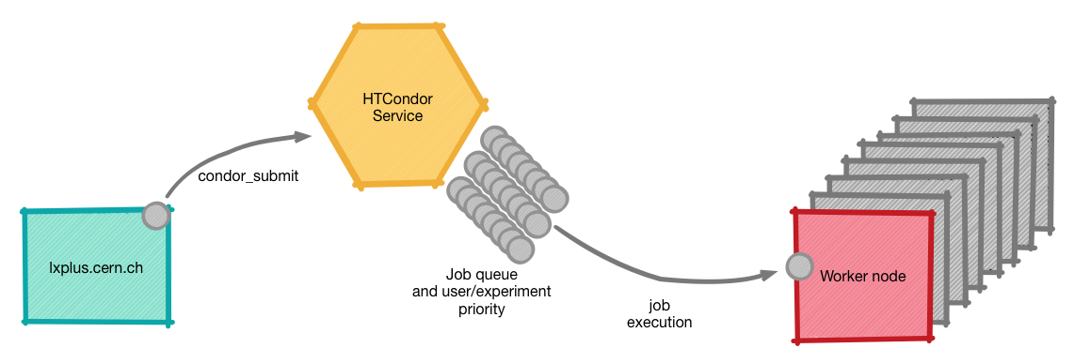
IT services used for numerical modeling
Batch service (lxbatch)
Very large amount of computing nodes managed through the HTCondor system ensuring fair-share access to CERN users (with different priority)
  Jobs submitted by users mostly through lxplus service
  Each job can use multiple cores on the same node but cannot use multiple nodes
Used when many relatively small jobs are required (typically 1-8 cores/job)
  BE-ABP load alone can on occasions reach ~10k cores
More info here
6

Slide 7

IT services used for numerical modeling
HPC service
Used for large jobs (100-1000 CPU-cores) requiring fast communication between nodes (MPI interface)
Cluster dedicated to ATS activities deployed in 2017
Presently features ~4000 CPU-cores (~8000 hyperthreaded)
Equipped with low-latency network
So far, coordination with IT responsibles through the ABP Computing Working Group (in general very good support)
  HPC workshop organized by G. Rumolo (ABP) and N. Hoimyr (IT)
More info here
7

Slide 8


IT services used for numerical modeling
BOINC
Platform for volunteer computing → allows people around the world to offer their PC (when idle) for scientific computing
BOINC service at CERN operated by IT (LHC@home) → used for beam tracking simulations in BE-ABP, as well as by TH department and LHC experiments
Access to a large number of resources (easily 100k jobs in parallel)
Interface is rather complex and rigid
  So far practically tailored to a single kind of simulation (Sixtrack-DA)
  Requires specific functionality on the application side (e.g. checkpointing)
  Difficult to find resources in a ABP for the required follow-up
On our side we are in the process of refactoring the simulation engine and the job-management tools:
  It would be helpful to have IT support to evolve the setup and make it more flexible and easier to maintain, possibly leveraging modern technologies (e.g. containers)
8

Slide 9



IT services used for numerical modeling
Shared filesystems
All services mentioned above rely on shared filesystems to exchange data and programs between the user and the running jobs
Presently using different complementary services:
  AFS filesystem used for lxbatch jobs, interactive work on lxplus and mounted on user’s office PCs
  CephFS, very performant, available only on HPC cluster
  EOS for long term storage (large capacity)
IT planned to phase out AFS by the end of LS2. This required several iteration between the responsible IT team and the ABP Computing Working Group
  Proposed alternatives (mostly EOS) were not suitable for our applications
  Ultimately, the phaseout has been put on hold
9

Slide 10
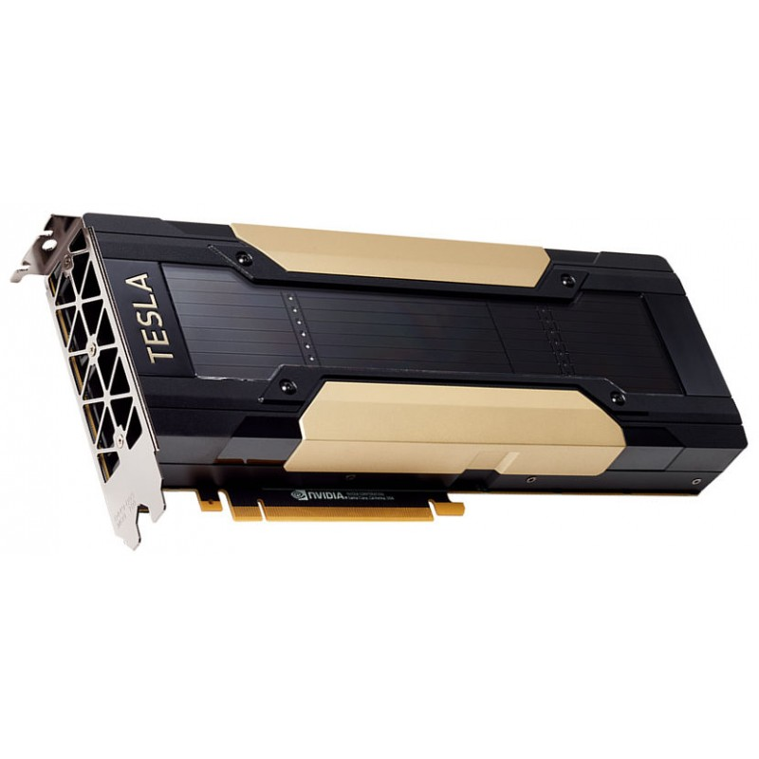
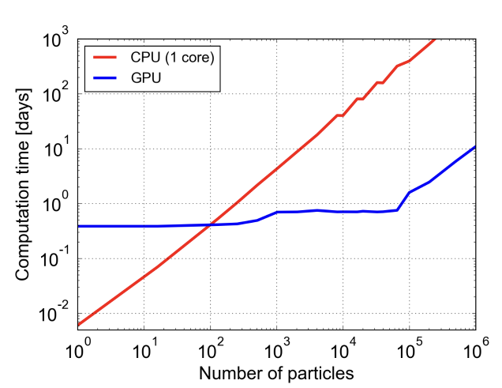
Graphics Processing Units (GPUs)
Thanks to recent code development, beam tracking simulations can exploit large computing power of Graphics Processing Units (gain is significant)
Some GPU cards were deployed in the LXBATCH system over the last two years
  full available capacity is already being exploited
  we could easily exploit more
Useful to know plans and timescale for future upgrades, to plan accordingly
Our applications impose stringent constraints on the type of hardware (double precision performance)
  → need to be considered before procurement!
For 10⁵ particles
1 GPU card ≃ 200 CPU cores!
10

Slide 11
Thanks for your attention!

