Slide 1
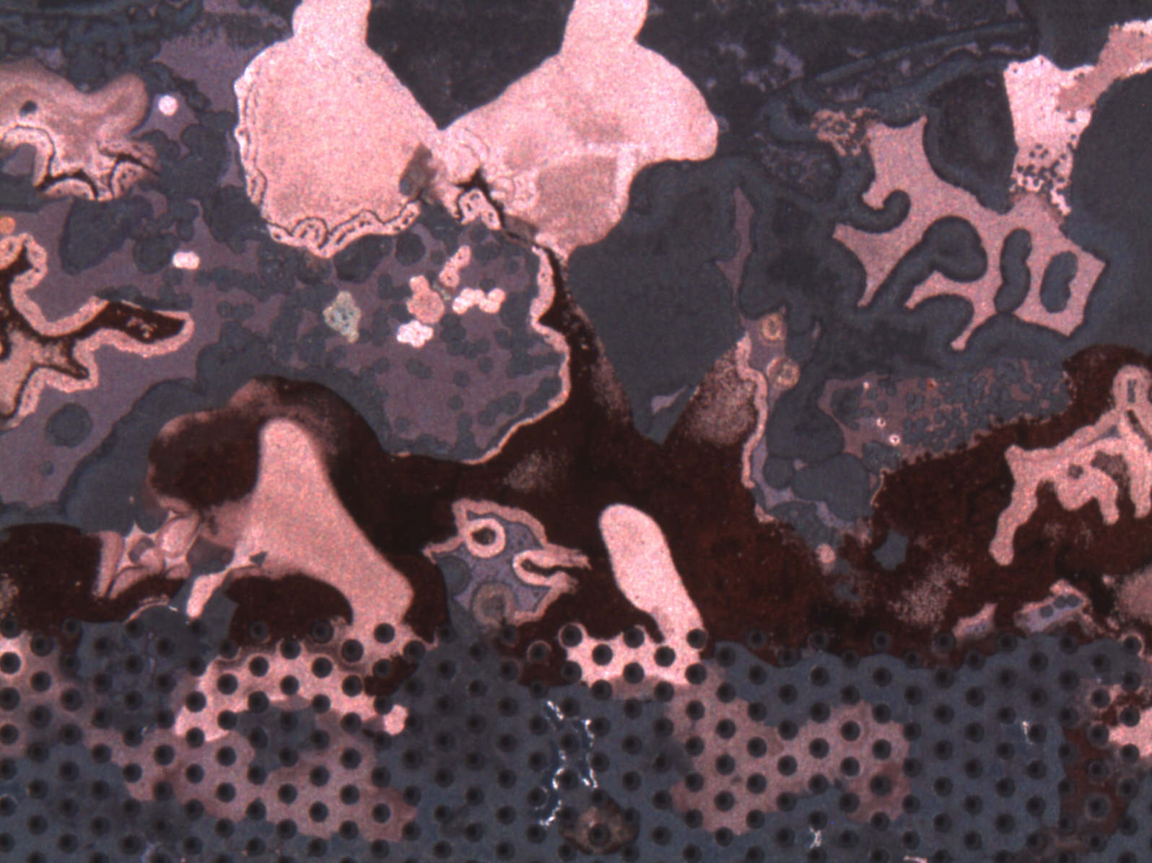
Large volume GEM production
Rui De Oliveira
TE/MPE/EM

Slide 2
Summary
GEM Single mask production process in details
Production at CERN
  New equipments
  New building

Slide 3
Process step by step

Slide 4
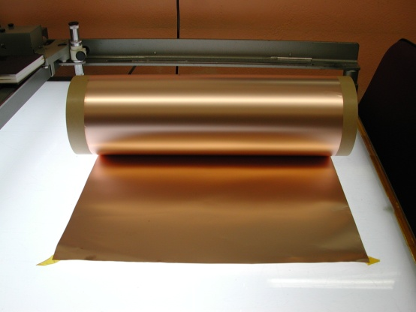
2 suppliers :
Sheldhal (US)
Nippon steel (Jp)
5um Copper
50um Polyimide
CR layer 10nm
5um Copper
Base material
50um adhesiveless copper clad Polyimide
Rolls of 100m x 600mm
Polyimide : APICAL NP or AV

Slide 5
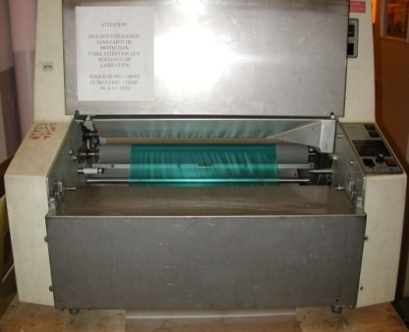
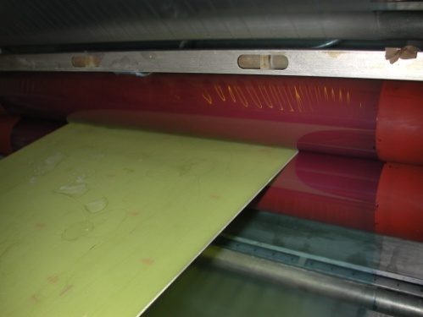
Maximum size 100m x 600mm
Dupont manual laminators
15um resist
15um resist
Photoresist deposition
Optimized process
15um dry resist (KL 1015 – Korea)

Slide 6
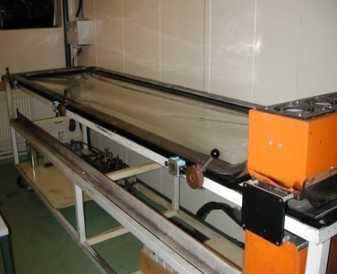
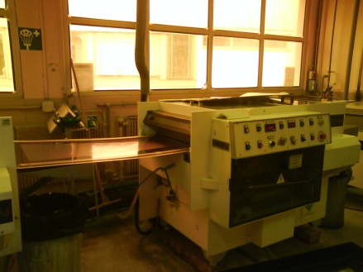
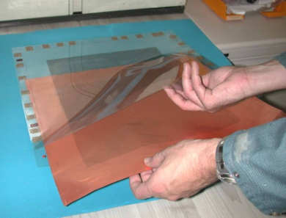
UV exposure
2.2m x 0.6m
Continuous
Development
0.65m
70um
hole
15um resist
15um resist
Photoresist holes patterning
Optimized process

Slide 7
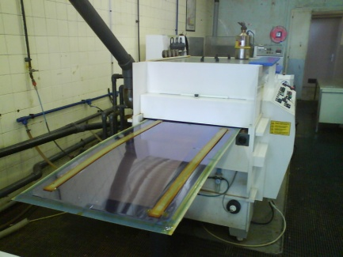
Continuous spray copper etching
0.65m width
Top copper etching
Optimized process
Add some test patterns for fast check?

Slide 8
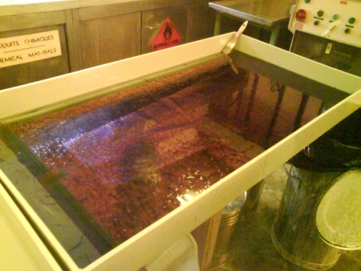
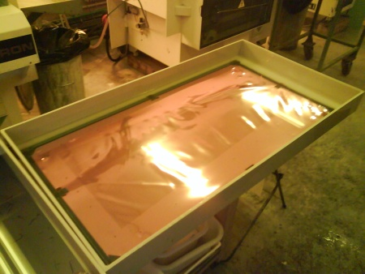
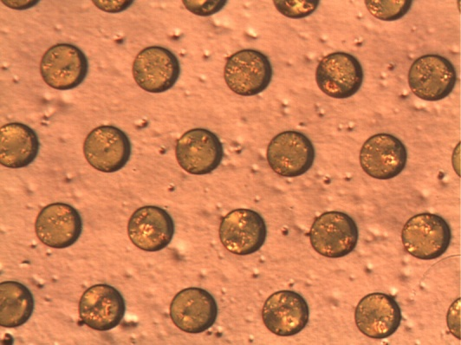
Dead bath : alcohol
Resist stripping 10GEM/day
Should be improved to strip 5 to 10 GEM / hour

Slide 9
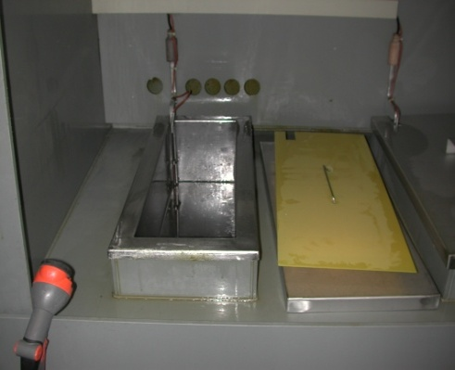
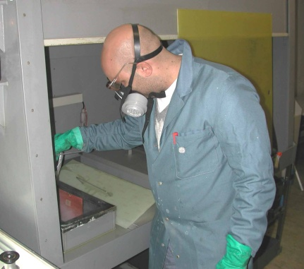
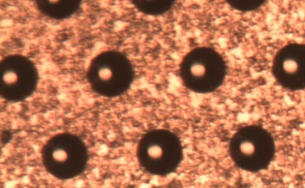
Dead bath
70um
30um
Polyimide anisotropic etching
5 GEMs/day
Not optimized process

Slide 10
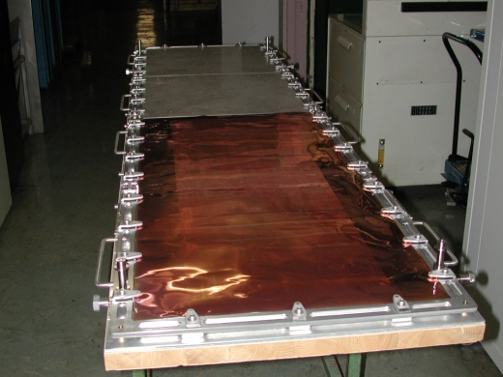
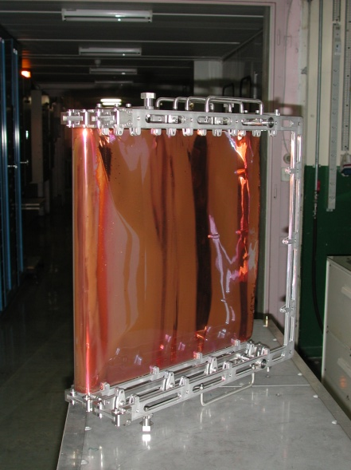
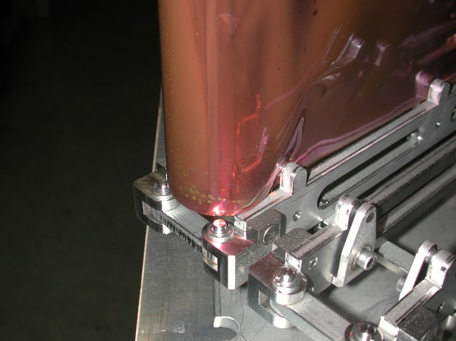
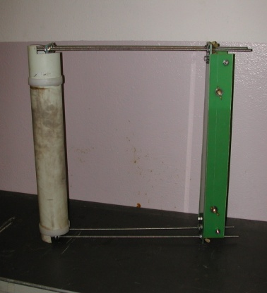
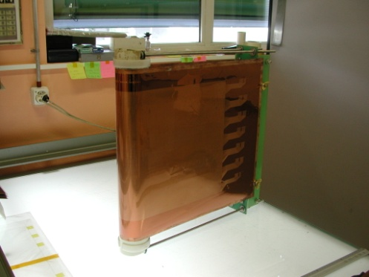
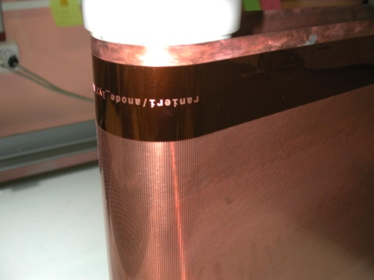

Tooling for polyimide etching
Previous tool
2m x 0.6m
Risky handling
Heavy
3 GEMs/day
Present tool
1m x 0.6m
Less risky
Light
5 to 6 GEMs/day
Future
No tool
100m x 0.65m
30 to 40 GEMs/Day
Optimized process
Poliymide etch , rinse and dry

Slide 11
STD lamination
0.65m width
15um resist
Bottom resist protection deposition
Optimized process
We have moved from liquid resist to solid

Slide 12
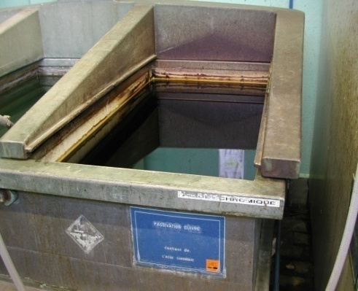
Top copper protected by galvanic connection
etchant
Bottom copper etch by chemical reaction

Slide 13
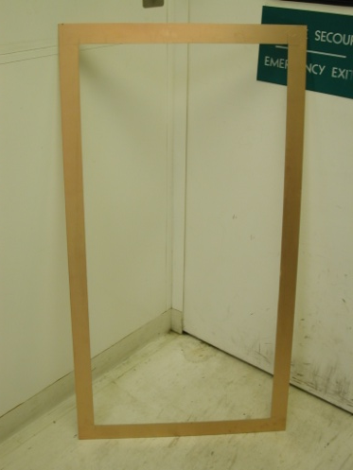
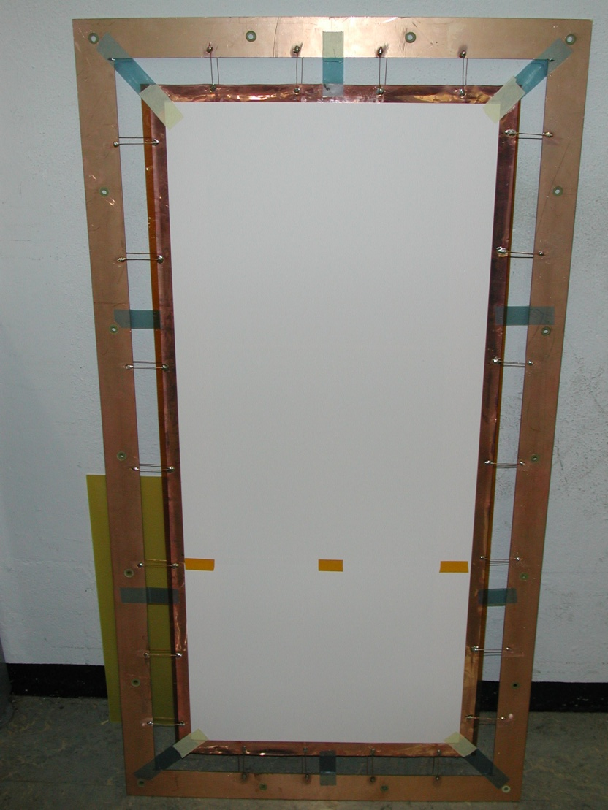
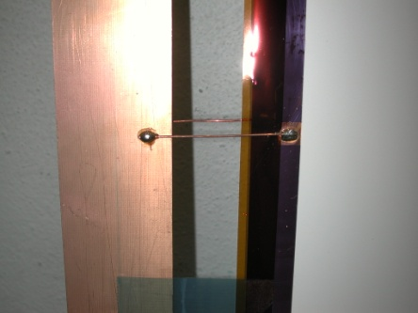
Tooling for electro-copper etching
1 to 2 cm needed
to make the
connection
FR4 frame
Copper on both sides
Electrically isolated
Top and bottom GEM
connection to frame
Lots of manual operation
Limiting to 4 to 5 GEMs/day
Need to be improved

Slide 14
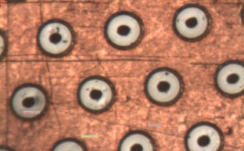
Dead bath : alcohol
Resist stripping
Not optimized process
Will move from 10 GEM/day to 30 GEM/day

Slide 15
Soft Polyimide etching
The hole become double conical
Not optimized process : 6 to 7 GEM/day
Will move to more than 30 GEM/day

Slide 16
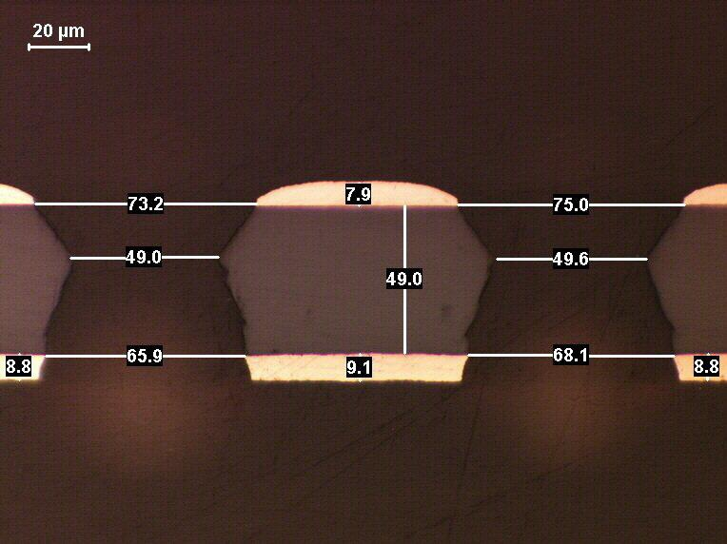
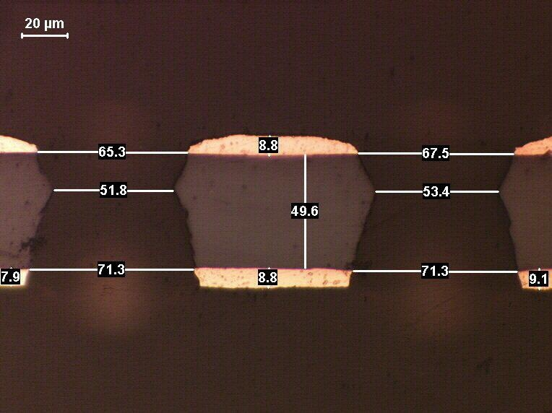
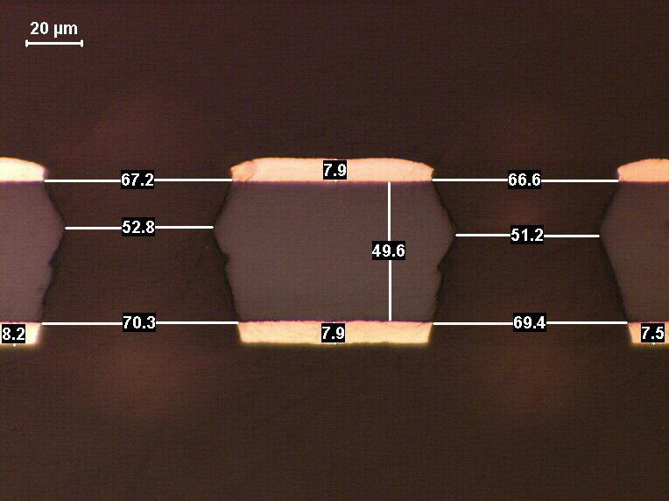
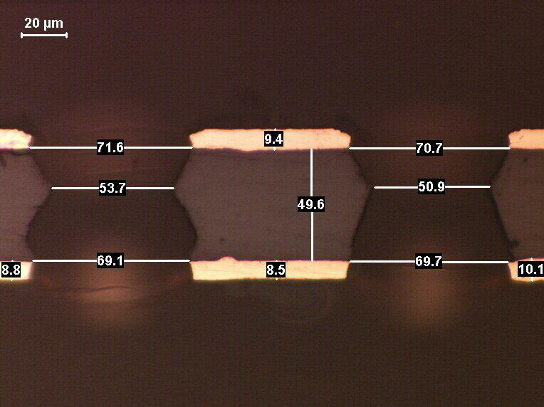
cross section pictures

Slide 17
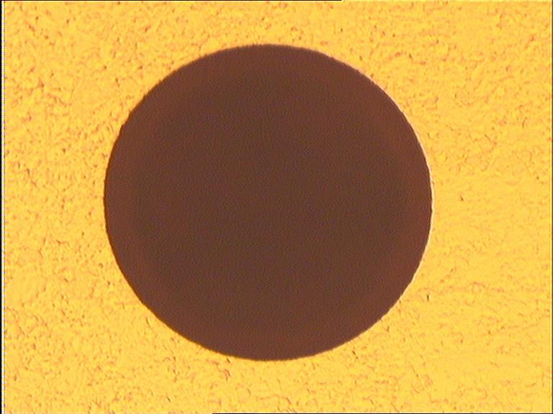
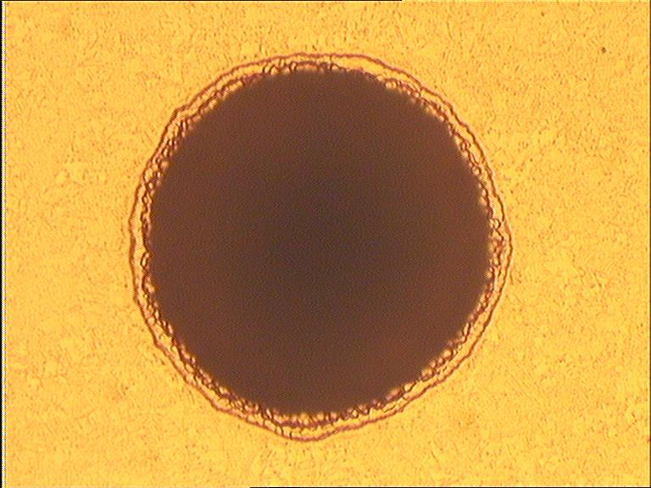
Top and bottom aspect
TOP
With liquid resist during
Copper electro etching
With solid resist in
last productions It’s hard
to make a difference
BOTTOM

Slide 18
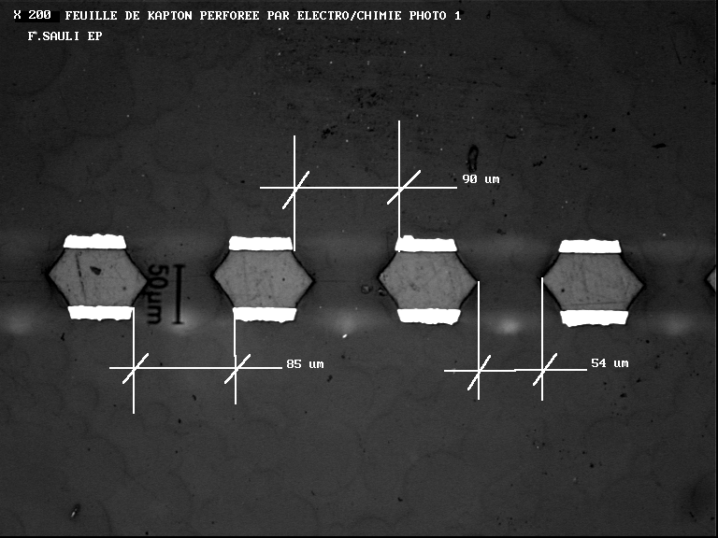
Comparison with std GEM from external supplier
70um copper hole diameter target
Polyimide hole above 50um

Slide 19
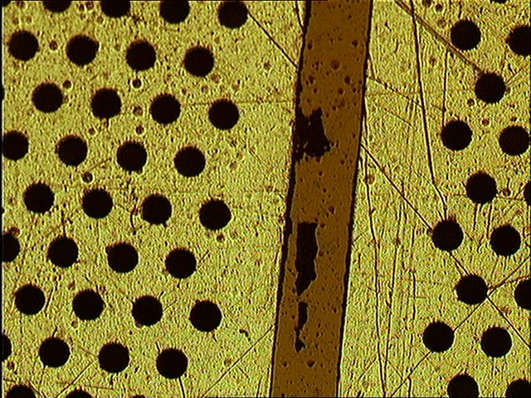
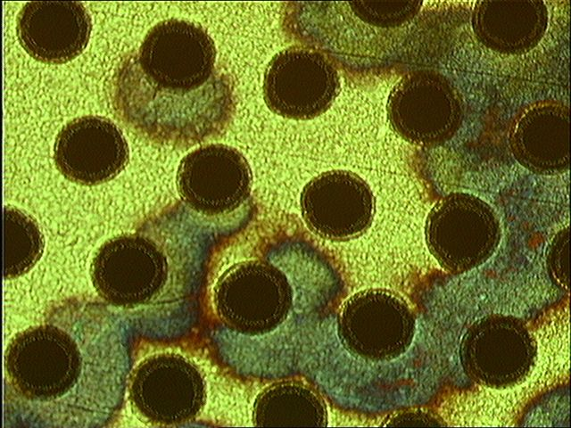
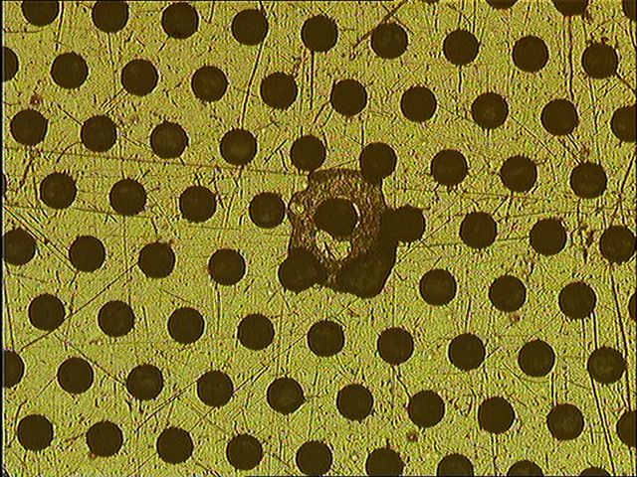
Defects (CMS GEM)
-Copper remains in between some sectors
-We have introduced
a HV test between sectors before delivery
-Previously only an isolating test was performed
-Oxide traces
-No electrical effect
-But we try to avoid them
-Defects due to dust during photoresist patterning.
-Improve cleanliness during image transfer
-No incidence in sparks

Slide 20
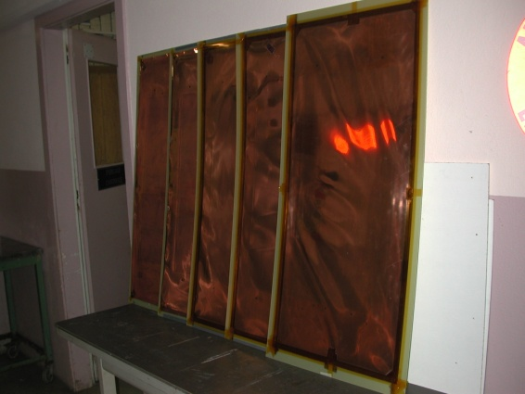
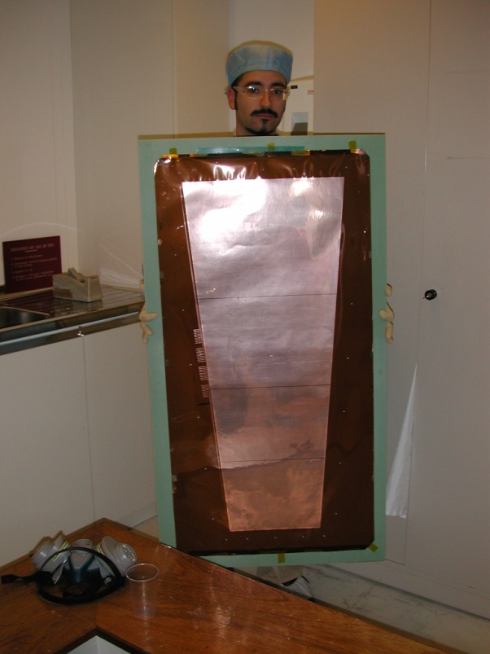
Examples
KLOE
CMS
Large GEM already produced:
ILC Dhcal: 1m x 33cm (5 pieces)
Kloe: 750mm x 40cm (30pieces)
CMS: 1m x 45cm (6 pieces)

Slide 21
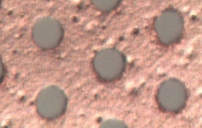
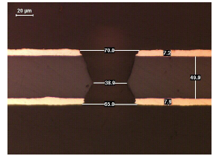
GEM single mask processes needed to be optimized
Chemical Polyimide etching
Copper electro etching
Stripping
Second Polyimide etching
Reality

Slide 22
Production at CERN
GEM size
  With existing equipments 1.5m x 0.5m active area
  Mid 2011: 2m x 0.5m active area
Volumes
  With existing equipment: 10 GEMs/month.technician
    We can hire one more technician
  Mid 2011: 24GEMs/month.technician (240GEM/year)

Slide 23
GEM equipment investment in the existing CERN premises early 2011
  -1 continuous polyimide etch machine 100 kCHF
    Existing equipment limits us to 5 GEM/day (polyimide etch step) with heavy tooling and big handling risks (for the GEM)
    The new equipment will do 1 GEM every 5mins without tooling and no handling risk
  -1 Cu electro etch line 140 kCHF
    Existing equipment is limited to 1m x 0.6m with baths in different places
    The new equipment will be able to treat 2m x 0.6m GEM in the same line
  total: 240 kCHF

Slide 24
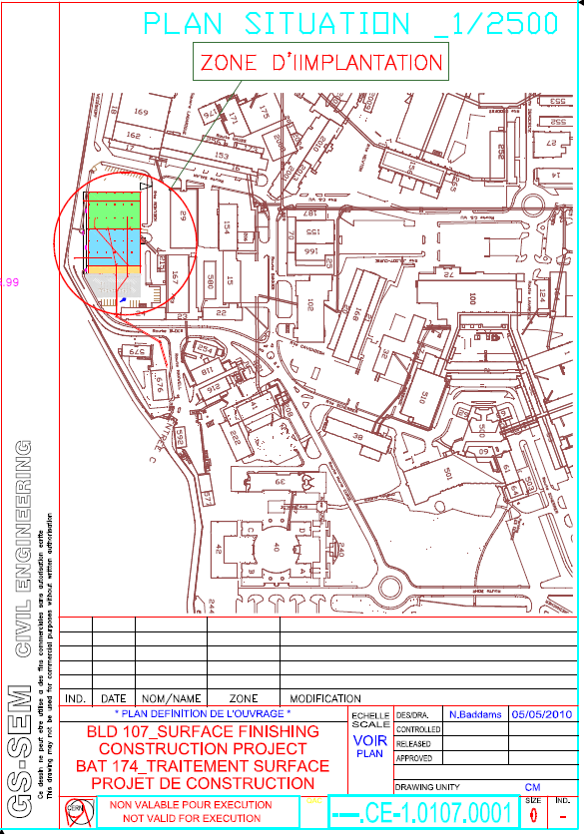
New building
PCB workshop
-1400 m2 (now 1000m2)
-Modern Chemical zone
-Modern Water/air treatment
-Room for new processes
-laser
-plasma
-MPGD
-Replacement of old equipment
-Ergonomic layout

Slide 25
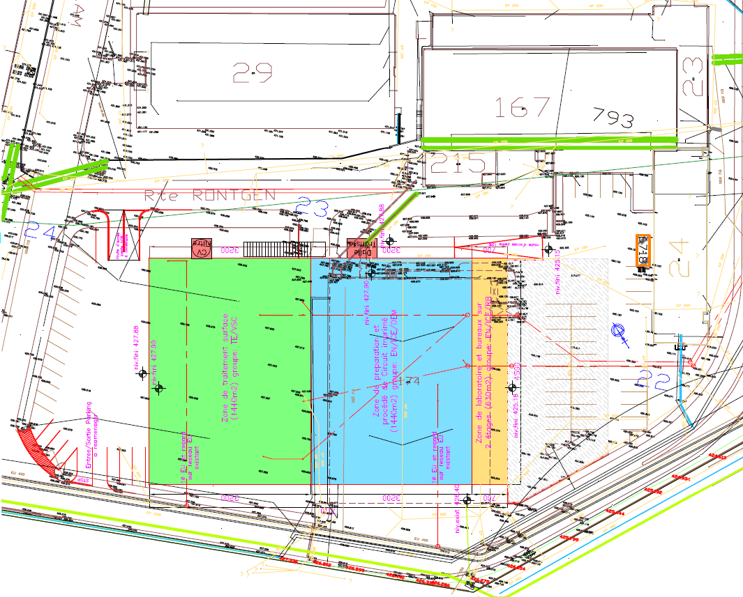

Slide 26
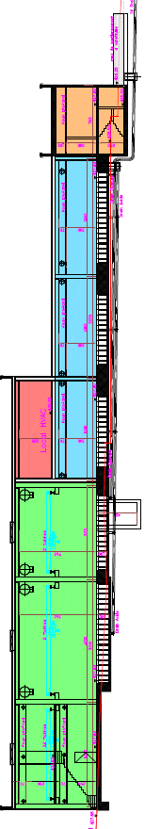
Cross section
Timing:
Nov 2010 Market survey results for consulting
Design 3 months
Market survey for construction
March 2011 call for tender for construction
Mid 2011 construction start
Mid 2013 construction end

Slide 27
Other GEM possibilities
Copper hole diameter down to 30um
Hole pitch down to 50um
Polyimide thickness 12.5 , 25 or 50 um
Sectors down to 1mm
Possibility to add holes in the gluing regions

Slide 28
Outsourcing
Micrometal (Germany)
New Flex (Korea)
Keerthi industries (India)
Tech-etch (US)
With some offers for large volume production
we start to see the limit price of the GEMs : in
the range of 600 CHF/sqr.meter

Slide 29
Summary
We have some possibilities to make GEM outside CERN
Still need work to find the best choice
  We are now interesting for industry.
TE-MPE-EM can increase its capacity to face GEM productions up to 500 pieces/ year (1m x 0.5m)
Should we propose std 100 x 100 single side GEMs at CERN store (50% cost reduction)?

