Slide 1
diagnostic requirements for the e+ production experiment in SwissFEL
R. Zennaro
08.04.2021

Slide 2
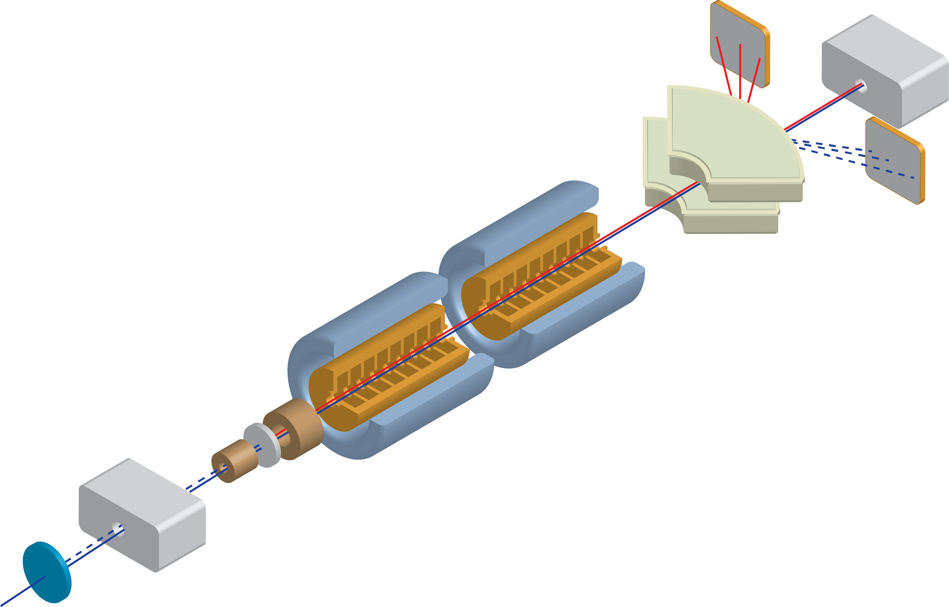
layout
0.2 nC e- (6 GeV) 100 Hz drive beam:
At target:
13.8*0.2 nC=2.76 nC e+
1.25*2.76 nC=3.45 e-
At end of beamline:
0.79 nC e+ (28.6%)
1.0 nC e- (29.3%)
Main goal:
Yield measurement and optimization

Slide 3
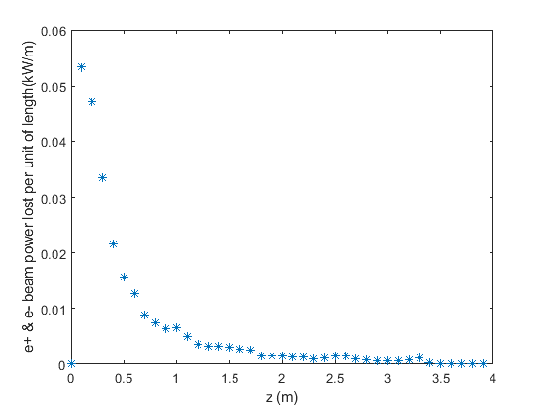
Beam losses
24 W beam losses in 1st RF cavity

Slide 4
Basic requirements for diagnostic
Drive beam 6 GeV e-:
Beam size and position at target
Beam size and position at crystal
Beam charge
Diagnostic on beamline from Aramis
e+ beam:
Beam charge
Energy profile at spectrometer
Photons:
Spectrum
Beam losses in RF cavities

Slide 5
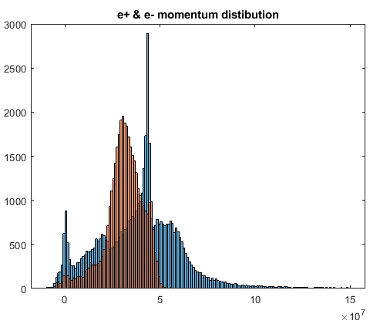
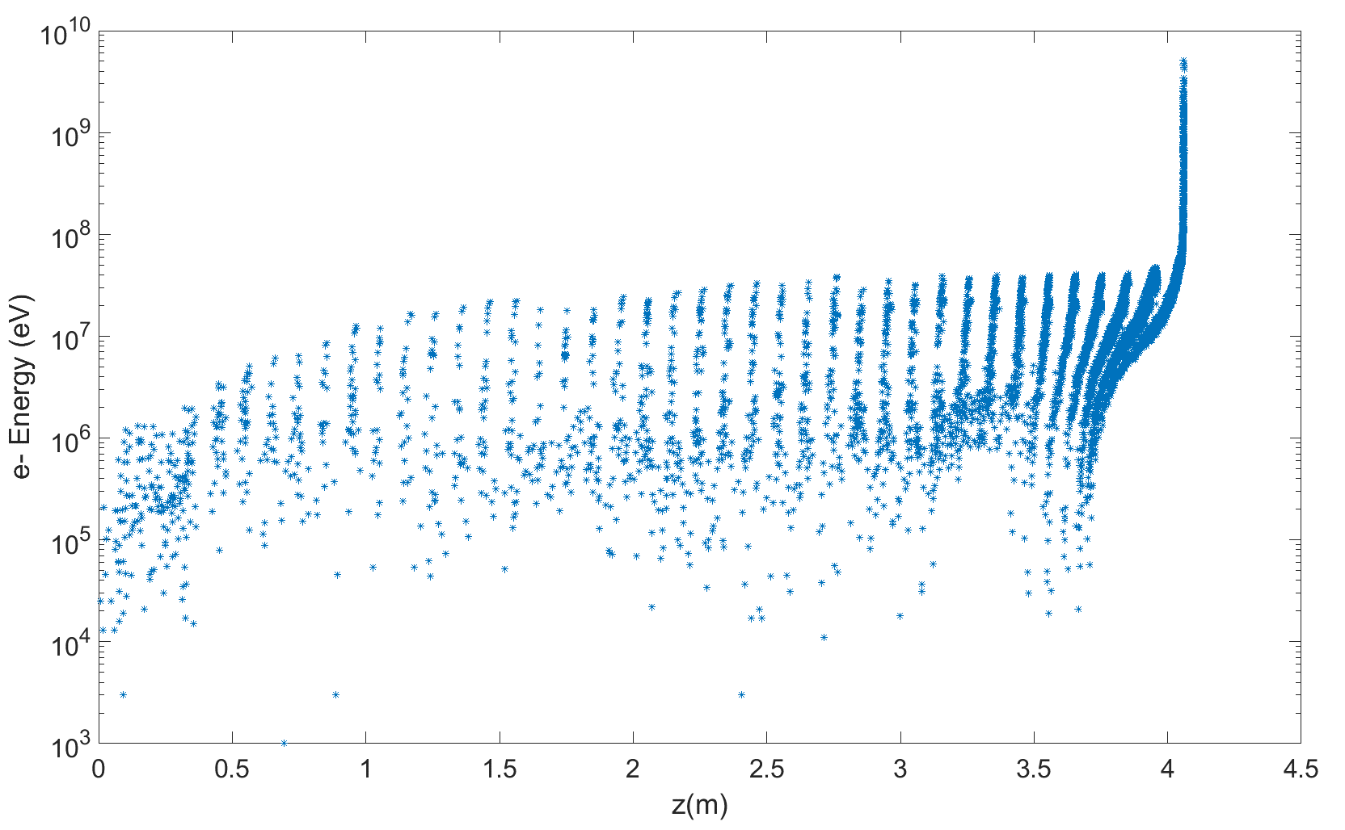
Energy distribution

Slide 6
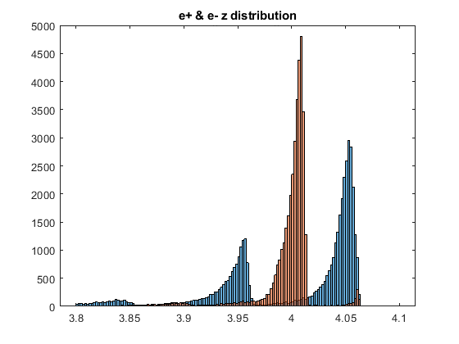
Longitudinal distribution

Slide 7
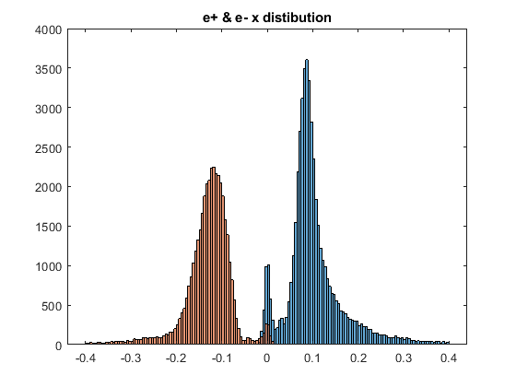
Distribution in X after spectrometer
Last design: spectrometer: 0.8 m (X), 0.3 (Z) gap (Y) 0.1, 0.1 T

Slide 8
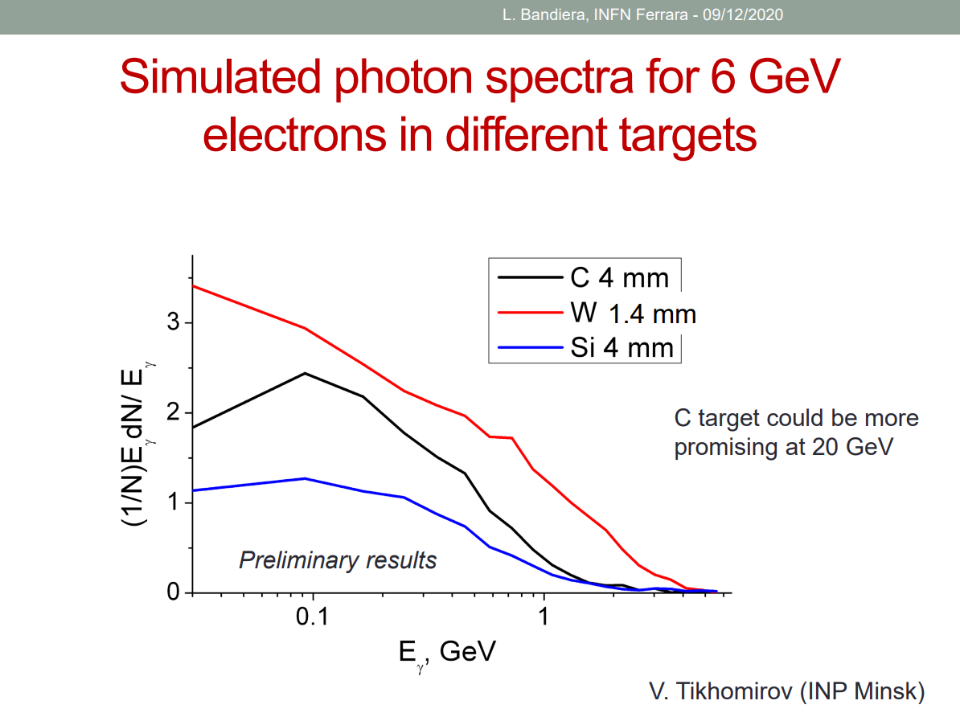
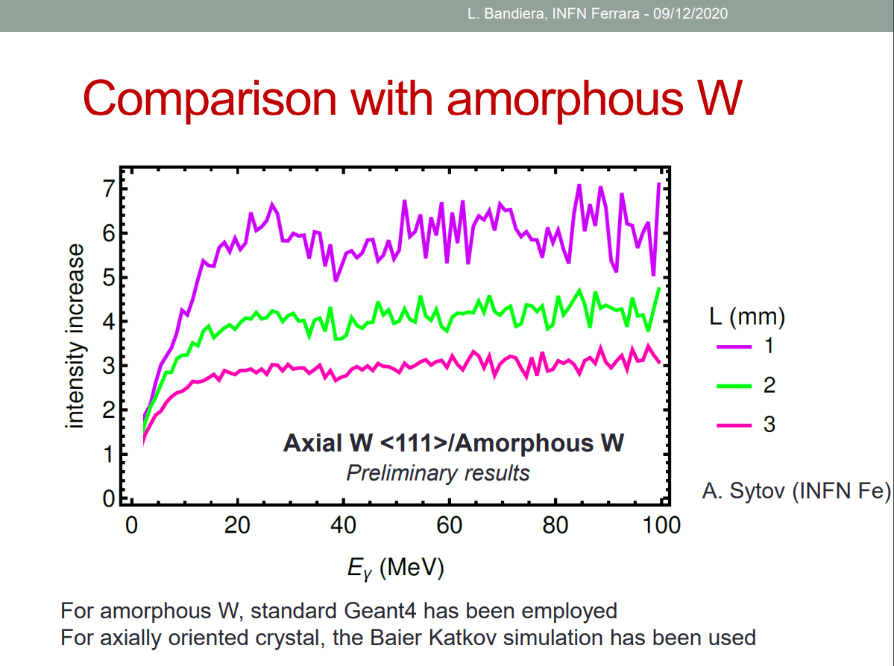
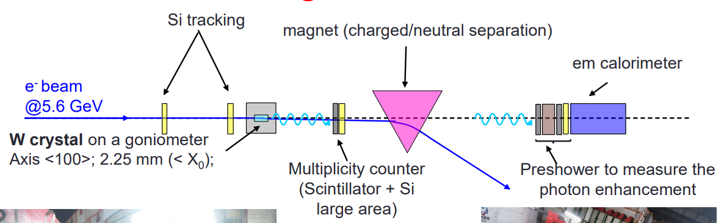
Photons from Crystal courtesy of L. Bandiera INFN Ferrara
Test on beam DESY 2019

Slide 9
Some open questions
Should we have the complete line in vacuum? The vacuum chamber could be very large at the spectrometer, can diagnostic operate in air?
Spectrometer: do we really need a specific magnet for this experiment? Should we instead borrow an existing one? If yes any idea?
Beam stopper huge , heavy and expensive (?) device, can we clean up the beam after the crystal in a different way? How can we minimize the distance between crystal and target?
Radioprotection could be an issue, can we reduce the beam charge and/or rep. rate? If yes, how much? What are the drawback for diagnostic?
Should we have this meeting on regular basis? If yes, how often?

