Slide 1

The Nightmare of Securing a
Multi-Purpose Computer Centre
Dr. Stefan.Lueders@cern.ch
CERN Computer Security Team
pre-GDB workshop on
data-centre network architectures
2021/6/7

Slide 2
The Three Mantras of Cyber-Security
1. “Convenient, cheap, secure --- Pick two”:
No wonder that “security” looses as it brings no immediate benefits.
2. “KISS --- Keep it simple, stupid”:
Avoid over-complication, too much complexity & too many deviations from or exceptions to the “standard”.
Unfortunately, it is the complexity of today’s IT infrastructures which makes security a nightmare.
3. “Defense in Depth”:
Protective means must be deployed at every level of the H/W & S/W stack, e.g.
Agile and timely updating, secure & professional S/W development, tested business continuity plans & disaster recovery means, logging & IDS, …
Network segregation & compartmentalization, firewalls, bastion hosts, gateways & proxies
Disclaimer: No, I don’t have the ultimate truth. I hardly even understand 100% of the problem.
Notes:
2

Slide 3

Just one Example: A web-based eLogbook
Another Disclaimer: I will not discuss best-practices of securing H/W & S/W components themselves:
Vulnerability management & patching, business continuity & disaster recovery
Secure software development, input sanitization & filtering
Access control, AuthN & AuthZ, eligibilities, …
Containerization can host completely different services
Alternative: Full separation, but this kills elasticity
The eLogbook
Another eLogbook
Yet another eLogbook
One more eLogbook
Other apps
Container
More containers
VM
(incl. O/S)
More VMs
Hypervisor
can host completely different services
Alternative: Full separation, but this kills elasticity
O/S
Hypervisor
Some H/W
Other Hardware (IPMI/BMC)
Notes:
3

Slide 4
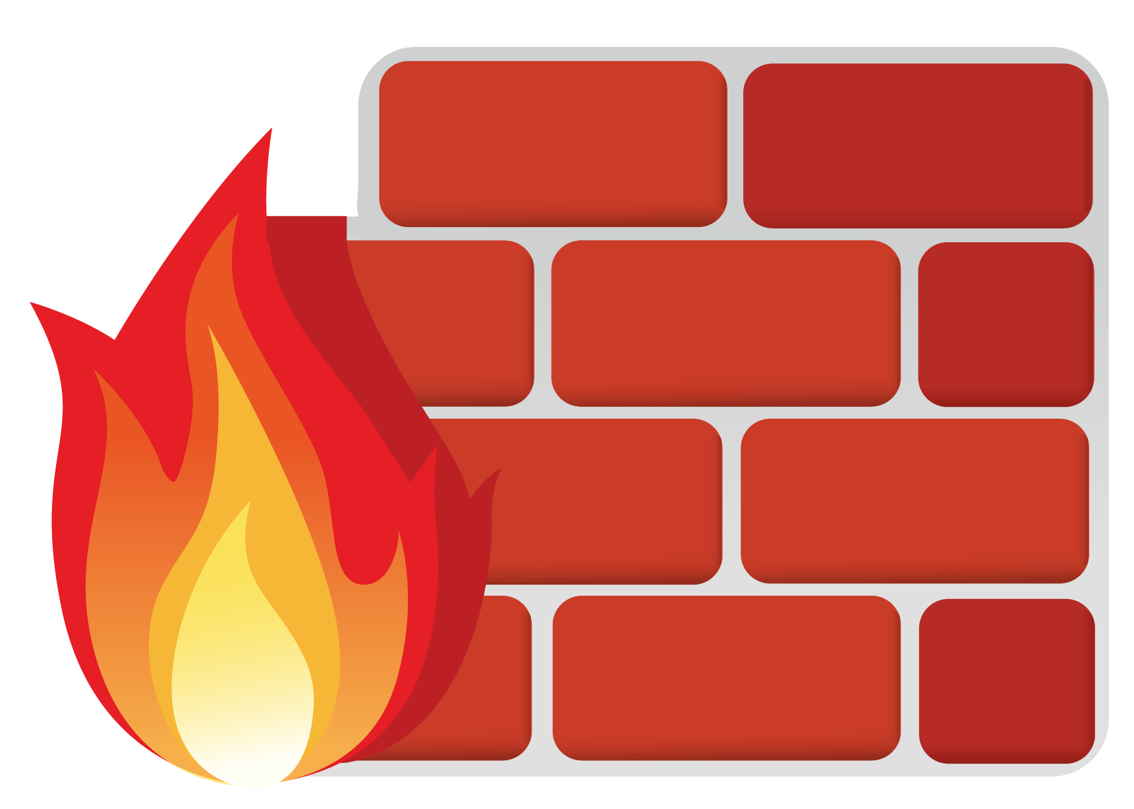
Ideal network stack already problematic
Exposing service to the Internet
…
…
…
App
Full
cross-exposure!
…
Container
Exposing service to critical networks
…
VM
Hypervisor
Containerization can bridge networks
Hardware (IPMI/BMC)
Hypervisor & SDNs
can bridge networks
Management
Provisioning
OT
Industrial
Intranet
Internet
WLCG
Notes:
4

Slide 5
Here come some Dependencies (1)
…
…
…
App
…
Container
Common service bridges networks
Alternative: Duplication, but this requires Primary/Replica synchronization
…
VM
Hypervisor
DNS, {S|D}HCP, NTP, …
Hardware (IPMI/BMC)
Management
Provisioning
OT
Industrial
Intranet
Internet
WLCG
Notes:
5

Slide 6
More Dependencies (2)
…
…
…
App
…
Container
Docker
…
VM
Puppet
Hypervisor
Admin Console
DNS, {S|D}HCP, NTP, …
Hardware (IPMI/BMC)
Admin Console
Management
Provisioning
OT
Industrial
Intranet
Internet
WLCG
Notes:
6

Slide 7
Complication (1): Admins!
Admin access requires a DMZ for a controlled network bridging
…
…
…
App
…
Container
Docker
…
VM
Puppet
Hypervisor
Admin Console
Convenience
vs. security
DNS, {S|D}HCP, NTP, …
Hardware (IPMI/BMC)
Admin Console
Management
Provisioning
OT
Industrial
Intranet
Internet
WLCG
DMZ
Notes:
7

Slide 8
And more Dependencies (3)
More common services…
Did we get all dependencies?
They are agile!
…
…
…
App
SSO
LDAP/AD
Storage, DBs, …
…
Container
Docker
…
VM
Puppet
Hypervisor
Admin Console
DNS, {S|D}HCP, NTP, …
Hardware (IPMI/BMC)
Admin Console
Management
Provisioning
OT
Industrial
Intranet
Internet
WLCG
DMZ
Notes:
8

Slide 9
Next Complication (2): Clouds
How to funnel in external cloud services?
…
…
…
App
SSO
LDAP/AD
Storage, DBs, …
…
Container
Docker
Git
Oracle
Jira(?)
PyPI
npm
…
VM
Puppet
Hypervisor
Admin Console
How to securely import external packages & libraries?
DNS, {S|D}HCP, NTP, …
Hardware (IPMI/BMC)
Admin Console
Management
Provisioning
OT
Industrial
Intranet
Internet
WLCG
DMZ
Notes:
9

Slide 10
One final Dependency (4)
Monitoring needs to “ping”…
…
…
…
App
SSO
LDAP/AD
Storage, DBs, …
…
Container
Docker
Git
Oracle
Jira(?)
PyPI
npm
…
VM
Puppet
Monitoring
Hypervisor
Admin Console
DNS, {S|D}HCP, NTP, …
Hardware (IPMI/BMC)
Admin Console
Management
Provisioning
OT
Industrial
Intranet
Internet
WLCG
DMZ
Notes:
10

Slide 11

Summary (for your Nightmares)
This got damn complex, complicated and convoluted.
The Risks:
Hypervisors, container platforms & alike when serving different networks as they bypass any firewalling
Multi-purpose applications (Intranet, Internet, WLCG, OT) as those require tight firewalling
High risk networks (e.g. OT) requiring even tighter firewalling, proxies, gateways, and data diodes
Common services (e.g. for provisioning or monitoring) as they bridge different networks
A quickly growing DMZ. At CERN, the Meyrin CC is considered to be the DMZ…
…and a cacophony of dependencies, agile, quickly changing, and adding more complexity
External cloud services (Git, Oracle, Jira?, …) adding uncontrolled complexity governed just by contracts
External S/W dependencies (through Github or usage of PyPI/npm) unless S/W is verified and curated
The solution:
Notes:
11

Slide 12
Thank you very much!

