Slide 1
Transitions
20/4/2021

Slide 2
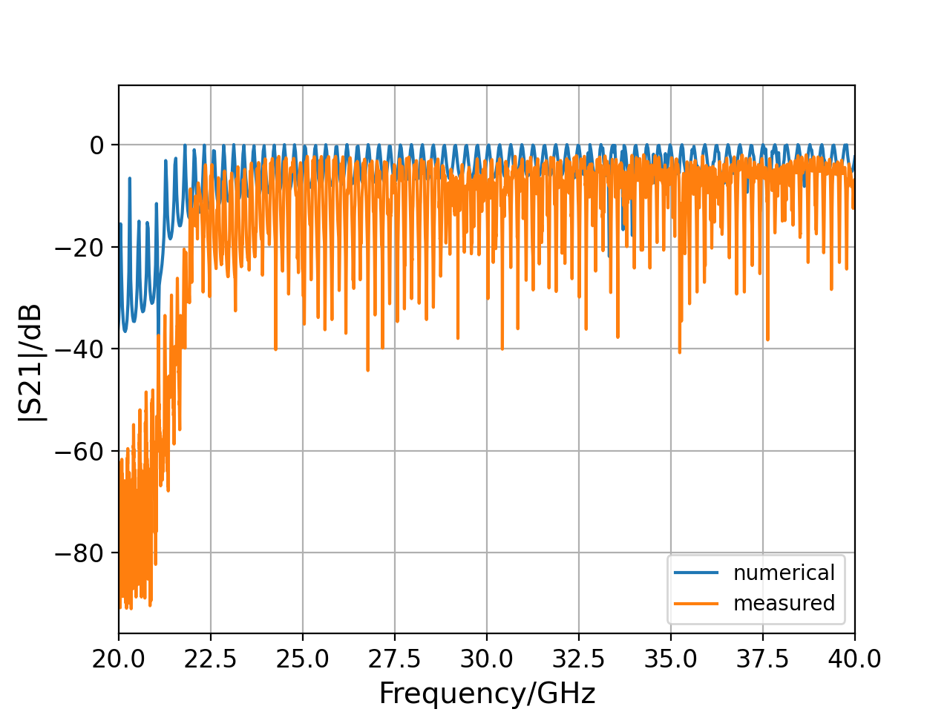
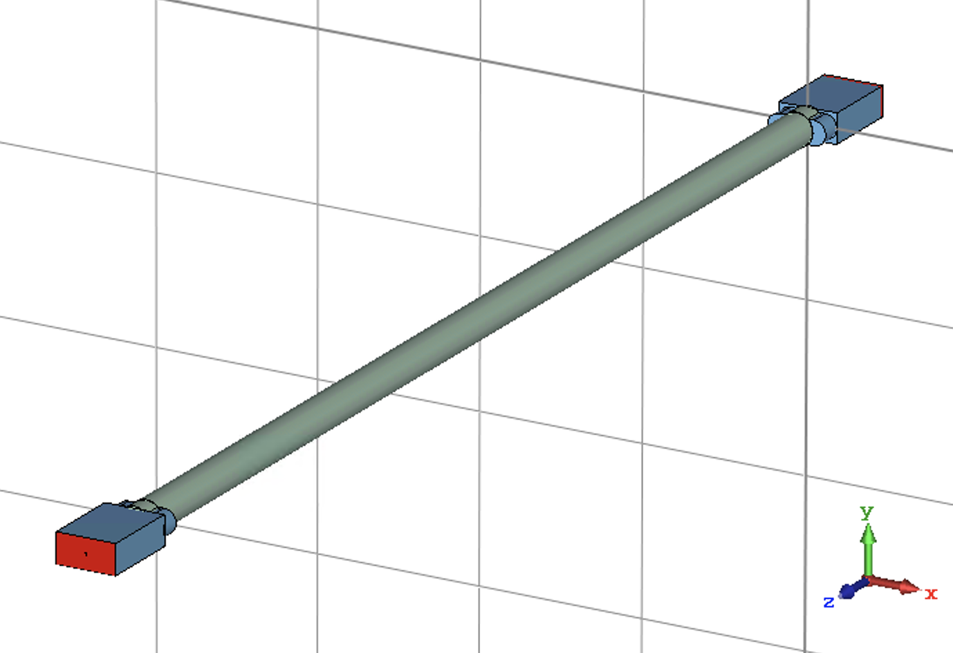
4mm
21.1 GHz cut-off ✔️

Slide 3
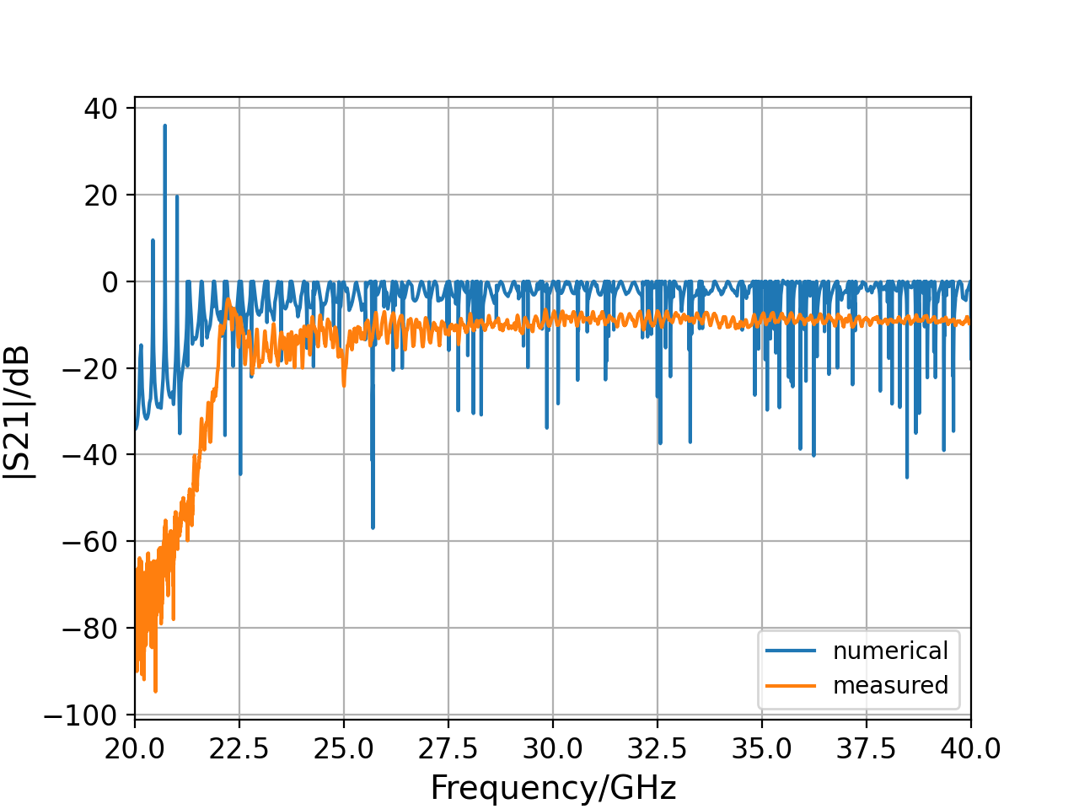
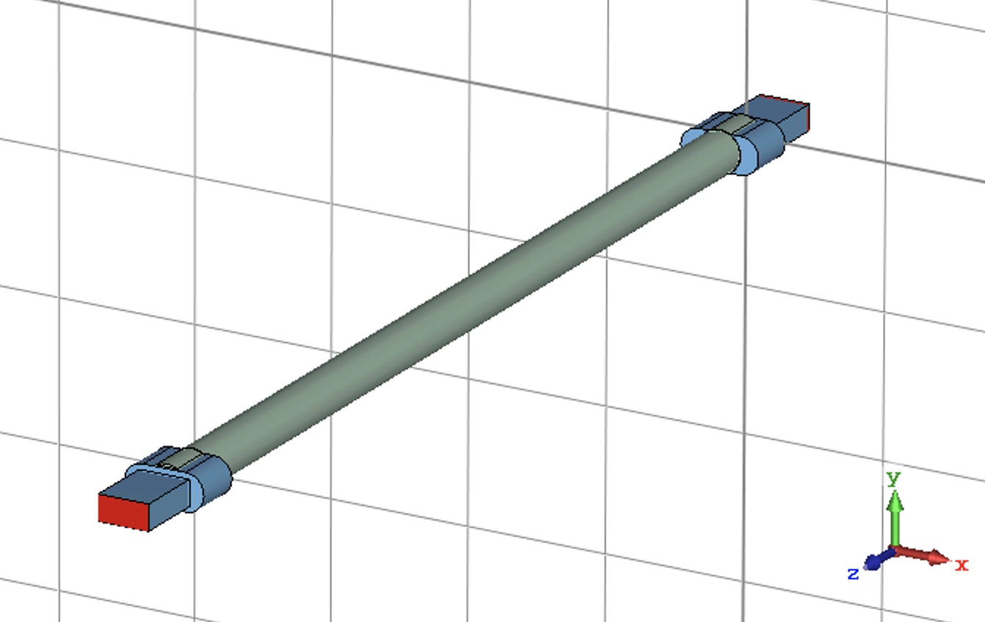
6mm

Slide 4
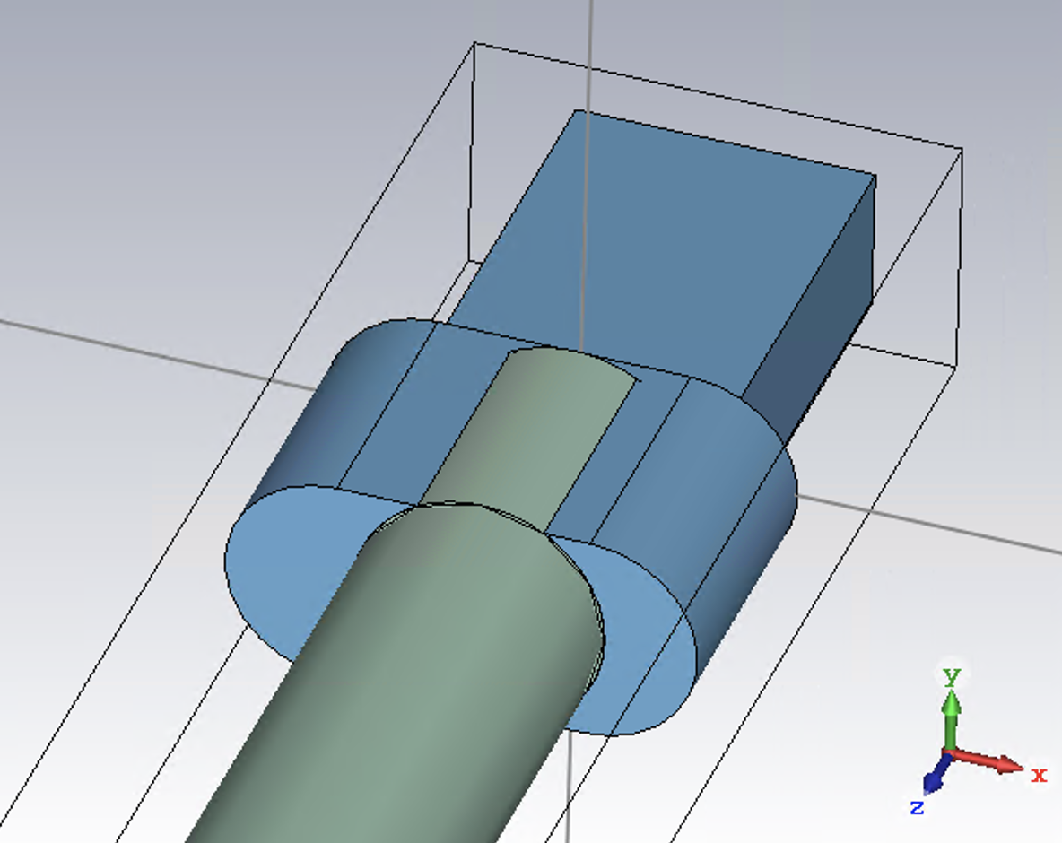
x_offset
y_offset

Slide 5
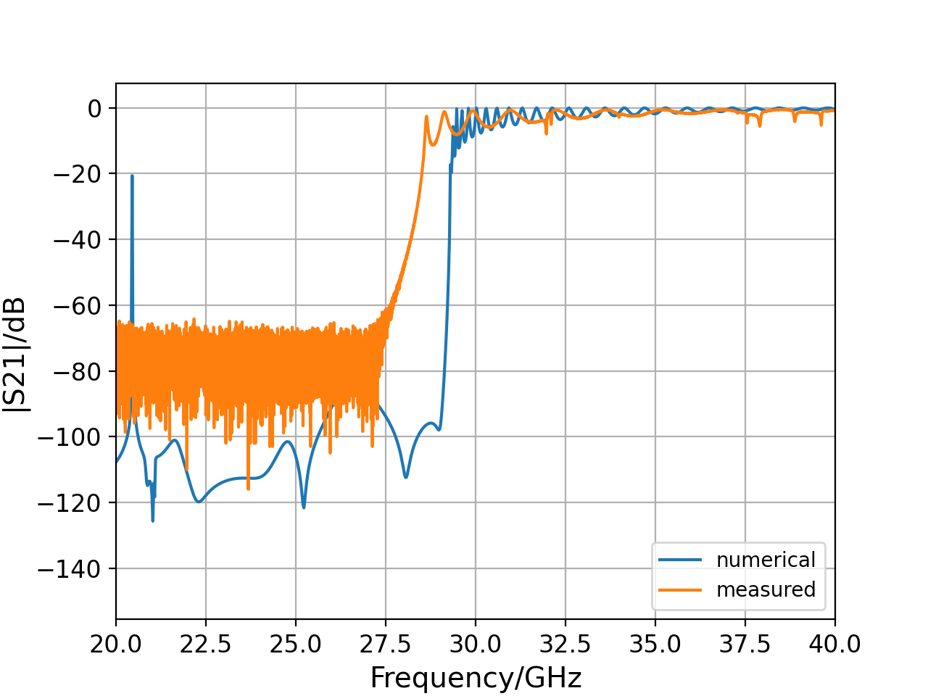
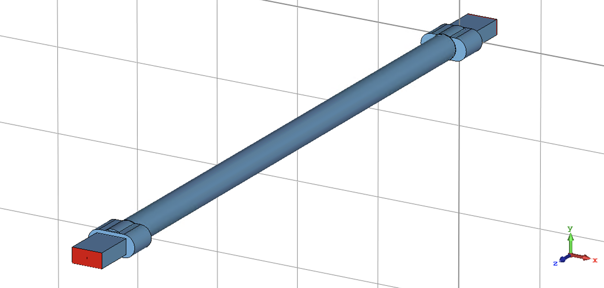
6 mm no alumina
Cut-off 29.3 GHz
In practice central pipe diameter cut to 6.15 mm = 28.6 GHz cut-off
28.6 GHz
29.4 GHz

Slide 6
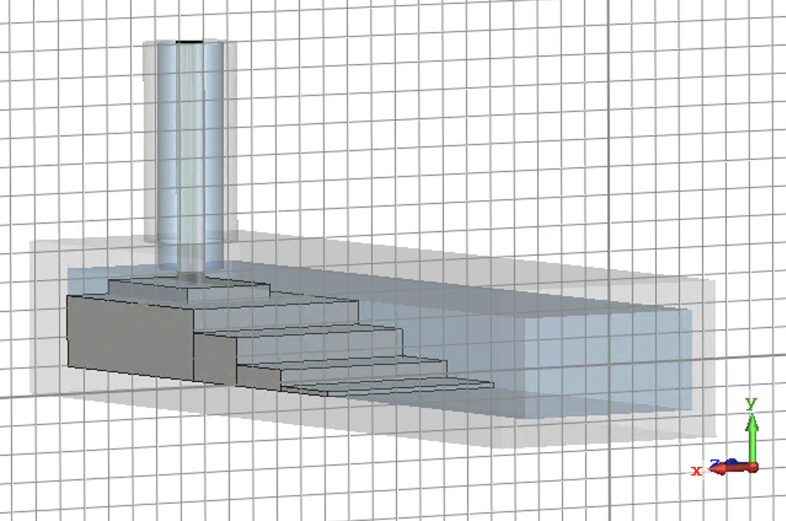
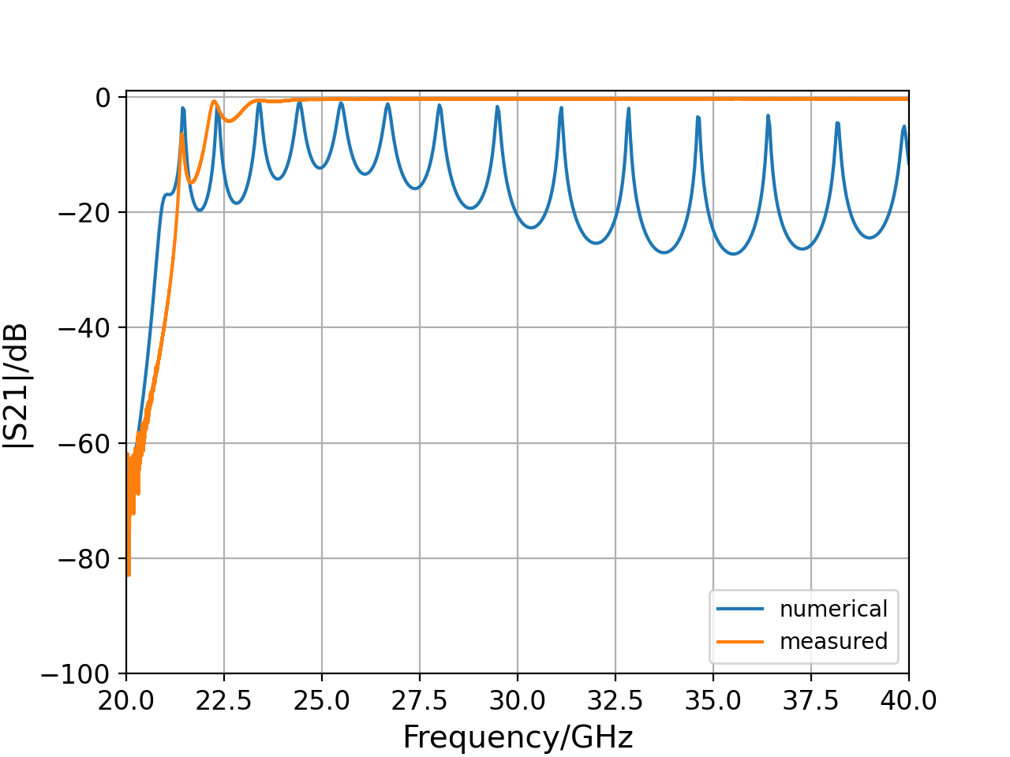
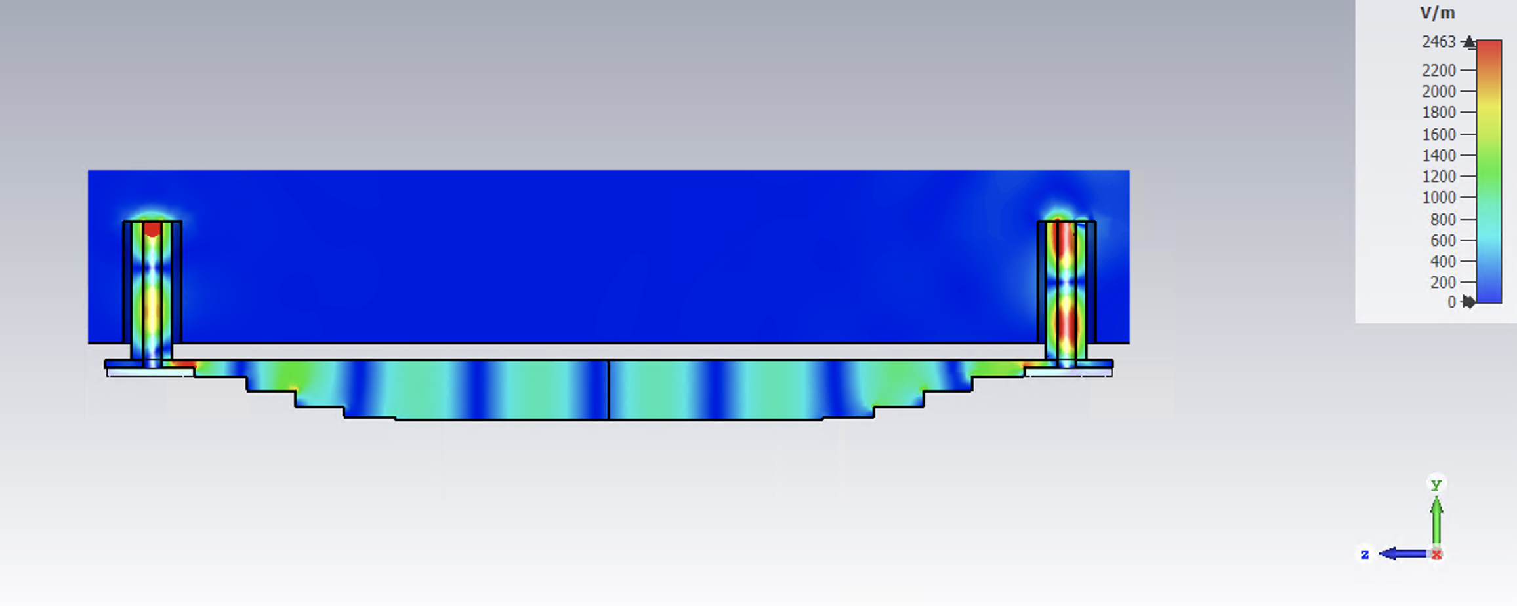
Adapters back2back

Slide 7
EOS

Slide 8
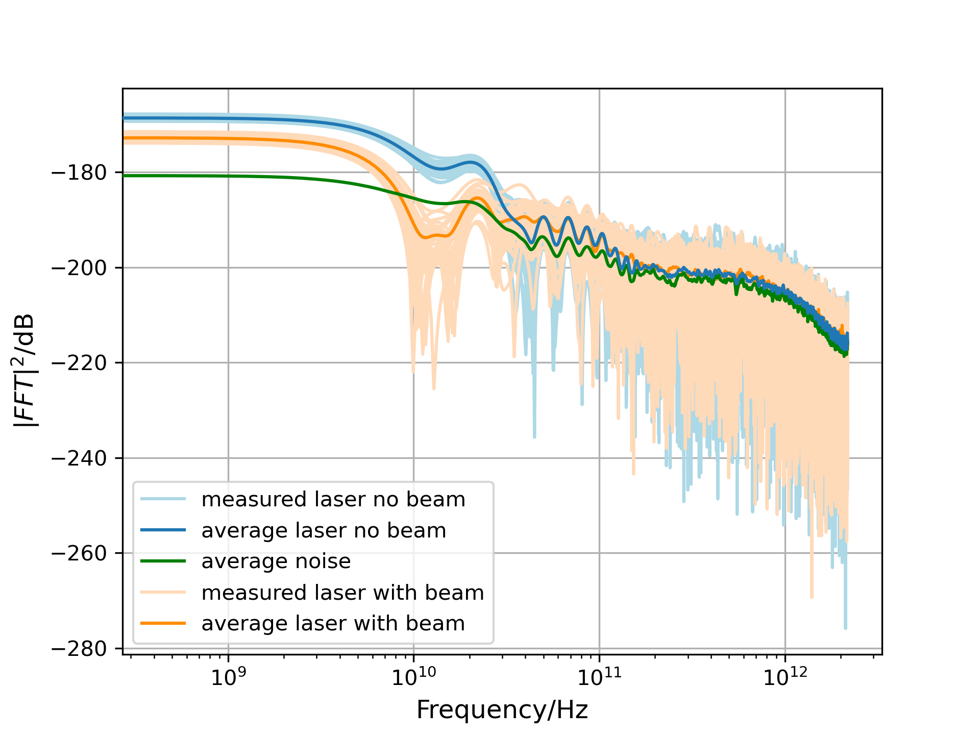
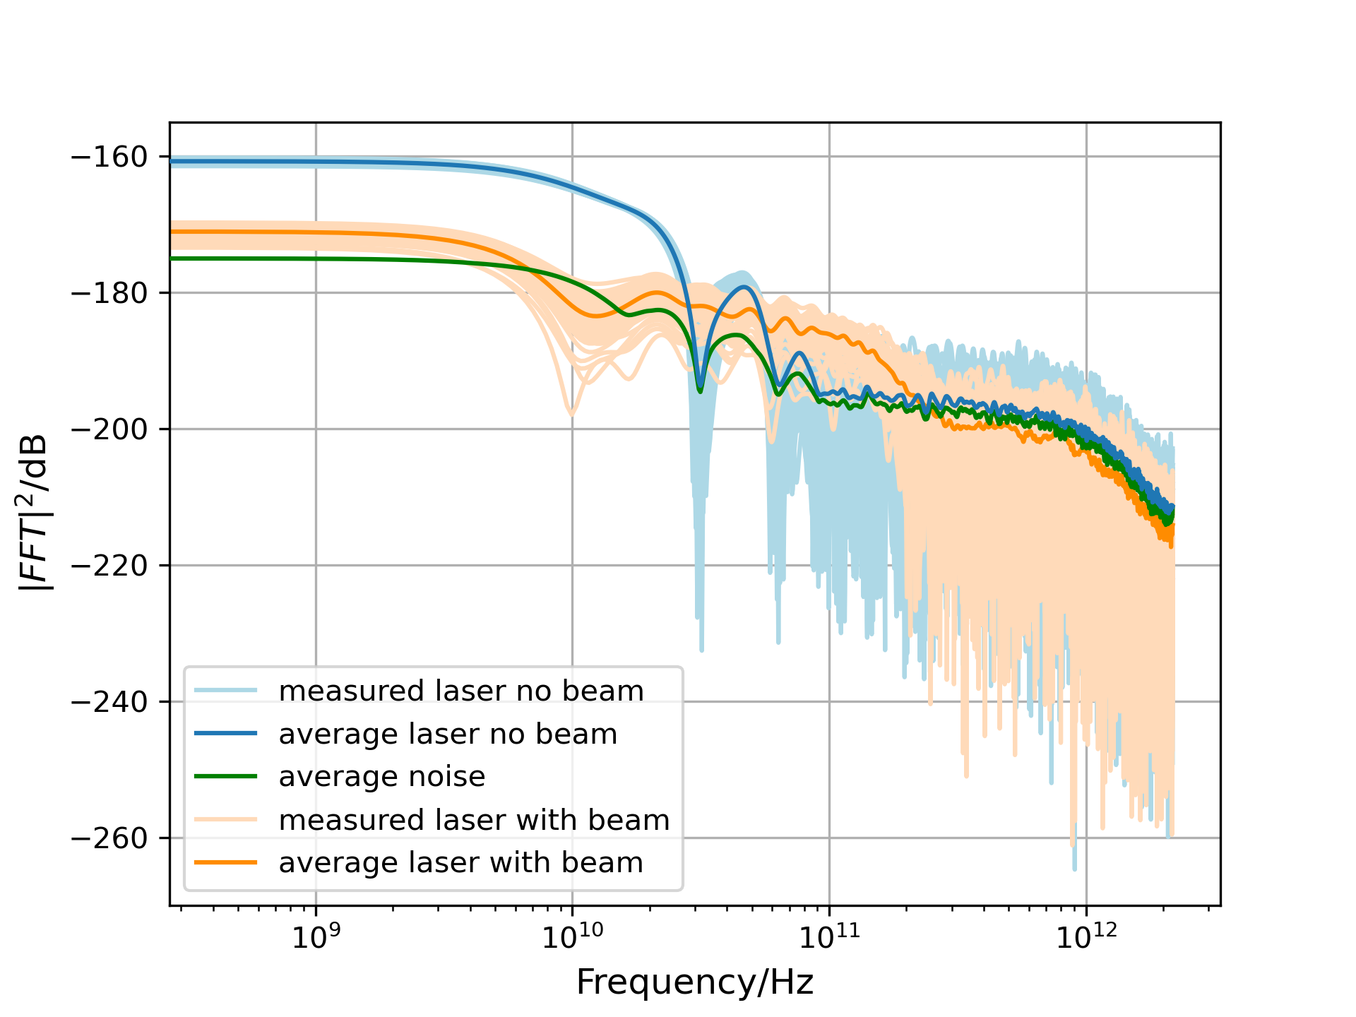
laser_pol_through_gain_900_75000
laser_pol_through_gain_999_87000

Slide 9
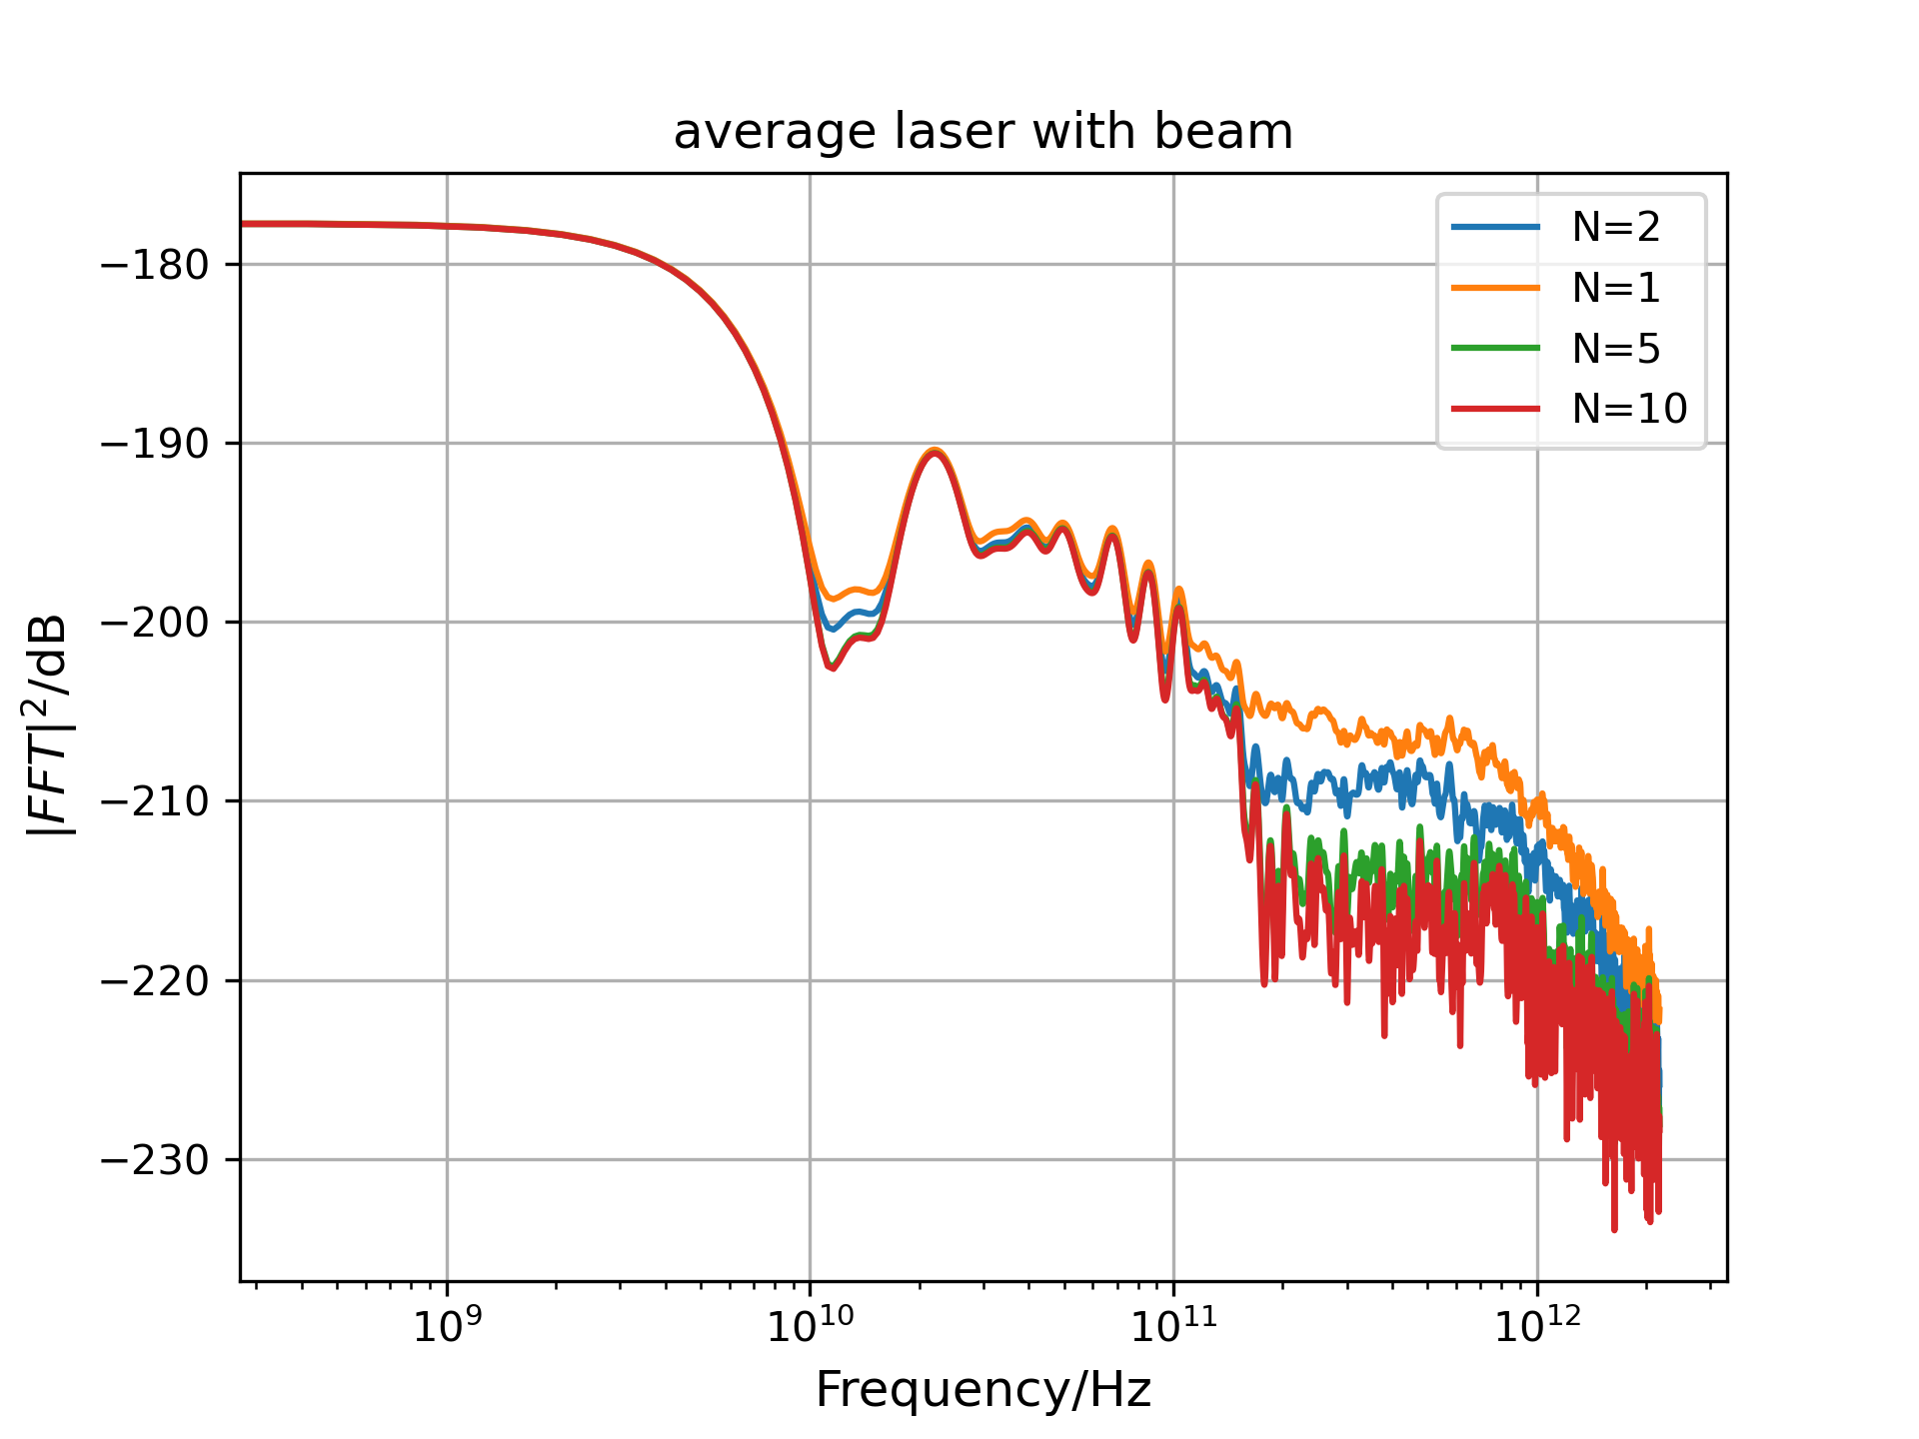
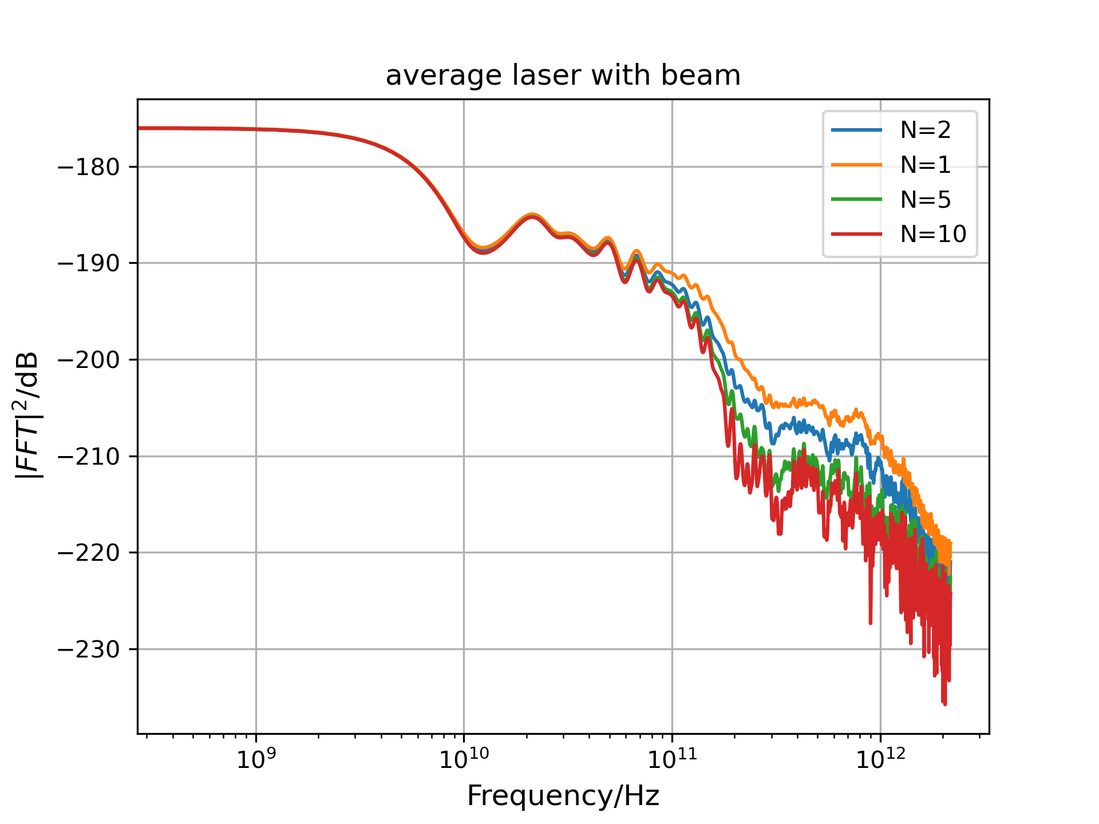
Summing images with beam
75000
87000

Slide 10
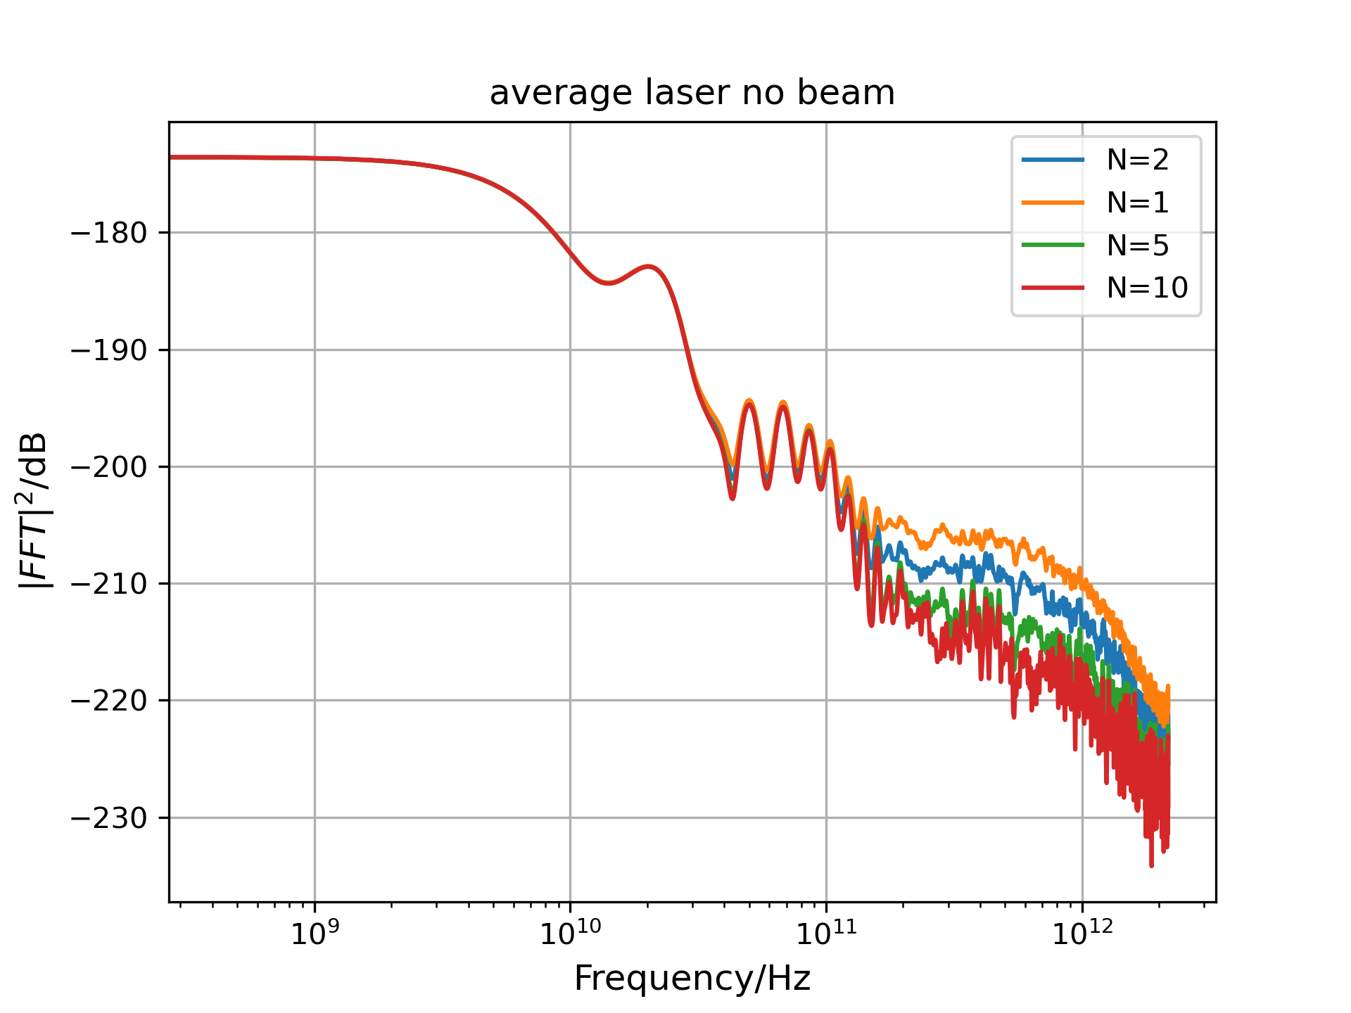
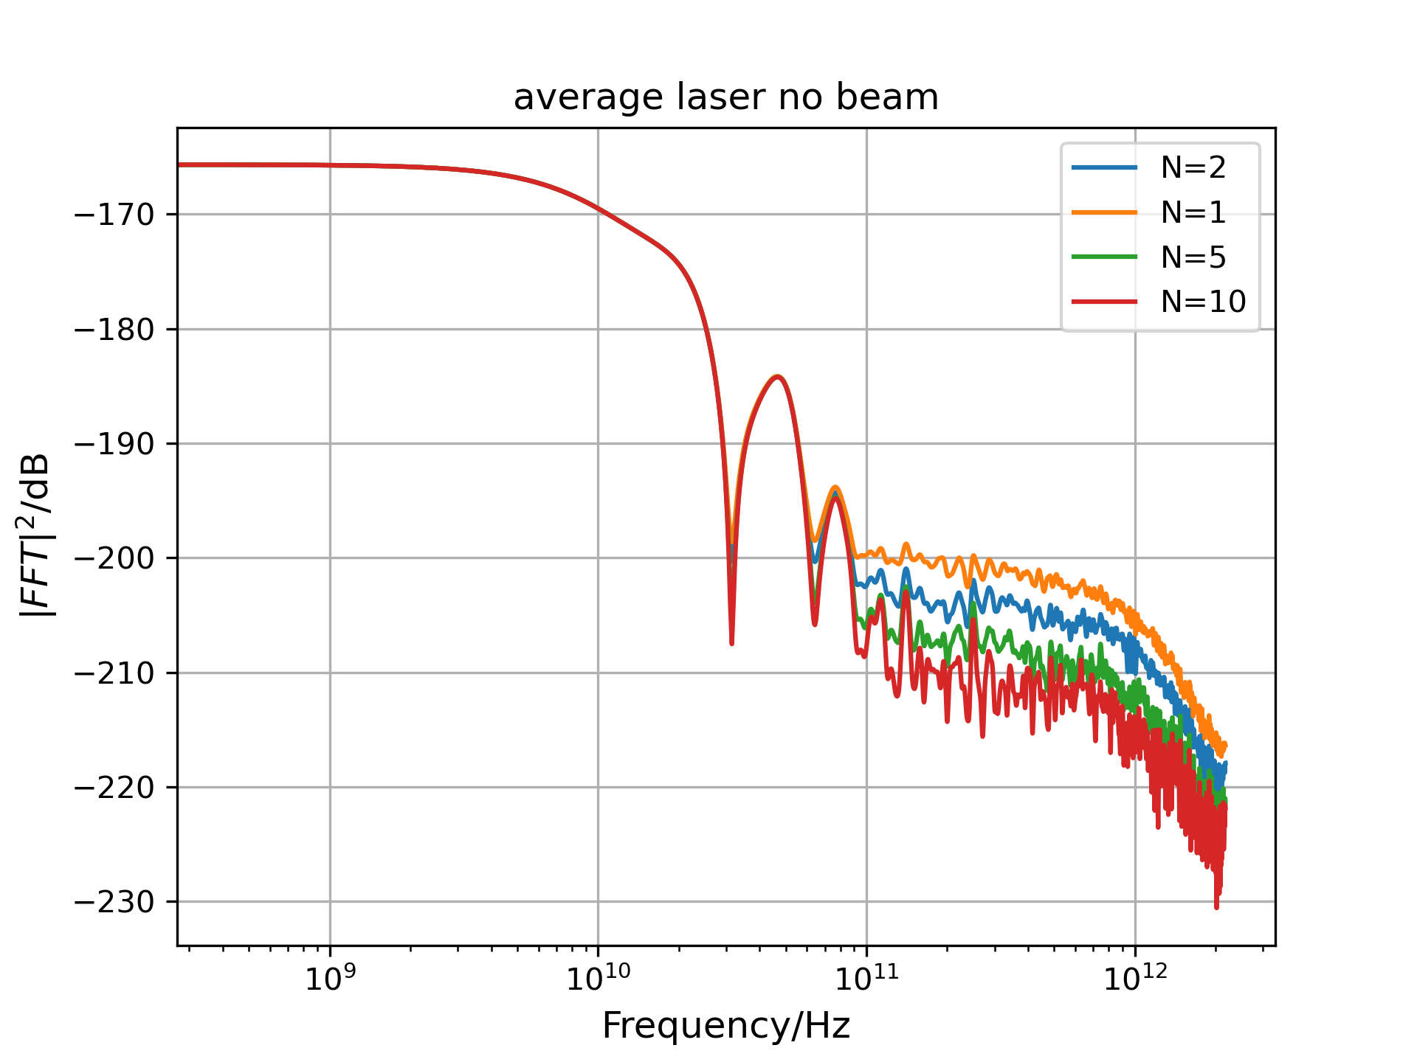
Summing images without beam
No beam: laser_pol_through_gain_900
No beam: laser_pol_through_gain_999

