Slide 1
Progress meeting
11/5/21

Slide 2
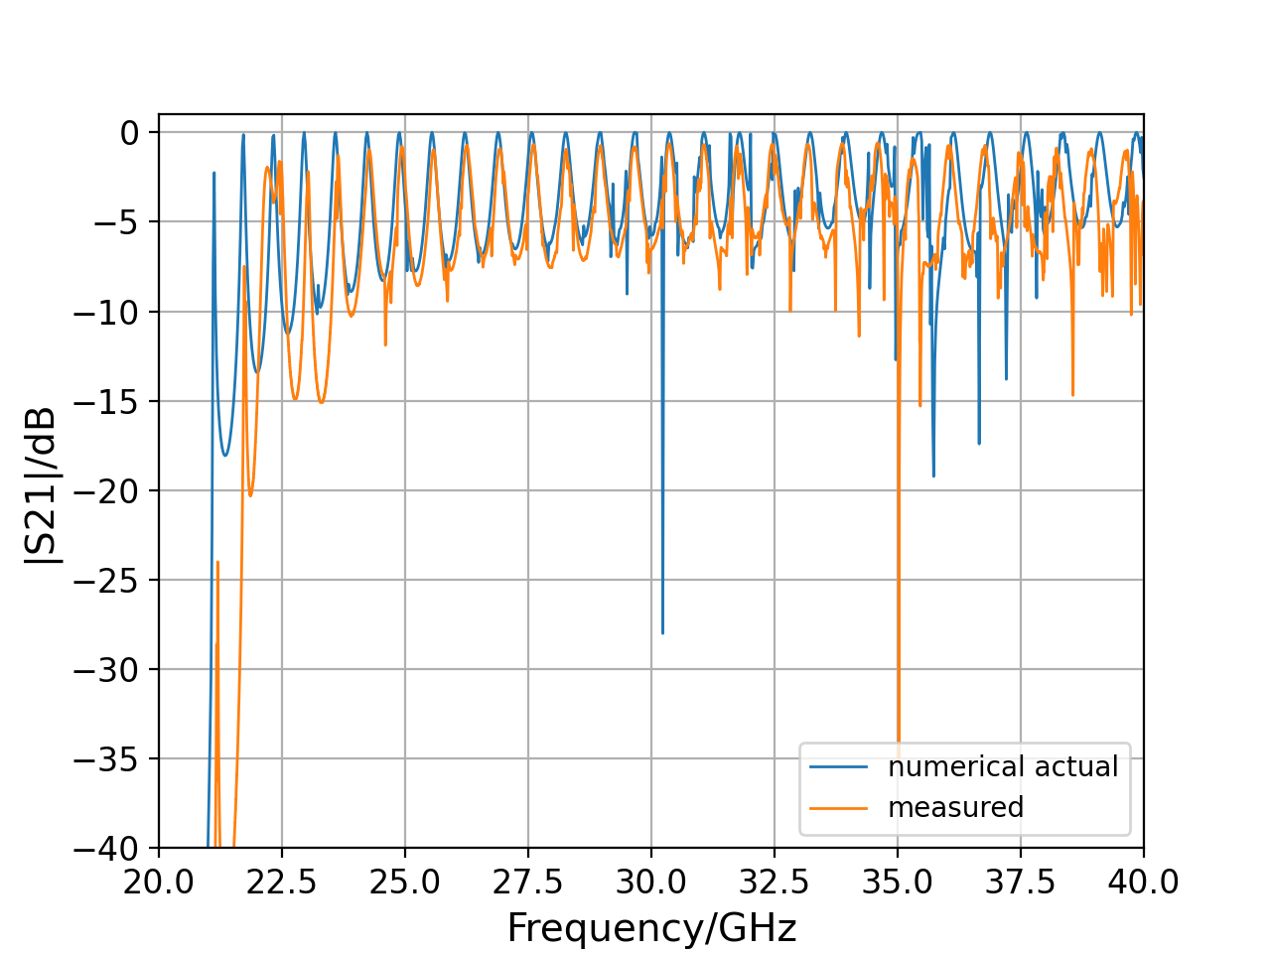
4mm no central bar, 60 mm long alumina

Slide 3
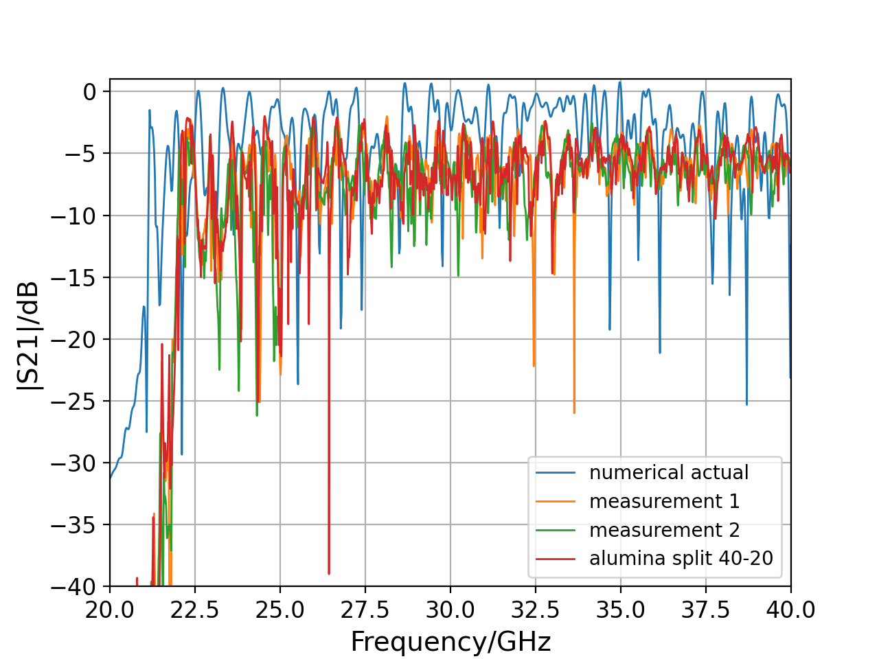
6mm no central bar, with alumina

Slide 4
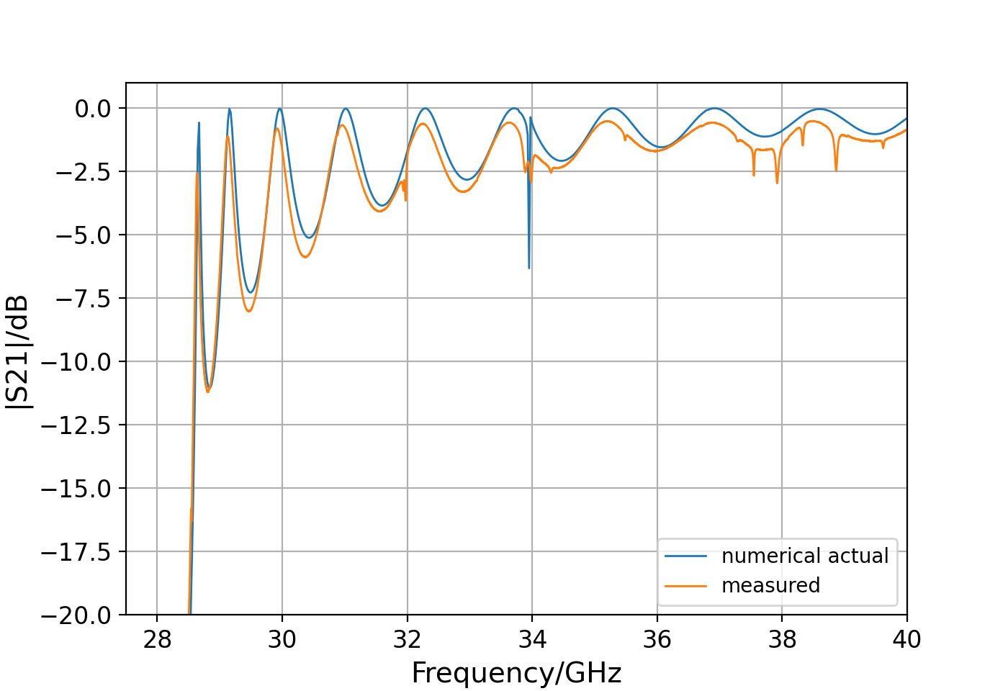
6 mm no central bar, no alumina

Slide 5
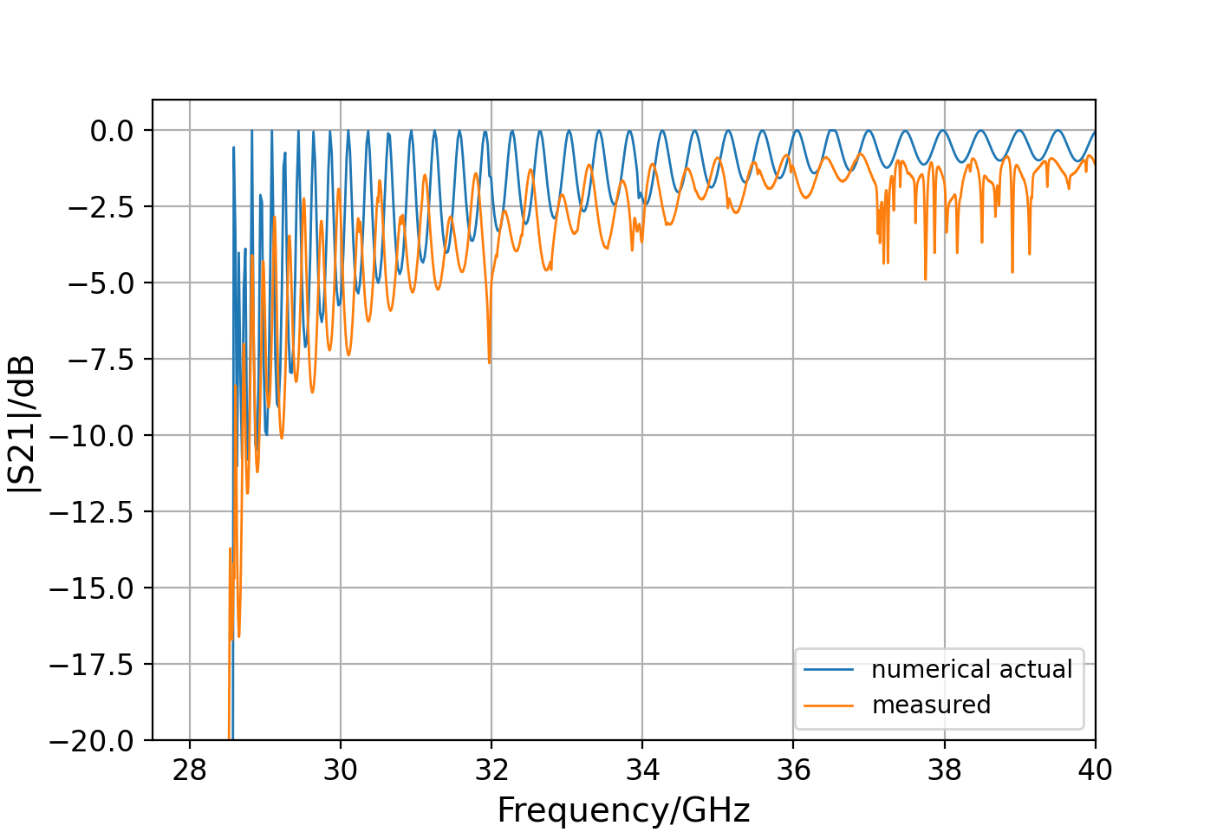
6 mm with central bar, no alumina

Slide 6
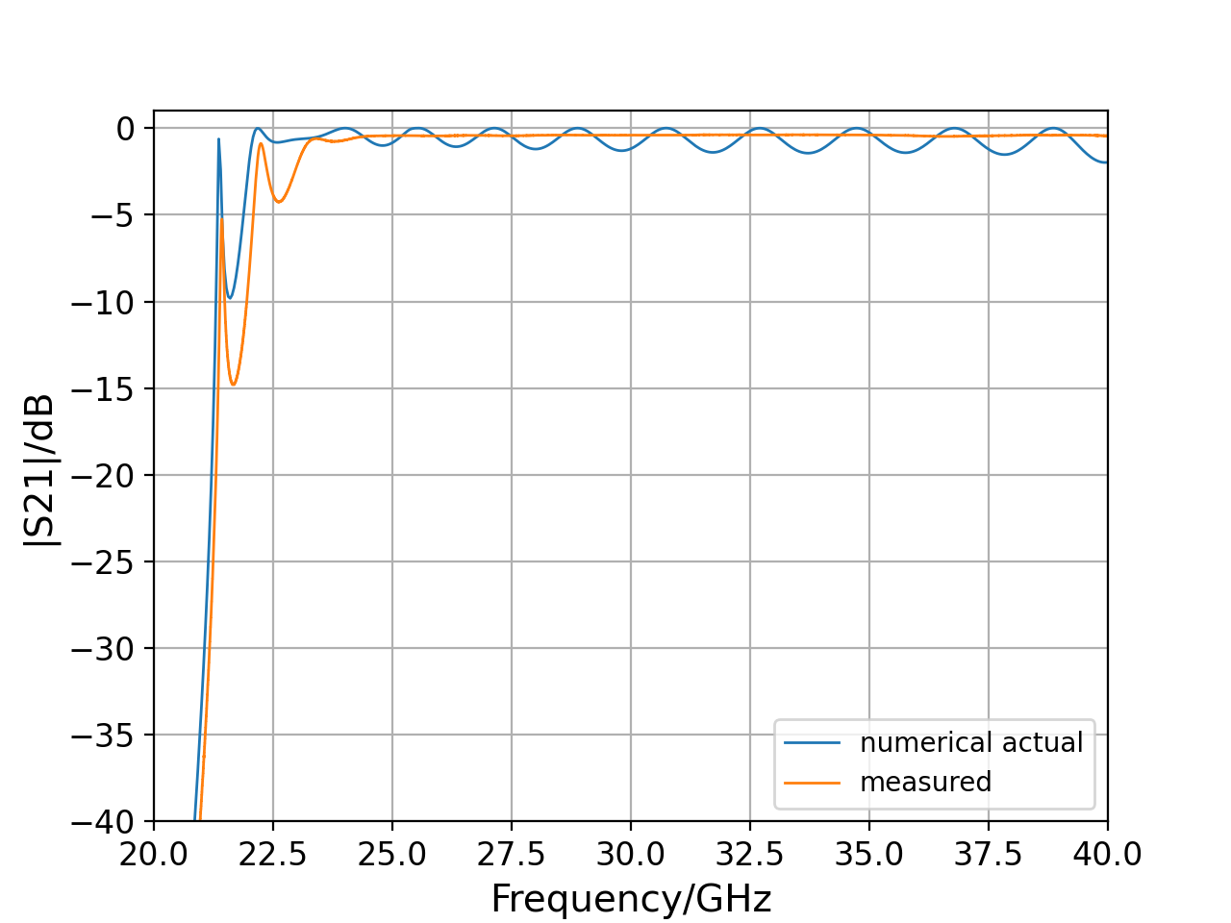
Adapter

Slide 7
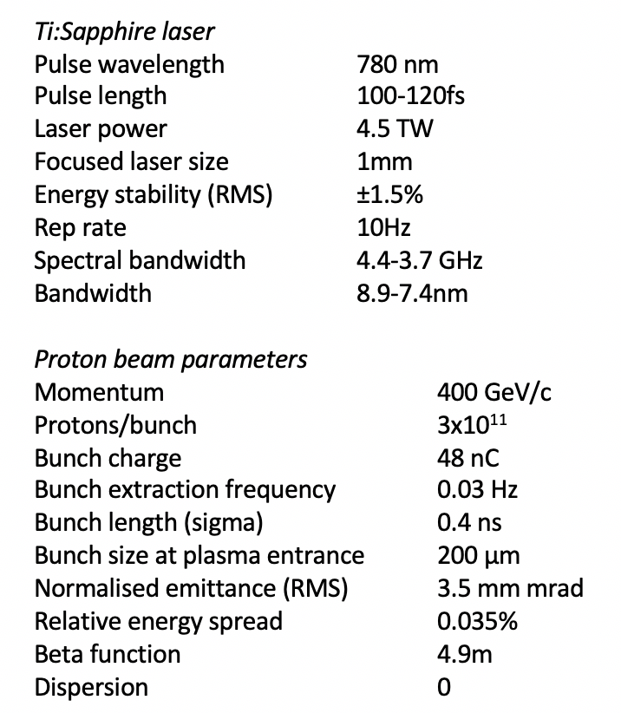
AWAKE parameters

Slide 8
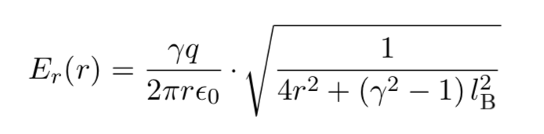
Field at EO crystal
Field of line charge (first approximation)
For proton beam with gamma=427 and distance 30 mm from bunch, maximum field strength is 230 kV/m

Slide 9
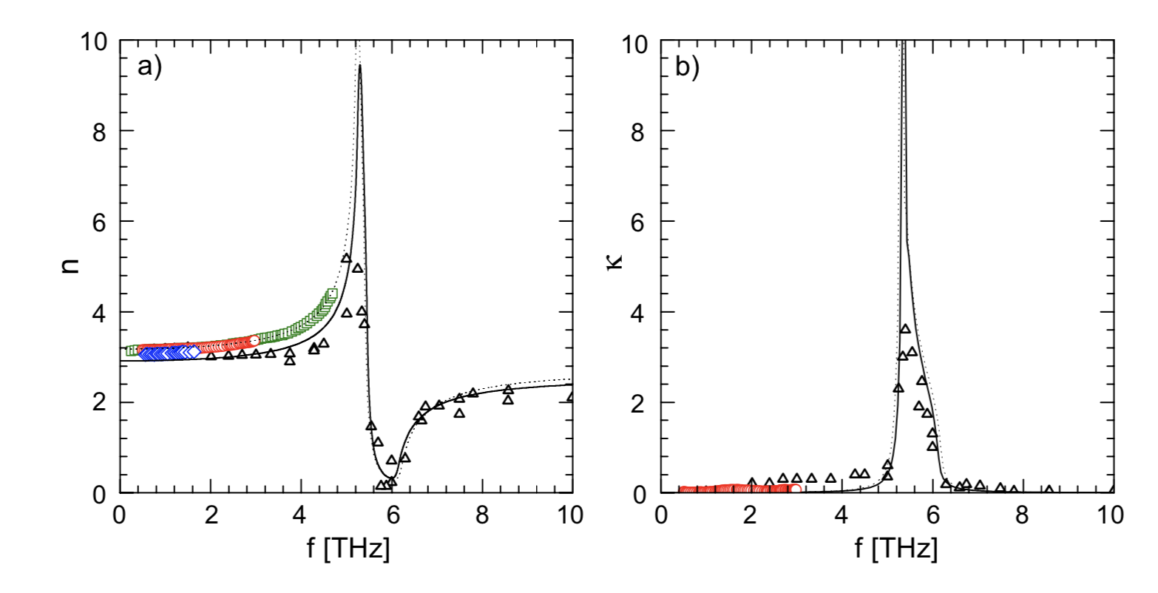
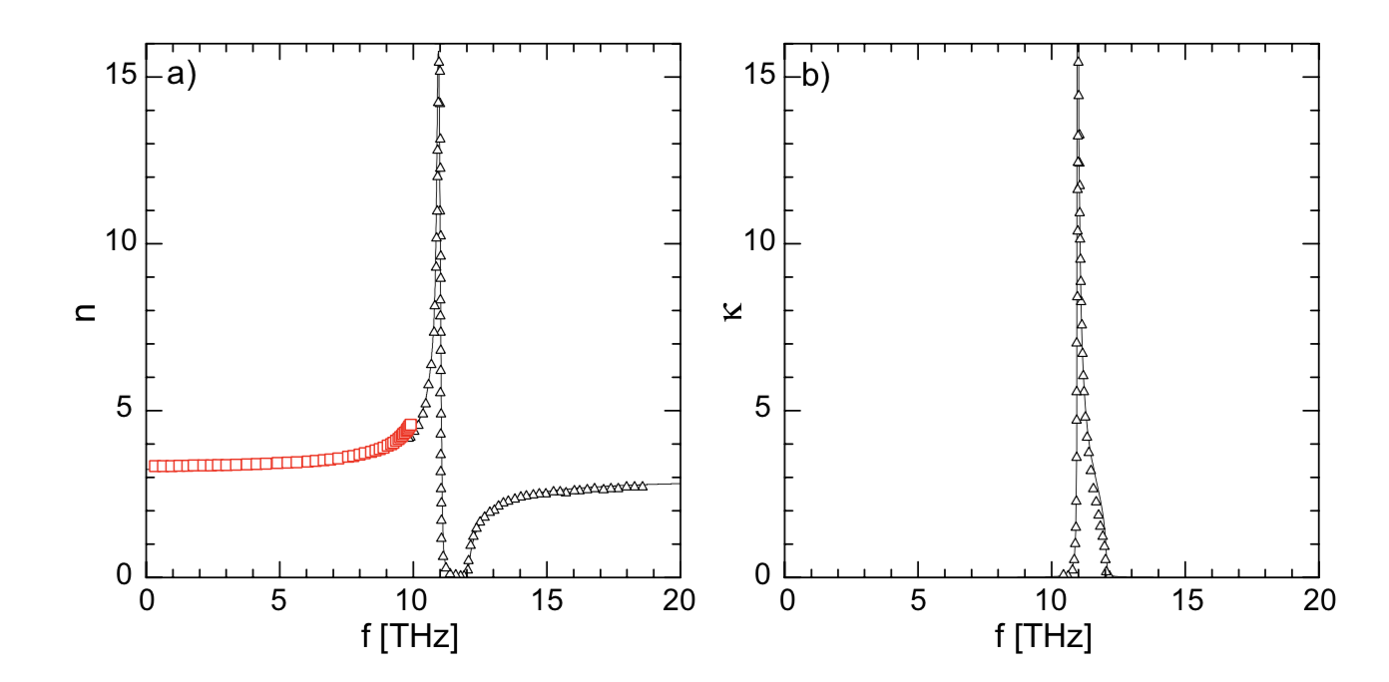
Choice of EO crystal
Temporal resolution limited by:
Chirped pulse width of probe laser T_{min}=(T₀T_{c})^0.5=(100 fs x 10 ns)^0.5 = 30 ps
Absorption in THz range – ZnTe and GaP have absorption at 5 THz and 11 THz respectively so temporal resolution limited to 120 fs (FWHM). Shorter pulses will lead to a distortion.
Velocity mismatch between bunch E-field and laser.
Velocity mismatch between different spectral components of probe laser.
Geometrical limitation, E-field of particle bunch has opening angle 2/gamma, the resolution is T_{geo}=r/(gamma x c) = 30 mm/ (427 x c) = 0.2 ps
ZnTe
GaP

Slide 10
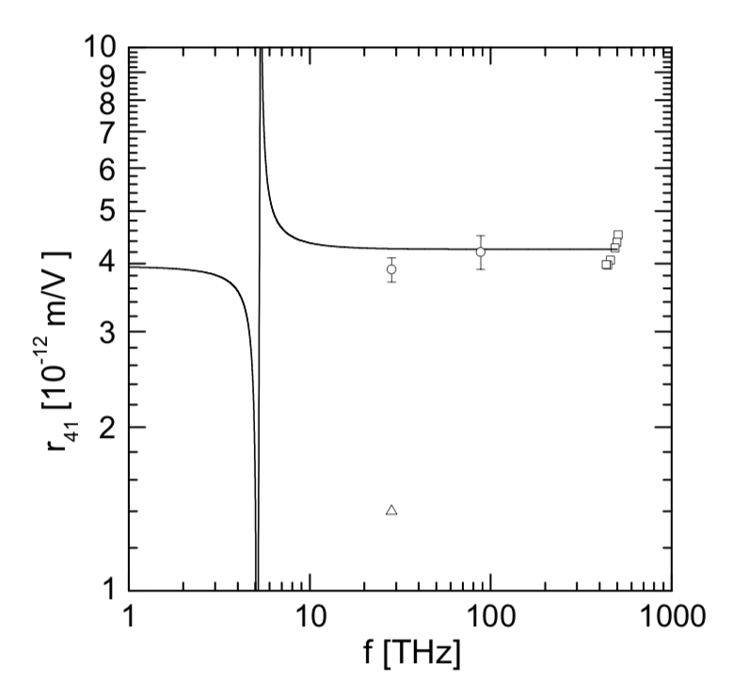
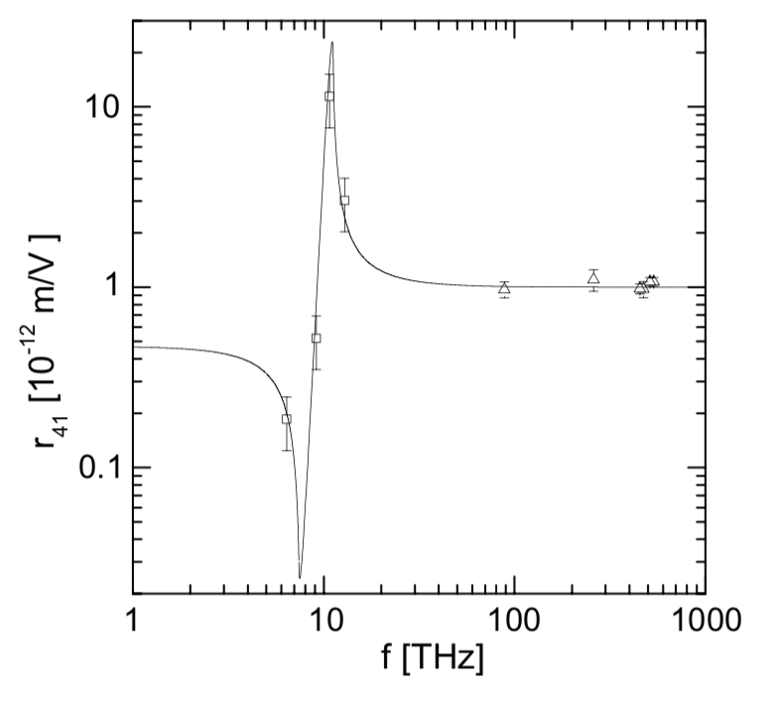
Choice of EO crystal
GaP more suited to measure short pulses due to higher TO frequency
But Pockels coefficient is about factor 8 lower
ZnTe
GaP
About factor 8 lower

Slide 11
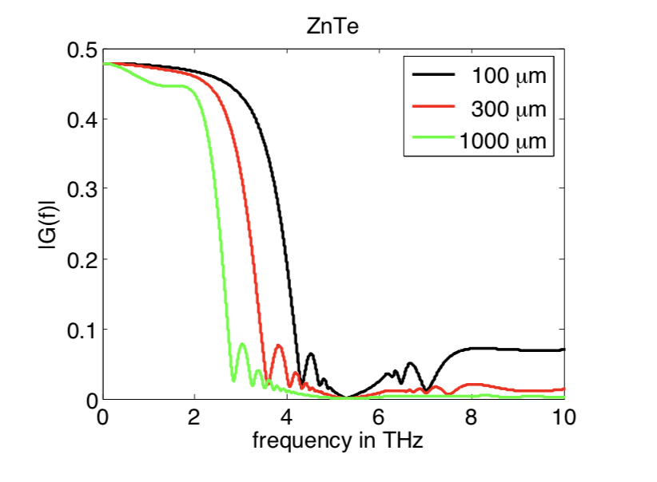
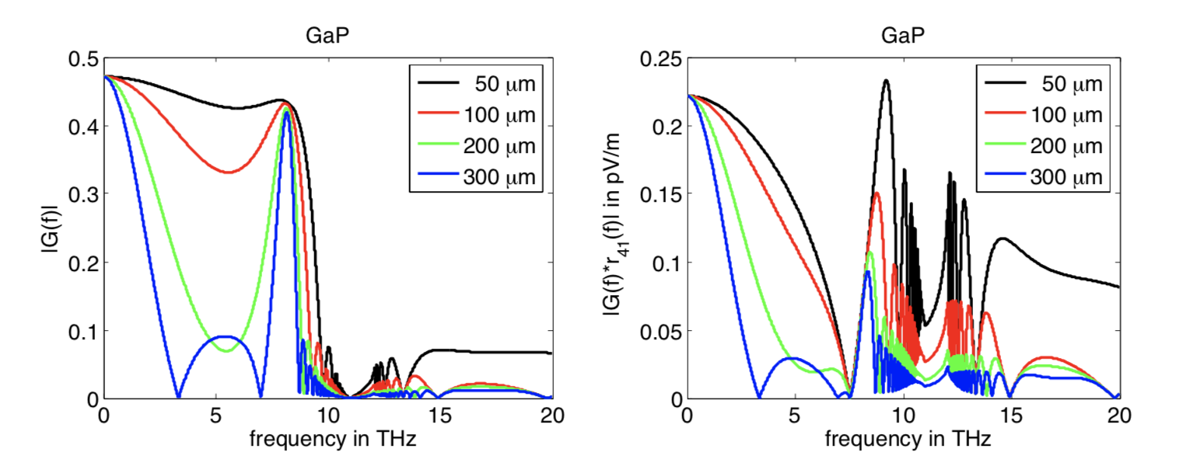
Frequency response
GaP permits to increase frequency range when short crystals are used
But for crystal thickness d = 300µm, response reaches about 3 THz. Therefore ZnTe is better at this thickness.
For ZnTe d ≈ 200-300µm as compromise between high-frequency response and signal amplitude.
For GaP d ≈ 100µm to detect signals with frequencies up to 7.5 THz
In our case, radiation from proton bunch is in flat region of response curve

