Slide 1


Principle of operation of an innovative new sensor for neutron detection based on resistive AC coupled LGADs
LUCA MENZIO
UNIVERSITÀ DI TORINO-INFN
UFSD group – LISS
38th RD50 Workshop
Supported by the FARE MIUR Grant

Slide 2
Index
Introduction
Thermal Neutrons Detection
Neutron detection with silicon sensors
Our Project: AC-LGADs with ⁶LiF
Conclusions

Slide 3
Introduction

Slide 4
Neutron detection
Neutron detectors are not vertex detectors!
Lower energies (typically below 10 MeV)
Low rates and fluxes
Should be photons insensitive
Classification | Energy
Cold | < 0.012 eV
Thermal | 0.012 eV - 0.4 eV
Epithermal | 0.4 eV – 0.01 MeV
Fast | 0.01 MeV – 20 MeV
High Energy | > 20 MeV
Luca Menzio – INFN Torino
Neutrons need conversion into charged particles to be detected
Recoil (high energies)
Induced fission
Nuclear capture by elements with A > 40 (passive)
Nuclear capture by light elements
22 June 2021
38th RD50 Meeting

Slide 5
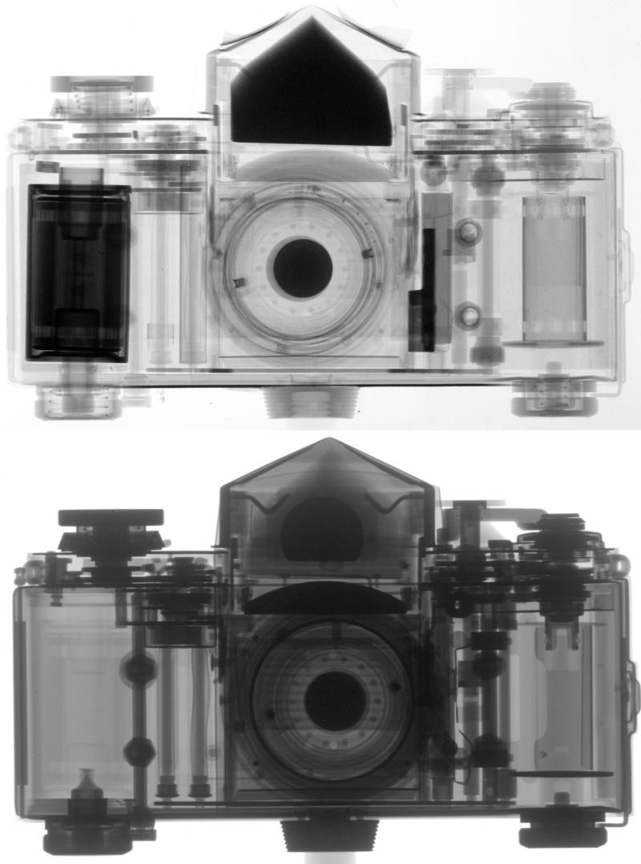
Field of application: neutron imaging
Neutron Imaging is a radiographic non- destructive method.
It exploits neutrons ability to penetrate materials with attenuation coefficients specific for each material (isotope).
In this field are employed
cold or thermal neutrons beams
Fluxes in the order of 10⁵-10⁹ n/(cm²s)
Luca Menzio – INFN Torino
Normally, images are shot using neutron cameras
Maximum resolution ever achieved of circa 14 μm, normally around 100 μm
Camera integration time is around 1-2 s
Xrays (top) and neutrons (bottom).
Image taken from PSI website.
22 June 2021
38th RD50 Meeting

Slide 6




How to detect thermal neutrons
Given the high cross section, traditional methods to detect thermal neutrons rely on neutron capture and subsequential detection of secondary charged particles with scintillators or gases.
Excluding fissionable isotopes and materials which don’t provide good neutron-photon discrimination, the main useful thermal capture reactions are
$${}_{2}^{3}{He+n→ {}_{1}^{3}{H+p}}$$
Q = 764 keV
5330 barn @ 25 meV
Luca Menzio – INFN Torino
$${}_{3}^{6}{Li+n→ {}_{1}^{3}{H+α}}$$
Q = 4.78 MeV
940 barn @ 25 meV
$${}_{3}^{10}{B+n→α+{}_{3}^{7}{Li}}$$
Q = 2.79 MeV
3840 barn @ 25 meV
${}_{3}^{10}{B+n→α+{}_{3}^{7}{Li}}$*
Q = 2.31 MeV
High Q-value, good photons rejection
Solid compounds (i.e. LiF and LiI)
Easy to enrich – relatively cheap
Most employed with silicon devices
22 June 2021
38th RD50 Meeting

Slide 7
Neutron Detection with Silicon Sensors

Slide 8
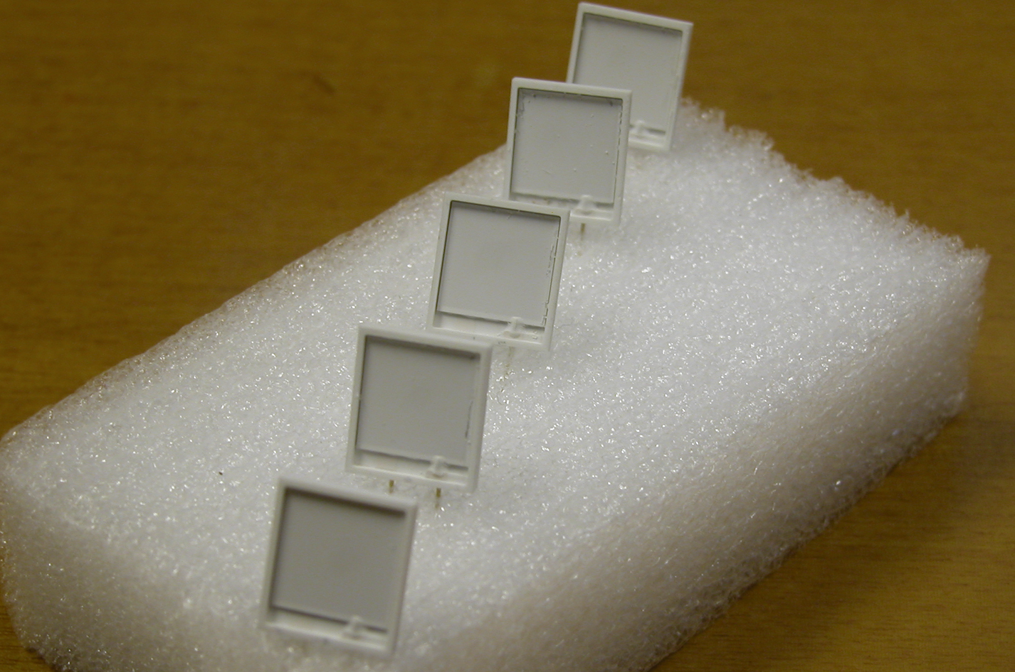
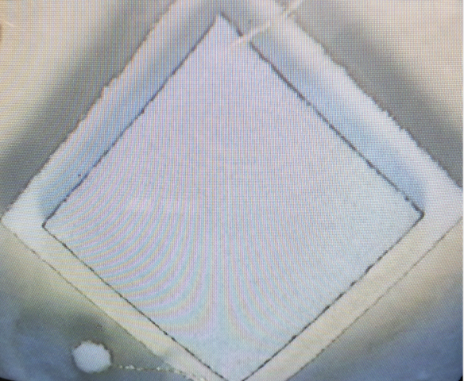
Silicon detectors and ⁶Li
At INFN LNF (Laboratori Nazionali di Frascati) Roberto Bedogni’s team is successfully using a LiF deposition technique to assemble silicon neutron detectors. It consists in:
Suspension with ⁶LiF enriched powder
Evaporation process
The method is quite simple, cheap and provides a good reproducibility
Luca Menzio – INFN Torino
S3590-09 Hamamatsu Diode
Area 1 cm²
SgLux UV photodiodes Silicon carbide
Area 7.2 mm²
22 June 2021
38th RD50 Meeting

Slide 9
Diodes sensitive to neutrons
The detectors are assembled, wired and tested by the LNF group. The testing is carried out in the Hotnes facility.
Most recently, a set of diodes with ⁶LiF deposit have been studied and produced for the NCT-WES project.
Both experimental and simulation results show that the maximum efficiency is achieved with 34 µm thick ⁶LiF deposition on the diode surface
Extremely good for beam monitoring and neutron spectroscopy (inside Bonner Spheres), but not for position and time measurements.
Luca Menzio – INFN Torino
Efficiency results obtained with a LiF coated detector in the Hotnes facility.
22 June 2021
38th RD50 Meeting
Notes:
Meno parole

Slide 10
Our Project:
RSDs for neutron detection

Slide 11
Combining RSD with ⁶LiF
⁶LiF Layer
AC coupling oxide
30 μm
n
Luca Menzio – INFN Torino
Resistive n+ electrode
α
50 μm
Gain layer
The alpha particle or the trizium nucleus are detected in the RSD
p++ electrode
22 June 2021
38th RD50 Meeting

Slide 12
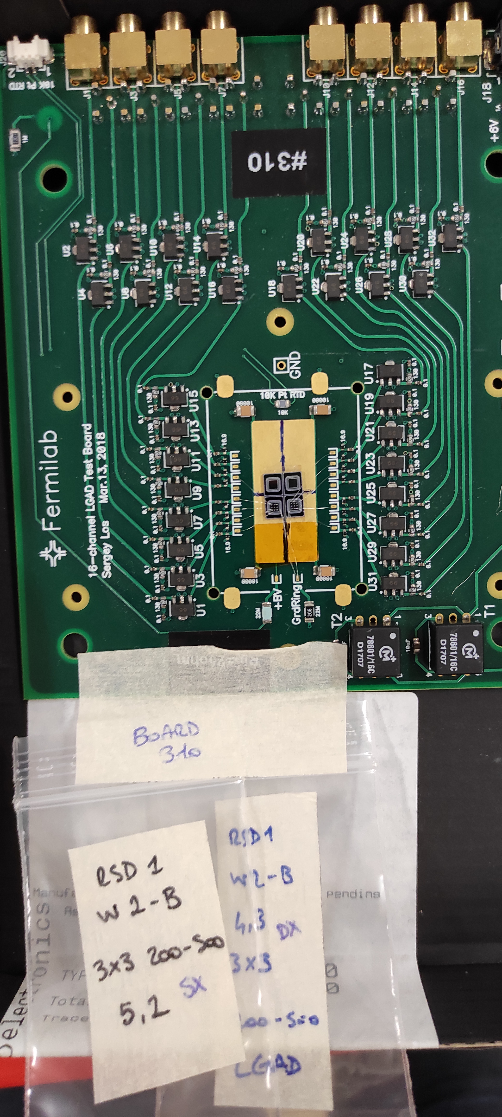
AC-LGADs with LiF coating
AC-LGADs with LiF coating: an innovative neutron detector!
Great timing performances, 40-50 ps
Optimal spatial resolution, some µm for MIP protons
LGAD multiplication provides optimal signal/noise
Carbonated gain implant provides radiation resistance
Intrinsic photon rejection
  Photons with energy greater than 20 keV are very unlikely to generate signals in 55 µm thick sensors (1000 µm absorption length)
Alphas are completely absorbed (15 µm range in silicon)
Luca Menzio – INFN Torino
22 June 2021
38th RD50 Meeting

Slide 13
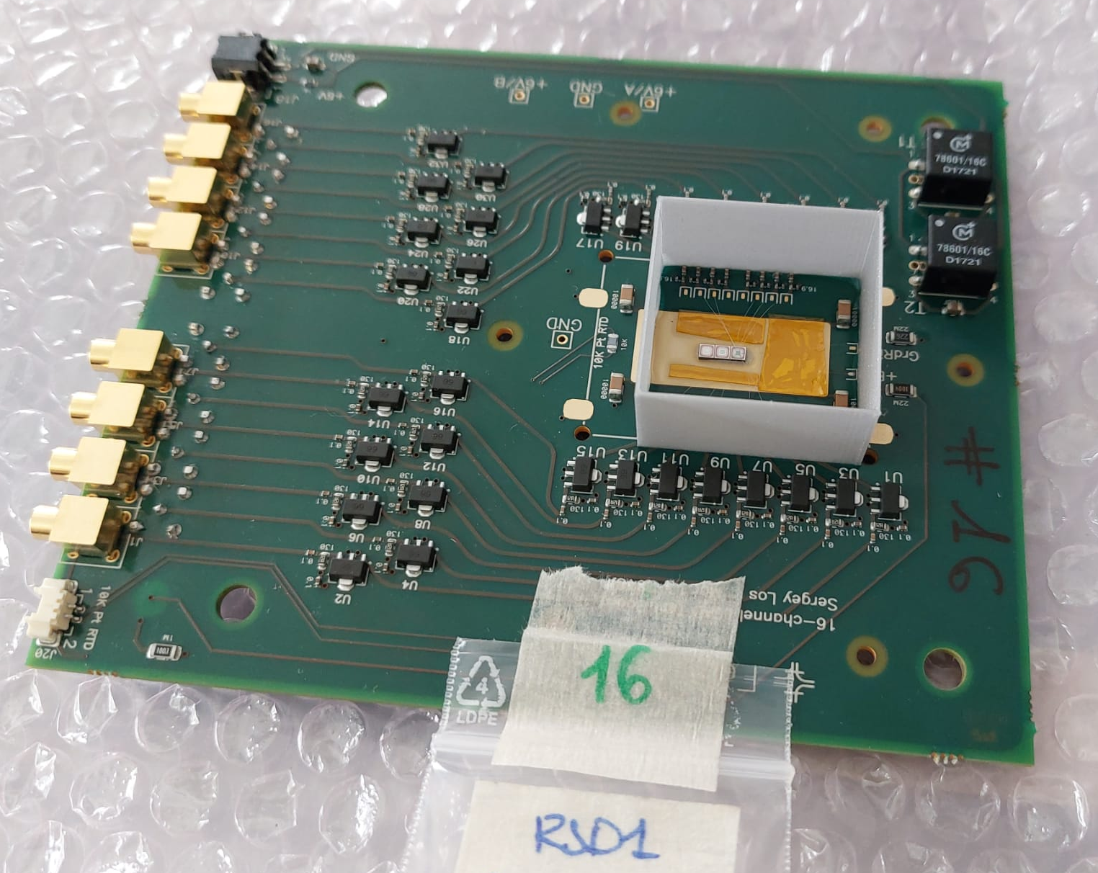
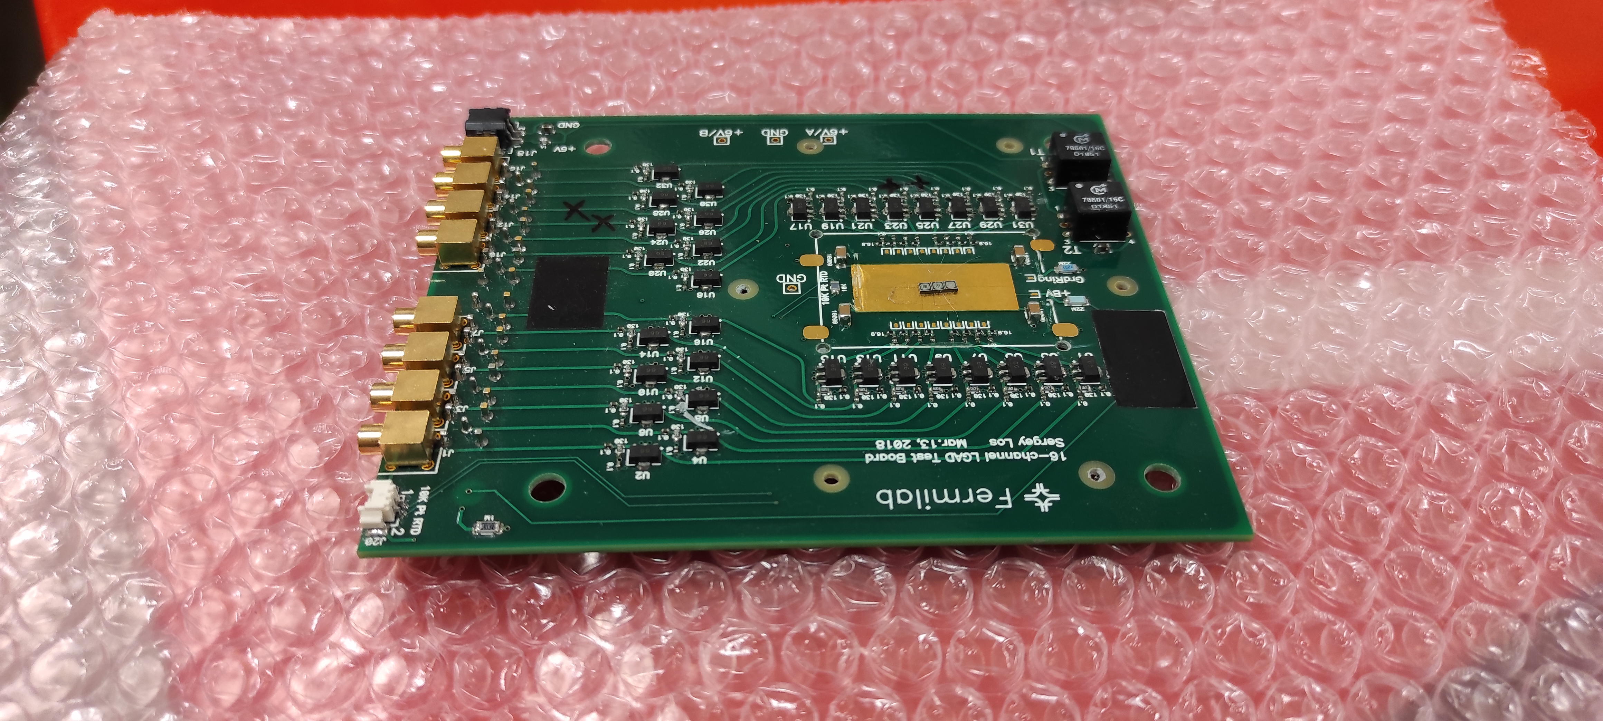
AC-LGADs with LiF in practice
For this first trial three different types of detectors were employed: 50-100, 100-200 and 200-500 FBK AC-LGADs.
Practically, coating these sensors proved difficult because of the many bonds.
Therefore
⁶LiF
Luca Menzio – INFN Torino
Bonded the sensors to a 16 channels FNAL board
Glued 3D printed containment walls outside the bonds area
Sent the boards to the Frascati Labs to do the ⁶LiF deposition
Work in progress! We should receive them back by the end of June
22 June 2021
38th RD50 Meeting

Slide 14
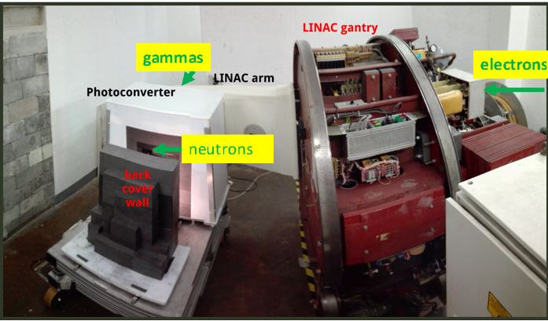

Detector testing
Detectors will be tested in the Turin Thermal Neutron Source.
Based on the Elekta SL18 Precise Linac.
Accelerates electrons (up to 18 MeV) and can be operated in photon mode
A photoconverter provide a testing region with thermal neutrons
Maximum fluence rate:
Luca Menzio – INFN Torino
$${\dot{Φ}}_{th}=\left(1.75±0.04 \right){10}^{6} n cm^{−2} s^{−1}$$
22 June 2021
38th RD50 Meeting

Slide 15
Conclusions
Our group is currently developing a method to detect thermal neutrons with the RSD devices, possibly for neutron imaging.
This detector would provide
Good radiation resistance
LGAD-like timing resolution
Spatial resolution of few microns
First experimental tests are going to be carried out in the next future!
Luca Menzio – INFN Torino
22 June 2021
38th RD50 Meeting

Slide 16
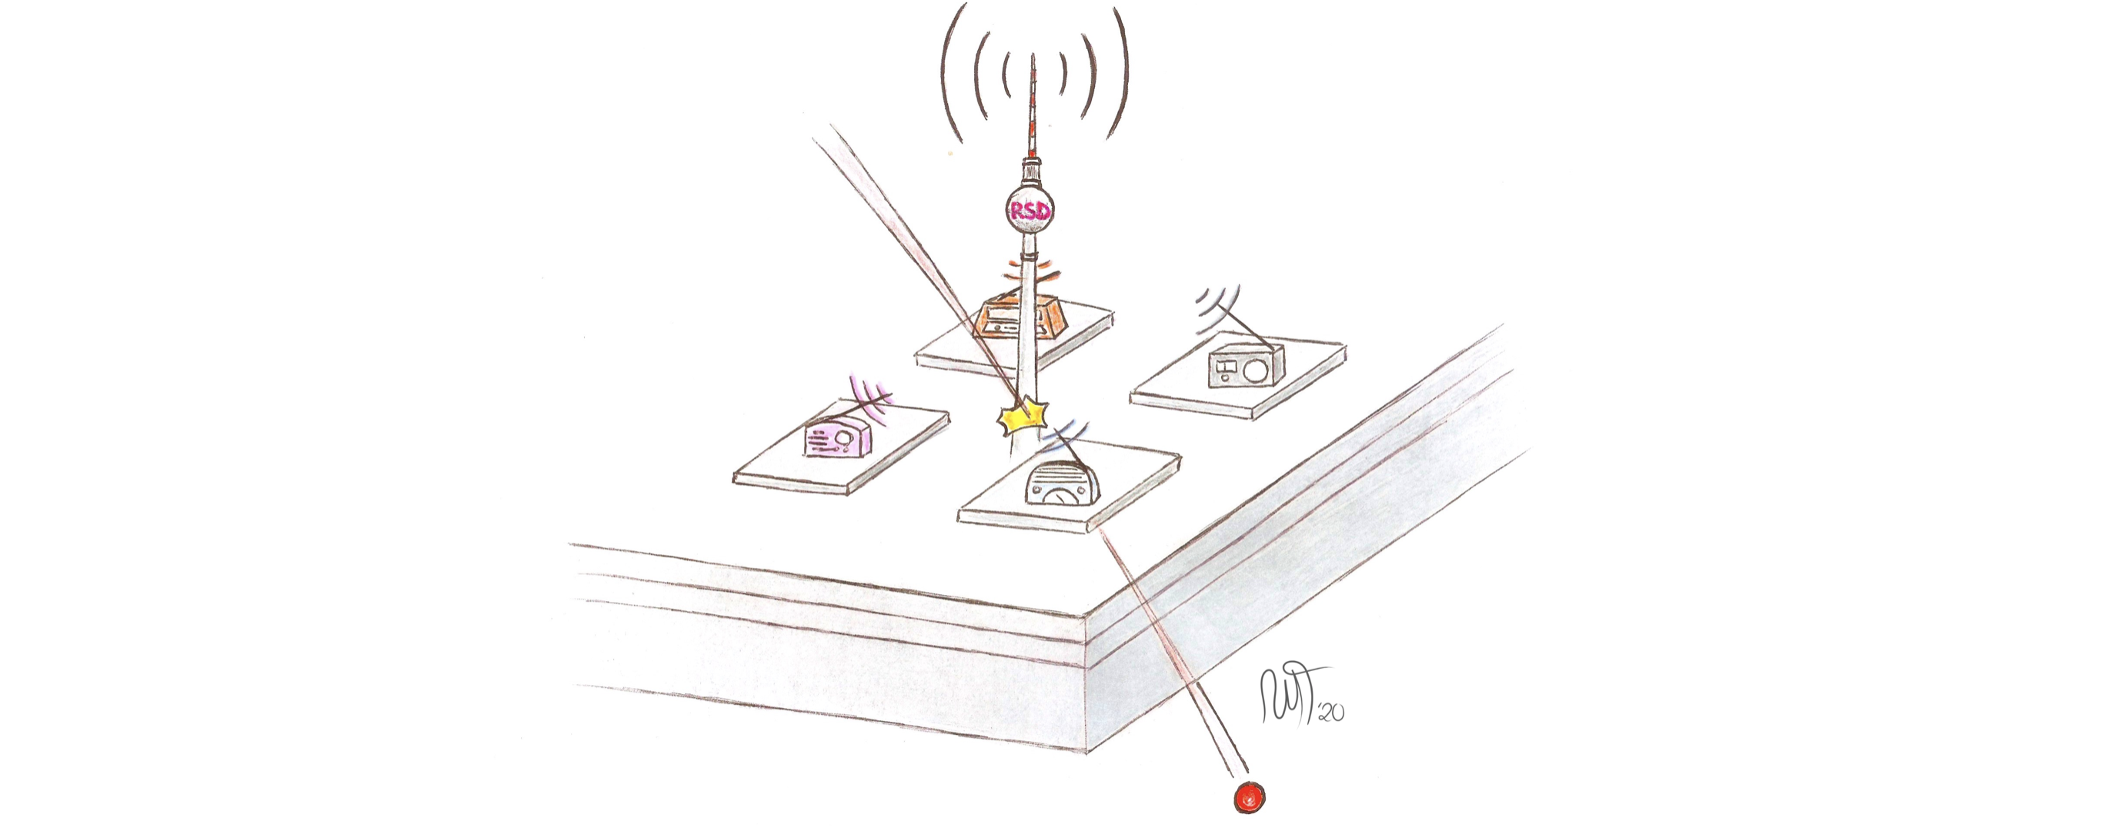
Thank you!

Slide 17
Special Thanks to
We kindly acknowledge the following funding agencies, collaborations:
INFN - Gruppo V, UFSD and RSD projects
INFN – FBK agreement on sensor production (convenzione INFN-FBK)
Horizon 2020, grant UFSD669529
Dipartimenti di Eccellenza, Univ. of Torino (ex L. 232/2016, art. 1, cc. 314, 337)
Ministero della Ricerca, Italia , PRIN 2017, progetto 2017L2XKTJ – 4DinSiDe
Ministero della Ricerca, Italia, FARE, R165xr8frt_fare
Luca Menzio – INFN Torino
22 June 2021
38th RD50 Meeting

Slide 18
References
Detection system for microimaging with neutrons, S.H. Williams et al., JINST (2012)
Roadmap for High Efficiency Solid-State Neutron Detectors, R. J. Nikolic et al., Proceedings of SPIE (2005)
Resistive AC-Coupled Silicon Detectors: principles of operation and first results from a combined analysis of beam test and laser data, M. Tornago et al., NIM A (2020).
Experimental characterization of semiconductor-based thermalneutron detectors, R. Bedogni et al., NIM A (2015)
A new active neutron detector, R. Bedogni et al., Radiation Protection Dosimetry (2013)
The e_LiBANS facility: A new compact thermal neutron source based on a medical electron LINAC, V. Monti et al, NIM A (2020)
Characterization of large area avalanche photodiodes in X-ray and VUV-light detection, Luis M. P. Fernandes et al., JINST (2007)
Luca Menzio – INFN Torino
22 June 2021
38th RD50 Meeting

Slide 19
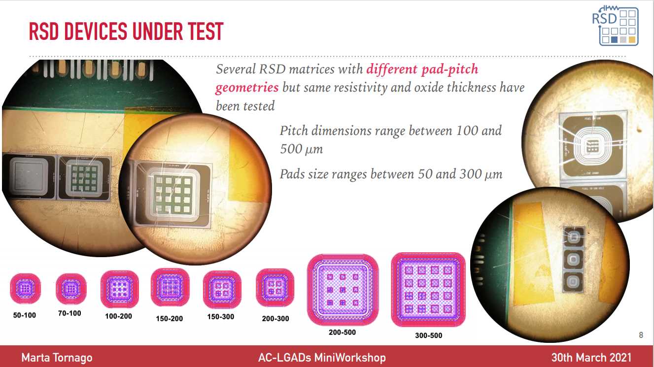
Luca Menzio – INFN Torino
22 June 2021
38° RD50 Meeting

Slide 20
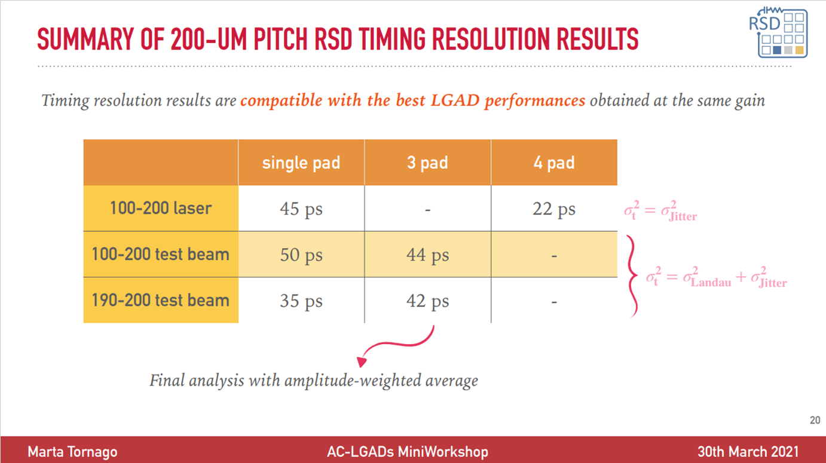
Luca Menzio – INFN Torino
22 June 2021
38° RD50 Meeting

Slide 21
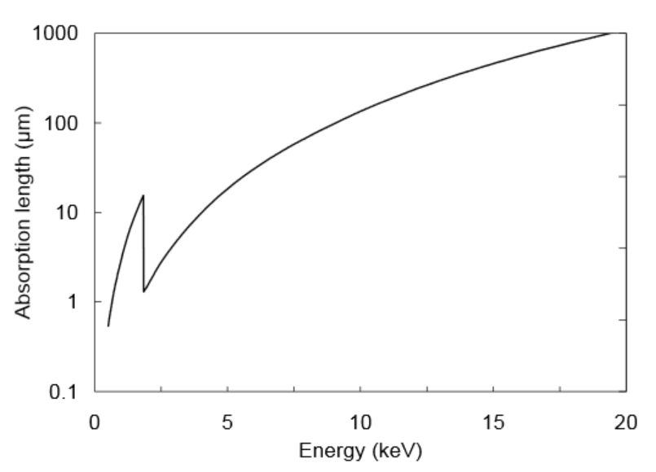
Photon absorption length in silicon
Luca Menzio – INFN Torino
22 June 2021
38° RD50 Meeting

Slide 22
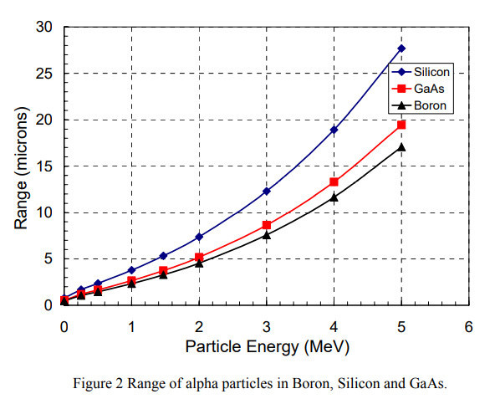
Luca Menzio – INFN Torino
22 June 2021
38° RD50 Meeting

Slide 23
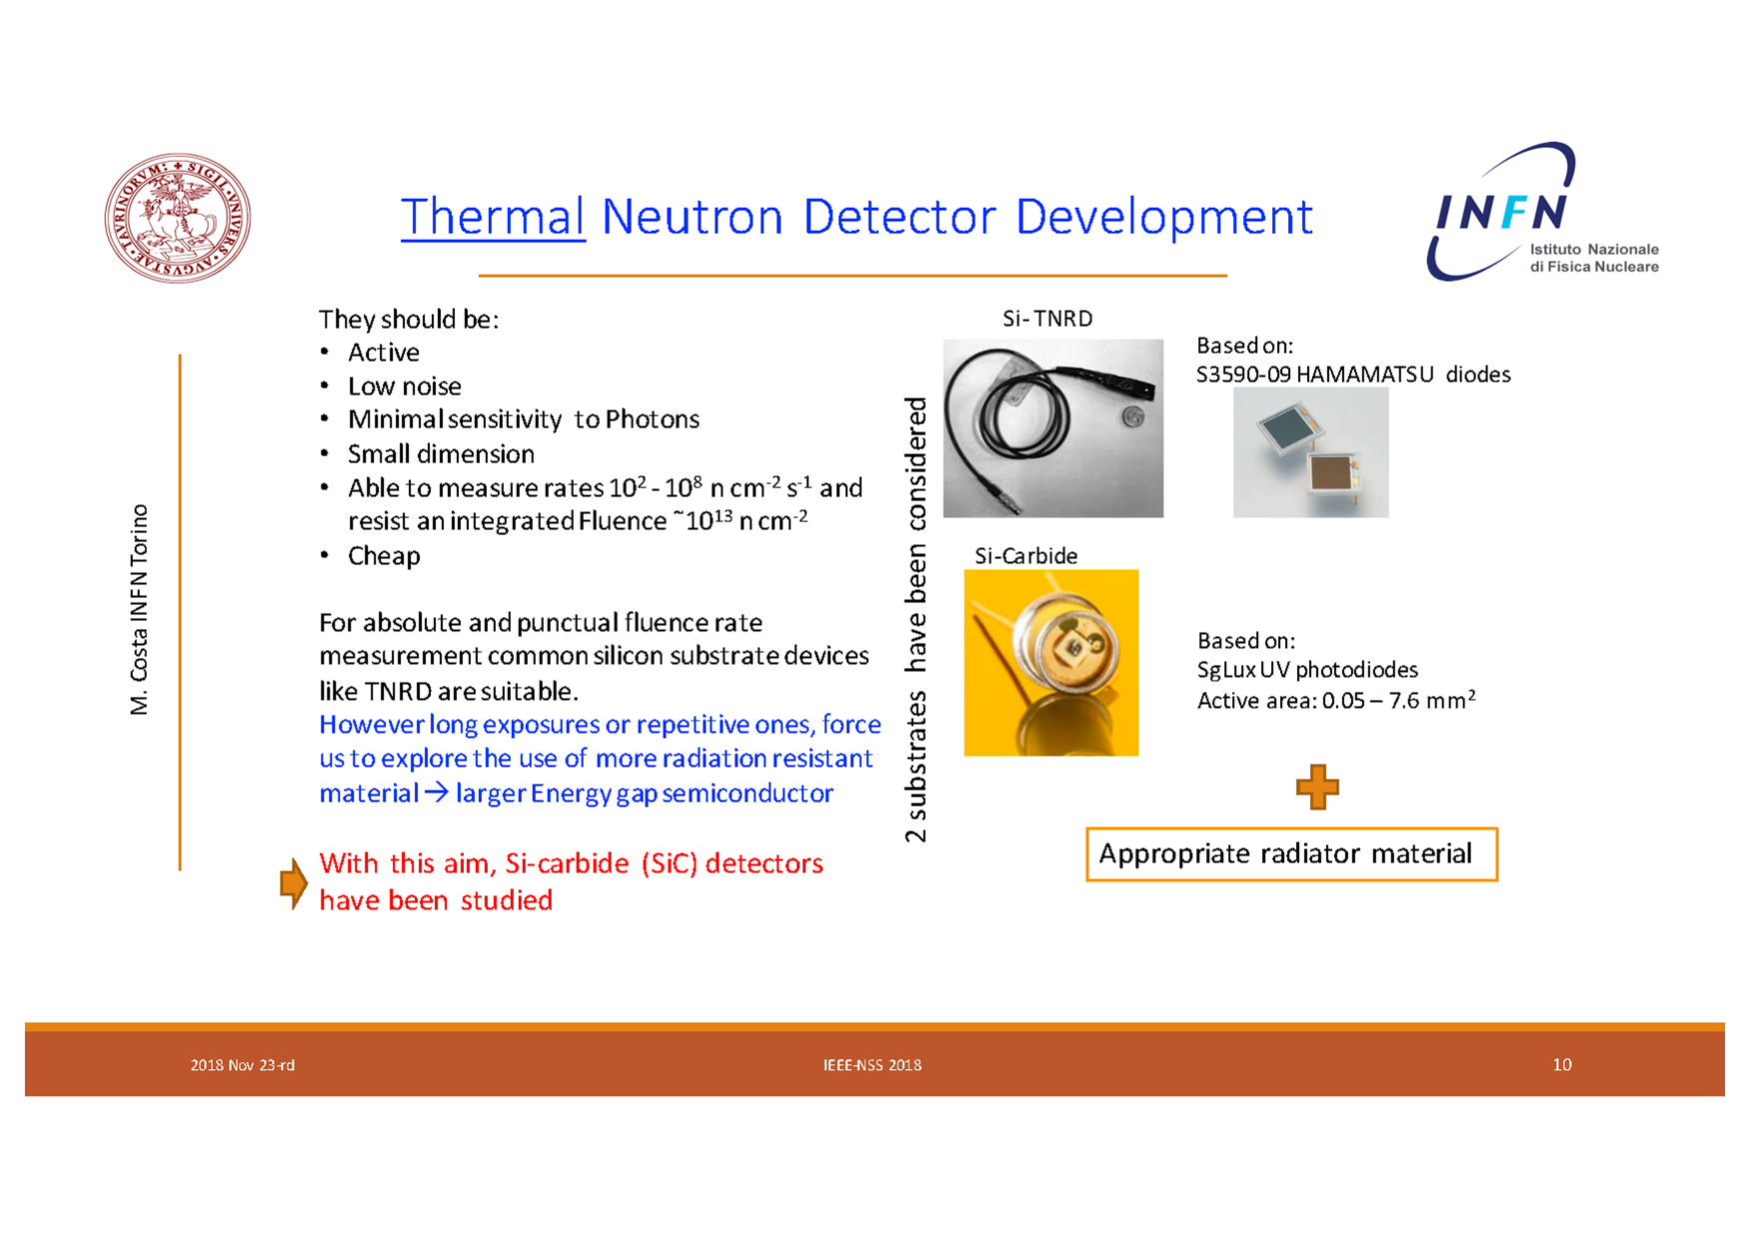

Slide 24
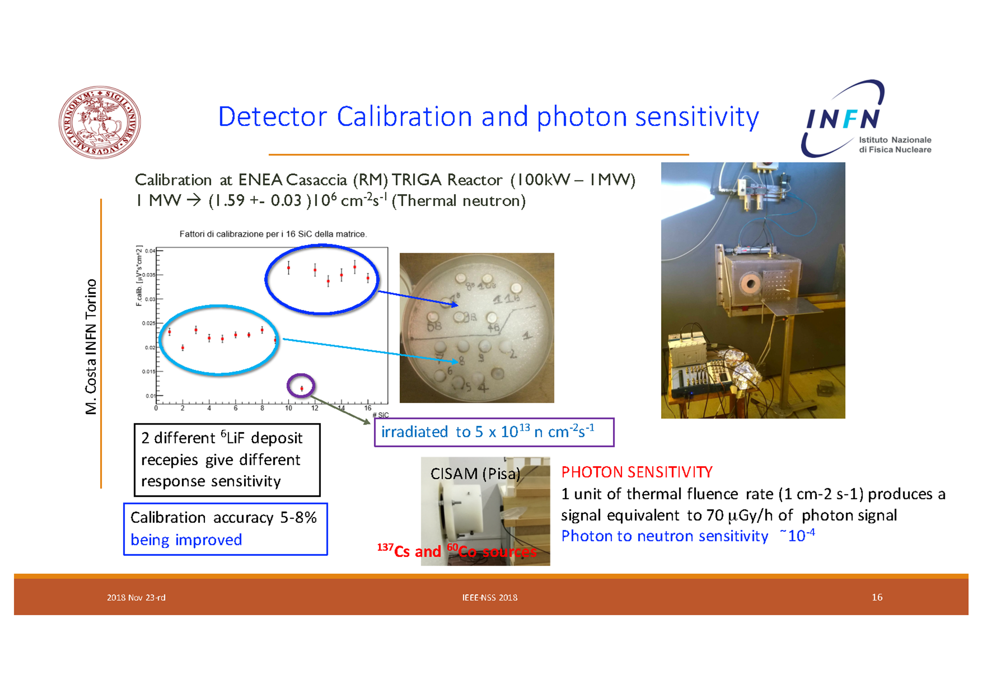

Slide 25
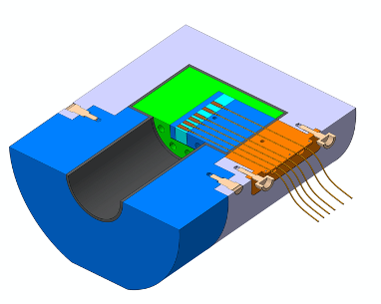
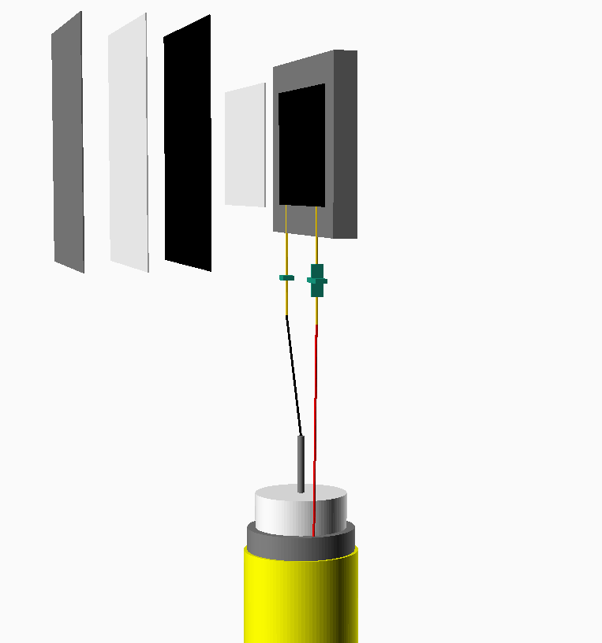
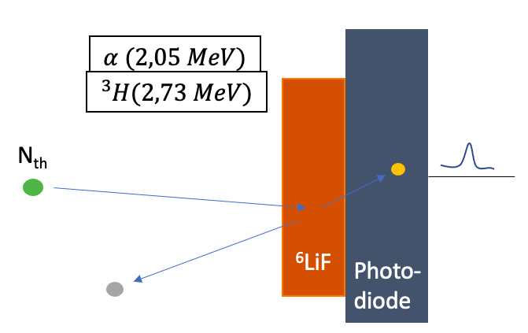

TNPD
(Thermal Neutron Pulse Detector)
How do we measure thermal neutrons?
⁶LiF
Black PVC
⁶LiF
My work
My work
Transparent PVC
$σ_{th(25meV)} [ 6Li\left(n,α\right){}_{ }^{3}H]=940 b$
Dedicated measure for the determination of the optimal ⁶LiF thickness = 30 µm
Aluminium
My work
1x1 cm² S3590-09 Hamamatsu Photodiode

Slide 26
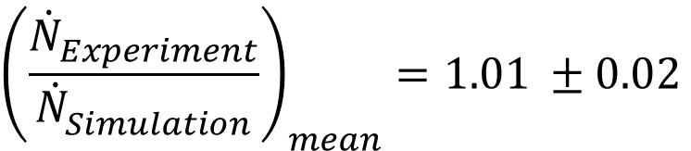
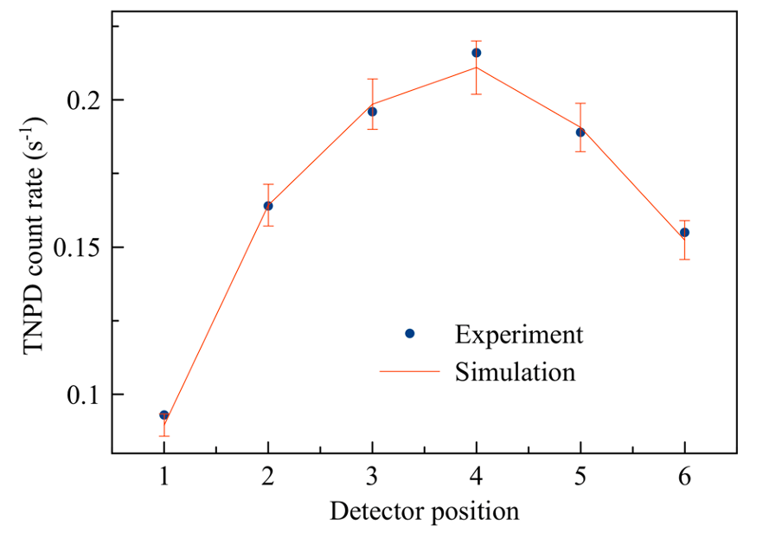
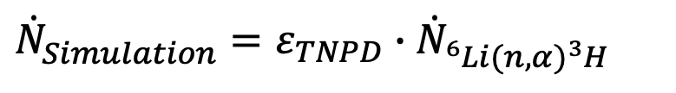
Absolute comparison between experiment and simulation
Results
$${\dot{N}}_{Simulation}^{ }=ε_{TNPD}∙{\dot{N}}_{{}_{ }^{6}{Li}(n,α){}_{ }^{3}H}^{ }$$
$${\left(\frac{{\dot{N}}_{Experiment}^{ }}{{\dot{N}}_{Simulation}^{ }}\right)}_{mean}=1.01 ±0.02$$
My work

