Slide 1






Mortality study on irradiated W36 LGADs and PINs (II part): TCT-TPA
Gordana Lastovicka-Medin
University of Montenegro
Gregor Kramberger
Jozef Stefan Institute
Mateusz Rebarz, Jakob Andreasson, Kamil Kropielniczki
ELI Beamlines
Jiří Kroll, Michal Tomášek, Tomáš Laštovička
Institute of Physics, Academy of Sciences, CZ
Valentina Sola, Nicolo Cartiglia
INFN Torino
38th RD50 Workshop, July 21-23, 2021, CERN

Slide 2
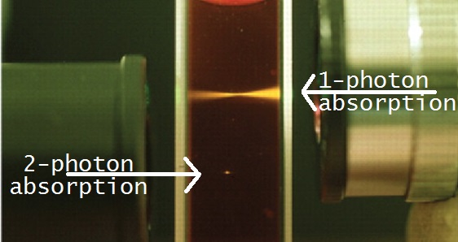
Research question
First of all ELI TCT-SPA fs-laser shows capacity for SEU studies
Tests confirmed that huge amount of charge in a single collision cause a conditions that lead to a destructive LGAD breakdown.
NEW Research Q: Does the position of deposition matter? It can be that it is not the same if large amount of charge is released on top or on the bottom of the active layer.
A clear case for TPA since TPA-TCT is a way to generate very localized electron-hole pairs in semiconductor devices (microscale volume).
Differently to standard TCT where the energy deposition (pair creation) is continuous along the beam, TPA-TCT reduces this region to an ellipsoidal volume, achieving thus, true 3D spatial resolution.

Slide 3
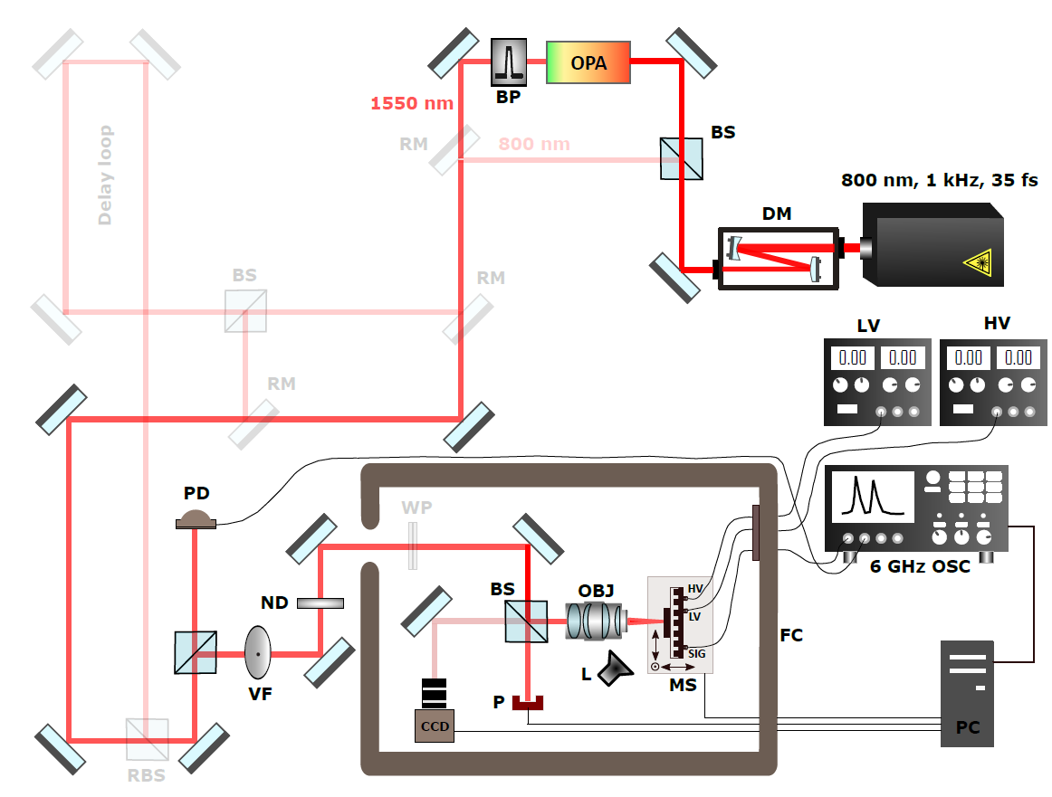
TPA configuration at ELI Beamlines (Prague)
For more details see 37th RD50 Workshop
DM – demagnifier, BS – beamsplitter, OPA - optical parametric amplifier, BP - bandpass filter, RM - removabe mirror, RBS - removable beamsplitter,
PD - reference photodiode, VF - variable gradient ND filter, ND - fixed neutral density filter, WP - half waveplate, P – powermeter, OBJ - 100X objective
L- lamp, MS - motorized XYZ stages, LV - low voltage power supply, HV - high voltage power supply, FC - Faraday cage

Slide 4
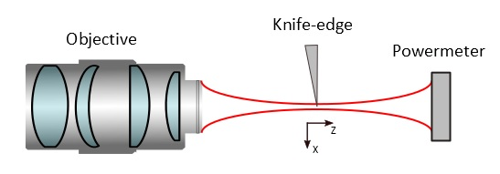
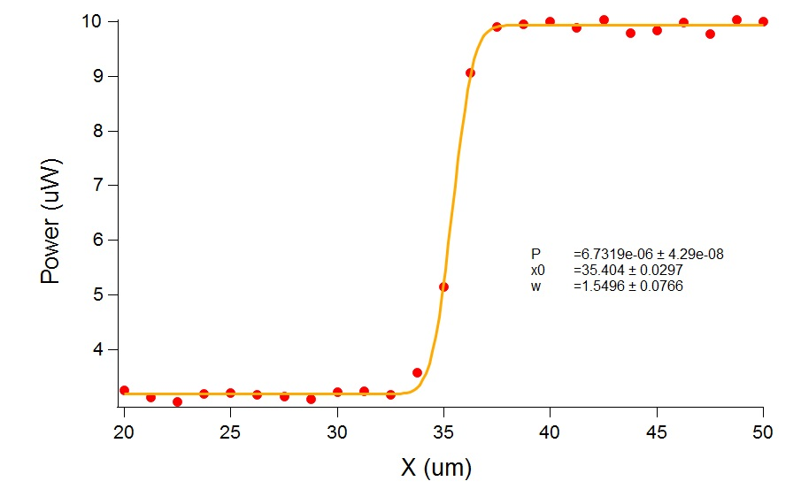
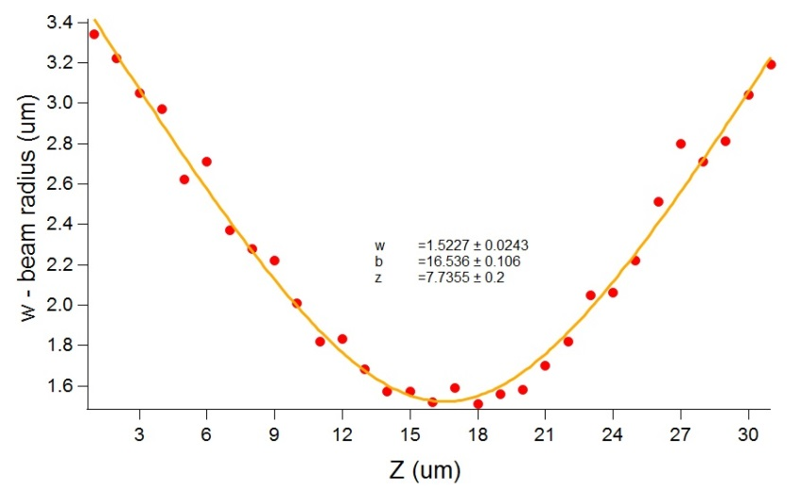
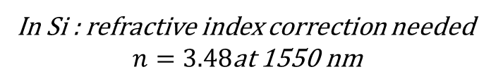
Beam profile and parameters at 1550 nm (for TPA)
1. P(x) measured for series of Z points around focal point
2. w(Z) obtained by fitting for every Z
3. w₀ and Z_{R} obtained by fitting w(Z) curve
100X Mitutoyo Plan Apo NIR HR
Infinity Corrected Objective
λ = 1550 nm
Example P(x) curve
with fit measured
close to focal point
Final parameters (in air):
w₀ = 1.52 μm
Z_{R} = 7.74 μm
In Si : refractive index correction needed
$$n=3.48\text{at}\text{ 1550 }\text{nm}$$
$NA=0.31$ (nominal NA=0.7 but probably not valid for focal point)
For more details see 37th RD50 Workshop, 2020

Slide 5
Method & Summery of Procedure Steps
Conditions:
λ = 1550 nm (beam focused in the center of pad)
Beam diameter: d = 3 μm
Temperature: -25 °C
Laser power/energy range 90 nW-3.2 uW = 90 pJ-3.2 nJ
After SPA studies we had still two non-damaged and operational samples (both LGAD 1.5e15) so we used them for TPA tests.
The results for both samples are very similar so only one was used for final damage by TPA (the second one was used for additional SPA damage to complete those data).
The first step was confirmation of TPA character of the signal, so Q vs P (actually pulse energy) was checked, and Z-scans were performed for low and high illumination level.
After that, the sample was set at Z giving maximal signal at bias 650 V and laser power was increased until the first symptoms of instability occurred.
Then sample was shifted to different Z positions to “see” if there are any changes of stability threshold in the studied Z-range
In the end the sample was exposed to higher energies until the breakdown of the sensor happened.

Slide 6
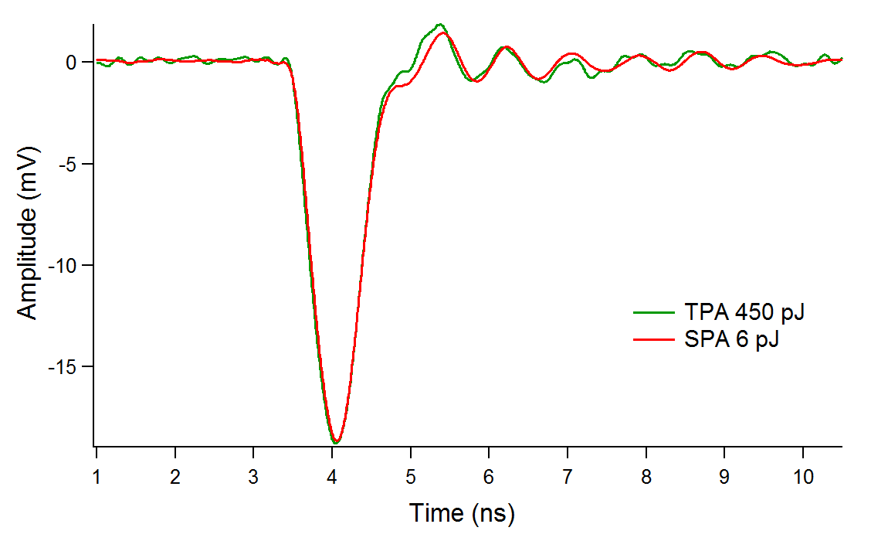
TPA vs SPA signal
TPA waveforms are nearly identical to those obtained by SPA.
Here we show an example of comparison for signal obtained by SPA at 6 pJ and TPA at 450 pJ (recorded at position Z_{max} ). Both signals correspond to HV bias of 100 V

Slide 7
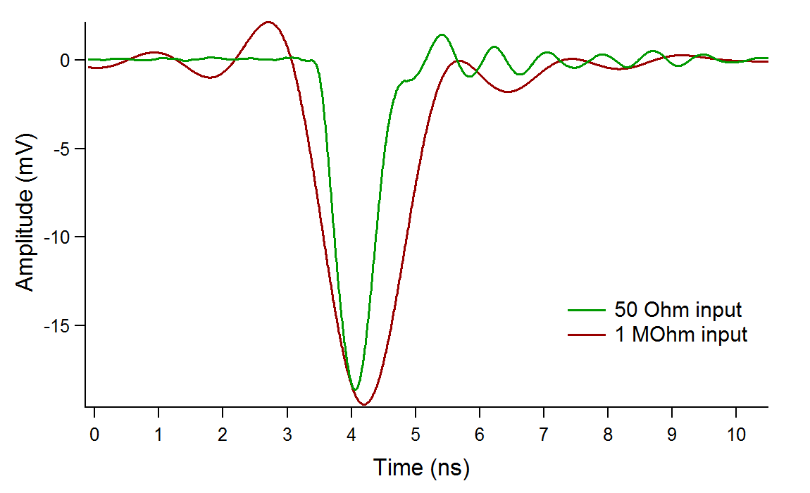
50 Ohm vs 1 MOhm input
Since TPA mortality studies are more unpredictable we used 1MOhm input for oscilloscope safety. Therefore the waveforms obtained by TPA are slightly broader.
Below comparison of the same signal for 50 Ohm and 1MOhm at 450 pJ and 100 V

Slide 8
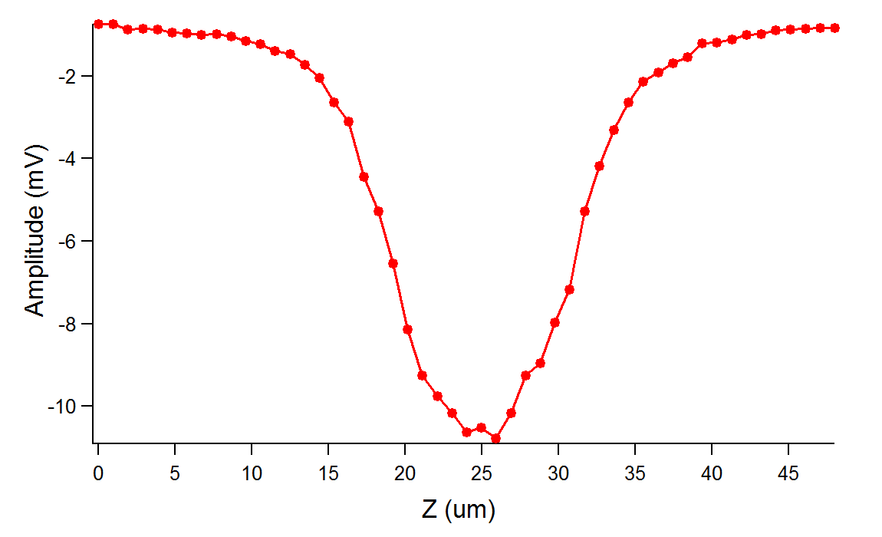
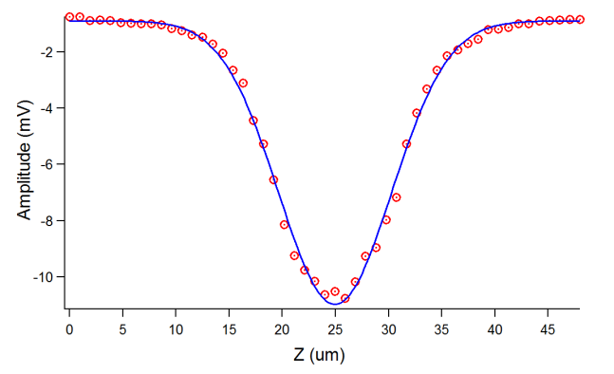
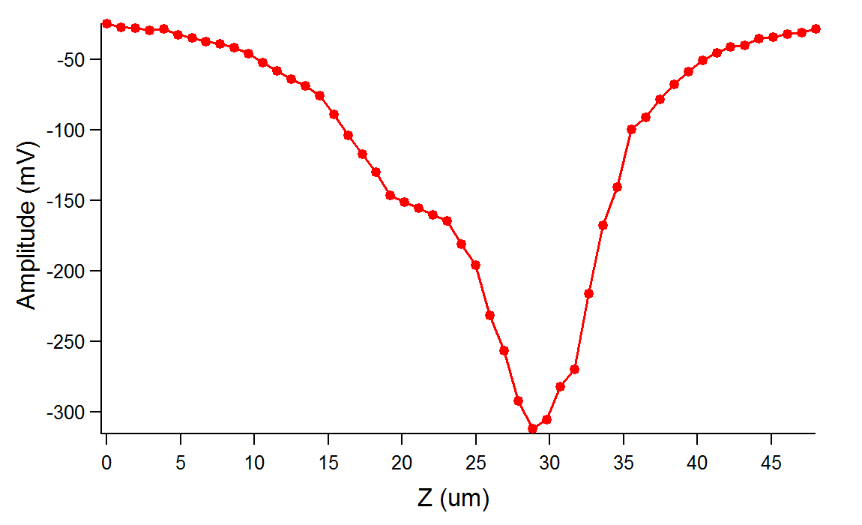
Z-scans
Z-dependent signal was measured for two quite different laser power at 100 V.
Signal does not vanish completely when the beam is focused out of the sensor. It suggests small SPA contribution what is probably expected for highly irradiated samples.
Pretty good Gaussian fitting
for lower power. FWHM ~12.5 um
LGAD 1.5e15 at 100 V and 450 pJ
LGAD 1.5e15 at 100 V and 2.3 nJ
For higher power, the shape is very different, and the curve is shifted.
Something similar was observed for irradiated samples in one presentation from Uni Freiburg

Slide 9
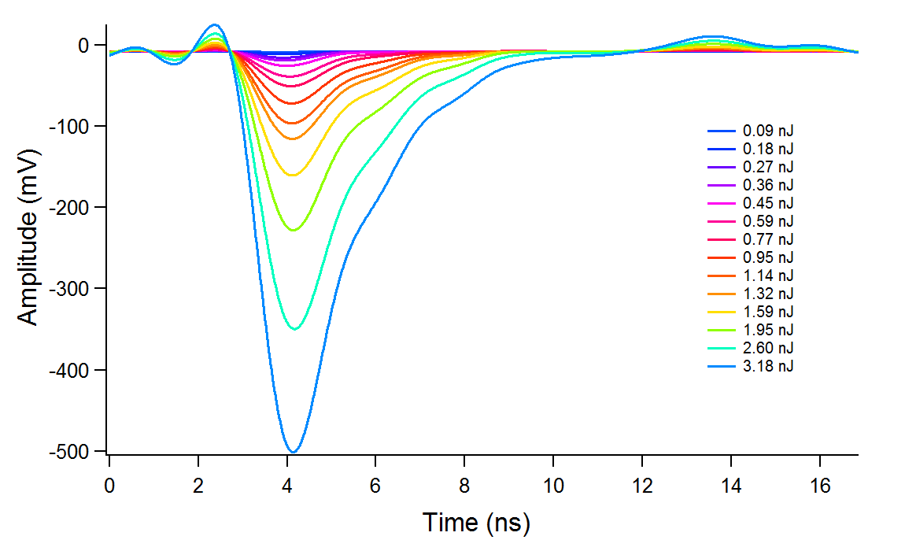
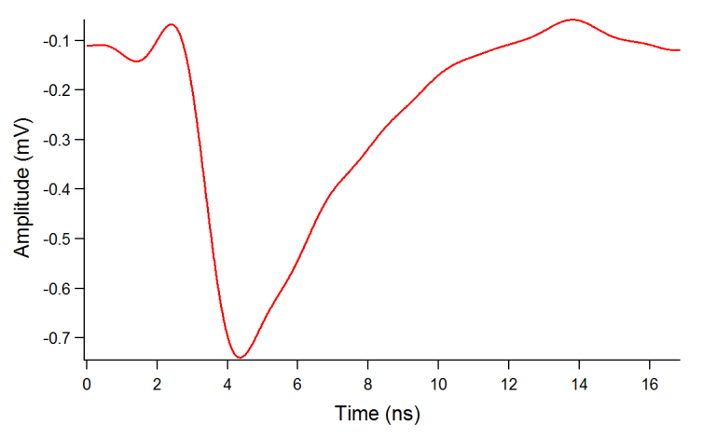
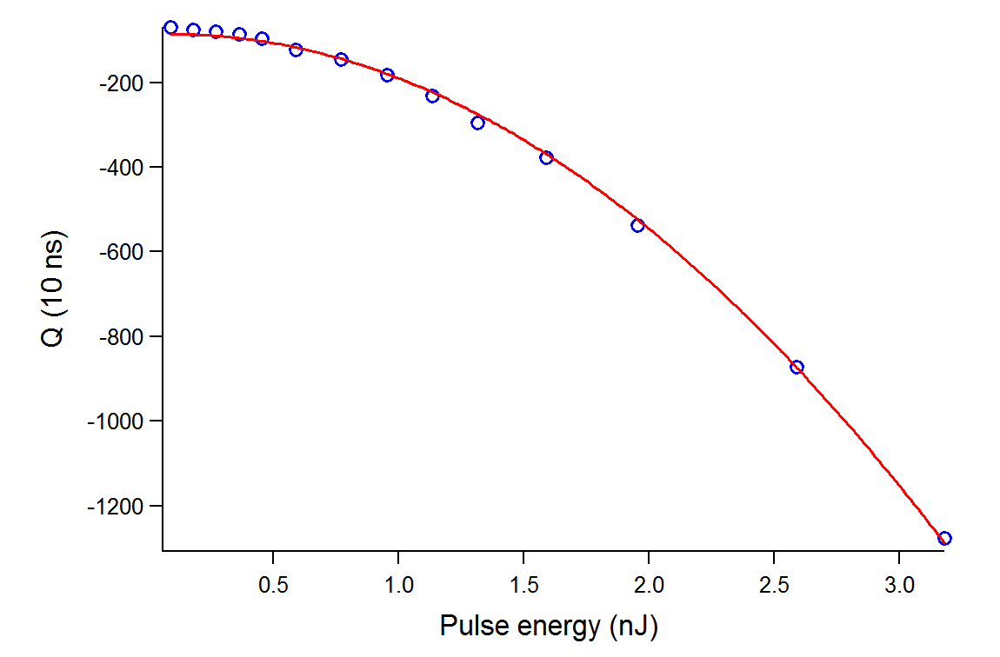
Power dependence
Waveforms recorded for LGAD 1.5e15 at Z_{max} corresponding to maximal signal (bias = 100 V)
For TPA Q vs power (or pulse energy) should exhibit pure quadratic character
Small SPA contribution: very small but non-zero signal is observed when the focus of the beam is located out of the device.
the curve is “almost” pure quadratic
Small imperfections in fitting are probably due to SPA contribution (very small but “non-zero” signal at Z laying out of device

Slide 10
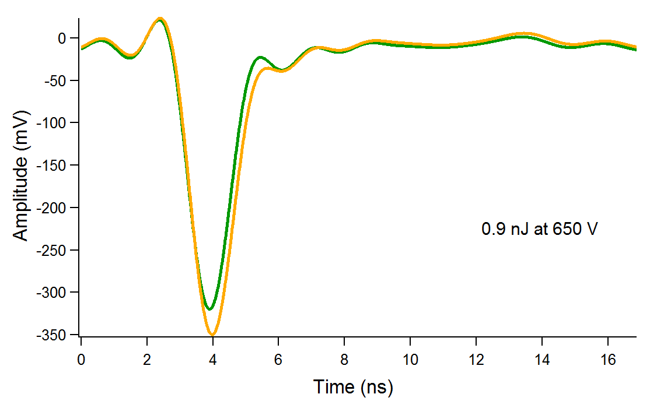
Stability threshold
Similarly, to SPA the stability threshold was found as pulse energy/bias conditions when the signal started jumping at the constant laser power. However here bias was first set to constant value 650 V and laser power was increased until the effect was observed.
Example of two waveforms measured at the constant laser power and bias at two different moments for LGAD 1.5e15

Slide 11
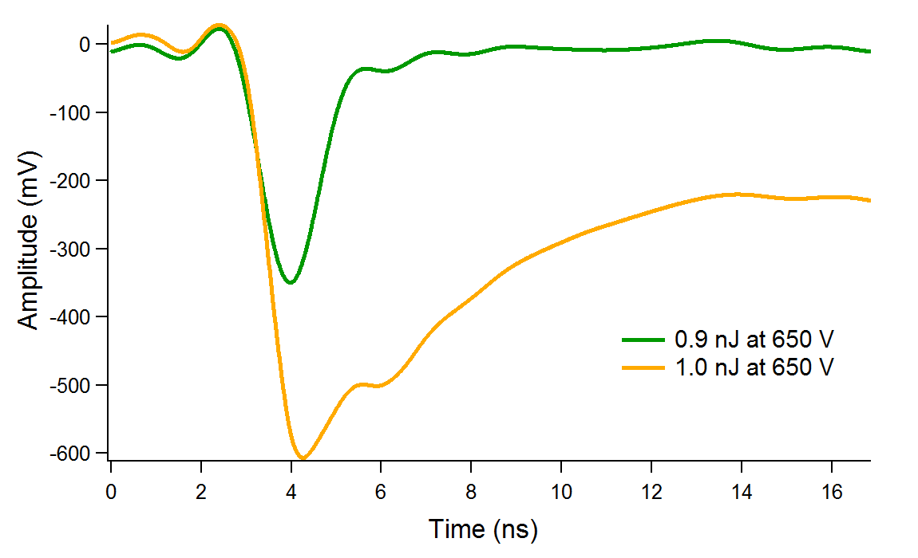
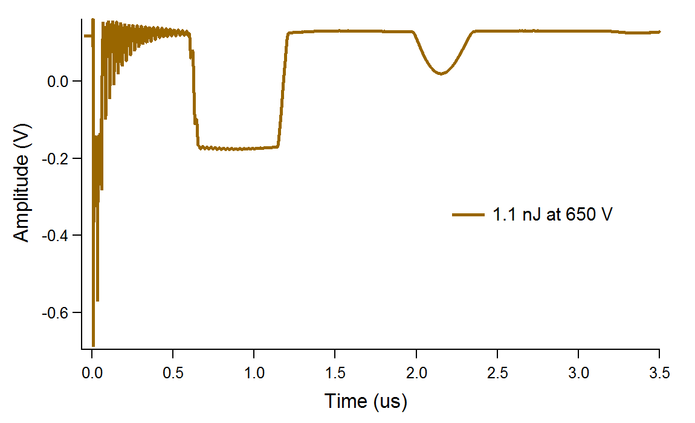
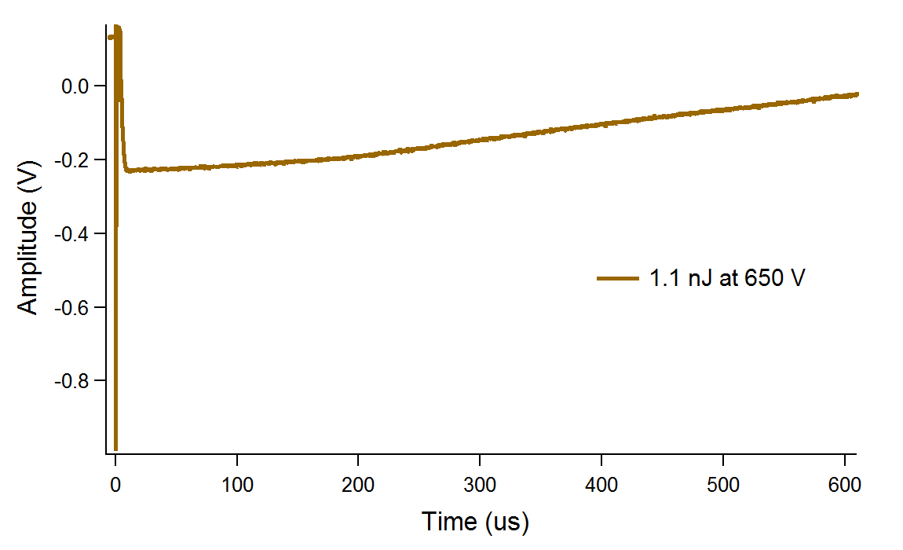
Unstable region
Unstable region corresponds to the power giving significant changes in the signal.
Example of waveforms for LGAD 1.5e15
Above certain threshold the signal is completely deformed and extended to microsecond range. Situation is very similar to SPA case.

Slide 12
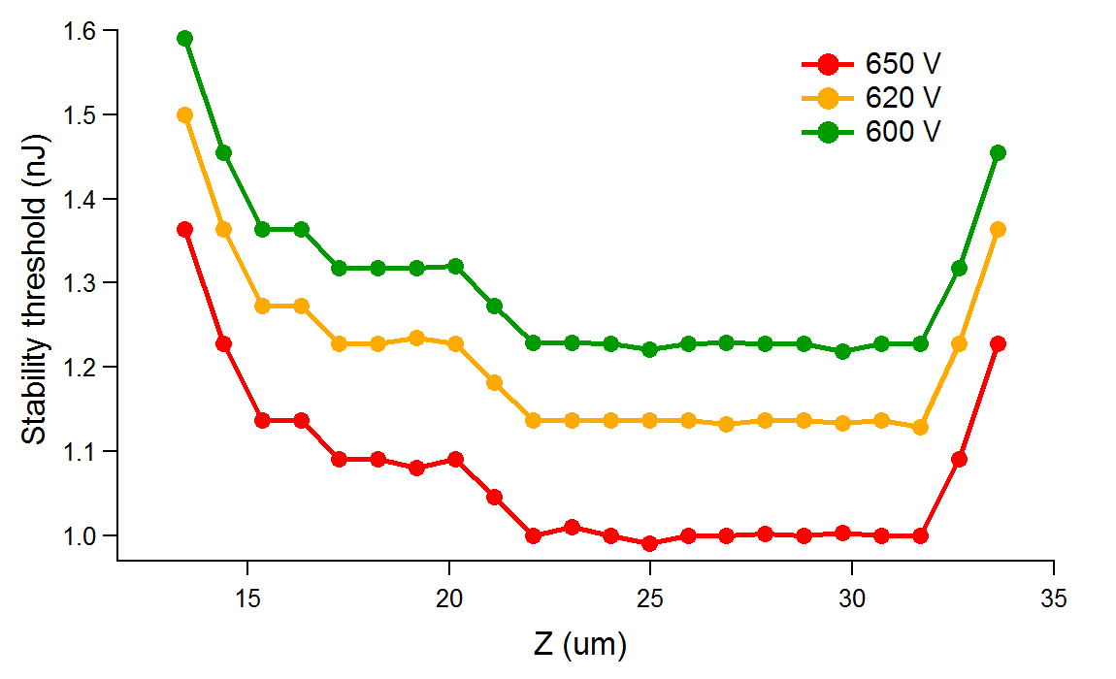
Stability threshold vs Z
We managed to measure stability threshold for three different values of bias (650 V, 620 V, 600 V) in the most relevant Z range.
Instead of amplitude of the signal we use stability threshold (defined as laser energy causing instabilities in the signal).
Thus for every Z-position in relevant range the threshold was found. Idea was to see if mortality/stability limits of the device depends on the depth (position where the charge is generated).
We can see that in the range considered as “inside device” corresponding to 20-32 um. the stability is more or less constant
Conclusion: It seems that stability (maybe also mortality) does not change if we generate the charge closer to the front or closer to the back of the device.

Slide 13
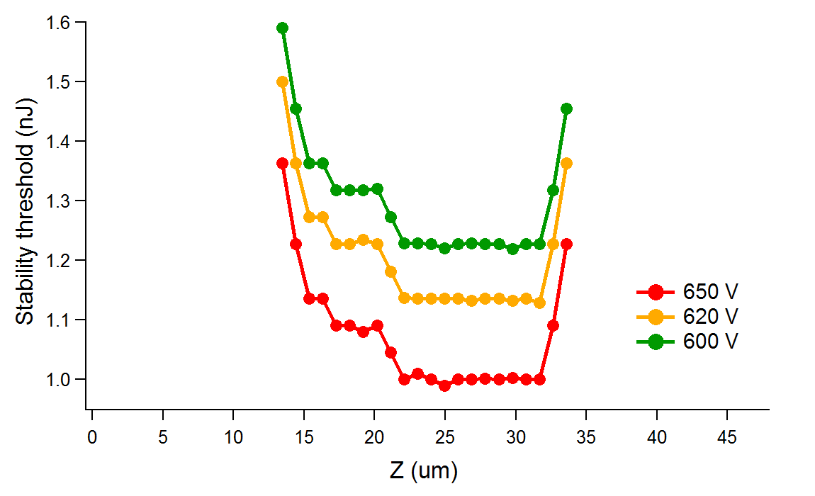
Z-Scan & Stability threshold vs Z
Lessons learnt:
If we draw stability graph and Z-scan graph in the same scale it’s clear that we have correspondence in the regions laying out of device.
Nevertheless, the stability threshold is pretty constant as long as the beam is focused inside the sensor.
HV bias 100 V
If we are on the edges or out of the main junction stability increases (more power is needed to destabilize the device).
The aim was to see if the trend of these changes follows normal Z-scan.
HV bias: 650 V, 620 V, 600 V

Slide 14
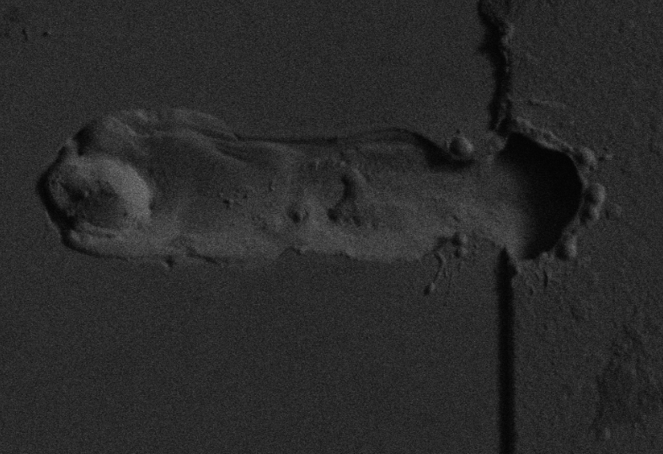
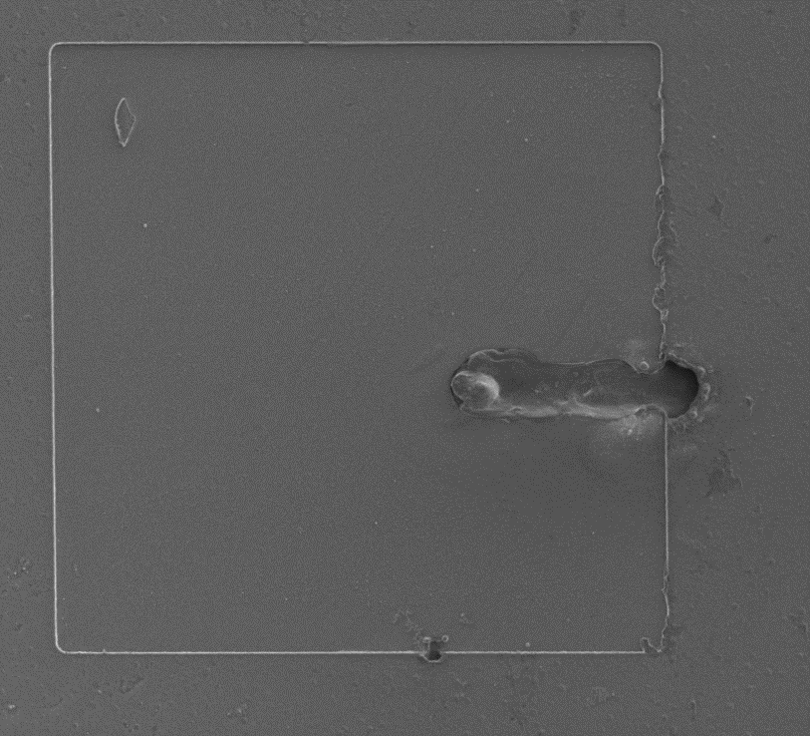
Mortality study: electron microscope images
Finally, LGAD 1.5e15 was completely damaged by TPA at 3.2 nJ and 600 V
Location and character of damage areas look quite similar to those obtained by SPA breakdowns

Slide 15
Conclusion: TPA
Aside from the SPA mortality studies, the first attempts with the TPA mechanism have been performed towards better understanding of the irreversible breakdown of LGAD.
ELI TCT-TPA fs-laser set up has capacity for SEU studies (not yet achieved by TCT-TPA table set up)
In particular, the stability and mortality of the system were monitored with well localized TPA generation of charge in different depths of the device (Z – direction,
The first results suggest that the stability of the devices varies rather weakly as long as the charge is generated inside the device. Stability (maybe also mortality) does not change if we generate the charge closer to the front or closer to the back of the device. We saw that in the range that we can consider as “inside device” , 20-32 μm, the sensor’s stability is constant.
In addition, the location and character of damage features observed by electron microscopy are similar to those obtained by SPA damage.

Slide 16
Thank you.
Final remarks
SPA & TPA
Fs-SPA study on LGAD Mortality: PINs and LGADs show the same behaviour in terms of irreversible breakdown ( confirmed in ELI studies): gain (multiplication) level does not play role. in the LGAD irreversible breakdown. No gain dependence! No damage dependence; irradiation shift HV bias to higher values ➔ HV dependence; electric field relate breakdown.
Fs-TPA study on LGAD Mortality: TPA brings new insight: it shows that for LGAD’s irreversible breakdown it does not matter if charge was induced in junction or at the back contact.
More to be explored in future (TCT-TPA from backside, Edge TCT-TPA, etc).

