Slide 1
Discussion on TCT techniques (INTRO)
TCT – Transient Current Techniques
  pioneered in RD48/50 communities
  recent intro/overview: see G.Kramberger [10.June 2021]
  wide range of laser induced techniques (TCT, edge TCT, TPA-TCT)
  ..add ion/electron induced transients techniques (TRIBIC, test beam…)
TPA-TCT within AIDAinnova: see AIDA kick-off [13.4.2021]
  Design of a fiber laser system for TPA-TCT (with Fyla)
  Development of a turnkey TPA-TCT system
  Formation of a TPA-TCT user community … this is an RD50 activity
This Workshop
  ‘standard’ TCT is widely used in the community
  Table-top TPA-TCT is coming into the game, delivering first impressive results
    beam parameters of w0=0.9um and z0= 6um confirmed!
  IBIC techniques complementing the set of techniques

Slide 2
Discussion on TCT techniques
This Workshop
  ‘standard’ TCT is widely used in the community
  Table-top TPA-TCT coming into the game, delivering first results
  IBIC techniques complementing the set of techniques
TPA TCT setups – next steps / open questions
  system development still ongoing
    Daniel: Do we need a Hexapod for tilt correction?
  only few institutes using this technique so far (CERN, Santander, Ljubljana,
  .. NIKHEF(?), Lancaster (updating to latest laser version)
  initiative to develop a more flexible system based on fibers under way
TPA-TCT/TCT – experiments to be performed
  need to fully explore potential and limitations of the new tool
  …community starts to explore the new technique
    depth profiling from top
    feasibility of performing LGAD mortality studies (next session)
  Have a TCT (TPA-TCT) workshop ! 3rd edtion (Marcos, Gregor, Michael,…..)
  Include TPA-TCT charge generation into simulation tools
    ..work ongoing in Sevilla for integration into Synopsys TCAD
  Revisiting trapping times (‘dead layer’ in n+ region)
    variation of experimental data in literature : tau_e > tau_h and vice versa … !

Slide 3
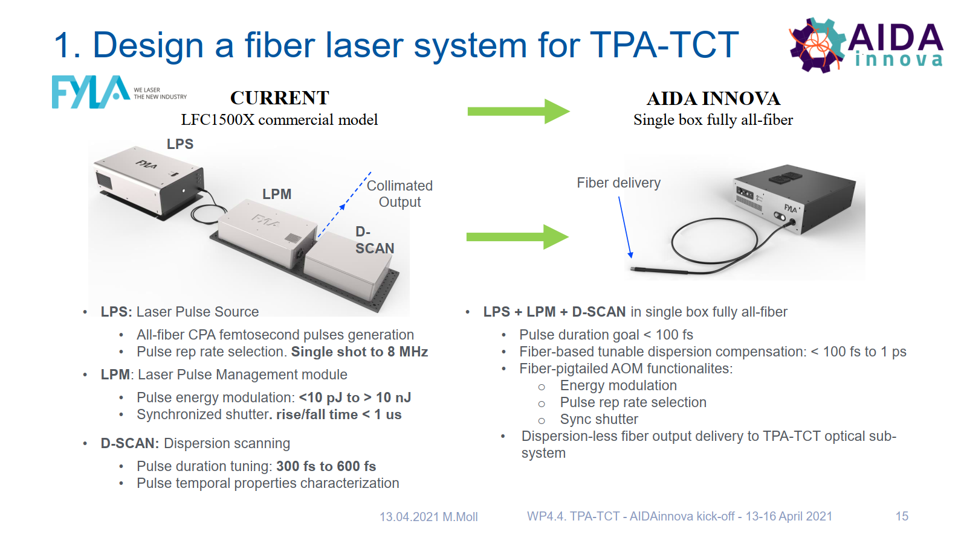
AIDAinnova WP4.4. – TPA-TCT
for more details: AIDA-innova kick-off meeting [WP 4.4.] link

Slide 4
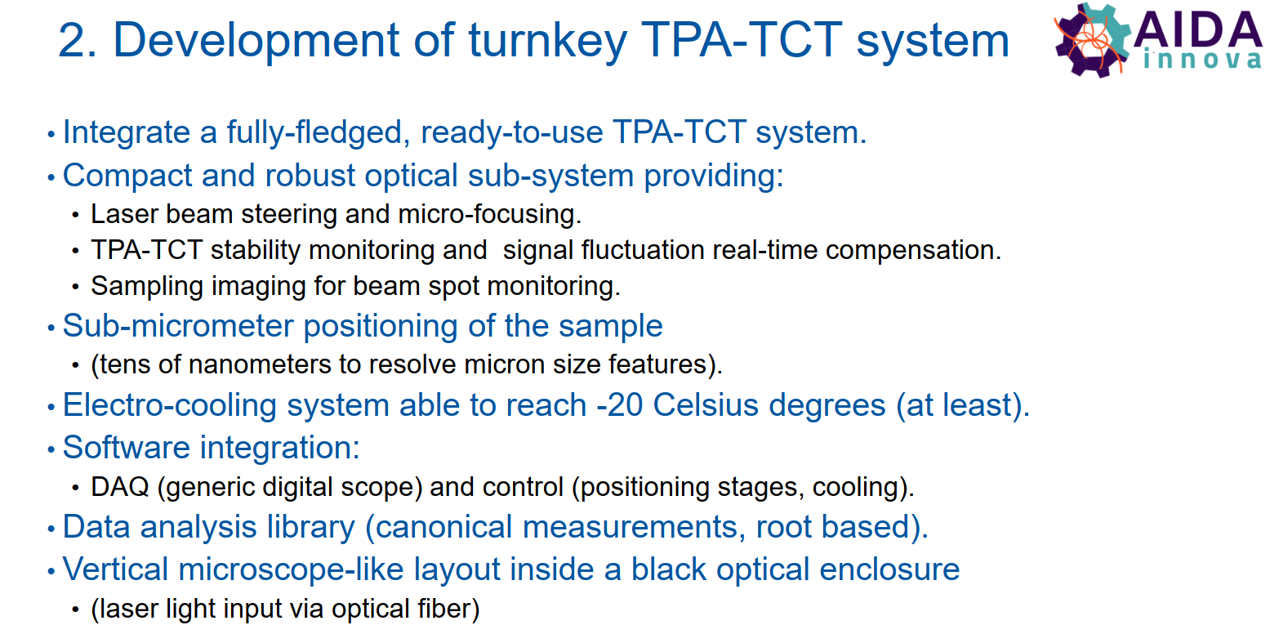
AIDAinnova WP4.4. – TPA-TCT

Slide 5
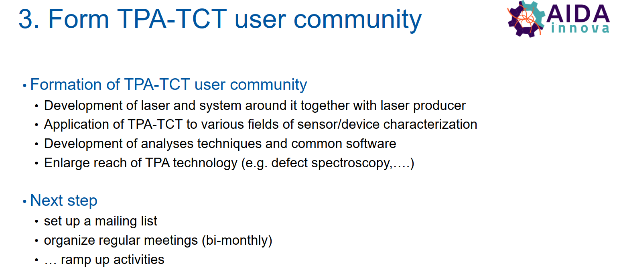
AIDAinnova WP4.4. – TPA-TCT
for more details: AIDA-innova kick-off meeting [WP 4.4.] link

