Slide 1
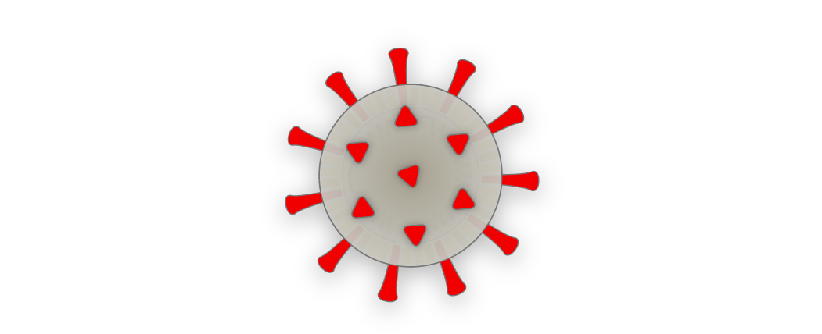

Welcome to the
38th RD50 Workshop
Radiation hard semiconductor devices for very high luminosity colliders
RD50 online Workshop – 21-23.06.2021
CERN (online) 21-23.06.2021

Slide 2
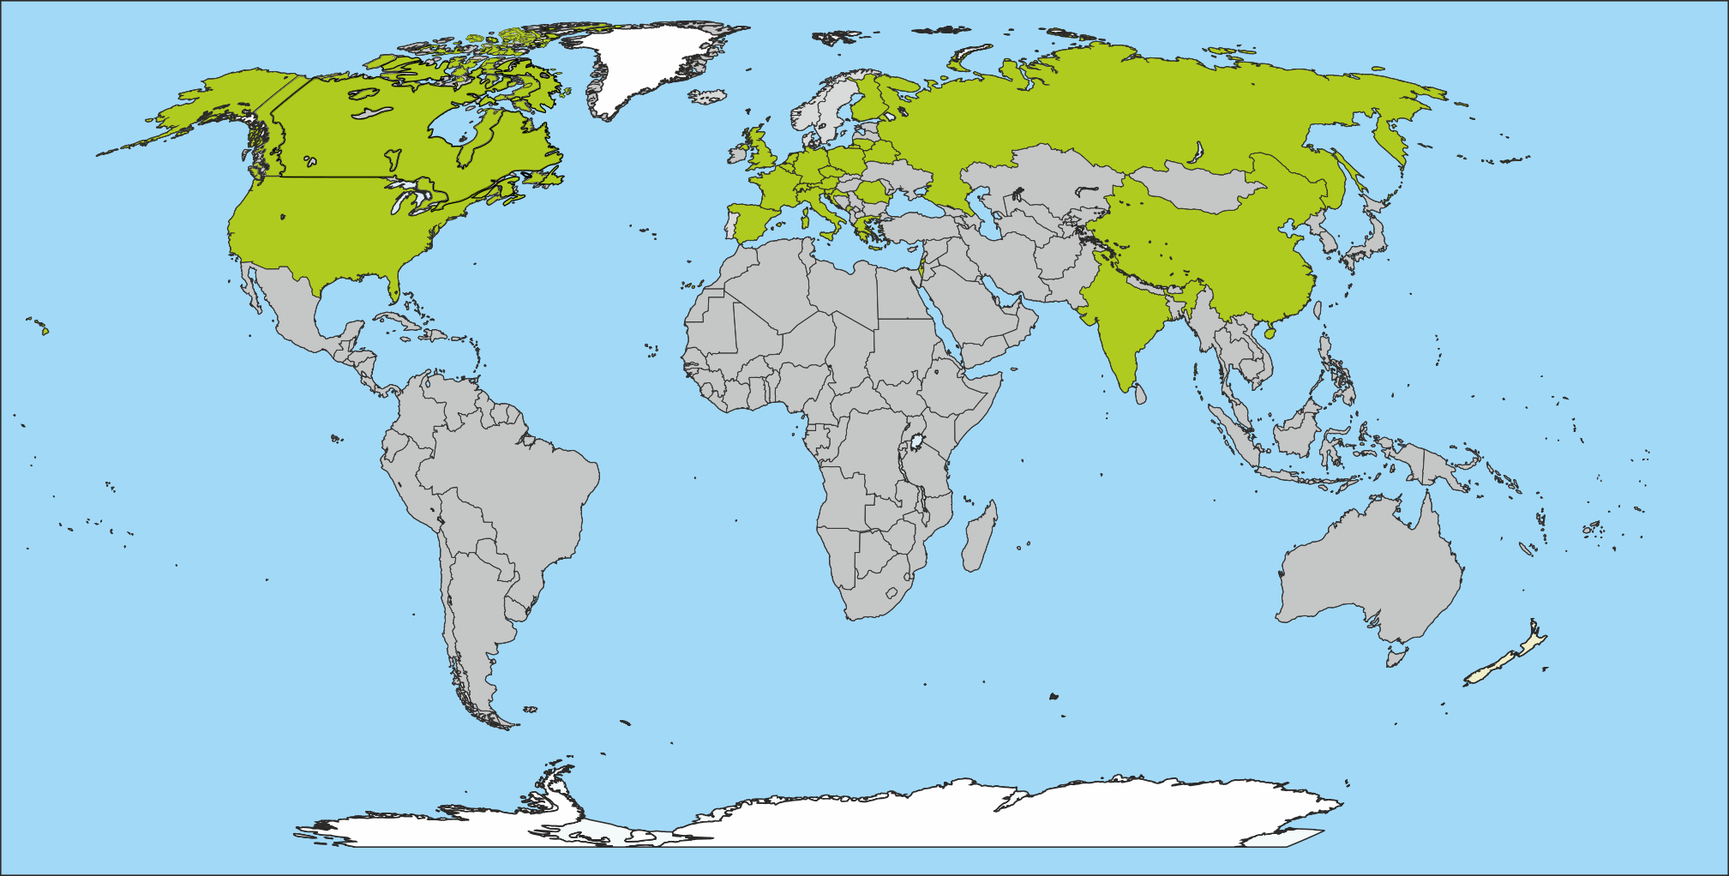
The RD50 Collaboration
last changes in June 2020;
Jilin joining
RD50: 64 institutes and 410 members
51 European institutes
Austria (HEPHY), Belarus (Minsk), Czech Republic (Prague (3x)), Finland (Helsinki, Lappeenranta ), France (Marseille, Paris, Orsay), Germany (Bonn, Dortmund, Freiburg, Göttingen, Hamburg (Uni & DESY), Karlsruhe, Munich (MPI & MPG HLL)), Greece (Demokritos), Italy (Bari, Perugia, Pisa, Trento, Torino), Croatia (Zagreb), Lithuania (Vilnius), Montenegro (Montenegro), Netherlands (NIKHEF), Poland (Krakow), Romania (Bucharest), Russia (Moscow, St.Petersburg), Slovenia (Ljubljana), Spain (Barcelona(3x), Santander, Sevilla (2x), Valencia), Switzerland (CERN, PSI, Zurich), United Kingdom (Birmingham, Glasgow, Lancaster, Liverpool, Oxford, Manchester, RAL)
8 North-American institutes
Canada (Ottawa), USA (BNL, Brown Uni, Fermilab, LBNL, New Mexico, Santa Cruz, Syracuse)
1 Middle East institute
Israel (Tel Aviv)
4 Asian institutes
China (Beijing-IHEP, Hefei, Jilin), India (Delhi)
Full member list: www.cern.ch/rd50

Slide 3
Organizational Structure / Work Program
Covering all fields of semiconductor detectors
exposed to radiation
Co-Spokespersons
Gianluigi Casse and Michael Moll
(Liverpool University, UK (CERN EP-DT)
& FBK-CMM, Trento, Italy)
Targeting new detector technologies including high precision 4D detectors
Defect / Material
Characterization
Ioana Pintilie
(NIMP Bucharest)
Detector
Characterization
Eckhart Fretwurst
(Hamburg University)
New
Structures
Giulio Pellegrini
(CNM Barcelona)
Full Detector
Systems
Gregor Kramberger
(Ljubljana University)
RD50
work program
and
key achievements
documented
in a
5yrs work plan
2018-23
(70 milestones)
[LHCC-SR-007]
Characterization of microscopic properties of standard-, defect engineered and new materials;
pre- and post- irradiation
DLTS, TSC, ….
SIMS, SR, …
NIEL (calculations)
Cluster and point defects
Boron related defects
SiC/GaN based detectors
Characterization of test structures (IV, CV, CCE, TCT,.)
Development and testing of defect engineered devices
EPI, MCZ and other materials
NIEL (experimental)
Device modeling
Operational conditions
Common irradiations
Very high radiation fluences
Wafer procurement (M.Moll)
Acceptor removal (Kramberger)
TCAD modeling (J.Schwandt)
3D detectors
Thin detectors
Cost effective solutions
Other new structures
Detectors with internal gain
LGAD:Low Gain Avalanche Det.
Deep Depleted Avalanche Det.
Slim Edges
HVCMOS
LGAD (S.Hidalgo)
HVCMOS (E. Vilella)
LHC-like tests
Links to HEP (LHC P2, FCC)
Links electronics R&D
Low rho strips
Sensor readout (Caribou,Alibava)
Comparison:
- pad-mini-full detectors
- different producers
Radiation Damage in
HEP detectors
Timing detectors
Test beams
(M.Bomben & G.Casse)
Collaboration Board Chair & Deputy: G.Kramberger (Ljubljana) & J.Vaitkus (Vilnius), Conference committee: U.Parzefall (Freiburg)
CERN contact: M.Moll (EP-DT), Secretary: V.Wedlake (EP-DT), Budget holder: M.Moll & M.Glaser (EP-DT) , EXSO: R.Costanzi (EP-DT)
Notes:
https://cds.cern.ch/record/2320882/files/LHCC-SR-007.pdf

Slide 4
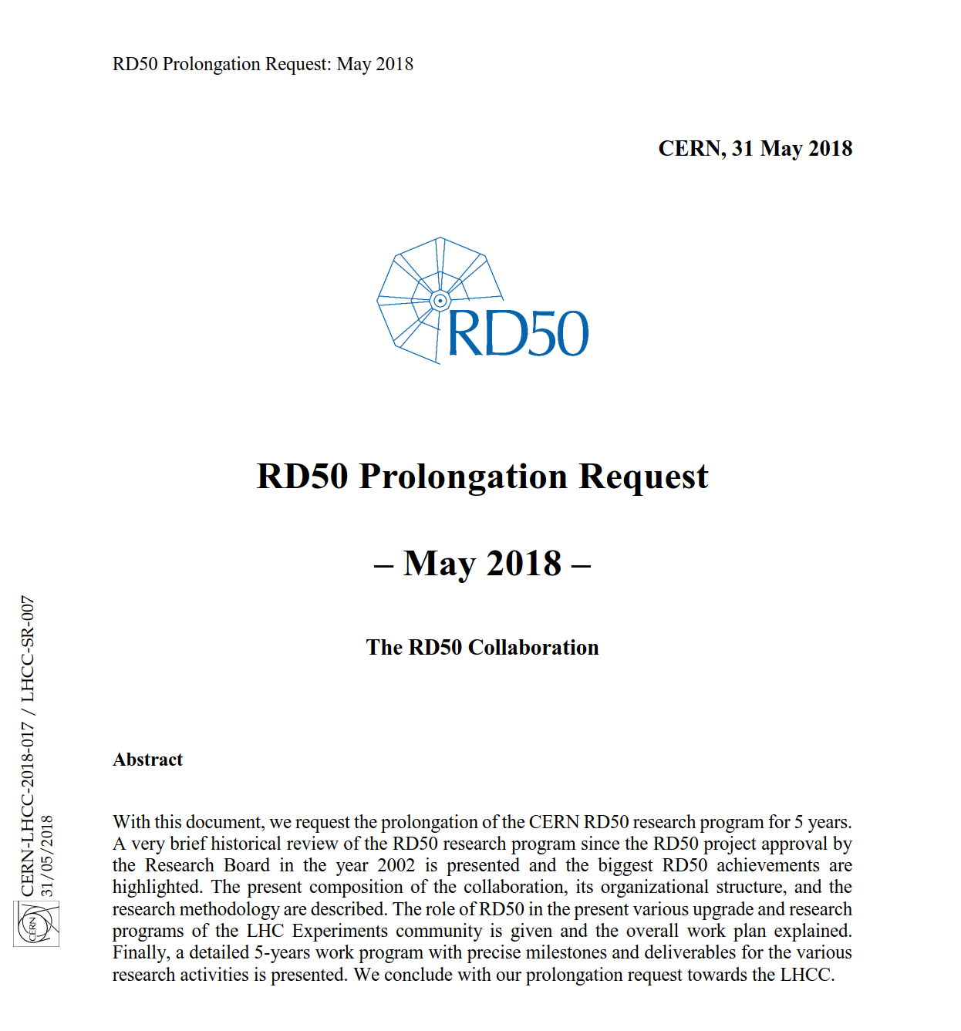
RD50 – 5 Year Work Plan
5 year work program submitted in May 2018
  Approved by CERN Research Board in June 2018
Workplan [70 milestones]
  Defect and Material Characterization [16 MS]
    p-type silicon [7 MS]
    Cluster defects [4 MS]
    Theory of defects [5 MS]
  Device Characterization & Device Simulation [21MS]
    Silicon materials [5 MS]
    Extreme fluences [5 MS]
    Experimental techniques [3 MS]
    Surface damage [1 MS]
    TCAD simulations [7 MS]
  New structures [21 MS]
    3D sensors [6 MS] ; LGAD [4 MS]
    CMOS [6 MS] ; New Materials [5 MS]
  Full Detector Systems [12 MS]
    LHC [7 MS]; HL-LHC [3 MS]
    FCC [2 MS]
https://cds.cern.ch/record/2320882/files/LHCC-SR-007.pdf
…starting to think about an update in-line with European Strategy update..

Slide 5
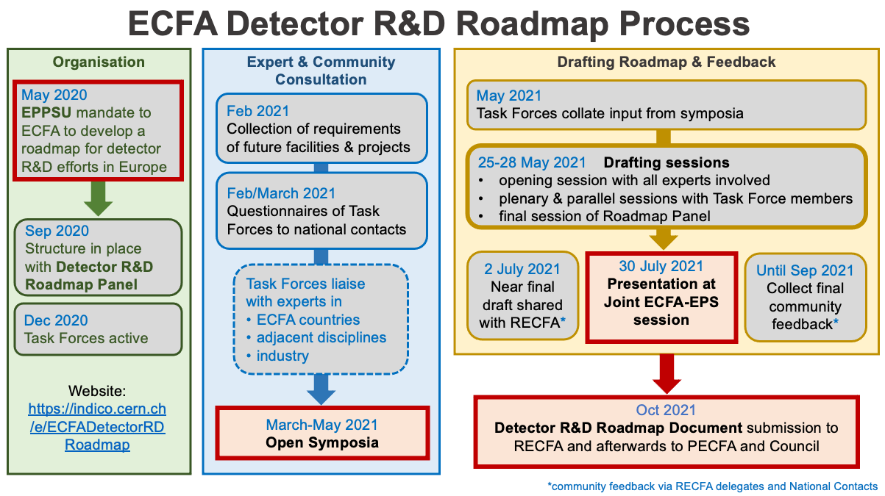
European Strategy on Particle Physics
ECFA Detector R&D Roadmap Symposium of Task Force 3 Solid State Detectors
  23.4.2021 - https://indico.cern.ch/event/999816/

Slide 6
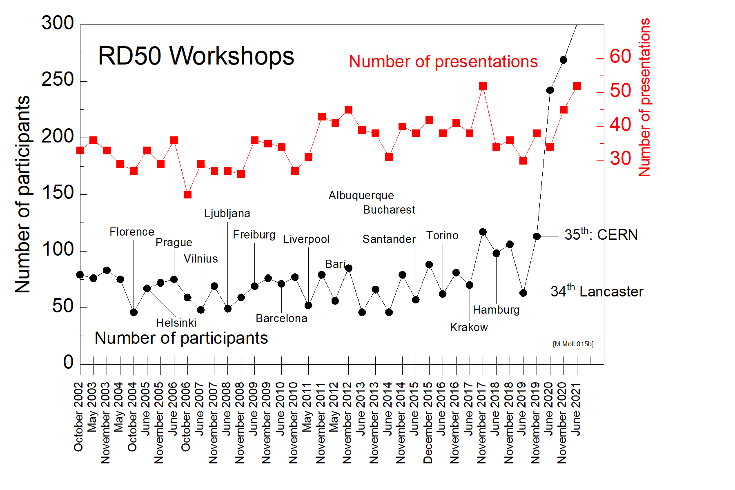
RD50 Workshop statistics
Online workshops
RD50 holds every year two RD50 workshops
  Average numbers for RD50 Workshops: <35 talks> <85 participants>
June 2021:
- 38th RD50 Workshop
“third online workshop”
  Online Workshop:
  Very high number of participants
  (> 216 participants → >50% of collaboration);
  51 talks + 6 discussions
  Online workshops since June 2020:
    higher number of participants
    fruitful discussions in discussion sessions
    are possible
    However, we miss the social contact & ‘coffee meetings’
    We learned for the future:
      Future workshops to be tailored as well
      for online participation,
      online discussions and online presentations.
  November 2021
    Workshop in Valencia (week 15-19 November)

Slide 7
Program: 38th Workshop
Monday 21.06.2021
  Defect, Material and Sensor Characterization (9 talks + discussion)
  SiC, Ultrahigh fluences, Detector Characterization, Passive CMOS (7 talks + discussion)
  18:00 Collaboration Board (closed session)
Tuesday 22.06.2021
  LGAD – Low Gain Avalanche Detectors (17 talks + discussion)
Wednesday 23.06.2021
  3D sensors (3 talks)
  Sensor characterization with TCT and IBIC (5 talks + discussion)
  Studies on LGAD mortality (3 talks + discussion)
  CMOS sensors and readout electronics (7 talks + discussion)
51 talks
&
6 discussion sessions

Slide 8
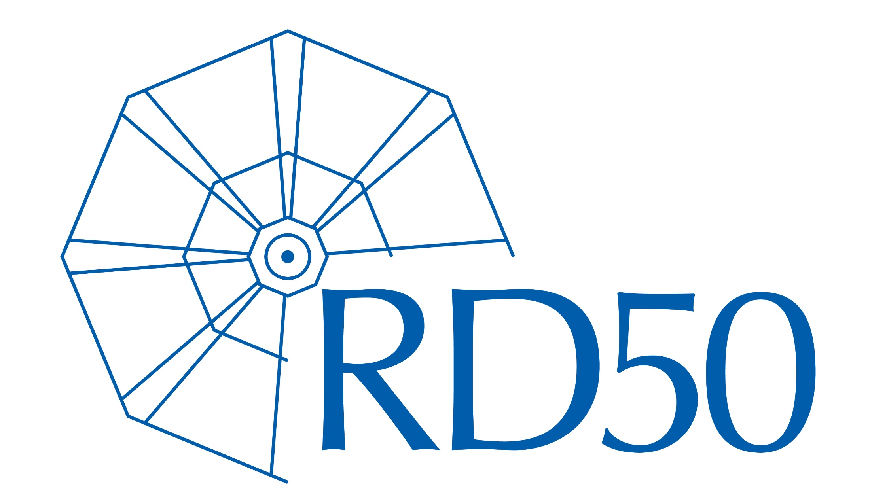
Enjoy the Workshop!
…many thanks to
the session chairs and discussion session leaders,
… all speakers
the local organization team
… Esteban, Anja ….
… and on behalf of all RD50
.. to Veronique Wedlake for doing such a great job as RD50 secretary!
.. to Maurice Glaser for helping to handle the RD50 finances
while enjoying his retirement in Brazil!
Next RD50 Workshop
in person in Valencia.
3 days in week 15-19 November 21
Stay healthy and in good mood!

