Slide 2

IT Staff compared to CERN
Total: 2594 Staff
19 January 2021
Total: 215 Staff
19 January 2021
1 | Experimental & Theoretical Physics
2 | Scientific & Engineering Work
3 | Technical Work
4 | Manual Work, Crafts & Trades
5A | Administrative Work
5B | Office & Administrative Work
5C | Office Work

Slide 3
Staff Age Profile – CERN vs. IT
13 January 2020

Slide 4
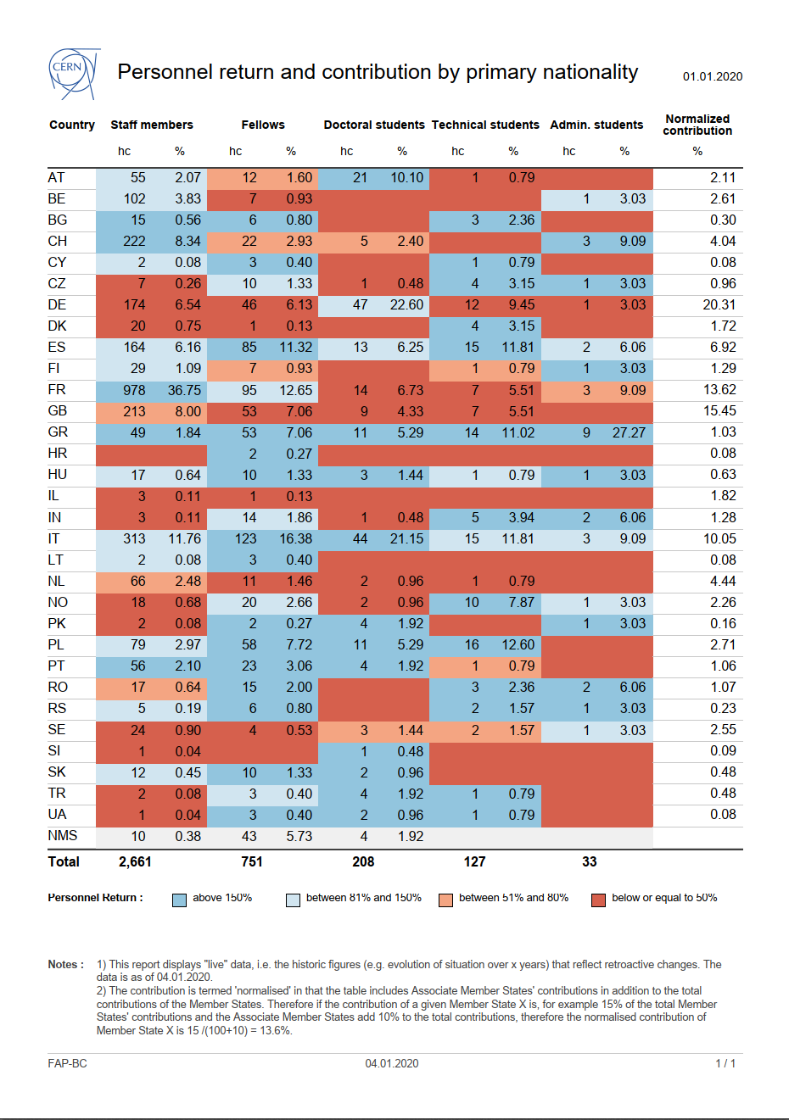
Diversity
19 January 2021

