Slide 1
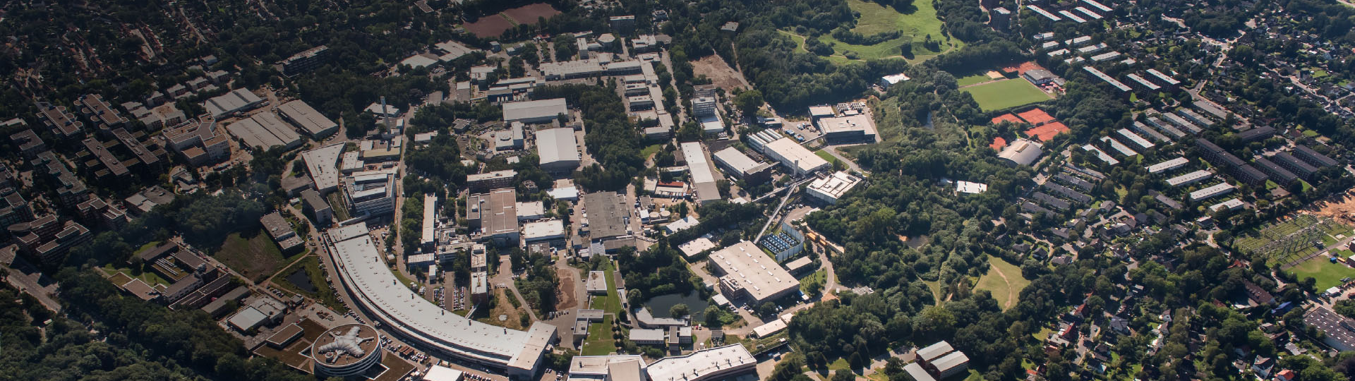
DESY Participation in IFAST Task 10.4.
First thoughts
Lutz Lilje, Rūta Širvinskaitė, Nils Plambeck
Hamburg, 12.5.2021

Slide 2
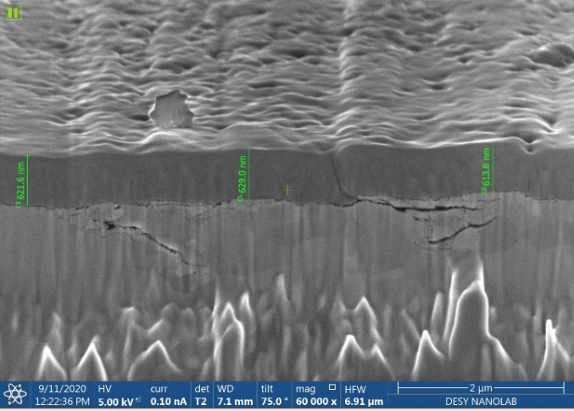
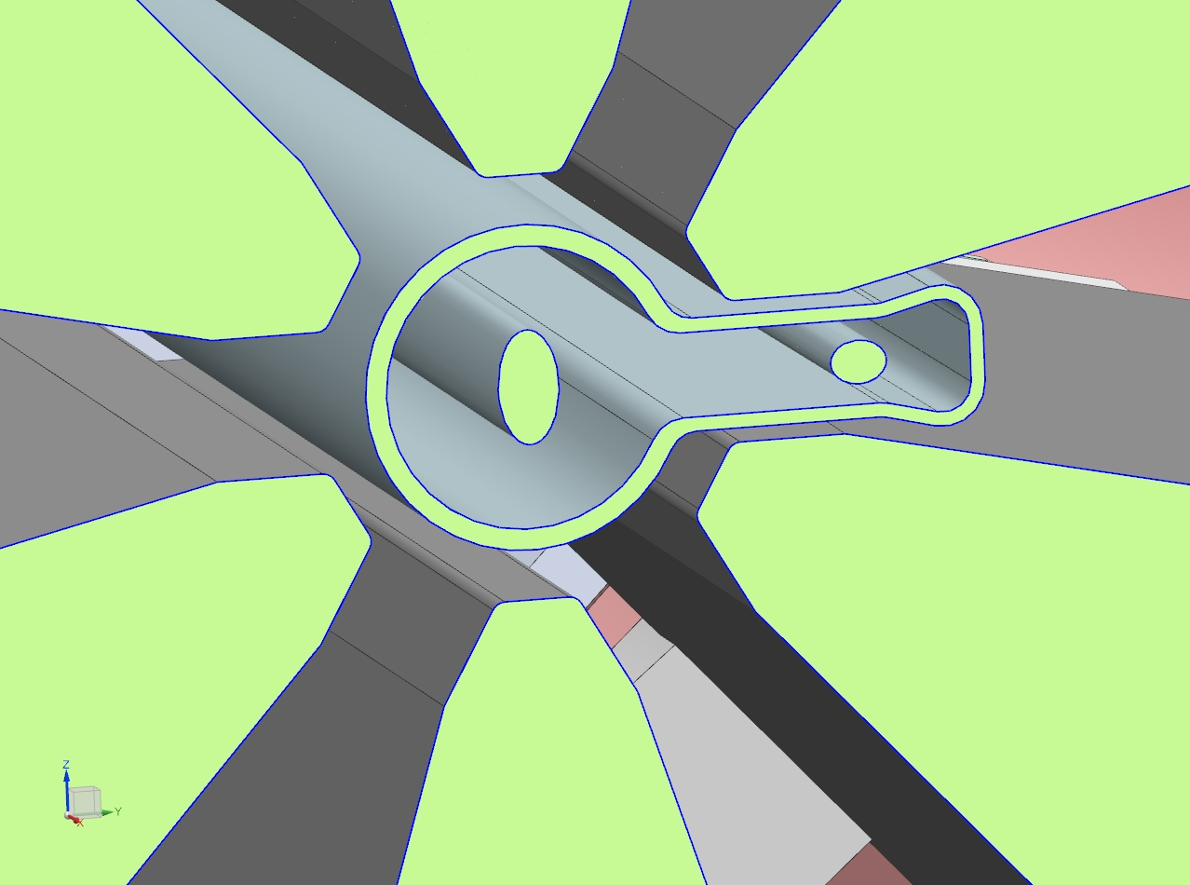
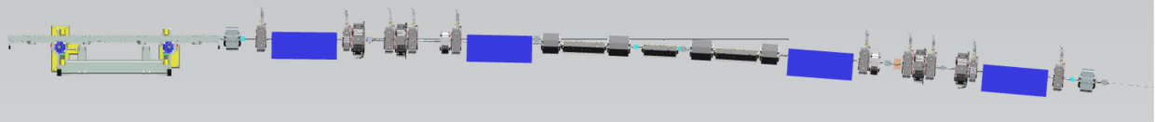
DESY and NEG films: PETRA IV Project
DESY has an increased interest in NEG films because of PETRA IV
We would like to follow the successful operation of MAX IV
  Because we have very similar challenges
Basic layout is similar and compatible with IFAST sample geometry
  Copper chambers 20 mm inner diameter (0.5 and 1 m long tubes used for sticking probability/ESD tests)

Slide 3
Sample production at DESY
Etching and cleaning
  Automated procedure for cleaning samples of various lengths (up to 5 m)
Types of substrates
  Lengths between 0.2 – 5 m
  Inner diameter of 20 – 38 mm
  Pure or OFHC copper
Types of coatings
  TiZrV, Zr
  Columnar structure available for now
  Thicknesses between 0.5 – 5 µm

Slide 4
DESY Interest in Parameters
PSD yields and sticking probabilities
  Dependence on photon dose, activation temperature and duration, film thickness
  Testing various morphologies and compositions of NEG coatings
  Specific interest in providing samples in the PETRA IV geometry and substrates
  Relating ESD results to PSD data
Operation of NEG films
  Effects of leaks
  SR induced activation
  Effect of storage conditions: vacuum, nitrogen, argon, etc.
  NEG lifetime
  RF properties

Slide 5
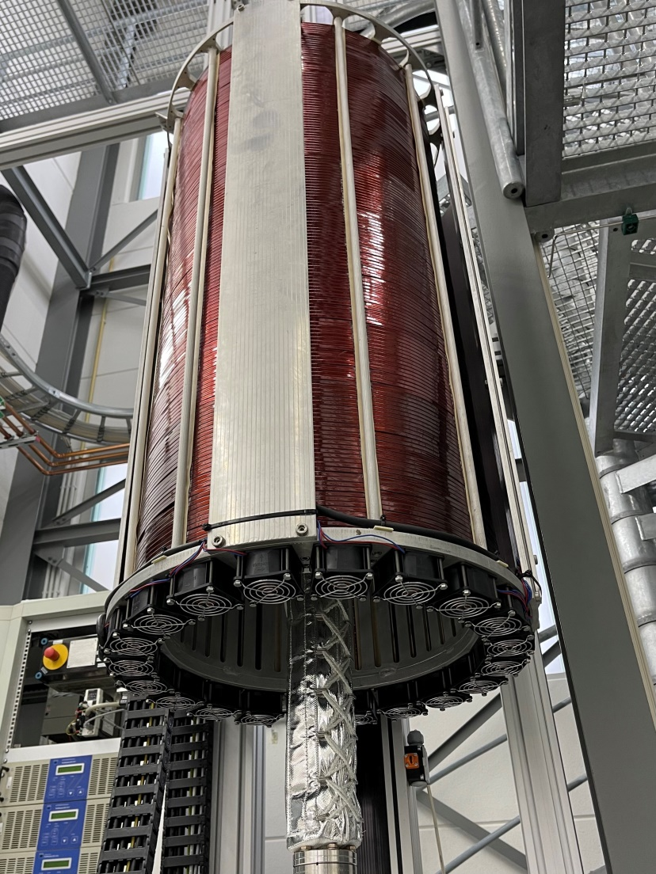
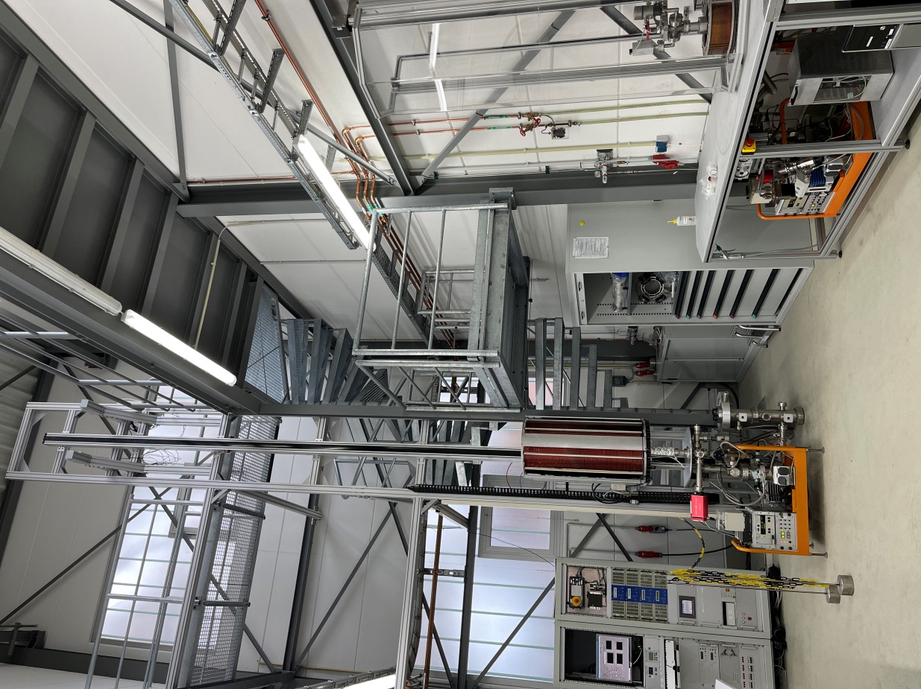
What could DESY bring to IFAST Task 10.4?
Support by main future project of DESY
Hardware
  1 sputtering setup for long chambers (up to 5 m)
  1 deposition system for short chambers
    Not yet modified for NEG
  Test stands
    Pumping speed x 2
    ESD
  Surface characterisation
    At DESY: optical inspection, SEM, EDX, XPS
    Outside DESY: XPS, TEM
  RF properties
Samples
  IFAST 3-gauge method sample
    Prepared to built 2-3 samples
  PETRA IV geometry and substrates
    Number of samples for IFAST framework needs to be defined

Slide 6
Thank you

Slide 7
Lutz Lilje, Rūta Širvinskaitė, Nils Plambeck
- MVS -
Lutz.Lilje[at]desy.de
+49 40 8998 3074

