Slide 1

Soleil: update on status of pumping property testing facility, SR beamline and capabilities in thin film characterization
C. Herbeaux
On behalf of Vacuum group
IFAST Task 10.5 Kick-off Meeting
May 12, 2021

Slide 2
Contents
Reminder on NEG coating capabilities at SOLEIL
  Sticking factor and sorption capacity characterisation
  PSD beamline
Possible evolution of the PSB beamline
Last results for PSD measurement
Conclusion

Slide 3
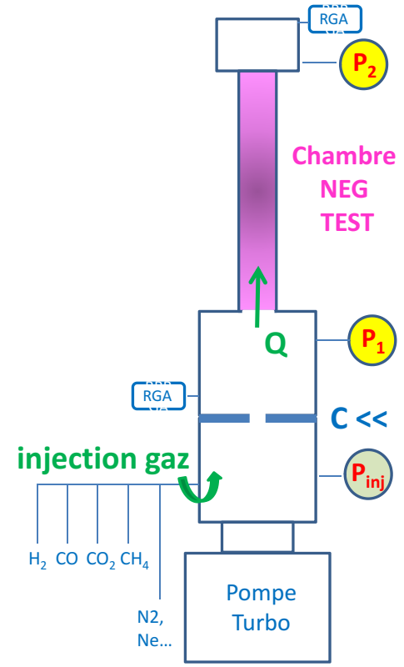

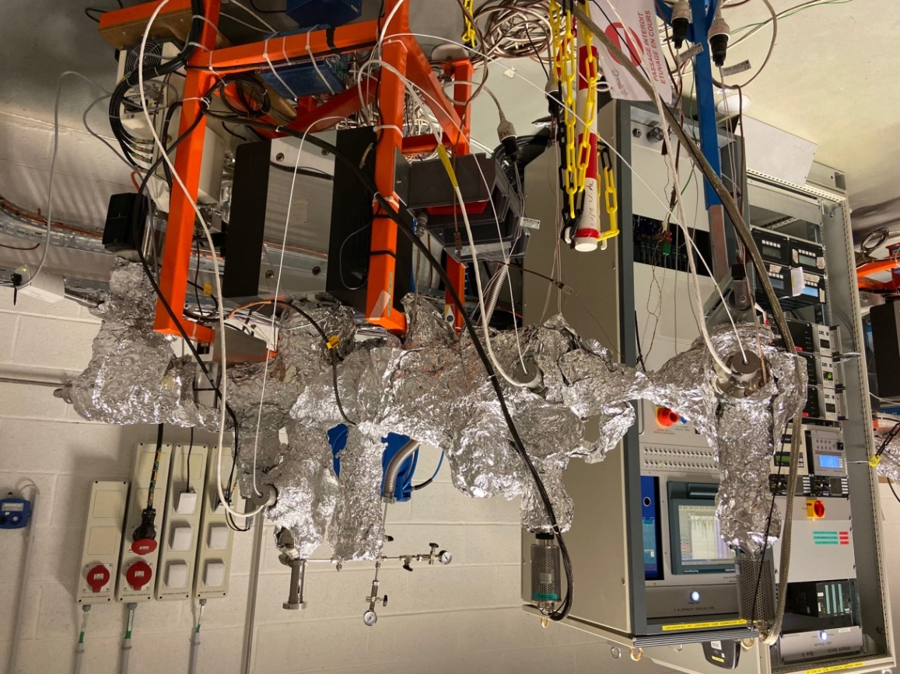
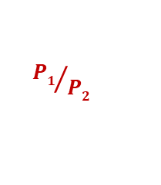
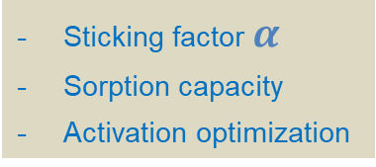
NEG coating Characterization
See Nicolas Béchu presentation for more details
@ Vacuum LAB
2 Transmission Method Test Benches for NEG coating characterization
Sticking factor $α$
Sorption capacity
Activation optimization
Gas inlet
P_{inj}
C <<
Turbo
P₂
P₁
Transmission Method
${P1}/{P2}$
is calibrated with MOLFLOW+ to find $α$
P. Costa Pinto, P. Chiggiato, A. Sapountzis, T. Sinkovits, M. Taborelli,
CERN
80th IUVSTA Workshop, NSRRC, Hsinchu, Taiwan (2016)

Slide 4
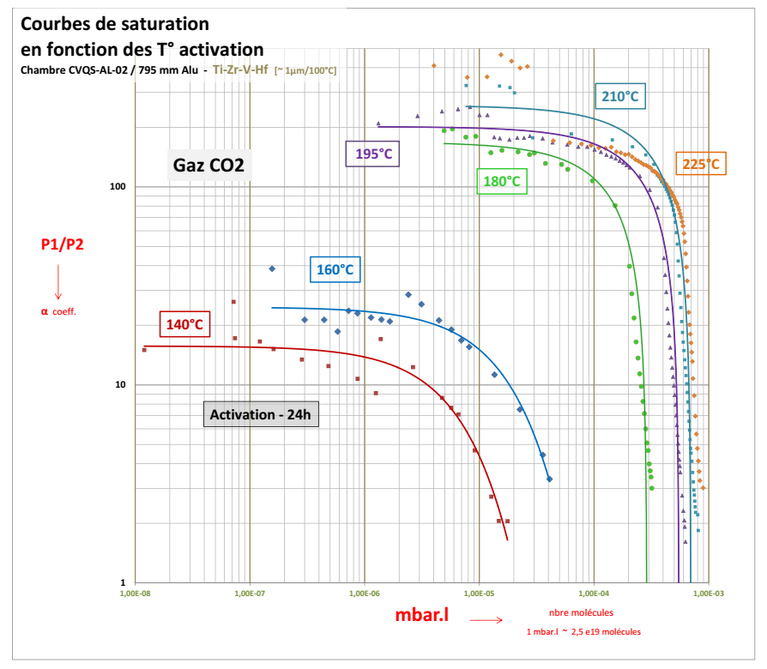
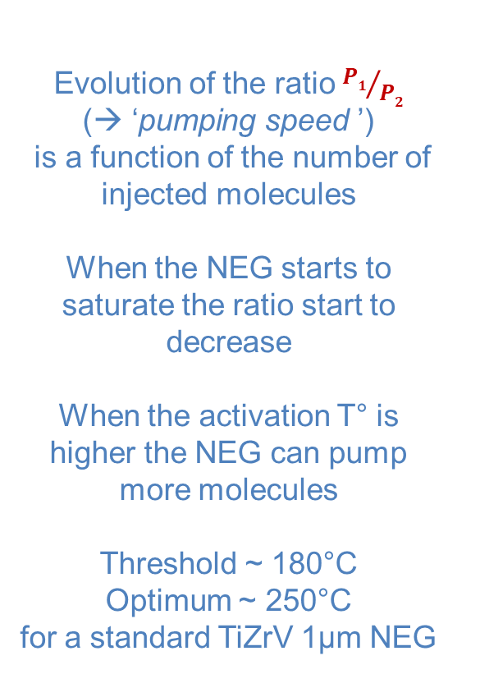
NEG coating Characterization
@ Vacuum LAB
Typical
Sorption Capacity curves of NEG coating
for Increasing activation T°
Evolution of the ratio${P1}/{P2}$
(→ ‘pumping speed ’)
is a function of the number of injected molecules
When the NEG starts to saturate the ratio start to decrease
When the activation T° is higher the NEG can pump more molecules
Threshold ~ 180°C
Optimum ~ 250°C
for a standard TiZrV 1µm NEG

Slide 5
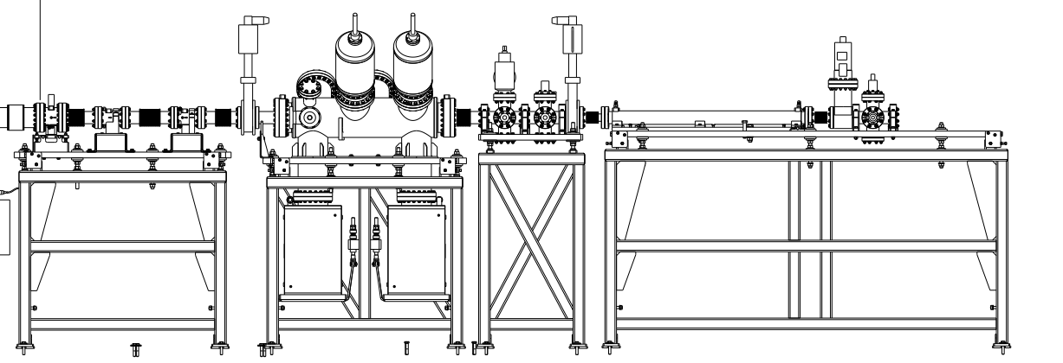
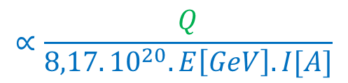
NEG coating Characterization
@ PSD Beamline on D08-1
In operation since October 2020
→ photon exit D08-1 but inside the Storage Ring
Evolution of the PSD yield with the photon dose
Activation of the NEG with RS?
‘Have an insight’ into the NEG
« dynamic pumping »
« dynamic saturation »
S [l.s⁻¹]
P_{T} [mbar]
C [l.s⁻¹]
S.R
Q [mbar.l.s⁻¹]
beam collimation
(gas load)
TEST Chamber
SIP
SIP
Photon to molecule yield η
η
$$∝\frac{Q}{8,17.{10}^{20}.E\left[GeV\right].I[A]}$$
Q ~ C x P_{T}
_{C << S}

Slide 7
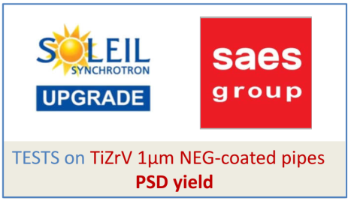
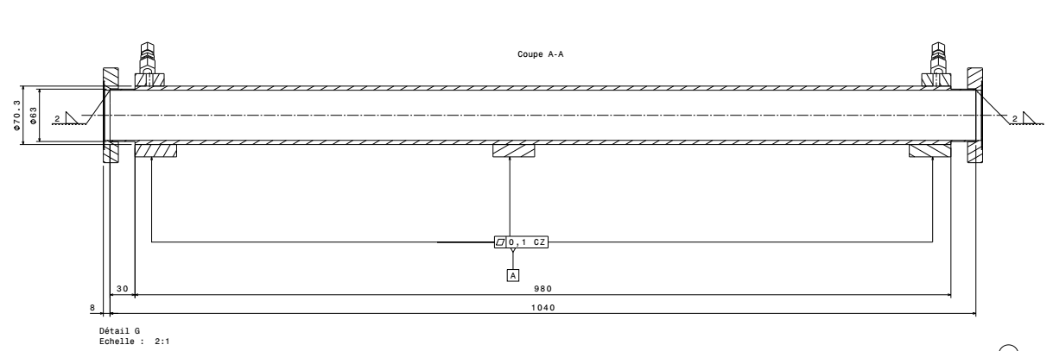
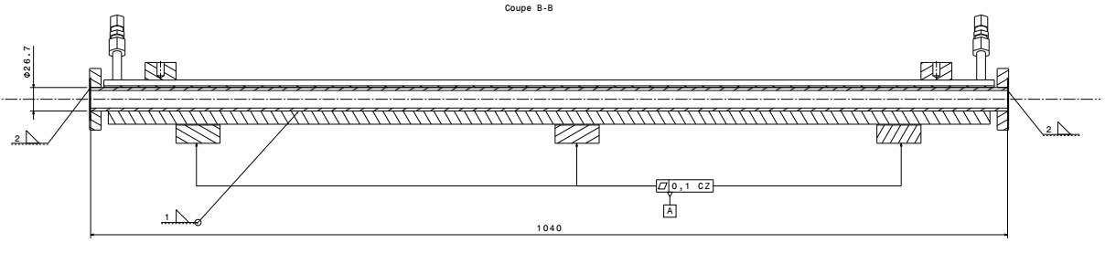
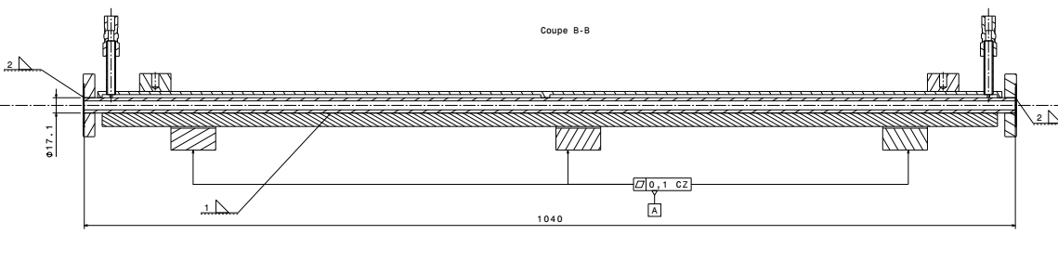
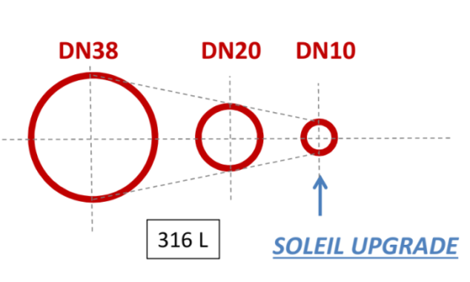
NEG coating Characterization
Ongoing ‘TEST PLAN’
NEG-coated,
Water cooled chambers
from SAES
DN63
[→ april 2021 ]
Cu-OFS

Slide 8
Possible evolution of PSD Beamline
Adapt the PSD beamline for 3 gauge method
gauge+RGA
P_{T} [mbar]
S [l.s⁻¹]
C [l.s⁻¹]
S.R
Q [mbar.l.s⁻¹]
beam collimation
(gas load)
TEST Chamber
SIP
SIP
Turbo molecular pump
+ gauge+RGA
Turbo molecular pump
+ gauge+RGA

Slide 9
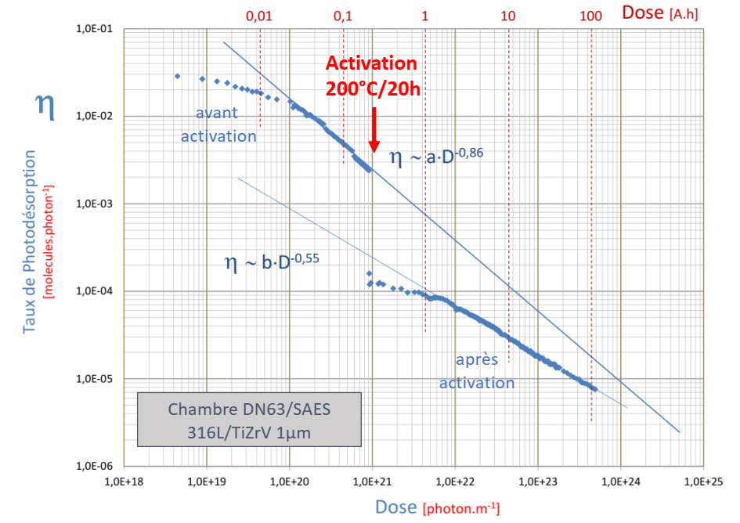
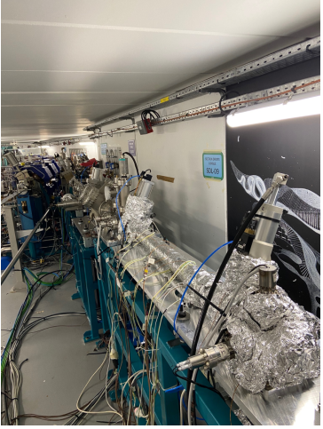

NEG coating Characterization
@ PSD Beamline on D08-1
Very first experiment / Oct-Nov 2020
DN63
chamber
1 m
Representative
Data

Slide 10
Last PSD Measurements
Red curve : DN20 SS chamber showing bad results maybe consequence of problems occuring during bake out and activation
Green curve : DN20 Cu OFS chamber showing good results before and after activation

Slide 11
After PSD measurement the sorption capacity of the bad DN20 SS chamber has been measured : The NEG coating is not efficient.

Slide 12
Comparison od DN60 and DN20 chambers
Slopes after activation are different : geometry effect?

Slide 13
Conclusion
The characterization of NEG coating are going on with sorption and PSD measurement
Evolution of the PSD beamline in considered for 3 gauges method measurement
Recent experience indicates that sorption characterization must be done before PSD measurement in order to validate the coating quality.

