Slide 1
Update on the DLS testing facilities
IFAST 10.5 kick-off meeting
C. Burrows
M.P. Cox
12th May 2021

Slide 2
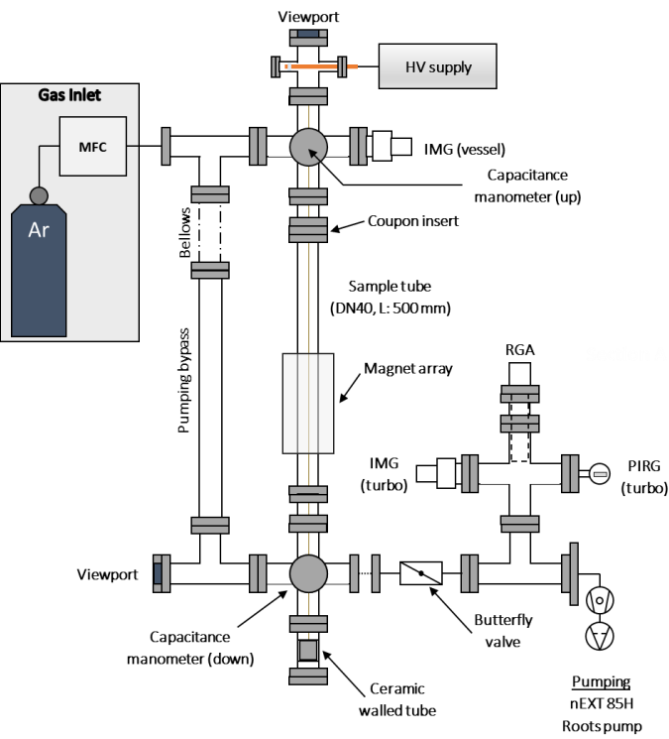
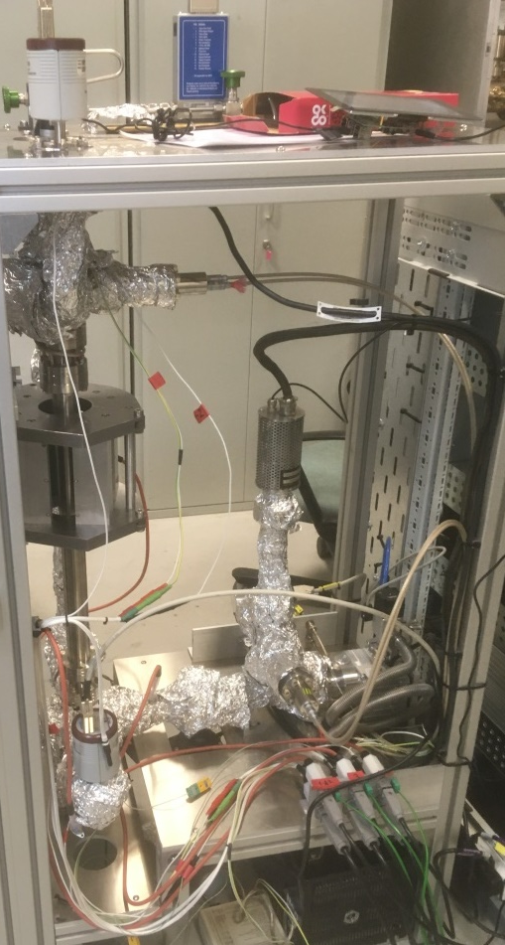
Coating Rig - Overview
Overview
DC magnetron sputtering rig, DN40 vessels up to 0.5 m
Base pressure around low 10⁻⁹ mbar range (unbaked)
Ar sputtering gas operating between 3x10⁻³ and 1 mbar
Moving permanent magnet (approx. 600 G) on rail
Static and pulsed DC HV modes
Twisted wire(s) tensioned by 0.5 kg mass in vacuum
System controlled using PLC
Notes:
Cylindrical magnetron

Slide 3
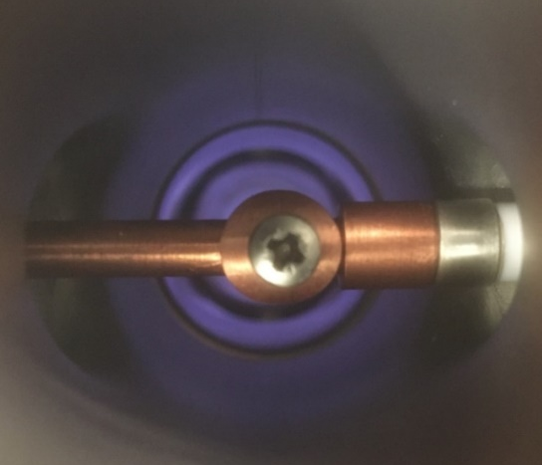
Coating Rig - Status
Status:
Increased operating pressure limit to 1 mbar
Several short (1 hour) coating runs with Zr wire, operating at low plasma power (<4 W)
Next steps:
Increase plasma power to approx. 15 W and perform longer coating run
Thickness and composition determination on Si coupons
Notes:
Currently limited plasma stability, possibly due to wire cleanliness?

Slide 4
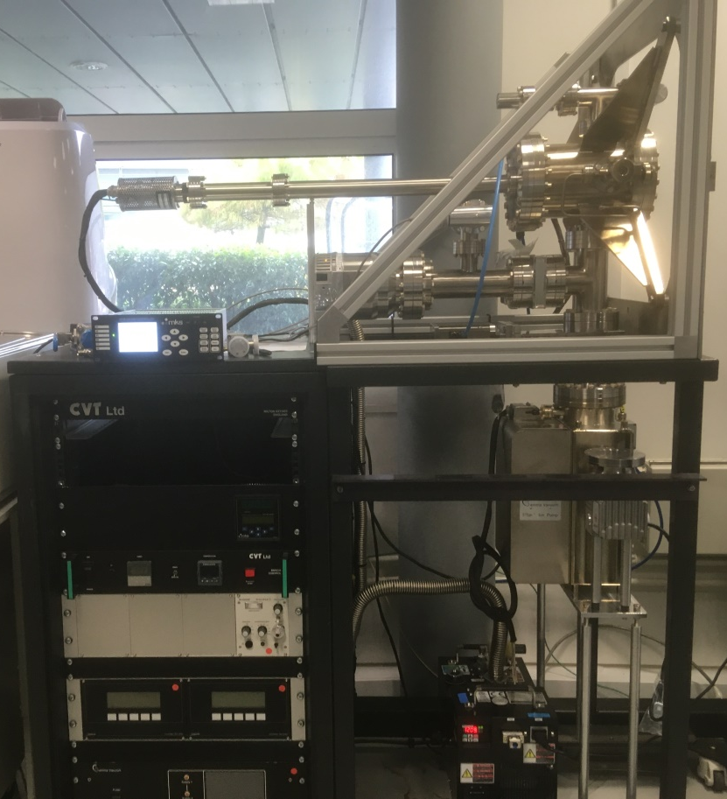
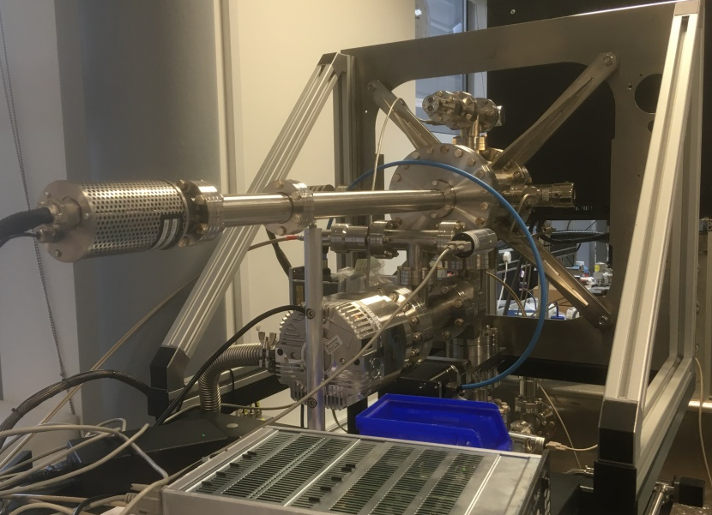
Measurement Rig - overview
Overview
RGA-based or extractor gauge pressure ratio method to estimate sticking probability
Pumping provided by a 300 l/s turbo and a 150 l/s SIP
Gas injection through dedicated system based on expansion volumes
Four gases (H₂, CO, CO₂, CH₄) let through regulated leak valve, expected operating pressures up to 10⁻⁵ mbar
System to be controlled by PLC
Notes:
Pre-existing rack, challenge to wire and fit in controls

Slide 5
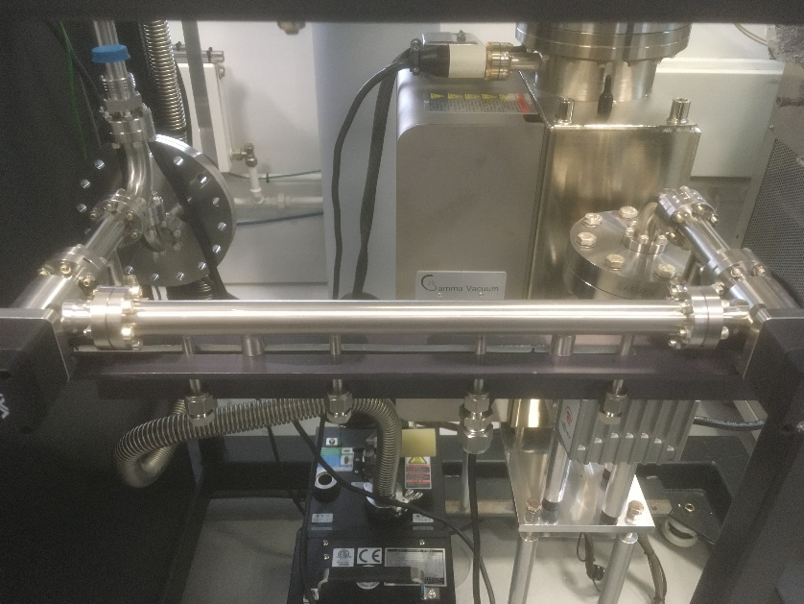
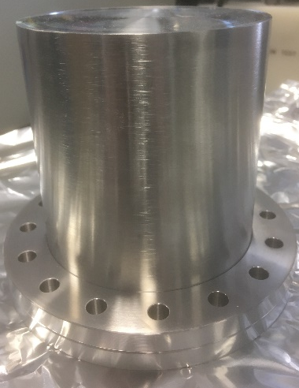
Measurement Rig - status
Status:
System currently in development
Gas injection system design work complete and parts received from supplier (layout to the left with primary expansion volume also shown)
Next steps:
Use Zr coated test piece as initial commissioning test
Simulation work ongoing - update 3D model with finalised rig layout and re-run simulations with improved numbers
Notes:
Simulation work promising, think odd near-unity problems due to RGA model and how I’ve calculated impingement rate (only first guess) – based on Oleg’s paper
Gas system should be first assembled within 4-6 weeks, following that cleaning then testing/volume measurements by 8 weeks

Slide 6
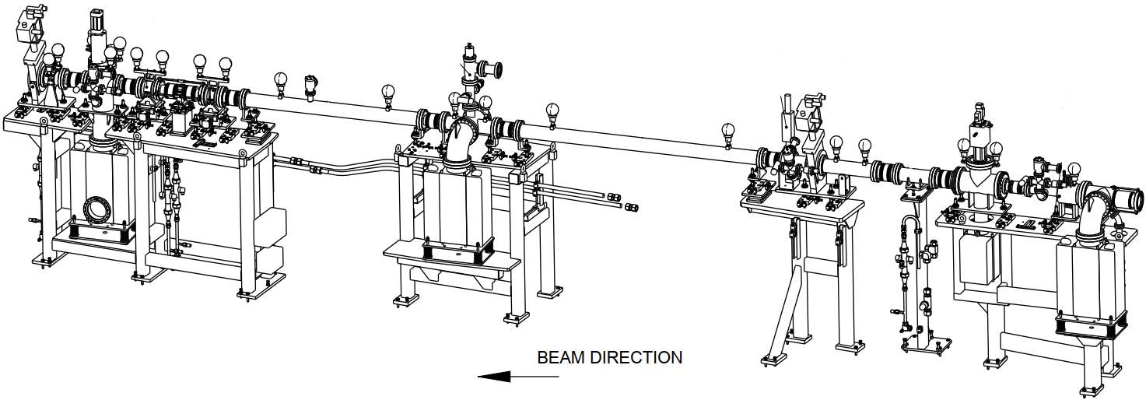
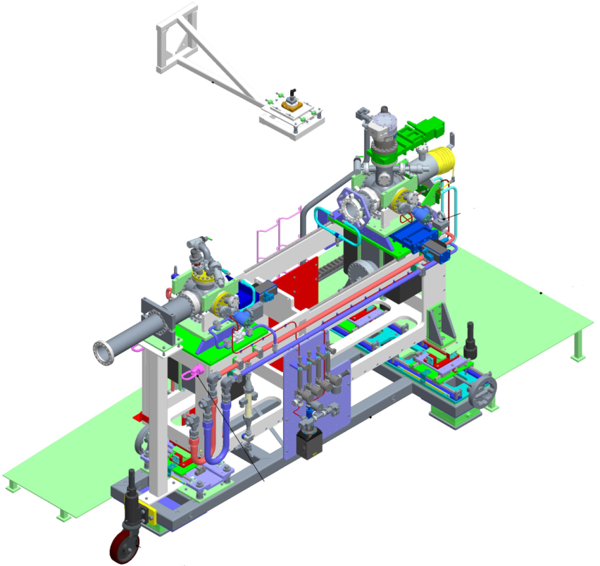
DLS Front-end - overview
Overview
Typical DLS dipole front-end (FE10B):
  Photon flux: 3.86 x 10¹⁴ photon/sec/mradH/mA
  Critical energy: 8.379 keV
Beam width at test piece up to 20 mm
Test vessel angular range of up to 60 mrad (3.5º)
Two 300 l/s ion pumps and a 300 l/s turbo pump for gas injection or coating saturation measurements
Status
Front-end section: installed November 2020
Experimental end-station: currently in build
Front-end section
Experimental end-station
Notes:
1 RGA on front-end to run in conductance measurements, other three for measurements on end station alone
Pumping can be isolated for conductance measurements, requires an understanding of the background of the system
Orifice conductance to be simulated and determined that way

Slide 7
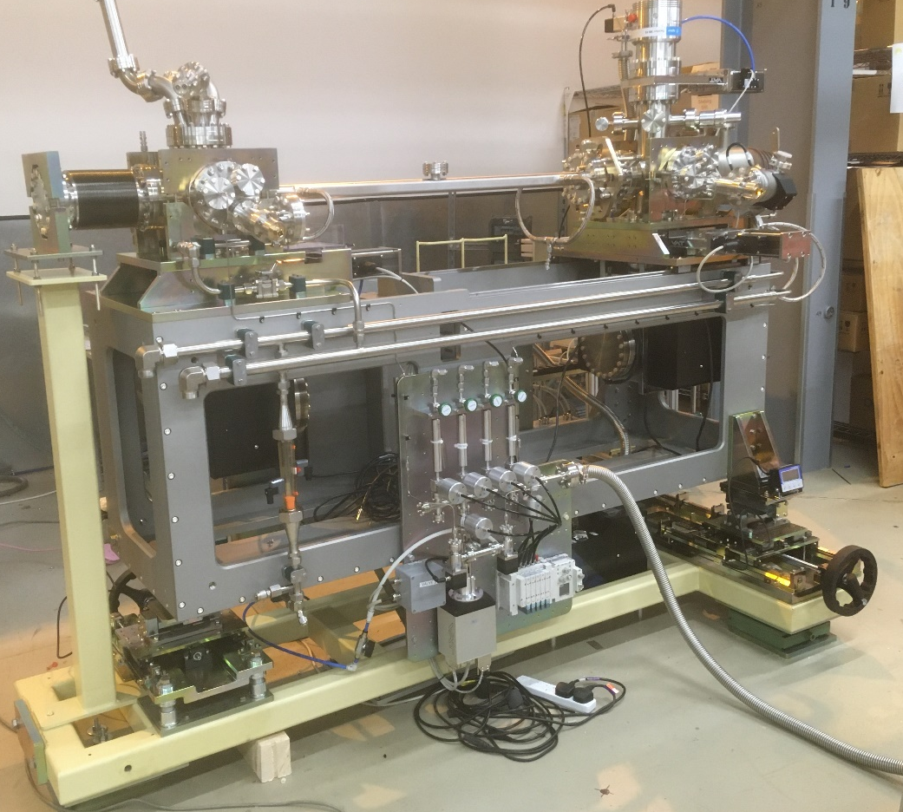
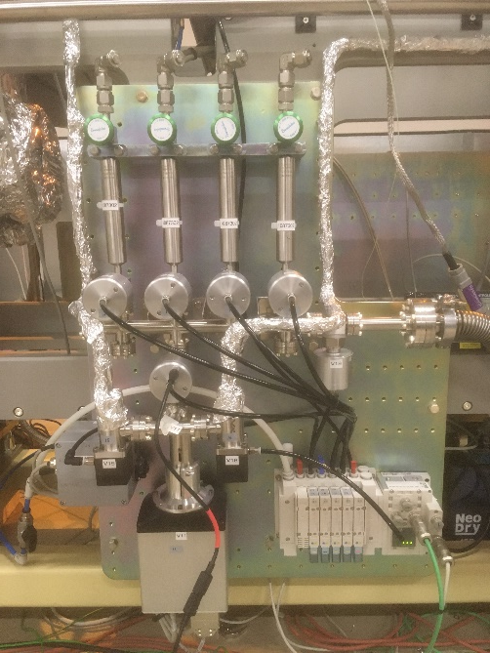
DLS Front-end – end station
Measurements
Pressures monitored using three MKS RGAs (plus one on front-end) with standard IMGs/PIRGs
Determine PSD yields using three-gauge or conductance methods
Test pieces
Can accommodate 1 metre test pieces up to DN100
Test pieces with integrated water cooling and central RGA port
Pumping
Two 300 l/s ion pumps and a 300 l/s turbo pump for coating saturation runs
Notes:
Gas injection system similar to measurement rig, automated for use on storage ring (accounting for filling opportunities and remote operation with beam)
In principle any water cooled absorbing vessel/body can be tested on system (up to 1 metre in length) although removing pumping tee 2 provides more space…

Slide 8
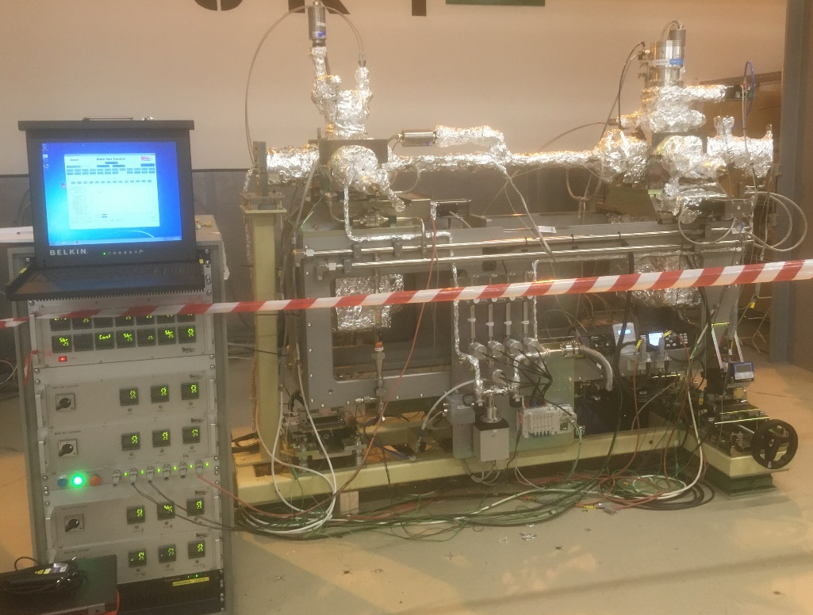
Vacuum Development Front-end - status
Status
Initial gauge calibration and testing complete - transfer to end
station looks good
Build complete and initial control system testing complete
System currently under bake in preparation for installation
Next steps
Post-installation commissioning
Testing of stainless steel test piece with 3-gauge and throughput
methods.
Develop new test pieces within IFAST framework and in collaboration with DESY and SOLEIL
Notes:
Simulation work promising, think odd near-unity problems due to RGA model and how I’ve calculated impingement rate (only first guess) – based on Oleg’s paper
Gas system should be first assembled within 4-6 weeks, following that cleaning then testing/volume measurements by 8 weeks

Slide 9
Conclusion
Coating capability
Coating system is running reliably, optimisation of plasma conditions is needed
Measurement capability
Build of system nearly complete, testing and commissioning to follow
PSD end-station
Currently preparing for installation and expected initial measurements and commissioning to take place in the next Diamond machine run.
Notes:
Simulation work promising, think odd near-unity problems due to RGA model and how I’ve calculated impingement rate (only first guess) – based on Oleg’s paper
Gas system should be first assembled within 4-6 weeks, following that cleaning then testing/volume measurements by 8 weeks

