Slide 1
1st IFAST Task 10.5 meeting
Objectives, Milestones and Deliverables
Agreeing in schedules
Oleg B. Malyshev (UKRI)
Task 10.5 leader

Slide 2
Agenda
 | Item | Speaker | Duration
1 | Introduction | Oleg Malyshev | 10 min
2 | DLS: update on status of pumping property testing facility, SR beamline and capabilities in thin film characterisation | Matthew Cox | 10 min
3 | Soleil: update on status of pumping property testing facility, SR beamline and capabilities in thin film characterisation | Christian Herbeaux | 10 min
4 | DESY: update on status of pumping property testing facility, SR beamline and capabilities in thin film characterisation | Lutz Lilje | 10 min
5 | UKRI/SRFC/ASTeC update on status of pumping property testing facility, SR beamline and capabilities in thin film characterisation | Reza Valizadeh | 10 min
6 | Discussion Design of PSD sample First sample exchange for pumping properties (substrate manufacturing, deposition, measurements, schedule, action list Scheduling first 12 months activities | Chris Borrows, Nicolas Bechu Nicolas Bechu All | 30 min
7 | Closing

Slide 3
IFAST started
IFAST duration 1/05/2021 – 30/04/2025
  IFAST coordinator is Dr. Maurizio Vretenar (CERN) (Maurizio.Vretenar@cern.ch)
  WP10 coordinator is Prof. Toms TORIMS (RTU) (Toms.Torims@cern.ch).
IFAST kick-off meeting tool place on 04/05/2021 by zoom
  All talks are available at https://indico.cern.ch/event/1024993/
  See a few talks from the IFAST coordinator team on administration and finance
  There were talks from each WP:
    Toms TORIMS gave a WP10 overview talk
      I gave a talk for Task 10.5

Slide 4
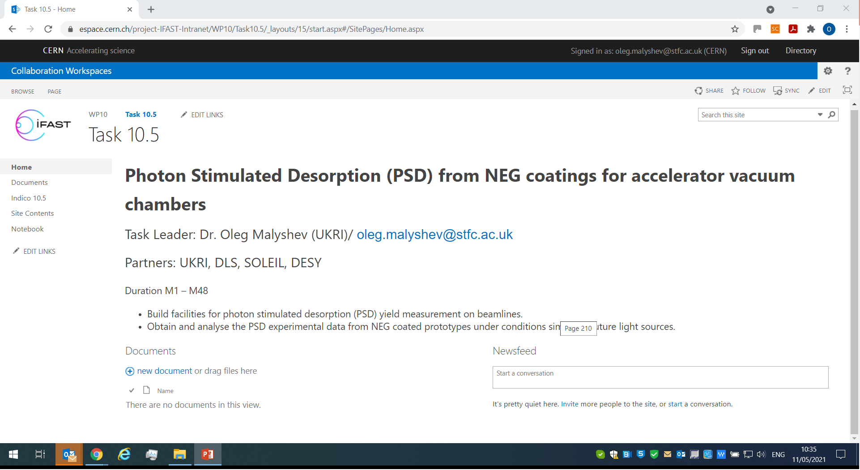
Task 10.5 Collaboration Workspace

Slide 5
Task 10.5 Objectives
Building facilities for photon stimulated desorption (PSD) yield measurement on beamlines at DLS (UK) and Soleil (France) employing an experience from STFC (UK)
Obtaining and analysing the PSD experimental data from NEG coated prototypes under the conditions similar to future light sources such as Diamond-2 and Soleil-2
 | Milestone/Deliverable name | Delivery date (in months) | Content
Milestone | First NEG coated sample are installed on SR beamline at DLS and Soleil | 12 | Report
Deliverable | First PSD data from NEG coating | 36 | Report

Slide 6
Schedule for PSD
Tasks | 1 May21 | 2 Jun21 | 3 Jul21 | 4 Aug21 | 5 Sep21 | 6 Oct21 | 7 Nov21 | 8 Dec21 | 9 Jan22 | 10 Feb22 | 11 Mar22 | 12 Apr22 | 13 May22 | 14 Jun22
DLS
PSD sample S1a and S2a design (d), manufacturing (m) and delivered to UKRI (u)
PSD sample S1a and S2a coating with NEG at UKRI
SR beam line design (D), installation (I), tested (T)
Sample installed (SI), SR testing (SR), data analysis (DA) |  |  |  |  |  |  |  |  |  | SI
Soleil
PSD sample S1b and S2b design (d), manufacturing (m) and delivered to UKRI (u)
PSD sample S1a and S2a coating with NEG at UKRI
SR beam line design (D), installation (I), tested (T)
Sample installed (SI), SR testing (SR), data analysis (DA) |  |  |  |  |  |  |  |  |  | SI
Milestone report writing |  |  |  |  |  |  |  |  |  |  |  | M

Slide 7
Schedule for pumping properties
Tasks | 1 May21 | 2 Jun21 | 3 Jul21 | 4 Aug21 | 5 Sep21 | 6 Oct21 | 7 Nov21 | 8 Dec21 | 9 Jan22 | 10 Feb22 | 11 Mar22 | 12 Apr22 | 13 May22 | 14 Jun22
Samples for pumping properties (Sp1 – Sp12)
DLS: manufacturing (m) and delivered to UKRI (u)
Soleil: manufacturing (m) and delivered to UKRI (u)
DESY: manufacturing (m) and delivered to UKRI (u)
UKRI: sample Sp1 – Sp12 coating with NEG (C), delivering to DLS, Soleil and DESY
DLS: installation (I), tested (T), data analysis (DA)
Soleil: installation (I), tested (T), data analysis (DA)
DESY: installation (I), tested (T), data analysis (DA)

Slide 8
Schedule for ESD
Tasks | 1 May21 | 2 Jun21 | 3 Jul21 | 4 Aug21 | 5 Sep21 | 6 Oct21 | 7 Nov21 | 8 Dec21 | 9 Jan22 | 10 Feb22 | 11 Mar22 | 12 Apr22 | 13 May22 | 14 Jun22
Samples for ESD (Se1 – Se8)
DLS: manufacturing (m) and delivered to UKRI (u)
DESY: manufacturing (m) and delivered to UKRI (u)
UKRI: sample Se1 – Se8 coating with NEG (C), delivering to DLS and DESY
DLS: installation (I), tested (T), data analysis (DA)
DESY: installation (I), tested (T), data analysis (DA)

