Slide 1

Open discussion on first sample exchange for pumping properties
Nicolas Béchu
On behalf of Vacuum Group and Transmission Bench Task Force
12th Mai 2021
IFAST Task 10.5 Kick-off Meeting

Slide 2
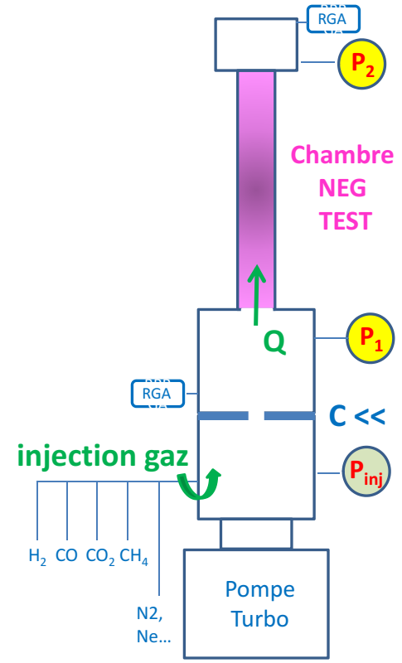

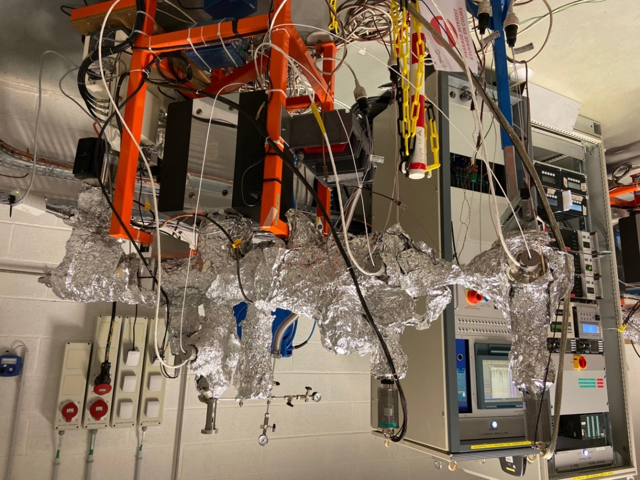
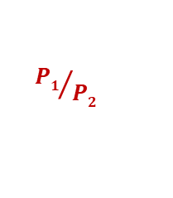
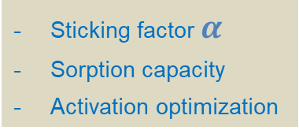
NEG coating characterization by transmission method
@ Vacuum LAB
2 Transmission Method Test Benches for NEG coating characterization
Sticking factor $α$
Sorption capacity
Activation optimization
Gas inlet
P_{inj}
C <<
Turbo
P₂
P₁
Transmission Method
${P1}/{P2}$
is calibrated with MOLFLOW+ to find $α$
P. Costa Pinto, P. Chiggiato, A. Sapountzis, T. Sinkovits, M. Taborelli,
CERN
80th IUVSTA Workshop, NSRRC, Hsinchu, Taiwan (2016)

Slide 3
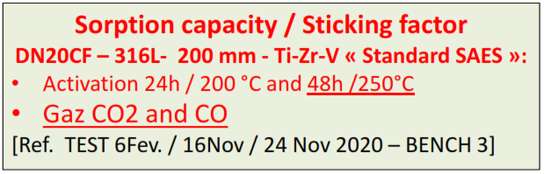
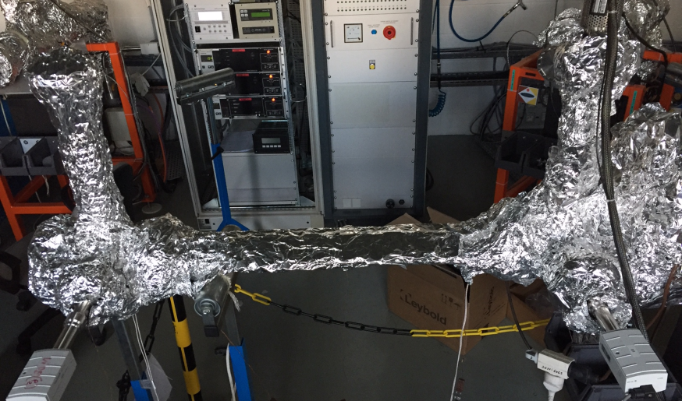
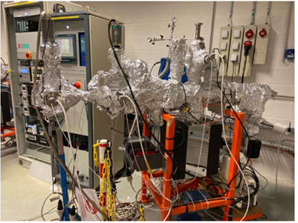
Two transmission method test benches
Bench #4
Maybe dedicated to Ne venting for a while
Bench #3
Could be used for quick measurements
TESTS Chambre CVQS-AL-02 / Ti-Zr-V-Hf
[Ref. TEST B1 du 17 avril 2019 – BANC 4]

Slide 4
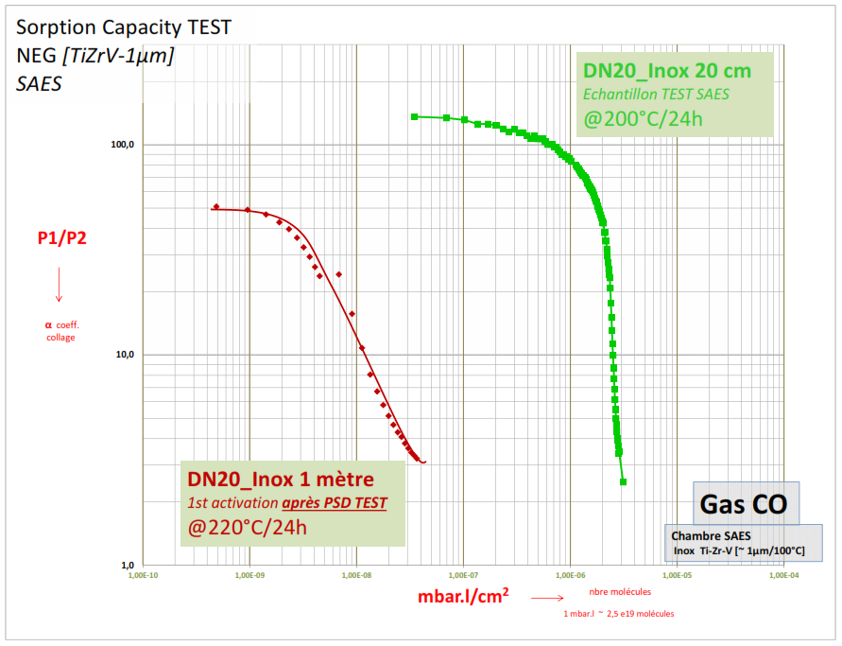
Good or bad NEG by transmission…

Slide 5
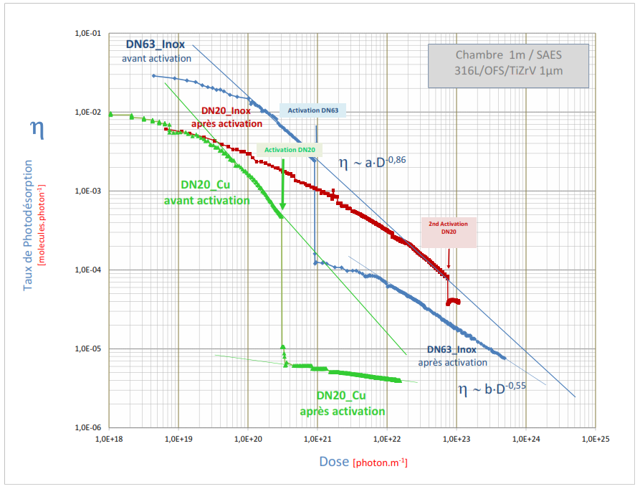
... good or bad NEG with PSD
18

Slide 6
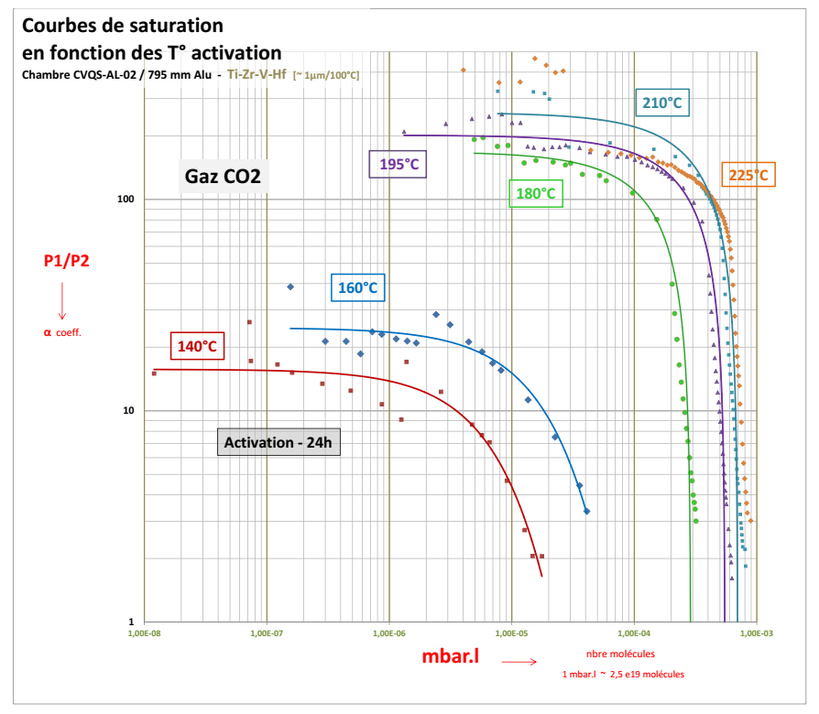
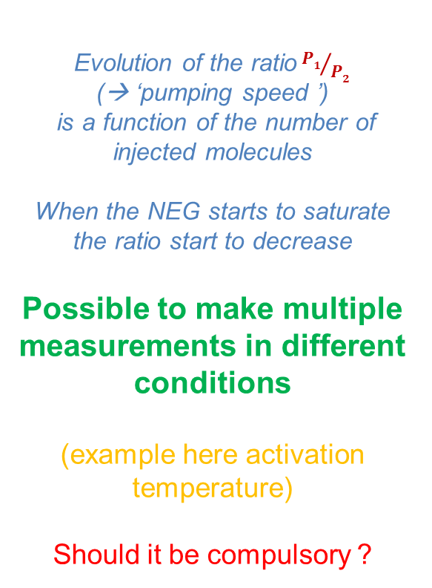
Quite easy fist NEG coating characterization
@ Vacuum LAB
Typical sorption capacity curves
of NEG coating
for increasing activation T°
Evolution of the ratio${P1}/{P2}$
(→ ‘pumping speed ’)
is a function of the number of injected molecules
When the NEG starts to saturate the ratio start to decrease
Possible to make multiple measurements in different conditions
(example here activation temperature)
Should it be compulsory ?
8

Slide 7


Slide 8
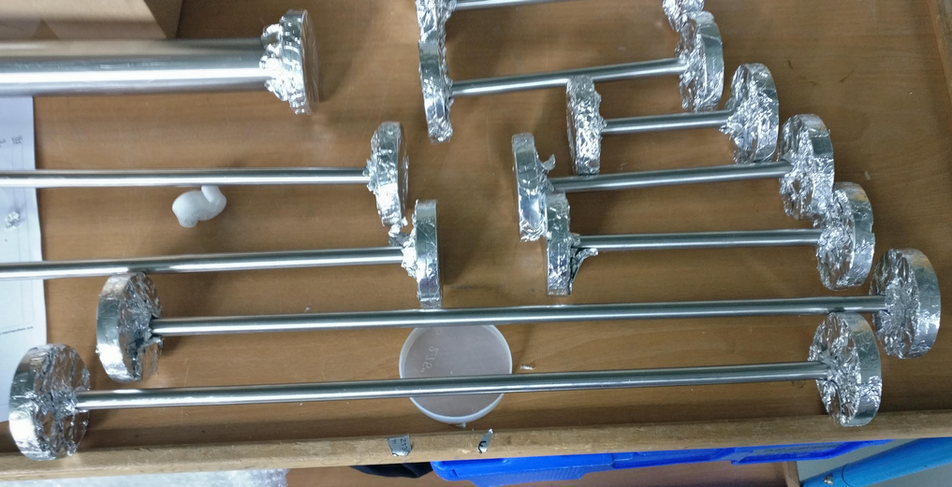
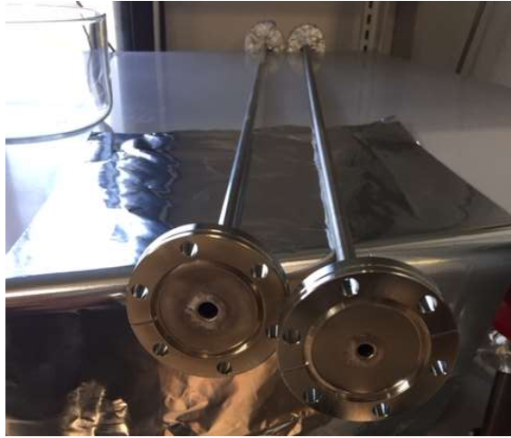

SOLEIL DN10 samples
to be NEG coated soon…
SAES Getter S.p.A
Tested samples

