Slide 1
Polymeric Fabrication

Slide 2
Two different approaches
1) Create a channel and fill it with scintillating material
1) Create self standing channel made of scintillating resin

Slide 3
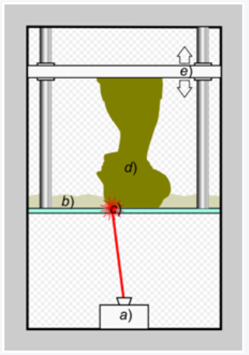
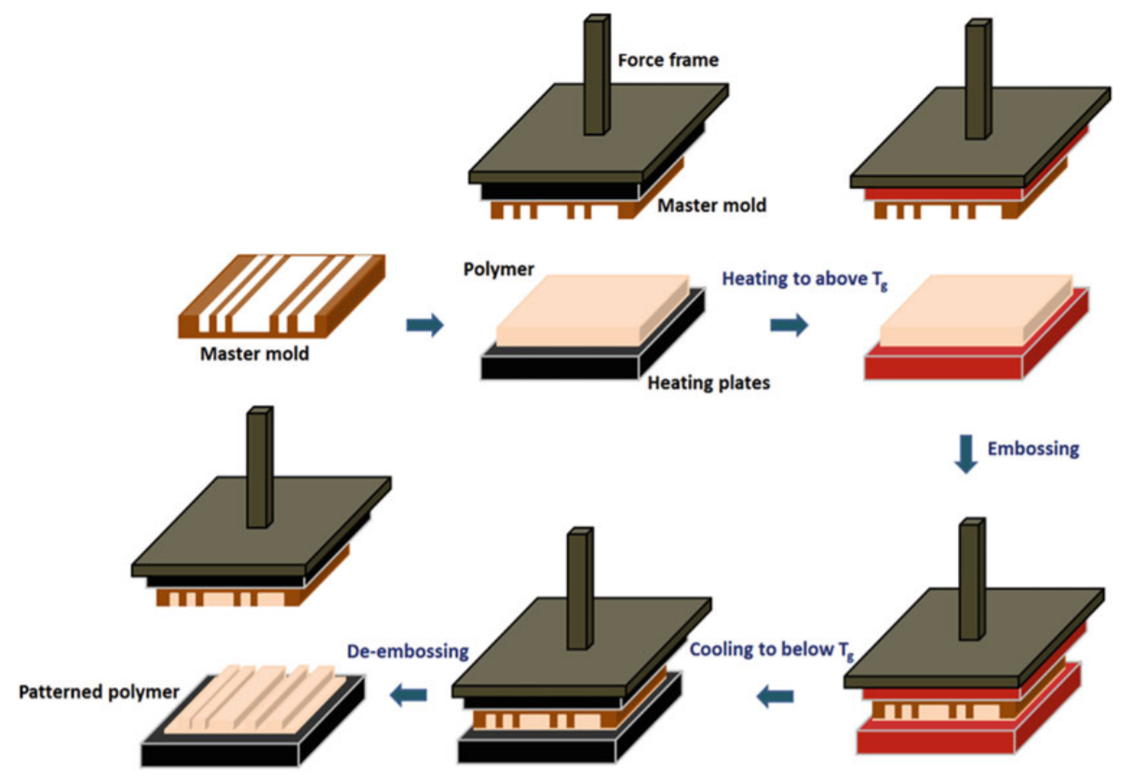
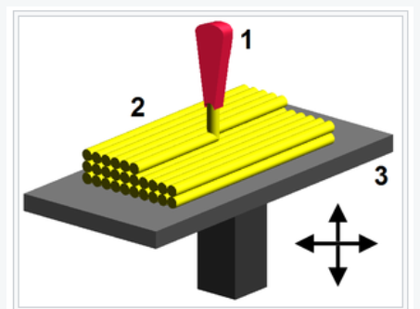
First Approach – several alternatives
Liquid
SLA with thermosetting resin + scintillating liquid
Hot embossing with thermoplastic + scintillating resin
FDM with thermoplastic + scintillating resin
Resin

Slide 4
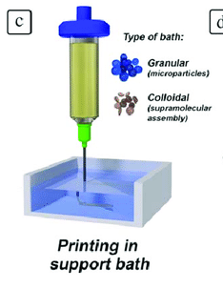
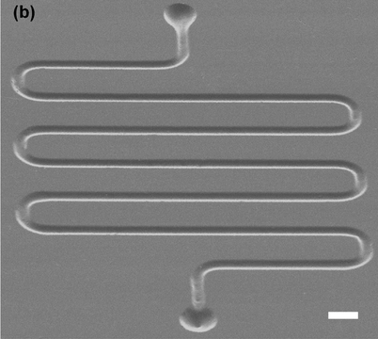
Second Approach – several alternatives
PS filament
FDM with thermoplastic engineered polymer
PDMS Casting with scintillating resin
Direct Ink Writer with scintillating resin
PDMS mould
Resin

Slide 5
Wrap up
Filled Channels | Polymer |  |  | Scintillating material
 | Thermosetting | Thermoplastic | Elastomer | Liquid | Resin | PS filament
SLA | Resin
Hot Embossing |  | PMMA and PTFE
FDM |  | PMMA
Self-standing Channels
Casting |  |  | PDMS
FDM
Direct Ink Writer

Slide 6
First Approach
Hot Embossing
Pros:
Higher resolution achievable
NanoImprint at CMi
Limitation:
Linked to mould
To do:
Fabricate Si mould and understand processes
FDM
Pros:
PMMA filament at LPAC
Plan B
Limitation:
Resolution limited by noozle
SLA
Pros:
Thermosetting better resistance to radiation
Available at CERN and EPFL
1:1 comparison with Silicon devices
Limitation:
Resolution 50 um
To do:
Find appropriate resin

Slide 7
Second Approach
FDM
Pros:
PS filament at CERN
Limitation:
Resolution limited by noozle
Direct Ink Writer
Pros:
Available at EMPA with Luca
Limitation:
Resolution limited by noozle
Lots of time to define resin rheological properties
PDMS Casting
Pros:
Useful proof of concept
Facilities at CMi
Limitation:
Cross-talking
To do:
Fabricate PDMS cast

Slide 8
To scale down dimension
Two-photons stereolithography
  Once SLA process is established, scaling down is possible with this technique.
    Pros:
    nm resolution achievable
    Available at EMPA
Hot Embossing
  Once process is established, scaling down by reducing dimensions’ mould.
    Pros:
    Feasible at CMi

Slide 9
Next steps investigation
Considering the first approach of fabrication and for the reasons already mentioned, we can investigate SLA and Hot Embossing approaches
  To validate the new fabrication process
  To have a 1:1 comparison with the Silicon device
Considering the second approach, we can create a proof of concept using the PDMS casting method
  To explore new self-standing concept

