Slide 1



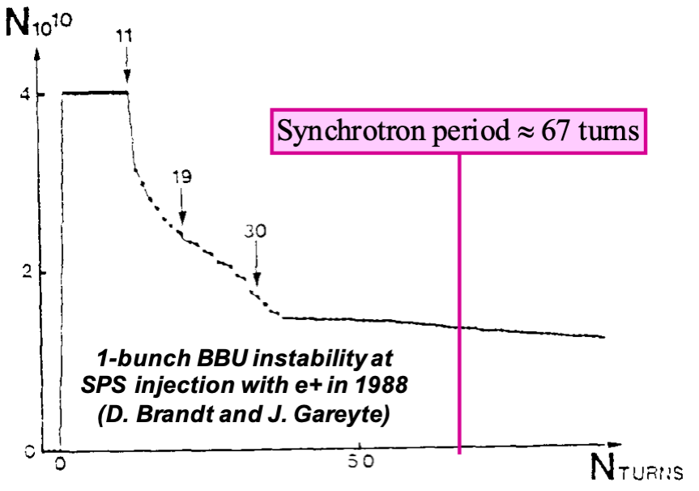
BD-WG: Summary of R&D list
  Conveners: R. Ryne, T. Raubenheimer and E. Métral
Many thanks to the
participants of the BD-WG!

Slide 2
BD-WG: Summary of R&D list
  Conveners: R. Ryne, T. Raubenheimer and E. Métral
Many thanks to the
participants of the BD-WG!

Slide 3
BD-WG: Summary of R&D list
  Conveners: R. Ryne, T. Raubenheimer and E. Métral
Many thanks to the
participants of the BD-WG!

Slide 4
BD-WG: Summary of R&D list
  Conveners: R. Ryne, T. Raubenheimer and E. Métral
Many thanks to the
participants of the BD-WG!

Slide 5
BD-WG: Summary of R&D list
  Conveners: R. Ryne, T. Raubenheimer and E. Métral
Even if everything needs to
be done quickly with muons (due to short lifetime), many issues can happen with high bunch charges and high impedances (which is the case) => Need to be
carefully studied!
Many thanks to the
participants of the BD-WG!

Slide 6
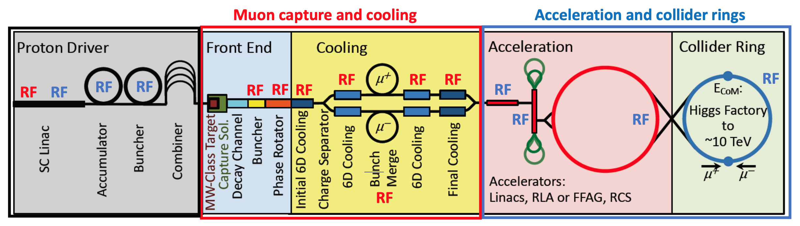
Challenges at all stages!

Slide 7
R & D item #1:
Halo formation and beam losses in the Proton Driver
  Why is it important? Criticality: 3 [1 = high / 2 = medium / 3 = low]
    The more protons (and therefore the more muons we create), the “easier” it is afterwards
  What are the key issues
    High (few MW) beam power, short (1-2 ns) bunch length, low (5 Hz) RepRate
  What do we need before next ESPPU
    Detailed simulation studies to check that there are no major beam quality degradations and study in detail the halo formation and beam losses (mainly space charge effects)
  Which resources are required / who is willing to do it
    Ongoing discussions

Slide 8
R & D item #2:
Check all cooling studies with a 2nd code
  Why is it important? Criticality: 3
    Cooling it the key ingredient for a muon collider, so it has to be fully understood and optimized
  What are the key issues
    Should not rely on only 1 code (ICOOL, for which the most complete simulation studies were made) => G4BL and G4MICE (e.g. ICOOL does not do hadronic interactions)
  What do we need before next ESPPU
    Get all the lattices used in the past with ICOOL and redo all past cooling simulations with another code. Improve / optimize (some past constraints could be relaxed)
  Which resources are required / who is willing to do it
    Ongoing discussions

Slide 9
R & D item #3:
Collective instabilities during ionization cooling
  Why is it important? Criticality: 3
    Such mechanism could jeopardize the generation of high brightness muon beams through ionization cooling
  What are the key issues
    Knowledge of collective instabilities that could arise from the interaction of the beam with electromagnetic wake fields propagating in matter (absorbers, gas-filled RF cavities, etc.) as well as with the pair of charges generated by ionization is practically non-existing
  What do we need before next ESPPU
    Elaborate models that describe the electromagnetic wake fields generated by the beams passing through matter, as well as the dynamics of the charges generated by ionization including their generation, interaction with the beam and recombination
  Which resources are required / who is willing to do it
    Ongoing discussions => Xavier Buffat (CERN) with some students?

Slide 10
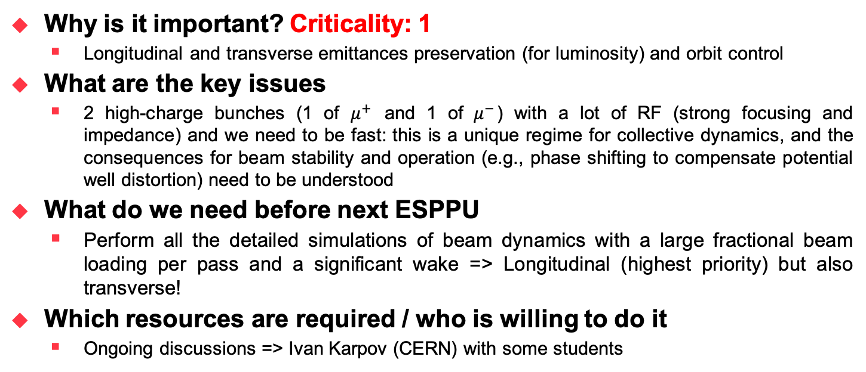
R & D item #4:
New beam dynamics regime during acceleration
  Why is it important? Criticality: 1
    Longitudinal and transverse emittances preservation (for luminosity) and orbit control
  What are the key issues
    2 high-charge bunches (1 of $μ^{+}$ and 1 of $μ^{−}$) with a lot of RF (strong focusing and impedance) and we need to be fast: this is a unique regime for collective dynamics, and the consequences for beam stability and operation (e.g., phase shifting to compensate potential well distortion) need to be understood
  What do we need before next ESPPU
    Perform all the detailed simulations of beam dynamics with a large fractional beam loading per pass and a significant wake => Longitudinal (highest priority) but also transverse!
  Which resources are required / who is willing to do it
    Ongoing discussions => Ivan Karpov (CERN) with some students

Slide 11
R & D item #5:
Are sextupoles needed in pulsed synchrotrons?
  Why is it important? Criticality: 3
    In an ordinary synchrotron, it would be important to correct chromaticity to mitigate head-tail instabilities. Is that needed in our operating regime?
  What are the key issues
    It would be preferable to avoid sextupoles to maintain a high dipole packing fraction and avoid feed-down since the beam will likely have to move in the sextupoles during the ramp
  What do we need before next ESPPU
    Perform detailed simulation studies to decide on the mitigation measure: None (as we are fast enough)? Chromaticity? Transverse damper? Landau damping too slow
  Which resources are required / who is willing to do it
    Ongoing discussions

Slide 12
R & D item #6:
Opposite sign bunches – beam crossing and wakes
  Why is it important? Criticality: 1
    Both signs of muons are accelerated simultaneously in our rings. There will be 2 beam-beam collision points with wakes in the cavities, which will vary depending on where the cavities are in the ring (cavities must be distributed in several uniformly-spaced stations in the ring)
  What are the key issues
    The impact of these collective effects should be understood
  What do we need before next ESPPU
    Perform detailed simulation studies, studying one by one all the different aspects
  Which resources are required / who is willing to do it
    Ongoing discussions

Slide 13
R & D item #7:
FFAs as an alternative to pulsed synchrotrons
  Why is it important? Criticality: 2
    Particularly at lower energies, driving the magnets requires very rapid ramp rates. The challenges associated with this may drive us towards alternatives, in particular FFAs
  What are the key issues
    E.g. vFFA relatively new concept (unique coupled optics, importance of fringe fields), no machine constructed yet, no dedicated tools to study collective effects
  What do we need before next ESPPU
    E.g. vFFA is a linac from the BD point of view, so Linac tools should be able to be used but there is a need to develop dedicated tools for collective effects
  Which resources are required / who is willing to do it
    Ongoing discussions

Slide 14
R & D item #8:
Design of the full chain (acceleration in particular)
  Why is it important? Criticality: 1
    Right now most of the acceleration designs are conceptual, with few details available. We should start to put together detailed designs
    Agreed set of baseline accelerator parameters is essential for refined studies (lattices for all stages, from past studies or to be developed/optimized => CERN repository; RF frequencies; etc.)
  What are the key issues
    Particular emphasis should be placed on the longitudinal dynamics since preservation of longitudinal emittance is critical (but let’s not overlook the transverse plane)
  What do we need before next ESPPU
    Consistent simulation studies from the start of acceleration till the end and also the transport between the different machines
    Would be important to decide whether we stick to the MAP setup (mostly in terms of energies and size of the RLAs and RCSs, based on other constraints) to study the feasibility, or whether we already review this before making the corresponding models and estimates
  Which resources are required / who is willing to do it => Ongoing discussions

Slide 15
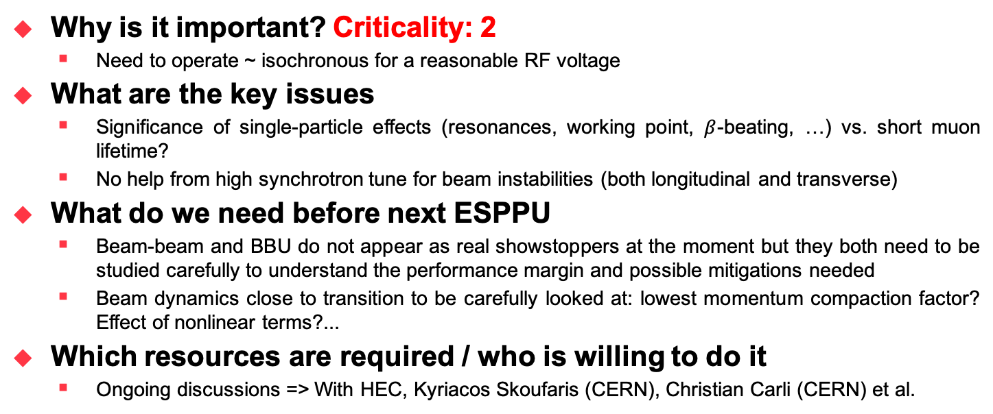
R & D item #9: Longitudinal and transverse
beam dynamics studies in the collider
  Why is it important? Criticality: 2
    Need to operate ~ isochronous for a reasonable RF voltage
  What are the key issues
    Significance of single-particle effects (resonances, working point, $β$-beating, …) vs. short muon lifetime?
    No help from high synchrotron tune for beam instabilities (both longitudinal and transverse)
  What do we need before next ESPPU
    Beam-beam and BBU do not appear as real showstoppers at the moment but they both need to be studied carefully to understand the performance margin and possible mitigations needed
    Beam dynamics close to transition to be carefully looked at: lowest momentum compaction factor? Effect of nonlinear terms?...
  Which resources are required / who is willing to do it
    Ongoing discussions => With HEC, Kyriacos Skoufaris (CERN), Christian Carli (CERN) et al.

Slide 16
R & D item #10: Impedance models
  Why is it important? Criticality: 3
    Building a realistic impedance model of a machine is a necessary step to be able to evaluate the machine performance limitations, identify the main contributors in case an impedance reduction is required, and study the interaction with other mechanisms such as optics nonlinearities, transverse damper, noise, space charge, electron cloud, beam-beam (in a collider)…
  What are the key issues
    Requires time and resources (and many interactions with equipment group) + Many machines
    However: RF and Resistive-Wall dominate cooling and acceleration => Could be done quickly
  What do we need before next ESPPU
    Build reasonable impedance models for all the machines => CERN repository
    Define impedance budgets for all the machines
  Which resources are required / who is willing to do it
    Ongoing discussions

Slide 17
R & D item #11: Radiation mitigation
by moving the beam / magnets in the collider
  Why is it important? Criticality: 1
    This might be needed to reach acceptable level of radiation => Fundamental aspect of the study
  What are the key issues
    All the consequences for the beam dynamics need to be carefully analysed
  What do we need before next ESPPU
    Check what is needed, time scale, etc. and evaluate the impact on the collider performance
  Which resources are required / who is willing to do it
    Ongoing discussions

Slide 18
R & D item #12:
Development of simulation tools
  Why is it important? Criticality: 2
    Need to have a detailed understanding of many challenging mechanisms / new regimes
  What are the key issues
    Collective beam-matter interaction to be studied (new wake field; impact on beam dynamics)
    Non-standard acceleration schemes to be developed
    Tools to study collective effects for vFFA
    What about the study of the muon losses (we cannot collimate because muons go through everything and the issue is the decay products…)?
  What do we need before next ESPPU
    Develop necessary simulation tools after review of what already exists (e.g. FCC)
  Which resources are required / who is willing to do it
    Ongoing discussions => Elena Fol (CERN)

Slide 19
Quite some challenging and interesting
work ahead of us: let’s do it together!
Thank you
for your attention

Slide 20
Another recent example in the LHC
few years ago: “16L2” instability!
  16L2: cryogenic beam vacuum at half-cell 16 left of LHC-IP2
  67 beam dumps in 2017 due to fast beam losses in 16L2, which led to transverse coherent instabilities with rise-times of few 10s of turns (i.e. 1-2 orders of magnitude faster than instabilities from e-cloud or impedance)
  Cause: accidental air inlet into LHC beam vacuum with beam screen at 20 K at end of Technical Stop => Condensation and solidification of gases on beam screen surface in and around beam plug-in-module

