Slide 1
Update on the US Snowmass Process
Mark Palmer
Co-convener, Accelerator Frontier Topical Group 4 (AF4) – Multi-TeV Colliders
1st Muon Collider Community Meeting – May 20, 2021

Slide 2
Snowmass 2021 a 2022
Impacts of COVID-19:
  Both the Snowmass Report and the Community Summer Study meeting (CSS) will be delayed by one year a 2022.
Overall schedule for Snowmass process to be adjusted accordingly.
  High-level activities will be on hold until the end of June 2021.
  These activities include:
    Frontier-level and Topical Group-level workshops,
    All-conveners meetings, Advisory Group meetings and Newsletters.
  Other Topical Group and cross-frontier activities should be either paused or reduced to a significantly lower level, proceeding only as necessary to ensure scientific continuity, meet essential programmatic needs, or maintain collaborative work with other units and communities.
    No critical decisions will be made during the hiatus.
    No individuals should feel obligated to participate in these activities.
    Individual, collaborative and self-organized work can continue at the discretion of the individuals involved.
All paused individual or group activities will continue to receive full consideration once the Snowmass process formally resumes.

Slide 3
Statement from the Accelerator Frontier Conveners (January `21)
The Accelerator Frontier plans to slow down most of the topical group activities. Still, we anticipate to continue joint discussions with EF, TF and IF on issues related to future colliders (from major machine parameters to physics signatures, from Higgs factories to energy frontier pp, mumu and ee colliders, including plasma-based), to take part in organization and initial activities of the Muon Collider Forum, to hold the third in series Workshop on Physics Limits of Ultimate Beams (AF1, et al, Jan 22, 2021) and to proceed (at reduced rate) future collider parameter collection as part of the Implementation Task Force work.

Slide 4
Key Dates
White Paper submission to arXiv: no later than March 15, 2022.
Late submissions and updates are likely not to be incorporated in the working group reports, but will be included in the Snowmass on-line archive documents.
  Preliminary reports by the Topical Groups due: no later than May 31, 2022.
  Preliminary reports by the Frontiers due: no later than June 30, 2022.
  Snowmass Community Summer Study (CSS): July 2022 at UW-Seattle.
  All final reports by TGs and Frontiers due: no later than September 30, 2022.
  Snowmass Book and the on-line archive documents due: October 31, 2022.

Slide 5
Looking Ahead
Multi-TeV Collider (AF4) group
  Interface point for the International Muon Collider Collaboration
    Coordinate MC-related inputs and papers for the Snowmass Process
    Facilitate interfaces with the other frontiers
  Will re-launch regular meetings in the July time frame
    Planning for a joint meeting with EF and TF when activities resume
    Coordination Meeting for the Multi-TeV Collider Report sections

Slide 6
Useful Links
Snowmass Site:
  Main page: https://snowmass21.org/start
  Accelerator Frontier: https://snowmass21.org/accelerator/start
  AF4 – Multi-TeV Colliders: https://snowmass21.org/accelerator/energy_frontier/start
  Energy Frontier: https://snowmass21.org/energy/start
Muon Collider Forum:
  Muon Collider Forum mailing list:
  SNOWMASS-MUON-COLLIDER-FORUM@FNAL.GOV.
    Please join the list in order to receive announcements. For instructions on how to join an email list refer to https://snowmass21.org/energy/start#communications.
  Slack channel: “muon-collider-forum” for related discussions.

Slide 7
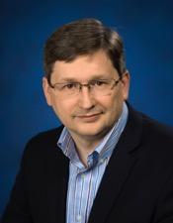

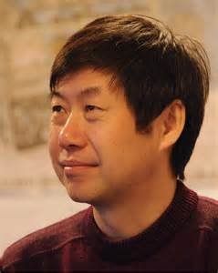
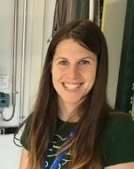

AF4 Contacts
Mark Palmer mpalmer@bnl.gov
Nadia Pastrone pastrone@to.infn.it
Jingyu Tang tangjy@ihep.ac.cn
Marlene Turner marleneturner@lbl.gov
  Snowmass Young Accelerator Frontier Liaison
Alexander Valishev valishev@fnal.gov

