Slide 1
MAP R&D as Input to the International Muon Collider
Design Study
1st Muon Collider Community Meeting
May 20, 2021
Mark Palmer for the Muon Accelerator Program (MAP)
Brookhaven National Laboratory
Drawing on work conducted by:
the US Muon Accelerator Program (MAP),
the International Design Study for a Neutrino Factory (IDS-NF), and
the International Muon Ionization Cooling Experiment (MICE)

Slide 2
Context
The MAP effort was formed in 2011 to address the key feasibility issues of muon collider and neutrino factory technology
  Leveraged prior decades of studies to identify a design path
    But not charged to deliver a design – specifically to look at the individual elements to determine whether “self-consistent” designs with the necessary performance were within the realm of possibility
  Focused on proton-driver based solution
    Other potential production paths, while having some appealing parameters would not deliver working luminosity for HEP
    Perhaps new eyes will identify an alternative, but we were unable to
    A special feature of a proton-driver path is that it intrinsically produces high brightness muon beams at relatively low energies a thus supporting a very broad range of physics applications
  Message for today –
  While the MAP Effort concluded “early,” the most critical feasibility issues were addressed – thus providing a strong foundation for a new international collaboration to move forward with a detailed design study.

Slide 3
Can Muon Accelerators Address the HEP Community’s Needs?

Slide 4
Why Muons?
Physics
Frontiers
Intense and cold muon beams a unique physics reach
Precision sources of neutrinos
Colliders
Opportunities
Collider Synergies
High intensity beams required for a long-baseline Neutrino Factory are
readily provided in conjunction with a Muon Collider Front End
Tests of Lepton Flavor Violation
Anomalous Magnetic Moment (g-2)
Next generation lepton collider
s-channel production of scalar objects
Strong coupling to particles like the Higgs
Reduced synchrotron radiation a multi-pass acceleration feasible
Beams can be produced with small energy spread
BUT the accelerator complex and detector must be able to handle the impacts of μ decays
Beamstrahlung effects suppressed at the collider IP
Such overlaps offer unique staging strategies to guarantee physics output
while developing a muon accelerator complex capable of supporting
collider operations

Slide 5
Collider Luminosity
Detector and Physics Performance at a Muon Collider
N. Bartosik et al 2020 JINST 15 P05001
For a muon collider, we can write the luminosity as:
For the 1.5 TeV muon collider design, we have
  N = 2×10¹² particles/bunch
  σ_{x,y} ~ 5.9 μm, β* = 10 mm, ε_{x,y}(norm) = 25 μm-rad
  n_{turns}~1000
  f_{bunch}=15 Hz (rate at which new bunches are injected)

Slide 6
MC Parameters as Developed by MAP
Based on the MAP Design Targets
RAST, Vol 10, No. 01, pp. 189-214 (2019)

Slide 7
Key R&D Challenges
Issues
Status
Target
Multi-MW Targets
High Field, Large Bore Capture Solenoid
Ongoing >1 MW target development
Challenging engineering for capture solenoid
Front End
Energy Deposition in FE Components
RF in Magnetic Fields (see Cooling)
Current designs handle energy deposition
Cooling
RF in Magnetic Field
High and Very High Field SC Magnets
Overall Ionization Cooling Performance
MAP designs use 20 MV/m → 50 MV/m demo
>30 T solenoid demonstrated for Final Cooling
Cooling design that achieves most goals
Acceleration
Acceptance
Ramping System
Self-Consistent Design
Designs in place for accel to 125 GeV CoM
Magnet system development needed for TeV-scale
Self-consistent design needed for TeV-scale
Collider Ring
Magnet Strengths, Apertures, and Shielding
High Energy Neutrino Radiation
Self-consistent lattices with magnet conceptual design up to 3 TeV
> ~5 TeV – ν radiation solution required
MDI/Detector
Backgrounds from μ Decays
IR Shielding
Further design work required for multi-TeV
Initial physics studies at 1.5 TeV promising

Slide 8
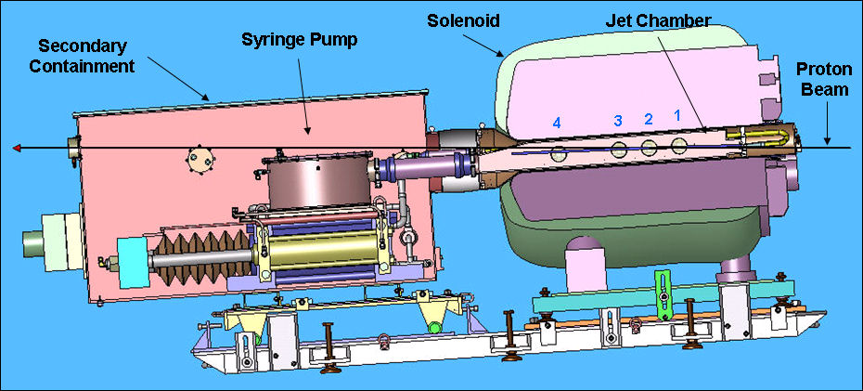
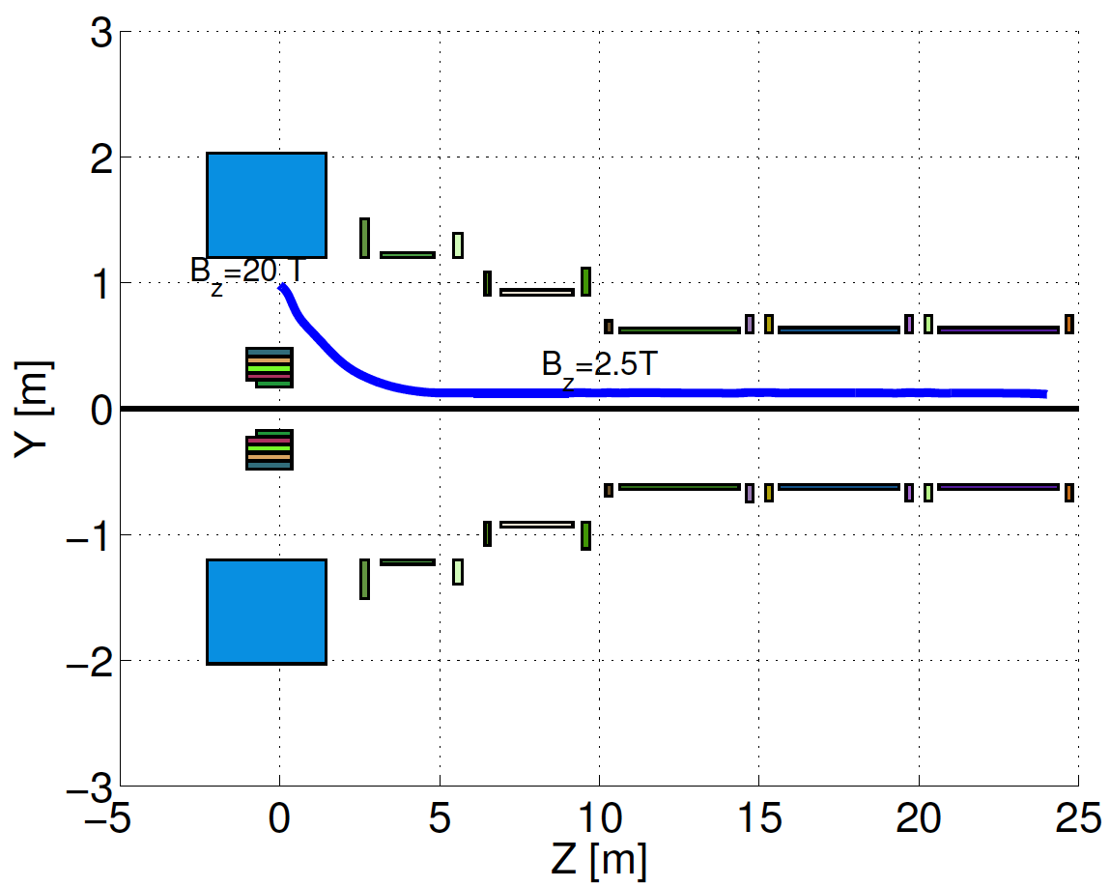
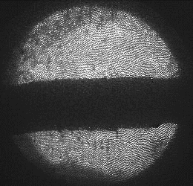
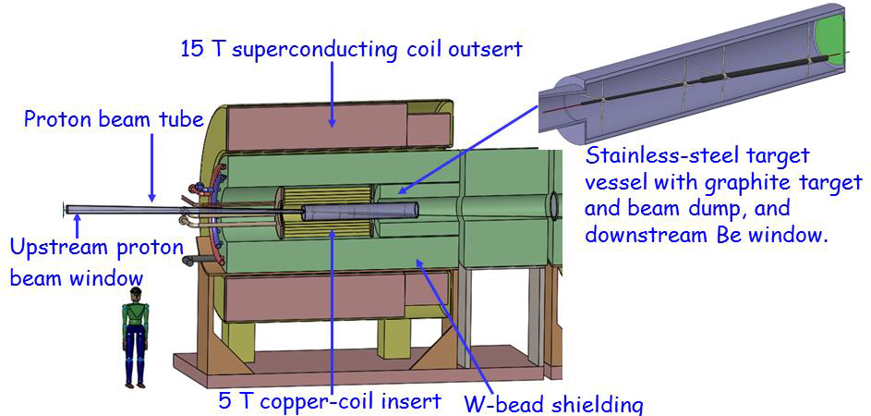
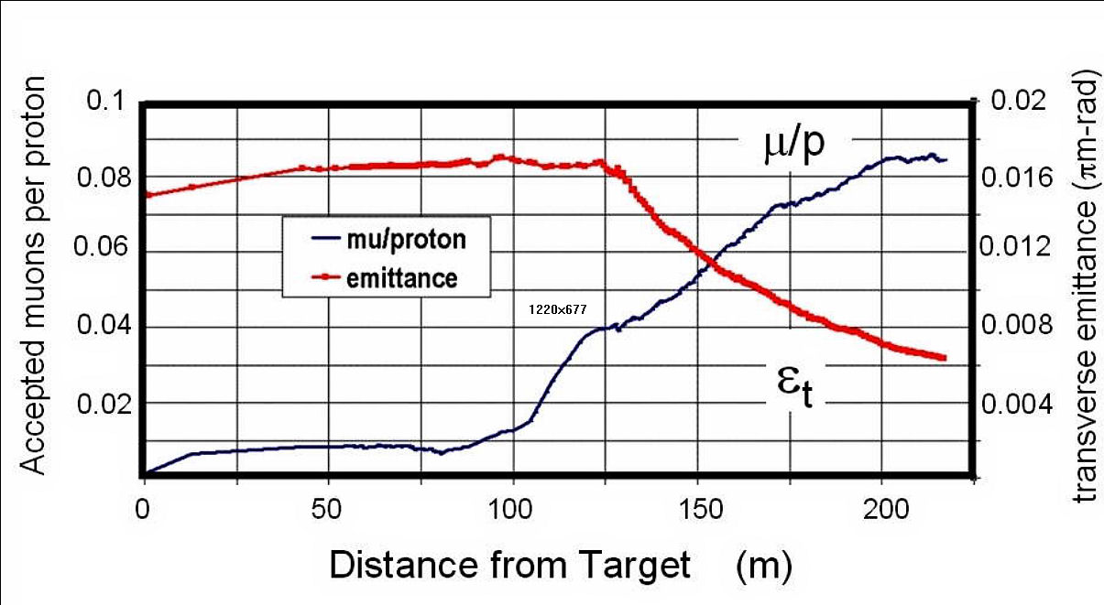
Target & Capture System
Explored the potential of a ≥ 4MW Target System
But with the goal of parameters that would lower
that requirement
Compact
Taper Design
1 cm
C Target
Option

Slide 9
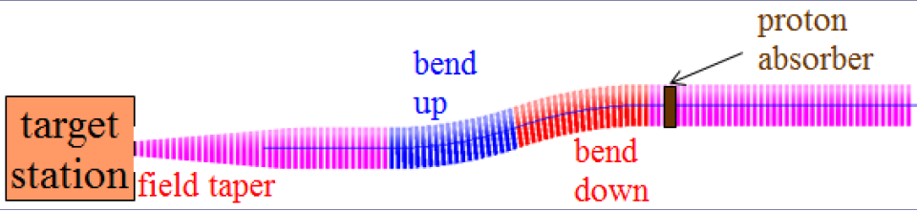
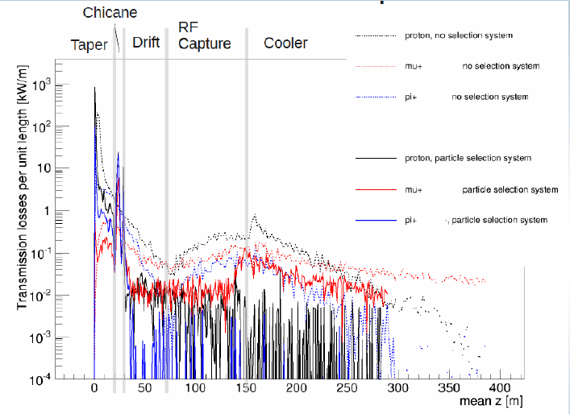
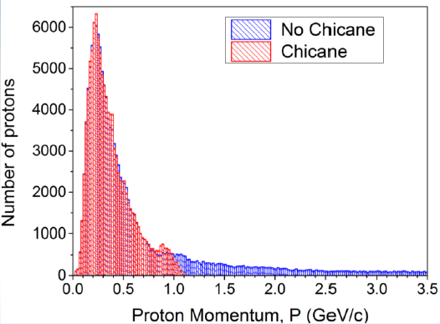
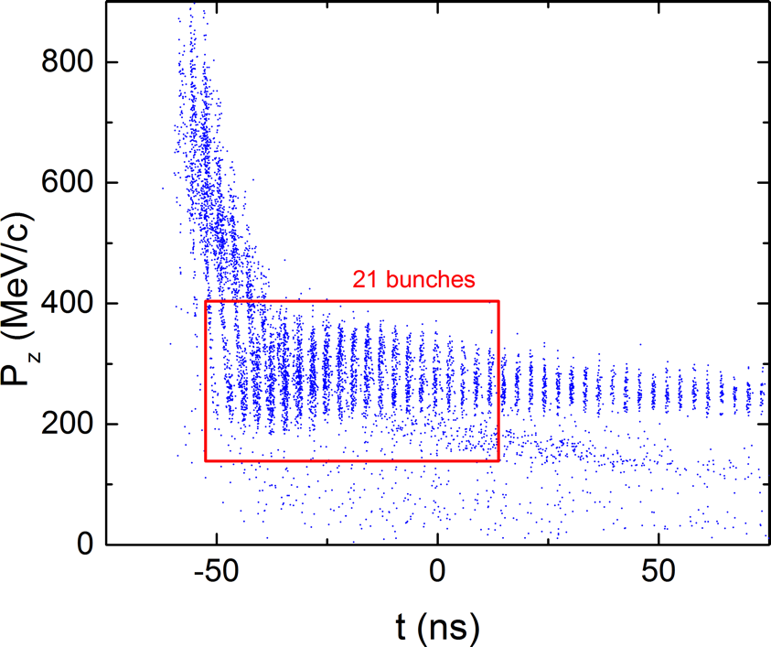
Front End and Energy Deposition
Neuffer, Snopok, & Alexahin,
JINST 11 T11007
Control of FE Energy Deposition
FE Energy
Deposition
Buncher and Phase
Rotator Matched to a
325 MHz Initial Cooling
Channel
μ⁺ within the front
end acceptance
9
Phase Rotator Initial Cooling

Slide 10
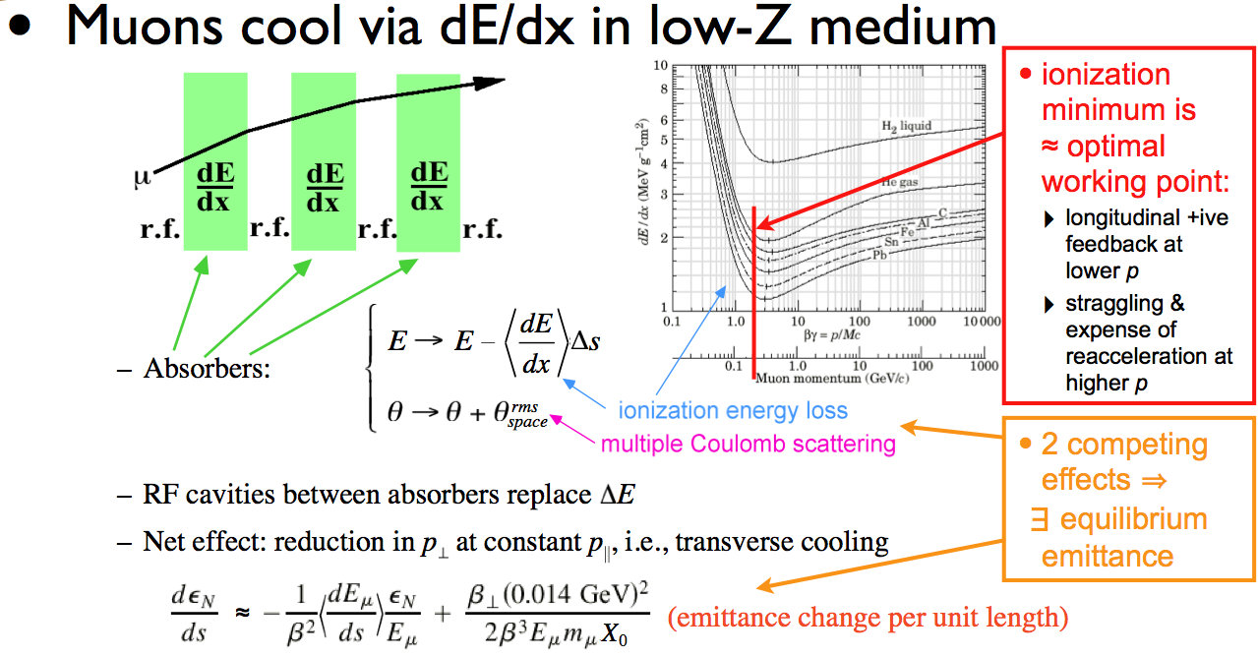
Cooling Methods
The unique challenge of muon cooling is its short lifetime
  Cooling must take place very quickly
  More quickly than any of the cooling methods presently in use
  a Utilize energy loss in
  materials with RF re-acceleration
MAP R&D Efforts:
  RF in High Magnetic Fields:
  MuCool Test Area (MTA) at
  Fermilab
  High Field Magnet Design
  and Development
  The International Muon
  Ionization Cooling
  Experiment (MICE)

Slide 11
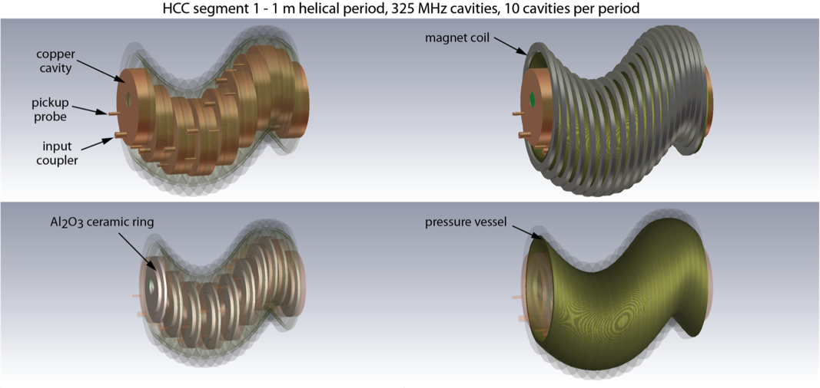
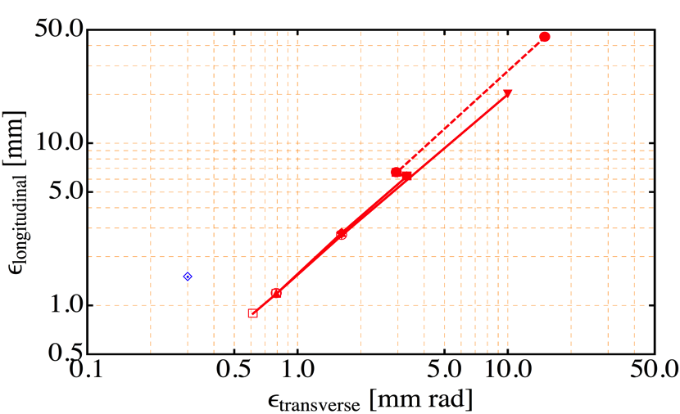
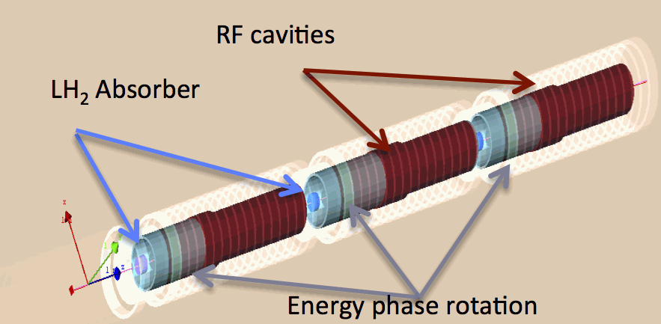
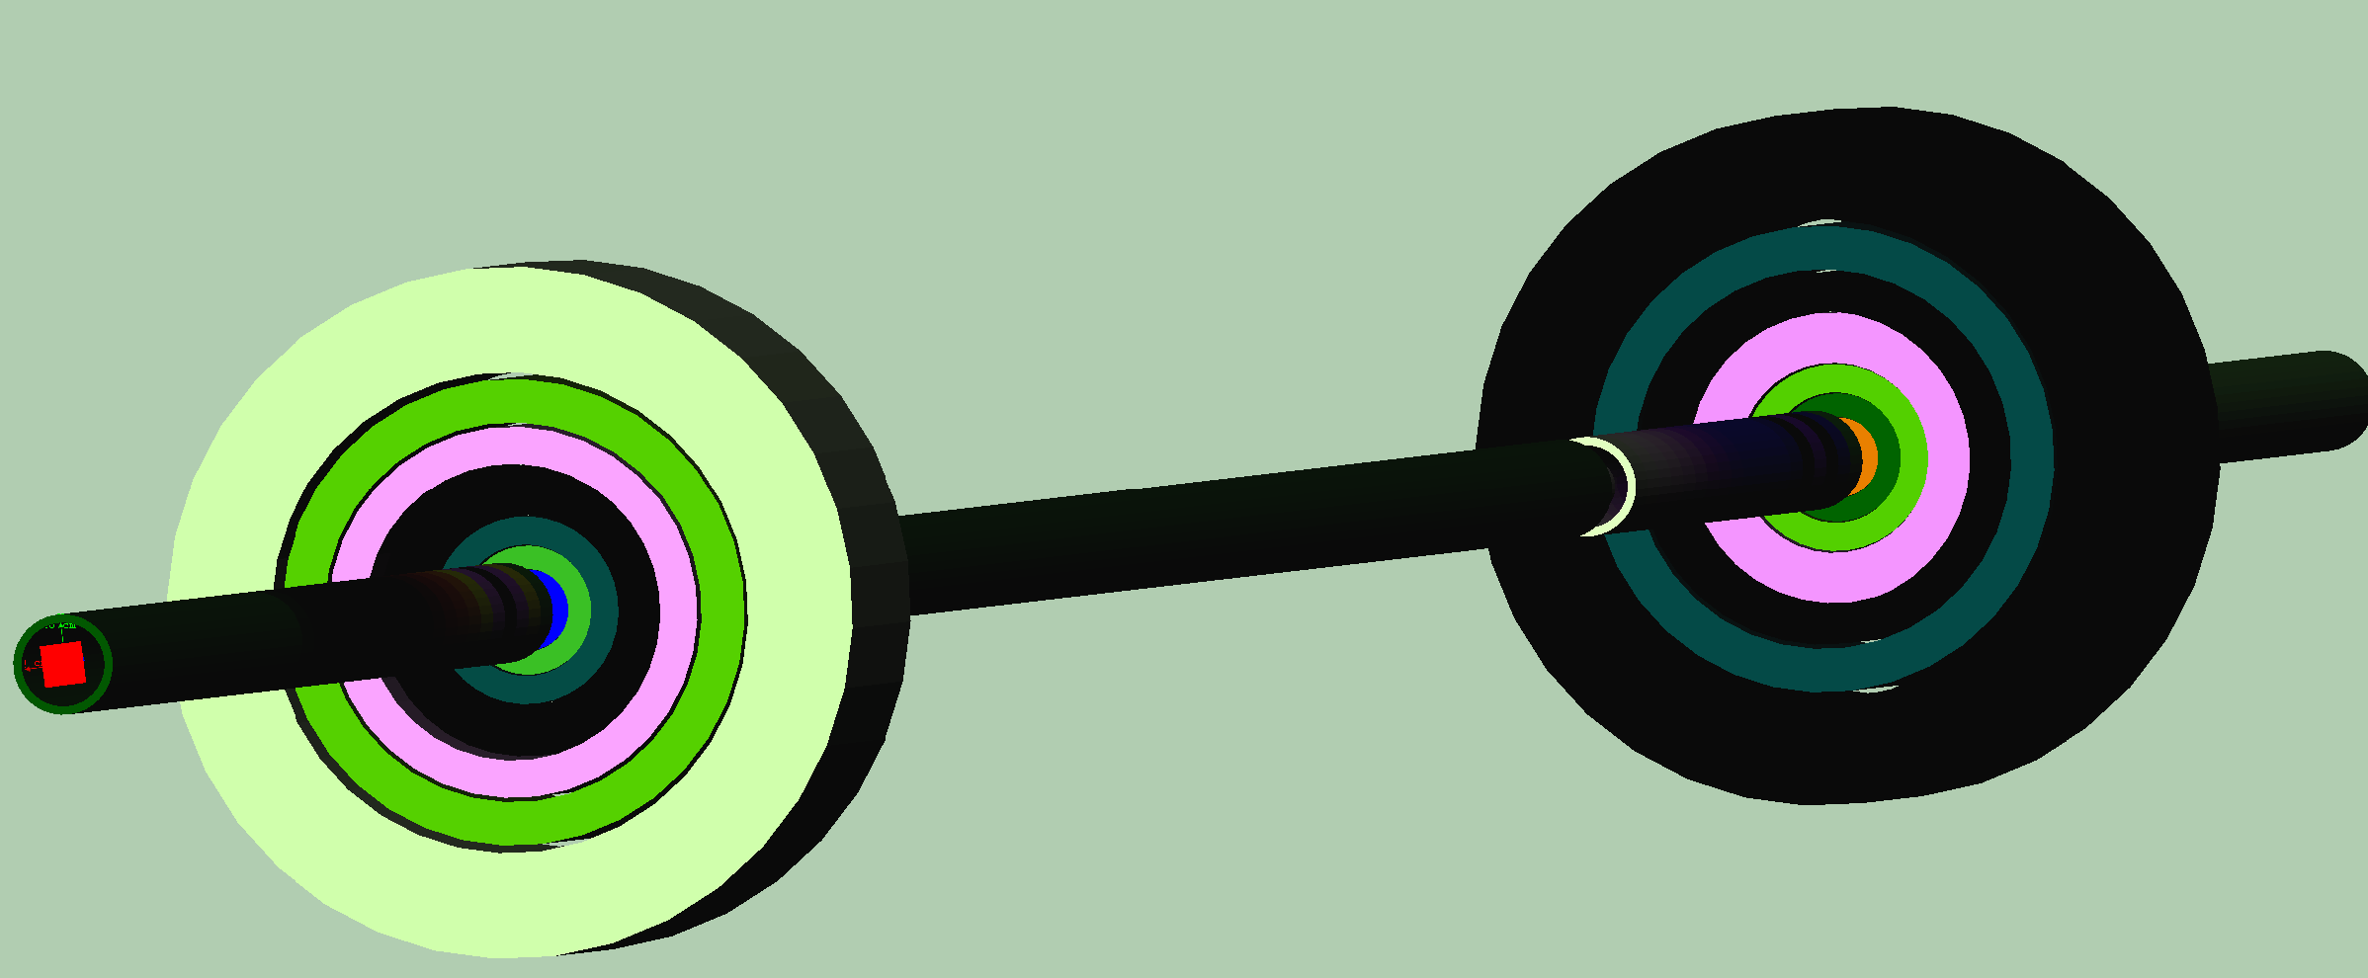
Muon Ionization Cooling (Design)
Initial 6D cooling
325 MHz cooling
Matching
650 MHz
Helical Cooling Channel (Gas-filled RF Cavities):
ε_{T} = 0.6mm, ε_{L} = 0.3mm
Late Stage w/ Induction Linac
World Record LTS-HTS Hybrid Magnet
32T on-axis field
NHFML
Final Cooling with 25-30T solenoids (emittance exchange):
ε_{T} = 55μm, ε_{L} = 75mm

Slide 12
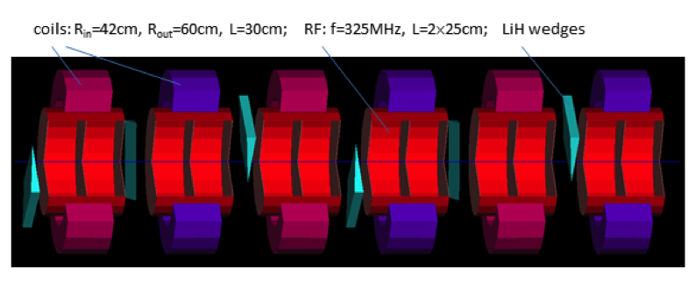
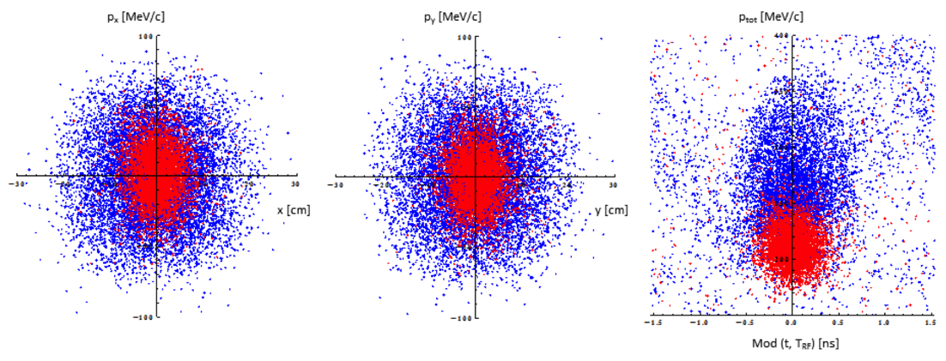
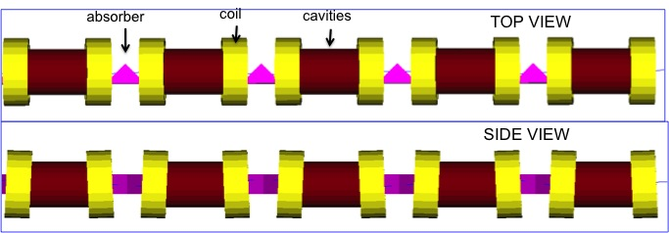
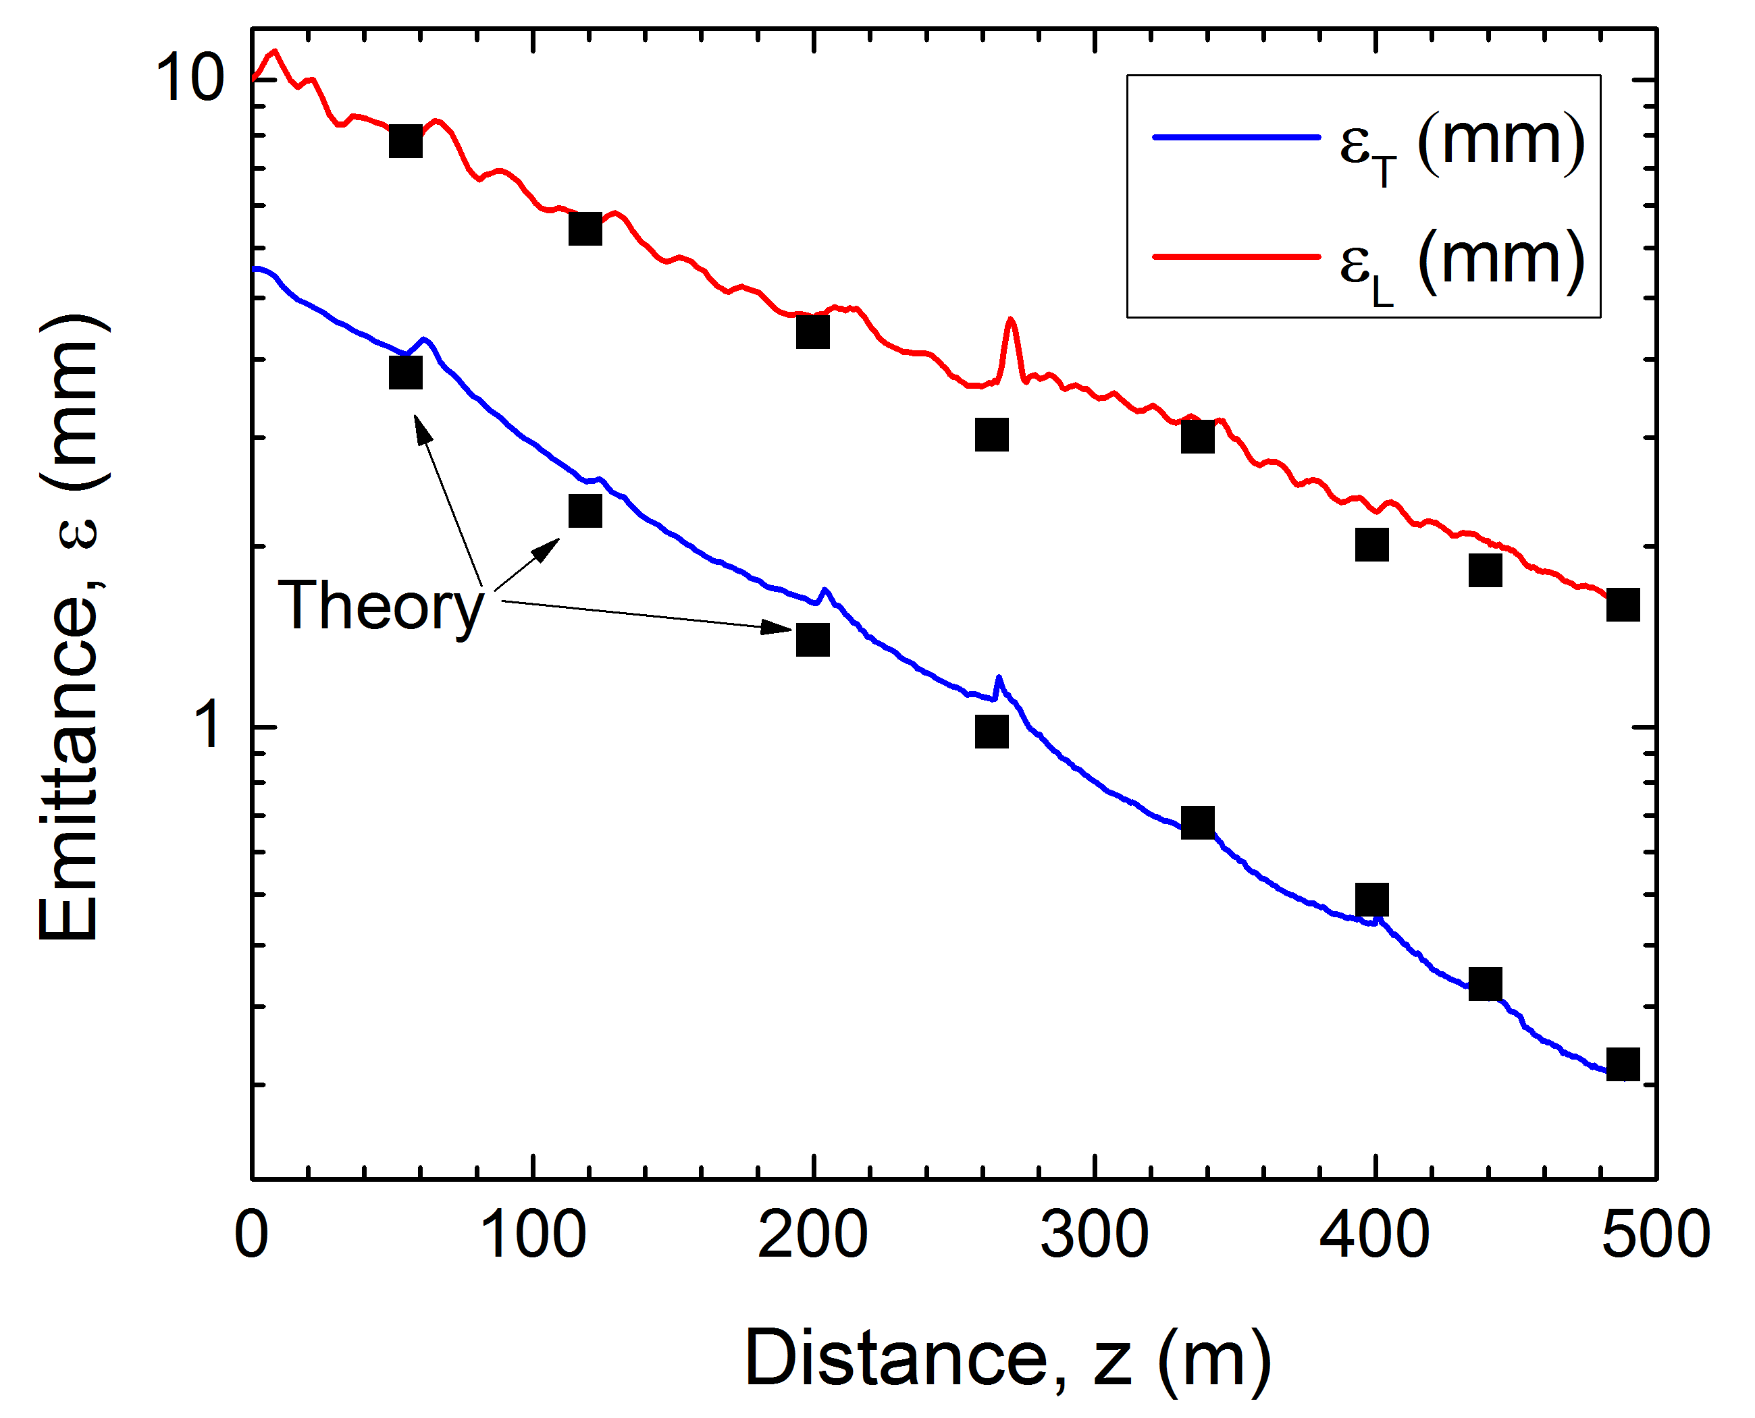
Muon Ionization Cooling (Design)
Bunch
Merge
Longitudinal Merge
Initial 6D Cooling: ε_{6D} 60 cm³ a ~50 mm³; Trans = 67%
Transverse Merge
ε_{T}
6D Rectilinear Vacuum Cooling Channel (replaces Guggenheim concept):
ε_{T} = 0.28mm, ε_{L} = 1.57mm @488m
Transmission = 55%(40%) without(with) bunch recombination
Hybrid Design: Equivalent performance with gas-filled cavity variant
Trans
σ_{t}

Slide 13
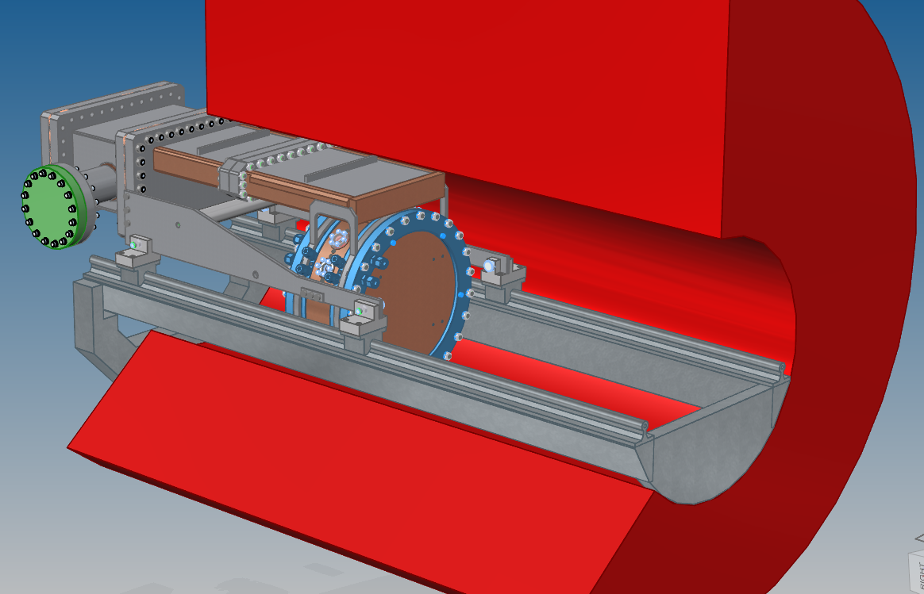
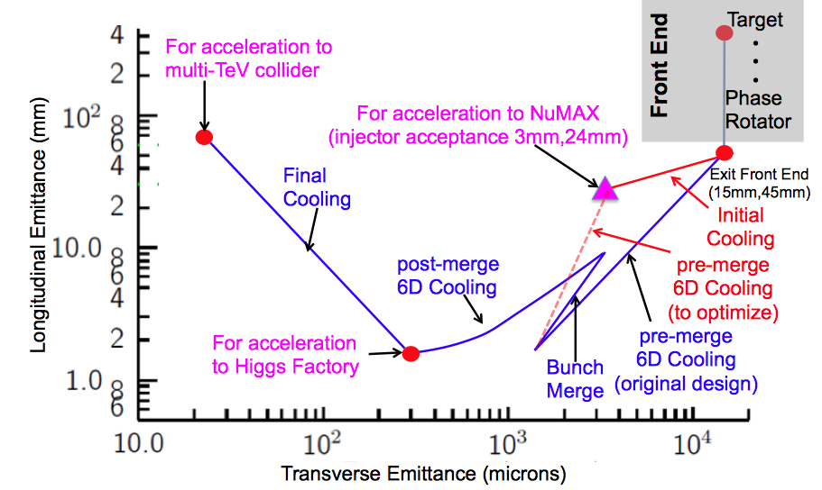
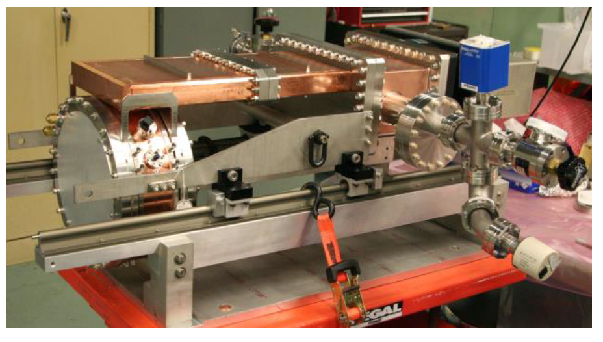
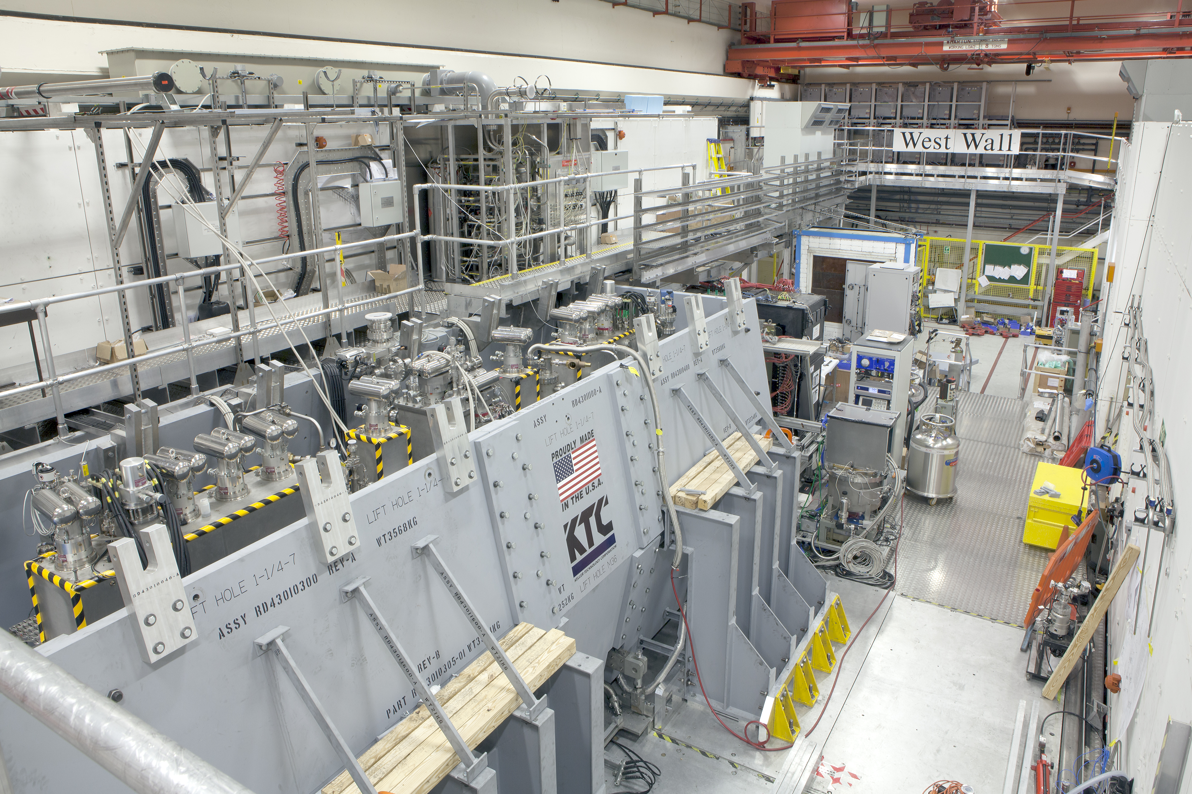
Ionization Cooling
>50MV/m operation
in up to 5 T B-field
Specification Achieved (simulations)
Final
MICE Cooling Channel
Initial
(X)
Initial
(Y)
VCC &
Hybrid
HCC
Potential improvements with Parametric Ionization Cooling
VCC HTS
Extrapolation
MAP Higgs
Factory Target
Advanced techniques a
Improved HF Luminosity
Simplified Final Cooling requirements

Slide 14
Some Cooling Comments
MICE confirms our understanding of the ionization cooling process for muons
MAP design studies and R&D provide a basis for the technologies in a full-blown cooling channel
  But only piece-wise studies completed
  Technology deliverables were achieved a now need to move to next-gen design effort
Cooling has huge leverage on the overall machine design
  What proton power is required on target?
  What luminosities can be envisioned?
A fully integrated design study is now warranted
A demonstrator will allow us to study the performance of the cooling concepts at high intensity
Will leave a deeper dive into the cooling concept to Diktys Stratakis’ talk

Slide 15
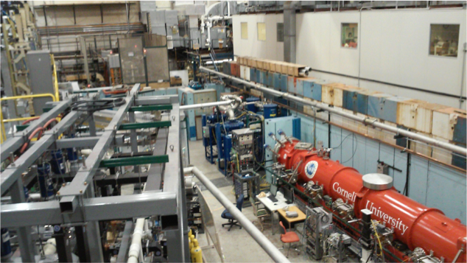
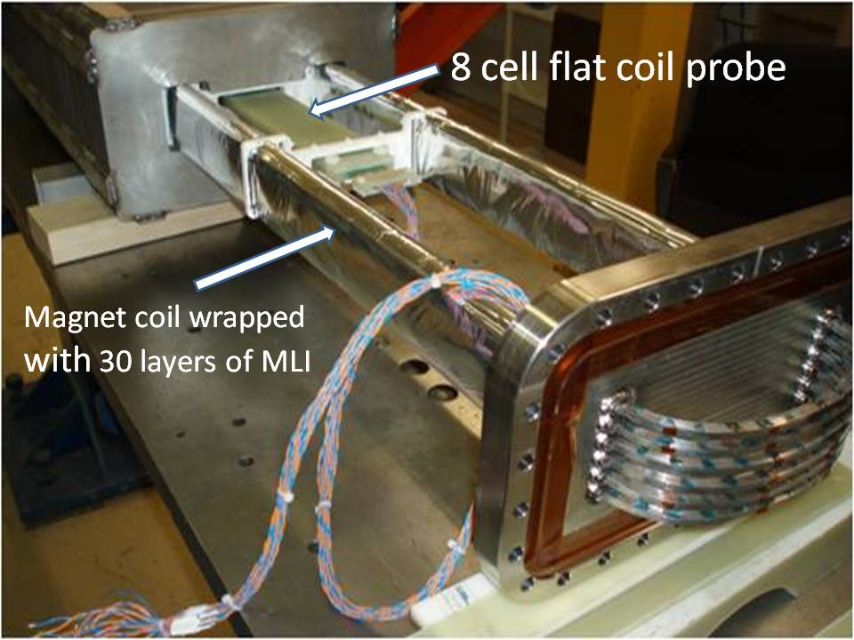
Acceleration
Technologies Include:
  Superconducting Linacs
  Recirculating Linear Accelerators (RLAs)
  Fixed-Field Alternating-Gradient Rings (FFAs)
  Hybrid Rapid Cycling Synchrotrons
Designs to
125 GeV CoM
Needed for
Multi-TeV Scale
EMMA
CBeta @ Cornell
Hybrid RCS
Accelerator suitable for
Neutrino Factory Applications

Slide 16
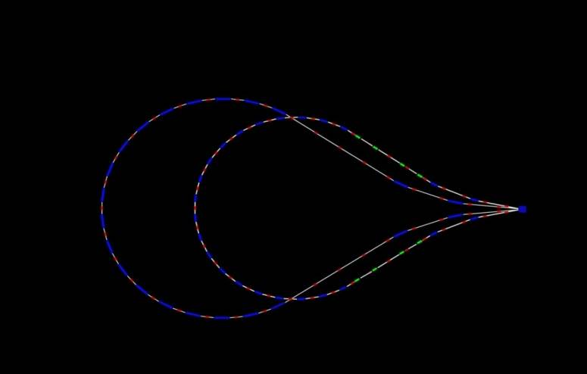
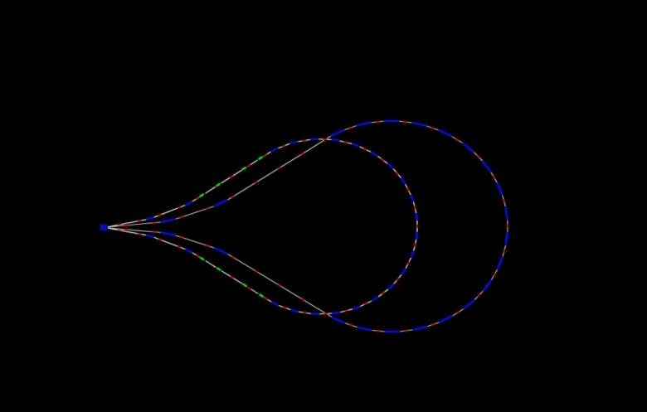
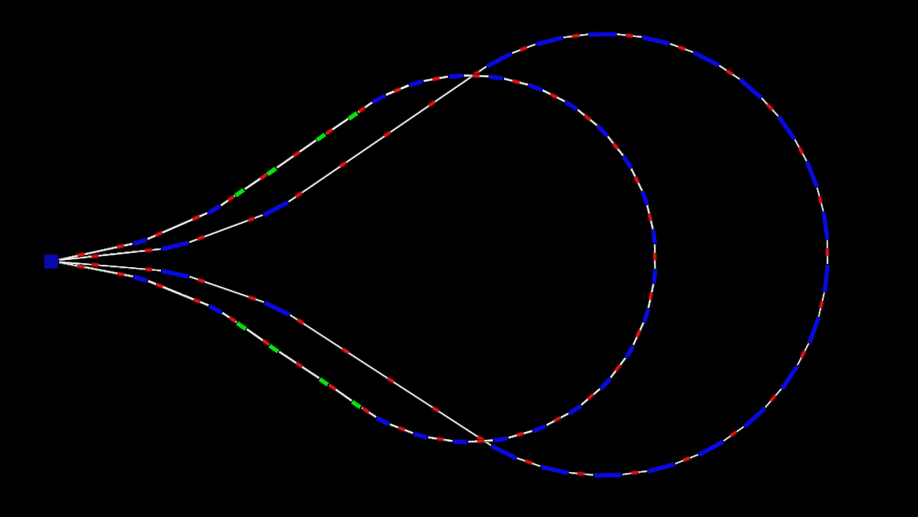
Acceleration to 63 GeV per Beam
5 GeV
28.2 GeV
16.6 GeV
51.4 GeV
63 GeV
39.8 GeV
829 m
11.6 GeV/pass
top view
E=5-63 GeV
16.6 GeV
39.8 GeV
RF: f = 650 MHz cells/cavity = 5 Gradient = 25 MV/m phase = 22∘

Slide 17
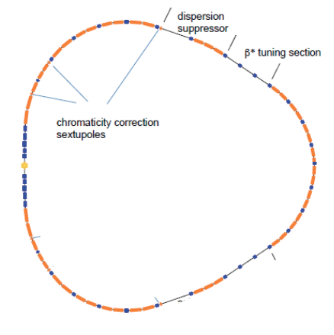
Higgs Factory (125 GeV) Lattice Design Alexahin, et al., JINST 13 P11002
MC Higgs Factory:
MAP design
with a single IP

Slide 18
Key Features/Challenges of MC Higgs Factory
Features:
  s-channel production
  Exquisite energy spread (δE_{b}/E_{b}~4x10⁻⁵)
  allows direct probe of Higgs line shape
  Spin precession of μ allows precise E calibration
  (Raja & Tollestrup, arXiv:hep-ex/9801004)
Challenges
  Higgs production rate with preliminary MAP assumptions (~13,500/Snowmass year) hasn’t been considered competitive
    However, VCC simulations already suggest we can do better than this
    Introduction of alternative techniques such as Parametric Ionization Cooling (PIC) offer the potential of further rate improvements
  Machine-Detector interface
    IR magnet aperture requirements
    Shielding detector from machine backgrounds
  Based on MAP R&D results, an updated design study is required to fully evaluate potential performance
Han & Liu, arXiv:1210.7803 [hep-ph]

Slide 19
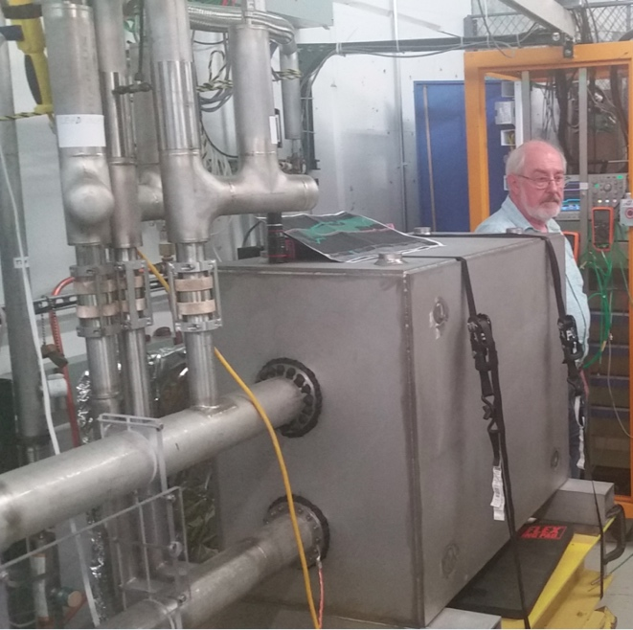
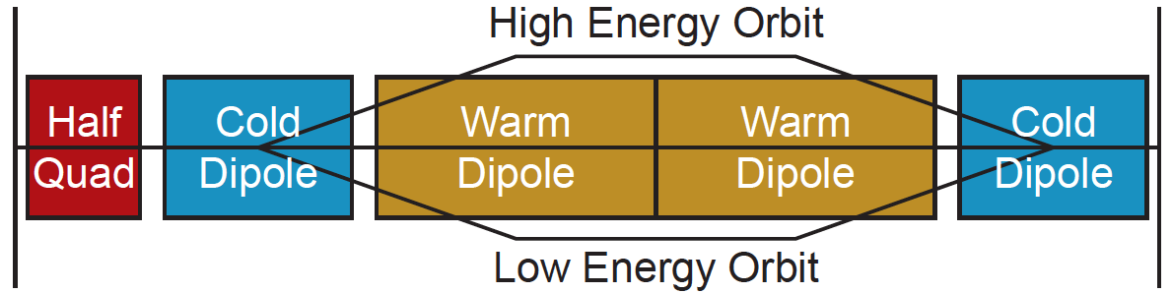
TeV-Scale Acceleration
FNAL
12 T/s HTS
0.6 T max
MAP identified concepts
  Final designs are not in hand
Challenges:
  Large energy bandwidth lattice at high energies
  Fast-ramping magnets
    Grain-oriented silicon steel [±1.8 T p-p @ 400 Hz]
    HTS?
  Power supply system and efficiency will determine the viability and energy efficiency of the accelerator
  systems
Hybrid Rapid Cycling
Synchrotron Cell Concept

Slide 20
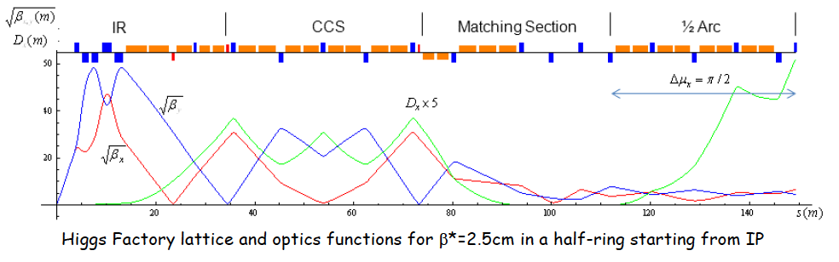
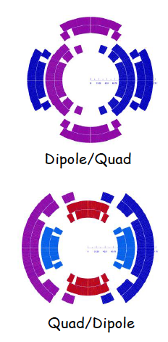
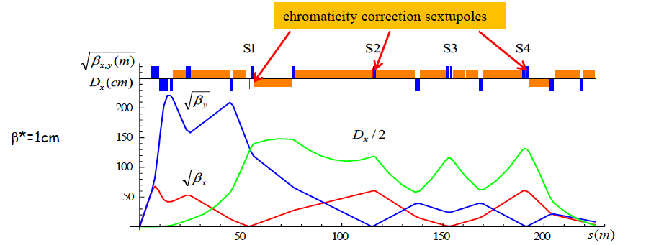
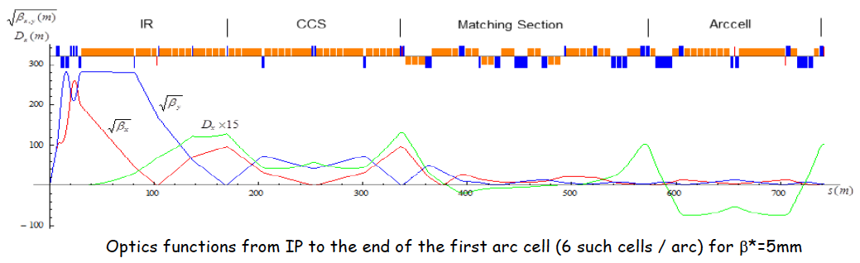
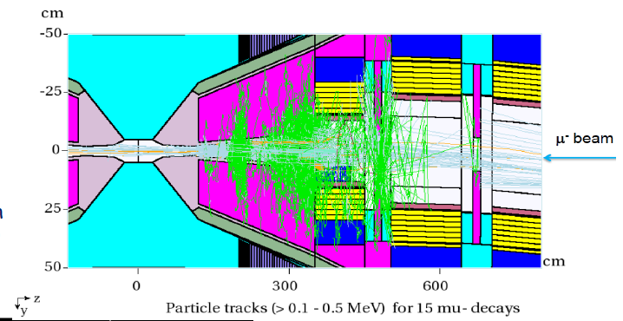
Collider Ring & Detector
Y. Alexahin et al 2018 JINST 13 P11002
MAP Optics Designs for
  Higgs Factory (125 GeV)
  1.5 TeV CoM
  3.0 TeV CoM
  6.0 TeV CoM [extrapolation]
Ring Magnet Designs
  All MAP dipoles <10T
IR Design
Higgs
1.5 TeV
3 TeV
Collider Lumi is
proportional to
the dipole field
available

Slide 21
Performance Targets
ICFA Beam Dynamics Newsletter 55, pp. 48-49
In 2011, MAP set performance targets for a 1.5 TeV Collider based on prior preliminary studies [NOTE: Emittance targets summarized on slide 13]
Accelerator Stage | Stage Transmission (%) | Cumulative Transmission (%) | Muons/proton
Phase rotation with p=226 ± 100 MeV/c |  | 100 | 0.22
Bunch Selection | 70 | 70 | 0.153
Charge Separation | 95 | 66 | 0.145
6D Cooling before Merge | 47 | 31 | 0.068
Merge | 88 | 27 | 0.057
6D Cooling after Merge | 48 | 13 | 0.029
Final Cooling | 70 | 9.2 | 0.020
Acceleration | 59 | 5.4 | 0.012
Estimated power on target: 3.2 MW [MASS Review a 2.6 MW]

Slide 22
MAP IBS Comparisons and R&D Implications
Adjust for 3 TeV final CoM Energy
IBS efforts fell short of goals by ~2x in transmission
NOTE: MAP utilized luminosity per detector criteria
However, R&D program suggests immediate routes to recovering a significant fraction of this
Accelerator Stage | Stage Trans (%) | Cum Trans (%) | MAP IBS Simulation Stage Trans (%) | MAP IBS Simulation Cum Trans (%) | Potential w/MAP R&D: Stage Trans (%) | Potential w/MAP R&D: Cum Trans (%) | Comments on R&D
Phase rotation with p=226 ± 100 MeV/c |  | 100 |  | 100 |  | 100
Bunch Selection | 70 | 70 | 70 | 70 | 70 | 70
Pre-Merge 6D Cooling & Charge Separation | 45 | 31 | 36 | 25 | 46 | 32 | Improved RF in B-Field Re-visit charge sep
Merge | 88 | 27 | 88 | 22 | 88 | 28
6D Cooling after Merge | 48 | 13 | 40 | 8.9 | 44 | 13 | Improved RF in B-Field
Final Cooling | 70 | 9.2 | 61 | 5.4 | 61 | 7.6
Acceleration | 55 | 5.1 | 51 | 2.8 | 51 | 3.9 | ~3.6 MW for ~4x10³⁴cm⁻²s⁻¹

Slide 23
Summary
Where are the discrepancies a opportunities
  Refined 6D Cooling Design provides improved transmission
    Review charge separation efficiencies
  Final Cooling with 30T solenoids falls ~2x short in emittance goal
    A funded effort is underway in the US to develop a >40T variant
    45 T solenoids would deliver a factor of 1.5x improvement in luminosity
  Ultimately, efficiency through acceleration stages given realistic technology constraints is key
    Next iteration on designs is needed ASAP
    The transmission challenge is concentrated in the lower energy (<500 GeV) acceleration systems
    Technology challenges are “distributed”
  Collider performance
    A unique feature of the MC is that the luminosity performance is directly proportional to the available dipole B-field
Some key design studies will significantly leverage the MC program moving forward

Slide 24
Key References
Boscolo, Delahaye, Palmer, RAST, Vol 10, No. 01, pp. 189-214 (2019)
The JINST dedicated volume on Muon Collider Research and Technology:
Muon Accelerators for Particle Physics
https://iopscience.iop.org/journal/1748-0221/page/extraproc46
Demonstration of cooling by the Muon Ionization Cooling Experiment,
Nature 578, 53-59(2020)

Slide 25
Thank you for your attention!

