Slide 1




Test Facility
(Demonstrator)
Roberto Losito
CERN-ATS-DO
1st Community meeting of the International Muon Colliders Design Study - 20 May 2021

Slide 2
Discussion topics
What do we have to demonstrate
In which timescale
With which resources
With which beam energy/power/intensity/time structure…
In synergy with which facilities
Road to Roadmap…

Slide 3
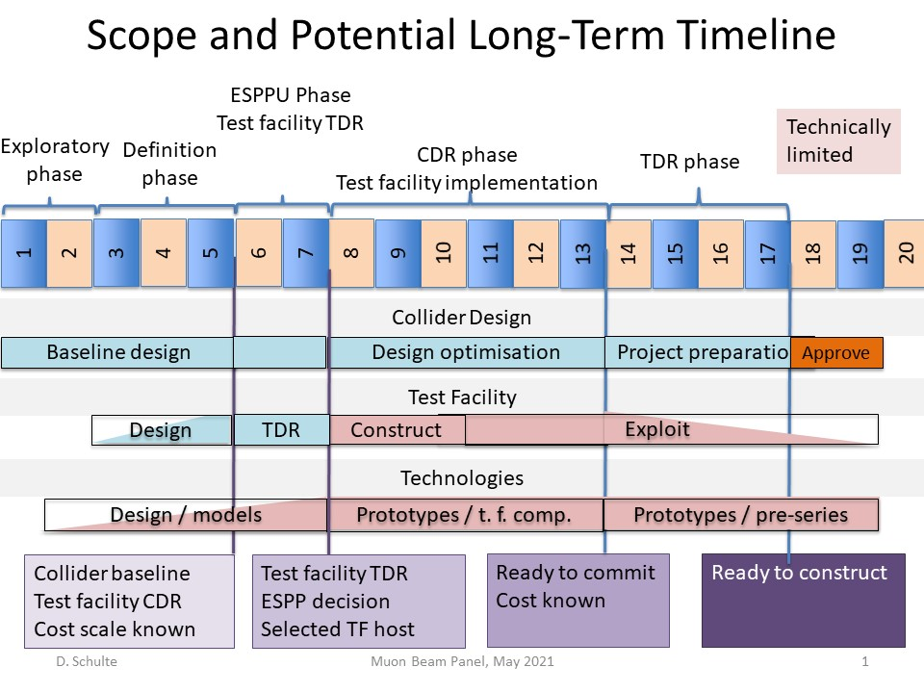
O(500 MCHF)

Slide 4
Resources
O(500MCHF)
  What’s the share we plan between Test facility and hardware test/prototype
    Test Facility: ~150 MCHF + operation (50 MCHF)
    Hardware Prototypes & Technology R&D: ~300 MCHF ?
  Assuming a baseline of 20 years (see next slides..)

Slide 5
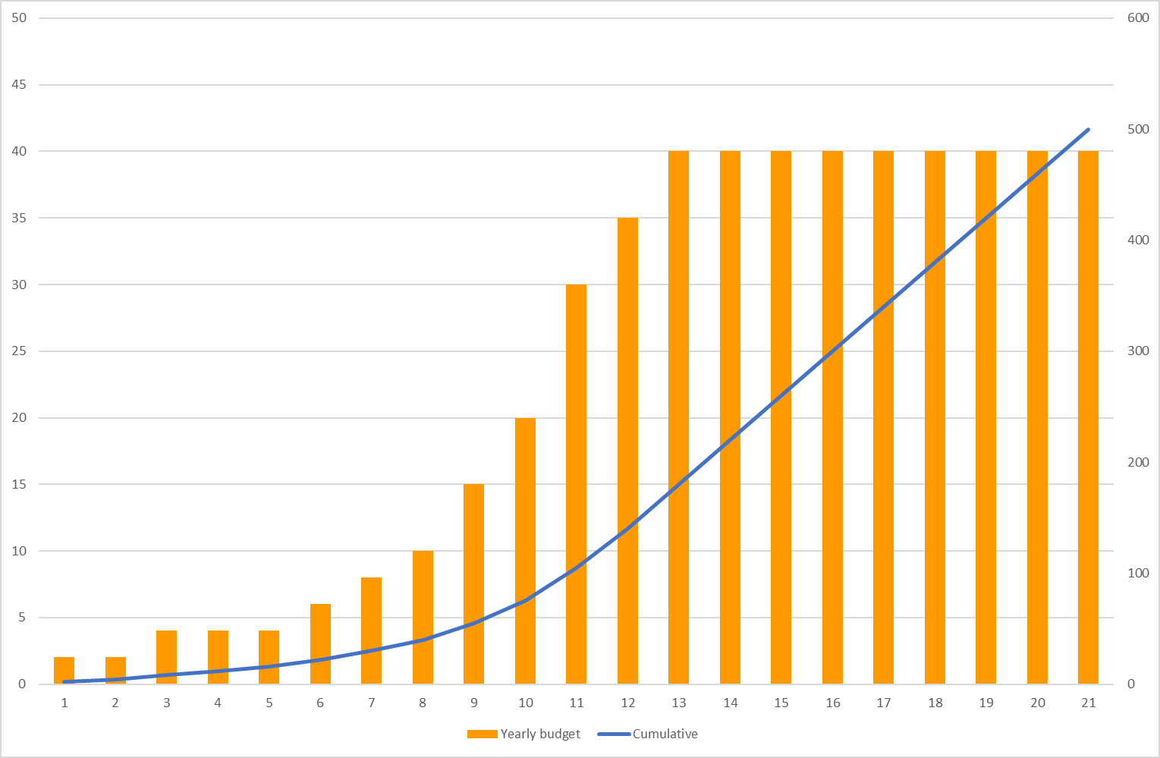
Budget Profiles – 1
[MCHF] Shy
2021 | 2022 | 2023 | 2024 | 2025 | 2026 | 2027 | 2028 | 2029 | 2030 | 2031 | 2032 | 2033 | 2034 | 2035 | 2036 | 2037 | 2038 | 2039 | 2040 | 2041
2 | 2 | 4 | 4 | 4 | 6 | 8 | 10 | 15 | 20 | 30 | 35 | 40 | 40 | 40 | 40 | 40 | 40 | 40 | 40 | 40

Slide 6
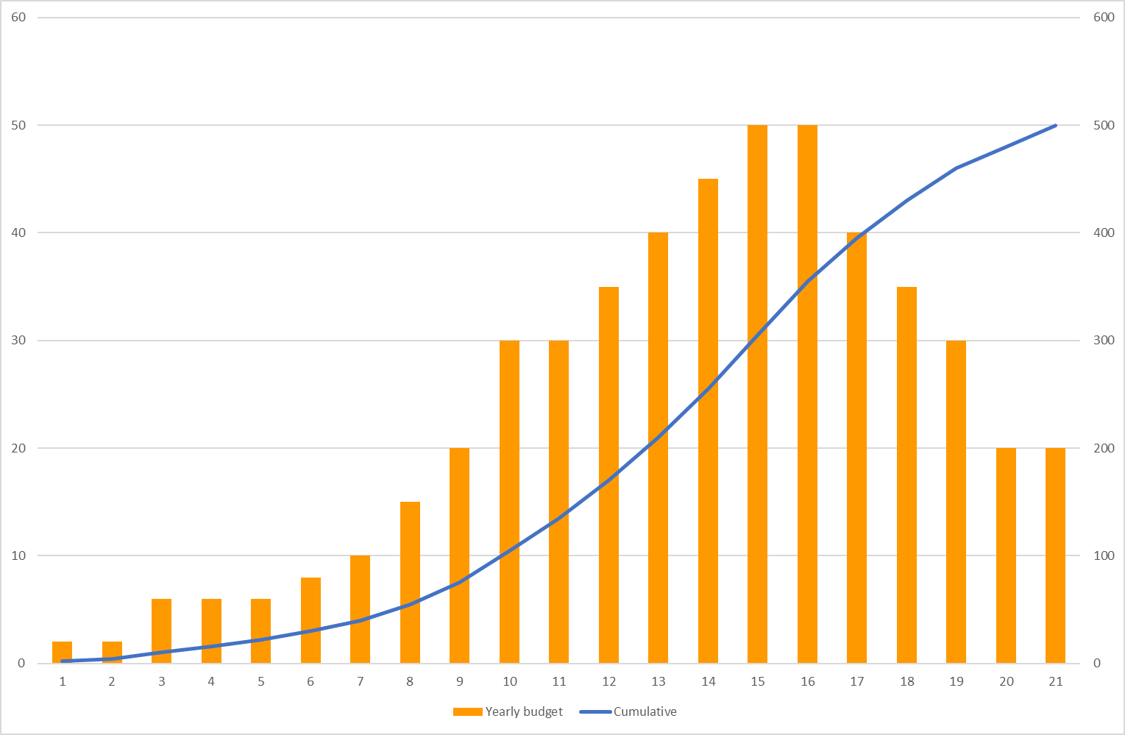
Budget Profiles – 2
[MCHF] Modest
2021 | 2022 | 2023 | 2024 | 2025 | 2026 | 2027 | 2028 | 2029 | 2030 | 2031 | 2032 | 2033 | 2034 | 2035 | 2036 | 2037 | 2038 | 2039 | 2040 | 2041
2 | 2 | 6 | 6 | 6 | 8 | 10 | 15 | 20 | 30 | 30 | 35 | 40 | 45 | 50 | 50 | 40 | 35 | 30 | 20 | 20

Slide 7
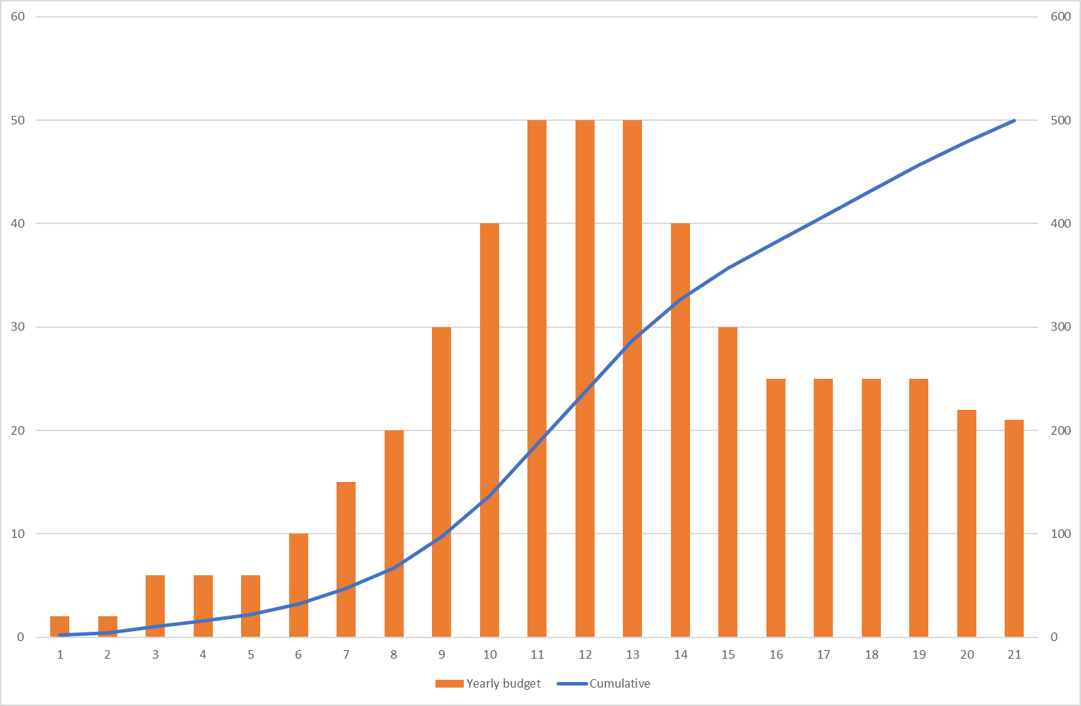
Budget Profiles – 3
[MCHF] In line with the roadmap
2021 | 2022 | 2023 | 2024 | 2025 | 2026 | 2027 | 2028 | 2029 | 2030 | 2031 | 2032 | 2033 | 2034 | 2035 | 2036 | 2037 | 2038 | 2039 | 2040 | 2041
2 | 2 | 6 | 6 | 6 | 10 | 15 | 20 | 30 | 40 | 50 | 50 | 50 | 40 | 30 | 25 | 25 | 25 | 25 | 22 | 21

Slide 8
Questions
Consensus that demonstration of muon production and cooling is key to convince ourselves (and the funding agencies) to move forward ?
How?
  Beam power at around 1.5 or 4 MW for final machine?
  Several cooling schemes are being studied. What are the criteria to decide which is the most convenient to test? Performance? Cost? Feasibility?
  Can we test more than one cooling scheme?
  A test facility at O(20÷80 kW) is sufficiently convincing? What will be left to demonstrate after?
  Will we be ready for a go-no-go decision after that?
  What has to be tested without beams, or with other beams (protons? Leptons?)

Slide 9
Beam Power
The design of the facility will depend critically on the desired beam power on target for the final complex.
A first decision to be taken quickly in order to prepare an R&D roadmap, is whether we limit to 1.5 MW or keep the 4 MW option.
  It is a critical decision since for 1.5 MW there are already concepts that seem (close) to work (JSNS, SNS, ESS, T2K?).
  The choice of beam power will have a substantial impact on the studies for a high gradient capture solenoid. A test facility would not be credible if it cannot demonstrate that the target station would somehow fit into the solenoid, and that the magnet can survive radiation (both instantaneous and integrated).
  Impact on downstream elements should also be assessed

Slide 10
Beam Power
The design of the facility will depend critically on the desired beam power on target for the final complex.
  The design of the final test facility will heavily rely in both cases on extensive remote handling/telemanipulation and environmental confinement. However, 4 MW imposes even more constraints, and solutions might have to be implemented in the test facilities to prove we can do it.
  The exchange rate of the target station/solenoid in the final complex might be a showstopper for both options ( but for 4 MW is worse of course).
  The above implies also to start thinking at the disposal path of the target material, short, medium and long term storage of special radioactive waste. Local and National authorities will request very early in the CDR phase a clear strategy for radioactive waste minimization and disposal. What studies should we launch to prepare to that request? Will we need to demonstrate anything in this respect in the Facility?

Slide 11
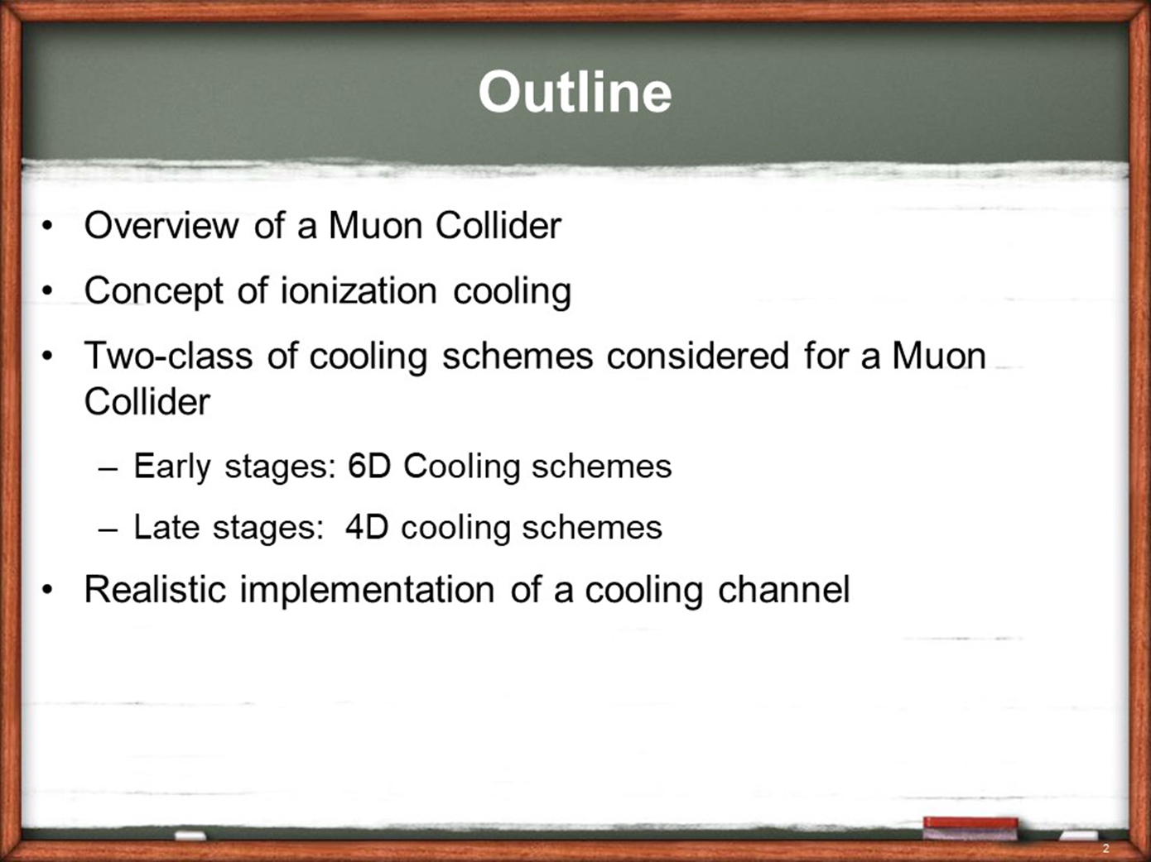
Cooling
Courtesy D. Stratakis (Workshop on Muon Collider Testing Opportunities: https://indico.cern.ch/event/1016248 )

Slide 12
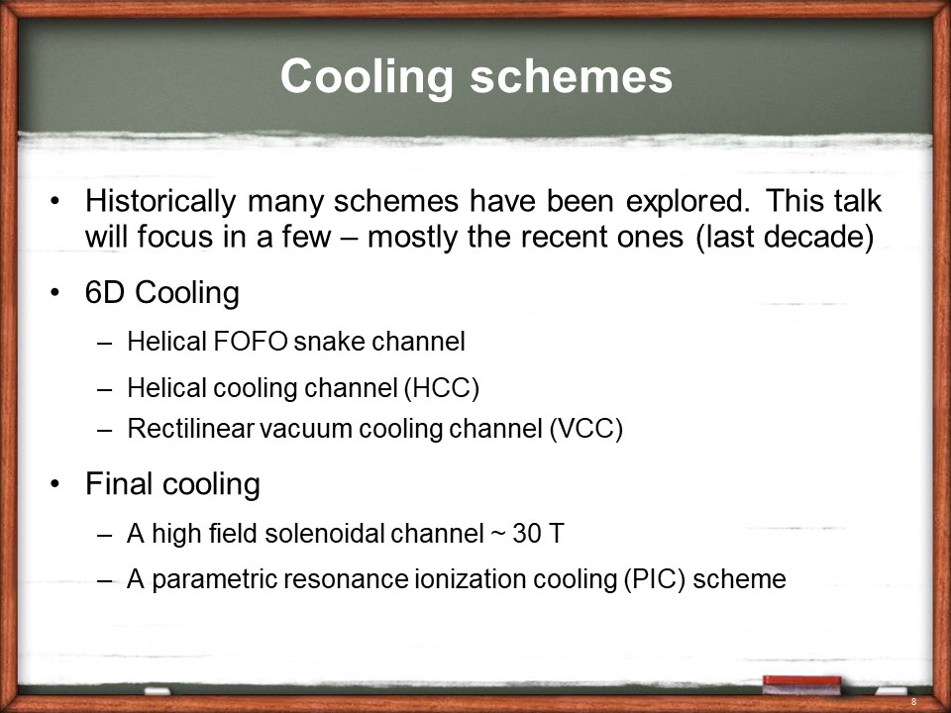
Cooling
Courtesy D. Stratakis (Workshop on Muon Collider Testing Opportunities: https://indico.cern.ch/event/1016248 )

Slide 13
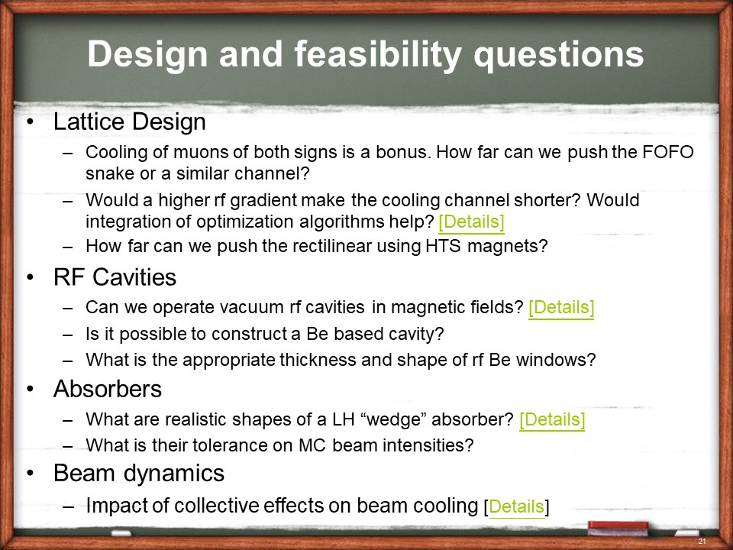
Cooling
Courtesy D. Stratakis (Workshop on Muon Collider Testing Opportunities: https://indico.cern.ch/event/1016248 )

Slide 14
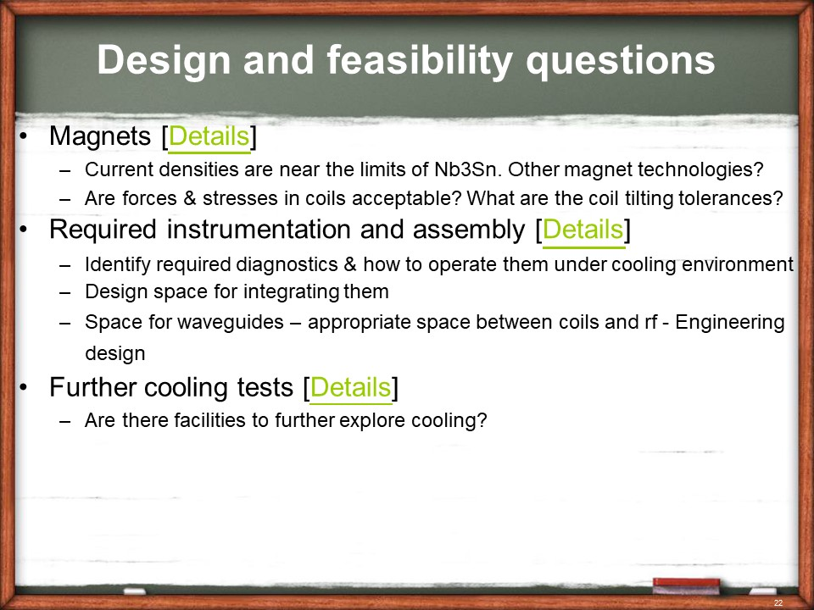
Cooling
Courtesy D. Stratakis (Workshop on Muon Collider Testing Opportunities: https://indico.cern.ch/event/1016248 )

Slide 15
Cooling
Further questions:
  We believe simulations are ok (?). Is there any specific development/benchmark needed?
  How many schemes can we test? One or more?
  …

Slide 16
Targetry/Solenoid
1.5 MW:
  Less to demonstrate for the target, still integration with the Solenoid has to be studied and tested
4 MW:
  Target concept to be decided and demonstrated
For both:
  can the solenoid and downstream magnets survive instantaneous power (quench limit) and integrated dose (what shielding needed)

Slide 21
Which beams ?
Is bunch length important for the demonstrator? What is the upper limit?
What intensity on the single bunch? What time structure?
Beam power: 10 kW? 80 kW?
Should we build directly for a target area/cooling channel cavern compatible with 1/4 MW? ($$$)

Slide 22
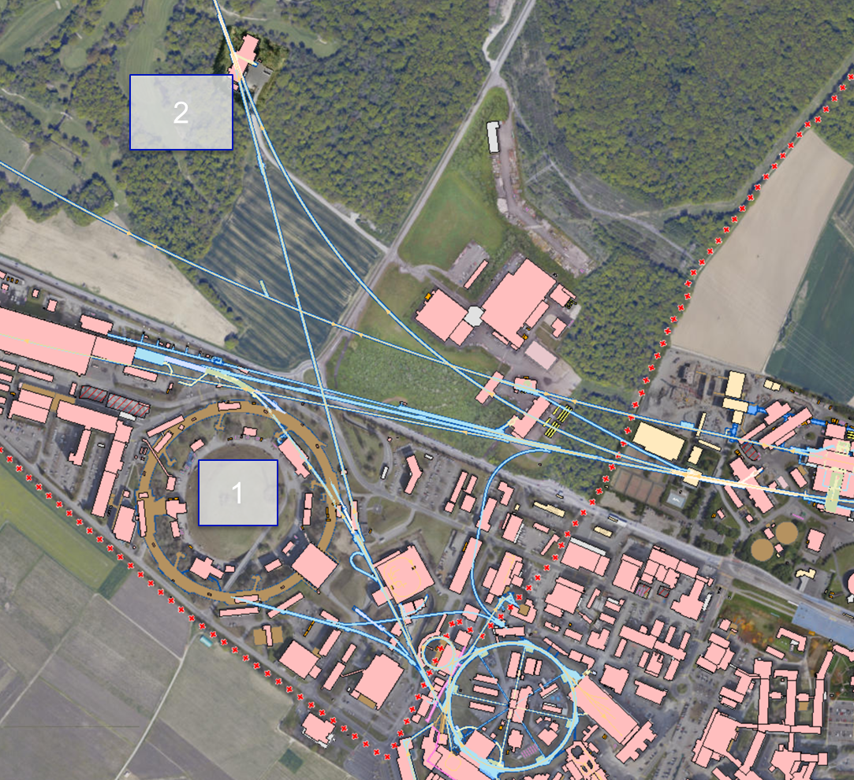
Working hypothesis
#1 – inside of ISR
  No upgrade possible to future muon complex (<10 kW or RP issue)
#2 – on TT10, transfer line to SPS
  Compatibility with future upgrades towards a collider and HP-SPL to be studied.
  O(80kW) should be easily feasible by going sufficiently underground.
  4 MW to be studied, but not impossible a priori.

Slide 23
Most attractive option
We will discuss what is needed to confirm full compatibility with a 4 MW option.
Some information already available from past studies.
Some requirements have to be provided to feed Civil engineering integration

Slide 24
In synergy with which facilities
ESS
  Interested to promote studies for an Initial Cooling Experiment (C.Rubbia)
PSI, STFC
  Have muon beams available for testing of components
  Any plans to host the Demonstrator?
US, Asia?

Slide 25
Road to roadmap
Need to have a few meetings to discuss for the facility:
  Deliverables (must do and nice to have).
  Beam parameters & 1.5 or 4 MW
  Cooling strategies to study
  Geometry of the facility (size, depth, shielding, confinement)
  Budget profile and timescale

Slide 26
Conclusion
There are possible options for building at CERN a Demonstrator after the next upgrade. Budget profiles, in the most optimistic scenarios, allow to start tests with beam around 2032/33, in line with the present roadmap, only if a substantial budget line is added in CERN’s and other institutes MTP before the next update of the European Strategy. If not, the start dates probably shifts towards 2035
Additional resources are needed as from next year in order to be ready in 2025 with a CDR of the facility. (EU Design Study is an option, but no guarantee of success)
Need to define parameters, as time is running fast and there is a lot of work to do.
CERN can profit of existing beams (PS?) to setup quickly (within 3÷5 years) a test facility once a decision is taken.
Support from other Institutes of the collaboration is needed!
Did not discuss facilities for detectors…
Looking forward to discussions tomorrow at 18.25

Slide 27
Thank you
for attention

