Slide 1




RF Systems Issues of Low Energy Muon Acceleration − Linac and RLAs
by Alex Bogacz
Jefferson Lab
May 20, 2021

Slide 2
Overview
5 GeV Neutrino Factory based on ‘Dogbone’ RLA
  Linac (255 MeV − 1.25 GeV) Longitudinal compression
  RLA (1.25 − 5 GeV ) 4.5 pass
Optimized RLA scheme for Higgs Factory (63 GeV)
  RLA (5 − 63 GeV ) 5-pass
  Beam loading considerations

Slide 3
Muon Acceleration − Choice of Technology
Acceleration of short-lived muons requires high average gradient, while maintaining very large transverse and longitudinal accelerator acceptances.
  The above requirement drives the design to low RF frequency, e.g. 325 MHz, 650 MHz
  If normal-conducting cavities at that frequency were used, the required high gradi­ents would demand uneconomically high peak RF sources.
  Superconducting RF is a much more attractive solution − the RF power can then be delivered to the cavities over an extended time, and thus RF source peak power can be reduced.
While recirculation (RLA) provides significant cost savings over a single linac, it cannot be used at low energy since the beam is not sufficiently relativistic and will therefore cause a phase slip for beams in higher passes

Slide 4
State of Thought for Multi GeV Muon Acceleration (Circa 2017)

Slide 5
Choice of Linac Repetition Rate
For optimum performance – to maximize number of events (μ → ν decays NF, μ± collisions MC) – the linac repetition rates should scale inversely with the laboratory lifetime of the muon in its storage ring:
  Repetition rates as high as 10 kHz for a 5 GeV Neutrino Factory
  Repetition rates as low as 10 Hz for a 5 TeV Muon Collider.

Slide 6
Initial 325 MHz Linac − Transverse Acceptance

Slide 7
Initial 325 MHz Linac – Longitudinal Compression

Slide 8
Longitudinal Compression

Slide 9
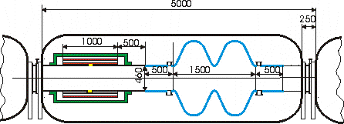
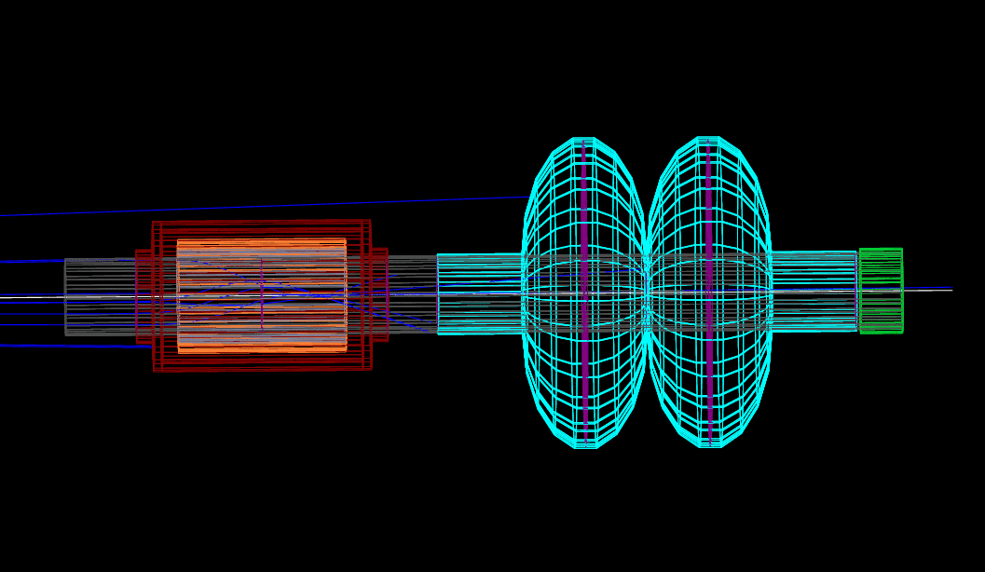
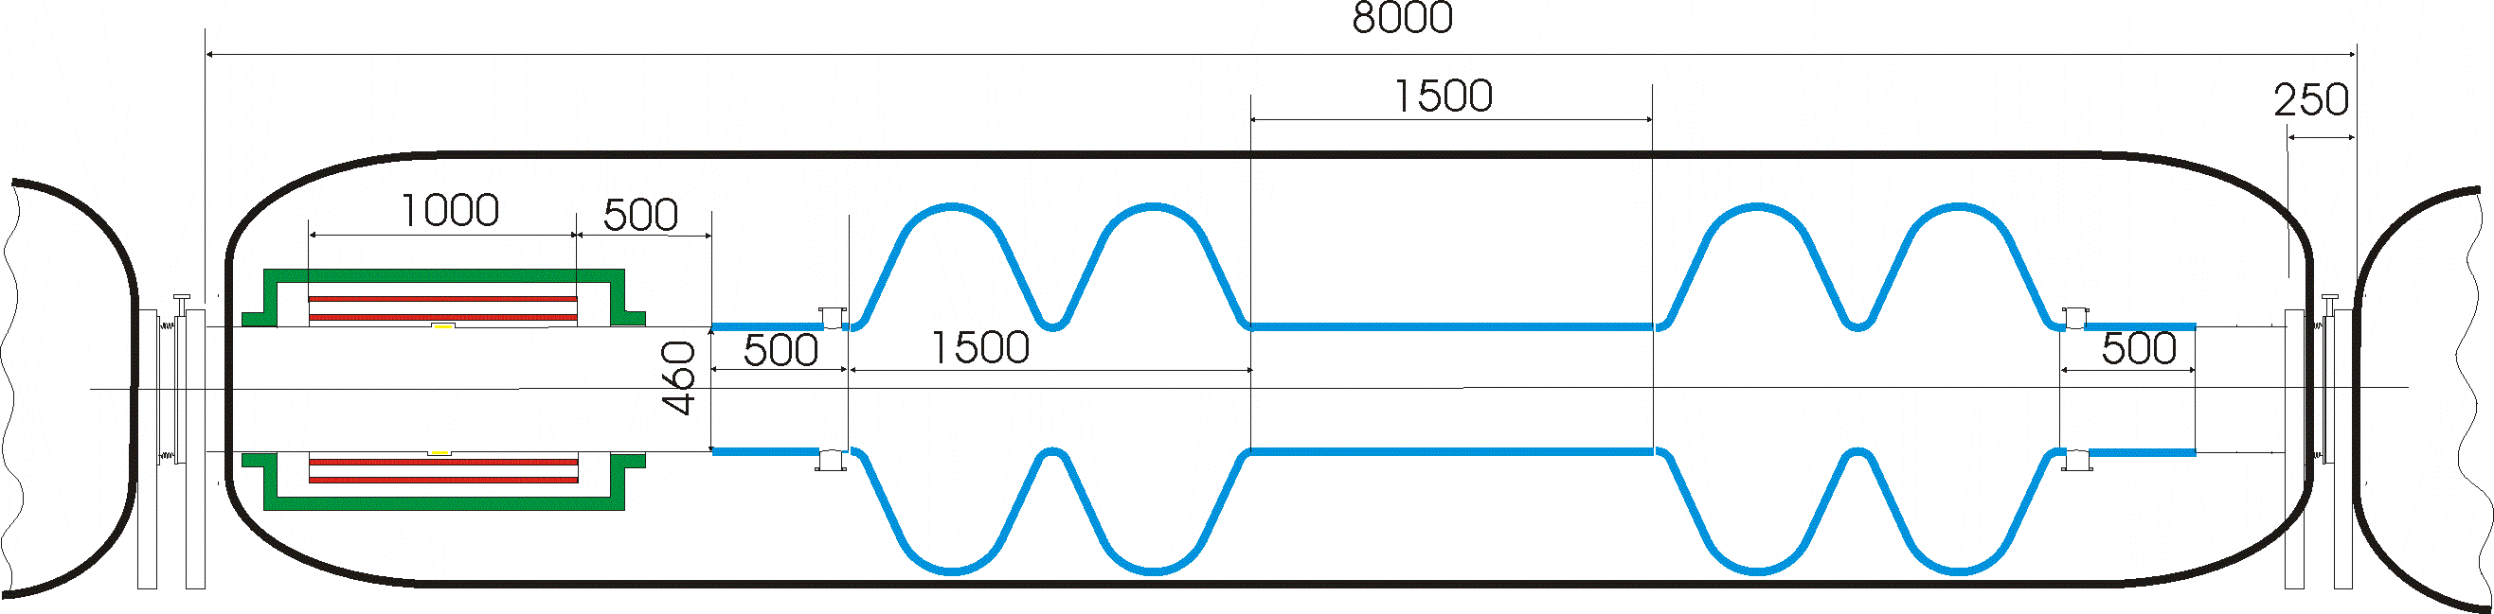
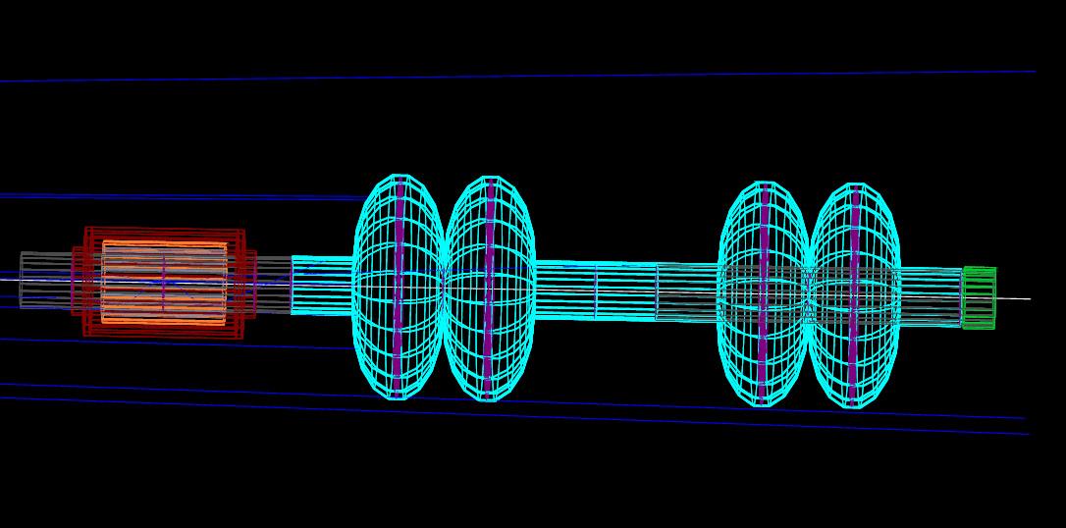
Single Pass Linac – RF Components

Slide 10
‘Dogbone’ RLA Linac

Slide 11
‘Dogbone’ RLA 1 – RF Components

Slide 12
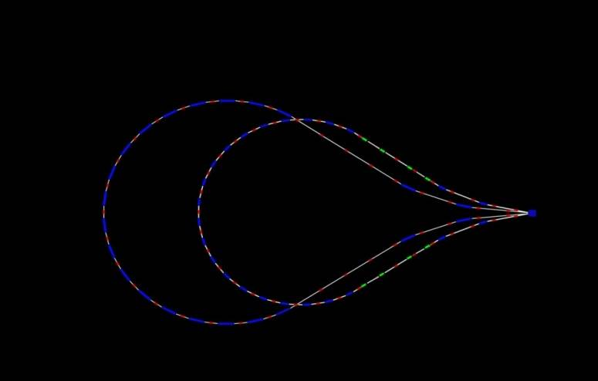
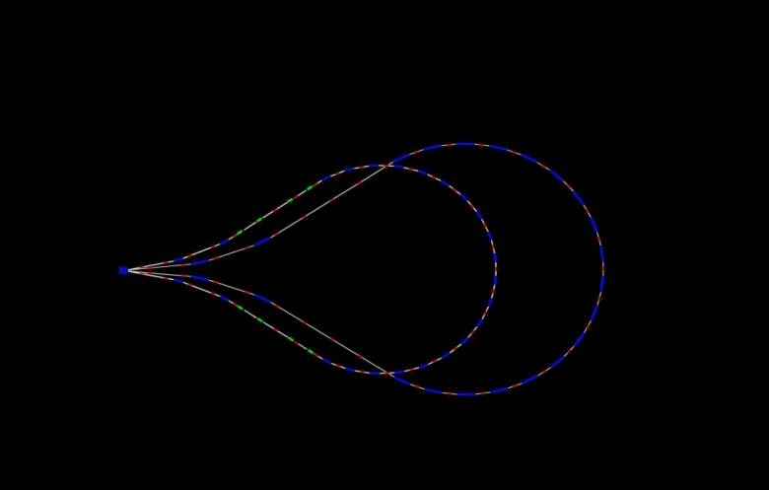
Higgs Factory: 5-pass RLA (5 − 63 GeV)
5 GeV
28.2 GeV
16.6 GeV
51.4 GeV
63 GeV
39.8 GeV
829 m
11.6 GeV/pass

Slide 13
Multi-pass Linac – Bisected Optics

Slide 14
Beam Loading Consideration

Slide 15
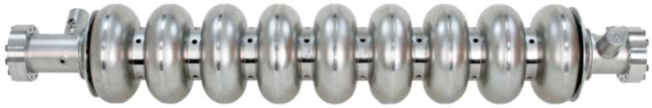
‘Dogbone’ RLA 2 – RF Components

Slide 16
Summary
RF system specs for low energy acceleration stages:
  Linac (255 MeV − 1.25 GeV) 1-pass
  RLA 1 (1.25 − 5 GeV ) 4.5-pass
  RLA 2 (5 − 63 GeV ) 5-pass
Next step….
  Optimized Linac + RLAs scheme for Higgs Factory and beyond…

Slide 17
Thanks for your
for attention
by Alex Bogacz
Jefferson Lab
May 20, 2021

