Slide 1
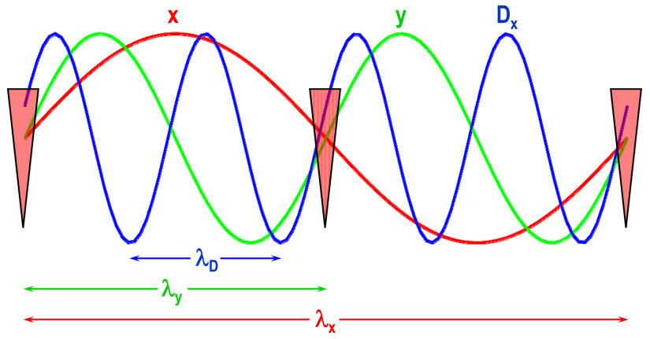
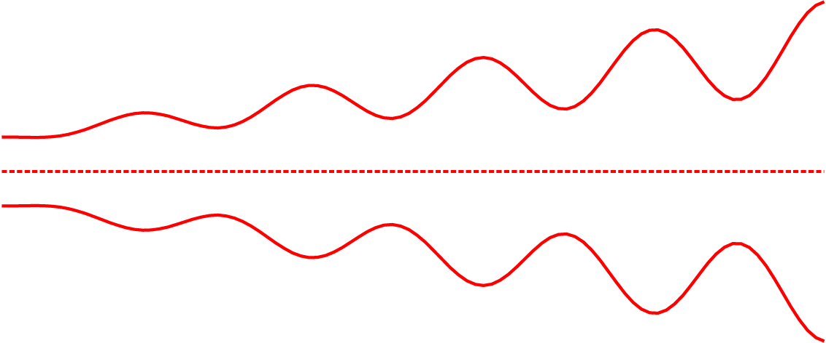
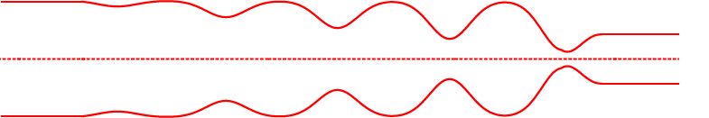
Parametric-resonance ionization cooling (PIC)
Half-integer parametric resonances induced in cooling channel
Enables order of magnitude equilibrium emittance reduction
Half-integer resonance at absorber positions drives reduction in x, growth in x’
Correlated optics for periodic focusing at absorber positions
Absorbers
Optics to restore parallel beam envelope
Beam envelope without absorbers
Ionization cooling occurs at absorber plates, and RF cavities restore longitudinal momentum

Slide 2
PIC possible parameters
Absorber plates
Parametric resonance lenses
w
Parameter | Unit | Initial | Final
Muon beam momentum, p | MeV/c | 250 | 250
Number of particles per bunch, N_{b} | 10¹⁰ | 1 | 1
Be (Z = 4) absorber thickness, w | mm | 20 | 2
Normalized transverse emittance (rms), ε_{x} = ε_{y} | μm | 230 | 23
Beam size at absorbers (rms), σ_{a} = σ_{x} = σ_{y} | mm | 0.7 | 0.1
Angular spread at absorbers (rms), θ_{a} = θ_{x} = θ_{y} | mrad | 130 | 130
Momentum spread (rms), Δp/p | % | 2 | 2
Bunch length (rms), σ_{z} | mm | 10 | 10
Equilibrium angular spread
and beam size at absorber
Equilibrium emittance
improvement by a factor of

Slide 3
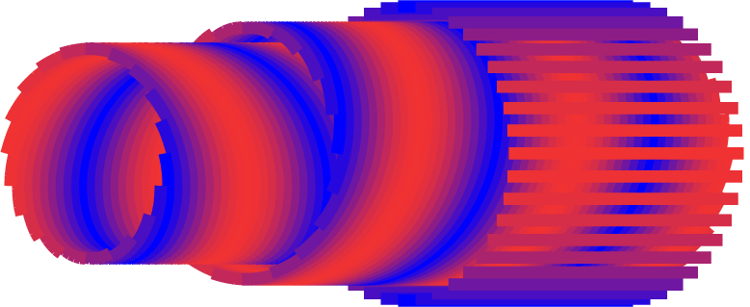
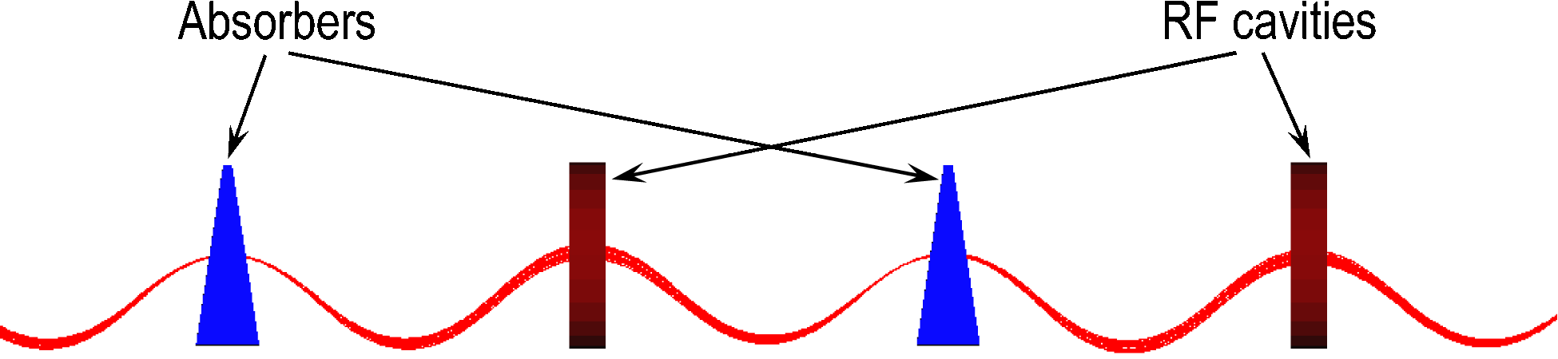
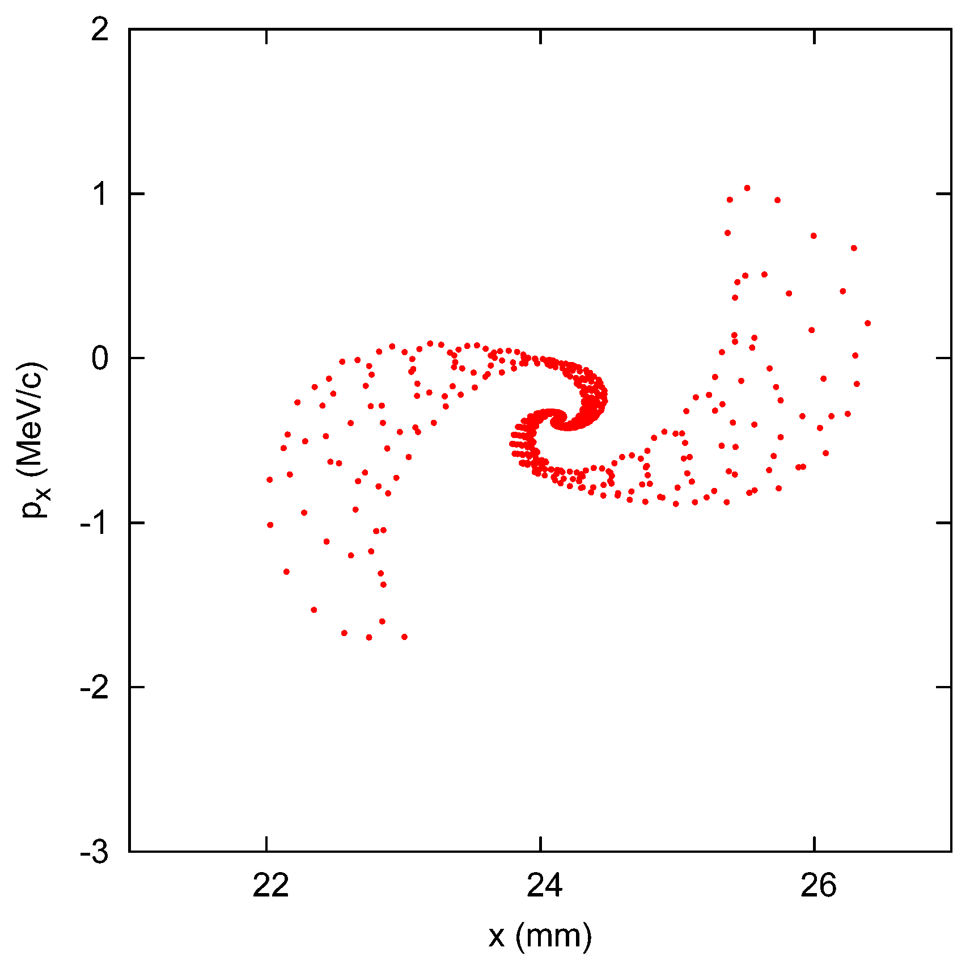
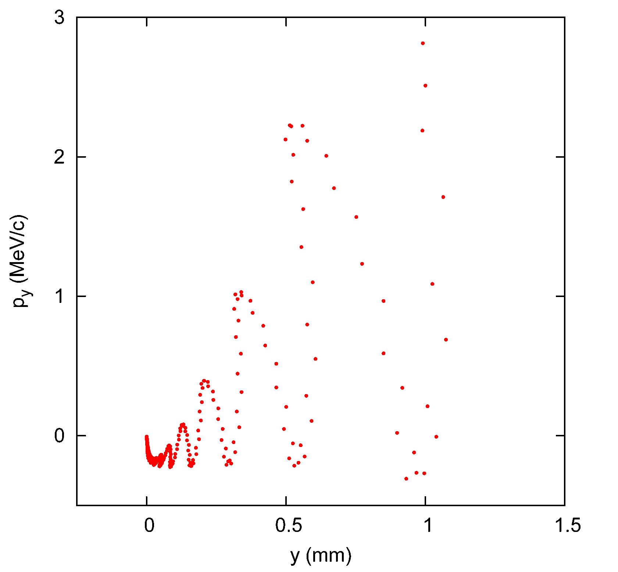
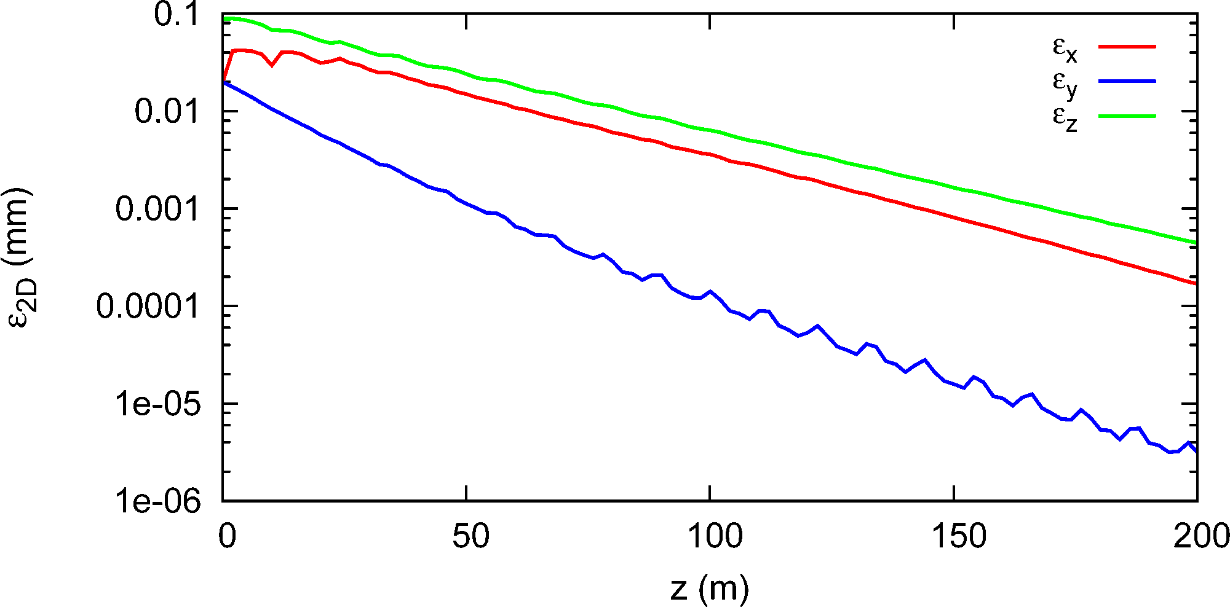
Twin helix implementation
Two equal-strength opposite-helicity helical dipole harmonics +
Straight quad to redistribute horizontal and vertical focusing
Orbit in horizontal plane + uncoupled horizontal, vertical motion
λ_{D} = λ ⇒ λ_{x} = 2λ_{y} = 4λ ⇒ ν_{x} = 0.25, ν_{y} = 0.5
Layer of positive-helicity helical conductors with cosφ azimuthal current dependence
Layer of negative-helicity helical conductors
Normal quad
“Twisted” Meyer magnet
Emittance evolution, no stochastics or energy straggling
Phase space behavior with induced parametric resonance

Slide 4
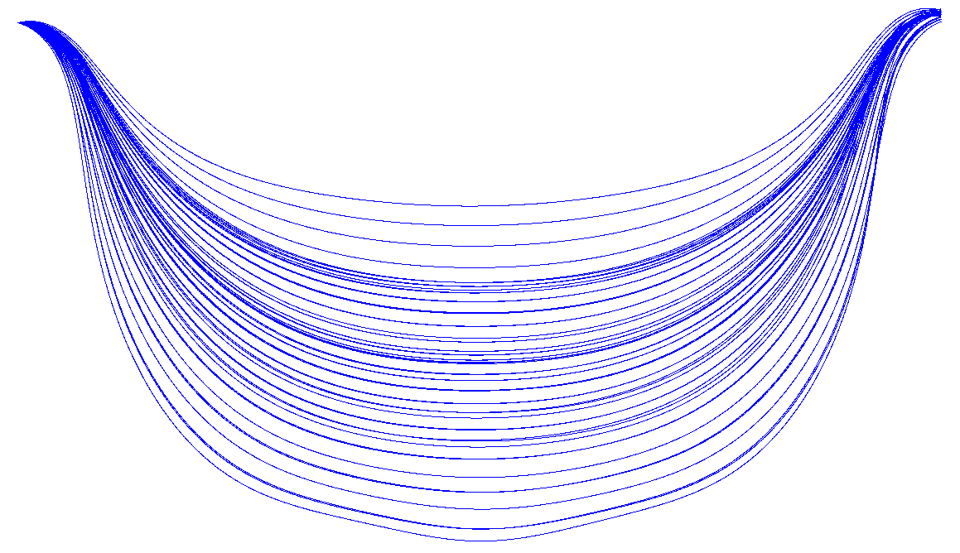
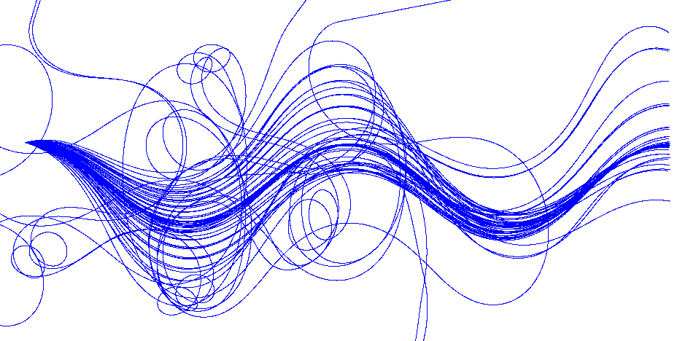
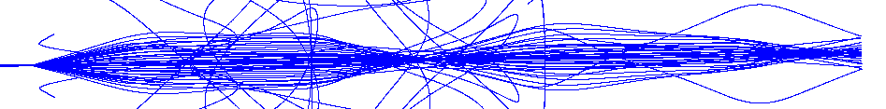
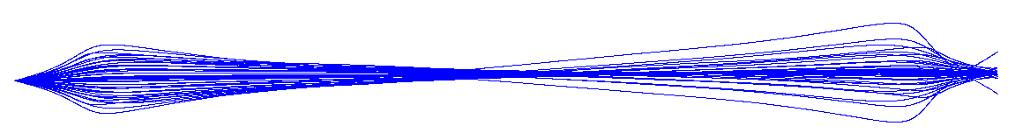
Twin helix challenges
Beam aberrations cause beam blowup at focal points
Under correlated optics conditions, continuous harmonically-varying multipoles excite nonlinear resonances
Aberration compensation is difficult with limited multipole choices
Horizontal
Horizontal
Absorber location
Absorber location
Absorber location
Absorber location
Helical and straight sextupoles, octupoles
Vertical
Vertical
Two helix periods

Slide 5
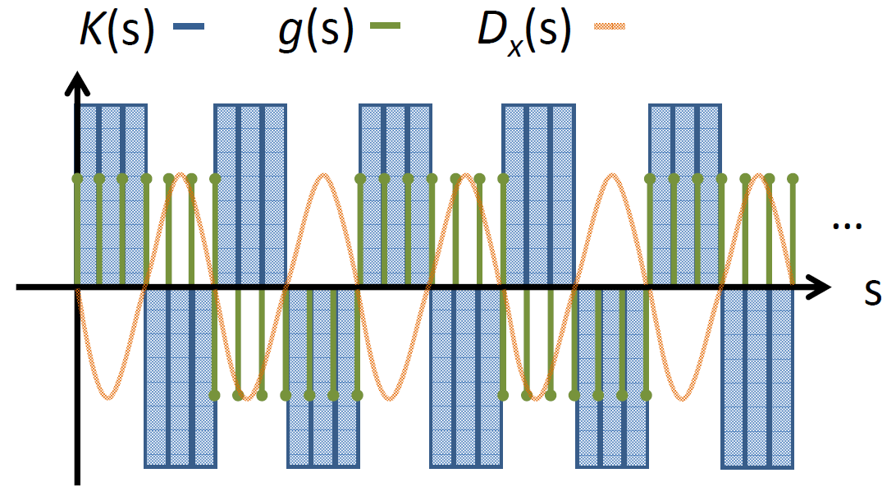
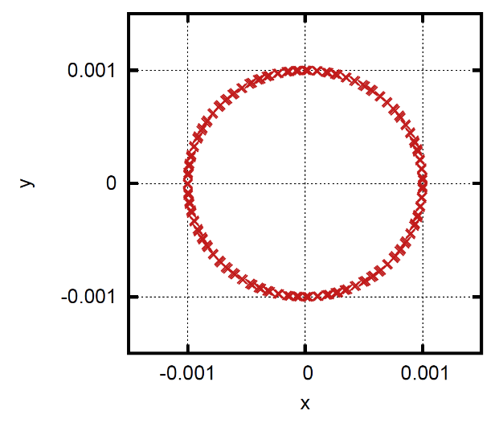
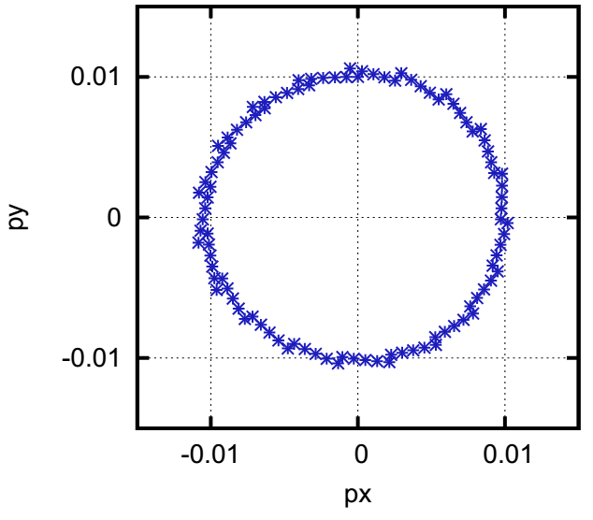
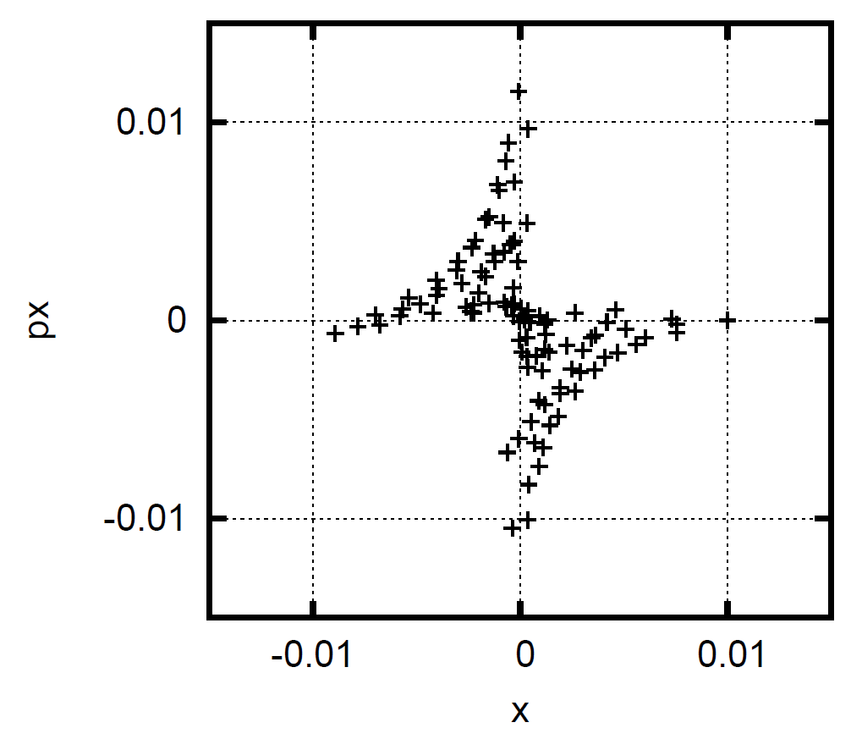
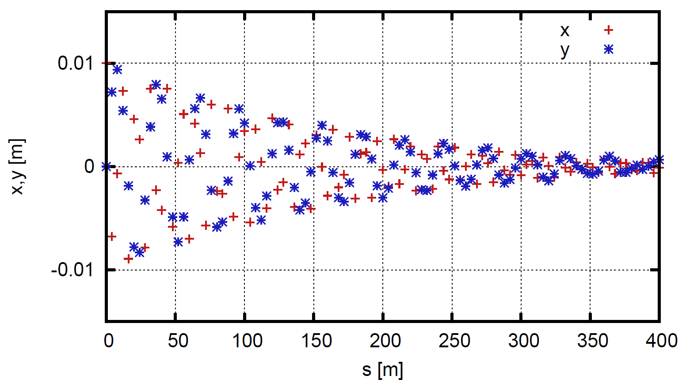
Skew PIC implementation
Skew quads in PIC channel for strong x-y coupling → correlated optics for radial motion
Betatron tunes shifted away from resonant values → easier aberration compensation
uncoupled
λ_{Dx} = λ ⇒ λ_{x} = 2λ_{y} = 2λ ⇒ ν_{x} = 1.0, ν_{y} = 2.0
Skew PIC theory
Rotational phase space behavior
for stability of linear motion
Simultaneous x, y focusing with induced parametric resonance

Slide 6
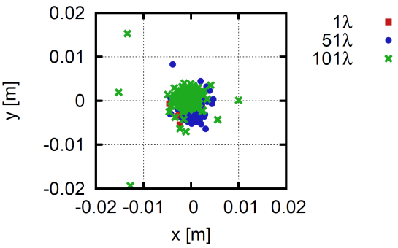
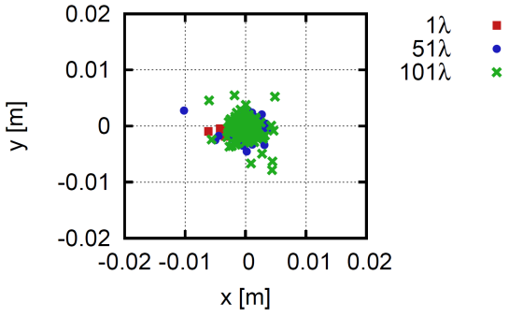
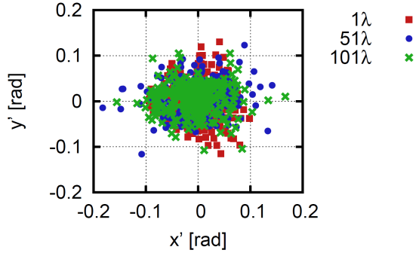
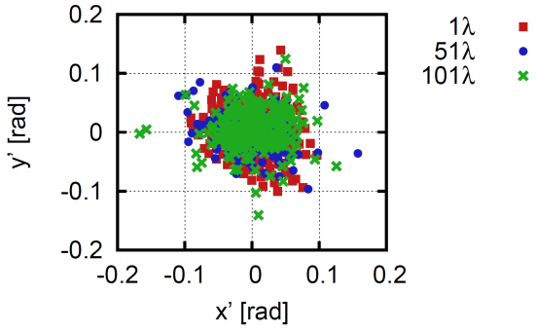
Skew PIC challenges
Dynamic aperture optimization easier than in normal PIC, but still challenging
Able to stabilize particle motion within ±90 mrad without damping and ±120 mrad with damping
However, ±120 mrad is ~1σ_{θ}
Serious problem with amplitude-dependent time of flight for large θ when longitudinal motion is included
x,y and x’,y’ phase space including sextupole, octupole, decapole harmonics

Slide 7
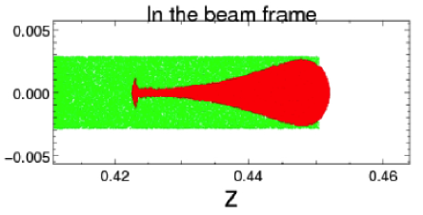
Plasma channel with PIC
Strong focusing would help alleviate many of the problems
Consider plasma focusing in gas-filled RF cavities (K. Yonehara)
Idea supported by initial simulations
Proposal submitted on this topic

