Slide 1



Introduction and Objectives of the BD-WG
  Introduction and Overview
  Programme
  Participants
  Objectives

Slide 2
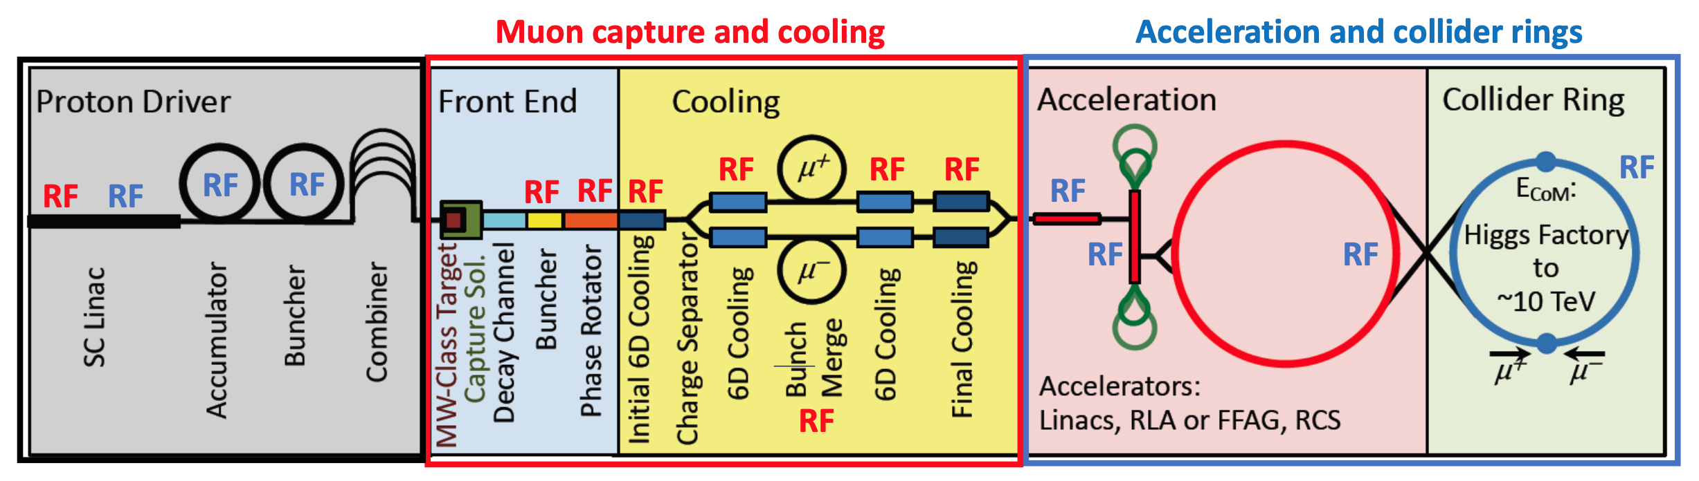
Introduction and Overview
  Courtesy of A. Grudiev et al.

Slide 3
Introduction and Overview
  Summary of
  RF systems
  Courtesy of
  J.P. Delahaye et al.
  (20/05/21)

Slide 4
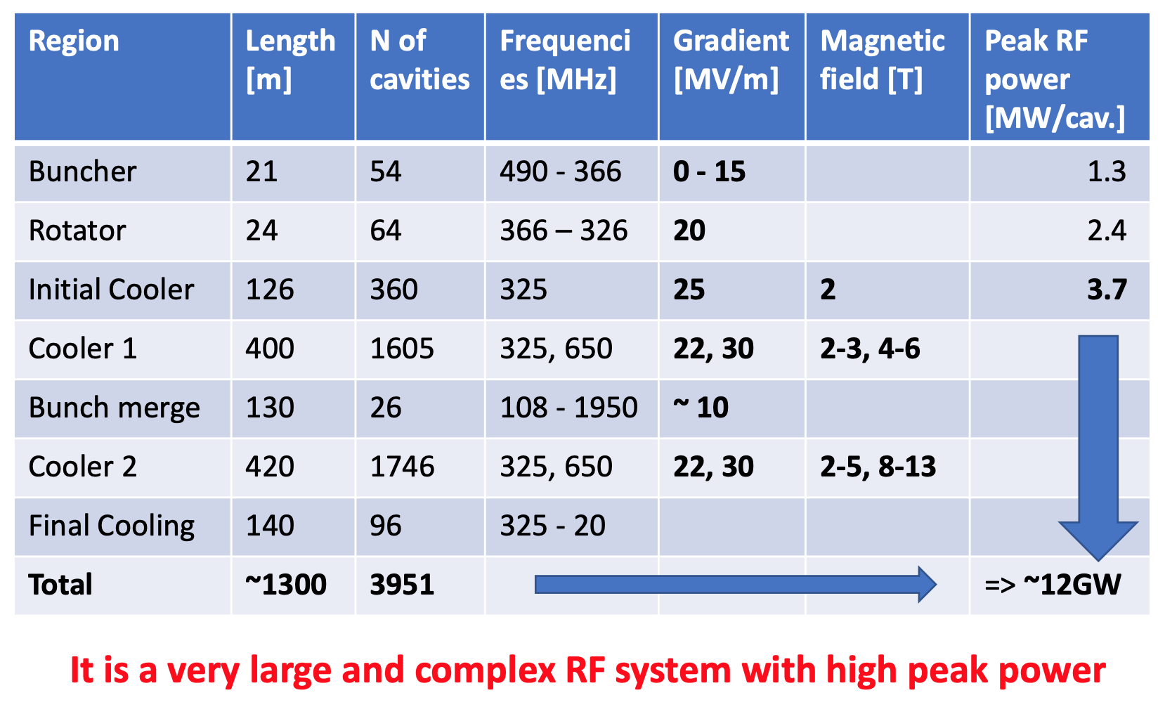
Introduction and Overview
  RF system for muon capture and cooling
  Courtesy of
  A. Grudiev et al.

Slide 5
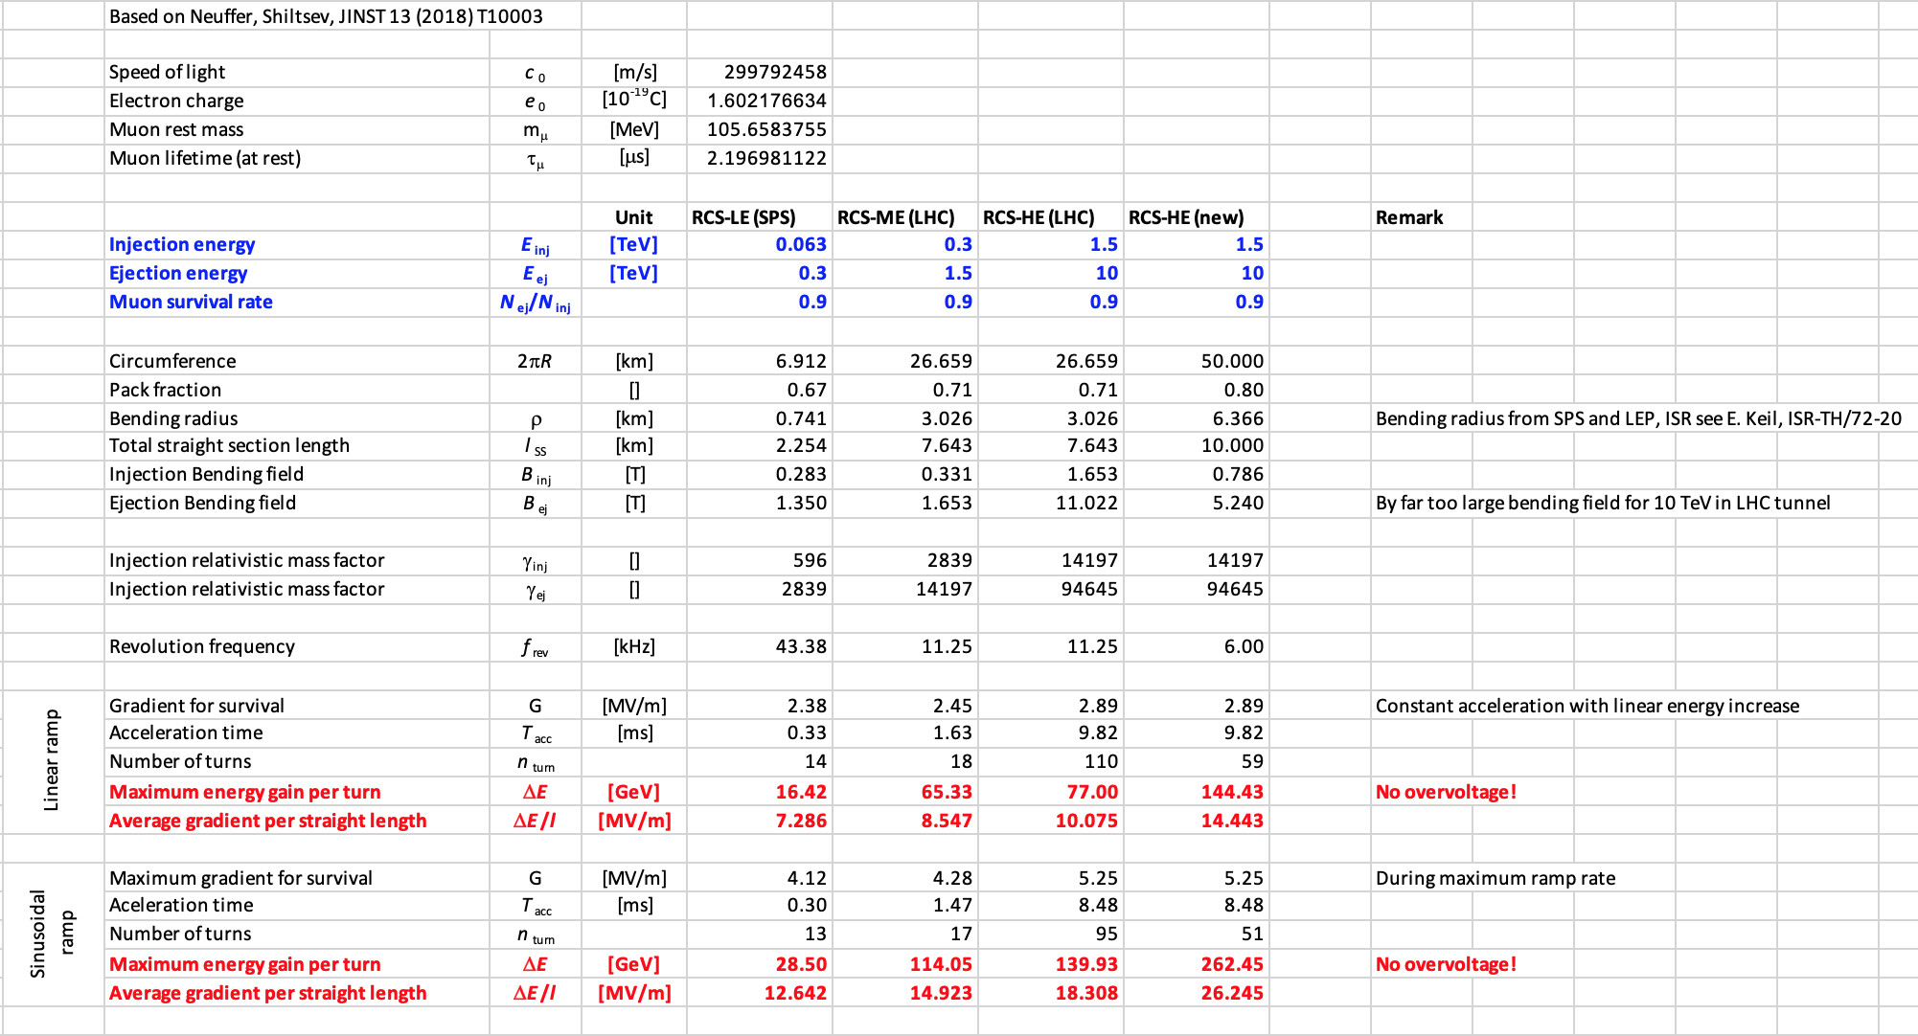
Introduction and Overview
  RCS chain parameters
  Courtesy of
  H. Damerau et al.

Slide 6
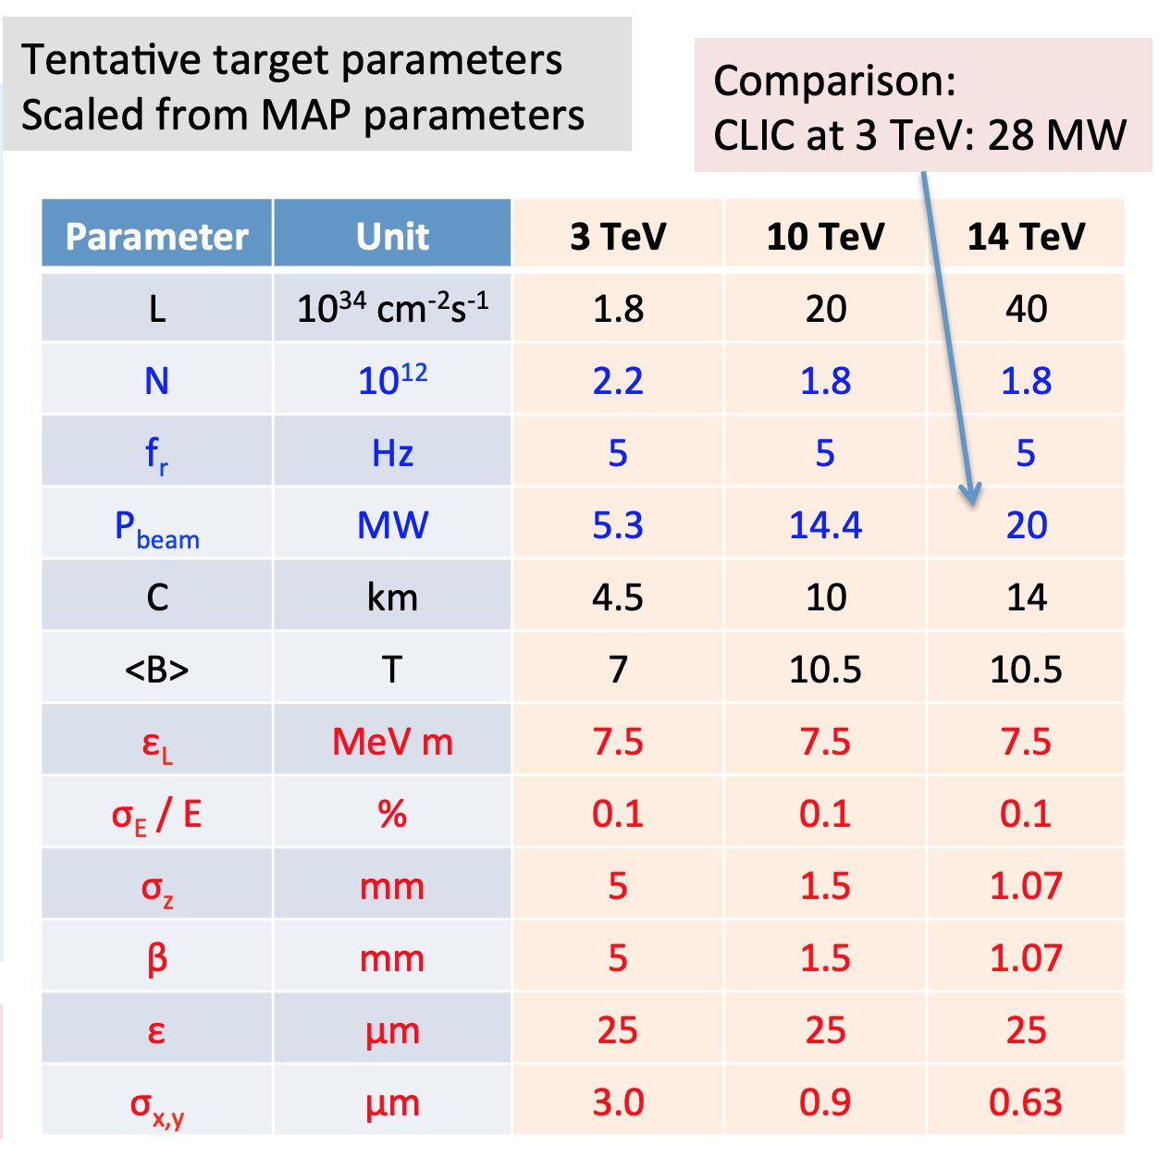
Introduction and Overview
  Target parameters for the Muon Collider ring
  Courtesy of D. Schulte

Slide 7
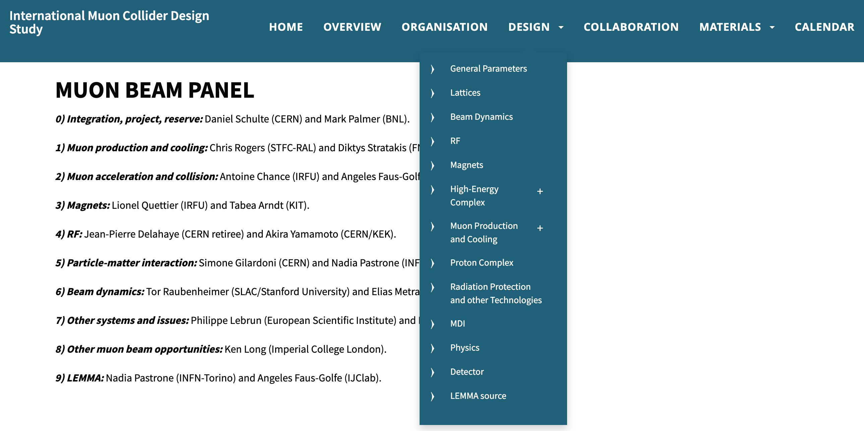
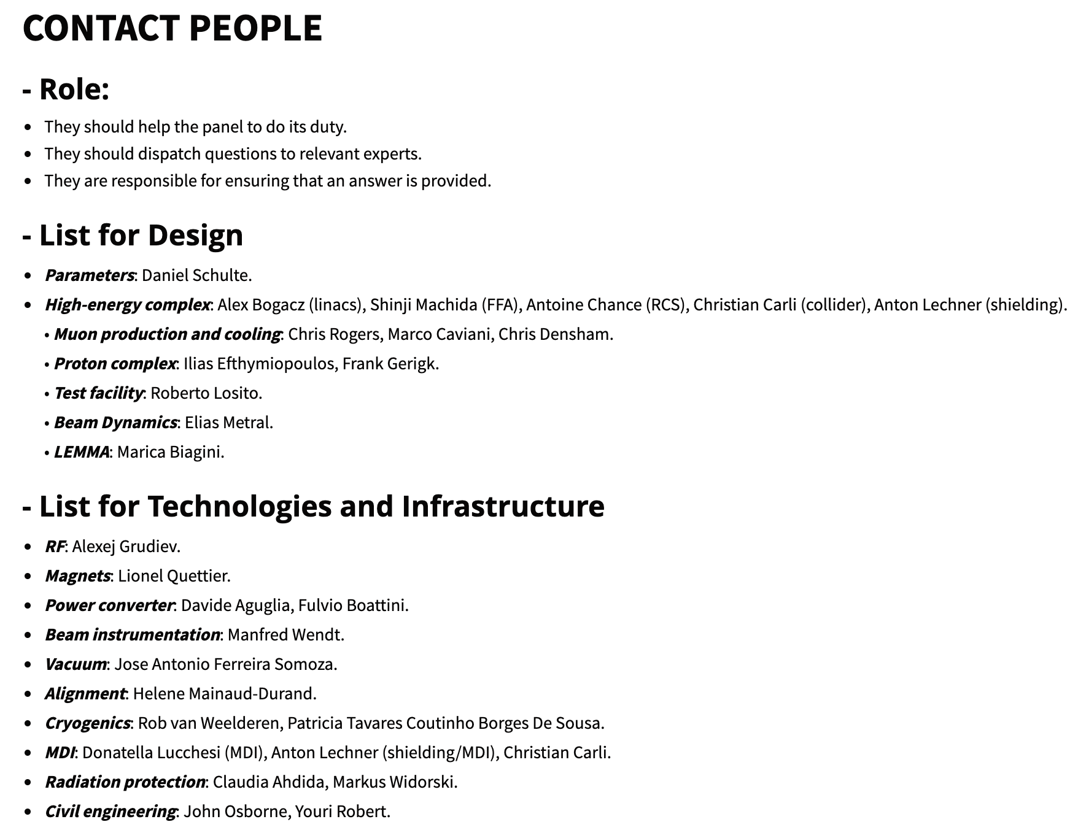
Introduction and Overview
  IMCDS website: https://muoncollider.web.cern.ch/welcome-page-muon-collider-website
  Organisation: https://muoncollider.web.cern.ch/organisation

Slide 8
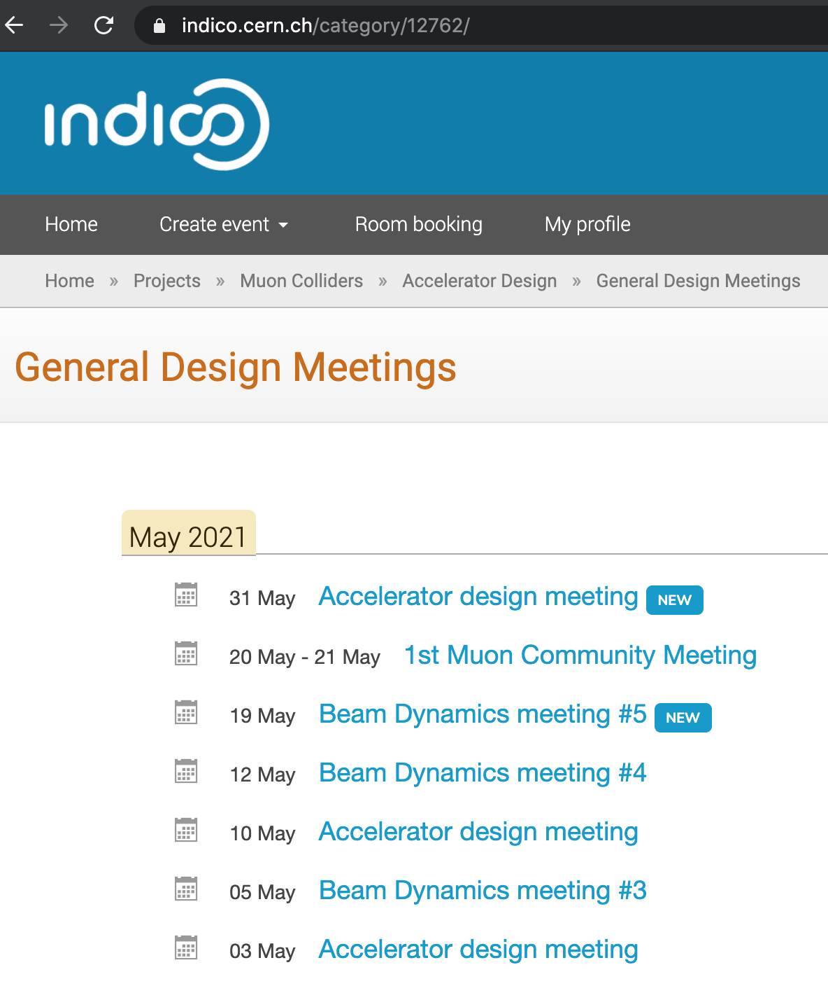
Introduction and Overview
  Direct link to the indico site for Accelerator Design Meetings (from Daniel Schulte, on Monday afternoons) and Beam Dynamics Meetings
  => https://indico.cern.ch/category/12762/

Slide 9
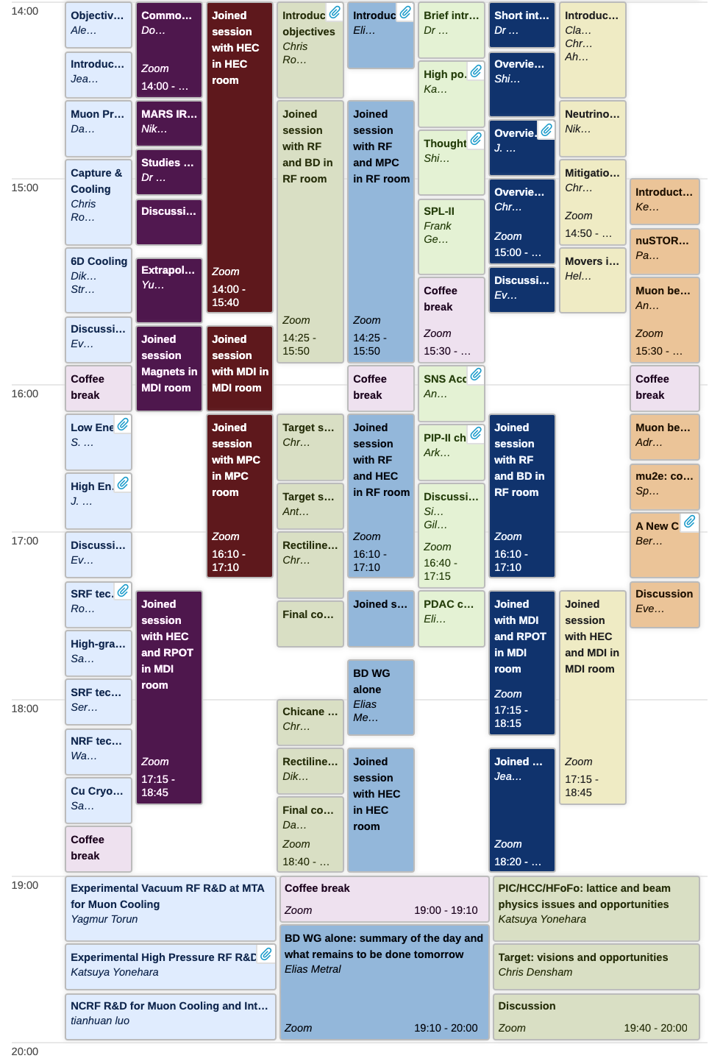
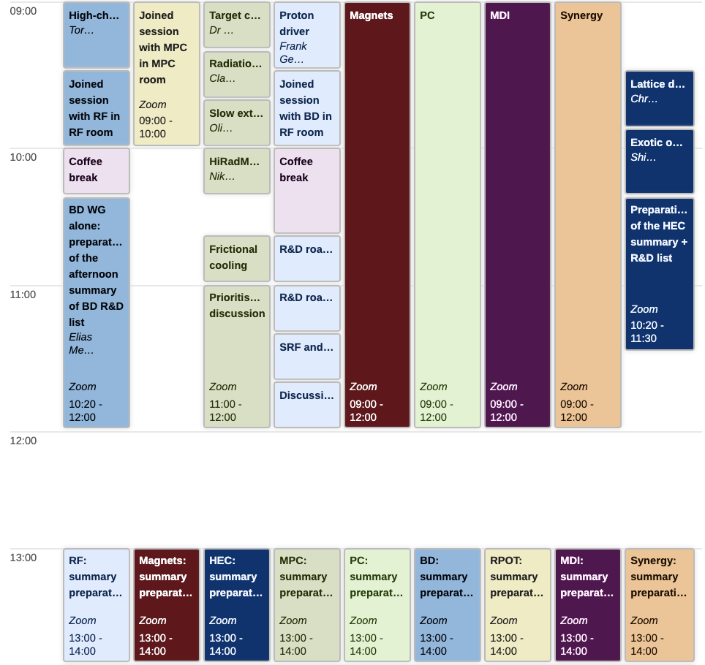
Programme
(https://indico.cern.ch/event/1030726/timetable/#all.detailed)

Slide 10
Participants: 39 (as of this morning) – 149 total

Slide 11
Objectives
  => Charge for this 1st Muon Community Meeting:

Slide 12
Objectives
  => Charge for this 1st Muon Community Meeting:
  The goal is to identify the R&D that has to be carried out before the next ESSU-PP to scientifically justify the investment into a full CDR for the muon collider and the corresponding demonstration programme

Slide 13
Objectives
  => Charge for this 1st Muon Community Meeting:
  The goal is to identify the R&D that has to be carried out before the next ESSU-PP to scientifically justify the investment into a full CDR for the muon collider and the corresponding demonstration programme
  This includes R&D to develop a baseline collider concept, well-supported performance expectations and to assess the associated key risks, cost and power drivers. Further, the main components of the demonstration programme should be identified together with the corresponding preparatory work

Slide 14
Objectives
  => Charge for this 1st Muon Community Meeting:
  The goal is to identify the R&D that has to be carried out before the next ESSU-PP to scientifically justify the investment into a full CDR for the muon collider and the corresponding demonstration programme
  This includes R&D to develop a baseline collider concept, well-supported performance expectations and to assess the associated key risks, cost and power drivers. Further, the main components of the demonstration programme should be identified together with the corresponding preparatory work
  The working groups should propose realistic but ambitious targets for the performance goals of the different collider systems. In particular they should consider what could be assumed for the demonstration programme, i.e. in one or more test facilities starting in 2026, as well what one can anticipate to be available in 2035-2040 for a first collider stage and in 2050 for an energy upgrade

Slide 15
Let’s do it together for the BD part!
Thank you
for your attention

