Slide 1



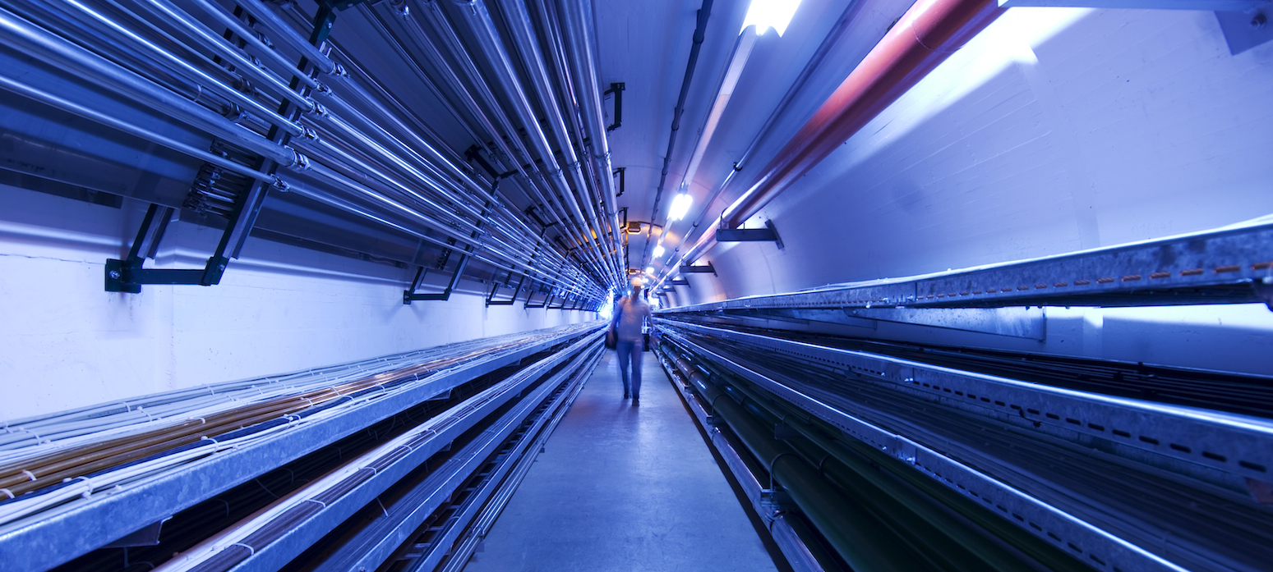
First radiation protection considerations for a muon collider target area
C. Ahdida, H. Vincke, P. Vojtyla, M. Widorski
1st Muon Community Meeting
20.-21. May 2021

Slide 2
Overview
General principles and guidelines of Radiation Protection
General RP considerations for a muon collider target complex
  Prompt and residual radiation
  Air and He activation
  Water and soil activation
  Radioactive waste production
Summary

Slide 3
General Principles of Radiation Protection
ICRP recommends the international guidelines, which are transcribed into law on European and national level
Justification
Any exposure of persons to ionizing radiation has to be justified
Limitation
The personal doses have to be kept below the legal limits
Optimization
The personal doses and collective doses have to be kept as low as reasonably achievable (ALARA)

Slide 4
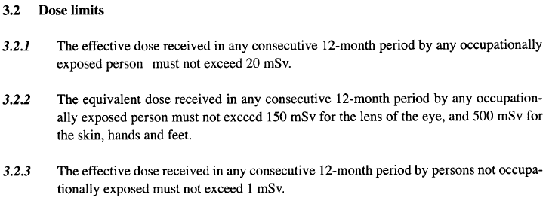
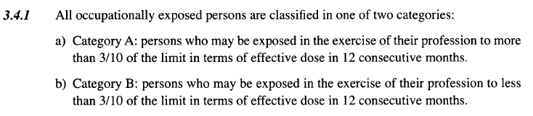
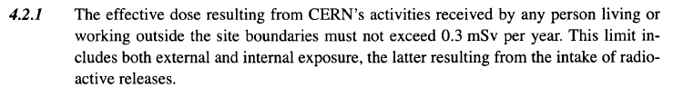
Limitation – Example of CERN Safety Code F
Occupationally exposed persons (Radiation Workers)
Yearly limit
A: 20 mSv/12 months ⁽*⁾
B: 6 mSv/12 months ⁽*⁾
⁽*⁾ Age 16-18: 6 mSv/12 months,
Pregnant women: 1 mSv during pregnancy
Not occupationally exposed persons
1 mSv/12 months
Environment (Public)
0.3 mSv/12 months
→ Optimisation can be considered as respected if the practice never gives rise to an annual dose above 10 µSv for members of the public
https://edms.cern.ch/ui/file/335729/LAST_RELEASED/F_E.PDF
100 rem = 1Sv

Slide 5

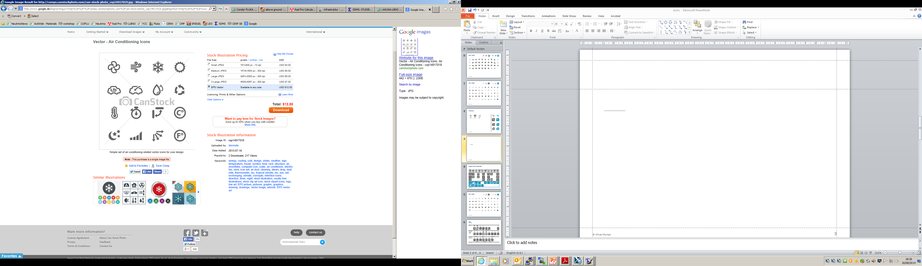

General RP considerations
Prompt and residual radiation
The optimization of the prompt and residual radiation must be taken into account for commissioning, normal beam operation, maintenance and accidents
To lower the prompt and residual radiation, adequate shielding needs to be installed
The activation properties of the materials used in the facility must be considered during the design process, as they may have a direct impact on later handling and waste disposal. For this the ActiWiz material catalogue could be consulted
Only absolutely necessary equipment should be installed in areas of high radiation levels. The higher the activation, the more reliable should equipment be
Depending on residual dose levels and tasks, manual interventions should partially or completely be replaced by remote maintenance/ repair. Any component should be optimized to lower maintenance time and repair needs
Prompt and residual radiation
Air and He
activation
Radiation Protection
Water and Ground activation
Radioactive waste

Slide 6
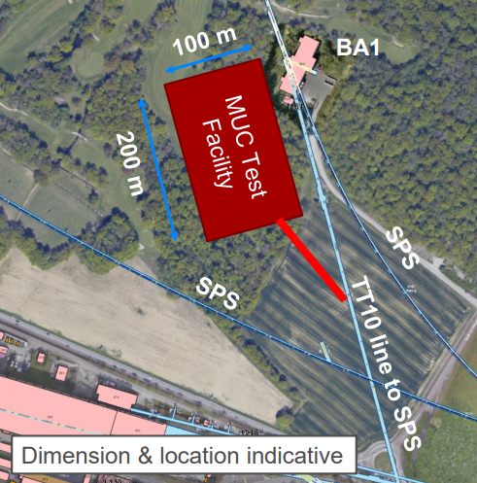
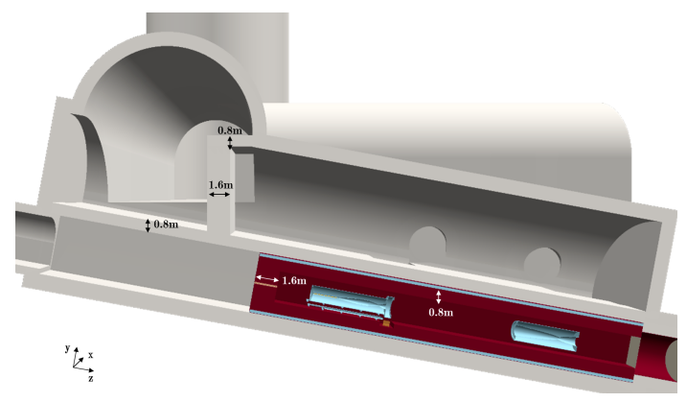
Prompt and residual radiation
“TT-10-like” option
Fully underground solution of around 40 m depth (e.g. “TT10-like”) reduces RP concerns due to prompt radiation
Depth of around 40 m for a O(4) MW facility is sufficient for the dose above-ground, but ground water activation to be checked (depth for 2 MW LLBNO was of O(80-100) m)
Considerable shielding for MW facility is nevertheless required to reduce the prompt radiation and thus the resulting activation levels of the surrounding infrastructure and molasse
Remote handling is required
A morgue room could be foreseen for allowing cooling of hot equipment
Streaming through shafts connected to the target area should be sufficiently reduced
LLBNO layout
50 GeV/c p+
2 MW
2.5e14 p/s

Slide 7
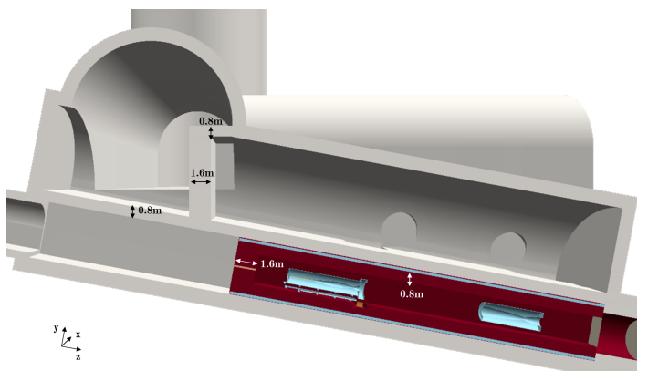
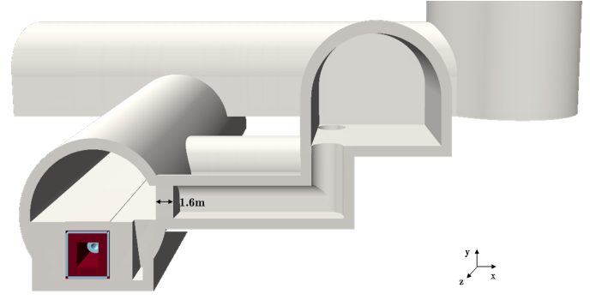
LLBNO design
Side view
Cross-sectional view
Morgue room
Transport tunnel
Service gallery
Target chamber
Connection tunnels
Iron
Concrete

Slide 8
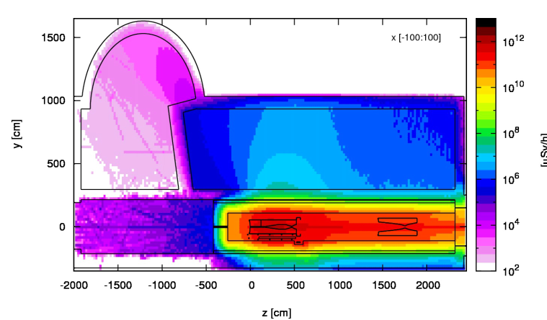
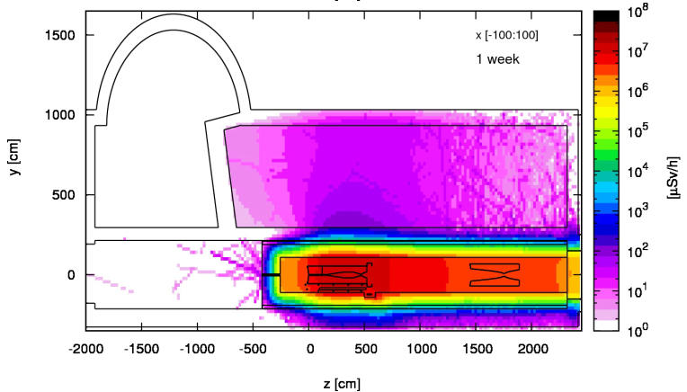
LLBNO prompt and residual dose rates
Prompt dose rates
Residual dose rates, 1 week cooling
End of
transport
tunnel:
<10 μSv/h
Service gallery: O(1) μSv/h
Few 10⁷ μSv/h
O(100) μSv/h
O(10¹²) μSv/h
O(10⁷) μSv/h
50 GeV/c p+
2 MW
2.5e14 p/s
Above-ground: < 0.05 μSv/h
Target at contact: up to 10⁸ μSv/h

Slide 9
General RP considerations
Air and helium activation
Air volumes should be minimized in areas of high levels of prompt radiation or even better be replaced by a helium or vacuum environment
Air volumes in which considerable air activation is expected should be separated from adjacent areas and the outside. Therefore, both static (e.g. sealing of air volumes) and dynamic (e.g. leak extraction) air confinement should be employed
A ventilation system should guarantee a pressure cascade from low to high contaminated areas
The air extraction system shall be equipped with high-efficiency particle and aerosol (HEPA) filters and an air monitoring station
Prompt and residual radiation
Air and He
activation
Radiation Protection
Water and Ground activation
Radioactive waste

Slide 10
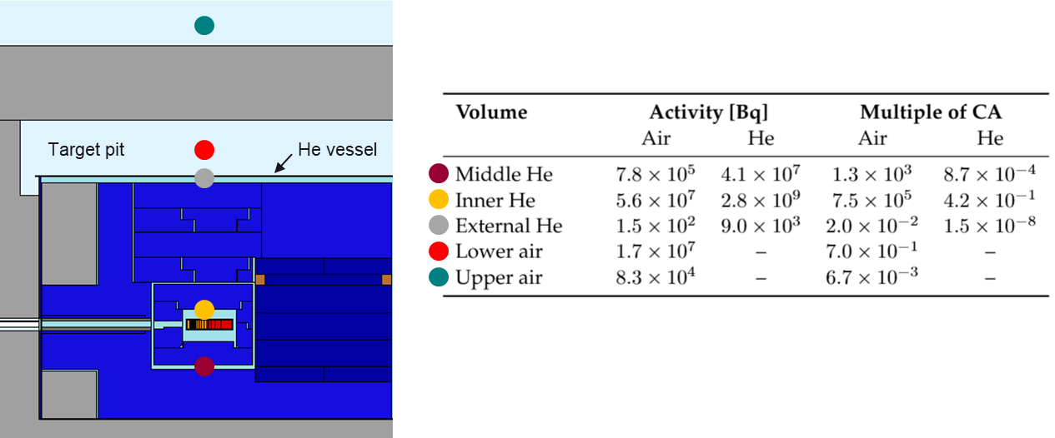
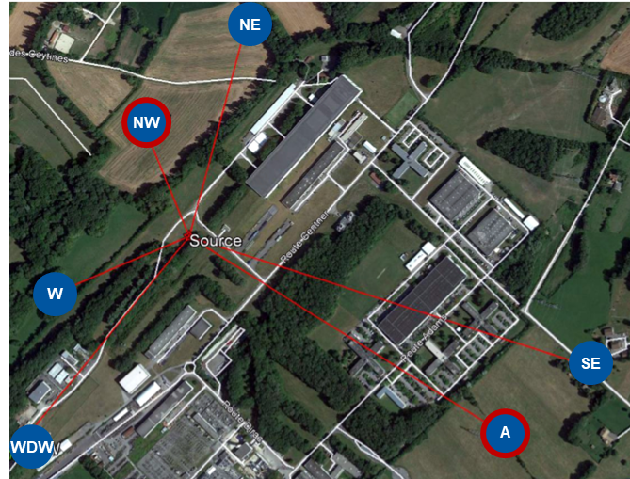
Air and He activation
BDF as an example for a optimized design with a minimization of air volumes by a He vessel around the target and proximity shielding
A requirement of a max. air contamination level of 0.1% was set
For a O(4) MW facility a He vessel would definitely be required (initial guess > 100 kW)
At BDF also a dynamic confinement was employed as well as HEPA filters to effectively reduce radionuclides attached to aerosols (Be-7, Na-22/24, P-32/33 and S-35)
Environmental impact from releases of activated air/He to be evaluated
Effective dose to members of the public to be <10 µSv/year from all CERN facilities and all sources (stray radiation, air/He releases, water activation, etc.)
Uncertainty connected to H-3 outgassing from shielding elements (eventually also target)
BDF
400 GeV/c p+
355 kW
4e13 p/s
Main contribution from 0.1% air contamination in inner He region
Identification of reference groups around BDF to evaluate dose to public from air / He releases
→ highest value of
10 nSv per year
¹ Person working 40h/w, 50w/y with standard breathing rate (1.2 m³/h) in activated air with CA = 1 receives 20 mSv

Slide 11
General RP considerations
Water and soil activation
Water cooling circuits for highly radioactive elements like the target and the dump should be closed and separated from others
Water sumps should be avoided in highly activated areas
Activation and/or contamination of ground water and earth should be avoided (e.g. by adequate shielding, dedicated sumps)
The facility should not be built in a “wet” environment. A hydrological study of the envisaged site should therefore be performed
Soil samples should be taken and analysed for their chemical and radiological composition
Prompt and residual radiation
Air and He
activation
Radiation Protection
Water and SOIL activation
Radioactive waste

Slide 12
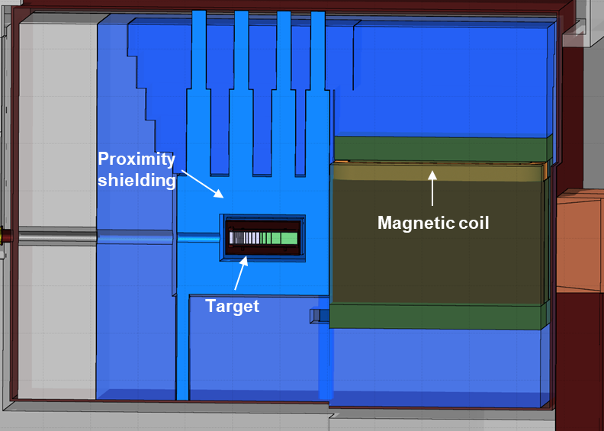
Water activation
BDF
Required depth for final O(4) MW facility to be checked for ground water activation (depth for 2 MW LLBNO was of O(80-100) m)
Ideally the placement of the most activated elements to be in deep impermeable molasse that is not in contact with shallower aquifers in moraine above and not suitable for drinking water exploitation
Environmental impact expected from molasses activation can be investigated with activation studies in combination with a hydrogeological study
For ground-water protection also geo-membranes can be employed
Activation of cooling water in the facility also to be taken into account like it was done for BDF
A large uncertainty for the cooling water activation comes again from H-3 out-diffusion
The use of an evaporator for eliminating activated water to be investigated (dosimetric impact)
400 GeV/c p+
355 kW
4e13 p/s
74 GBq from direct H-3 production (5 yrs)
18 TBq H-3 concentration in the target (5 yrs)
180 GBq assuming 3% out-diffusion from the target
3 demineralized water cooling circuits in BDF
Environmental impact from evaporation of cooling water (H-3) with 280 GBq H-3 was assessed to be of about 50 nSv/y

Slide 13
General RP considerations
Radioactive waste
The design must consider minimization, decommissioning and dismantling of radioactive waste
Prompt and residual radiation
Air and He
activation
Radiation Protection
Water and Ground activation
Radioactive waste

Slide 14
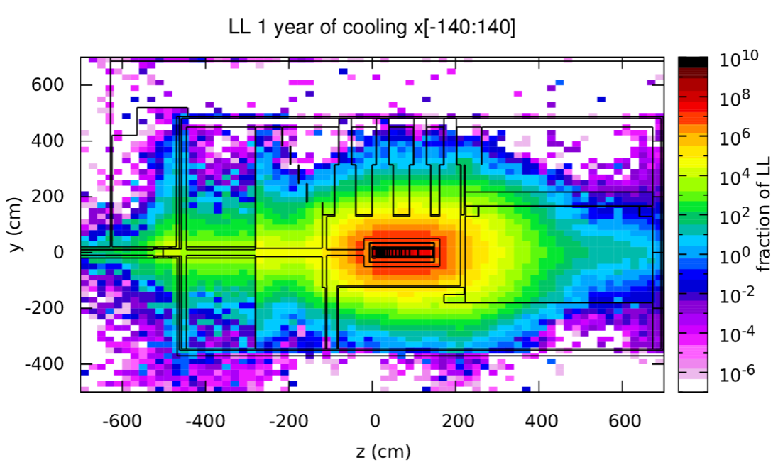
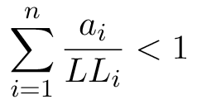
Radioactive waste production
BDF
The minimisation of radioactive waste is to be taken into account in the shielding design e.g. by having a modular shielding such that activated parts can easily be separated from non-radioactive parts
To distinguish areas of radioactive waste from conventional ones the Swiss clearance limits (LL) were used
The following sum rule was applied for material containing a mixture of radionuclides
1 year of cooling
For BDF, the fixed concrete structure of the building stays non-radioactive, which was envisaged in order to keep the flexibility for future installations
a_{i} - specific activity (Bq/kg) or total activity (Bq) of the i^{th} radionuclide
LL_{i} - respective Swiss clearance limit for the radionuclide i
n - number of radionuclides present

Slide 15
Summary
In past studies we have seen that the radiation protection considerations strongly determine the design of high power facilities
When aiming for a target facility of O(4) MW several RP aspects should be studied beforehand such as:
  The required shielding and other infrastructure (e.g. morgue room) as well as streaming of radiation through shafts (e.g. avoided by chicanes)
  The required depth of the facility for avoiding ground water activation and a hydrogeological study
  A He vessel around the most critical region (target) to avoid air activation
  The possibility for minimizing the radioactive waste production
Uncertainties related to H-3 out-diffusion may impact air/He/water activation

Slide 16

Thank you
for your attention!

