Slide 1




SNS Accelerator:
Major Challenges & Mitigation Measures
by Andrei Shishlo and John Galambos
SNS and PPU Projects, ORNL, USA
May 20-21,2021

Slide 2
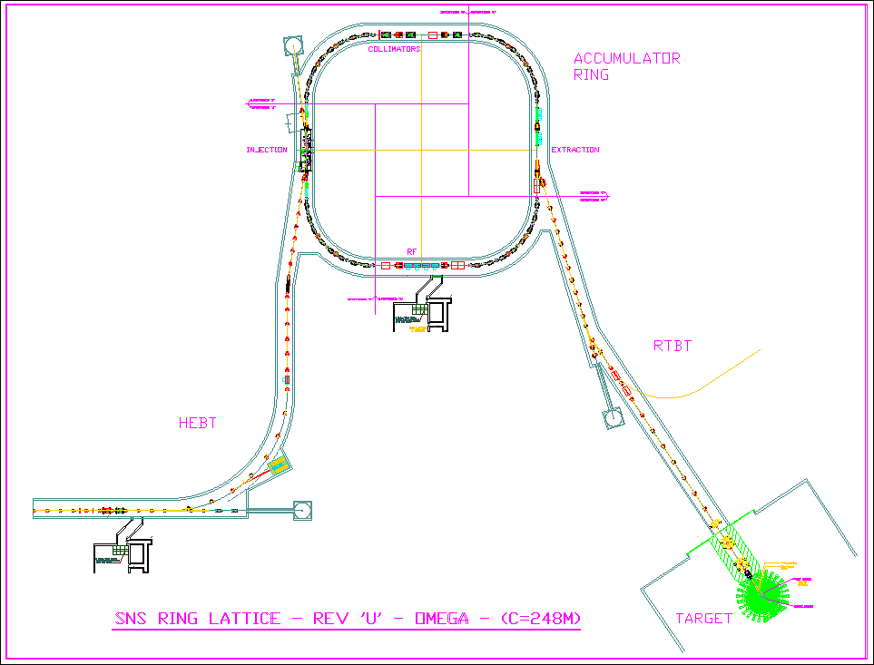
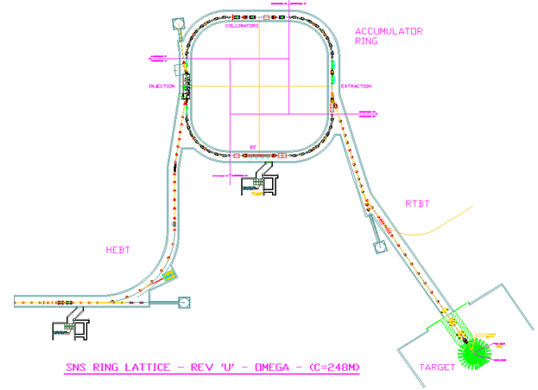
SNS Accelerator Complex
Front-End: Produce a 1-msec long, chopped, low-energy H- beam
LINAC: Accelerate the beam to 1 GeV
Accumulator Ring: Compress 1 msec long pulse to 700 nsec
H- stripped to protons
Deliver beam to Target
2.5 MeV
86.8 MeV
186 MeV
387 MeV
1000 MeV
Ion Source
RFQ
DTL
CCL
SRF, β=0.61
SRF, β=0.81
P beam on target : 1.44MW
I beam average: 1.44mA
Maximum Beam energy: 1 GeV
Duty factor: 6%
Rep. rate: 60Hz
Pulse width: 1ms
Current
1ms

Slide 3
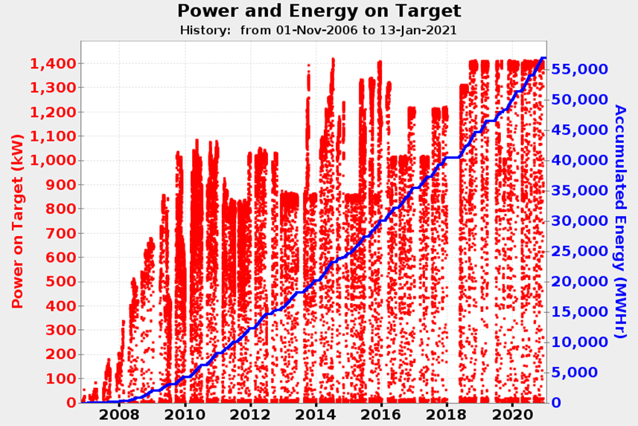
SNS Operations: April 2006 - Present
Despite all challenges, SNS operates at 1.4 MW with > 90% availability

Slide 4
RFQ: 1st (2002-2017) and 2nd (2017-Present)
1st RFQ is very robust machine, capable to take some abuse
Transmission is major figure of merit, it declined with time (reason is not clear)
Excessive heat generation at higher amplitudes and with beam presence
Resonance Control is instable (too slow) for “Beam On/Off” transitions
Stabilization with fast model-controlled addition/removal RF power solved this problem
2nd RFQ does not show this behavior (yet)
Discharge contribution
1st RFQ
2016.07.10
Normal operating range for the field

Slide 5
Warm Linac: DTL + CCL
High rate of vacuum trips inside cavities in the past
Ion pumps were replaced with turbo-pumps
Trips in Warm Linac/ RFQ/Ion Source are possible source of damage to SCL cavities due to beam loss
“Errant Beam Control” implemented. Comparing macro-pulse waveform with previous one allows to shut beam faster than using Beam Loss Monitor signals
Trip rate and beam loss in SCL were reduced further by empirical tuning Warm Linac cavities slightly (significantly) away from design parameters
Cavity | Design φ_{synch}, deg | Real φ_{synch}, deg | To Design A_{RF}, %
CCL 1 | -30.9 | -16.7 | 93
CCL 2 | -30.8 | -21.6 | 95
CCL 3 | -30.7 | -23.9 | 98
CCL 4 | -29.3 | -18.3 | 93

Slide 6
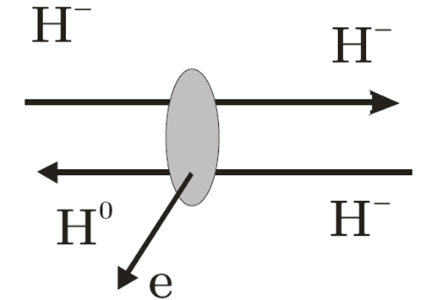
SCL: Intra-Beam Stripping (IBSt)
IBSt was encountered during power ramp-up
Initially mechanism of beam loss was unknown
Design showed zero SCL beam loss
Remedy was developed right away – reduced quad strength in SCL
IBSt was identified in 2011, experimentally confirmed in 2012
Since then, we using empirical beam loss tuning in SCL using big apertures
H⁻ beam
Proton beam

Slide 7
SCL: Superconducting Cavities Degradation
Problem: SCL cavities reducing gradients and low energy out of SCL
Solution: Plasma processing of inner surfaces of SCL cavities
Courtesy of Sang-Ho Kim

Slide 8
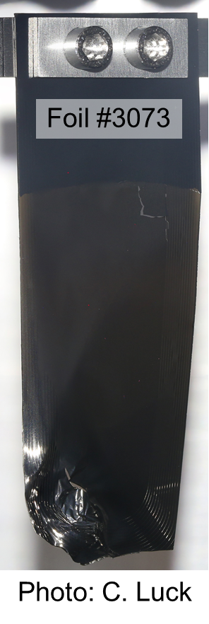
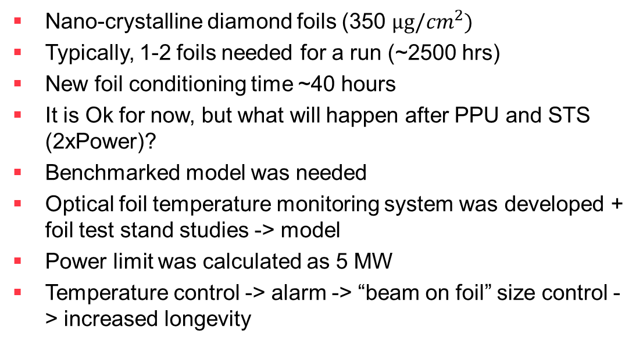
Ring Charge-Exchange Injection: Foil Longevity and Max Power
Nano-crystalline diamond foils (350 $μg/{cm}^{2})$
Typically, 1-2 foils needed for a run (~2500 hrs)
New foil conditioning time ~40 hours
It is Ok for now, but what will happen after PPU and STS (2xPower)?
Benchmarked model was needed
Optical foil temperature monitoring system was developed + foil test stand studies -> model
Power limit was calculated as 5 MW
Temperature control -> alarm -> “beam on foil” size control -> increased longevity
30mm

Slide 9
Notes on Other Technical Peculiarities and Lessons Learned at SNS
SCL operation is flexible! Much more than anticipated. E.g. run with missing cryomodules, on the fly retune….
We don’t use SRF piezo tuners nor HOM filters (for our low duty factor application)
Large aperture is useful for low beam loss if you can afford it
We don’t use 2 stage ring collimation nor RTBT collimation
We never used our e-p cloud suppression stuff (e.g. solenoid windings in Ring, transverse instability dumper )
We never used octupole magnets in ring

Slide 10
Summary
Technical and physics related challenges are there, but solutions have been found

Slide 11
Thank you
for attention

