Slide 1


First Considerations on Magnet Needs for the Muon Collider Ring
  Collider Ring Requirements
  Observations on the MAP 3 TeV c.o.m Proposal
  (version using quadruplet for focusing for small β)
    General Properties
    Neutrino Radiation
  First Ideas on further lattice Improvements
  (contributed by Kyriacos)
  On Magnet Requirements defined for MAP 3 TeV com Lattice
  Remarks
  Summary

Slide 2
Collider Ring Requirements
  Useful luminosity with available muons (large emittances and momentum spread) and their limited life-time
    Small β* and short bunches (hourglass effects!)
      Large βs and beam sizes in inner focusing structure
      Chromatic effects with large momentum spread
    Short circumference (increase number of bunch encounters during life-time)
      High magnetic fields
  Short bunch length (for one cycle lasting ~1000 turns)
  Neutrino radiation issue
      E.g., only short straights between magnets acceptable
  Protection against heat deposition from muon decay products
    No collimation foreseen!

Slide 3
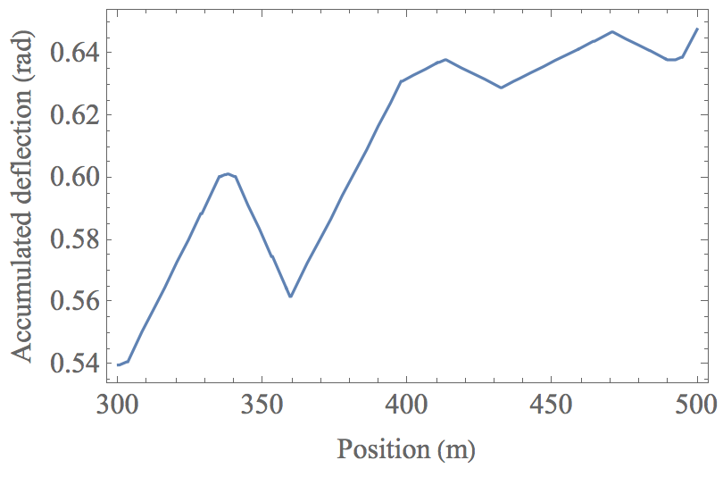
Observations on the MAP 3 TeV c.o.m Proposal
general Properties
  Self consistent lattice for very low β* = 5 mm
  working for very large momentum spread
  No straight lines for RF, injection …
  Matching sections with weak bendings
  with opposite signs
    Neutrino radiation from different bends add up
    Circumference increase and lumi reduction
  Further improvements of MAP lattice possible?
  Assumptions for next slides:
  Beam Energy (3 TeV c.o.m)
  muons per beam, repetition rate
  circumference ( ) with depth
  Operated for 5000 h per year

Slide 4
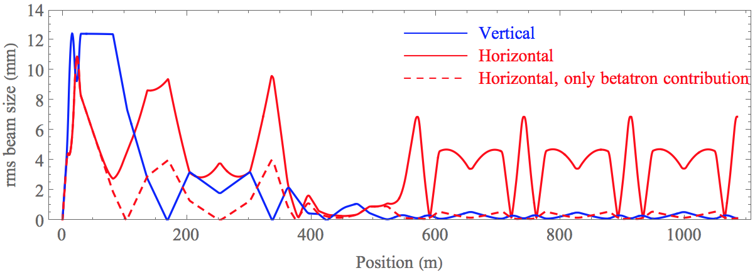
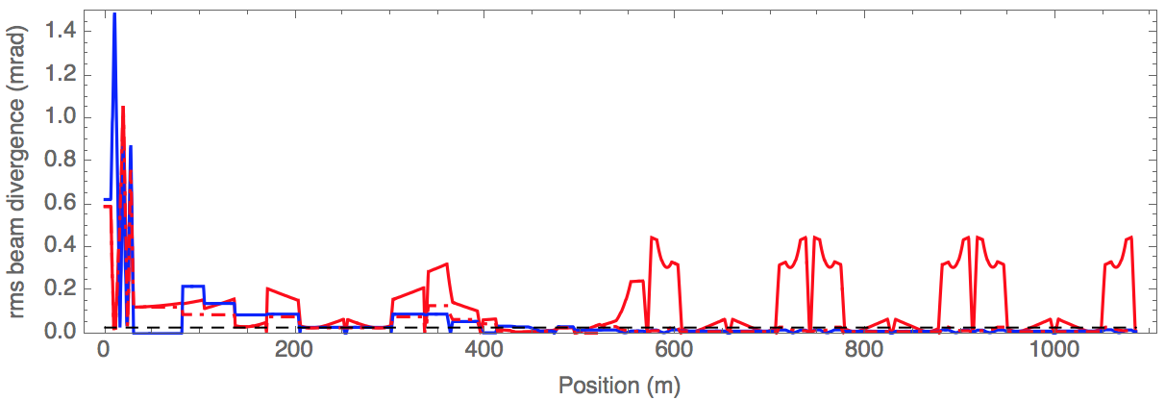
Observations on the MAP 3 TeV c.o.m Proposal
General Properties
  Large contribution from D and D’ to the horizontal beam width and divergence
    Even dominating
    contribution in arc
    Many locations with
    divergence from D’
    larger than neutrino
    radiation cone

Slide 5
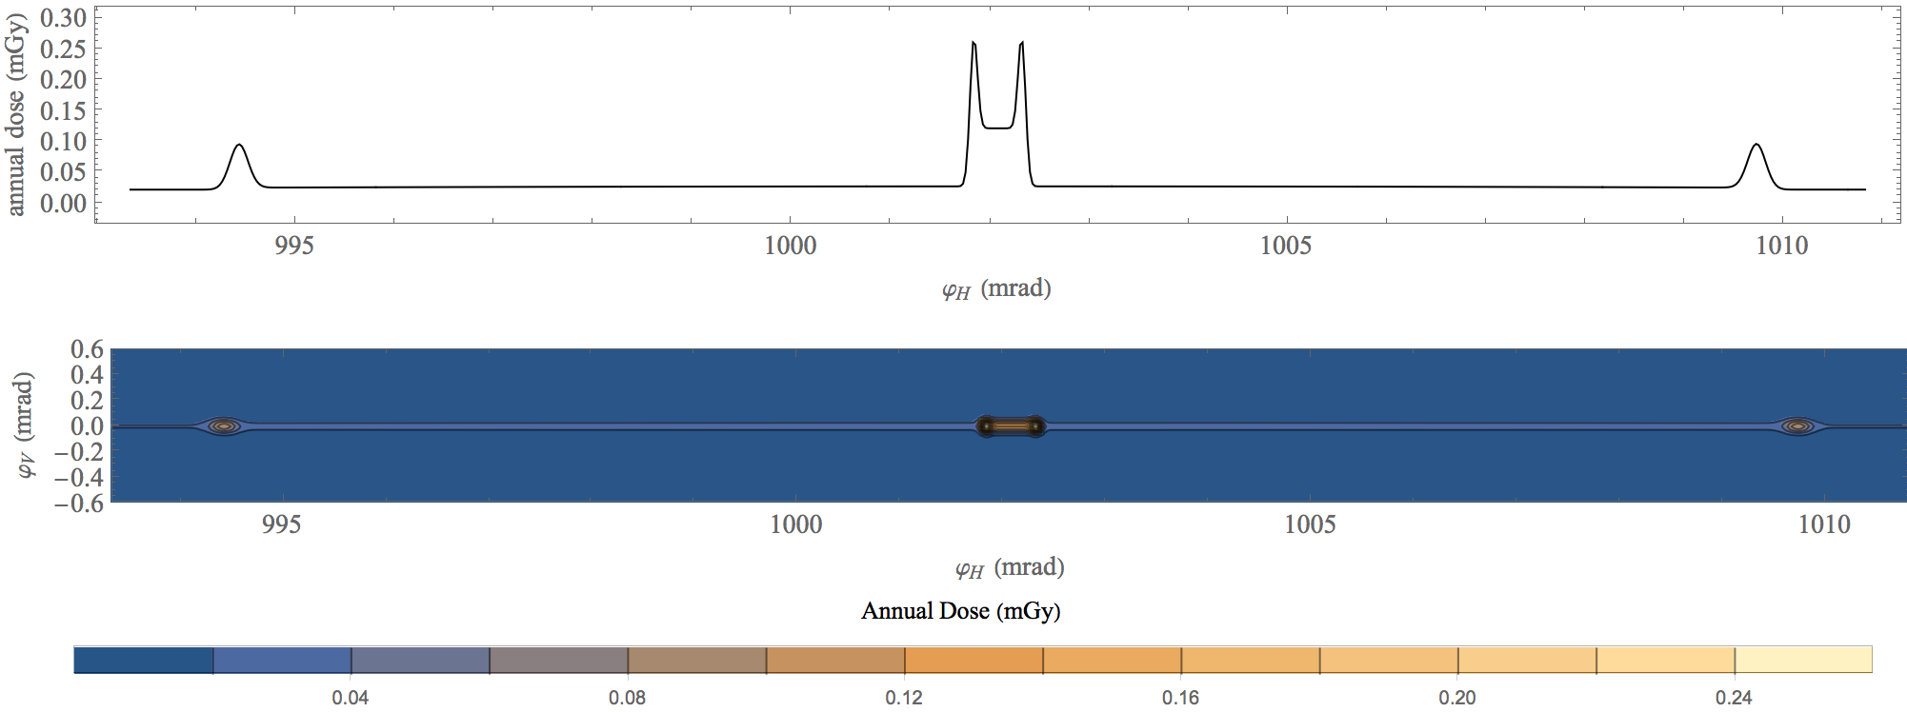
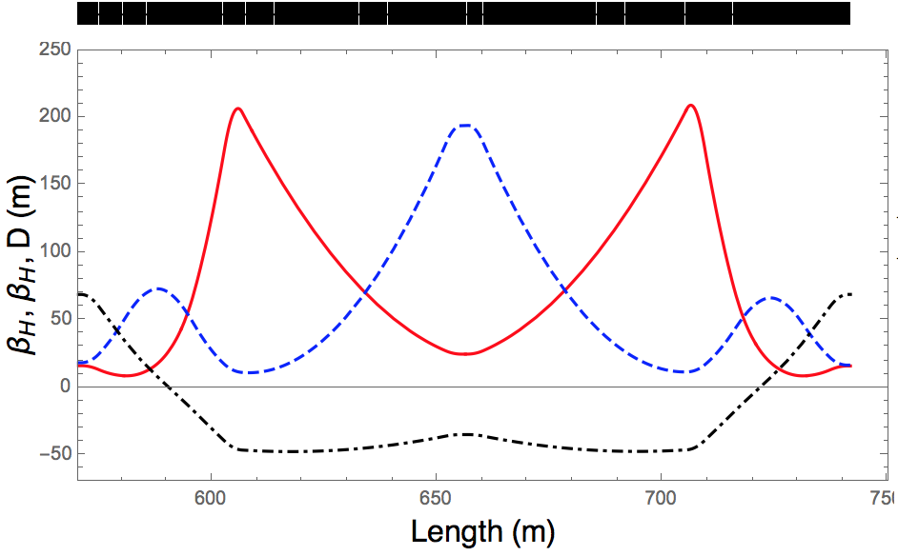
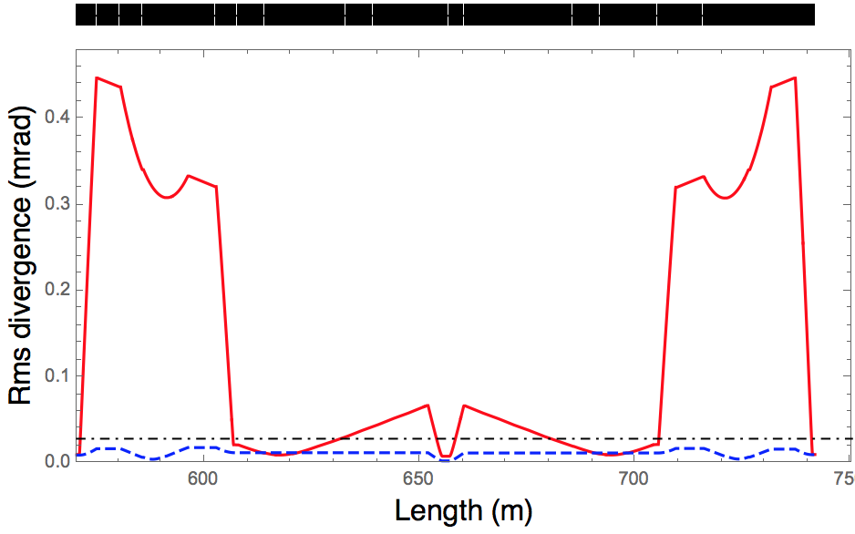
Observations on the MAP 3 TeV c.o.m Proposal
Neutrino radiation around arc cell center
0.30 m drift with
some divergence
X-pole with
2 T dipolar
0.30 m drift with
small divergence
Beam intensity
to be checked

Slide 6
Slide from K. Skoufaris on
further lattice optimizations

Slide 7
Slide from K. Skoufaris on
further lattice optimizations

Slide 8
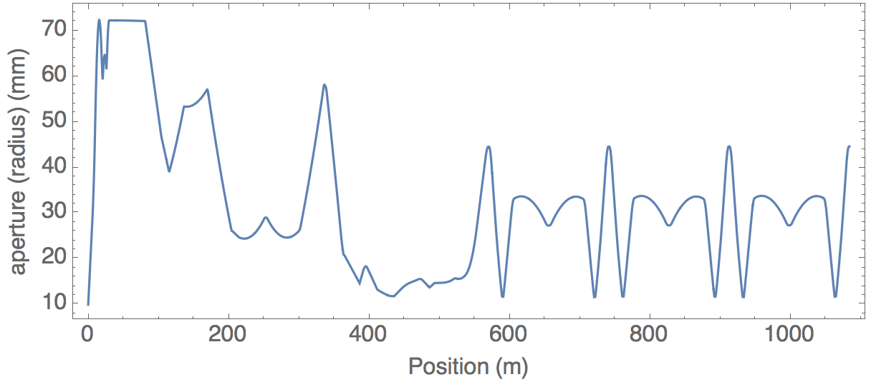
On Magnet Requirements defined for
MAP 3 TeV com Lattice
Following
Y. Alexahin et al 2018 JINST13 P11002
Assumption on required aperture (radius) 5 times
rms beam size plus 10 mm (for vacuum chamber, absorbers ..)
(10 mm for absorbers sufficient?)
Physical rms emittance
Rms relative momentum spread

Slide 9
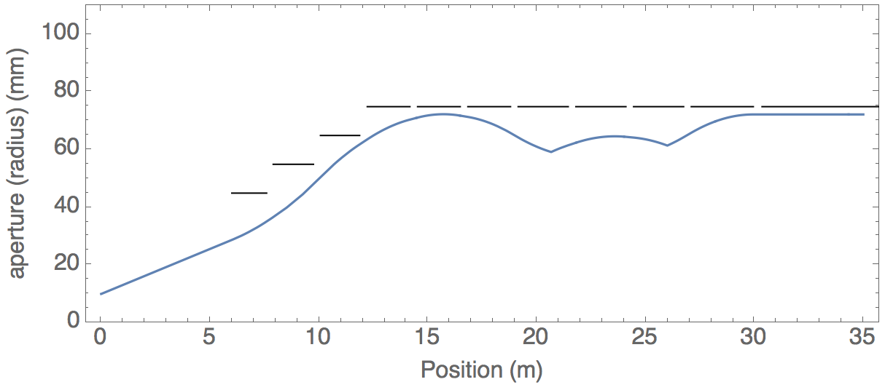
On Magnet Requirements defined for
MAP 3 TeV com Lattice
Around IP
Following
Y. Alexahin et al 2018 JINST13 P11002
Parameter | Q1 | Q1 | Q3 | Q4 | Q5 | Q6 | B1
Aperture (mm) | 90 | 110 | 130 | 150 | 150 | 150 | 150
Gradients (T/m) | 267 | 218 | -154 | -133.5 | 129 | -128 | 0
Field (T) | 0 | 0 | 2.00 | 2.00 | 2.00 | 2.00 | 6.86
Length (m) | 1.60 | 1.85 | 1.8 | 1.96 | 2.30 | 2.85 | 5.90

Slide 10
Remarks
  Minimum distance between magnets (straights with 20 cm or 30 cm in lattice designs)
    Details of magnetic field around magnet ends to be taken into account
  Field quality requirements
    Very large (vertical) βs make machine sensitive, but beam has to survive only ~1000 turns
    Higher order momentum compaction effects with large momentum spread?
  Straight sections for equipment (injection .. possibly no RF)
  Machine tuning with combined function magnets
    Quads, sextupoles .. with dipolar component
    Need to shift working point, adjust chromaticity (chromatic functions) …
    Low β* adjustment? Start with simple optics and gradually (from shot-to-shot) reduce β*?
  Open mid-plane magnets?
  Possible further constraints from neutrino mitigation measures
    Additional vertical aperture for time varying vertical closed orbit
    “Wobbling” (time varying movements of whole machine and thus magnets) of machine

Slide 11
Summary
  Magnet requirements extrapolated from MAP 3 TeV com lattice
    Qualitative description of needs
    Details will depend on energy, technological choices made and collider design made
  High field magnets with large apertures
    Combined functions magnets with large dipolar components
      Independent adjustment of dipolar and other components for tuning?
    Magnetic field around magnet ends an issue (field free regions as short as possible)
    Geometry of combined function magnets (curved magnet such that dipolar field constant?)
    Field quality requirements to be discussed, understood and defined
    Open mid-plane magnets?
    Likely further constraints from neutrino mitigation measures (aperture, “wobbling”)
  Definitive list of required magnets outcome of iterations between different work packages
    Collider design, magnets, MDI, radiation protection (neutrino radiation), magnet protection ..

Slide 12

Thank you
for your attention

