Slide 1




Mitigation studies using movers
H.Mainaud Durand
CERN BE-GM

Slide 2
Outlook
Context and brief look at state of the art
Proposals of studies to undertake / points to check
Summary: key issues + preliminary work programme

Slide 3
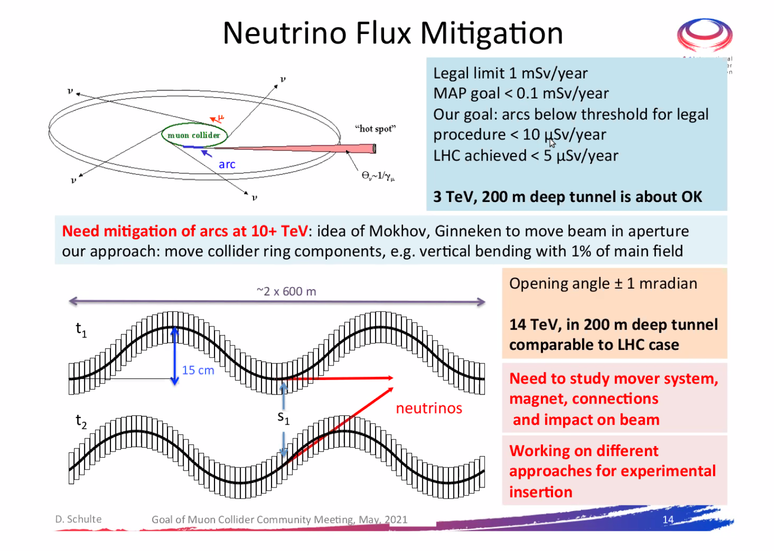
Mitigation studies using movers
Mitigation studies on the so-called neutrino radiation:
  One possibility would be to move the beam line components to change the beam direction (by deforming the beamline in the vertical plane).
  Very low frequency movements of components within 15 cm.

Slide 4
Brief look at the state of the art
From a recent mini-review on girders (DESY, 10-11/05/21):
  State of the art in Synchrotrons (surveyors, mechanical engineers, etc.)
  Not a lot of Synchrotrons using remote adjustment
  Only SLS using remote adjustment on a short range to limit the strength of correctors (with stored beam to verify directly)
  For SLS 2.0, they study different options, including one combining a short-range remote adjustment system (height & pitch stroke: ± 0.5 mm, resolution < 1µm and a long-range manual adjustment system: stroke ± 2.5 mm )
At CERN, we are preparing the Full Remote Alignment System (FRAS) for the remote alignment of LSS components

Slide 5
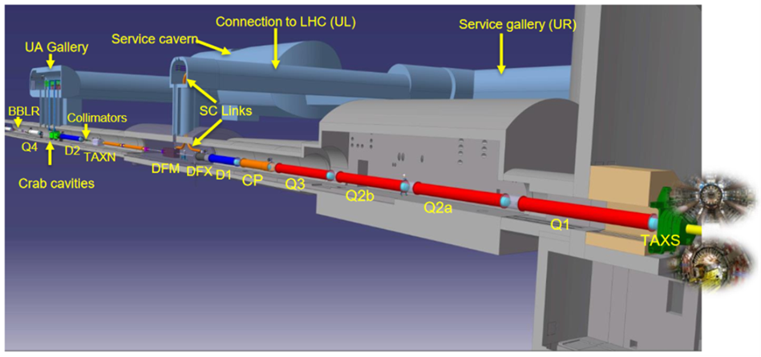
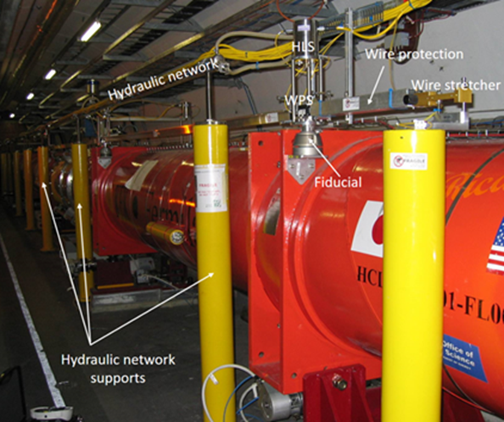
Brief look at the state of the art
Full Remote Alignment System (FRAS): ± 5 mm

Slide 6
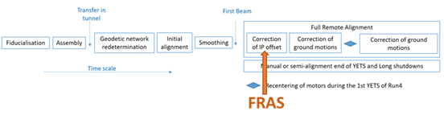
Brief look at the state of the art
One example of operational scenario:
The radial / vertical offset of Inner Tracker w.r.t. machine will be known after the first circulating beams.
Will be performed by steps of maximum 0.5 mm
  Per blocks of components that are linked to preserve interconnections
  Per translation (to preserve the interconnections & bellows): vertical and later radial, and simultaneously inside a block. The adjustment of roll shall not be needed (as corrected during the smoothing process).
  No constraints of time (max. duration = 1 day)
Conditions: all sensors qualified before, using remote diagnostic systems

Slide 7
Studies to undertake / points to check
Study in further details the state of the art concerning adjustment solutions
Have a better understanding of the requirements:
  Range of movers ? Resolution? Accuracy?
  Long-term stability, impact of vibrations?
  Frequency of adjustment?
  Constraints from other equipment like cryo and vacuum (acting forces, flexibility)?
  Weight, size of components?
  Number of components to be remotely displacements?
  In which environment (radiation level, temperature stability, etc.)?
Develop different options to demonstrate feasibility

Slide 8
Studies to undertake / points to check
To perform such a remote adjustment, we will need to know at a corresponding accuracy the position of the components:
  Solutions to determine remotely the position of components to be developed/adapted for a circular collider (they were only developed for a linear collider)
  Standard range of alignment sensors : ± 5 mm (resolution < 1 µm)
  Far larger range needed : 15 cm? For which resolution?
  Development of an affordable solution (cost and space).
Study and develop alignment solutions and associated sensors

Slide 9
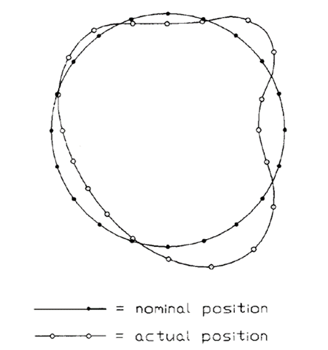
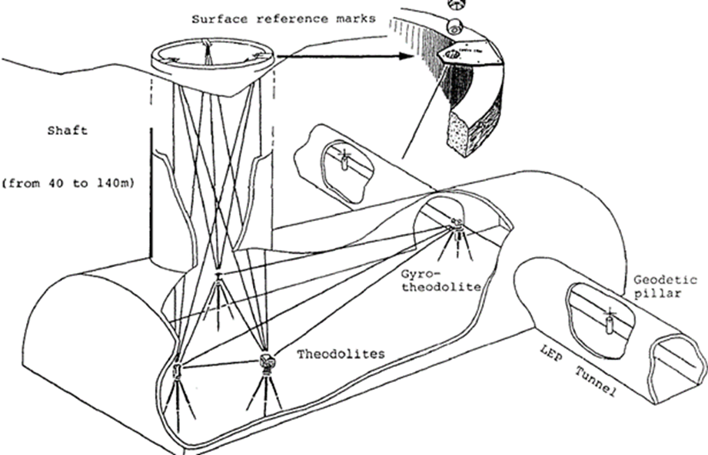
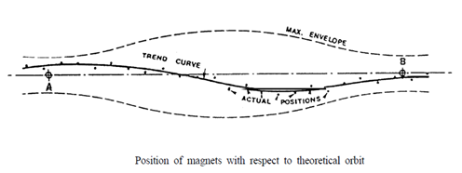
Studies to undertake / points to check
We will need to know the absolute position of the components underground, with respect to the surface, within an accuracy to be studied ➔ important number of geodetic studies and simulations to be undertaken
Any rough idea of such an absolute accuracy?

Slide 10
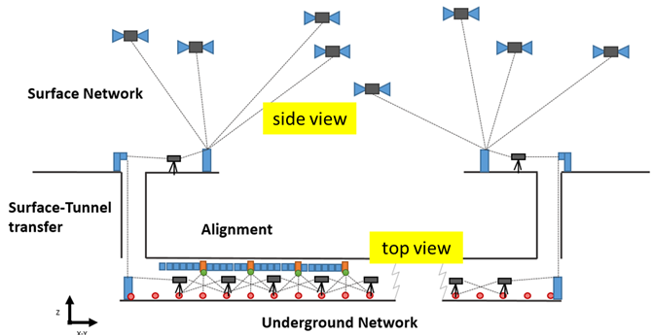
Studies to undertake / points to check
How to know in a continuous way the absolute position underground?
  Geodetic studies to transfer the absolute position underground in a permanent way, within a given accuracy
  Definition of a Geodetic reference network able to cover all the areas concerned by the emerging beams
We will need to develop solutions to store all positions underground and the corresponding location of the impact of neutrinos on the surface.

Slide 11
Studies to undertake / points to check
Development of a safe control system:
  protecting machine (bellows and flanges from vacuum/cryo and the machine integrity)
  preventing safe radiation levels outside the machine
Review of constraints created by/impact on other equipment of these «wobbling» magnets

Slide 12
Summary
3 key issues identified:
  K1. Development of large stroke/high resolution movers to perform safe remote displacements
  K2. Development of remote solutions to control the position of components (for circular collider), adapted to such ranges of displacements.
  K3. Study of the accuracy needed / necessity to develop a solution to determine in a continuous way the absolute position of components underground vs. surface.
+ specific points to address (impact on other equipment, safe control system)

Slide 13
Very preliminary work plan
K1: Development of large stroke/high resolution movers
  Study of SOTA / establishment of requirements (tech. Student) [ASAP]
  Study of different options, concepts, up to the engineering (PhD student) [2022-2024]
  Qualification of prototypes (tech student) [2025]
K2: Development of remote solutions to control the position of components
  Study of solutions + concepts of alignment sensors (PhD student) [2022-2024]
  Development of first options / solutions / qualification of prototypes (fellow) [2024-2026]
K3: Accuracy of absolute position needed (underground vs surface)
  Some synergies with Geodetic studies undertaken for FCC
  Adapt them to the specific case of muon collider: simulations (Post-doc) or development of specific methods (PhD student)

Slide 14
Thank you
for attention

