Slide 1




A Superconducting Detector Magnet for the Muon Collider
M. Mentink, A. Dudarev, and B. Cure, CERN
20/5/21

Slide 2
Introduction
First look at a Muon Collider detector magnet design: Properties, stray field, conductor, stability, mechanics, quench protection
Cost estimate
Challenges: Technical, organizational, conductor availability
HTS-based R&D

Slide 3
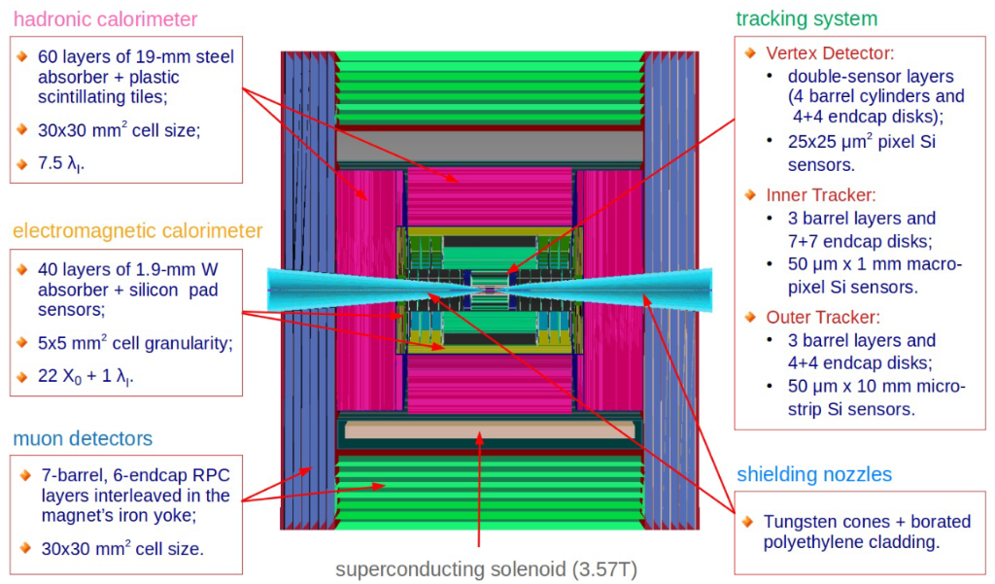
CLIC-like Solenoid Concept without Return Yoke
Property | Value
Magnetic field at IP [T] | 3.6
Cold mass length [m] | 7.89
Free bore diameter [m] | 6.85
Field and layout, [2]
Proposed Muon Collider layout [1]
Following [1], here considered: CLIC-like Superconducting Solenoid [2], with 3.6 T at the interaction point

Slide 4
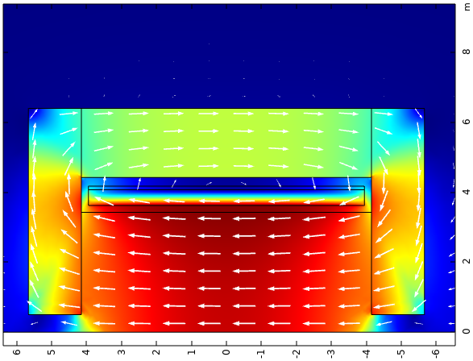

Magnet Properties
Property | Value
Operating current [kA] | 19.5
Stored magnetic energy [GJ] | 1.8
Inductance [H] | 9.4
Cold mass volume [m³] | 53
Cold mass weight [t] | 155
Energy density [kJ/kg] | 11.6
Windings (layers x turns-per-layer) | 4 x 320
Conductor length [km] | 36
B [T]
Radial position [m]
Axial position [m]
3.6 T at IP and with return yoke → 1.8 GJ stored magnetic energy
For reference, Compact Muon Solenoid has stored energy of 2.6 GJ

Slide 5
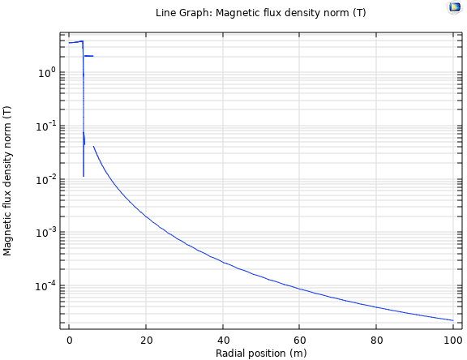
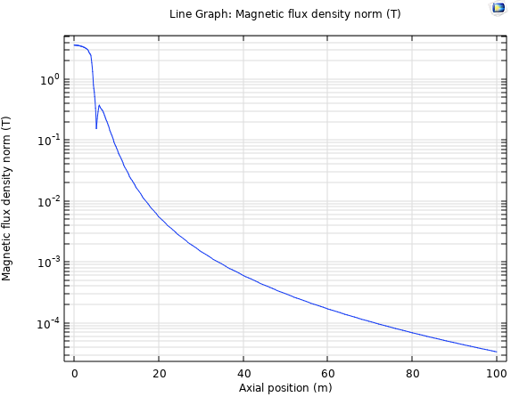
Magnetic Stray Field
Radial
Axial

Slide 6
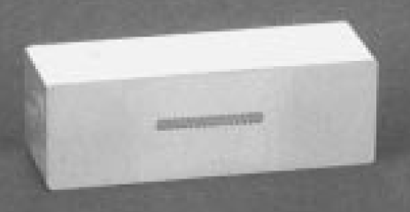
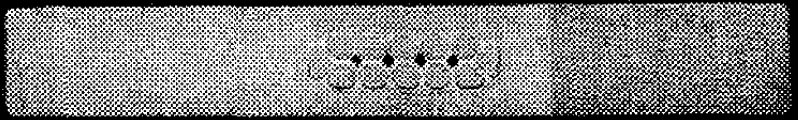
Conductor Considerations (1/2)
CMS conductor
CMS design philosophy: The conductor and mandrel support the Lorentz forces together
Aluminium-based conductor is cost-effective and gives favourable mechanical, electrical, and thermal properties
Nb-Ti: Affordable and robust work-horse superconductor
Two “Standard” options for combining good electrical, thermal, and mechanical properties
  CMS-like conductor [3]: Pure aluminium conductor with welded-on aluminium-alloy reinforcements
  ATLAS CS-like conductor [4]: Nickel-doped aluminium
An important consideration is manufacturing availability (more on this later)
Al-alloy reinforcement
(E-beam welded)
Pure aluminium
Rutherford cable comprising Nb-Ti/Cu strands
ATLAS CS conductor
Nickel-doped aluminium

Slide 7
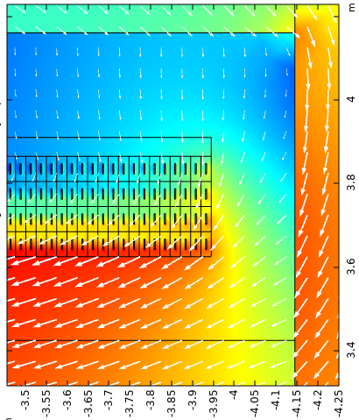
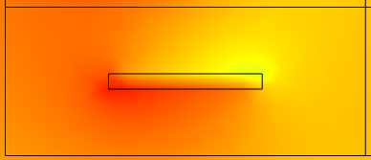
Conductor Considerations (2/2)
0.5 mm insulation surrounding the conductor
Envelope for vacuum vessel, cold mass insertion, and coil suspension
Composition | Vol. Fraction
Either (1) Nicked-doped aluminum or (2) pure aluminum + aluminum alloy | 90%
Copper | 2.2%
Nb-Ti | 2.2%
Insulation | 5.6%
Rutherford cable:
32 x 1.6 mm Ø
Cu/Nb-Ti strand
Aluminium mandrel
60 mm, with insulation
Radial position [m]
B_{Max} = 4.1 T
Volumetric density: 2860 kg/m³
Operating current: 19.5 kA → Current density: 13.2 A/mm²
25 mm, with insulation
Axial position [m]
Proposed conductor
Field map with peak field

Slide 8
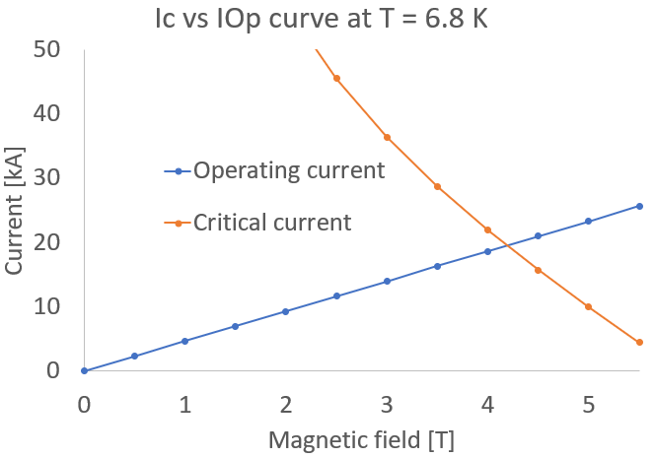
Conductor Stability
Peak field on the conductor at nominal current (19.5 kA) = 4.1 T
With: 32 x 1.6 mm Nb-Ti/Cu strands (50% Cu): Current sharing temperature = 6.8 K
Operating temperature: 4.5 K
Margin: 2.3 K → OK
The magnet is thus compatible with ‘standard’ aluminium-stabilized Rutherford cable technology
19.5 kA, 4.1 T

Slide 9
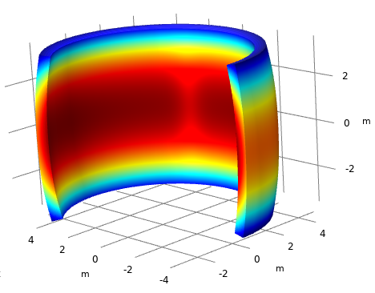
Mechanics
The energy density (= Stored magnet energy / cold mass) = 11.6 kJ/kg (same as CMS)
At nominal current: 94 MPa maximum von Mises stress, and 0.13% tensile strain (not considering bending strain)
All looks reasonable
Peak Von Mises stress:
94 MPa
Peak tensile strain:
0.13%
Simulation: Stress and strain at nominal current

Slide 10
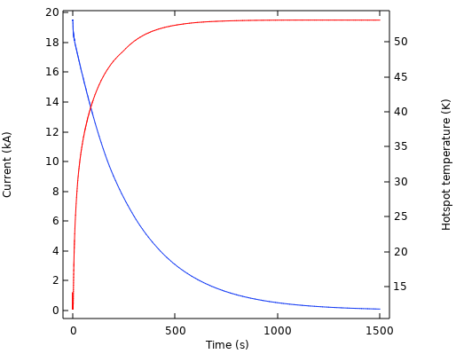
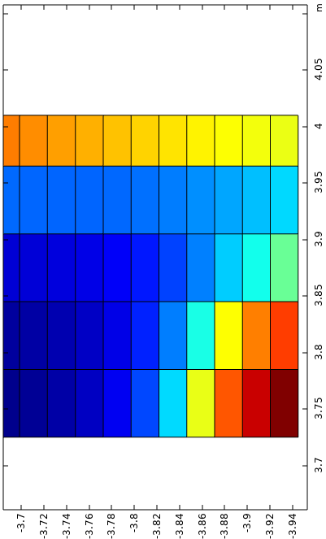

Quench Protection
t = 4 s
Quench-back from mandrel
T [K]
TMax →
Quench propagation
Radial position [m]
Assumed aluminium RRR = 500 (conservative)
← IOp
Hotspot origin at edge of magnet
(= worst-case)
Axial position [m]
FEM-based quench simulation:
Temperature development during quench
Simulation: Magnet protected with energy extraction
Quench protection choices: Energy extraction, quench heaters, or combination
Here considered: Energy extraction after 2 s, with 0.03 mΩ dump resistor (like CMS)
Gives hotspot temperature of 53 K with correct quench protection, and 149 K for complete absence of quench protection (= failure scenario)

Slide 11
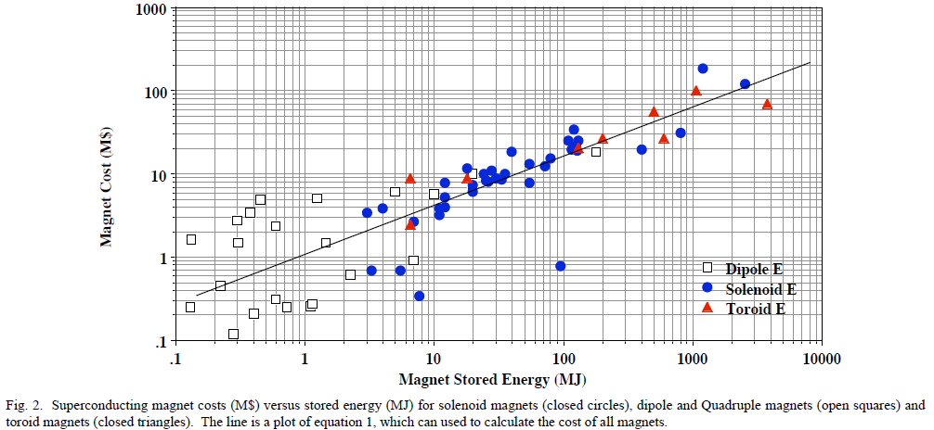
Cost Estimate
Stored magnet energy: 1.8 GJ
First-order cost estimate based on historical trends [5]: ~80-100 MCHF (2008, not corrected for inflation)

Slide 12
Challenges for the Future
Technical challenge: The solenoid properties are similar to those of the Compact Muon Solenoid, so there is a recipe to be followed
Organizational challenges (Based on ATLAS and CMS magnet development)
  There is a 8 – 10 year period between finalization of the design and commissioning of the magnet → Superconducting detector magnets have to be planned on a time-scale of 15-20 years
  Superconducting detector magnets of this scale are developed with strong support of multiple institutes, and tens of people will be working on it for a period of many years → High-level coordination is a must
  Associated cost is on the order of 80-100 MCHF (first estimate)
  One-of-a-kind magnet that must work without problems, so technology demonstrators are needed to check aspects of the design before the design is finalized
Conductor challenge: Unlike some tens of years ago, presently qualified suppliers of aluminium-stabilized conductors are hard to come by

Slide 13
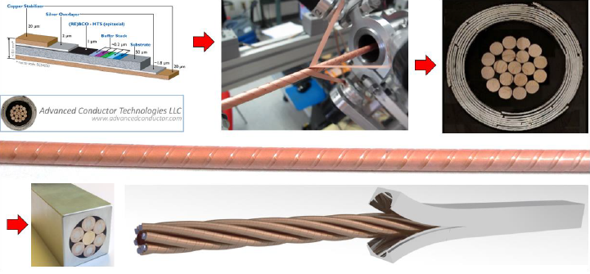
High-Temperature-Superconductor R&D
The Nb-Ti superconductor, a low-temperature-superconductor (LTS), is affordable and robust, but requires a low operating temperature (4.5 K)
High-temperature-superconductors (ReBCO / BSCCO) are (currently) more expensive than Nb-Ti in terms of upfront cost, but allow operation at elevated temperatures (30-40 K), for significant cryogenics cost savings
Therefore: HTS-based superconducting detector magnet conductor research in anticipation of the future (for example: CORC-CIC in recent years), for coils and for busbars
Example of HTS-based conductor:
CORC-CIC conductor

Slide 14
Summary
  A first look at the superconducting detector solenoid for the Muon Collider
    Similar to Compact Muon Solenoid, so there is a recipe to follow
    Conductor matrix options: Nickel-doped aluminium or pure aluminium + aluminium-alloy reinforcements
    No major showstoppers identified in terms of quench protection and mechanics
  Organizational challenges:
    Superconducting detector magnet of this size requires a long-term (15-20 years) schedule and support from multiple institutes
    This magnet will not be cheap, even though detector magnets are designed to be as affordable as possible
    Demonstrators are needed to check various aspects of the design before a design can be finalized
  Conductor challenge: Currently, no qualified suppliers of aluminium-stabilized conductors in industry
  Consideration of HTS-based detector magnets for potential future cost savings

Slide 15
References
[1]. D. Lucchesi et al., 1st Muon Community Meeting, (2021).
[2]. A. Gaddi et al., International Workshop on Future Linear Colliders, (2012).
[3]. B. Blau et al., IEEE Trans. on Appl. Supercond. 12, p. 345 (2002).
[4]. A. Yamamoto et al., IEEE Trans. on Appl. Supercond. 9, p. 852 (1999)
[5]. M. A. Green et al., IEEE Trans. on Appl. Supercond. 18, (2008).

Slide 16
Thank you
for attention

