Slide 1
Quality processes for mechanical design
30.04.2021 / Coordination of FCC Technology R&D programmes.
Diego Perini EN-MME
Procedures. Norms for computations, design and drafting

Slide 2
Table of content
30.04.2021 / Coordination of FCC Technology R&D programmes
Diego Perini EN-MME
International Norms
Quality Manual
  For a service
  For a project
Multi-CAD environment
CAD tools
  Life and aging
  Collaborations with different CADs
Conclusions

Slide 3
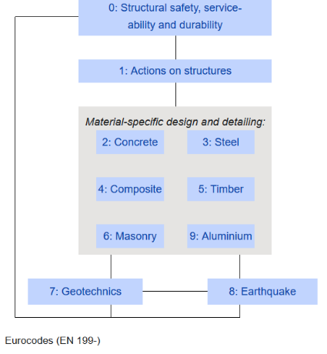
Use of international norms
Standard engineering processes are normalised
Euronorms and ISO norms are widely used by industries in member states and elsewhere. EN and ISO aim to have a consistent (complementary) system.
Other system are used (ASME in USA, JIS in Japan) but the spirit behind is not very different. At the beginning of a project it is enough to define which norm (or part of norm) is applied to each part of the job.
Some examples of important norms for design:
ISO Geometrical Product Specification (GPS). Definition of surface characteristics and tolerances.
Eurocode 3 with definition of safety factors and load cases,
More specific ones like pressure vessels, cryogenic vessels, raw material properties and delivery, etc.
Structure of the Eurocode 3

Slide 4

Use of a Quality Manual
General for a service, and specific for a given project
QM based on EN 9001.
Design and computations activities in EN-MME are covered by a QM (about 40 pages). This is an EN-MME specific document.
This MME QM can be extended, to include specific requirements for FCC project (for example the standardization of components).
Define a FCC design and computation QM to harmonize the tools, file naming and storage, specific procedures, etc. Can be a relatively short document with description of the important specific points and references to the main standards for all the rest.

Slide 5
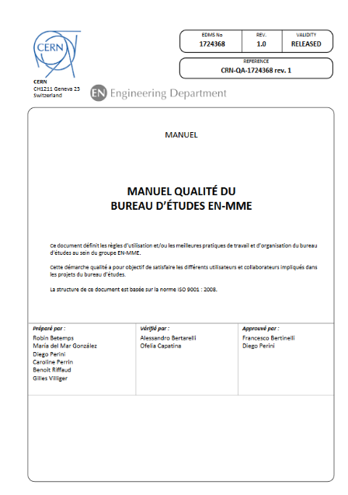
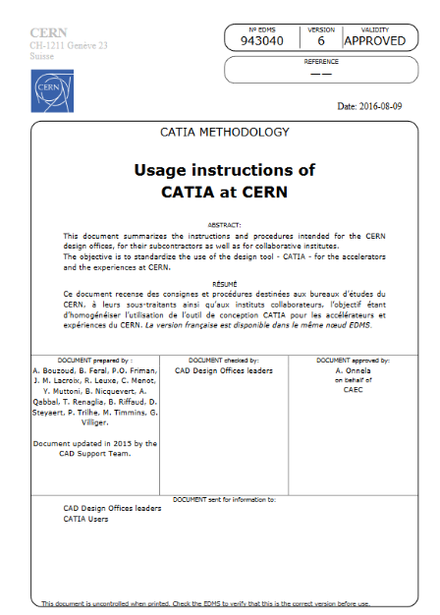
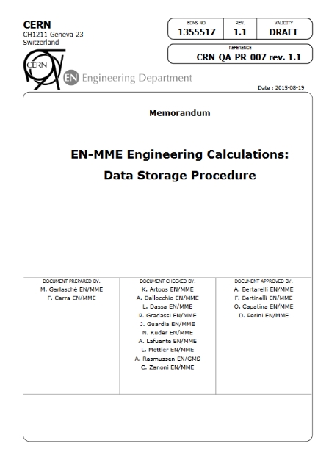
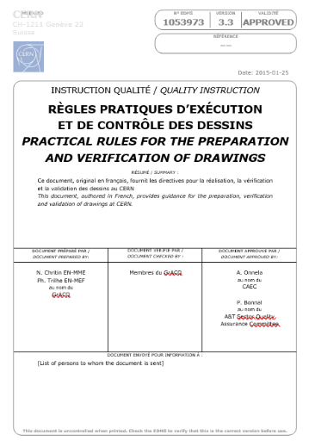
Quality manual: a clear set of documents to manage design and computation techniques.
Unified methodology and procedures

Slide 6
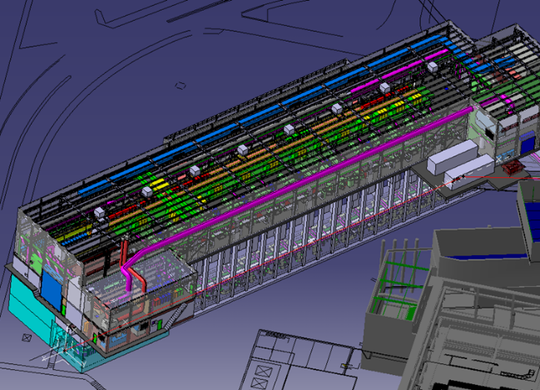
Multi-CAD environment of a large project
Not easy but it is the only possible way
Civil engineering – with its specific CAD (Revit, Autodesk products).
Mechanical engineering – with its specific CAD (Catia V5).
Integration – same CAD as mechanical engineering + some dedicated tools.
Robot assisted maintenance – with specific CAD (Inventor).
CAD models are used as well to generate FEM models for computations. CAD and FEM tools are more and more interconnected and integrated.
A typical integration 3D model

Slide 7
CAD and PDM / PLM tools – part 1
A CAD tool is used to produce 3D models, 2D drawings and 3D simplified models for FEM computations.
    The tendency is to go toward a 3D model federating all the information concerning shape, tolerances, fabrication procedures, controls, use, etc. 2D paper drawings will disappear (in some firms it is already the case).
A single designer working alone on his own computer can manage the CAD files as he prefers. For more designers working simultaneously on the same project, the CAD tool needs a PDM / PLM tool to manage the access rights, save the versions, assure traceability, etc. In a few words the PDM / PLM manages the life cycle of the designed element.
    Some firms sell the ‘couple of tools’ some others only one of the two. Some mixing of products is possible. On the market, different users have chosen different ways (the miracle solution seems not to exist).

Slide 8
CAD and PDM / PLM tools – part 2
Different CAD tools communicate only partially. This is the policy of the vendors.
    One can edit only native files using the same CAD and in same cases, the same version.
    CAD files can be exchanged using DXF or STP format. A DXF or STP file can not be edited. No modifications possible.
This has two consequences.
For design ‘in common’, design carried out simultaneously on the same model by different designers in different institutes, it is not economically reasonable to work with different CADs.
For well defined deliverables, the CAD barrier is not necessarily a draw back. It defines clear areas of responsibilities for each collaborator. One can not touch the part of the others, he must ask them to do.

Slide 9
CAD and PDM / PLM tools – part 3
Ideal condition would be to have an official CAD tool used by all the members of a collaboration.
But before joining a collaboration, the institutes have already their quality system, informatic tools, etc.
Define clear areas of competence. The deliverable is made of assets, but it includes as well STP or DXF “as built” drawings. Clear contract from the beginning and constant exchange of information during the design to keep interfaces in order. This configuration concerns more the big members of the collaboration.
For ‘design together (ping pong of files to modify)’ agree at the beginning of the collaboration a common working tool. This configuration concerns more small members. The cost of a few licences is negligible compared to the cost of manpower to re-make drawings (plus the risk of introducing mistakes). Open-source CAD?

Slide 10
CAD and PDM / PLM tools – part 4
A CAD tool has a life of 15-20 years (with different versions, one every 1-2 years). The presence on the market of a given product is a vendor decision. We can not influence it.
In this moment at CERN:
we are changing the PDM / PLM since the old one is discontinued by the producer (no more support of the old product)
We will use Catia V5 till 2025-26 and then we will need to change to a new CAD.

Slide 11
CAD and PDM / PLM tools – part 5
In a long – life project one can expect a change of tools along the way.
  Be prepared from the beginning of the project. Define the life cycle of the CAD files (in work, approved, obsolete, etc.)
  Have a CAD file storage system in order, so the transfer to different data bases can be automatized.
  Avoid the attitude: “I will put it in order when I have time. In any case we are just at the beginning.” After a while there will be an enormous number of files and a lot to be done ‘by hand’.
  The moment of change must be chosen to minimize the lost time. Arriving to a not supported old product is a risk. In case of problems, there is no help from the producer/vendor. Difficulties to find designers on the market who can or want to use the ‘old tool’.
Open source CAD? Things are moving. We are starting to test a product that looks promising. https://www.freecadweb.org/

Slide 12
Conclusions
Importance of extensive use of international standards and norms.
Importance of a quality manual for computations and design.
Importance of CAD and PDM / PLM systems flexible (multi-CAD) and in order (changes of tools).
Importance of agreeing all this from the beginning.

Slide 13
Thank you for your attention.
13

