Slide 1
Guidelines for survey
Jean-Frederic FUCHS (GM-ASG)
30.04.2021

Slide 2
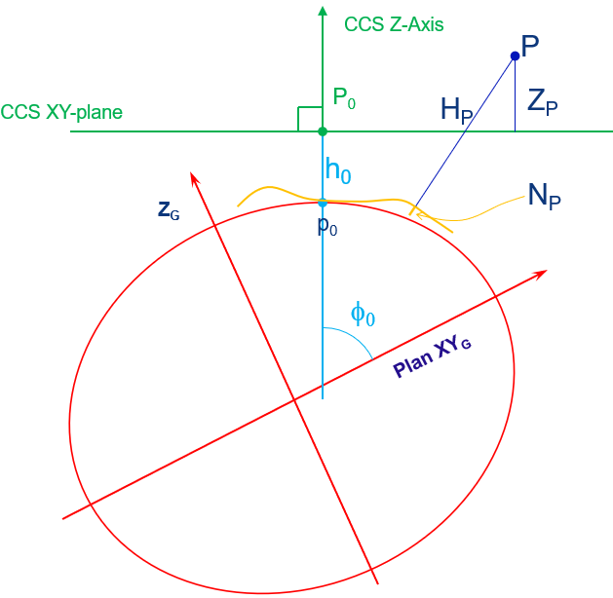
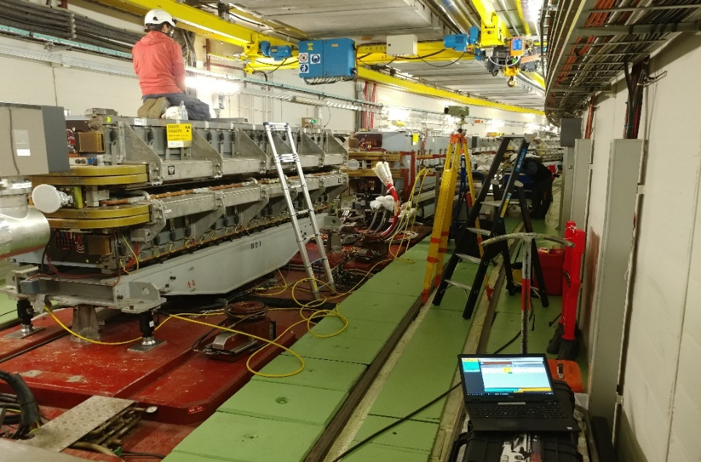
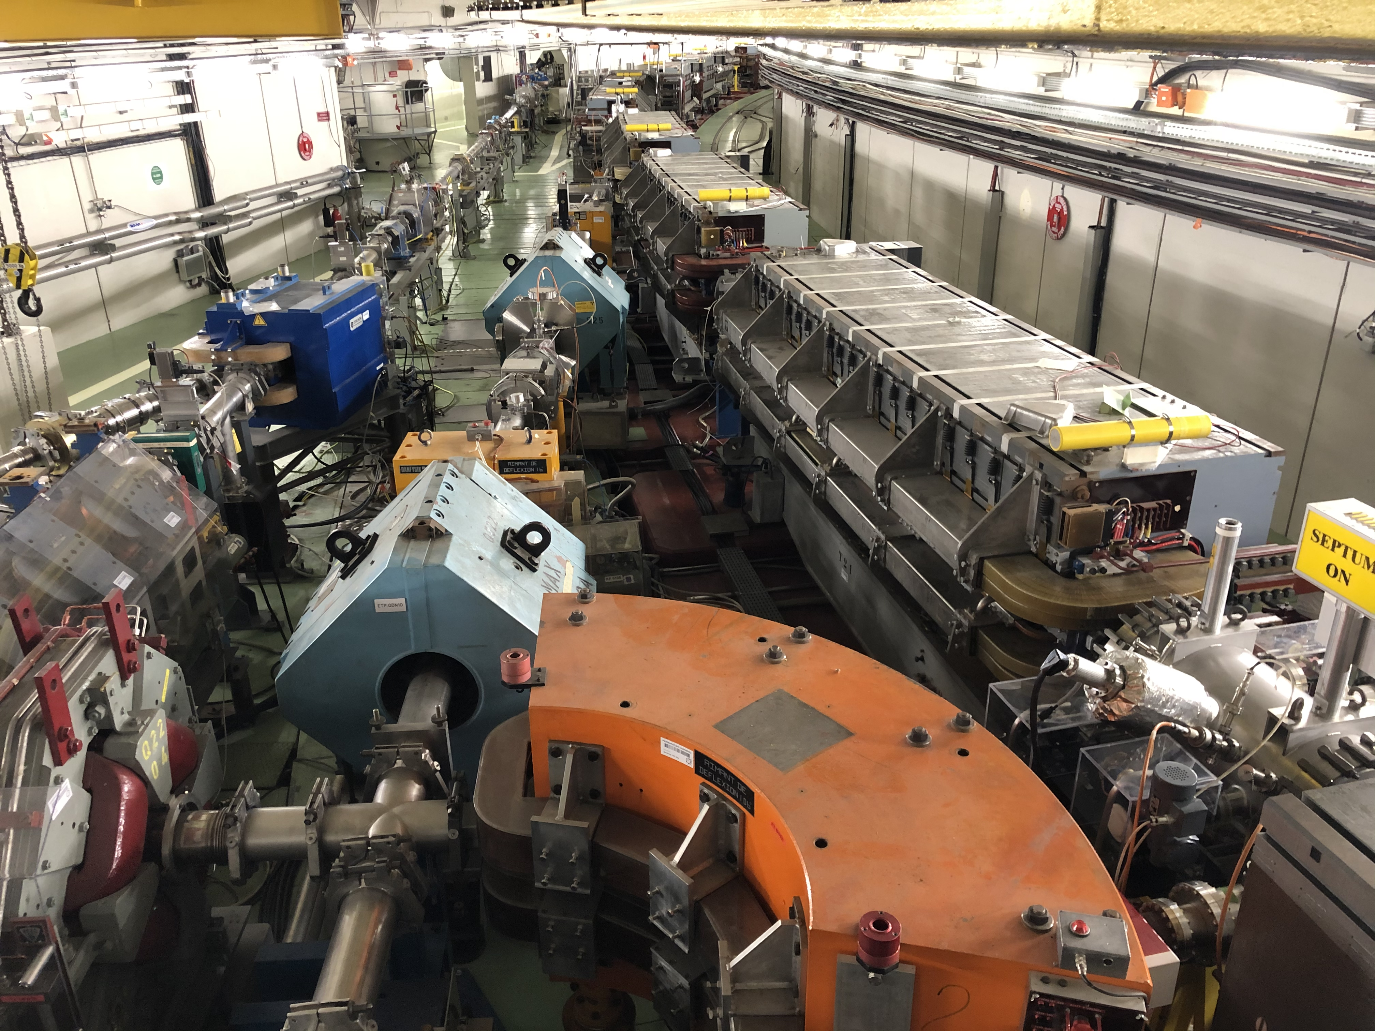
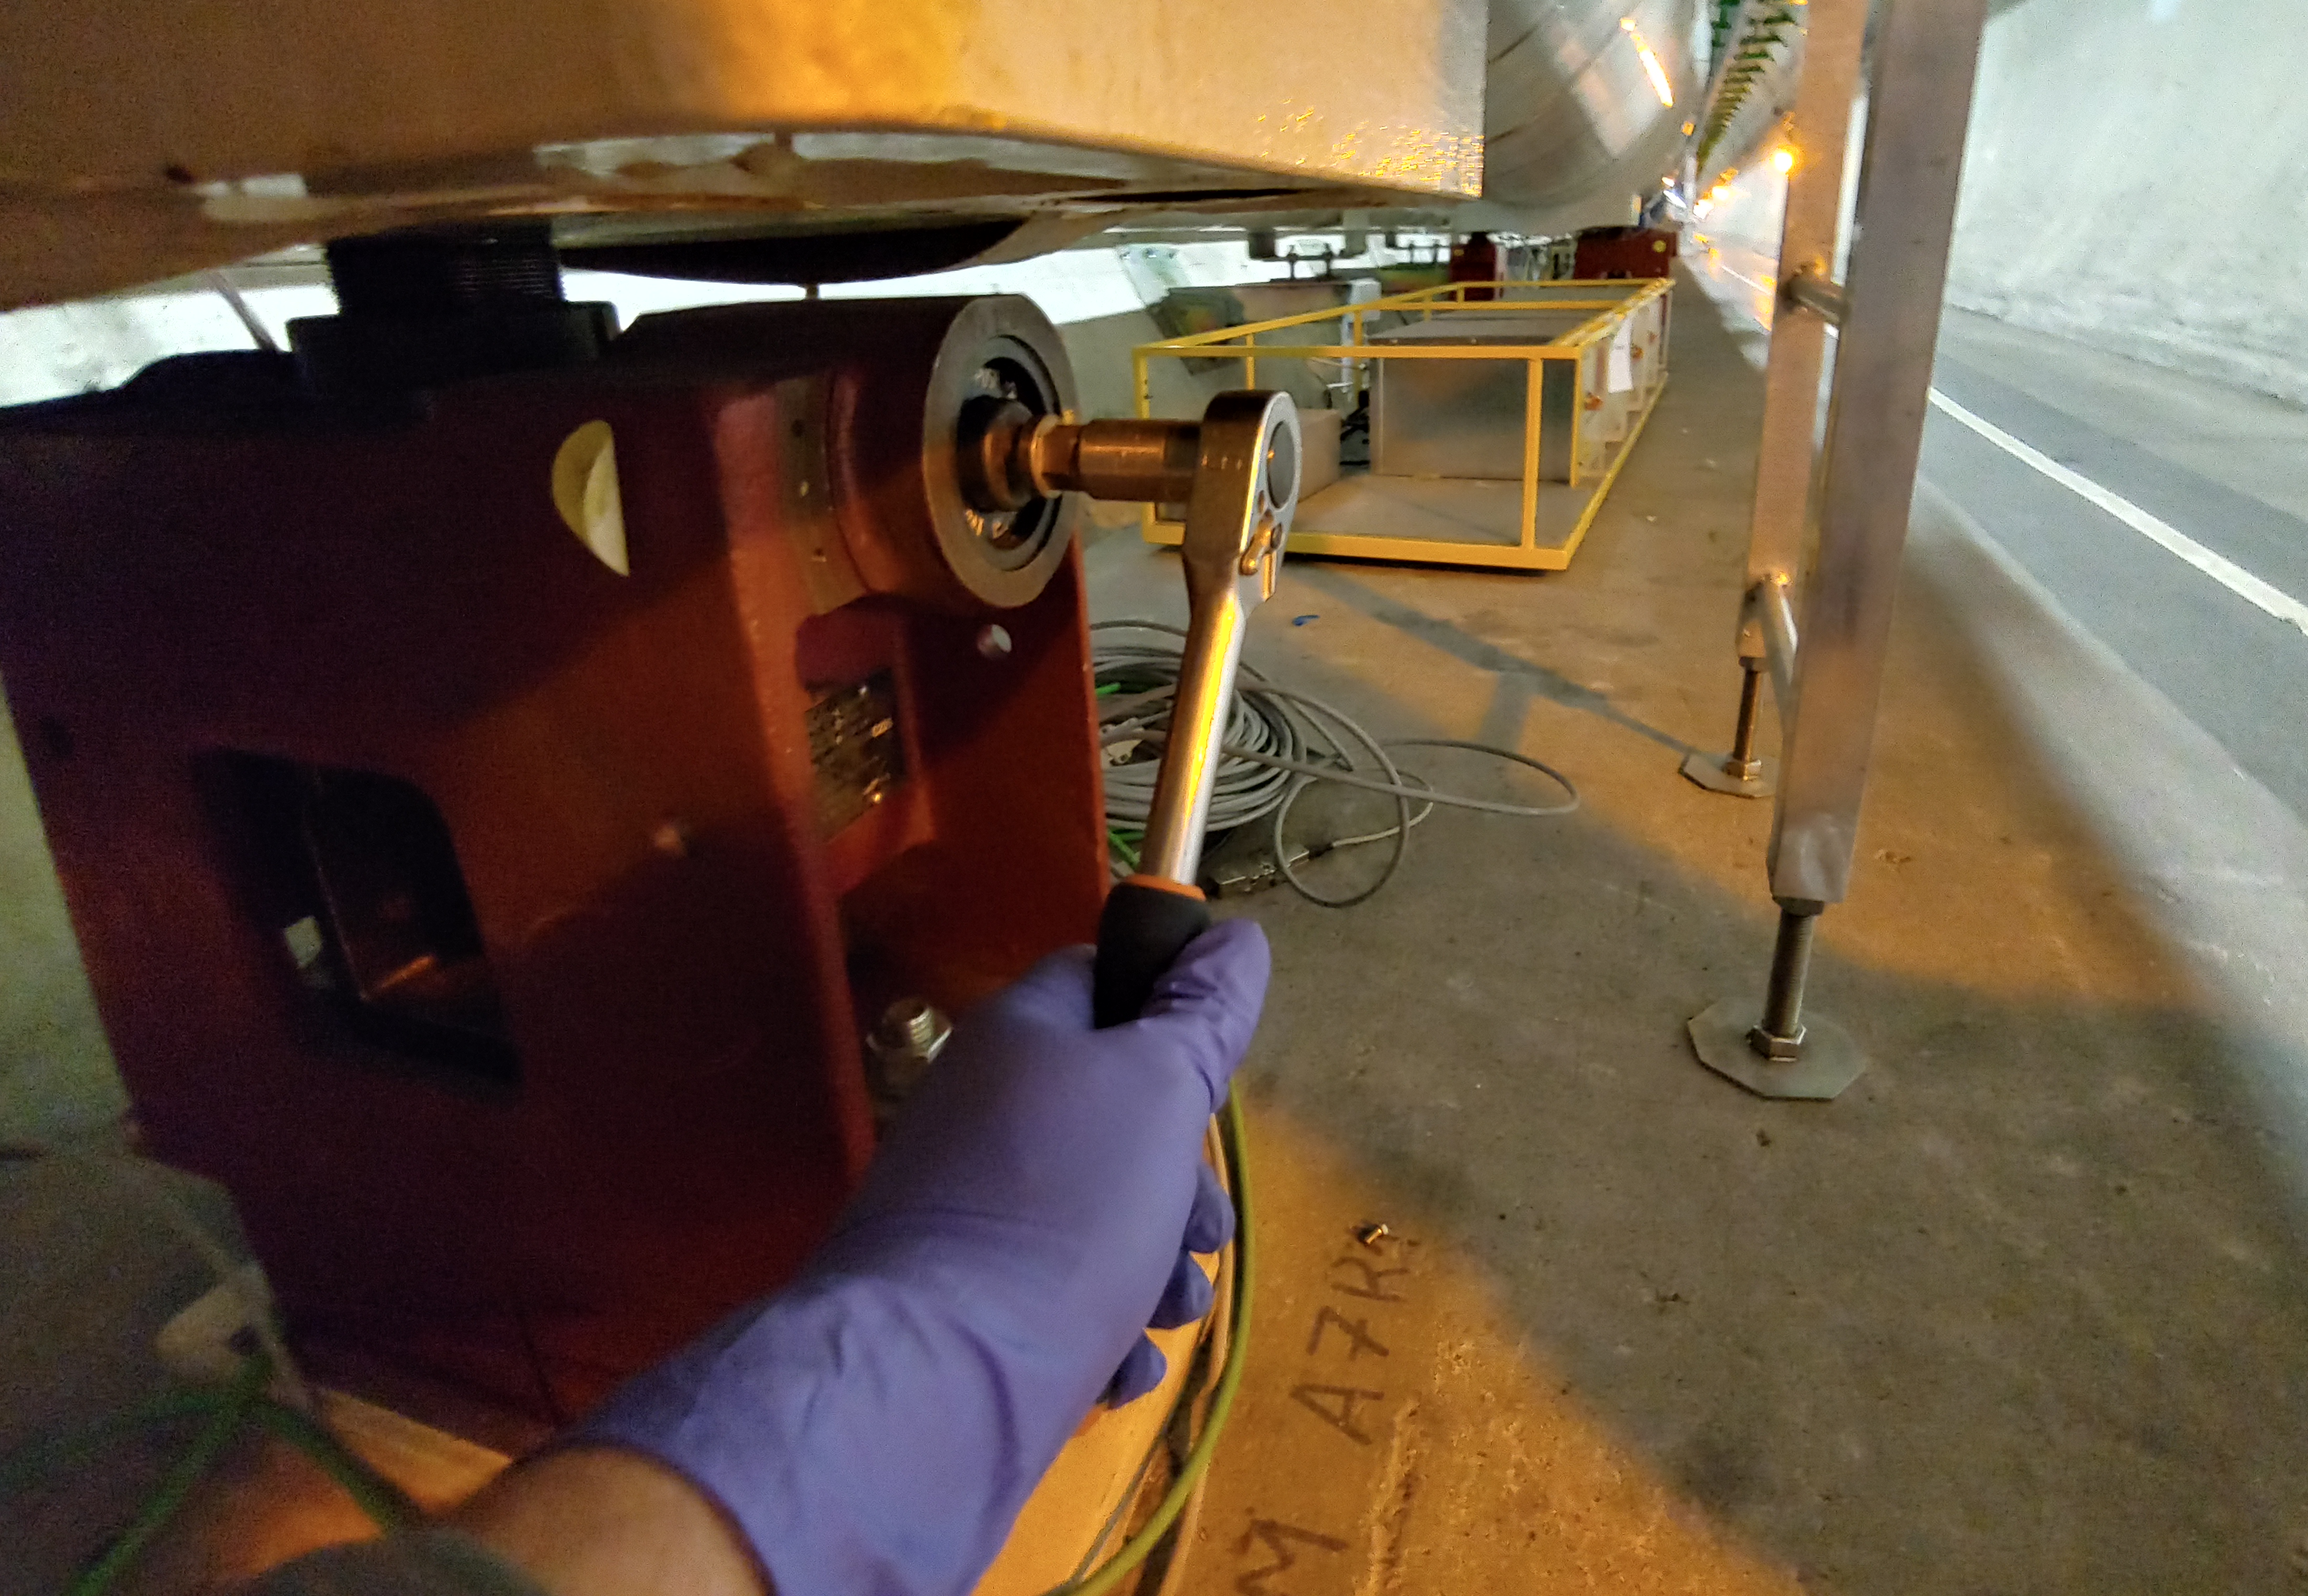
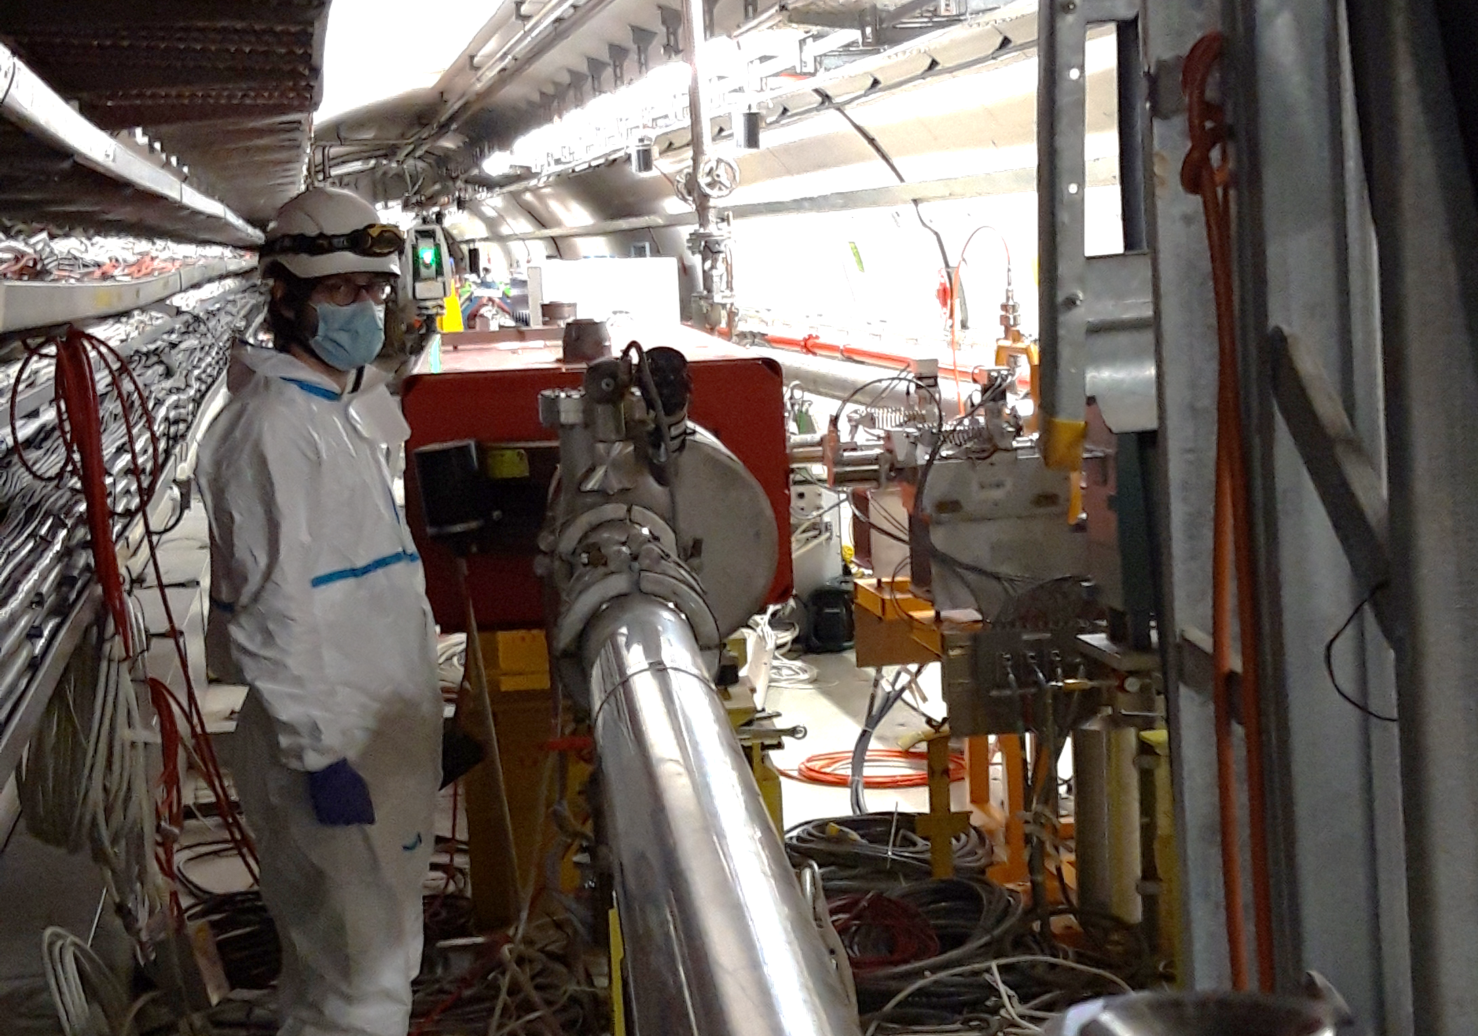
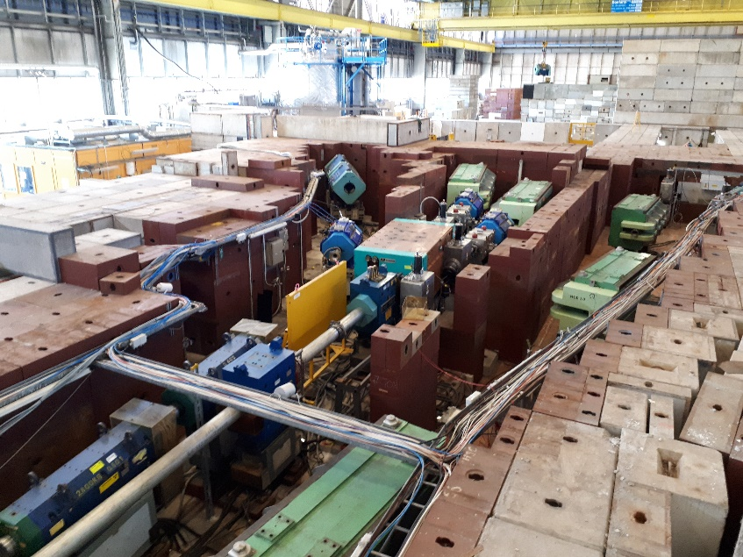
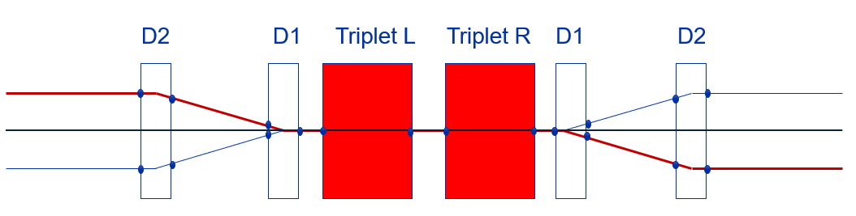
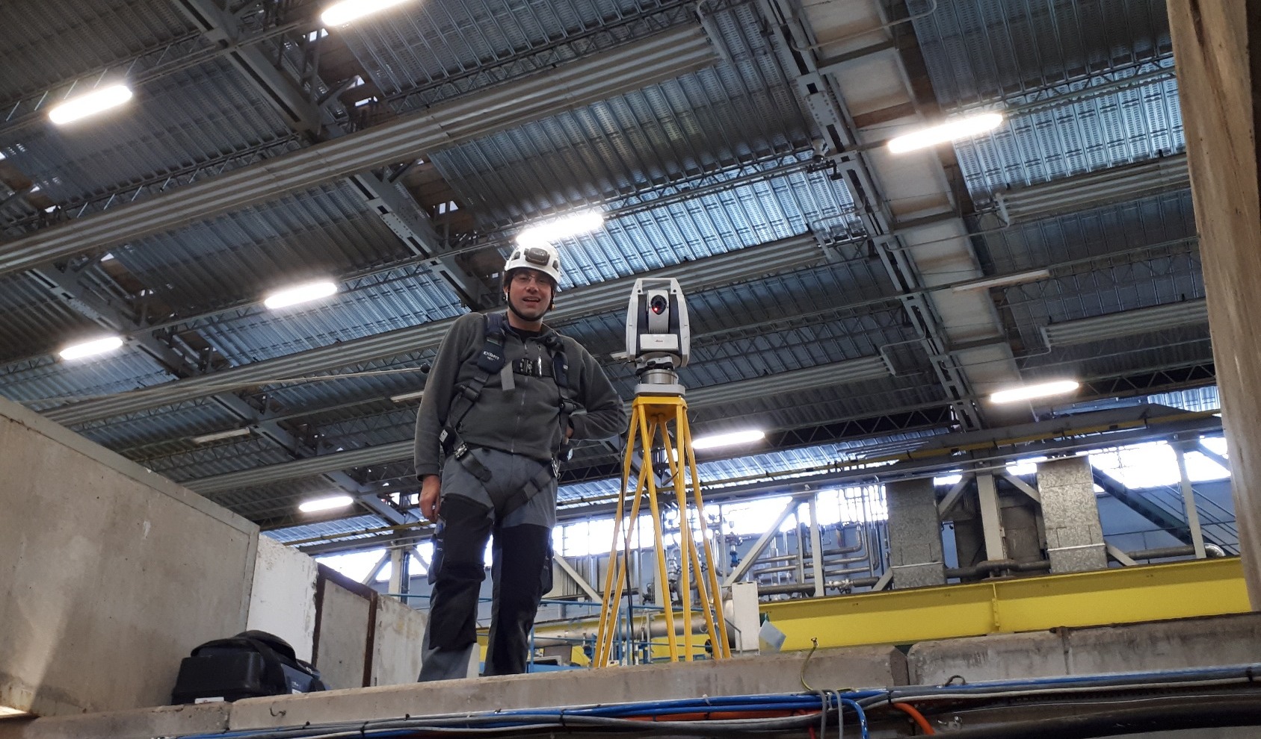
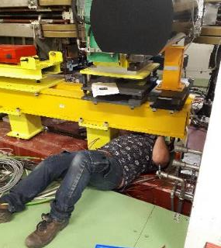


Network, Measurements, Alignment, ……
Input - Fidu
Drawings
BDL, MADX
Marking
on the floor
Pre-alignment
@atm. pressure
Smoothing
under vacuum
Voluntary
displacements
Studies
Design
Safety, VIC, WdP, …
Contractors
Network installation &
measurement

Slide 3
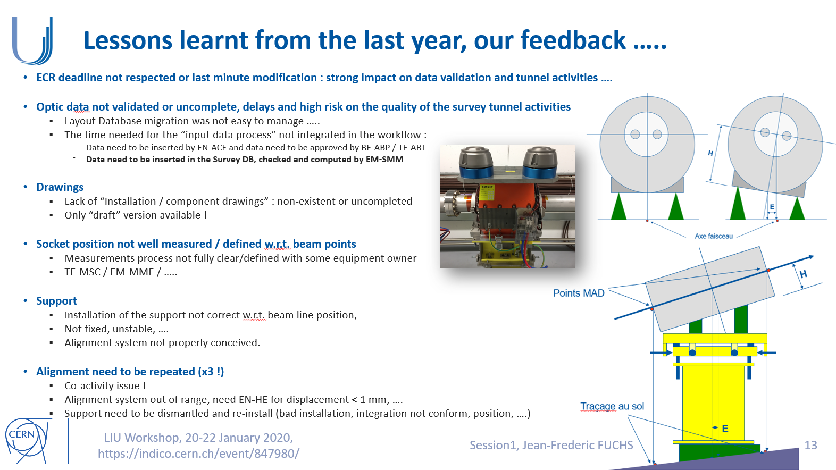
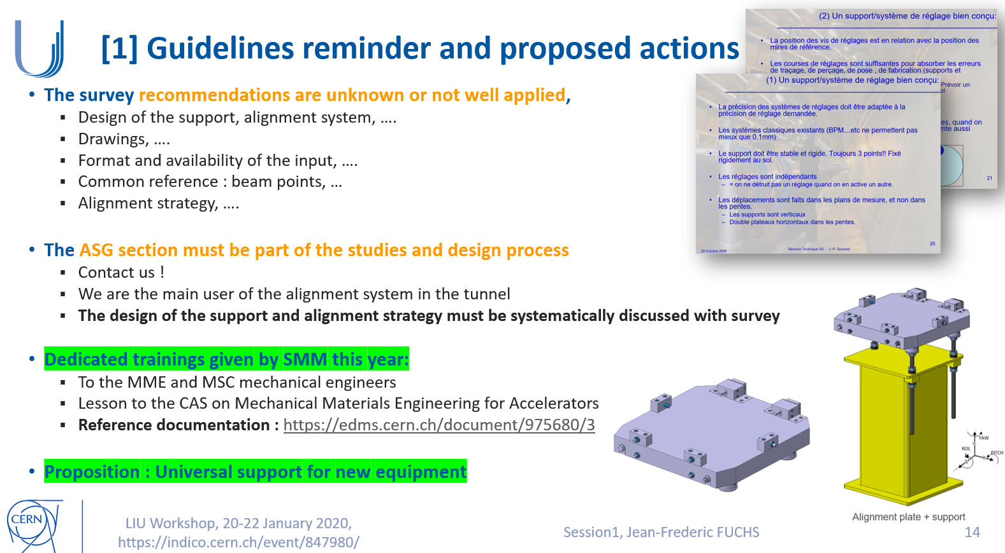
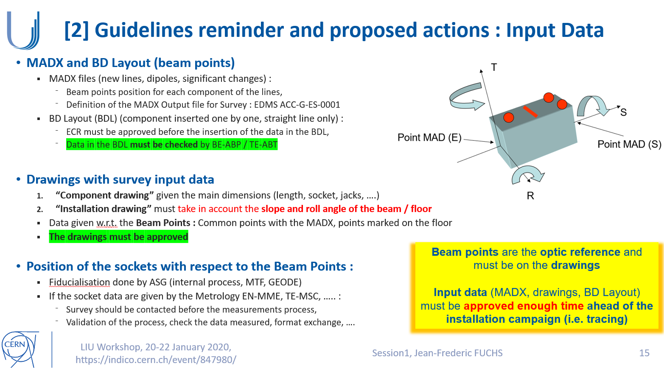
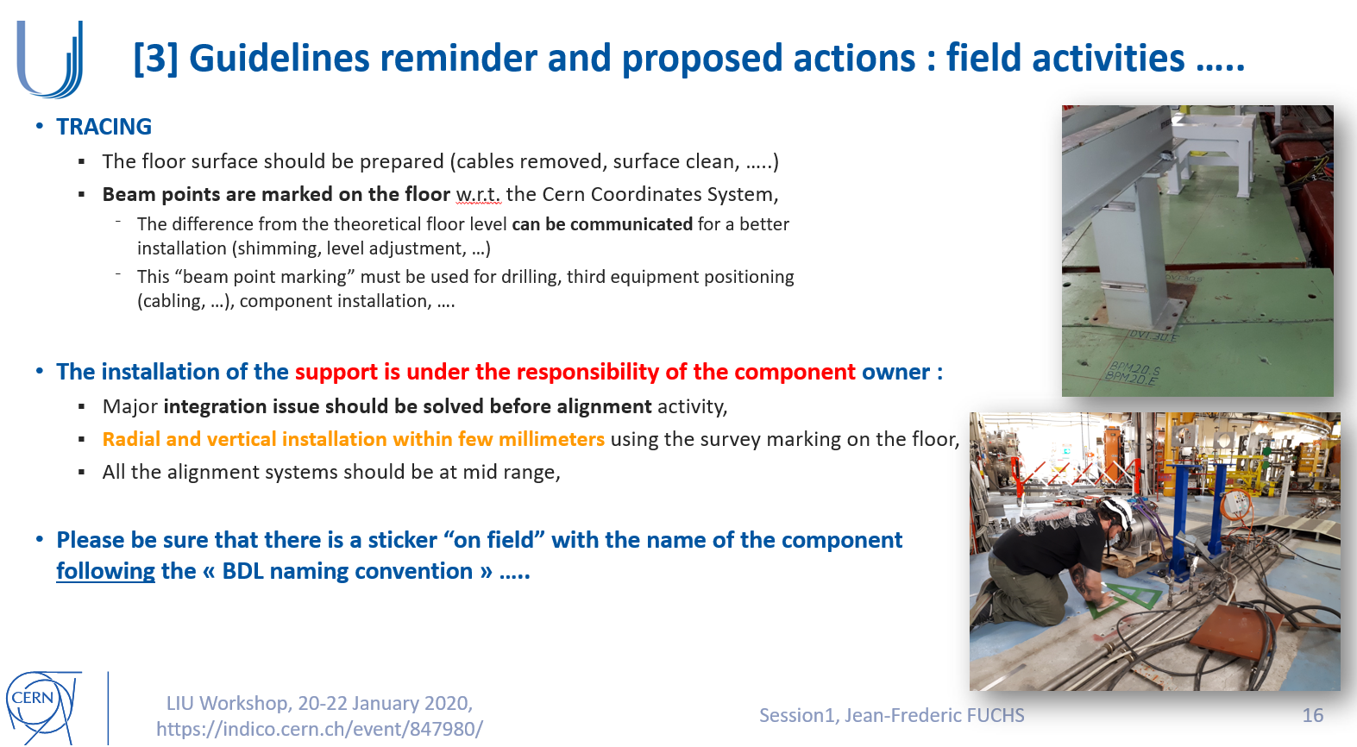
REX LS2
LS2 survey feedback :
Many issues with the “input” (data quality, LDB, drawings, …..)
Too many “surprises” in the tunnel during alignment,
The Survey recommendations are not well applied due to a lack of training and communication in addition of an important staff turnover during the last ten years :
  The communication and trainings need to be reinforced by Survey
  Lesson learnt and constructive LS2 feedback need to be shared
  The recommendations need to be formalized with Equipment Owner

Slide 4
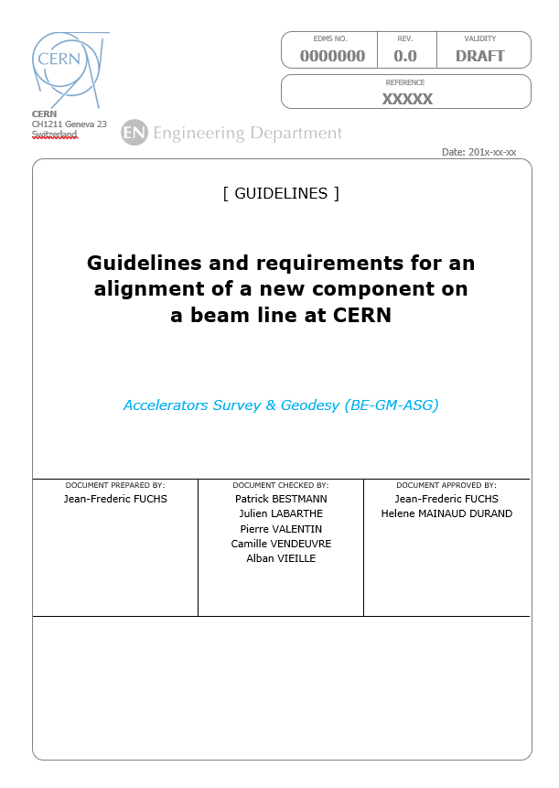
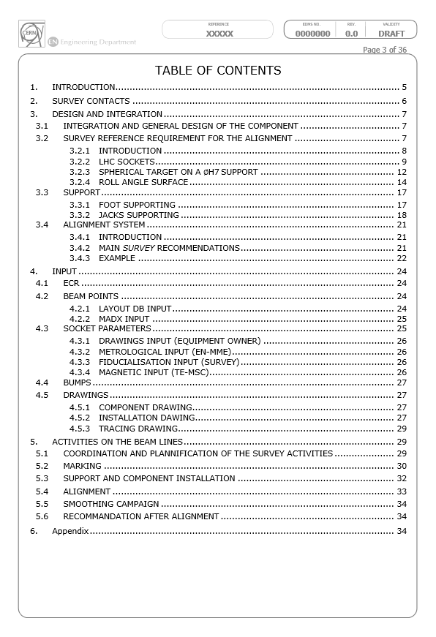
Document under preparation ….
Guidelines and requirements for an alignment of a new component
The standard tolerance for an alignment of a component, sometimes weighing several tons, is about two tenth of millimeter. Such an accurate challenge cannot be guarantee without many steps following the survey requirements.
The document will present all the survey specifications from the initial design to the installation and alignment of a new component on a beam line at CERN.
This document must be taken in account by Equipment Owners, new project leaders and integration / design teams

Slide 5
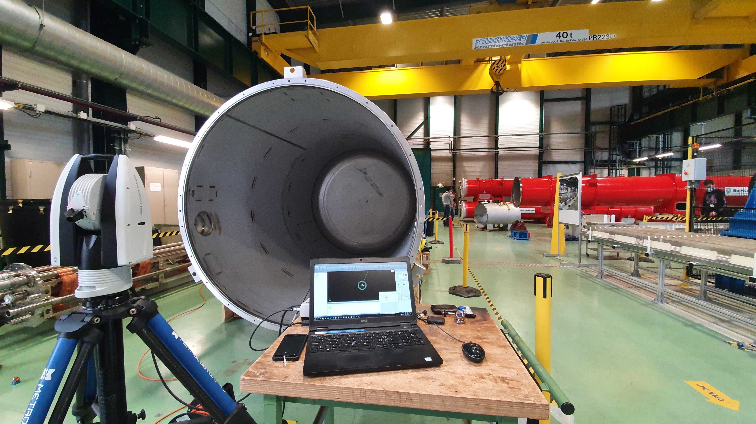
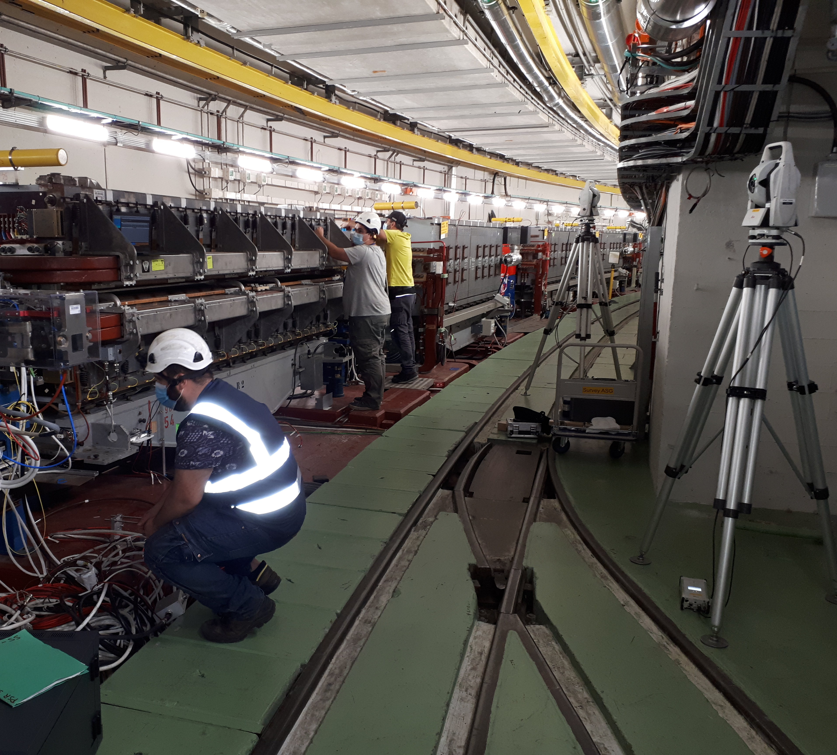
Guidelines for survey
Review, discussion, …. and approbation process :
Internal review in progress
Meeting with Equipment Owner after LS2 (STI, BI, MSC, RF, …)
  Presentation of the survey guidelines
  Discussion and feedback will be collected to improve the document
Approval process on EDMS with GL approbation
Training given by Survey are available online (videos) :
D. Missiaen – December 2020 : https://indico.cern.ch/event/998389/
This reference document and training should guide the FCC project to follow the survey recommendations and apply the best practises learnt at CERN
For any question and before starting a new project : contact us !

