Slide 1
Safety Rules at CERN
Simon Marsh (HSE-OHS-PE)
30th April 2021
EDMS reference

Slide 2


Slide 3
Legal Status
Intergovernmental Organisation governed by public international law with International Status recognised by its Member States, via treaties
International Status, and the associated privileges and immunities, guarantees functioning of the Organization without interference by individual states
Amongst others, this gives CERN the right (and therefore responsibility) to establish its rules as necessary for its functioning (e.g. labour laws, safety rules,…)

Slide 4
Specific challenges in matters of Safety
As an Intergovernmental Organisation, CERN is its own legislator and controlling authority
Use of cutting-edge and unusual technologies, to which limited (or no) relevant regulations and standards exist
Major industrial site, with a need to address a broad spectrum of hazards, hazardous situations and risks
Site straddles the France-Switzerland border
  How to deal with two different regulatory frameworks on a site that forms a technical and geographical unity, with no marked border
Diverse population accessing the CERN site and facilities
Size, complexity, duration and collaboration structure of CERN’s experiments

Slide 5
CERN Safety Rules
Host States legislation applies by default on a territorial basis but CERN establishes its own rules as necessary for its functioning
  Need for consistent unique framework for the whole of the site (differences between France and Switzerland)
  Need for comprehensive framework covering the diverse population
  Need to address CERN specific situations where no legal referential exists
  Need to transpose administrative provisions of Host State regulations into the CERN context (e.g. which CERN unit assumes the equivalent role to a national authority or notified body)

Slide 6
CERN Safety Rules
Basis, in order of priority:
  Protection of People
    Personnel, visitors, local community
  Protection of the Environment
    Water, air, soil
  Protection of assets and operations
    Safe operation, property protection, avoiding downtime

Slide 7
CERN Safety Rules
Basis is, as much as possible, Host States, EU or International regulations and standards
  Technical and commercial advantages
  In general, equipment in accordance with European Directives, using harmonised standards (and CE marked where applicable)
  Compliance with Essential Safety Requirements / Principal Elements of the Safety Objectives

Slide 8
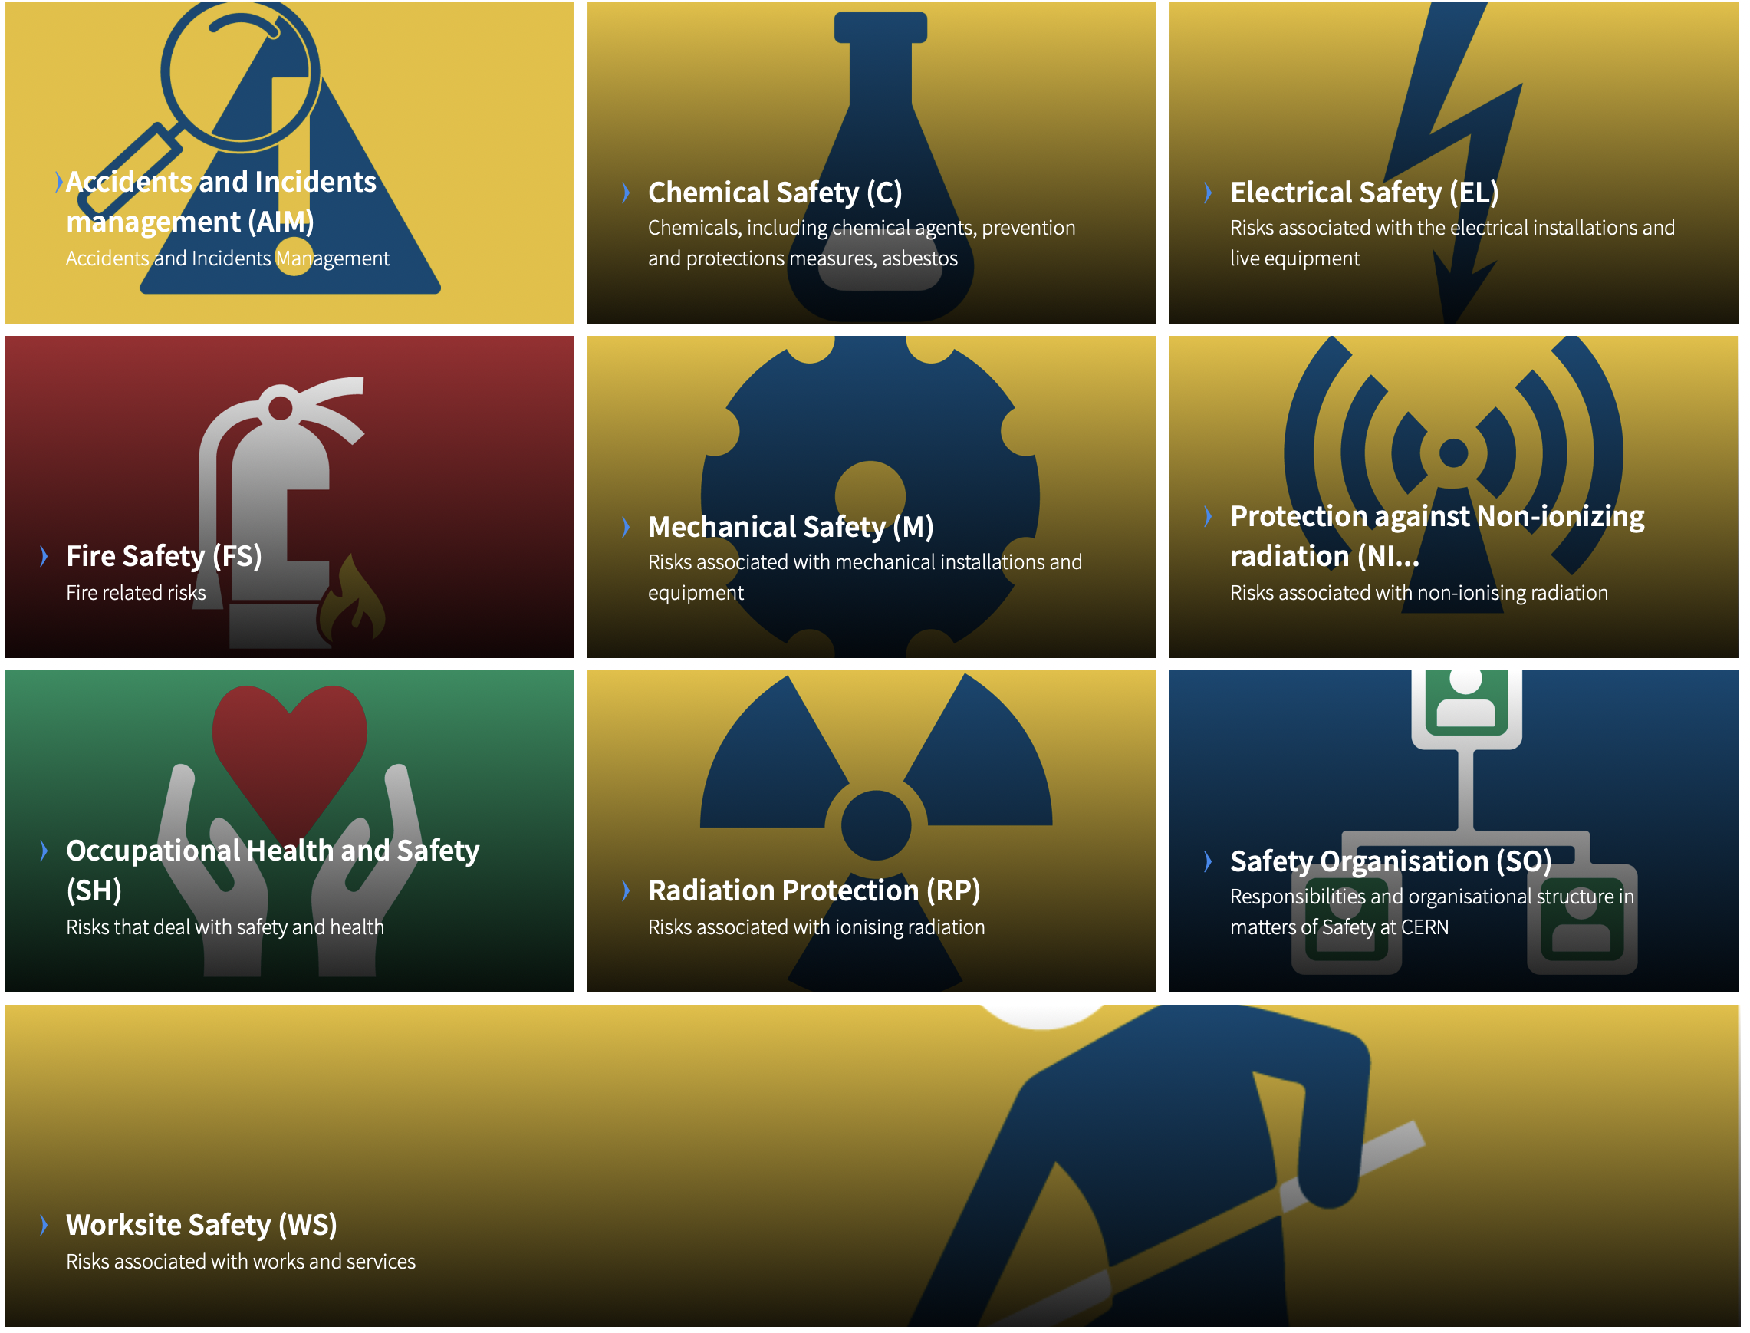
CERN Safety Rules
Domains covered by the CERN Safety rules
  Incident management
  Chemical safety
  Electrical safety
  Fire safety
  Mechanical safety
  Protection against non-ionising radiation
  Occupational health and safety
  Radiation protection
  Safety organisation
  Worksite safety.
Approximately 80 rules, with 800 references
Available to access at https://hse.cern/content/safety-rules

Slide 9
Approach
The CERN Safety Rules have to be followed for all equipment
  Made at CERN
  Procured by CERN
  Being brought to CERN, including in-kind contributions
  Used at CERN
Safety requirements have to be included from the beginning
  Conformity approach needs to be an integral part of the design, fabrication and testing

Slide 10
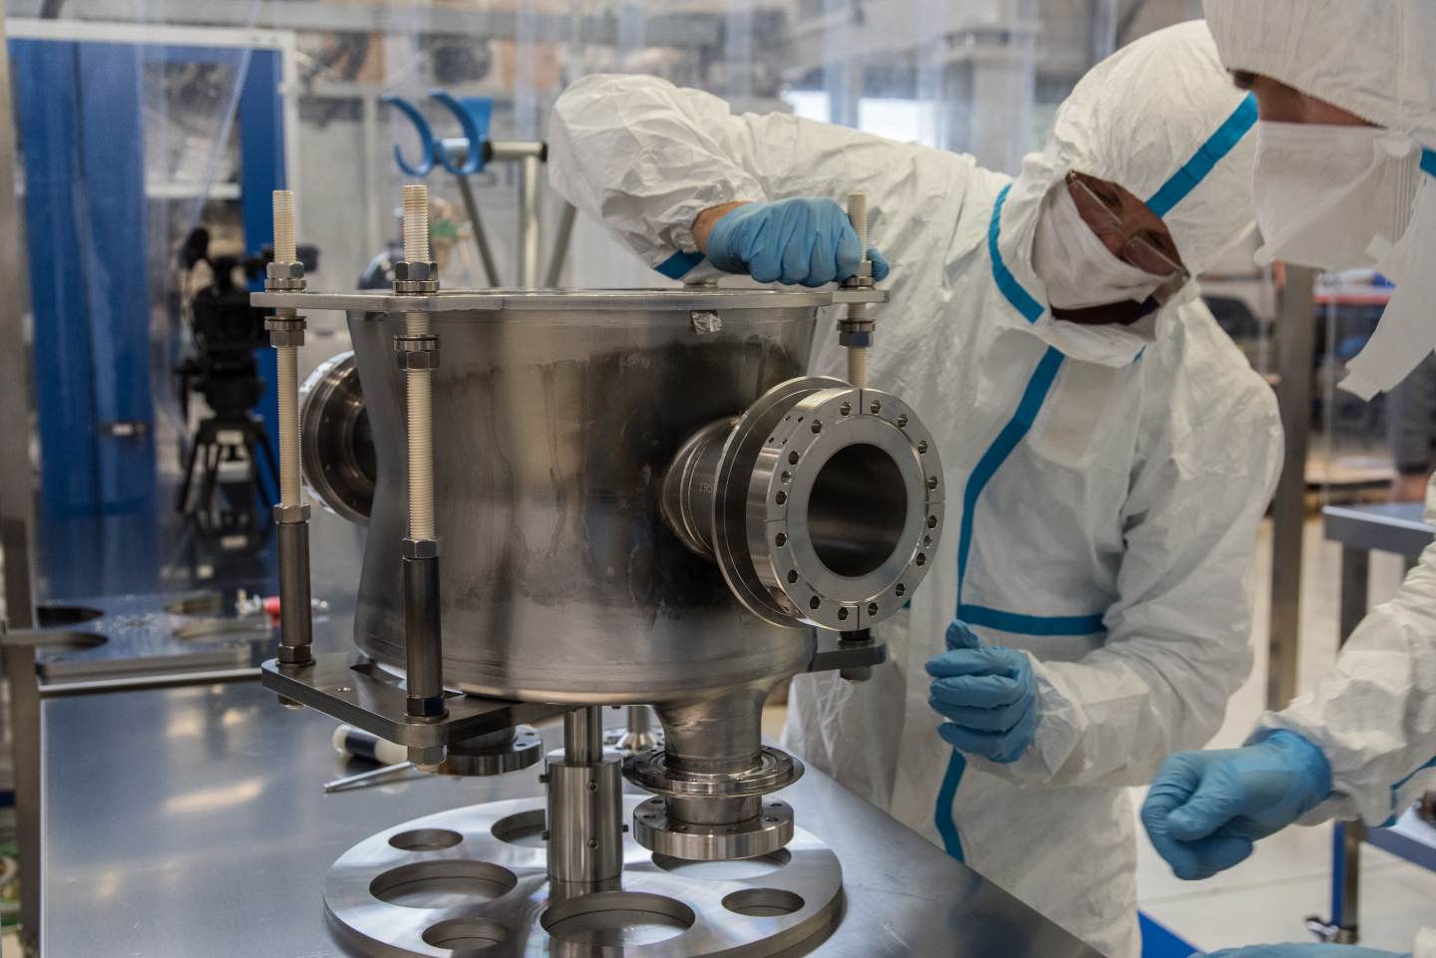
Approach
For certain equipment items, there may be technical reasons that make it difficult or impossible to fully align with standard practices and conformity assessment paths
  E.g. unusual materials, non-standard designs, limitations on pressure testing, etc.
The CERN Safety rules have a provision for such circumstances
The specialists within the CERN HSE Unit are available for discussion on compliance with the CERN Safety rules and equipment conformity approaches

