Slide 1

HITRIplus WP7 meeting
7/5/2021
Synchrotron injection energy
E. Benedetto
see also slides @ Joint SEEIIST/NIMMS Meeting 13/11/2020

Slide 2
Motivation
What is the best injection energy?
(Why Japanese inject at 4-5 MeV/u
and Europeans at 7 MeV/u?)

Slide 3
Injection energy in the synchrotron
  Space charge
    small for C-ions (…is it still the case if 20x intensity?)
  Geometrical emittance
    beam dimensions, magnet aperture
  Revolution frequency
    # particles that can fill 1 turn
  Stripping foil
    efficiency C⁺⁴ → C⁺⁶ is 95% at 4 MeV/u
    Multiple Coulomb scattering
  Linac design
    length, RF power, … cost

Slide 4
Scaling
  Space charge: ∼βγ²
  Geometrical emittance: ∼βγ
  Revolution frequency: ∼β
    Δν ~0.13 for C-ions @ 4 MeV and increases w. energy
…~not a problem for C-ions!
    Beam size ~ sqrt(β)
  γ ∼1
Energy MeV/u | Beta
4 | 0.09
5 | 0.10
7 | 0.12

Slide 5
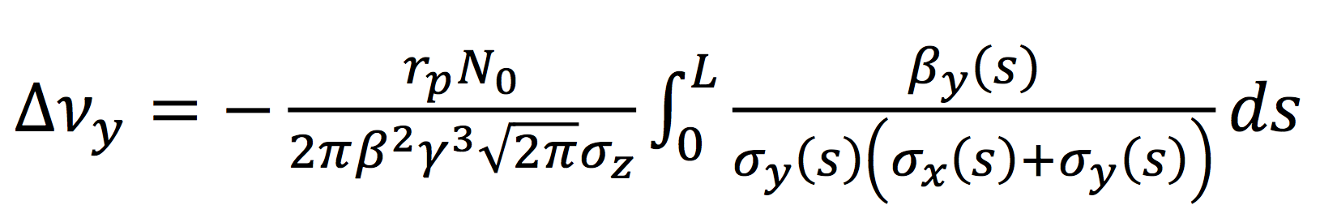
Space Charge
(*) with 1um ring emittance, worst case
  Δν ~0.13 (*) for C-ions @ 4 MeV and increases w. energy
…not a problem for C-ions!
  Δν ~0.42(*) @ 7 MeV protons (Δν=0.35(*) @ 10 MeV/u)
    → Δν=0.31 @ 7 MeV/u if 3um (more realistic!)
Δν < 0.25-0.3 “safe”
Δν ~ 0.5-0.6 “feasible but…”

Slide 6
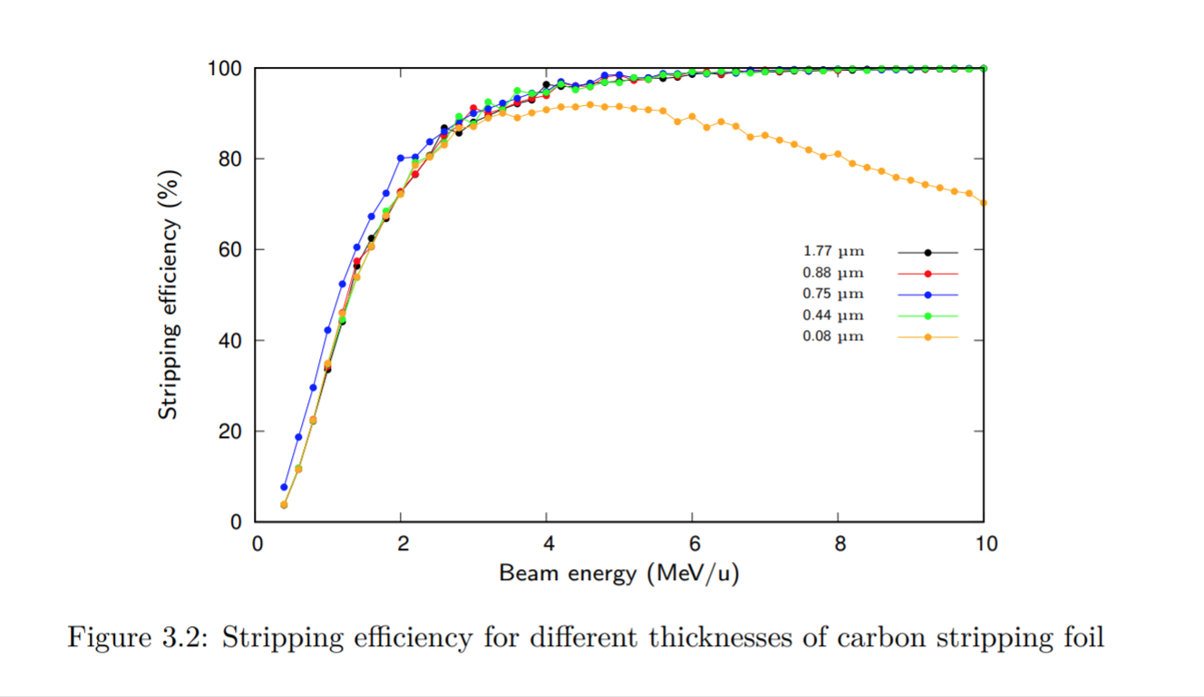
Stripping efficiency C⁺⁴ → C⁺⁶
95% @ 4 MeV/u
Amra, Mariusz

Slide 7
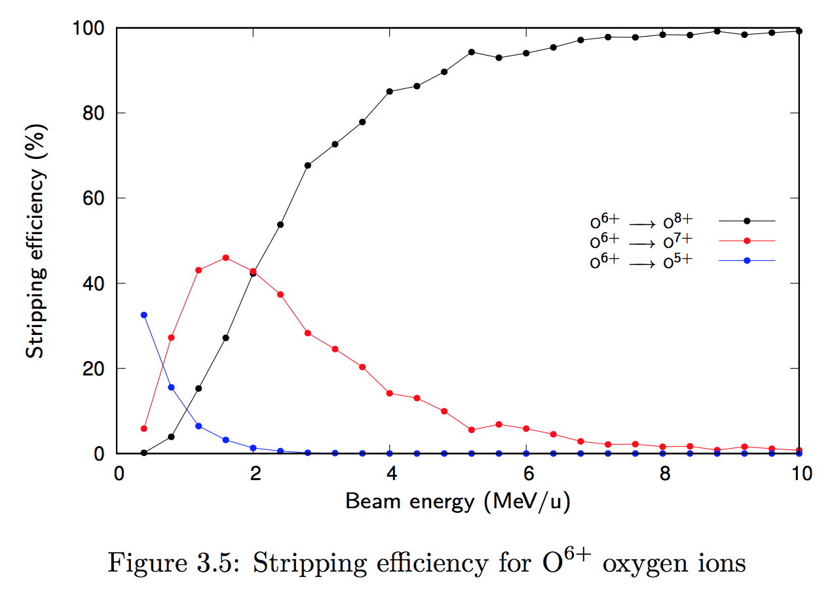
Stripping efficiency O⁺⁶
~85% @ 4 MeV/u
Amra, Mariusz

Slide 8
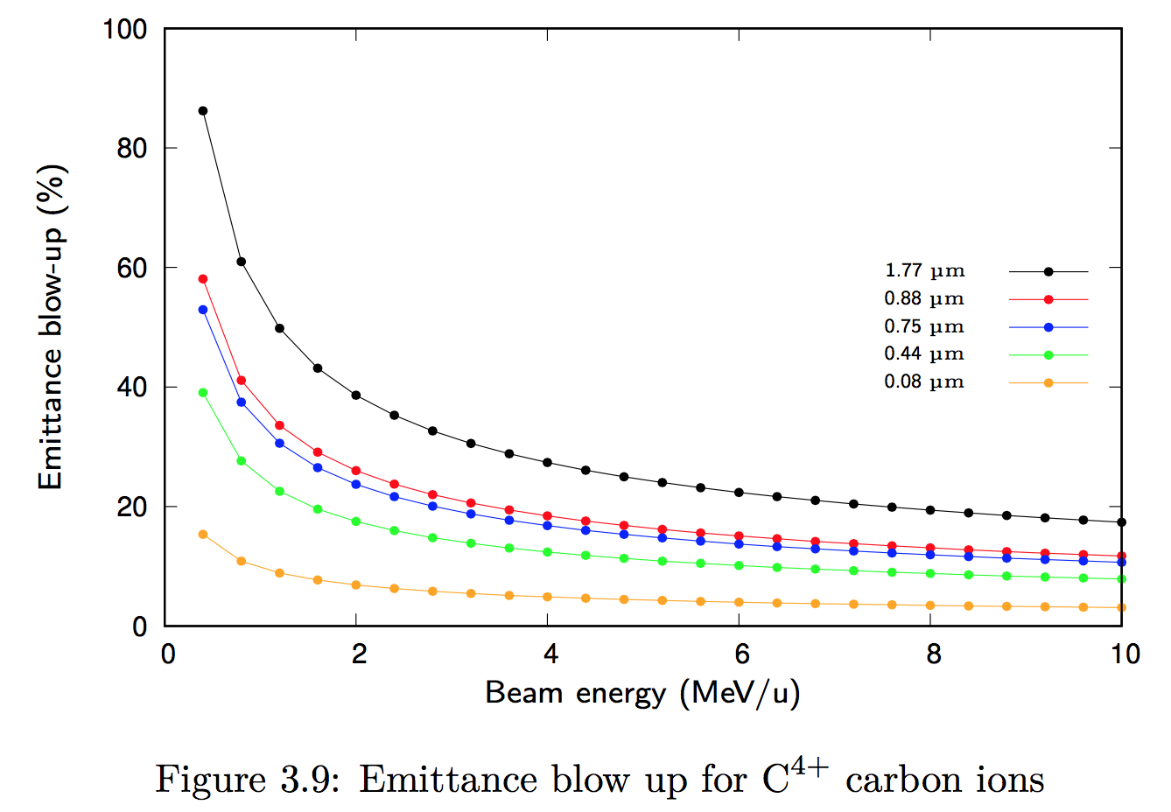
Multiple Coulomb Scattering @ foil
5% increase, if 0.6 pi mm mrad
(x2 if emi ~0.3 pi mm mrad)
Amra, Mariusz
E. Benedetto – NIMMS/SEEIIST Meeting 13/11/2020

Slide 9
Bfield in SC magnets
For C-ions:
  B@inj = 0.4 T @ 7 MeV/u
  For protons:
  B@inj = 0.2 T @ 7 MeV/u TOO LOW!
  Bmin= ~0.3 T corresponds to 16 MeV protons
  if protons @ 12 MeV ➔ B=0.26 T,
  if protons @10 MeV→ 0.24 T

Slide 10
Conclusions (for now…)
Lower energy for C-ions
  7 MeV/u looks OK
  5 MeV/u
    space charge not an issue
    Bfield in SC magnet getting low
    MCS at stripping foil increases
    beam size (and aperture) increases
Higher energy for protons?
  16 MeV ideal, but can compromise
    space charge OK
    Bfield = 0.3 T OK

Slide 11
Source
~500 euA of C+4 @inj point(!)
  assuming 100% linac transmission!
  with 30 turns x 50% efficiency MT, final emi 5um instead of 1um should be ok
emi = 0.7 pi um rms, normalized
AISHA, Lanzhau:
800euA
0.2-0.3 pi mm mrad
make sure all the emittances are rms (vs. full) and currents refers to C+4
CNAO Supernanogan
250 euA
0.52 pi mm mrad

