Slide 1
Beam energy and current for RI production with a HT-injector linac
G.Bisoffi,
May 7, 2021

Slide 2

Design of a compact linac for HT-injection and radioisotope production
Linac design aimed at: small, cheap, easy to operate and maintain, both an injector of a hadrontherapy facility and a linac for RI production.
Definition of «Interesting radioisotopes» for a compact linac: ready for clinical use or in advanced test phase, most requested by hospitals or most interesting for radiobiologists today, the production of which is competitive vs. cyclotrons.
Identify and freeze linac parameters: alphas (and protons), E_{fin} and I_{max}, d.c. ≤ 10% (keep cost and complexity smaller)
Target bunker, according to the RI’s to be produced; layout; shielding; areas for RI treatment preparation, irradiation, recovery, purification, quality control and packaging for transport.
Economic aspects: capital and running costs of accelerator, (targetry, radiochemistry, radiobiology), expected revenues.

Slide 3
More...
Scope: emerging isotope, small batches, or “industrial supply”)
RI purity grade
Target technology and or technology readiness level
Footprint
Reliability of the facility
Operation reliability, maintenance cycle, impact on operation of the facility for the rest of the complex
(…)

Slide 4
Which RI’s to select
Among thousands, RI’s with the desired decay mode (γ and β⁺ for imaging, β⁻ and α for therapy); convenient energy of emitted γ and β⁻ ; for diagnostics, therapeutic or theranostics combinations, choose the right beam energy, beam current, for the desired reaction cross-sections, considering also reaction cross-sections for undesired nuclides, target configuration, possible radiation damage, target mass and stopping power.
A multi-disciplinary field: accelerators; nuclear physics (irradiation of proper target materials); mech/nucl engin. for safe (remote) handling and target cooling, disposal/storage of radioactive wastes; radiochemistry for recovery and purification of the desired nuclides; radiobiology, nuclear medicine for identification of proper vector molecules and the most interesting applications; product distribution (logistics).

Slide 5
RI selection criteria for a compact linac
Only isotopes of primary interest for medical doctors, approved as radiopharmaceuticals or on the good track to be approved (with preference for therepeutic or theranostic radioisotopes -higher revenues - or RI couples). This «guarantees» that identification of useful vector biomolecules has been done (radiochemistry clear for most). With this «filter», one is still left with comparing the efficiency of different accelerator+target production routes (Physics).
The niche for linacs is in the use of alpha beams.
Alphas: e.g. the 70 MeV p,α cyclotron in Nantes (ARRONAX) achieves 750 uA proton and only 35 uA α current; few cyclotron have the option of α-beams; α-extraction is dirty, and lossy. Deuterons require a dedicated design, pose shielding and manipulation problems, are unfit to a «quasi-hospital» environment. Protons are ok, but small cyclotrons are winning (the linac is not designed around them)
Energy limit: ~ 10 MeV/u (based on carefully identified cases)
Beam current, at 10% d.c., up to I_{av}~100÷300 uA (4÷12 kW is already quite challenging for cooling issues)
Then, all RI that can be produced with protons at ~10 MeV can be produced too

Slide 6
References: The RI must be cited in at least 1 of the blue ones
(a) | Peltek et al. J Nanobiotechnol (2019) 17:90 | Current outlook on radionuclide delivery systems: from design considerations to translation into clinics
(b) | Vermeulen at al. Semin Nucl Med 49:339-356, 2019 Elsevier Inc | Design and Challenges of Radiopharmaceuticals
(c ) (c ) | IAEA-Technical Reports Series No.468, 2009 | Cyclotron Produced Radionuclides: Physical Characteristics and Production Methods
(d) | Kin et al. J Phys Society of Japan 82 (2013) 034201 | New Production Routes for Medical Isotopes 64Cu and 67Cu Using Accelerator Neutrons
(e) | www.adnkronos.com , June 3, 2020 | Clarity Pharmaceuticals Announces that US FDA Grants Rare Pediatric Disease designation to ⁶⁷Cu-SARTATE for the Treatment of Neuroblastoma
(f) | Duchemin et al, Applied Radiation and Isotopes 115 (2016) 113-124 | How to produce high specific activity 117-Sn using alpha particle beam
(g) | www.sbir.gov, IsoTherapeutics, Award Information (2018) | High Specific Activity 117-Sn by Post Irradiation Isotope Separation
(h) | Sudo et al. Translational Oncology (2019) 12, 879-888 | Preclinical Evaluation of the Acute Radiotoxicity of the alpha-amitting Molecular Tergetd Therapeutic Agent 211-At-MABG for the Treatment of malignant Pheochromocytoma in Normal Mice
(i) | Chatal et al., Eur J Nucl Med and Molecular Imaging (2018) 45:1362-1363 | Alphatherapy, the new impetus to targeted radionuclide therapy?
(l) | oncohemakey.com/radiopharmaceuticals-2/ (2017) | Radiopharmaceuticals
(m) | www.anl.gov | Radioisotope Research and Production Program
(n) | www.oakridger.com | 2019-ORNL's enriching radioisotopes again
(o1) | Walczak et al. EJNMMI Physics (2015) 2:33 DOI 10.1186/s40658-015-0136-x | Cyclotron production of ⁴³Sc for PET imaging
(p) | Koester, CERN Accelerator School, 2015, Medical Application of Accelerators | (Medical) Apllication of radioisotopes
(q) | Adriano Duatti, Prof. Of Radiochemistry, UniFE | priv. comm.
 | Plus tens of others for the specific cases...

Slide 7

A further focus with
Founder of an IDRC (Inter-Department Research Center) being born at Uni-Padova (I) with Medicine, Pharmacy, Chemistry, Biology, Physics, and INFN (with its newly built 700 uA, 70 MeV proton cyclotron at INFN, 10 km from Padova).
a lifetime of 20 minutes ÷ 3 days (some are interesting only if produced close to a hospital (¹¹C, ¹⁵O,…);
significant and increasing number of publications in the last 10/2 years (not disregarding cases which are susceptible to becoming a breakthrough even with few publications yet);
emphasis on isotopes suited for molecular theranostics («imaging and a therapeutic agent converging on a targeted molecular mechanism»)
Prefer radiosiotopes curing the most «interesting» cancers (breast, lung, prostate, brain, neuroendocrine^{(*)}…)
Special focus on radioistopes where alternative therapies are less efficient, or more expensive
Notes:
^{(*)} Neuroendocrine cells: combining endocrine (hormonal) and nervous functions, they have various regulatory function in the body: air flux regulation in lungs, velocity of food in the gastrointestinal system, … ; associated tumors may affect diverse organs – e.g. intestine, pancreas, lungs, thyroid, thymus or adrenal glands .

Slide 8
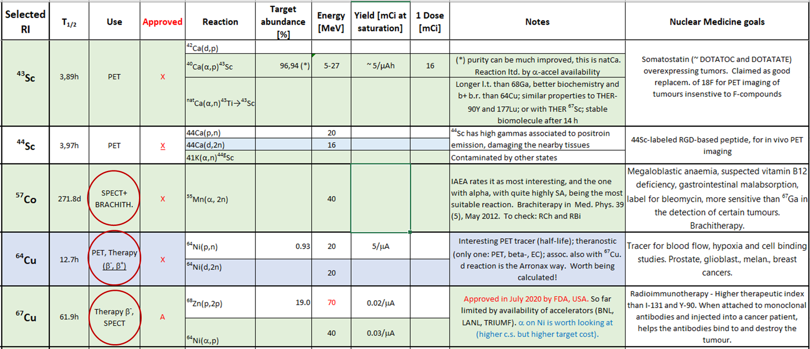
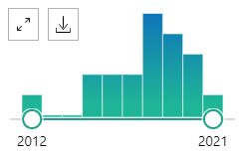
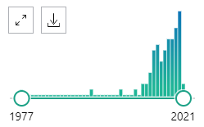
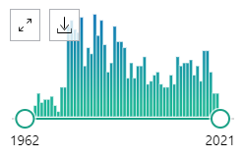
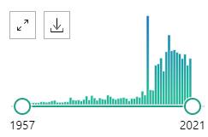
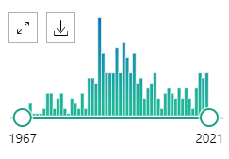
List of selected radioisotopes 1/2
(*)
(*) As a PET tracer, it has higher β+ fraction and 4x the lifetime of ⁶⁸Ga. Approved by AIFA for use in 2021, it is has theranostic features and is suited to recurrent therapy-resistent
prostate cancer Investigations on DOTA, theranostic agent for neuroendocrine tumors

Slide 9
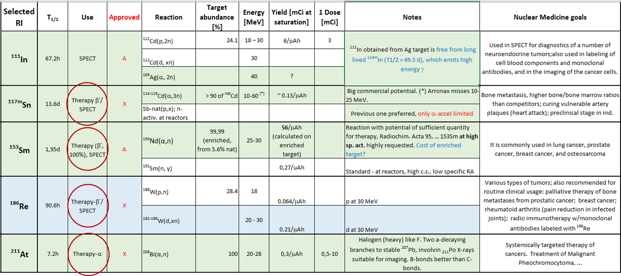
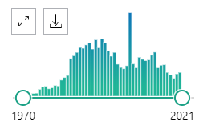
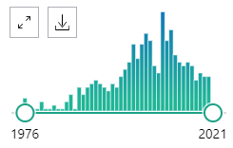
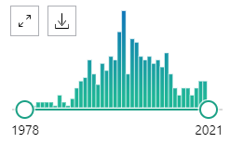
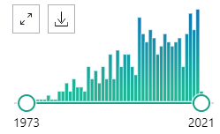
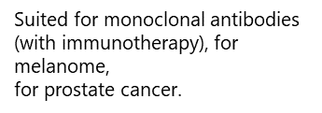
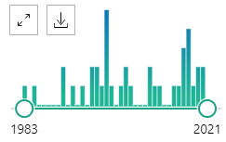
List of selected radioisotopes 2/2
(**)
(**) conversion electrons (higher LET than β⁻, much lowermyelotoxicity) and gammas , suited for blood (vulnerable plaque), muscles, kidney, splee, liver;
easy chemistry, in phase-II with animals, requires high-E p or lower-E α

Slide 10
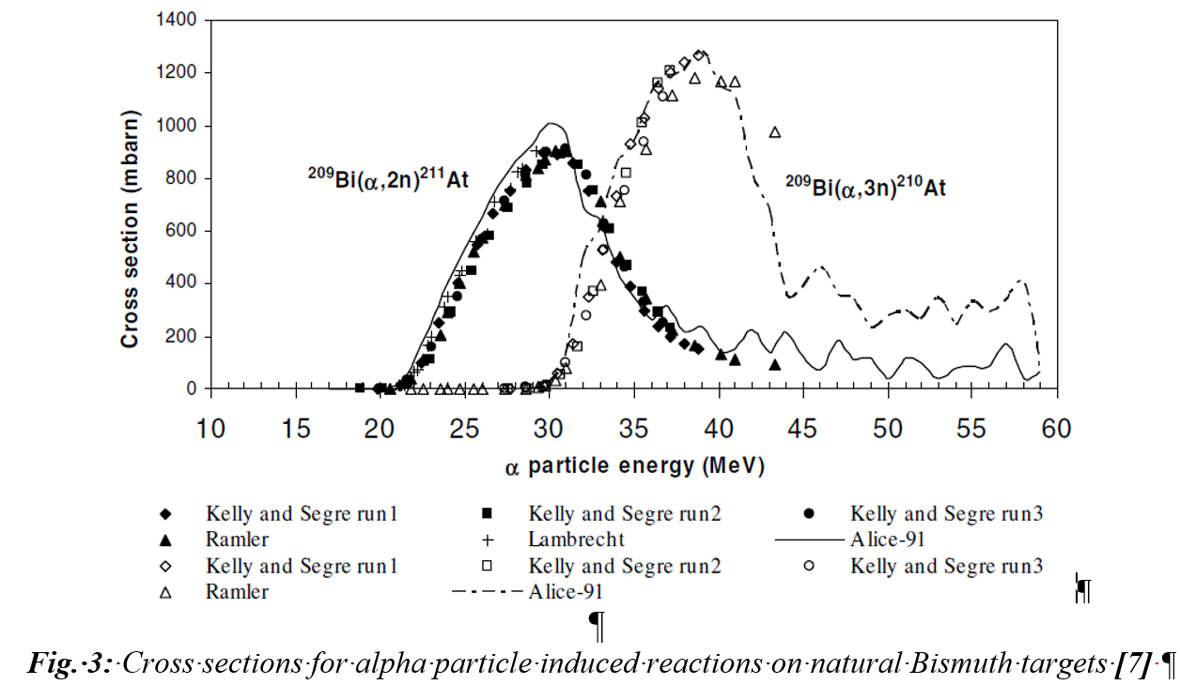
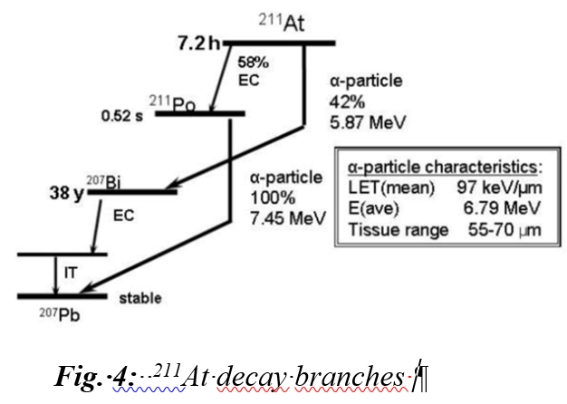
211At
Animal (mice) trials, clinical trial start exp. in 2 yrs
211At is the only alpha-emitter that can be produced in large quantities by accelerators
“Half life of 7.2 h, decay in a double branched pathway producing 1 α-particle per decay. (…)The mean ranges in tissue of the lower and higher energy α-particles emitted by ²¹¹At are approximately 55 and 80 μm, respectively. The LET mean of ²¹¹At α-particles is about 100 keV/μm, which is close to the value at which the relative biological effectiveness of ionizing radiation is highest. The electron capture decay of 211At to ²¹¹Po emits polonium K x-rays which make it convenient to count ²¹¹At activity levels and to perform scintigraphic imaging of ²¹¹At uptake in tissues in vivo”
Curr Radiopharm. 2008 September 1; 1(3): 177 (Duke University)
The main problem is getting the astatine to remain attached to
the molecule under physiological conditions. It should be pointed
out that there is a potential radionuclidic contaminant (210At) that
must be minimized because of its decay product (210Po), which is a
pure alpha emitter and chemically binds to the bone marrow.
²⁰⁹Bi(a,2n)²¹¹At | α | 28
211-Rn/211-At
Th,U p spallation | p | 100-1000 MeV
Ref (c )
(alternative, tested at TRIUMF)
Target: high purity ²⁰⁹Bi (=monoisotopic) layer (thin, due to poor thermal conductivity) on Al backing. Inclined, to maximize effective thickness. Separation: dry distillation at 650°C in a quartz oven. A dry nitrogen, argon or oxygen carrier gas is used to carry the 211At out of the still. The distilled astatine is trapped in a polyetheretherketone® (PEEK) tubing cooled to –77°C with a mixture of ethanol and dry ice. The trapped astatine can be recovered with a small volume of organic solvent.

Slide 11
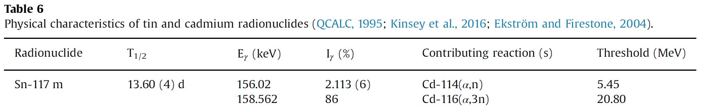
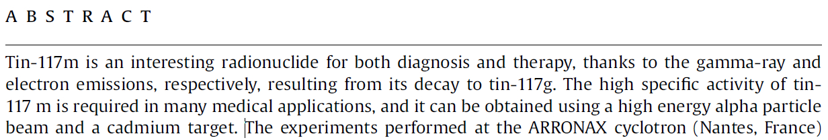
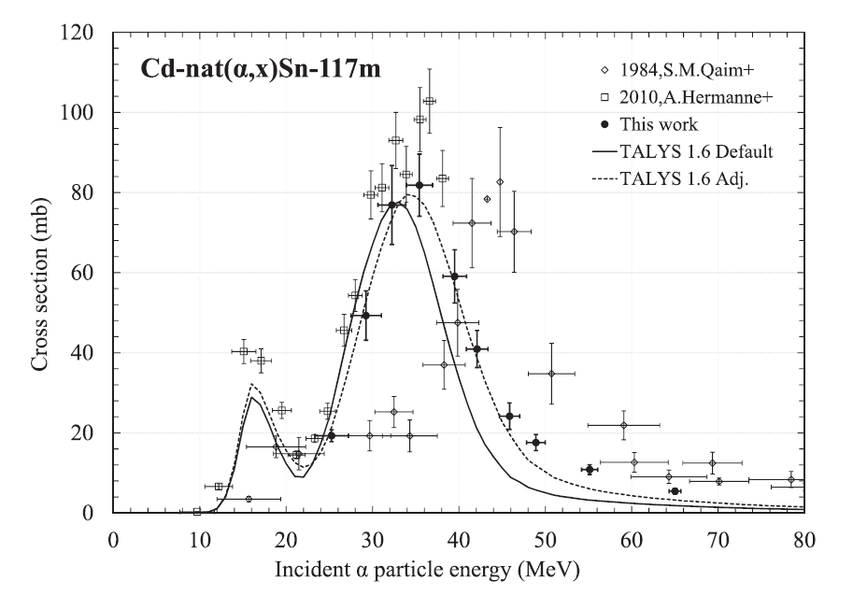
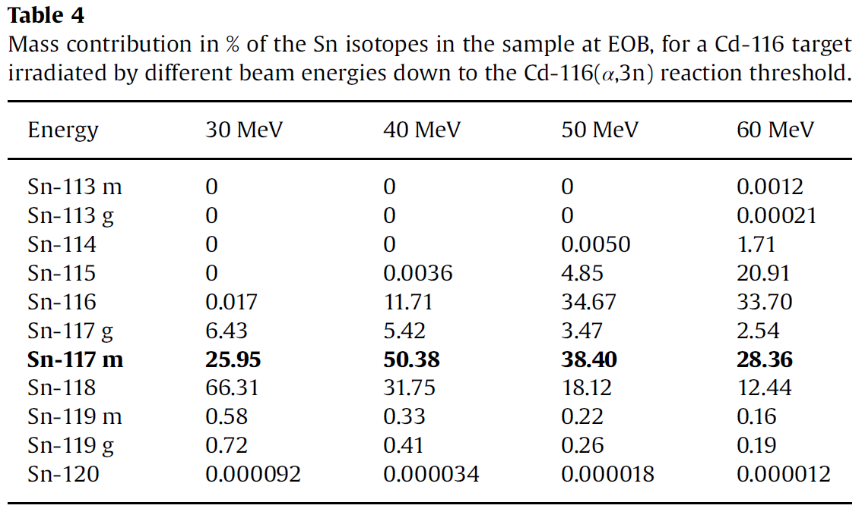
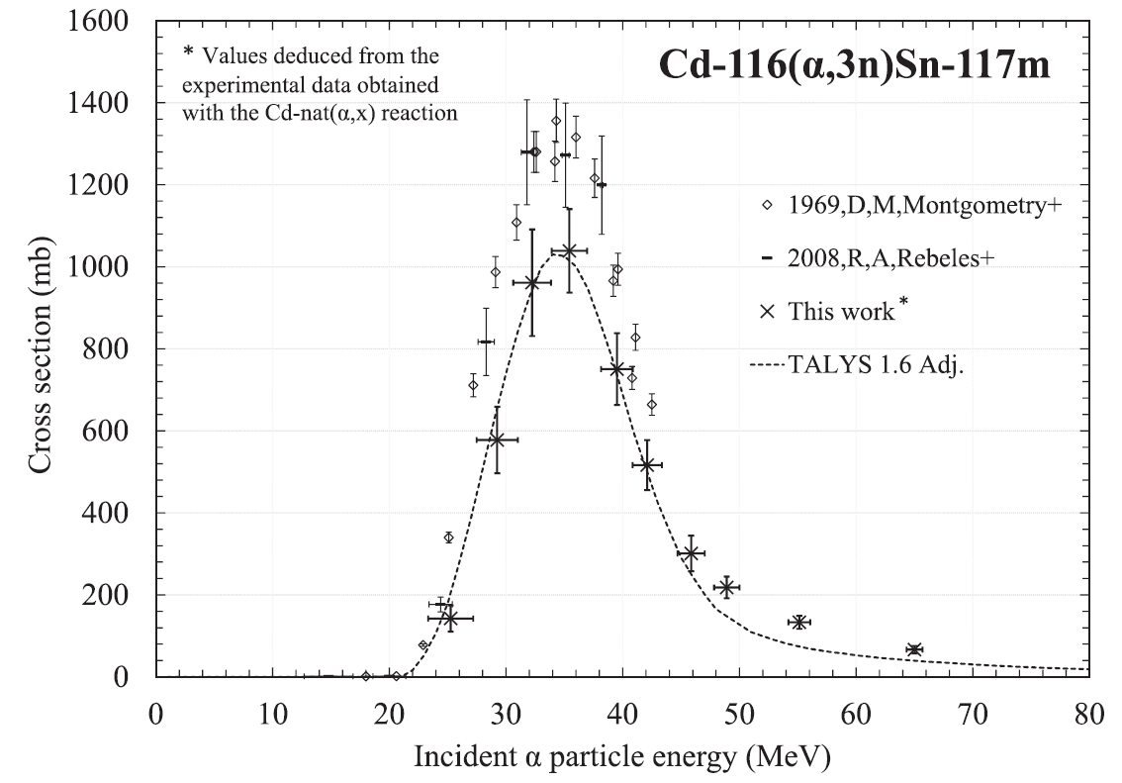
117Sn-m
Theraonostic element, in clinical test phase for artery plaque
C. Duchemin et al., Applied RadiationandIsotopes115(2016)113–124
Arronax currently working on it («commercial properties are outstanding», p.c.)
«Target preparation. stacked-foils method(Duchemin etal.,2015, Blessing etal.,1995),
which consists of the irradiation of a set of thin foils, grouped as patterns. Each pattern contains a
target to produce the isotopes of interest. Each target is followed by a monitor foil ...»
Lower limit for Arronax,
missing ¹¹⁴Cd
Par. 3.2.8 – Purification issue - Other Sn isotopes eliminated if enriched Cd targets are
chosen, In is eliminated chemically.
Cd-116(a,3n)117mSn | α | 40-50 MeV
With 40 MeV alpha, highest ^{117m}Sn specific activity. Useful to investigate the Y and SA with enriched 114Sn and 116 Sn, 0-40 MeV .

Slide 12
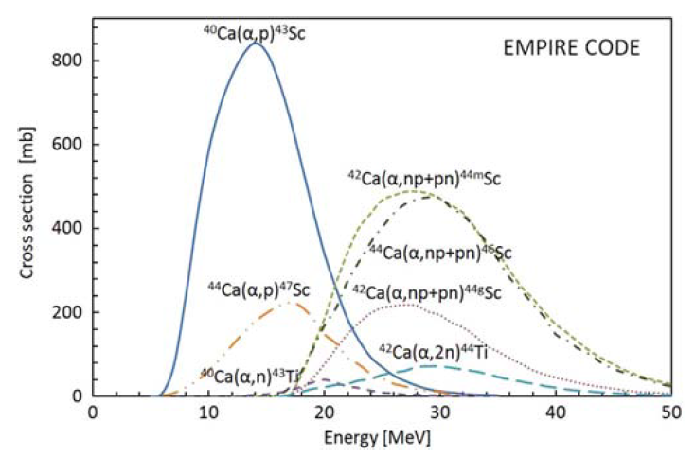
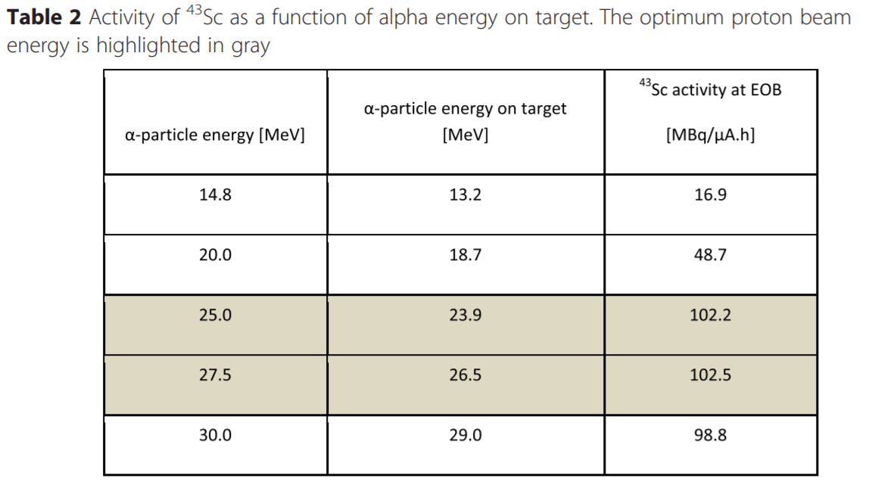
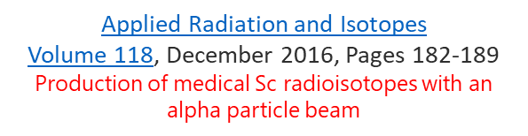
43Sc
Claimed as good replacem. of ¹⁸F for
tumours insens. to F-compounds
⁴⁷Sc only with p, high E
“Recently, significant interest in 44Sc as a tracer for positron emission tomography (PET) imaging has been observed. Unfortunately, the co-emission by 44Sc of high-energy γ rays (Eγ = 1157, 1499 keV) causes a dangerous increase of the
radiation dose to the patients and clinical staff. However, it is possible to produce another radionuclide of scandium—43Sc—having properties similar to 44Sc but is characterized by much lower energy of the concurrent gamma emissions. This work presents the production route of 43Sc by α irradiation of natural calcium, its separation and purification processes, and the labeling of [DOTA,Tyr3] octreotate
(DOTATATE) bioconjugate”
Medical interest to be checked, theranostic with 47Sc, in this paper
checked with cheap natCa target, yielding some contaminants.
On ^{nat}Ca, concurrent reactions below 27 MeV, yielding ⁴⁷Sc
^{nat}Ca(α,n)⁴³Ti→⁴³Sc | α
⁴⁰Ca(α,p)⁴³Sc | α | 27 MeV
Walczak et al. EJNMMI Physics (2015) 2:33 DOI 10.1186/s40658-015-0136-x
Cyclotron production of 43Sc for PET imaging
Compare with 16 MeV p reaction ⁴³Ca(p,n) ⁴³Sc

Slide 13
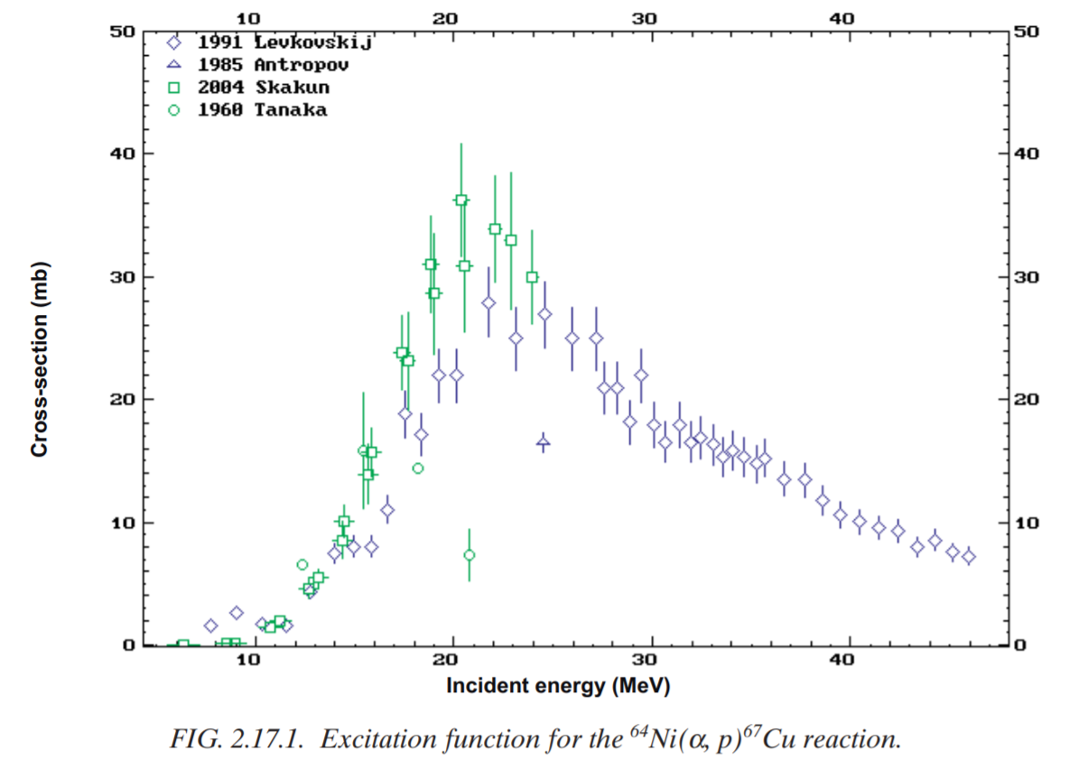
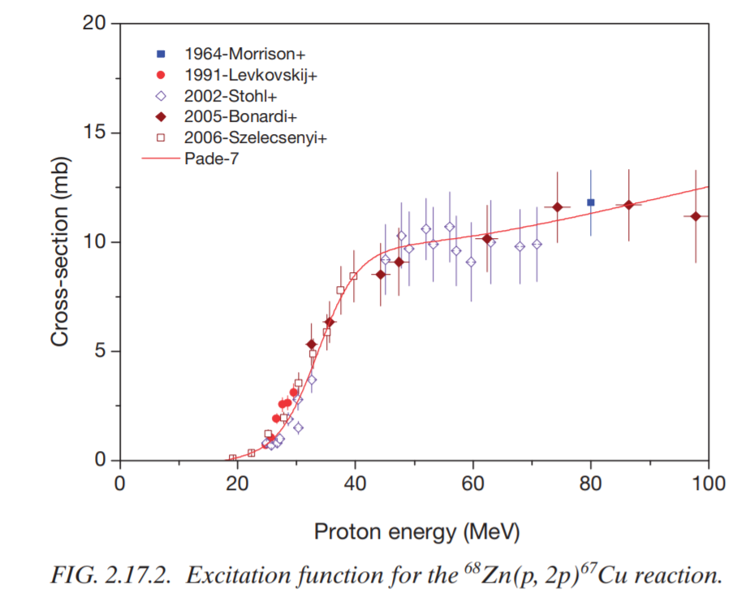
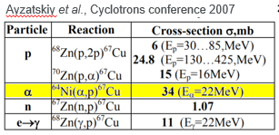
67Cu
Theraonostic element alone (γ and β⁻),
and with ⁶⁴Cu
Approved Radiopharmaceutical
“Compared to iodine-131 and yttrium-90 in a limited number of clinical studies, copper-67 showed the highest therapeutic index. However, its industrial production has so far been limited by the absence of the high-energy (70 MeV) and high-intensity (a few hundred microamps) cyclotrons needed to produce high activity for clinical trials”
⁷⁰Zn(p,α)⁶⁷Cu | p | 20-70
⁶⁴Ni(α,p)⁶⁷Cu | α | 10-40
“Widespread use of this isotope for clinical studies and preliminary treatments has been limited by unreliable supplies, cost, and difficulty in obtaining therapeutic quantities”. Applied Radiation and Isotopes 70 (2012) 2377–2383
Arronax website, RI’s
under investigation
«All of the common nuclear reactions used to
produce ⁶⁷Cu rely on enriched isotopes as target materials. These isotopes have fairly low natural abundances…”

Slide 14
Common approved RIs, more easily produced by protons
For these, E_{p}~15 MeV would be better than 10 MeV (but they are not the priority)

Slide 15
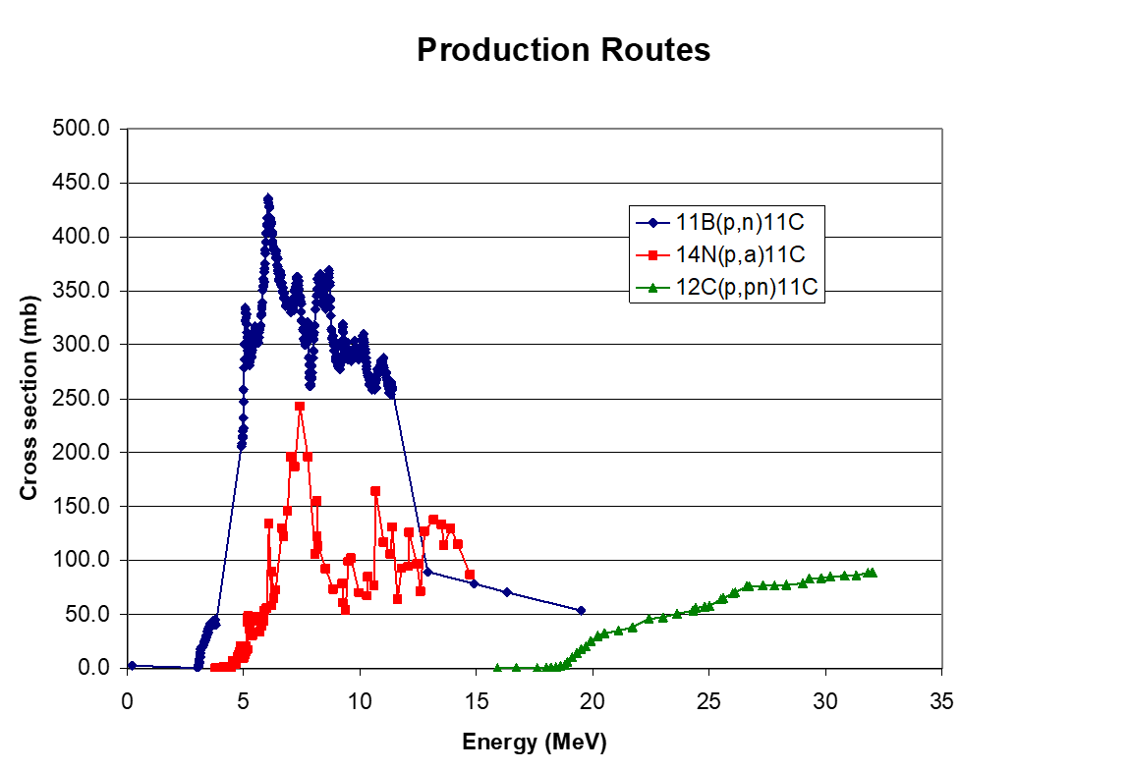
¹¹C as an example

Slide 16
Linac energy for RI production
We exclude deuterons, as they are too dirty in a «quasi hospital» environment.
Alphas: 40 MeV (10 MeV/u) looks adequate for all identified cases
Protons: 10÷12 MeV is a useful energy value for RI of short lifetime, which could be produced profitably close to a hospital by the combined-function linac (²H¹⁺ maybe the best choice, for a second portion of the linac going beyond the MeV/A needed for C?)

Slide 17
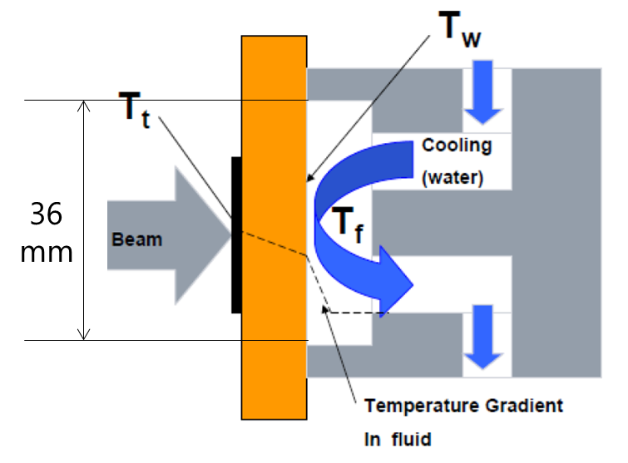
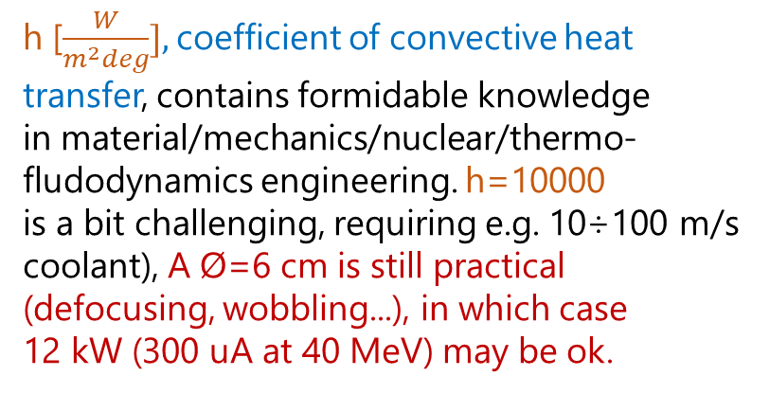
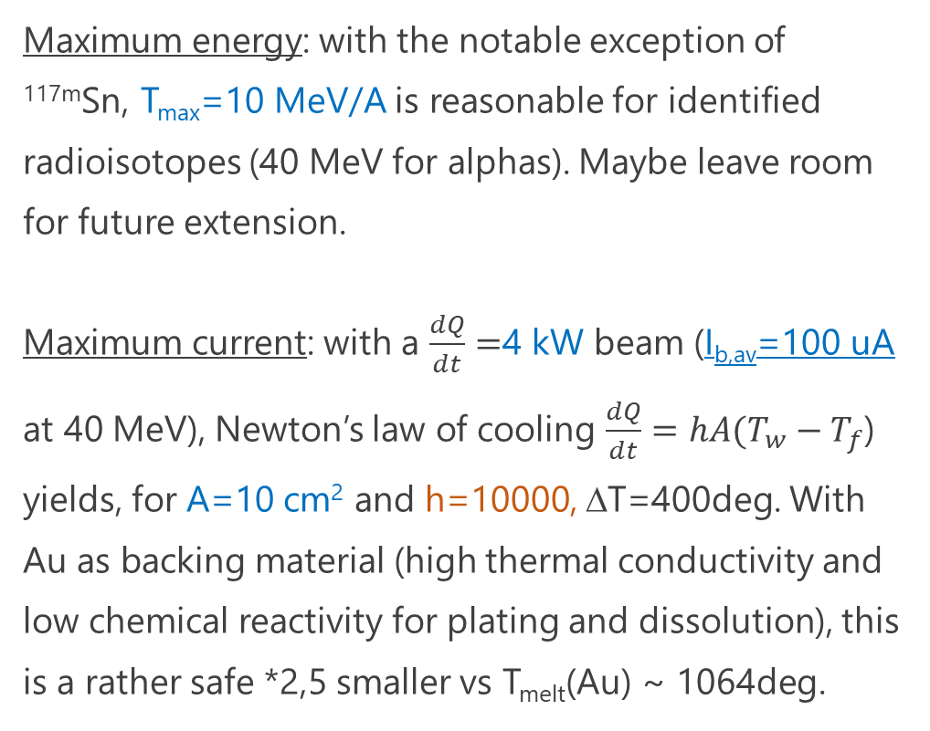
Beam energy and current (from the target viewpoint)
Maximum energy: with the notable exception of ^{117m}Sn, T_{max}=10 MeV/A is reasonable for identified radioisotopes (40 MeV for alphas). Maybe leave room for future extension.
Maximum current: with a $\frac{dQ}{dt}=$4 kW beam (I_{b,av}=100 uA at 40 MeV), Newton’s law of cooling $\frac{dQ}{dt}=hA(T_{w}−T_{f}$) yields, for A=10 cm² and h=10000, ΔT=400deg. With Au as backing material (high thermal conductivity and low chemical reactivity for plating and dissolution), this is a rather safe *2,5 smaller vs T_{melt}(Au) ~ 1064deg.
h [$\frac{W}{m^{2}deg}],$coefficient of convective heat
transfer, contains formidable knowledge
in material/mechanics/nuclear/thermo-
fludodynamics engineering. h=10000
is a bit challenging, requiring e.g. 10÷100 m/s
coolant), A Ø=6 cm is still practical
(defocusing, wobbling...), in which case
12 kW (300 uA at 40 MeV) may be ok.

Slide 18
Ion sources: current, emittance, extraction voltage. On linac d.c. ...
ECR ion sources would suit both RI production with ⁴He²⁺ and injection of ¹²C⁴⁺ or other ions for hadron therapy. Interchangeability of beams from the same type of ion source is an asset. A 3-front-end design iseems ok. Protons can be produced with the same type ECR, or a dedicated 3rd source. EBIS’s are lagging behind for high-I .
Best ECR ion sources today (e..g INFN-Catania, IMP-Lanzhou) offer in CW mode, with a 40÷50 kV extraction voltage:
0.6 mA of ¹²C⁴⁺ with ε_{rms,n}=0.2÷0.3 pi.mm.mrad
2÷5 mA of ⁴He²⁺ with ε_{rms,n}=0,2÷0.4 pi.mm.mrad (and I_{p}=3 mA with d.c.=10% is what is needed from previous slide)
A few mA protons, where ²H¹⁺ or ³H¹⁺ seem the most appropriate choices, at ε_{rms,n}=0,2÷0.4 pi.mm.mrad
With a 10% d.c. linac, the required beam current is at the state-of-the-art of ion sources. It needs a linac with a good transmission (95% minimum)

