Slide 1
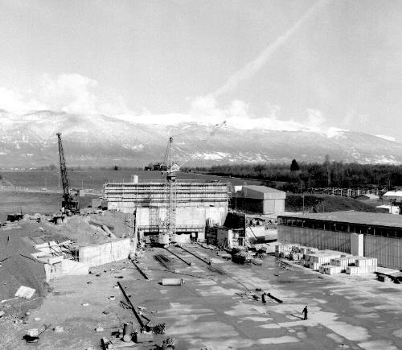
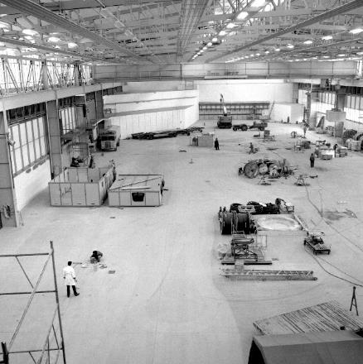
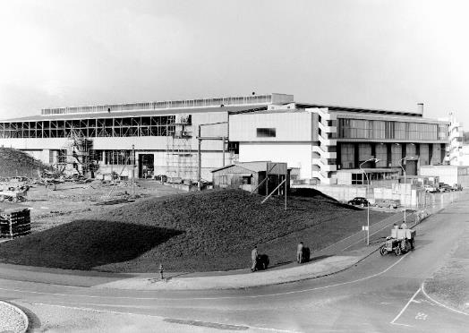

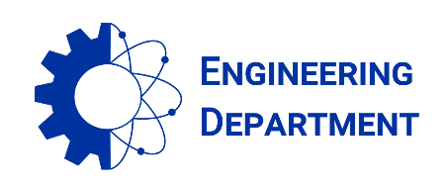
East Area Renovation - News and CSR4 feedbacks
Project Team #44 on 30.04.2021
East Hall under construction - 1962
S. EVRARD (EN-EA), on behalf of the project team

Slide 2
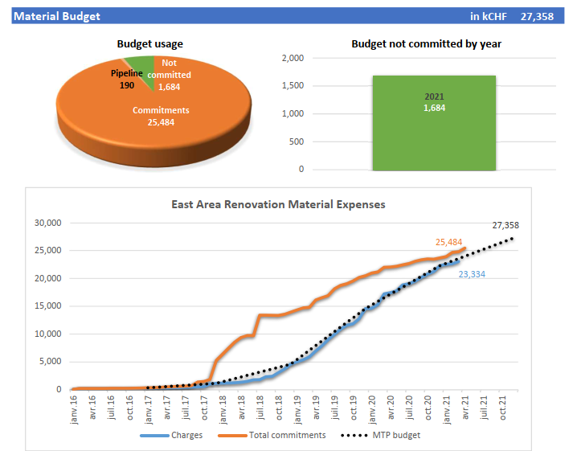
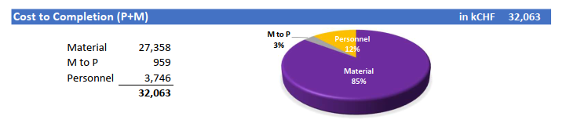
Budget situation on April 26th
Overall material budget: 27.4 MCHF
On April 26th: 93 % committed and 85 % charged
Still 1.7 MCHF to commit in 2021
Big orders just launched:
  Second batch of concrete beams for the mixed area roof (180 k)
  Gas systems distribution (110 k)
Courtesy of E. Delachenal

Slide 3
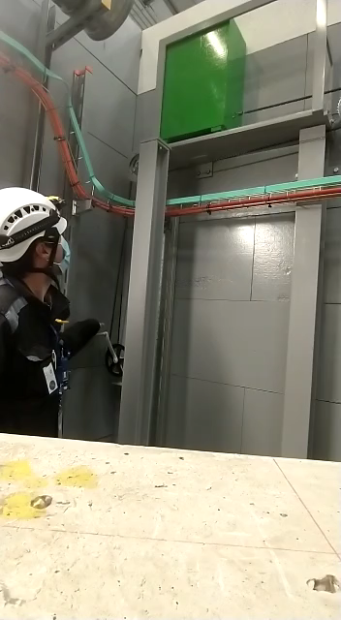
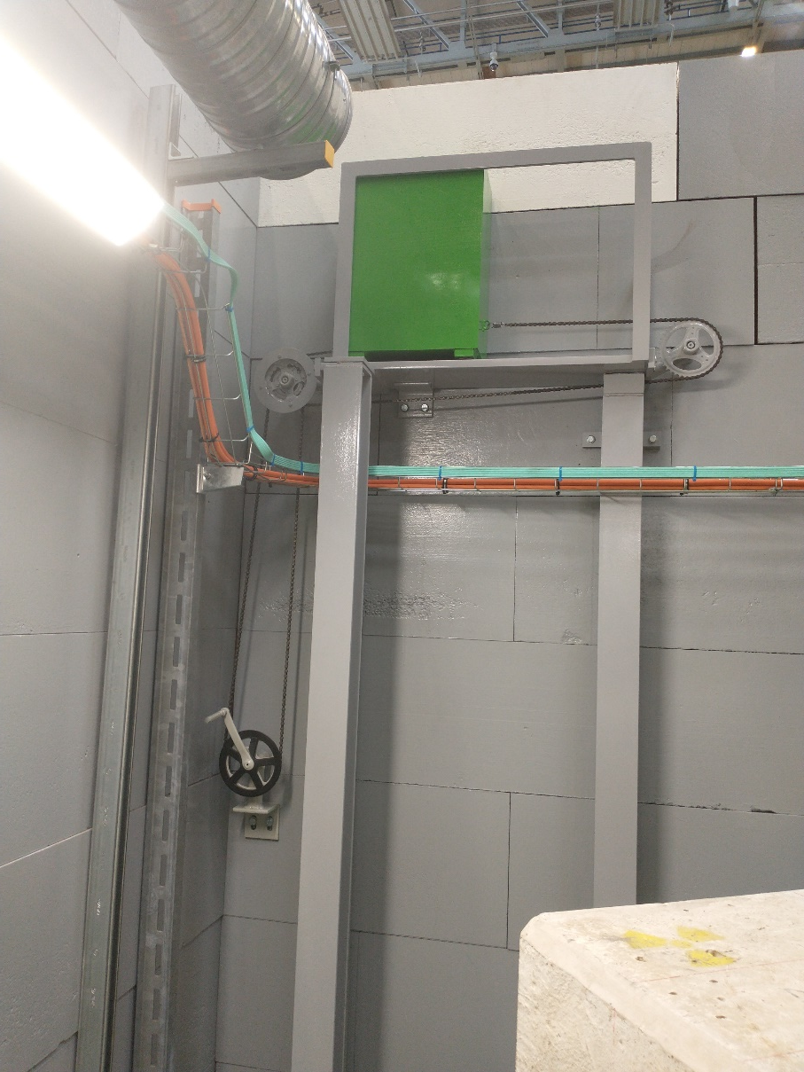
T11 mobile shutter

Slide 4
CSR4 recommendations
The main goals of the fourth Cost and Schedule Review (CSR) were to understand the point of the situation for B.251 renovations, which include Civil Engineering works and a new cooling and ventilation plant, to analyse the consequences of the COVID-19 pandemic, and the 2021-physics operation readiness. Each point has been reviewed in the light of their status, next steps, mitigation, risks and associated M+P.
Significant progress has been made since the last review as a result of the redesign of the work schedule in June 2020 with the goal of recovering from the delays induced by the COVID-19 pandemic. In order to have the facility operating in week 42 for a four-week physics run, the project must follow a dense schedule ahead with little margin for delay. More than 90% of the project material budget has been committed and 83% is already charged. The review committee congratulates the team for the work accomplished.

Slide 5
CSR4 recommendations
B.251 RENOVATION
The civil engineering budget for B251 has yet to be finalised.
It is not fully clear how the SCE activities will be managed in 2022, after the end of the EAR project.
The panel recommends the re-evaluation of the renovation scope (quality/cost/delay) and formalize the renovation project request to integrate it in the SCE Consolidation programme 2021-2025, following the new SCE IPR (Infrastructure Project Request) process.
The panel recommends to account for the installation of a redundant chiller in the budget. It is also recommended that the roof is consolidated in order to ensure safe and reliable operation of the new PCs and to further study the asbestos situation.

Slide 6
CSR4 recommendations
IMPACT OF COVID-19 PANDEMIC
There were some critical items that got delayed due to the global pandemic but was very well handled by the project.
Another lockdown similar to the one of March 2021 would result in a delay of extra 3 to 4 months, meaning no beam in 2021 in the East Area. It is therefore recommended to identify critical contractors and define a back-up plan.
The lack of Human resources has been identified by the project and several measures were put in place to guarantee that the physics run is not compromised. For this reason, this subject must be followed closely and extra measures should be put in place.

Slide 7
CSR4 recommendations
PHYSICS OPERATION READINESS
T08 commissioning is the current priority of the project to make full use of the four weeks in 2021 for physics.
It should be established a coordination task between IRRAD/CHARM operation team and the EA project to efficiently exploit the facility beam downtime.
The reviewers are pleased to note that ISTs have been scheduled as it was recommended at the last CSR. The ISTs are well prepared with a risk assessment for each set of equipment available on EDMS. The reviewers are also pleased to note that an ORA (Operation Readiness Analysis) was organized as it was found beneficial for the accelerators.
Gas installation is going accordingly.
CESAR's development is concerningly slow. Therefore it is recommended that the management issues a detailed planning for the CESAR upgrade and study to which extent it is possible to put in place a temporary solution for 2021.
A good communication of the EA project with BE-OP has been shown although, the beam commissioning phase should be further studied.

Slide 8
CSR4 recommendations
SAFETY
The Safety events (accidents, incidents) are effectively followed-up. The ground load is being monitored and the ground motions are within expected values. This point is being well managed in strong collaboration with HSE. The panel recommends the implementation of a continuous monitoring plan of the ground motions, even after the end of the project.
It is strongly suggested that the safety files are approved or at least in an almost final state before the start of the facility operation.

Slide 9

Thanks for your attention !

