Slide 1
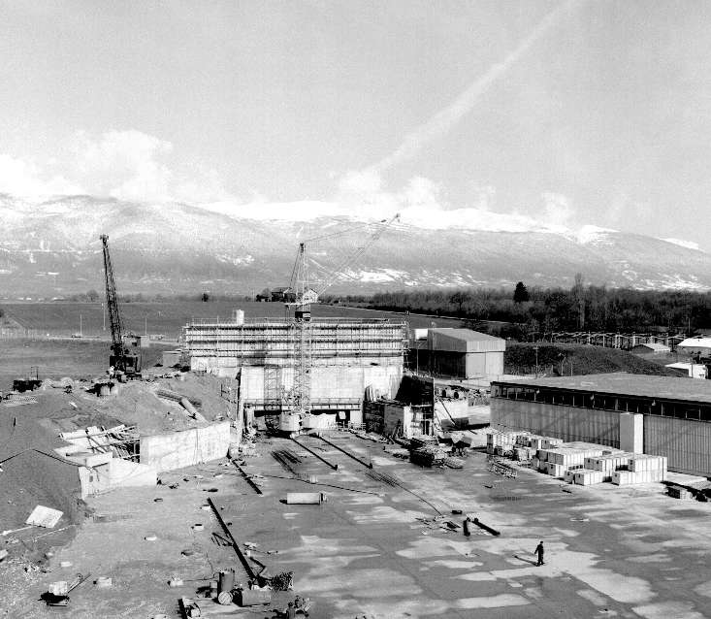
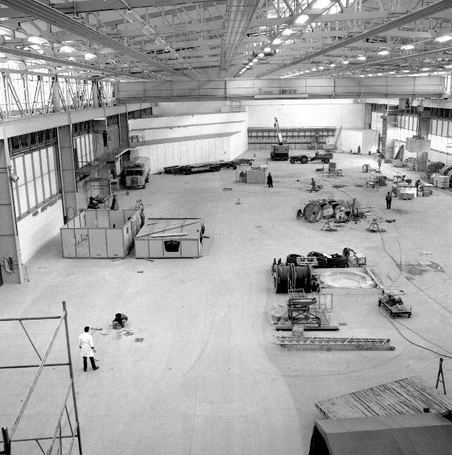
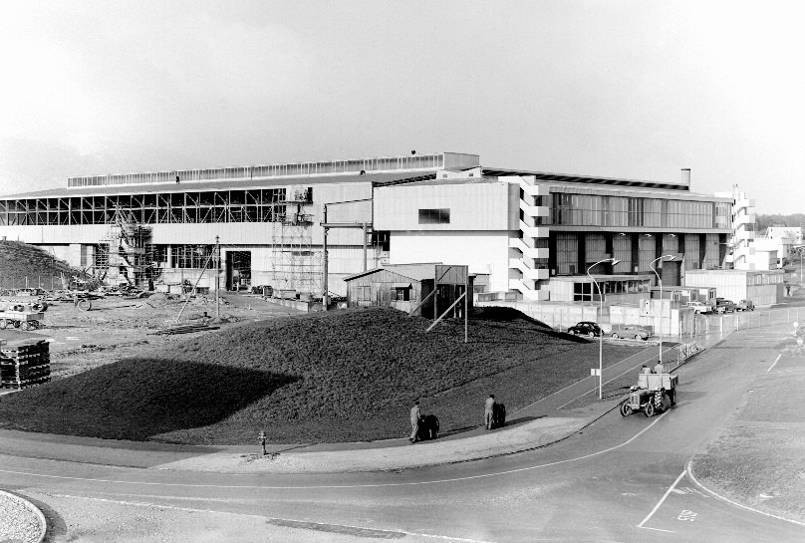


EAR Project Team #44 : 2021 Schedule
East Hall under construction - 1962
Bastien Raë

Slide 2

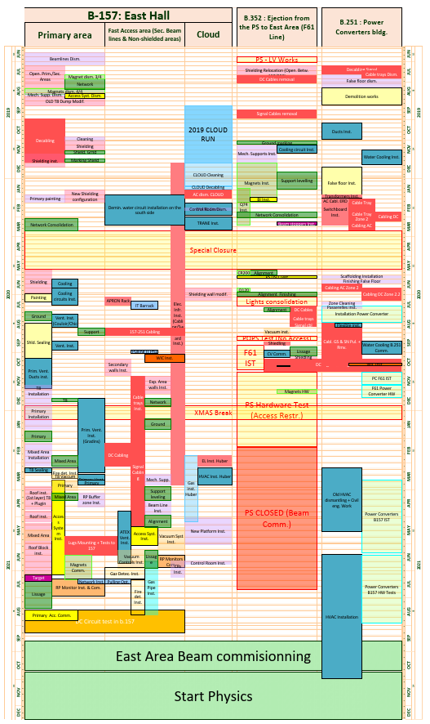
Index
Gantt : EN-EA Planning
Important info :
Primary Area : Critical path
  Signal Cabling beam area 99% done
    Please verify your cables
  Lugs mounting late → Start to be critical
  T8 installation and vacuum finished
  Primary vacuum almost finished
  Mixed area installation 90%
    All magnets installed → Thanks !
Secondary area :
  Installation on going.
B.352 : Closed
  On the waiting list for some work on magnets cooling (~1hr)
B.251 :
  Power converters test on going.
  HVAC dismantling done.
B.263 : OK

Slide 3
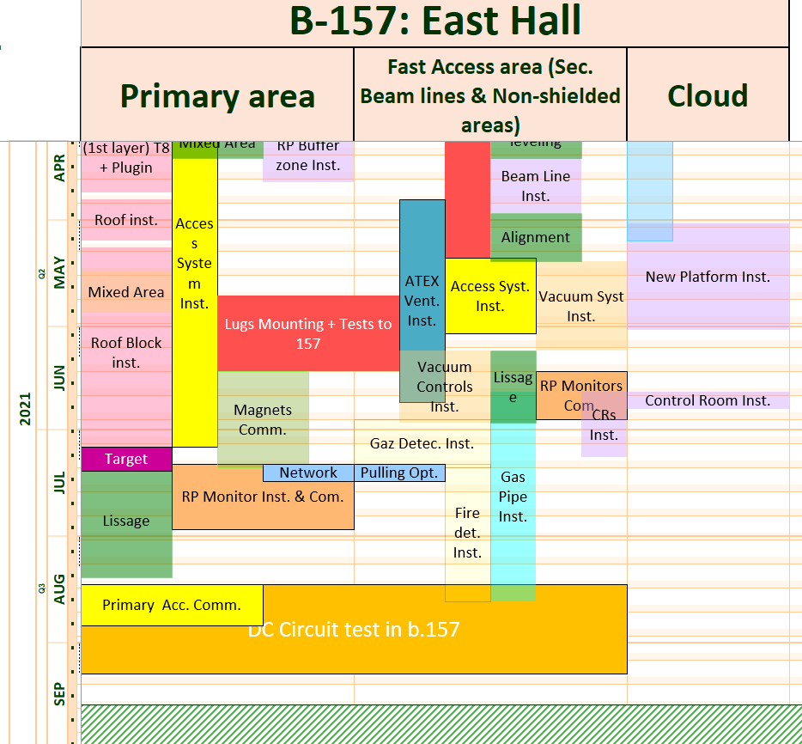
B.157
Access system progressing very well (advance on the schedule)
Roof installation
  Thanks of the 2 shifts progressing well
  T8 line almost done (all layers)
  Primary 1st layer done
  Mixed to be started soon
  Should finish on the 7th of July 2021
“Lissage” after the roof installation.
Control room should be ready only mid-June
  Lot activities to follow
Lot of services and safety related work to be done (network installation, fire detection, RP monitor,..)
Extraction to EAST dump and T8 readiness under review
  Split Power converters test in 2 part (zones under roof & secondary area)
  Meeting with all services to determine a possible date
Secondary Area installation progressing well

Slide 4
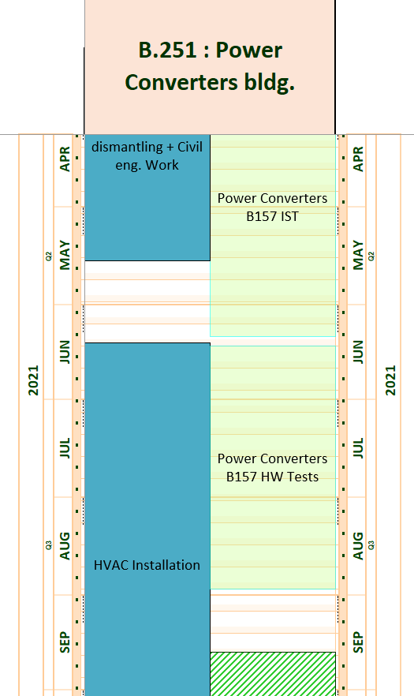
B.251
Lugs mounting delayed start to be critical for HW test
Converters IST progressing well.
  Planning to be review with priority to T8, target and mixed zone.
HVAC Installation to be confirmed
Old HVAC dismantling done

Slide 5
Summary
B.157 :
  Beam lines installation almost done for Primary and on going for secondary
  Roof installation has to be followed up closely → But progressing very well
  Heavy work to be able to finish on time.
  Services please cross check the dates for the installations (RP, Fire detection, Gas, …)
B251 :
  Lugs mounting to start ASAP
  Power converters test ongoing → priority given to zones under the roof
Global
  Please check you cables.

Slide 6
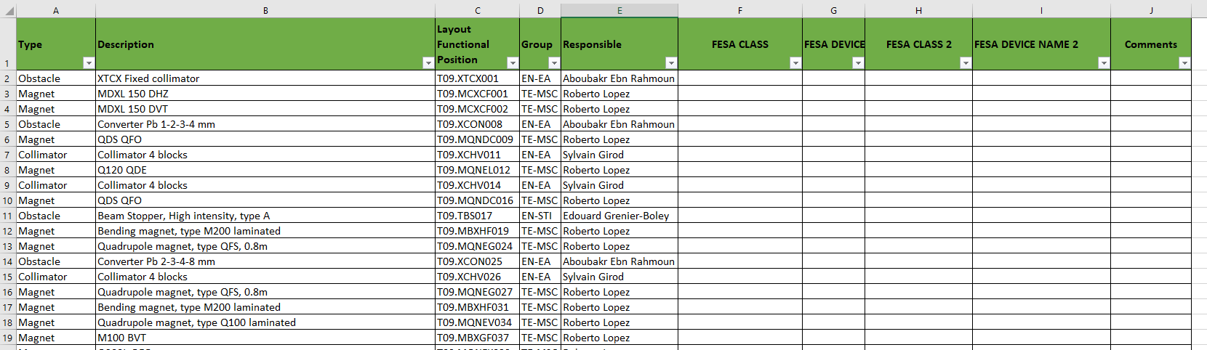
Control Software Preparation
CESAR Software will be updated for the new East Area.
  It become urgent to have all you FESA Class & Device name for all the equipment's in each lines.
  Please fill the Excel fill attach to the indico and send it to me ASAP.

Slide 7
Thanks for your attention !

