Slide 1
B.157 : Floor level survey
Camille Vendeuvre
30 April 2021

Slide 2
Context
  Floor load study predicted several millimetres of deformation (EDMS 2349640)
  HSE asked for a monitoring of this potential deformation (EDMS 2379351)
  A regular levelling measurment of points on the ground of building 157 and in the gallerie bellow 157 is part of this monitoring (EDMS 2398896)
  Point distribution is visible in EDMS 2398896
  Many point (40%) are not available anymore in 157 due to installation of équipements and services

Slide 3
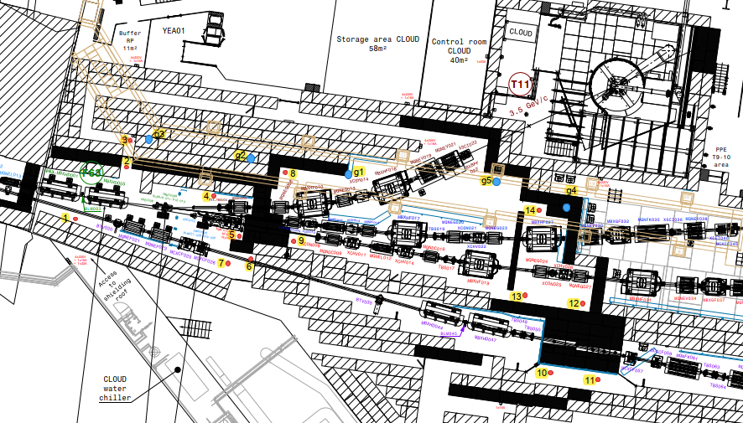
Point distribution (EDMS 2398896)
Underground gallery
Building 157

Slide 4
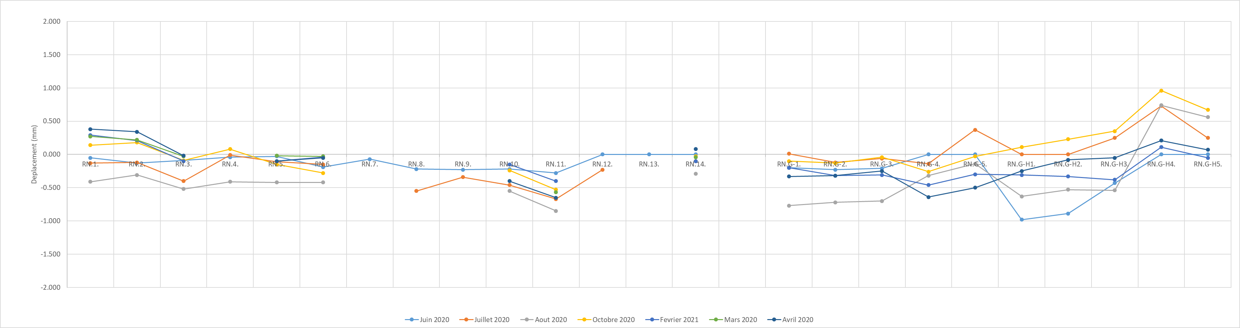
Results
Hall 157
Galerie technique
Natural movement of the building probably more important than deformation under load

