Slide 1
Harmonic based beam position measurement
CERN SY/BI technical board
6th May 2021
M. Bozzolan
Thanks for the useful discussions to F.Caspers, M.Gasior, J.Tan and M.Wendt

Slide 2
Linac 4 to PSB transfer line overview
PS Booster
Debuncher cavity
BSM2
BI.BPM20
End
LINAC 4
160MeV
L4T
LT
LTB
BI
Distance (z) [m]
0
22
30
60
90
110
130
140
Different H⁻ beams at 160MeV (β=0.5) are produced by changing the debuncher setting
13 stripline BPM locations
No issue with “normal” energy spread beam (<400keV)
ISSUE: Trajectory of high energy spread beam (450keV) is noisy in BI line

Slide 3
Remarks
Generals
This work comes from an issue observed by operation this year for the first time
A general approach is used, not specific to the installed system
Technicals
Perfectly collimated beam and straight transport line → no magnets
Monochromatic beam from LINAC4 → no initial energy spread
Gaussian longitudinal distribution
Zero transit time in the debuncher cavity
Only transverse field generated by the beam (as from relativistic beam)
Constant energy spread along the line

Slide 4
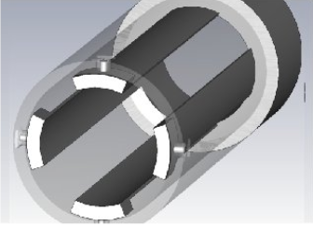
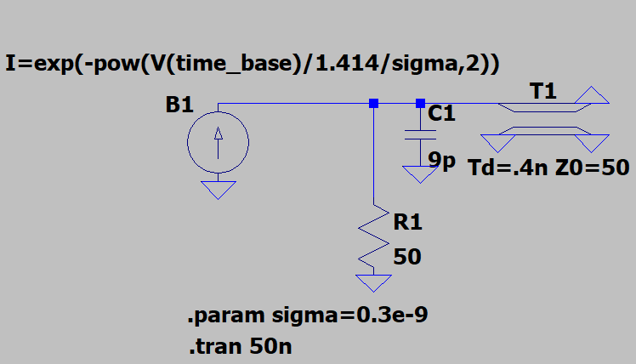
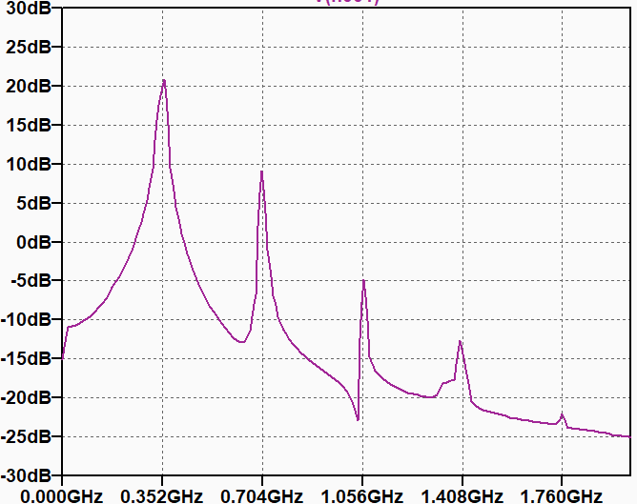
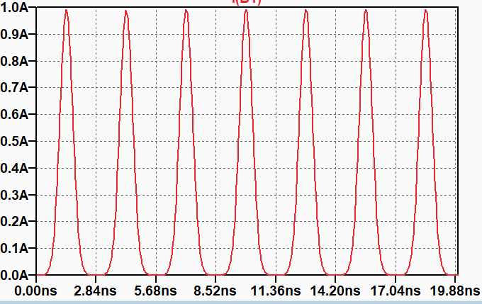
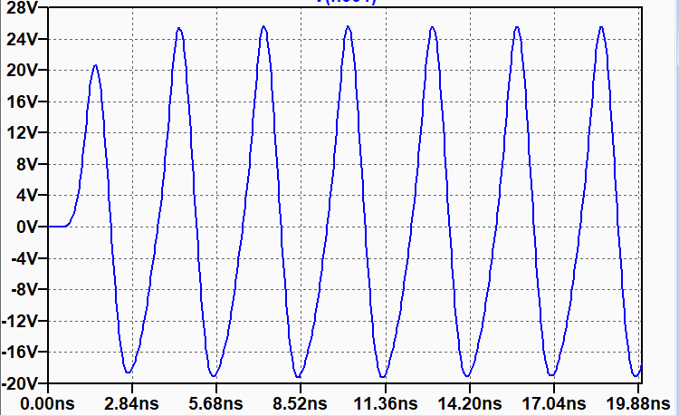
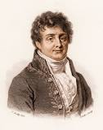
Shorted Stripline BPM
L4 and L4→PSB line use the same BPM
Good sensitivity and immunity to electrode charging due to beam loss and stray charges
but … RF bunched beam is required
Pick up
Output signal in frequency domain
SPICE model
H₁
Beam current
H₂
Output signal in time domain
H₃
No low frequency component : H₁ (352.2MHz) used

Slide 5
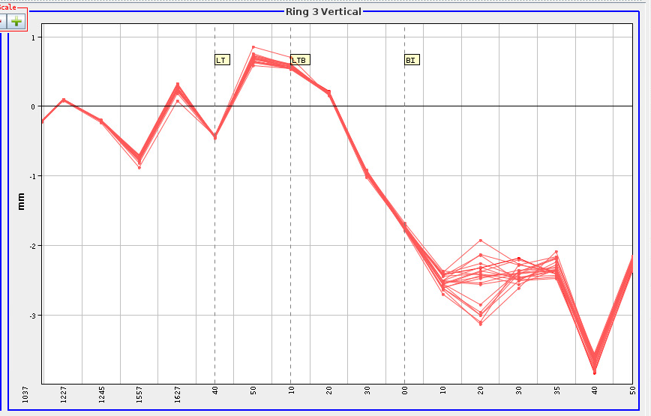
Trajectory fluctuation
V plane trajectory of several LHC25A injections in PSB
-0mm
BI.BPM20 & BI.BPM30 have the highest position fluctuation
Fluctuation decrease upstream and downstream
Low energy spread beams is OK
Same problem fot the H plane
-1mm
-2mm
-3mm
0
140m
L4T
LT
LTB
BI

Slide 6
BPM sum signal (intensity but not current)
Measured BPM signal for LHC25A beam
Good transmission along the line (measured by BCTs) → same current in all the line
Cable loss contribution removed
Intensity (Σ) depends on the beam current AND on the bunch shape
At location around BI.BPM20 a notch of the intensity signal is present
S/N ≥ 40dB
[m]
L4T
LT
LTB
BI

Slide 7
Simplified debuncher model
BEAM and RF VOLTAGE in debuncher cavity
No net energy change
Head of the bunch accelerated
Tail of the bunch decelerated
Debunching phase working point
travelling beam
deceleration
acceleration
time

Slide 8
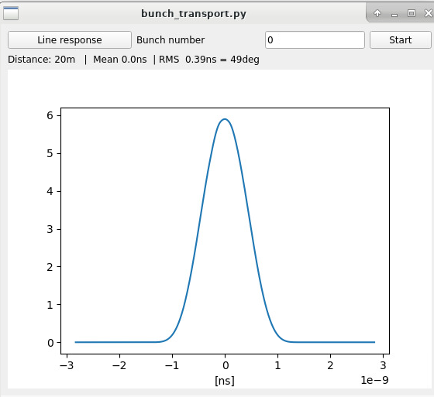
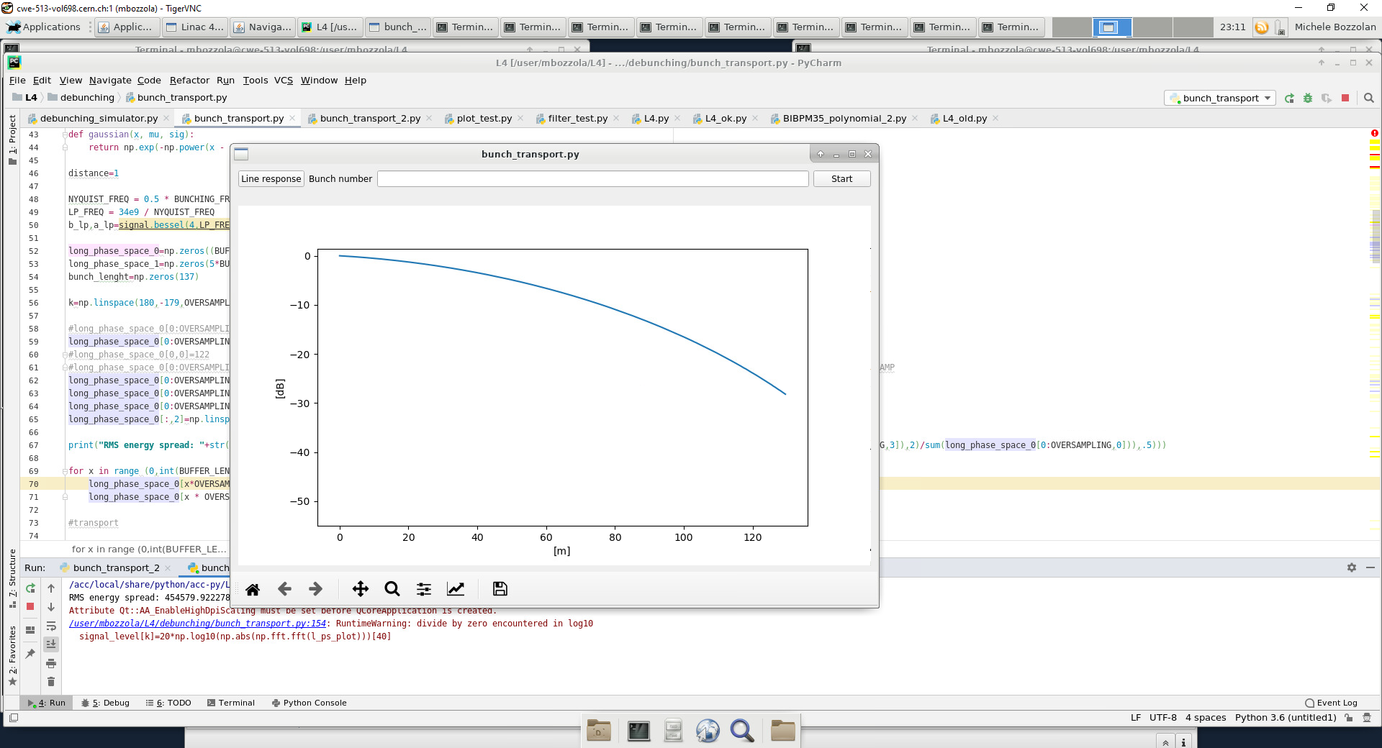
(my) Beam transport simulation
Sampling rate 0.1 ⁰
Two simulation modes:
Single bunch for bunch length measurement
Train of bunches for BPM response
Three initial conditions: average kinetic energy, energy spread and bunch length
Single bunch transport for pulse length calculation
Bunch train transport for BPM signal strength calculation
Beam amplitude [a.u.]
352.2MHz component
Distance from debuncher

Slide 9
Benchmarking my beam transport
σ=17⁰ @ debuncher (z=0)
Energy spread = 450keV
“Nominal” value from BE/ABP
Measured value by SY/RF in PSB
Bunch length simulation
BPM signal amplitude simulation
Reference level at debuncher (Z=0)
BSM2
352.2MHz component [dB]
Distance [m]
“my simulation” single bunch fits BE/ABP results ☺
BPM signal amplitude decrease monotonically along the line (but real measurements don’t) ☹

Slide 10
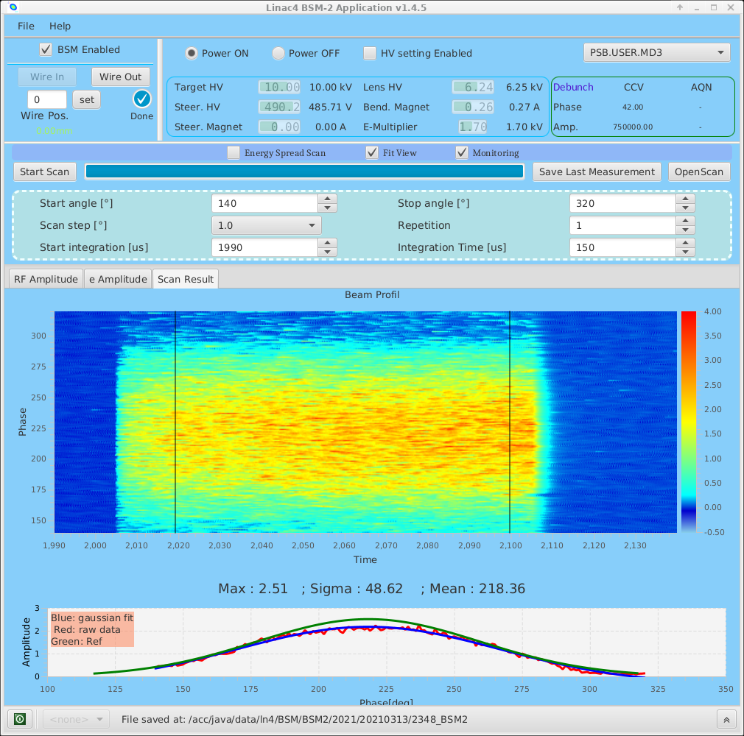
But the BSM2
From L4 elogbook on March 13th
https://logbook.cern.ch/elogbook-server/GET/showEventInLogbook/3190762
σ≈50⁰ @ Z=22m
σ≈31⁰ @ Z=0, not 17⁰
… doesn’t fit with the “nominal” bunch length

Slide 11
Bunch transport again
σ=31⁰ @ debuncher (z=0) and σ=50⁰ @ BSM2 (z=22)
Energy spread = 450keV
“Modified” bunch length
The notch of the harmonic component fit the measurements
Notch location depends on energy spread (debuncher setting) and initial bunch length (LINAC)

Slide 12
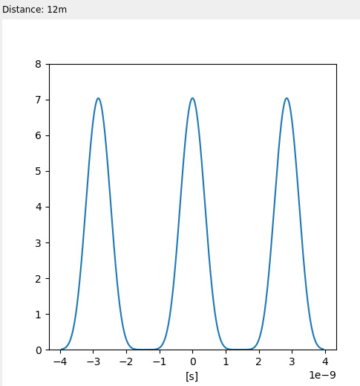
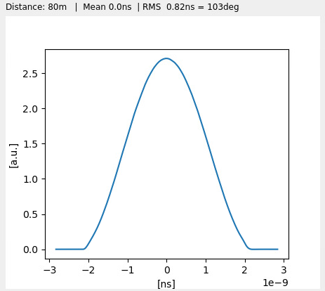
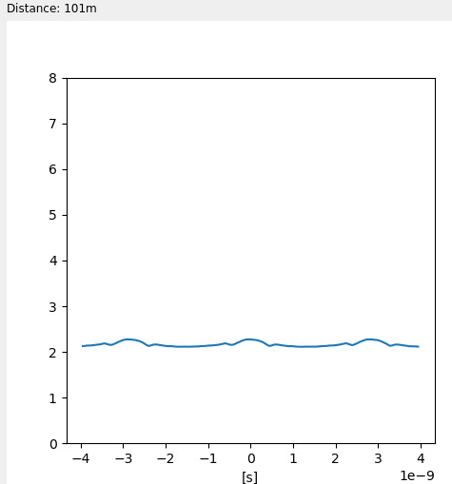
Time domain waveforms
Train of bunches @ 12m
Single bunch @ 80m
Train of bunches @ 100m
RF period
RF period
RF period
Transported bunches progressively lose the gaussian shape because of the sinusoidal energy spread
→ Be careful with beam simulation (e.g. CST)
At around 100m the beam is almost completely debunched.
Harmonic components barely visible in time domain, but well measured with narrow band filtering

Slide 13
Intuitive frequency response
Assuming the bunch shape is rectangular
At bunch length multiple of the RF period the beam current is flat
Distance: Z=0
Distance: Z₁>0
Distance: Z₂>Z₁
i(t)
i(t)
i(t)
t₀
2t₀
time
t₀
2t₀
time
t₀
2t₀
time
I(f)
I(f)
I(f)
1/t₀
f
1/t₀
f
1/t₀
f

Slide 14
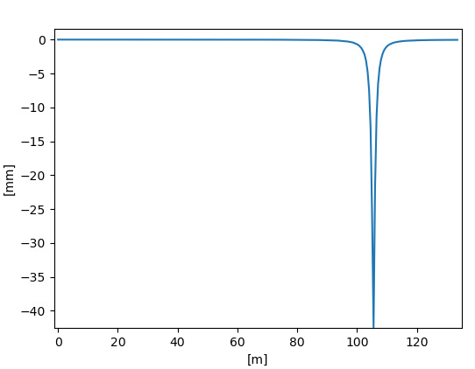
Bunch transverse distribution
Train of bunches are assumed to have linear position slope at z=0
Average position is 0 and it should stay 0 since the beam is assumed to be perfectly collimated
Bunch transverse position and amplitude @ Z=0
Simulated beam position calculated as BPM
Expected position
Region of bunch distribution dependance
In the highly debunched region:
The 352.2MHz component is dominated by the relation between transverse and longitudinal distributions
Position depends on the bunch transverse distribution

Slide 15
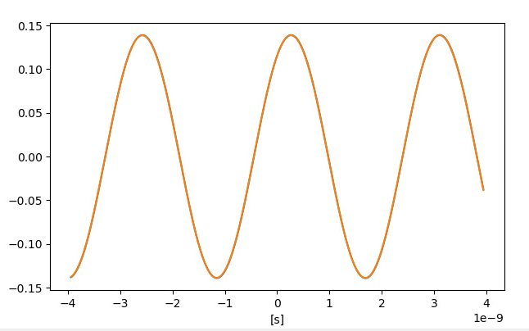

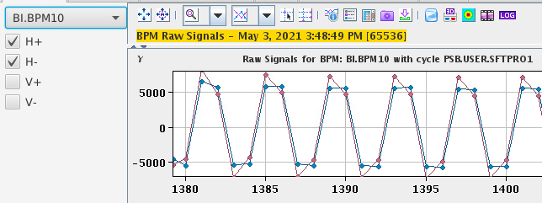
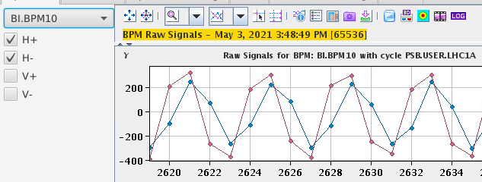
Transverse distribution effect on the same BPM
Plus and minus electrode signals for high and low energy spread beam
Low energy spread (bunched beam)
High energy spread (debunched beam)
Simulation
Simulation
Measurement
Measurement
Very close signals with minimal difference in amplitude & phase
Relevant amplitude and phase difference

Slide 16
Summary of harmonic based position
Harmonic based position measurement (e.g. stripline BPM) is in general a good choice for LINAC
For sake of uniformity transfer line can be equipped with the LINAC BPM type
Depending on the LINAC configuration, BPMs may work well also in the transfer line, nevertheless beam simulations must be carefully done (bunch not gaussian)
In the region of the harmonic component notch beam position depends on the initial bunch transverse distribution

Slide 17
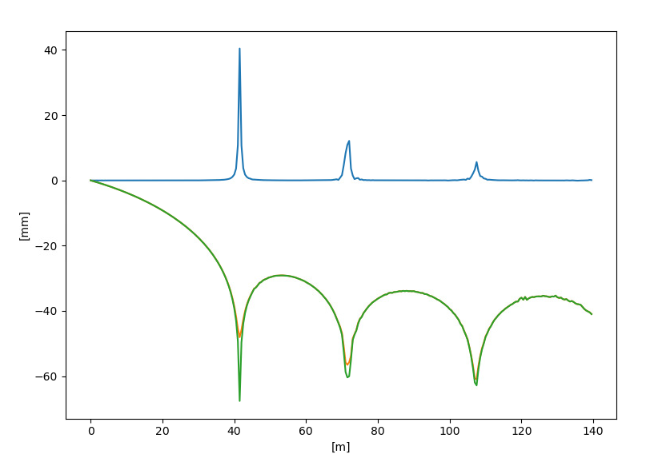
H₂ (704MHz) not an option
Position [mm]
[mm]
/
[dB]
H₂ level @ electrodes [dB]

Slide 18
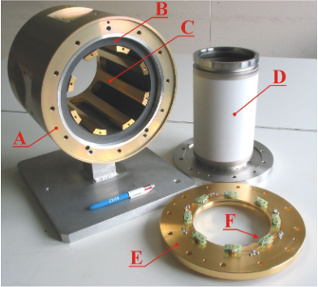
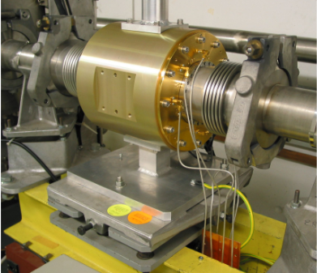
Possible workaround
M.Gasior @ DIPAC 2005
“A CURRENT MODE INDUCTIVE PICK-UP FOR BEAM POSITION AND CURRENT MEASUREMENT”
One inductive PU was built and installed in L2 transfer line ~ 2005 then removed during LS1
(now in 150/R-007)
Acquisition electronics and software to be developed
No dedicated cables
$$ relative expensive device to produce (coated ceramic chamber+big custom ferrite)

