Slide 1
MCBXF Magnet production at CIEMAT
Carla Martins (CIEMAT)
On behalf of MCBXF CERN-CIEMAT Collaboration
Series Production kick-off meeting – 23rd April 2021

Slide 2
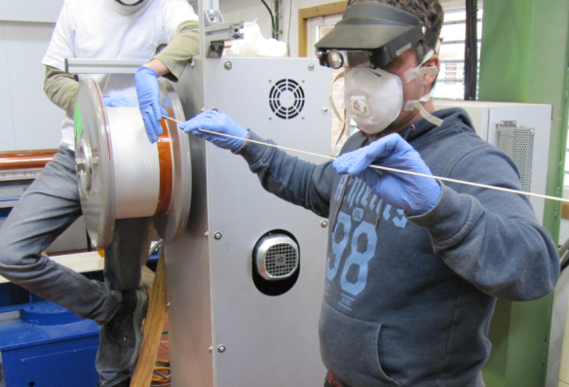
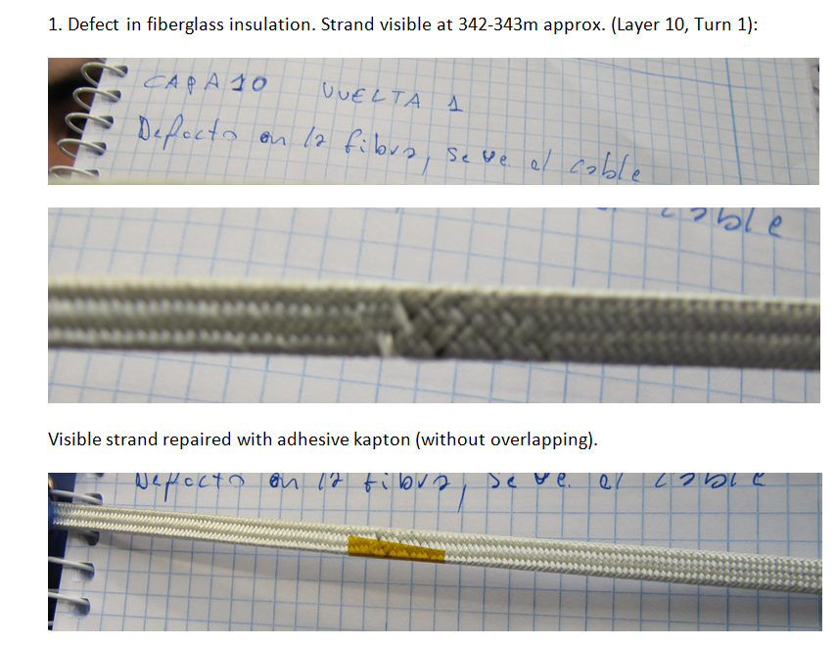
MCBXF Cable Revision
Position
Defect
Reparation

Slide 3
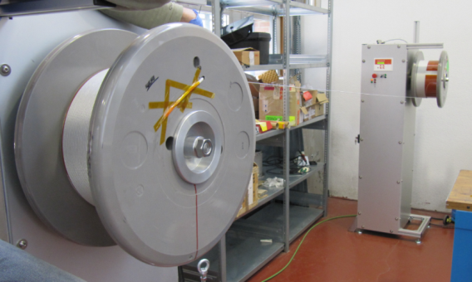
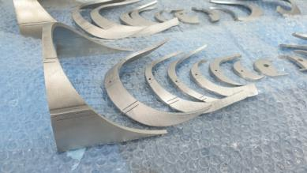
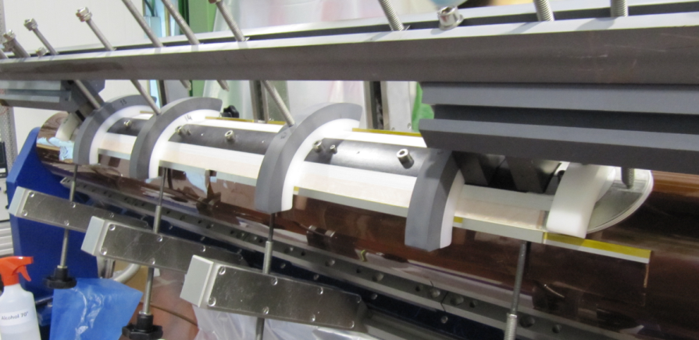
MCBXF Coil Winding
End spacers: 3D printing in stainless steel. Insulated with glass fiber tape impregnated with binder (acetone as solvent)
    Split cable for Inner and Outer Layer
Winding tension is decreasing while the turns are increasing (from 4.5 kg to 3.5 kg).
Measurement of last cable at both ends on every turn registered.
Copper wedges: insulated with glass fiber sleeves glued with binder at both ends

Slide 4
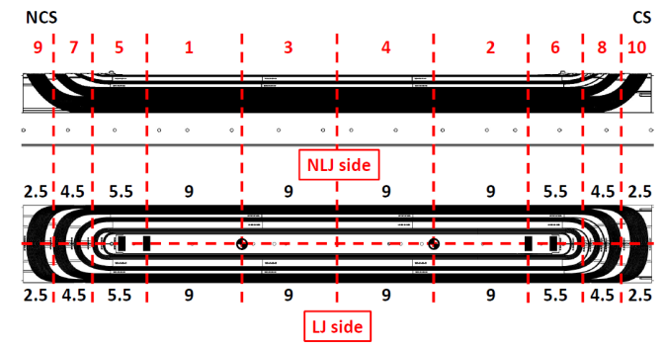
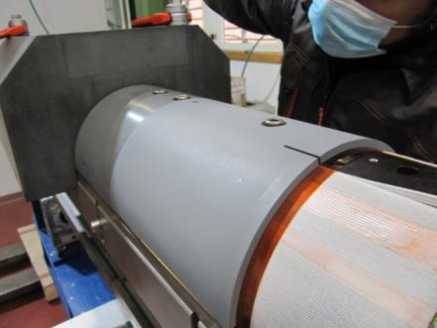
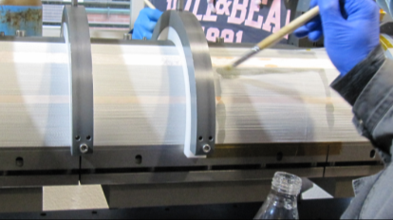
MCBXFB Coil Binding (I)
    We use binder (CTD 1.1) with butanone as solvent. Curing at 120ºC during 18 hours with slow cooling.
    Binder is applied with a brush, controlling applied weight by zones.
It is necessary to apply binder on both layers (inner and outer). For the inner layer, we use the same mould with fillers replacing the outer layer.
Binding mould is assembled at the winding machine. Delicate process to avoid cables loosening

Slide 5
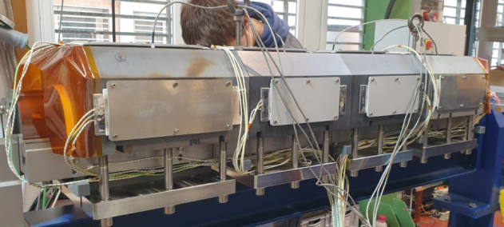
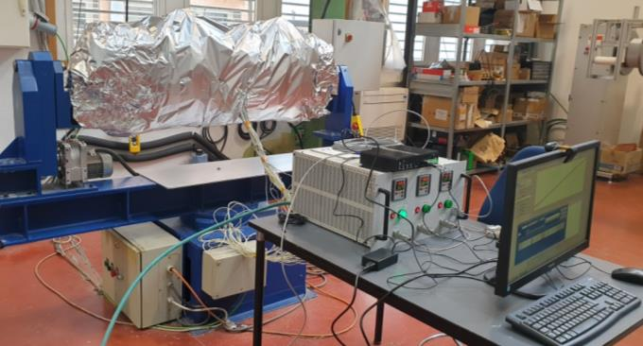
MCBXFB Coil Binding (II)
    Heating using resistors. The complete mould is thermally insulated with several layers of aluminium foil.
    Resistors (4 at each side of the mould and up)
    Aluminium foil insulation
    Temperature control system

Slide 6
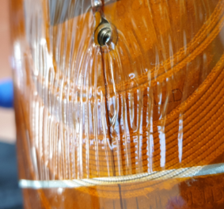
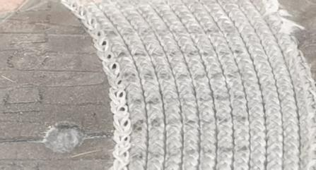
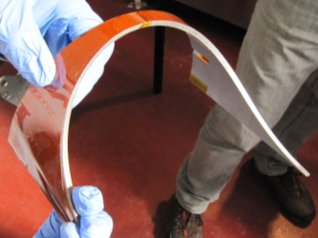
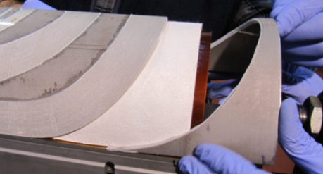
MCBXFB Coil Binding (III)
    Important to avoid wrinkles in kapton protective sheets during mould assembly. During the curing cycle, more and bigger wrinkles could appear and the cable insulation could be damaged.
    After the binding of each layer, the final end spacers must be adapted to the last cable block at each end of the coil.
    The coil length increases due to the pressure applied by the mould. Elongation usually is larger in the inner layer (winding over kapton foil) than in the outer one (winding over Nomex, less smooth).
    The coil is now rigid enough to be manipulated during the next steps of the fabrication.

Slide 7
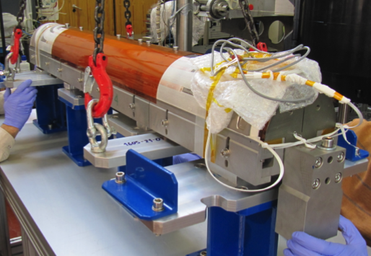
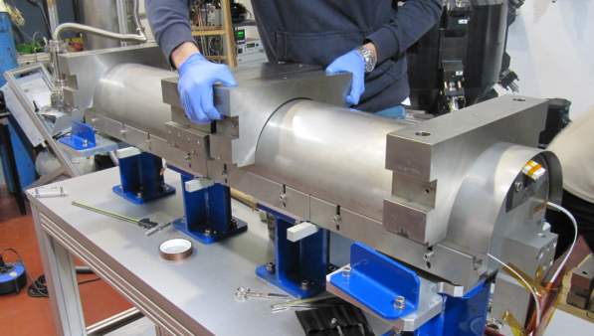
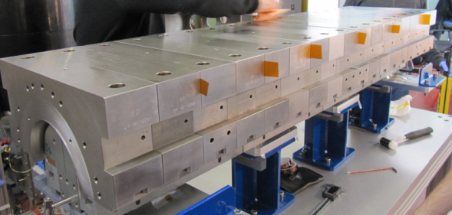
MCBXFB Coil Impregnation (I)
    The tasks needed to prepare the coil for impregnation take place in a custom table

Slide 8
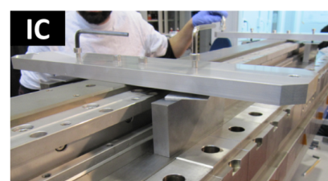
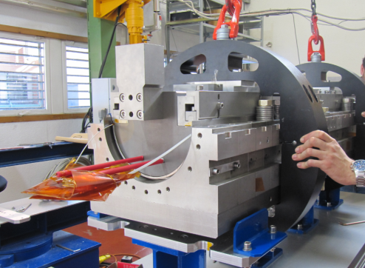
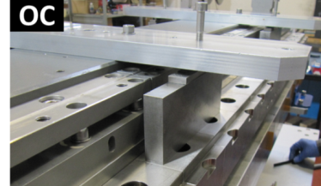
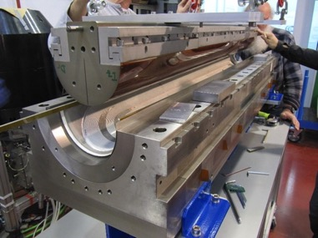
MCBXFB Coil Impregnation (II)
    Lifting of the winding mandrel is very delicate operation. It is important to be very careful with the previous steps to avoid damaging the coil

Slide 9
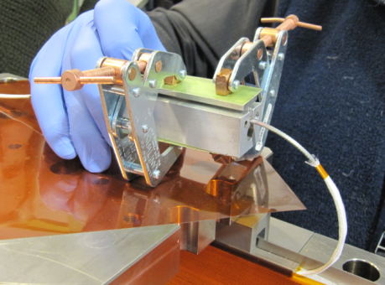
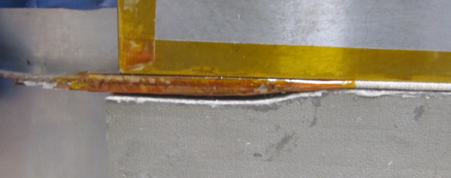
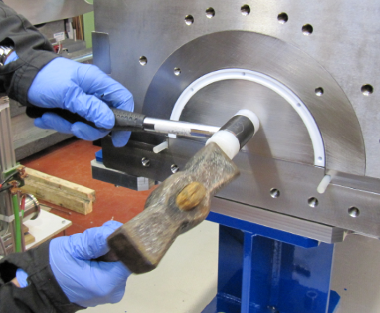
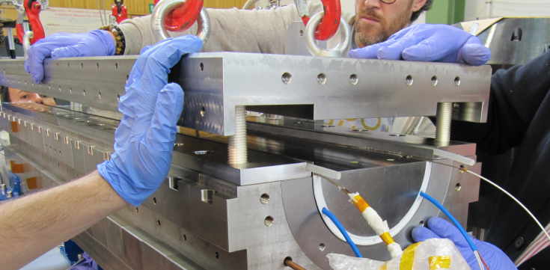
MCBXFB Coil Impregnation (III)
    Tinning mould used to stabilize the current leads of the coil
    Intermediate measurements between impregnation mould parts and adjustments needed to ensure that everything is in place (to avoid/minimize leaks).
Stabilized and insulated current lead

Slide 10
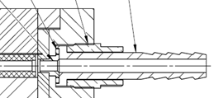
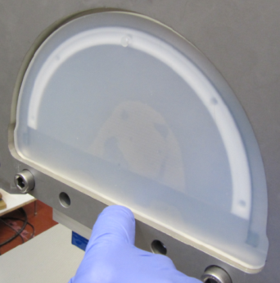
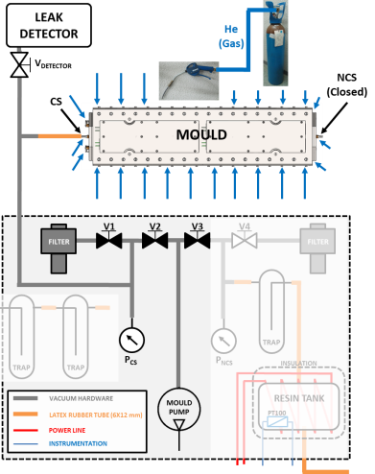
MCBXFB Coil Impregnation (IV)
    Transversal mould closing with silicone seals is also very delicate. To avoid the expansion of the resin entrance (& exit) holes, a new design has been implemented.
Hole
The hole in the silicone seal must be placed far from the closing sheet (to avoid ripping)
Closing sheet
  A first leak test of the mould with He gas take place outside the vacuum chamber
  A second leak test at warm conditions before starting each impregnation process is established to check that the mould is properly sealed

Slide 11
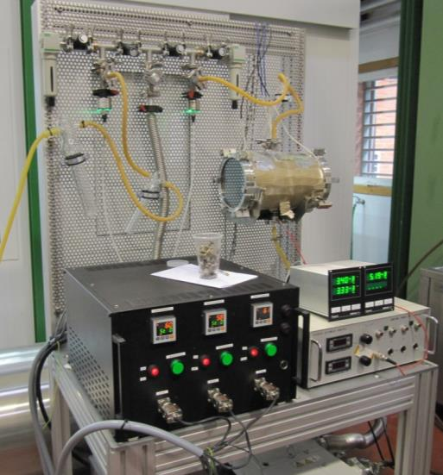
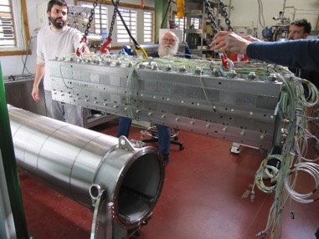
MCBXFB Coil Impregnation (V)
    The mould is introduced in a custom vacuum chamber to ease vacuum processing. The heating of the mould is also made by resistors (up & down the mould).
    The coils are impregnated with CTD-101K resin at 60ºC (mould and resin). Curing for 16 hours at 125ºC.
    Vacuum chamber

Slide 12
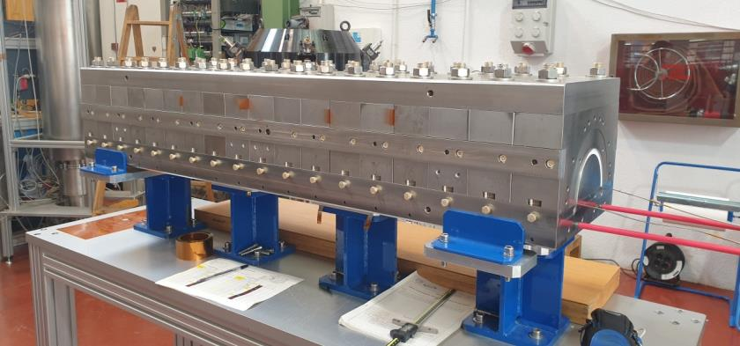
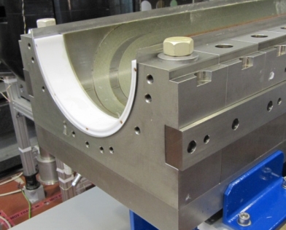
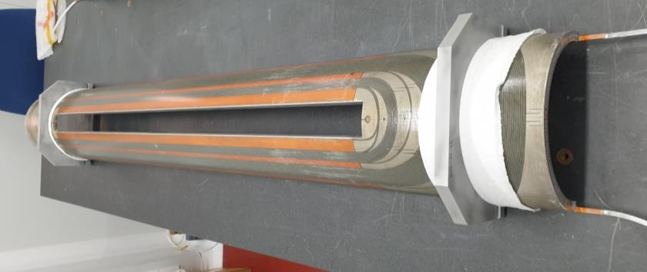
MCBXFB Coil Impregnation (VI)
    Impregnation mould opening

Slide 13
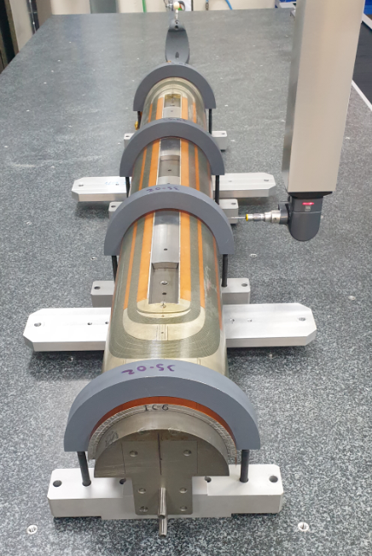
MCBXFB Coil Quality Control
Dimensional measurements with CMM to control principal dimensions of the coil (length, pole window, midplane). The coil is measured clamped onto the winding mandrel.
Electrical measurements: resistance, self-inductance and insulation. The self-inductance is measured with a frequency sweep to detect short-circuits, due to the large number of turns

Slide 14
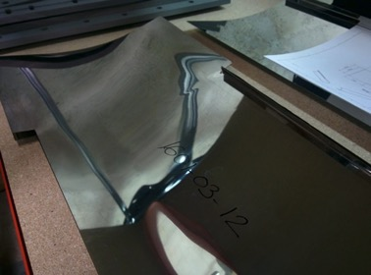
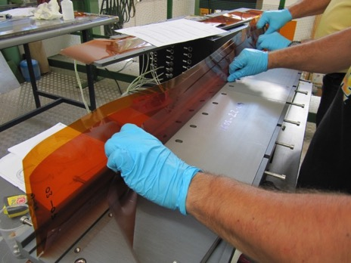
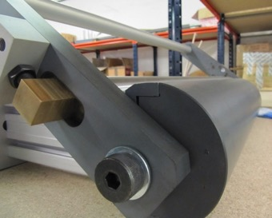
MCBXF Components: Collaring Shoes & GI
Collaring shoes are laser-cut and pre-formed with a custom tooling (0,5mm stainless steel sheet).
Ground insulation (kapton foils) pre-formed at 140ºC heating during 6 hours.

Slide 15
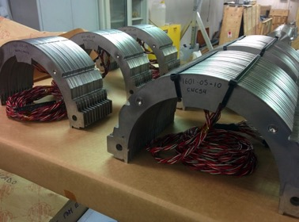
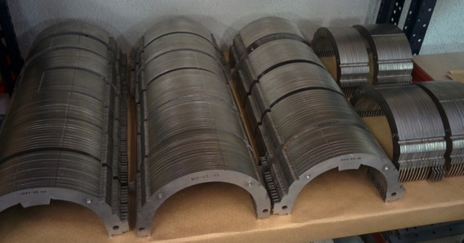
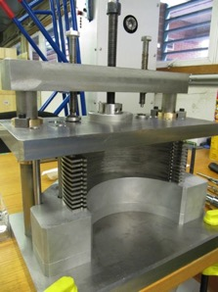
MCBXF Components: Collars
Prototype collars manufactured by EDM wire-cut
Collar sets assembled using a custom tooling
Instrumentation done at CERN

Slide 16
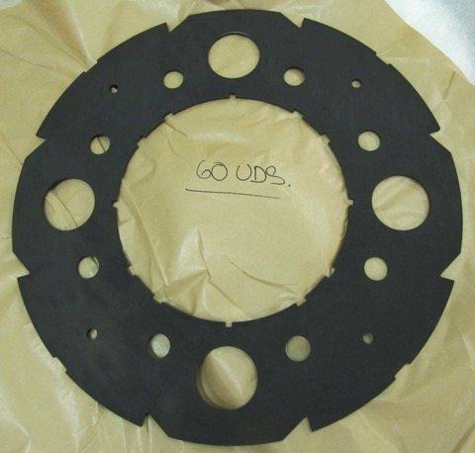
MCBXF Components: Iron Yoke laminations
Iron laminations for the prototypes manufacturing process:
  Laser cut
  EDM wire cut
  Black oxide for surface protection

Slide 17
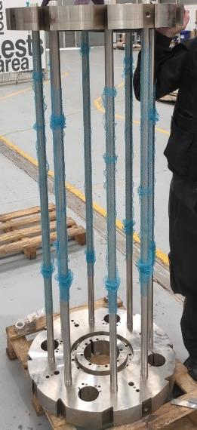
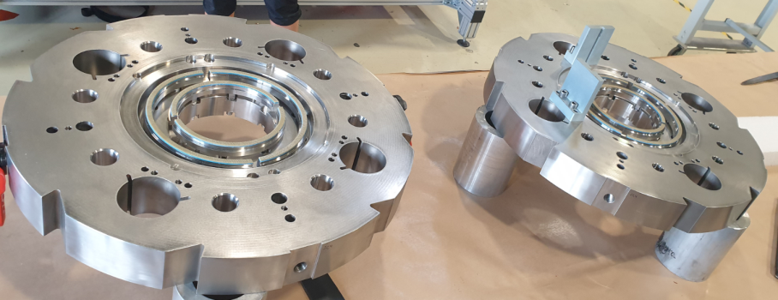
MCBXF Components: End Plates & Rods
Two 70mm thickness endplates (stainless steel), with eight rods (also stainless steel) compress the iron laminations

Slide 18
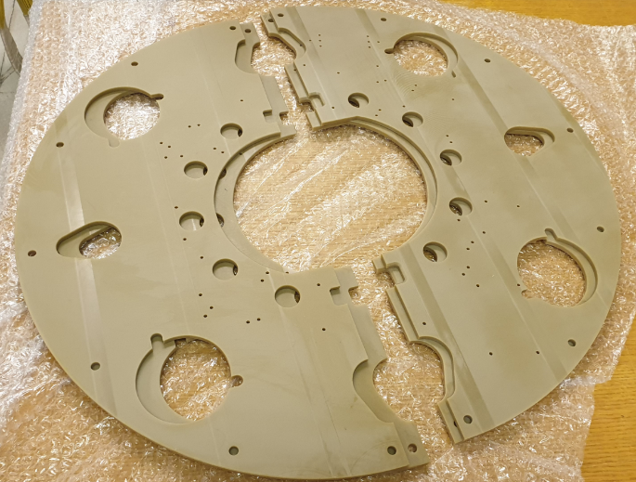
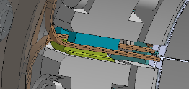
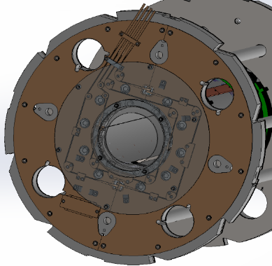
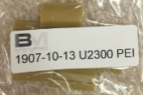
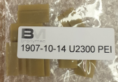
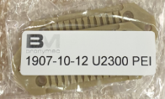
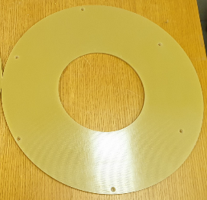









MCBXF Components: Connection Plate
Duratron and G10 parts (radiation resistant)

Slide 19
Summary (I)
    Cable revision (and reparation of insulation defects if any).
    Coil winding:
      Decreasing tension (from 4,5kg to 3,5kg). Cable position at both heads monitoring (compare with nominal values, and other coil data).
      Insulate (glass fiber tape) all components in touch with cable.
    Coil binding:
      CTD 1.1 with butanone. Control quantity applied by weight.
      Avoid kapton wrinkles.
    Coil impregnation:
      CTD 101K resin.
      Lifting of the winding mandrel and closing of the impregnation mould is a delicate operation.
      Leak test of the mould at room temperature + leak test (in vacuum chamber) at warm temperature.

Slide 20
Summary (II)
    Coil quality control:
      Dimensional measurements with CMM.
      Electrical measurements (resistance, self-inductance and insulation).
    Other magnet components:
      Ground insulation (GI).
      Collaring shoes.
      Collars.
      Iron Yoke laminations.
      End Plates and Rods.
      Connection Plate.

Slide 21
Thanks for your attention

